Slide 1

Rollback!?
Waaaat? Are you Kidding? OHH NOOO!!!
Saravanakumar B

Slide 2
About Me
OpenEdge Programmer & DB Administrator with 10+ years of experience
Working as Software Engineer @ Quicken Loans
Professional Corporate Trainer – trained about 75+ Progress Developers
PUG Speaker – 2015 & 2017
Frequent Speaker – presented multiple white papers/presentations both at National & International Level

Slide 3


Setting the TONE
NEWBIE to Progress 4GL?
Wanna Transaction, Locking & Record Scoping?
Expert? – hope I wont make you SLEEP

Slide 4
Agenda
What do you think an Embarrassing situation is?
Progress DB Files
Transaction Scoping
  Default & Forced Transactions
  Making Transaction Size Larger and Smaller – Why? How?
  Pin Down Transaction Issues
Sub Transactions
Record Locking
Record Scoping
  Rules
  Types of Record Scope
Record Scope Vs. Transaction Scope

Slide 5




Embarrassing situation
What do you think an Embarrassing situation is?
Performance Issue → OMG! my query is running for hours in PROD
Dead Lock → I’m Stuck, Will I get the record or NO?
Rollback of my code that is pushed to PROD → Functional (or) Non Functional
My CODE just crashed PROD DB → Sorry! Waaaat??? Oops - NOT ME…

Slide 6
Progress DB Files
Do you know couple of ignorant code snippets w.r.t Record Scoping & Transaction could crash your DB and put you in an embarrassing situation? – just by blowing up the BI or LBI file
Before Image (.b1..bn)
After Image (.a1…an)
Database File (.db)
Structure File (.st)
Lock File (.lk)
Log File (.lg)
Transactions
One per DB
Local Before Image
Temporary Table
Sort Table
Trap Table
Not Buffered; written to disk immediately
Sub Transactions
One per User
Uses Buffered I/O
[DB Files]
[Temporary DB Files]
Note: LBI files mark the start of a transaction as A/R Unit (Accept/Reject Unit). Each sub transaction is logged in its own A/R Unit and there is no dependency on BEGIN or END notes in local before image file.

Slide 7
Transaction Scoping

Slide 8
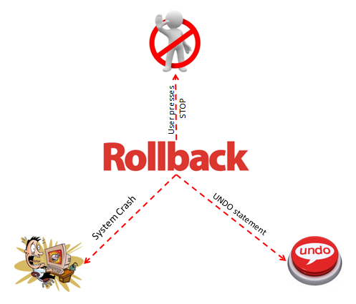
What is Transaction Scoping?
A transaction is a set of changes to the database that is either executed completely or leaves no modification to the database
One active transaction per Progress client session
Ctrl + C (or) Ctrl + Break
Note: A committed transaction can’t be undone.

Slide 9
Default Transaction Blocks
Default Transaction Blocks gets transaction property if they contain statements that updates DB
Default Transaction Blocks
PROCEDURE
REPEAT
DO ON ERROR
DO ON ENDKEY
UDF
TRIGGER
FOR
METHOD
DB Update Commands
CREATE
UPDATE
INSERT
ASSIGN
SET
DELETE
Note: DO block will NOT start a transaction.

Slide 10
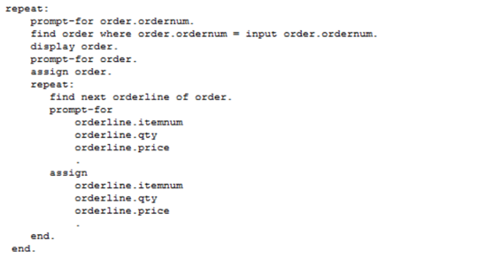
Default Transaction - Example
Every iteration is a net new Transaction Block
In the below example, every iteration of a REPEAT statement is a new transaction;
New transaction @ each iteration

Slide 11
Forced Transaction Blocks
Forced Transaction Blocks
DO
TRANSACTION
FOR EACH TRANSACTION
REPEAT TRANSACTION
FOR/REPEAT WITH EXCLUSIVE-LOCK
Tips:
Spanning transactions across programs or triggers are NOT advisable
Don’t keep transaction open when input from user is expected from UI
Long Running Jobs [LRJ's]
  NO-WAIT & LOCKED function usage is must (or if a dead lock scenario occurs the process will be hung while you are sleeping)
  Alternate way is to use STOP-AFTER (On DO/FOR/REPEAT)

Slide 12
Why will I Override Default Transaction?
If in case user wants to control how much work to rollback – user can make a transaction block smaller or larger based on the business need. This can be achieved by using forced transaction blocks.

Slide 13
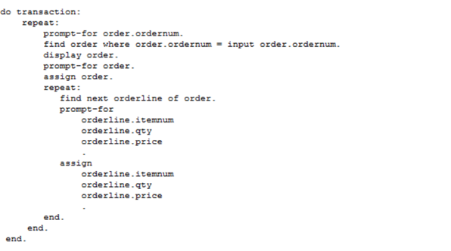
Making Transactions Larger
When? - If in case your business needs are to do all or nothing
In this case you will expand the size of transaction by wrapping the code with a DO..TRANSACTION block. All the iterations are part of a single transaction.
All in one Single Transaction

Slide 14
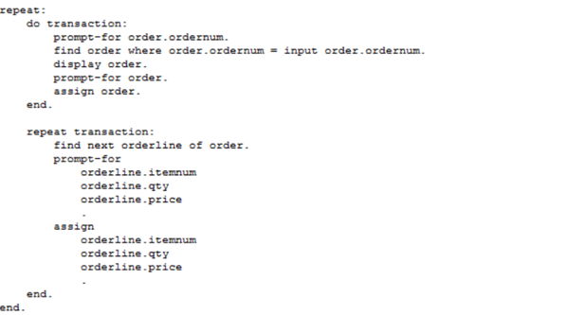
Making Transactions Smaller
On the same example if you want to minimize the transaction; and rollback only limited # of records then you can achieve the same by readjusting your transaction blocks as shown below;
Two Transaction Scopes

Slide 15
Sub Transactions

Slide 16
Sub Transactions
A Transaction nested within another currently active transaction is termed as a Sub-Transaction and allows to undo or error handling of smaller units. [Sub transactions are not involved in database recovery; rather they undo work from the user interface]
Helps to undo a portion of transaction
All DB activity occurring during that sub transaction is written to a local-before-image (LBI) file
Progress backs out work from beginning of the sub transaction, if an error occurs at sub transaction block level
Progress backs out work from beginning of the transaction, if a system crash occurs at sub transaction block level
Recommendation: DO NOT use sub transactions unless it’s really required; try to do most of your processing at transaction level.

Slide 17
Sub Transaction (continued...)
Active Transaction
Sub Transaction

Slide 18
Quiz Time → Will Progress start a transaction?
SI.NO | Code Snippets | Starts Transaction (Yes/No) | Comments
1 | FIND FIRST customer. REPEAT ON ENDKEY UNDO, LEAVE: FIND NEXT customer. END.
2 | FOR EACH customer: customer.name = “Saravana”. END.
3 | FIND FIRST customer. REPEAT ON ENDKEY UNDO, LEAVE: ASSIGN customer.custnum = updateCustNum(). FIND NEXT customer. END.
4 | FOR EACH customer EXCLUSIVE-LOCK: DISPLAY customer. END.
5 | FOR EACH customer TRANSACTION: DISPLAY customer. END.
Progress will NOT start a transaction; ON..ENDKEY is a default transaction block but there is no statement that updates the db within the REPEAT block to start a transaction.
NO
YES
Progress will start a transaction; FOR is a default transaction block and has an assignment statement that updates the db.
YES
Progress will start a transaction; REPEAT is a default transaction block and has an assignment statement that updates the db.
YES
Progress will start a transaction; FOR with EXCLUSIVE-LOCK falls under forced transaction block and starts a transaction by default.
YES
Progress will start a transaction; FOR..TRANSACTION falls under forced transaction block and starts a transaction by default.

Slide 19



What could an ignorant 3 liner code do?
Manager: Looks like we have a critical prod issue – DB got shutdown. Do you think the fix that we pushed to prod yesterday night could be the root cause for this issue?
Developer: ha… Noooo way; I just added 3 liner code and it has nothing to do with the DB shutdown.
Team Lead: oki dokie… Let’s have a look at the code once again to be on safe side.

Slide 20

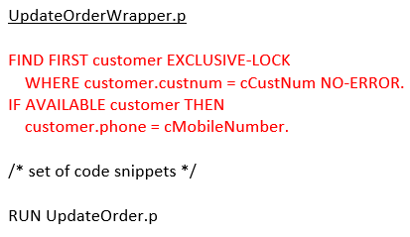
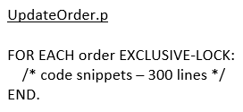


What could an ignorant 3 liner code do? (continued…)
Developer: Here you go!!
Team Lead: What have you done here? ☹ You have grouped whole bunch of orders into one single transaction block which will eventually blow up the BI/LBI file size…
Note: Thank God!! In real life DBA’s/DB Monitoring Tools are there to save us from these kind of scenarios; they would analyze and kick the user out (whoever is responsible for the sudden spike in the BI file growth) – but still will result in a ROLLBACK of your code…

Slide 21
Pin Down Transaction Issues
TRANSACTION function
LISTING File
PROMON (Transaction & Lock Table Details)
Virtual System Tables (_Trans, _Connect & _Lock)

Slide 22
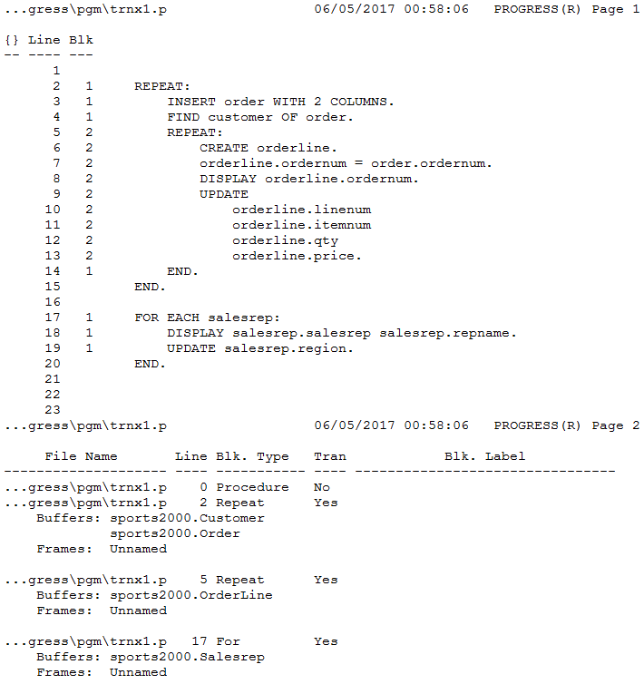
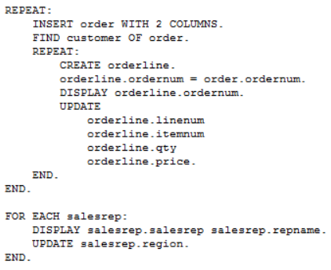
LISTING File
Listing File can be generated using COMPILE statement
COMPILE C:\saravanakumarb\progress\pgm\trnx1.p LISTING C:\saravanakumarb\progress\pgm\trnx1.lst

Slide 23
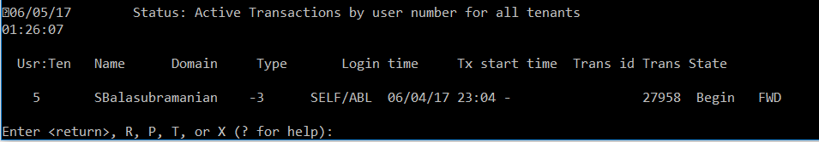
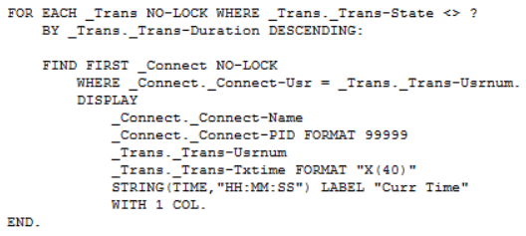
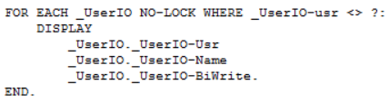
PROMON – Identify problematic transactions
PROMON <db_name> → R&D → 1 (Status Displays) → 4 (Processes/Clients) → 3 (Active Transaction)
VST’s
(OR)

Slide 24
FINE..!! How do I identify the program that causes issue?
Once you identify the client process id that is causing the transaction issue; use proGetStack command on the same machine where client process is running and generate the protrace (OpenEdge 10.1C or later)
proGetStack <pid>
This is similar to ‘kill -USR1 <pid>’ on most of the platforms but proGetStack can pull information when a process is running as well
Note: If a process is running we will get only ABL information but if a process is crashed we will get both C & ABL stack trace information.

Slide 25
How do we prevent DB from a crash?
The DB startup parameters like -bistall & -bithold can be used which will prevent DB from getting crashed;
Shuts down the database when bistall is not used
Alert administrator when size set in bithold is reached and stalls the database which will prevent BI file from growing

Slide 26
Record Locks

Slide 27
Record Locks
Locks are necessary to resolve concurrency issues and ensure data integrity in a multiuser environment
How do we do that? – Let's explore more on type of record locks!
Record Scope can have adverse effect on Record Locks
NO-LOCK
EXCLUSIVE-LOCK
SHARE-LOCK
If user wants to only read a record, then use NO-LOCK
If user wants to read update or delete the record then use EXCLUSIVE-LOCK.
If user wants to read, update or delete a record, user could use SHARE-LOCK [but the lock will be upgraded by Progress only when no other user holds the same record in SHARE-LOCK or EXCLUSIVE-LOCK]
Ill Effects: DEAD LOCK situation could occur more often due to locking contention issues. You could follow proper locking strategies to make sure your system doesn’t get into embarrassing situations.

Slide 28

Locking Strategy
Default
Locking
User retrieves a record with SHARE-LOCK. Progress attempts to upgrade the lock to EXCLUSIVE-LOCK when user tries to update the record. [User may end up getting blocked from updating the record in a multi user environment while other users are accessing the same]
Pessimistic
Locking
User always retrieves a record with EXCLUSIVE-LOCK. [What can other users do? – they can only bye pass and read a record using NO-LOCK. None of the other users could update the record until its released – Pretty Bad Strategy! Unless you are sure that the record will always be accessed by only one user at a time]
Optimistic
Locking
User retrieves a record with NO-LOCK and re-fetches the record with an EXCLUSIVE-LOCK when he wants to commit the record changes to the database. [Better Strategy! But the only ill-effect is the record could be updated or deleted by another user when you are holding the record with NO-LOCK. CURRENT-CHANGED function will serve as a helping hand though]

Slide 29
Record Scoping

Slide 30



What is Record Scoping?
When Progress reads a record from the database, it stores it in a record buffer. The scope of a record is the portion of the procedure where the record buffer is available.
Record scope does not guarantee that the record is always available
Record Buffer holds one record from one table at a time. If in case user wants to access 2 records of the same table in parallel, user has to create a new reference to the table by defining a buffer
FIND/FOR/PRESELECT
FIND/FOR/PRESELECT
FIND/FOR/PRESELECT
[Database]
[Record Buffer]
[Database]
[Database]
DISPLAY
DISPLAY
DISPLAY
[Screen Buffer]
[User Screen]

Slide 31
Types of Record Scope
Strong Scope
A STRONG scope is one in which no other reference of ANY kind may be made to the record outside of the scope
Progress will not compile a procedure which has a reference to a frame or record outside a strongly-scoped block
Ex: DO..FOR & REPEAT..FOR
Weak Scope
A WEAK scope is one which limits the transaction scope for the record, but does not limit the record scope
Buffer can be referenced outside the weak scope block → raises the scope of the buffer to the outer block
Ex: FOR..EACH & PRESELECT..EACH
Free Reference
All other references to records are free reference
Progress tries to scope the record to the nearest enclosing block with record scoping property
Ex: FIND, DISPLAY, AVAILABLE

Slide 32
Record Scoping Rules
Strong
+
Strong
Strong
+
Weak
Strong
+
Free
Weak
+
Weak
Weak
+
Free
Free
+
Free
Strong scope in a weak scope
Weak scope in a Strong scope
Nesting of same scope
Record Scoping
Rules

Slide 33
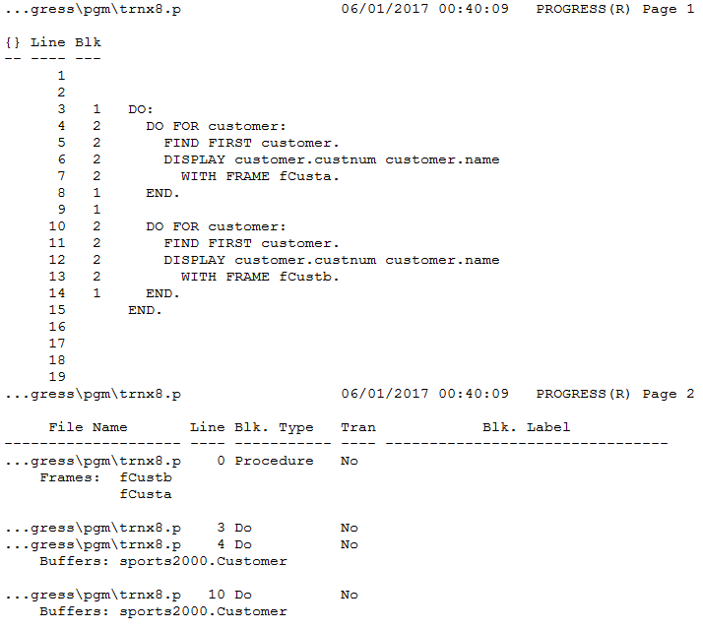
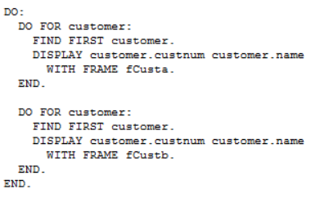
Strong + Strong
Strong Scope
Strong Scope

Slide 34
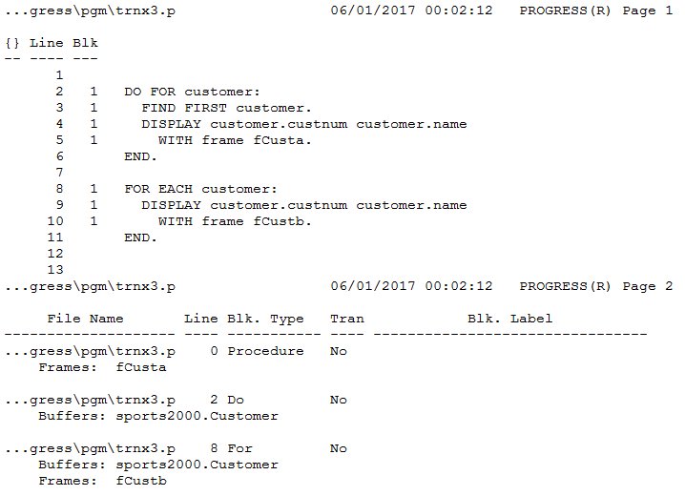
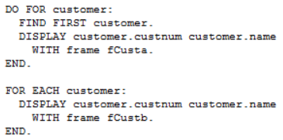
Strong + Weak
Strong Scope
Weak Scope

Slide 35
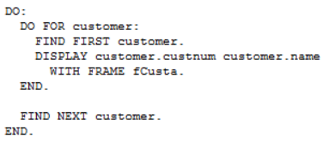
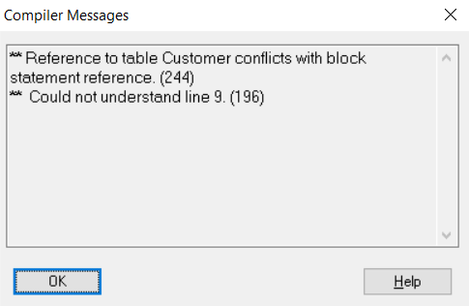
Strong + Free
Strong Scope
Progress Error

Slide 36
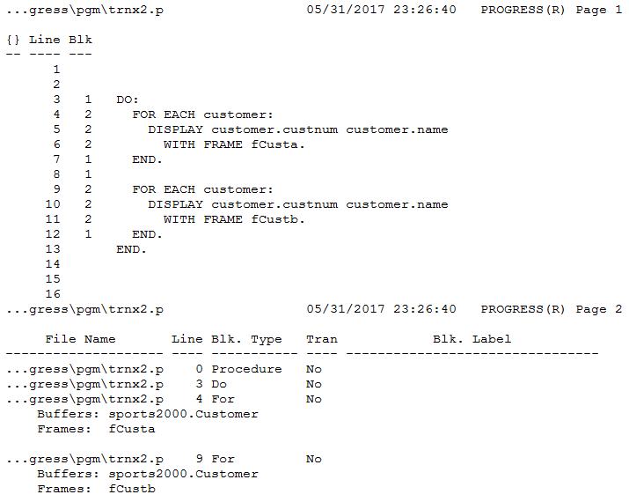
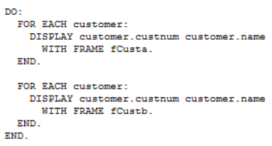
Weak + Weak
Weak Scope
Weak Scope

Slide 37
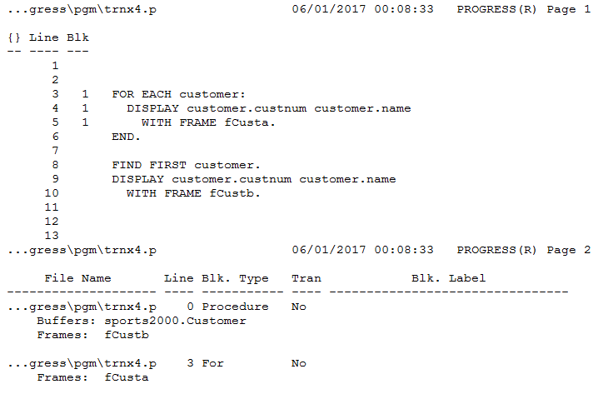
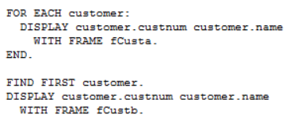
Weak + Free
Scope raised to Procedure Level

Slide 38
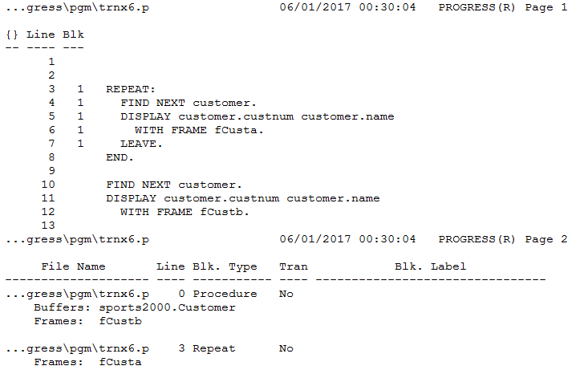
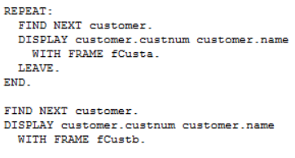
Free + Free
Free Reference
Free Reference

Slide 39
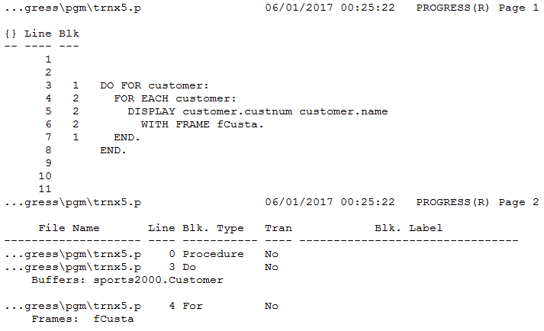
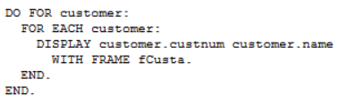
Weak scope in a strong scope
Strong Scope
Weak Scope

Slide 40
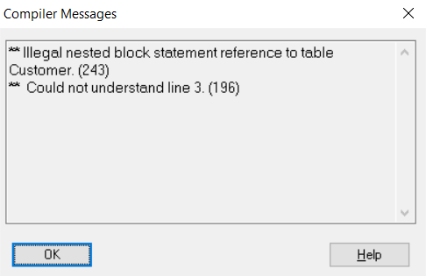
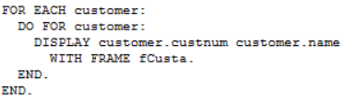
Strong scope in a weak scope
Weak Scope
Strong Scope

Slide 41
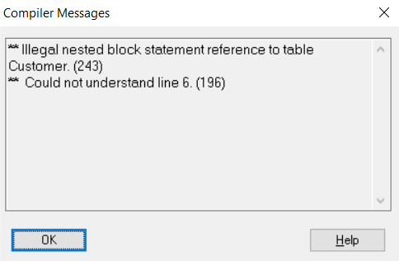
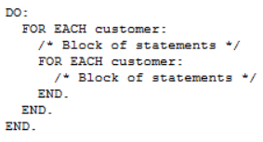
Nesting of same scope
Weak Scope
Weak Scope

Slide 42




Blocks & Record Scoping Properties
Record Scoping Property
FOR
REPEAT
DO
PROCEDURE
(or)
TRIGGER

Slide 43
Quiz Time → Where does the Record Scope start?
SI.NO | Code Snippets | Comments
1 | REPEAT: FIND NEXT customer. DISPLAY customer.custnum customer.name WITH FRAME fCusta. LEAVE. END. REPEAT: FIND NEXT customer. DISPLAY customer.custnum customer.name WITH FRAME fCustb. END.
2 | REPEAT: DO TRANSACTION: INSERT order WITH 2 COLUMNS. FIND customer OF order. END. REPEAT TRANSACTION: CREATE orderline. orderline.ordernum = order.ordernum. DISPLAY orderline.ordernum. UPDATE orderline.linenum orderline.itemnum orderline.price. FIND item OF orderline. END. END.
...ress\pgm\trnx10.p 06/01/2017 02:29:08 PROGRESS(R) Page 2
File Name Line Blk. Type Tran Blk. Label
-------------------- ---- ----------- ---- --------------------------------
...ress\pgm\trnx10.p 0 Procedure No
Buffers: sports2000.Customer
...ress\pgm\trnx10.p 1 Repeat No
Frames: fCusta
...ress\pgm\trnx10.p 8 Repeat No
Frames: fCustb
File Name Line Blk. Type Tran Blk. Label
-------------------- ---- ----------- ---- --------------------------------
...ress\pgm\trnx11.p 0 Procedure No
...ress\pgm\trnx11.p 1 Repeat No
Buffers: sports2000.Customer
sports2000.Order
Frames: Unnamed
...ress\pgm\trnx11.p 2 Do Yes
...ress\pgm\trnx11.p 6 Repeat Yes
Buffers: sports2000.Item
sports2000.OrderLine
Frames: Unnamed

Slide 44
Connecting the DOTS…

Slide 45
Record Scope Vs. Transaction Scope
Record Scope
<
Transaction Scope
All record locks will be released only at the end of the transaction, if record scope is less than a transaction scope (Note: Few application uses RELEASE statement within the transaction block but it just flushes the record from the record buffer but doesn’t release the lock until the transaction gets released).
Record Scope
=
Transaction Scope
Ideal Scenario! It’s better to keep Record Scope equivalent to a Transaction Scope to run your application smooth without an adverse effect.
Record Scope
>
Transaction Scope
Record Bleeding – At the end of a transaction if the record scope is greater than the transaction scope, the EXCLUSIVE-LOCK gets downgraded to SHARE-LOCK which could cause embarrassing situations to your application.
How do I resolve?
By defining a buffer for the table reference (strong scope block preferred)
Or Find the record with NO-LOCK at the end of the transaction

Slide 46
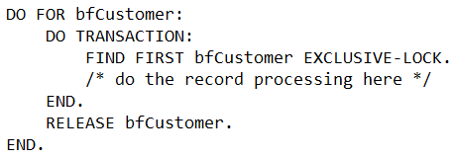
Recommendation
If you are going to update a record inside a transaction block, DO NOT read that record with same table reference even with NO-LOCK before the transaction starts
Use Strong Scope (DO..FOR) to limit the buffer scope to that block.
Record Scope
Transaction Scope

Slide 47

Questions
&
Answers

