Slide 1
SQL Best Practices
Chandra Sekhar
Notes:
In the world of big data, where numerous complex queries run on databases involving terabytes of data, a single inefficient query can affect application performance catastrophically. In the planning and design phases of an OpenEdge Database implementation, it is important to understand how SQL interacts with it. Keeping the optimization practices of OpenEdge SQL Server for performance, protection, and growth of the database in mind, lets go through some best practices for better performance of your database transactions using SQL.on with OpenEdge CDC for ETL, Data Replication and Master Data Management.

Slide 2
Agenda
Application failing with "String too large error"
My application is not running fast enough
Push your application logic to User Defined Functions
Use Scalar Subquery to simplify your query
Which Isolation level is good for your application?

Slide 3
PROGRESS SQL-92 DATABASE PERMISSIONS & SECURITY
Granting permissions on tables to regular users:
  000078878, How to GRANT permissions for SQL92 to a user?
  000010288, How to grant SELECT permissions to a user?
  000022114, How to generate SQL script to GRANT all privileges on all the database tables using 4GL?
  000001611, Progress SQL-92: Grant privileges Without Creating Users?
  000039715, How to generate SQL script to GRANT Read and Write privileges on all the database tables using 4GL?
Revoking permissions on tables to regular users:
  000067931, Basic SQL 92 REVOKE syntax.
  000022121, How to revoke a SQL92 user right to update the database?
  000014112, SQL: How to revoke SQL privileges of the Default DBA and hide Progress Schema tables from public ?
  000078881, ABL/4GL Code to revoke rights to SCHEMA or ALL tables.

Slide 4

Application failing with
"String too large error"

Slide 5
Application failing with "String too large error"
It is problem with SQL Maximum column width.
SQL: “ahh, (The Sellout) you are the best!!”
SQL: “I can read but partially (The)!!”
SQL: “You are too big for me!!”
ABL: “I Can read you(The Sellout)!!”
SQL
ABL
DB
varchar(3) :
“Hey, can you read me (The Sellout)?”

Slide 6
SQL width problem & classic solution
Select X from DB
dbtool
Opt 2:scan and fix
done
SQL
ABL
Too Large
DB
X Varchar(3)
X Varchar(5)

Slide 7
SQL width problem & other solutions
Server side fixes
Client side fixes
  Data Dictionary: Options -> SQL Properties -> Adjust Field Width
  OE SQL as DBA: ALTER TABLE ALTER COL SET PRO_SQL_WIDTH …..
  Find column which has size problem from error text
    SELECT Name, city, state, country FROM pub.customer ……
    “Column Name in table PUB.Customer has value exceeding its max length or precision.”
  Change sql statement column reference to “substr()”
    SELECT SUBSTR( Name, 1, 84) AS ‘Name’, city, state, country, ……
Table1 result set rows
Table2 result set rows
Table3 result set rows
App
Query
Do not always set to 32k!!
DB
output buffers
32K * 100 cols * 50 rows = 160M

Slide 8
SQL width problems & Modern solution
Select X from DB
SQLTruncateTooLarge -11.5.1
Too Large
SQL
SQLWidthUpdate -11.6
ABL
proserve –db <dbname> -S <port-number> -SQLTruncateTooLarge <output/on/off/>
DB
proserve –db <dbname> -S <port-number> -SQLWidthUpdate <on/off>
X Varchar(5)
X Varchar(3)
https://www.progress.com/papers/authorized-data-truncation
https://www.progress.com/papers/autonomous-schema-update
Notes:
SQLWidthUpdate does not reflect in current Query result.

Slide 9

My application is not running fast enough

Slide 10

Troubleshooting Performance problems
Check whether Statistics are up to date or not?
Get and analyze Query plan
Overloaded server due to configuration
Corner the SQL queries which are causing problems
  Enabling logging – server log, connection log
  Correlating .lg and server log files to match a particular user
Check if there are any changes that happened recently
  Changes in Query
  Startup Parameters
Notes:
Release – Optimization are improved. Better to get latest versions.
- Statistics will change release over release. Especially for Major release

Slide 11
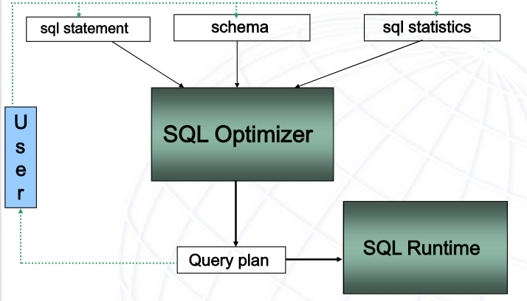
Building the Query Plan

Slide 12
Importance of SQL Statistics
A – Customer
B – Order
C – Orderline
Consider a join between three tables A,B, and C
Which one is good???
Join
A – 10k
B – 10k
C - 10k
Query Optimizer
5k
Join
A
SQL Engine
Join
B
C
5K
Join
B
A
C
Without Statistics
All tables are Equal

Slide 13


Update Statistics – verify and update
UPDATE TABLE STATISTICS AND INDEX STATISTICS AND ALL COLUMN STATISTICS FOR PUB.Customer;
Table
Column
A – 10
B – 10k
C - 1000k
_SysTblStat
Index
_SysColStat
Query Optimizer
_Sys<datatype>Stat
_SysIdxStat
SQL Engine
Join
Join
1k
8k
Join
B
Join
A
How do I update?
How often I should update?
A
C
B
C
DB with statistics
Notes:
ABL script to generate sql stat commands:
http://knowledgebase.progress.com/articles/Article/P115266
Update statistics must be committed;

Slide 14
Analyze Query Plan
SELECT "_Description" FROM Pub."_Sql_Qplan"
WHERE "_Pnumber"=(SELECT MAX("_Pnumber")
FROM PUB."_Sql_Qplan" WHERE "_Ptype">0);
  SQL query plan (_SQL_Qplan)
  Last 10 queries!!
| JOIN [13][AUG_NESTED_LOOP-JOIN]
| | | PUB.Order. [12](
| | | | INDEX SCAN OF (
| | | | | AmountDate,
| | | | | | (PUB.O.Amount) between (…)
| | (PEXPR3) = (PEXPR5)
| | -- above defines ANL left side keys <relop>
right side keys.
| | | PUB.Customer. [11](
| | | | INDEX SCAN OF (
| | | | | CustNum,
| | | | | | (PUB.C.CustNum) = (null))

Slide 15
What to look in query plans
Query plan and check for below operations
    Sort and Aggregations
PROJECT [31] (
| SORT [30] IN TMPTBL0000011d(
| | HASH AGGREGATE [24] [ INTO TMPTBL0000011c
| | | PROJECT [19] (
| | | | PUB.ORDER. [3](
| | | | | TABLE SCAN
PROJECT [23] (
| PROJECT (STREAM AGGREGATE) [29] (
| | PROJECT [17] (
| | | PUB.ORDER. [3](
| | | | INDEX SCAN OF (
| | | | | CUSTORDER,
SELECT Custnum, COUNT(Ordernum) FROM
Pub.Order GROUP BY Custnum
ORDER BY Custnum
CREATE INDEX custorder ON pub.Order(Custnum);

Slide 16
What to look in query plans
Query plan and check for below operations
    Sort and Aggregations
    Dynamic index
| | | INDEX SCAN OF DYN. INDEX ON SYSPROGRES
| | | | [Dynamic Index with key == fld lis
| | | | [ Pexpr map for Dynamic Index data
| | | | PEXPR1, PEXPR2 ]
| | | | [ Fldids
| | | | FldId 0, FldId 1 ]
| | | | [Dynamic Index] TMPTBL000000f5BL00
| | | | | (SYSPROGRESS.TMPTBL000000f4.0)
| | | | PROJECT [19] (
| | | | | PUB.O. [2](

Slide 17
What to look in query plans
Query plan and check for below operations
    Sort and Aggregations
    Dynamic index
    Nested loop joins
| PROJECT [21] (
| | JOIN [3][NESTED_LOOP-JOIN](
| | | PROJECT [16] (
| | | | PUB.SI. [1](
| | | | | TABLE SCAN
| | | | )

Slide 18
What to look in query plans
Query plan and check for below operations
    Sort and Aggregations
    Dynamic index
    Nested loop joins
    Table scan
Most of the scenarios above operations can cause performance problems
Probably Indicates a missing index or missing predicate
| | PROJECT [16] (
| | | PUB.CUSTOMER. [2](
| | | | TABLE SCAN
| | | )
Notes:
Talk about missing predicate

Slide 19
Optimizer Hints
Use SQL hints to see if it mitigates (workaround) the performance problem.
NO REORDER – This will set given join order
  If suspicious join order is selected by optimizer this hint can be used this to set the join order
  Table1 INNER JOIN table 2 {NO REORDER}
FORCE INDEX – Forces optimizer to use particular index
  FORCE (INDEX (<index_name>))
NOEXECUTE – Use this to generate query plan without execution
    This hint will make query to go through optimizer phase
    Execution will be skipped
      SELECT * FROM Pub.Customer NOEXECUTE;

Slide 20
Overloaded server due to configuration
Example configuration: -Ma 10 –Mn 30
New sql servers are not started due to given configuration
SQL Connections
SQL Connections
-Ma maximum clients per server
-Mi minimum clients per server
-Mn max number of servers
SQL1
SQL2
…
SQL30
DB

Slide 21
Overloaded server due to configuration
Example configuration: -Ma 10 –Mn 30
New sql servers are not started due to given configuration
Use –Mi to distribute connections
Ma 10 –Mi 3 –Mn 3
SQL Connections
-Ma maximum clients per server
-Mi minimum clients per server
-Mn max number of servers
SQL1
SQL2
…
SQL10
DB

Slide 22
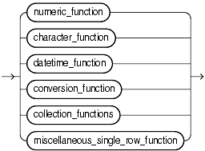
Push your application logic to Database to improve network traffic.

Slide 23
Application generate huge data flow over network
All orders in last 3 Months where it took more than 2
days to dispatch an order after receiving the order.
Generate
Report
DB
Order Table has million rows while
only few orders satisfies the criteria
Push your application logic to Database using User Defined Functions.

Slide 24
User Defined Function
JAVA based User Defined Function
Create Function DiffDate(startDate Date, endDate Date)
return integer
begin
/* calculate date difference in java. */
long dayDiff = ChronoUnite.DAYS.between(startDate, endData);
return dayDiff
end

Slide 25
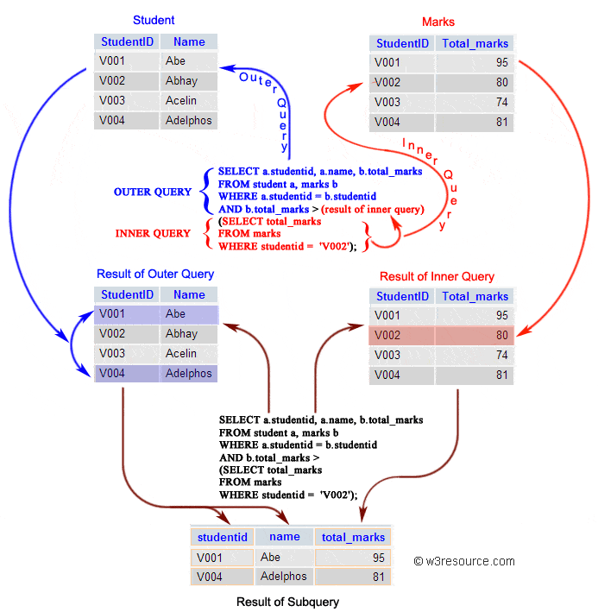
Use Sub Query(SQ) and Scalar-SQ to simplify your query.

Slide 26
Use SSQ to simplify your query.
Select employee_id, name,
salary from employees where
salary > (select avg(salary) from employees);
SELECT first_name, last_name,department_id
FROM employees WHERE department_id NOT IN
(SELECT DEPARTMENT_ID FROM departments
WHERE manager_id BETWEEN 100 AND 200);
Scalar Sub Queries are very powerful tools.
To list few, Scalar Subqueries can be used
  CASE expression
  VALUE clause of INSERT statement
  WHERE
  ORDER BY
Progress OpenEdge SQL Compliance to Core SQL:2011
  https://www.progress.com/papers/progress-openedge-sql-compliance-to-core-sql-11

Slide 27
What’s good Isolation level for your application?

Slide 28
DIRTY READS
Thread 1
Thread 2
Col 50
SELECT Col
Col = 100
Col 100
Update Col
SELECT Col
Col 100
Roll Back
Col 50
Col 100

Slide 29
NON REPEATABLE READS
Thread 1
Thread 2
Col 50
SELECT Col
SELECT Col
Col 50
Col = 100
Col 100
Update Col
Commit
SELECT Col
Col 100
Col 100
Col 100

Slide 30
PHANTOM READS
Thread 1
Thread 2
N
Count(Customers)
INSERT Customers
N+1
Count(Customers)

Slide 31
What’s good Isolation level for your application?
Isolation Level
Read
Uncommitted
Read
committed
Repeatable
Read
Serialization
Isolation level | Dirty reads | Non-repeatable reads | Phantoms
Read Uncommitted | may occur | may occur | may occur
Read Committed | don't occur | may occur | may occur
Repeatable Read | don't occur | don't occur | may occur
Serializable | don't occur | don't occur | don't occur

Slide 32
Questions?

