Slide 1

Harness the Power of IoT with
Rollbase
Thierry Ciot

Slide 2
Agenda
IoT Market and Introduction to Rollbase
Employees Transportation Management Case Study
Building Management Example
High-Value/Low-Code Platform
Q&A

Slide 3
IoT Market Opportunities
2016 to 2021 Estimated to grow:
  From $157 billion to $661 billion,
  CAGR of 33.3%.
Example: IoT and Healthcare: $32.4 Billion in 2015
Ref: http://www.postscapes.com/internet-of-things-market-size/

Slide 4
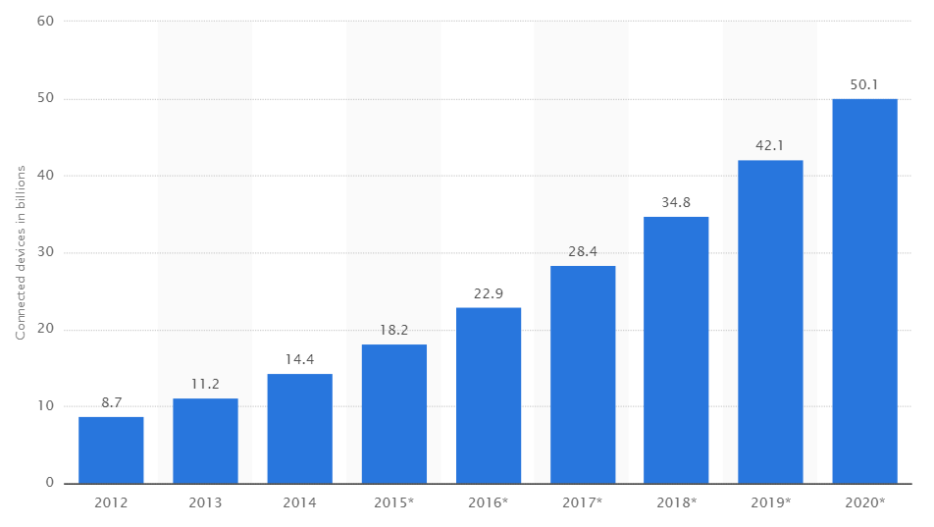
Number of Connected Devices growth (in billions)
From https://www.statista.com/statistics/471264/iot-number-of-connected-devices-worldwide/

Slide 5
What’s Rollbase low-code platform

Slide 6
Characteristics
A low-code, high-value platform has the following characteristics:
  It allows creating responsive and adaptive Web applications using point and click - drag and drop methodology as well as extending the application with code at specific hook points.
  It provides deploying, running and scaling the applications
  If offers lots of built-in services
Allows to Build Apps in days/weeks not months/years
Notes:
An app built with large % no code compared to a traditional development method.

Slide 7
Agenda
Intro
IoT Market
Employees Transportation Management Case Study
Building Management Example
High-Value/Low-Code Platform
Q&A

Slide 8
Transportation Management
Kingslake a Progress Partner
They built a transportation management solution based on Rollbase
Started with clothing industry

Slide 9
Context
SriLanka has issues with infrastructures, public transport, so factories provide transportation from and to home as well as between factories and suppliers.
Some interesting numbers: in clothing industry 2 main employers:
  120,000 employees
  Factories split around country
  2000 to 5000 employees per factory
  > 100 buses for 5000
  1000s requests on daily basis (routine, overtime, change shift, other plants or suppliers visit)
Transportation is contracted

Slide 10
Problems
Lots of problems with previous/manual solution:
Pooling difficult
High cost (buses, cars, vans) - Under utilization of vehicles
Billing disputes (No visibility on mileage)
Employees security hard to maintain particularly for around the clock requests when there is no overview or tracking of employees during transit.
Too many trips exceeded max journey time
No way to ensure right people are on right bus

Slide 11




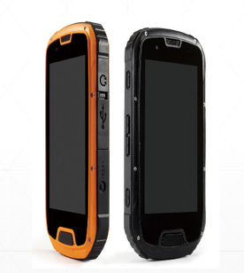









Solution Architecture
Devices and Sensors
Solution Backend
Presentation layer
Rollbase
Data Model
Workflow & Logic
Org. Model
Integration Model
NFC
User Interface
Application Directory
Permissions
Application Runtime
Engine

Slide 12


New Development Architecture
Core Application
On
Drivers Mobile App
GPS Tracking
NFC
Data Sync
Workforce Transportation
REST Services / Calls
On
On Board GPS Device
Cargo Transportation
Data Server
GPS Tracking
Engine Status
Speed
Tour Transportation
Progress Corticon
Business Rules
Rule-based route planning
Progress Rollbase
For more on RB decision services https://goo.gl/NYG9wv
Notes:
Using progress tech to build end to end transport solution. The first part is what we walked u through work force , built on core roll base, communicating with onboard device with gps and NFC features.
We have explored cargo transportation, probably NFC devides are not required for this scenario. Onboard GPS data helps us provide the dashboard details, this onboard device can be extended to other sensors like humidity and temp
Since India and sri lanka is tourist oriented, we expanded the use case to implement a tour transport use case, which has extended features to track the guests, and provide information on their moment and arrival and also plan to connect to activity monitoring platform to handle events and activity
Another extension planned is to enhance the various planning features and utilize corticon rule based platform. This helps us to aggregate the rules on corticon and utilize the new version of rollbe which is tightly integrated with corticon.
This is what we plan to do on the IOT framework.

Slide 13










Functionality
Plan
Track
Monitor and Control
Maintain Employees, Drivers, Vehicles, Destinations
Loading the trip info, Start and Stop
Employee on-board status.
Transport Requests via “Employee Self Service Portal”
Mark on-boarding and off-boarding with NFC
Vehicle capacity utilization
Schedule routine transportation with predefined routes
GPS tracking with location, time and speed
Trip History with actual routes
Dynamic route planning with “Visual Planner”
On board even notification to the center
Monthly transportation costing
Notes:
We understood the customer journey and how the solution is interacting with the touch points in our previous slide.
The TranSmart solution addresses three main functional aspects :
o Plan
o Track
o Monitor & Control
Planning: The requests raised by employees is channeled through the employee portal for ease of handling requests and also raising them.Routine route planning is handled by the system. Adhoc requests lead to dynamic route planning. This is enabled by visual and co-ordinate based planning. Factors like distance , journey time etc are looked at during planning, to both optimize and also keeping in mind employee comfort. The planning aspects brings together information on vehicle / driver availability and creates visibility to aid the scheduling and allocating process of these resources when assigned to different routes.
• Tracking: Tracking features serve to major themes. Safety / Security of employees and visibility of the vehicles for scheduling and planning. The employee safety aspect is enabled by the TOUCH / NFC card. An employee boarding or alighting the vehicle taps the NFC card. This action captures the timestamp of the employee boarding the vehicle This enables the system to track the movement and presence of employees during the pick up, transit and drop off. The employee is also notified on the vehicle destination and time of arrival at the designated spot. Notifications are through an email or sms. Location trip information is preloaded to a designated smartphone provided to the driver. The start time, stops and speed is monitored. GPS corresponders on board keep a tab on vehicle location.
• Monitoring and Control : The schedule allocation provides information on the availability of vehciles and the drivers. This enables an optimum capacity utilization. This also provides information for a regular transportation exercise. Reports can be generated and shared through emails with the key stake holders.
Note : Employee onboard event notifications - through emails / sms
Planning :
Routine route planning is handled by the system
Adhoc requests lead to dynamic route planning. This is enabled by visual and co-ordinate based planning. Factors like distance , journey time etc are looked at during planning, to both optimize and also keeping in mind employee comfort.
The requests raised by employees is channeled through the employee portal for ease of handling requests and also raising them.
The planning aspects brings together information on vehicle / driver availability and creates visibility to aid the scheduling and allocating process of these resources when assigned to different routes.
Tracking
Tracking features serve to major themes. Safety / Security of employees and visibility of the vehicles for scheduling and planning.
The employee safety aspect is enabled by the TOUCH / NFC card. An employee boarding the vehicle taps the NFC card. This action captures the timestamp of the employee boarding the vehicle. And a similar tap while alighting also provides the location and time stamp of the employee. This enables the system to track the movement and presence of employees during the pick up, transit and drop off.
The employee is also notified on the vehicle destination and time of arrival at the designated spot. Notifications are through an email or sms.
For the vehicle visibility, the onboard GPS corresponder helps in providing geographical co-ordinates to the system at any given time.
Monitoring and control

Slide 14
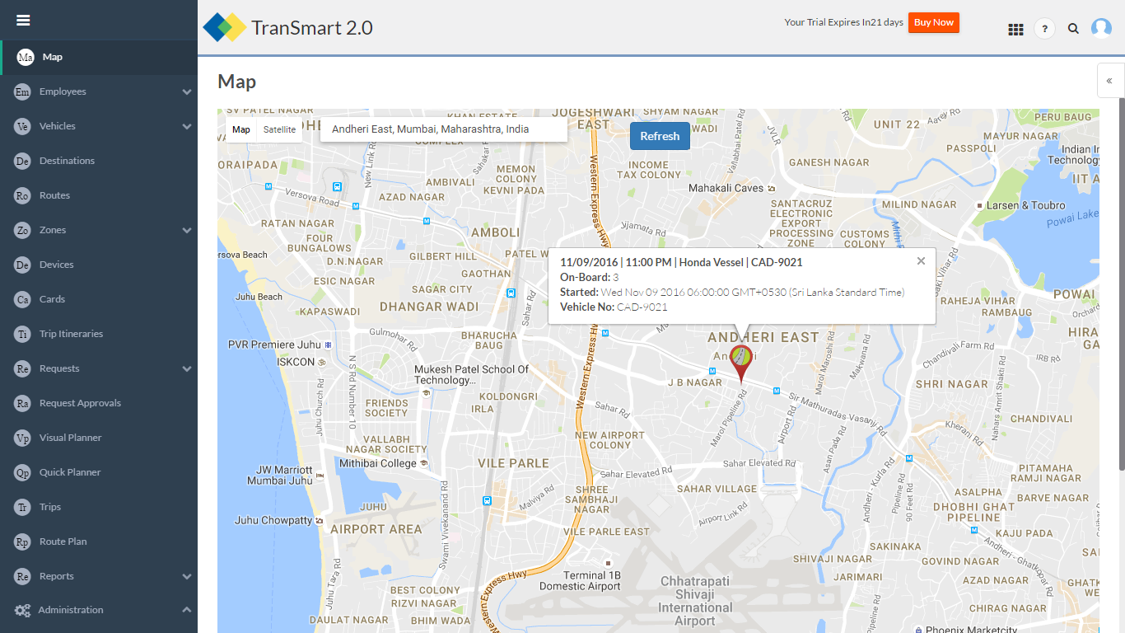
TranSmart Dashboard

Slide 15
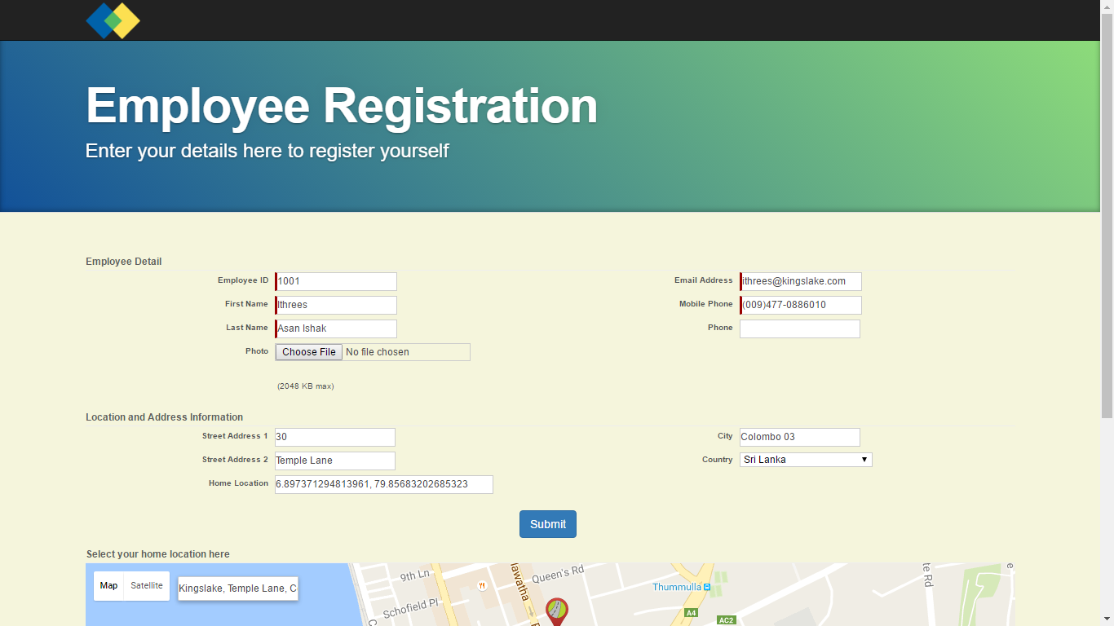
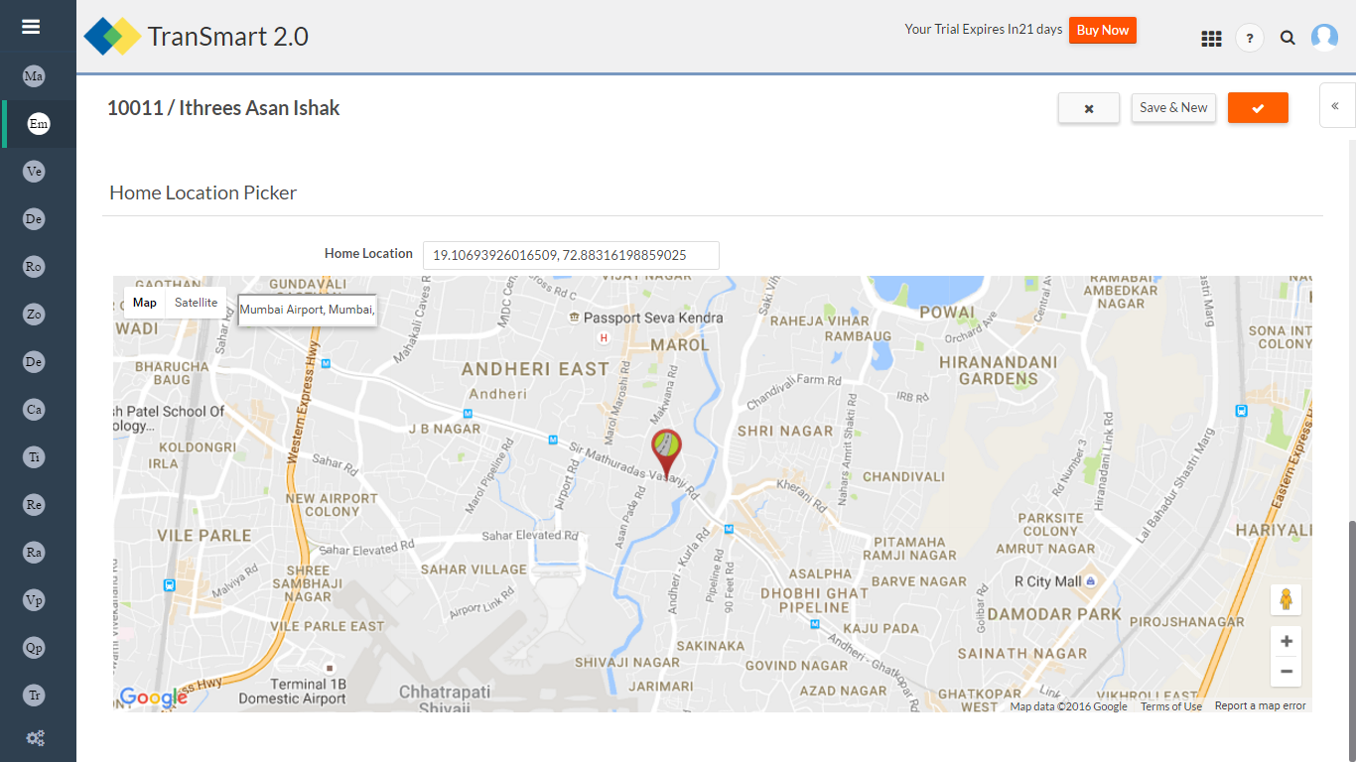
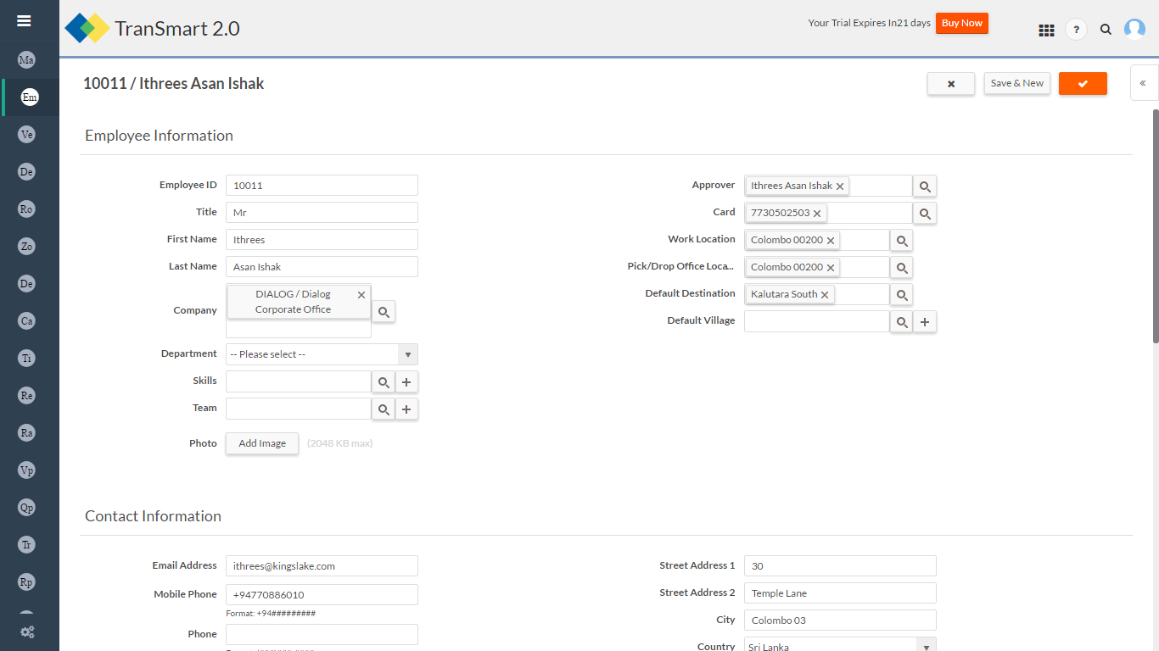
TranSmart Employee Self Registration

Slide 16
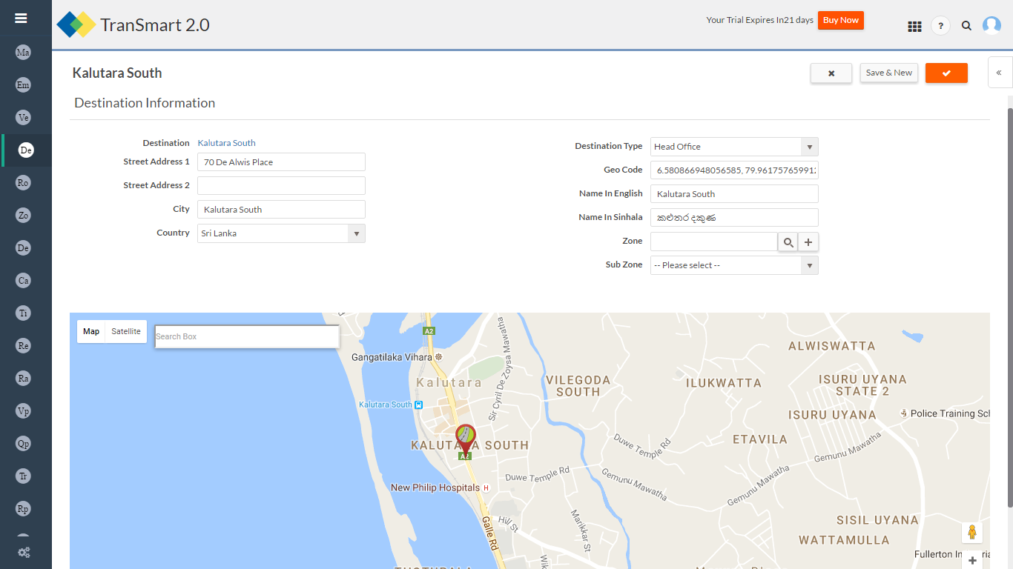
TranSmart Destination Maintenance

Slide 17
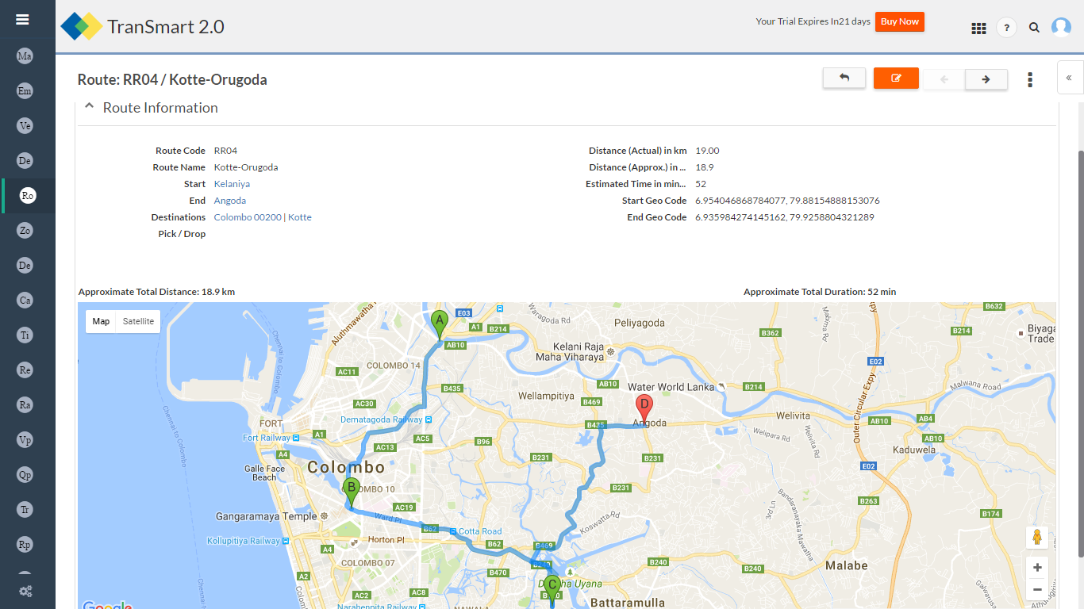
TranSmart Route Planning

Slide 18
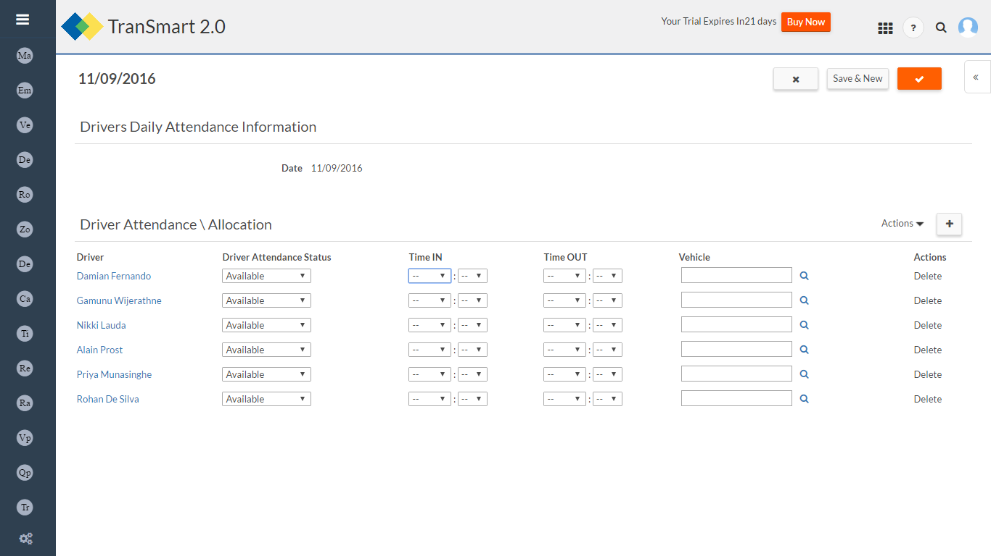
TranSmart Driver Attendance and Vehicle Allocation

Slide 19
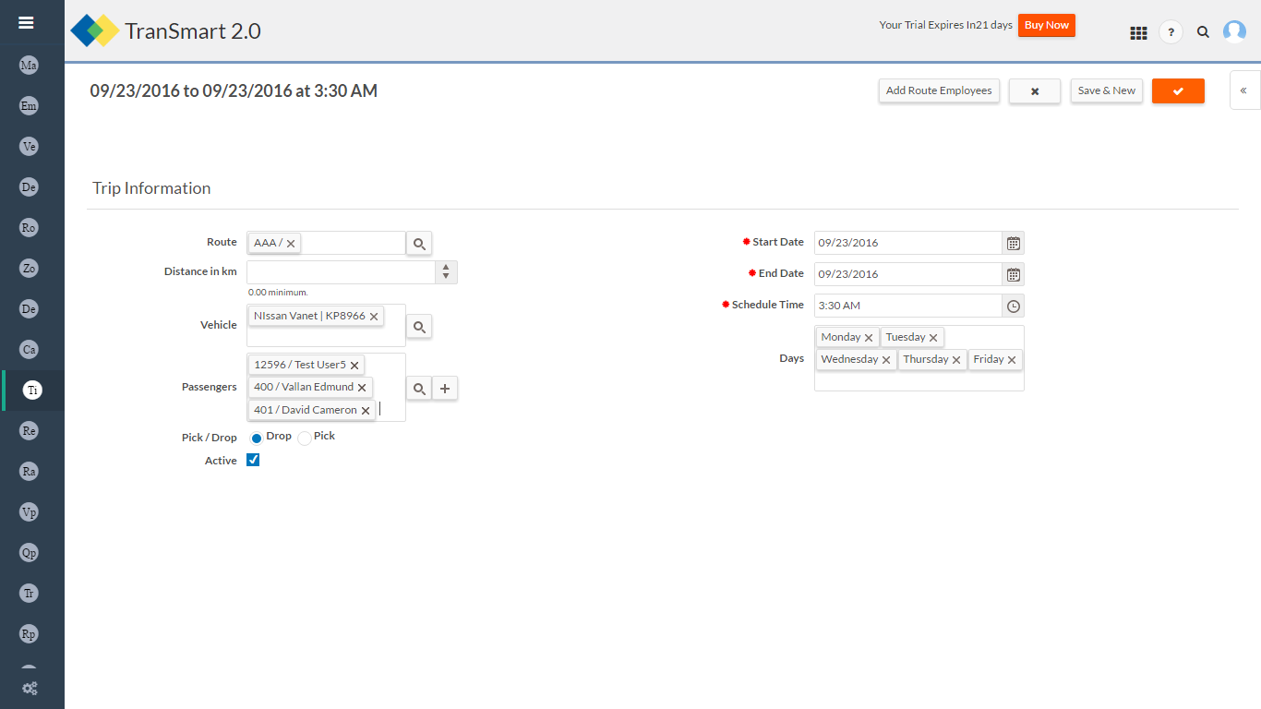
TranSmart Trip Itinerary

Slide 20
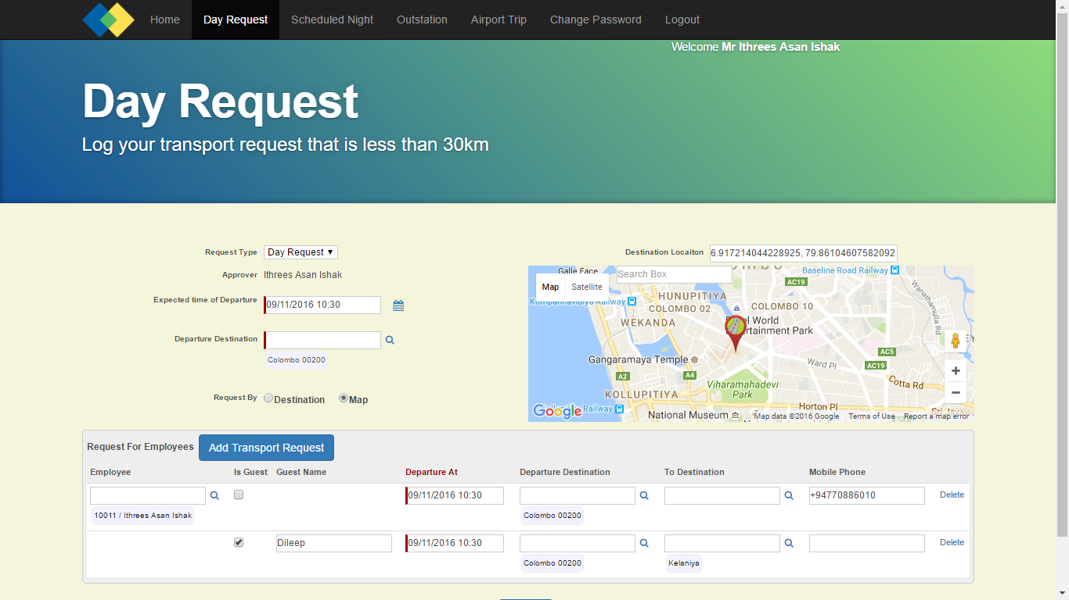
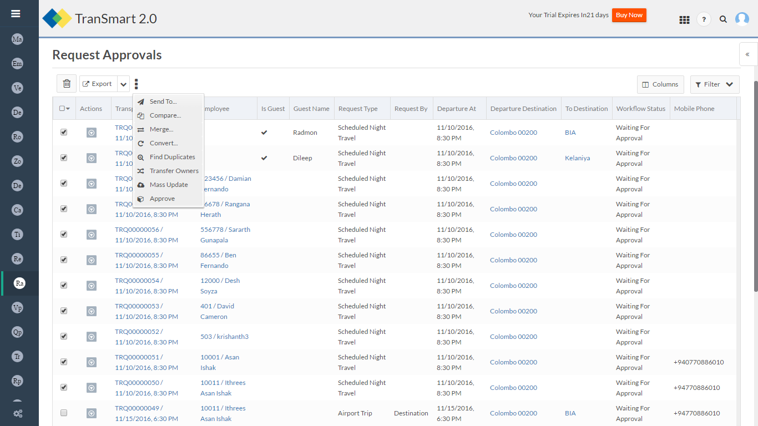
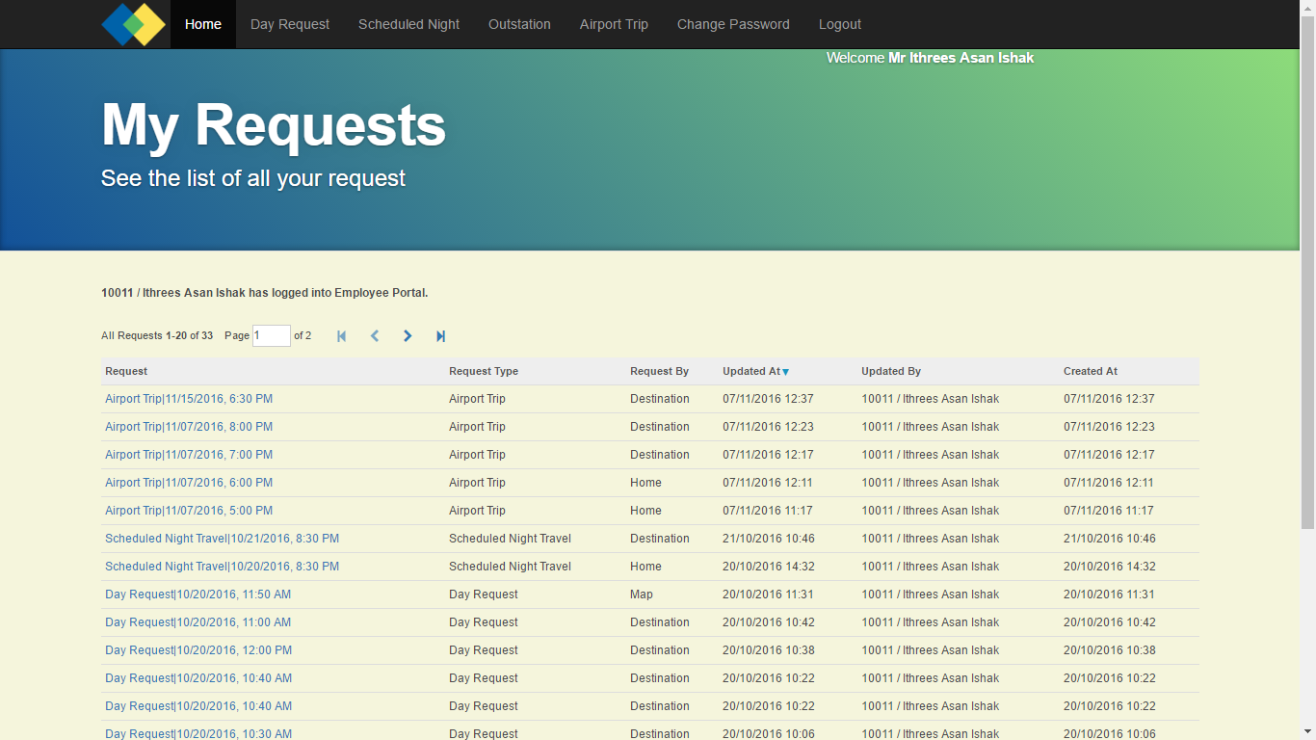
TranSmart Transport Request

Slide 21
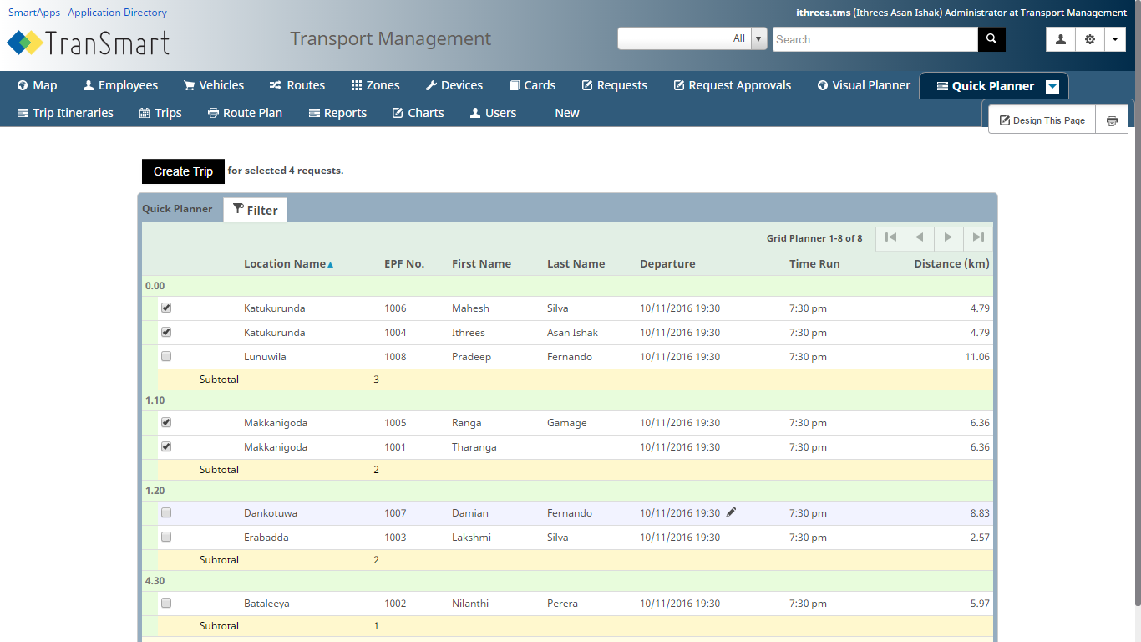
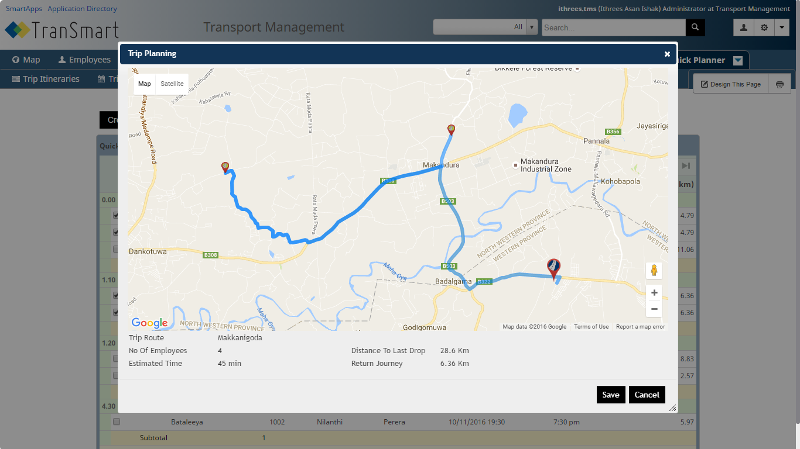
TranSmart Quick Planning

Slide 22
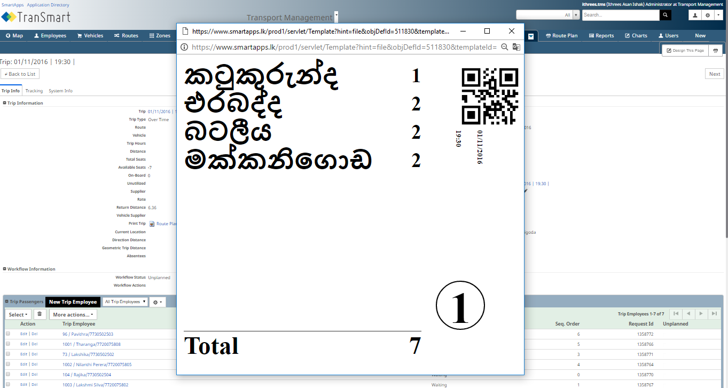
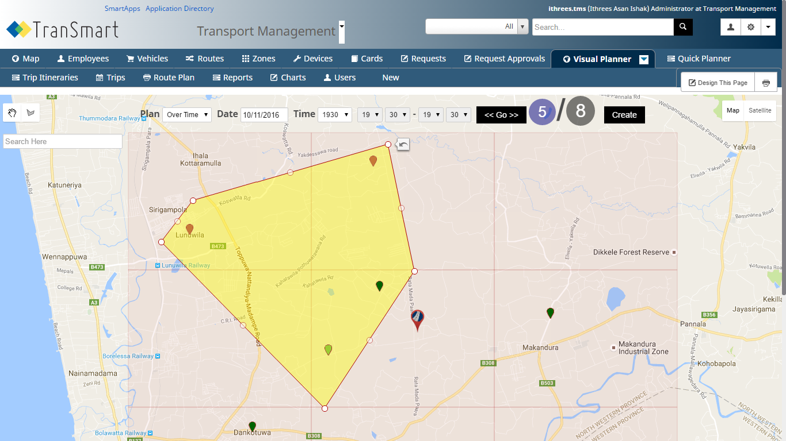
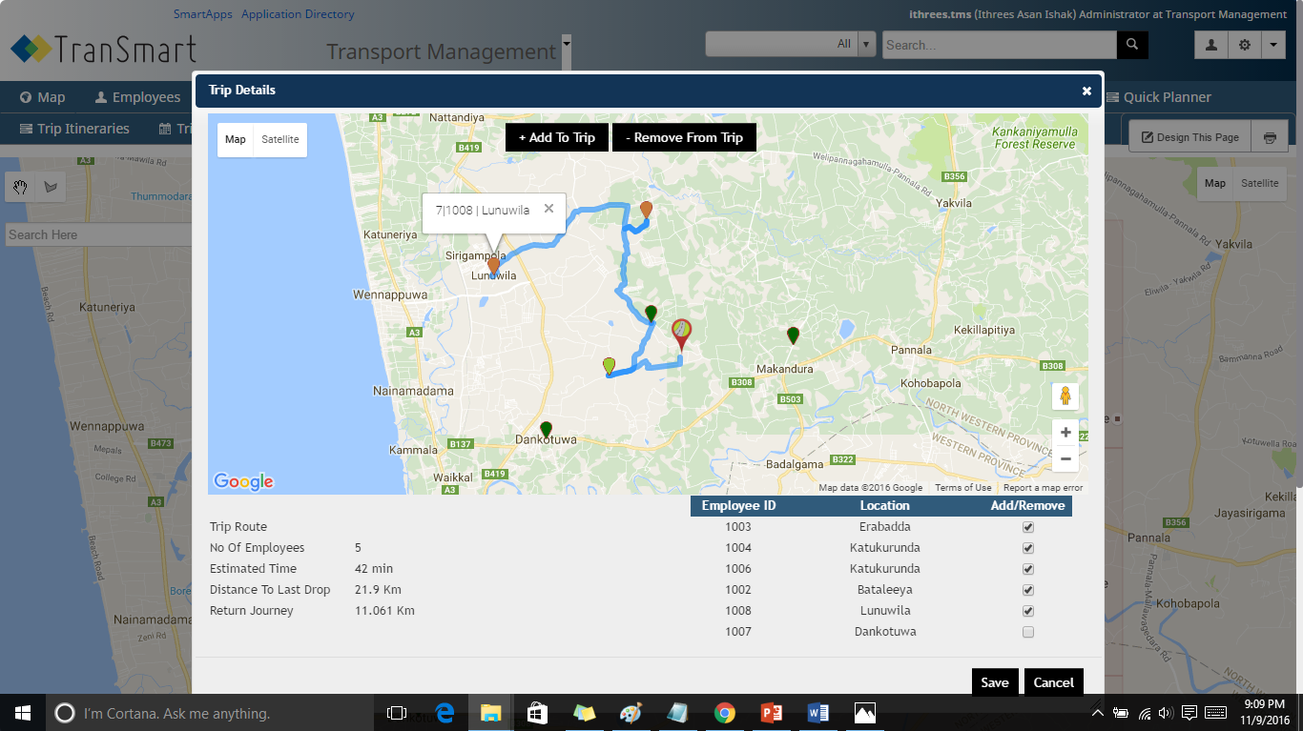
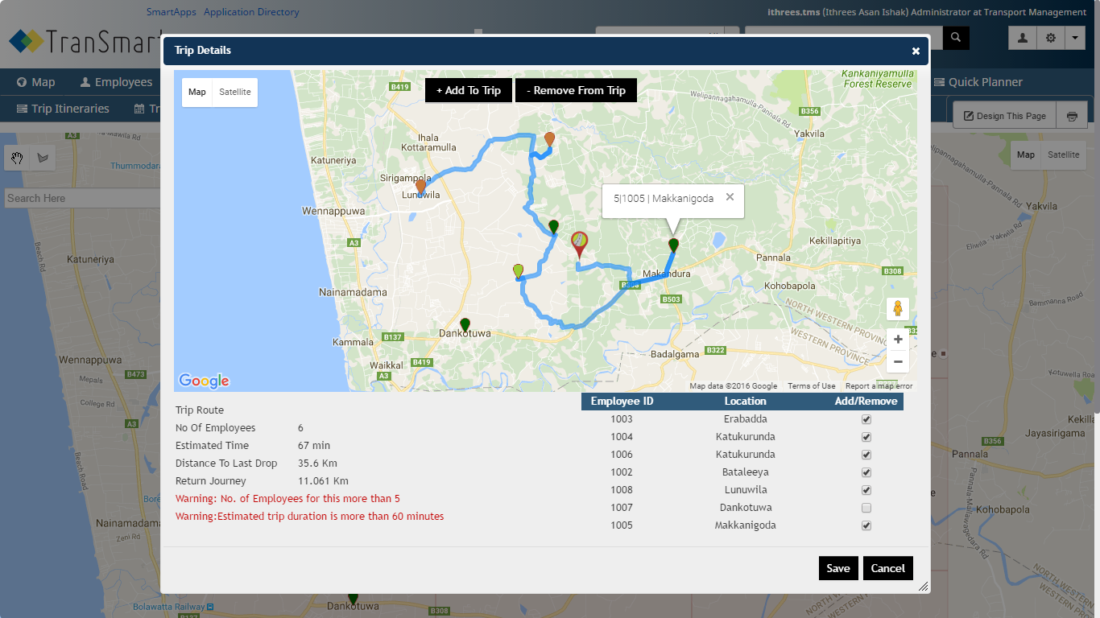
TranSmart Visual Planner

Slide 23
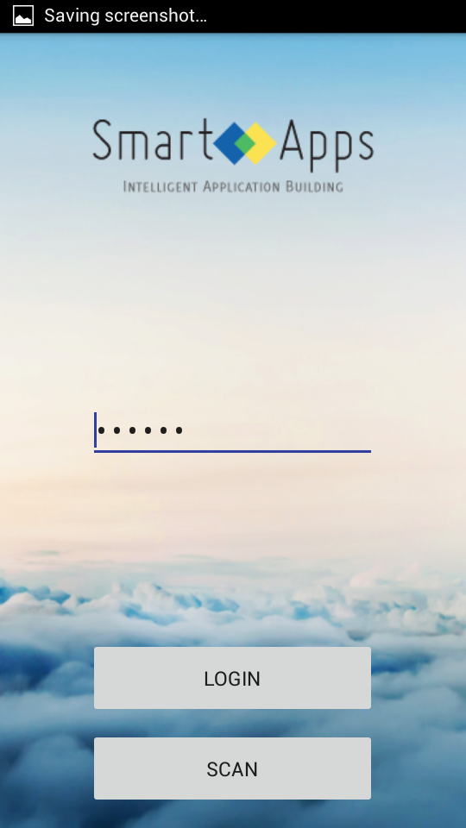
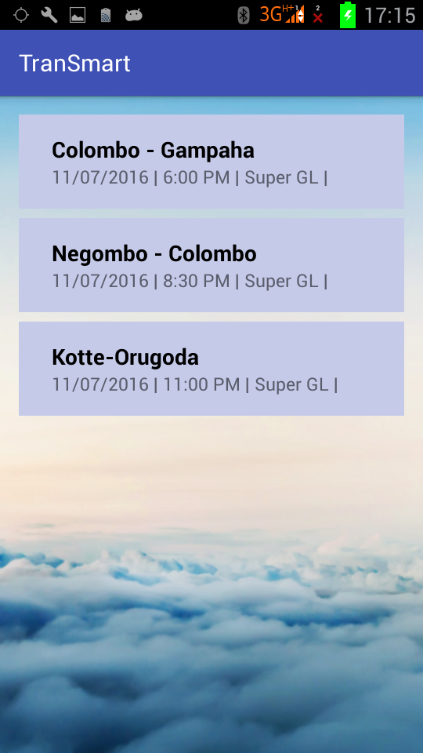
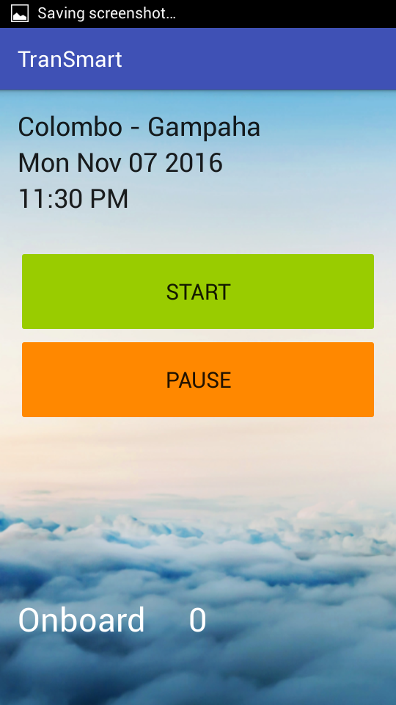
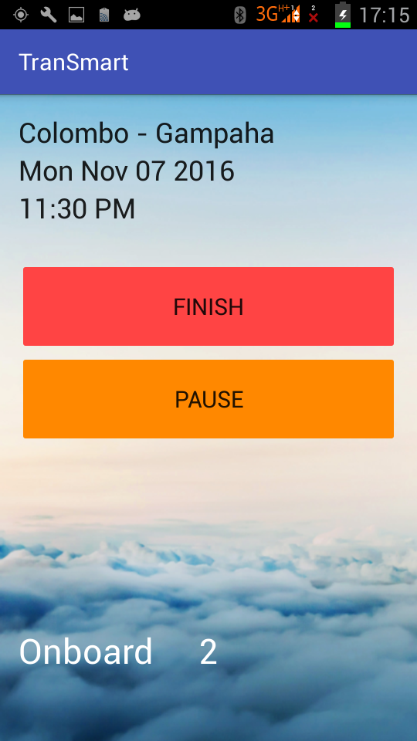
TranSmart Mobile Application

Slide 24
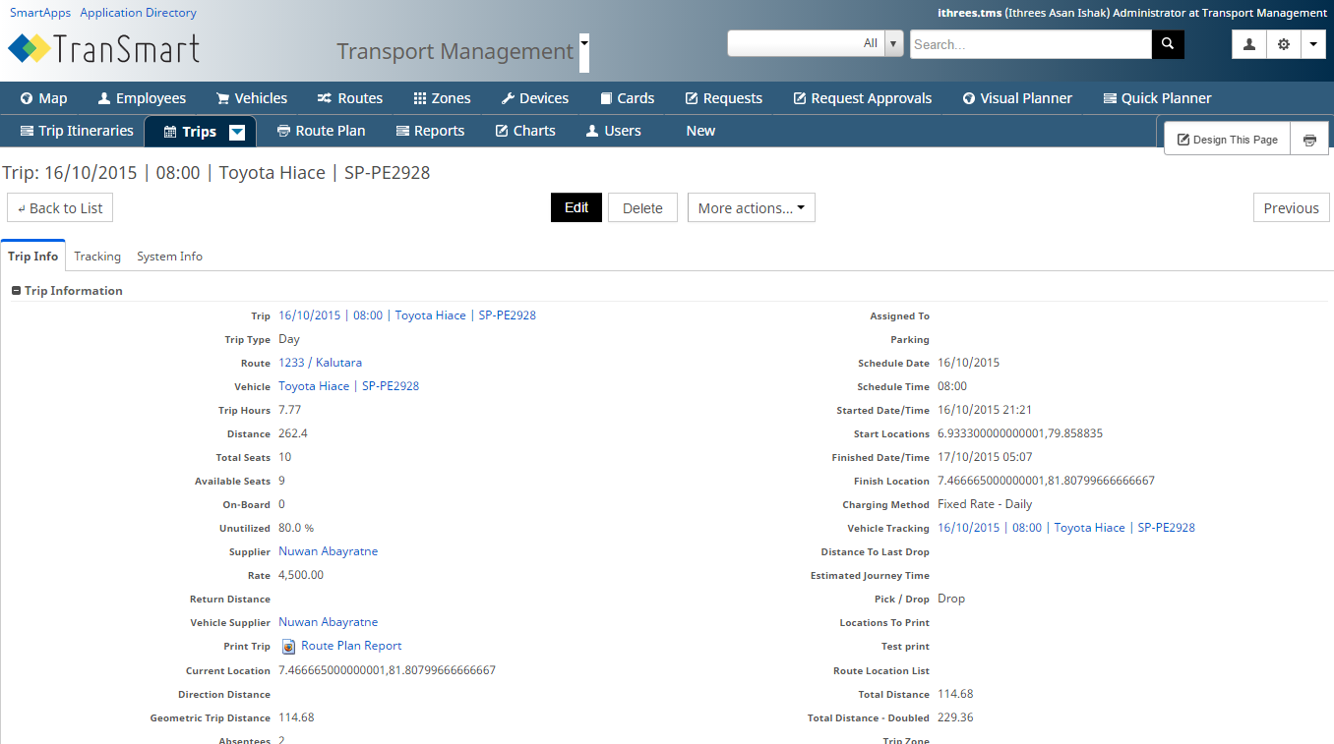
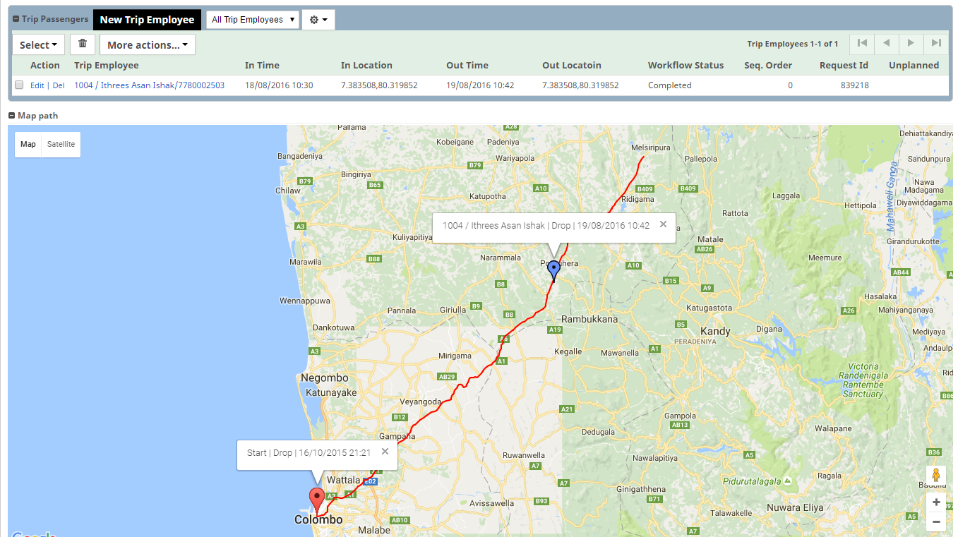
TranSmart Trip Review

Slide 25
Benefits
Visibility:
  Pick-up and drop-off time and location
  Vehicles utilization
  Routes and trips time
Optimum vehicles utilization -> Reduced transportation cost

Slide 26
Benefits Operational Efficiency
Overtime decision: had to be decided by 1 o’clock now 4pm.
Cloud solution:
  Billed as pay per use and by number of employees
  Saving: on premise servers + maintenance
Unplanned benefit with major impact:
  Early access to employee availability (workforce planning – line balancing)
  Employees availability was only known when they arrive at factory
  5% absentee (250 people absent in average – some with special skills)
  Can loose up to 1hour of factory production

Slide 27
Benefits to Transport Contractors
Efficient Billing thanks to accurate mileage
Fleet Visibility
Sales tool for new business

Slide 28
Benefits to Employees
Reduce wait time thanks to vehicle status notification
Reduction in journey time
Personal safety

Slide 29
Why was Kingslake Successful with Rollbase
Faster to build (conservative estimate at 60% compared to traditional methods)
Very quick to demo initial concepts and iterate with customers.
Were able to leverage lots of built-in services (Built-in user management, Security, APIs, reporting, workflow engines, cloud, …)
Allowed to outsmart competition by providing feature rich solution

Slide 30
Agenda
Intro
IoT Market
Employees Transportation Management Case Study
Building Management Example
High-Value/Low-Code Platform
Q&A

Slide 31
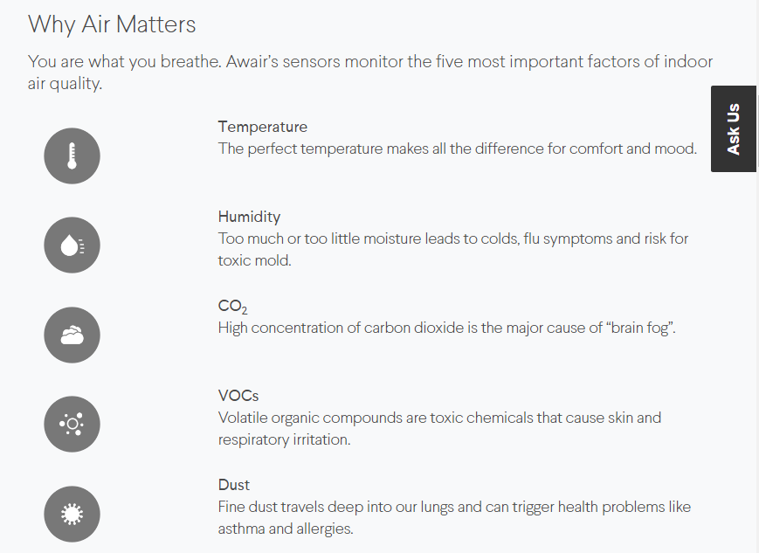

An Application for a Prospect
Building Management for:
  Residential
  Industrial
Check blog: https://goo.gl/jAXwoF

Slide 32
Demo Time

Slide 33
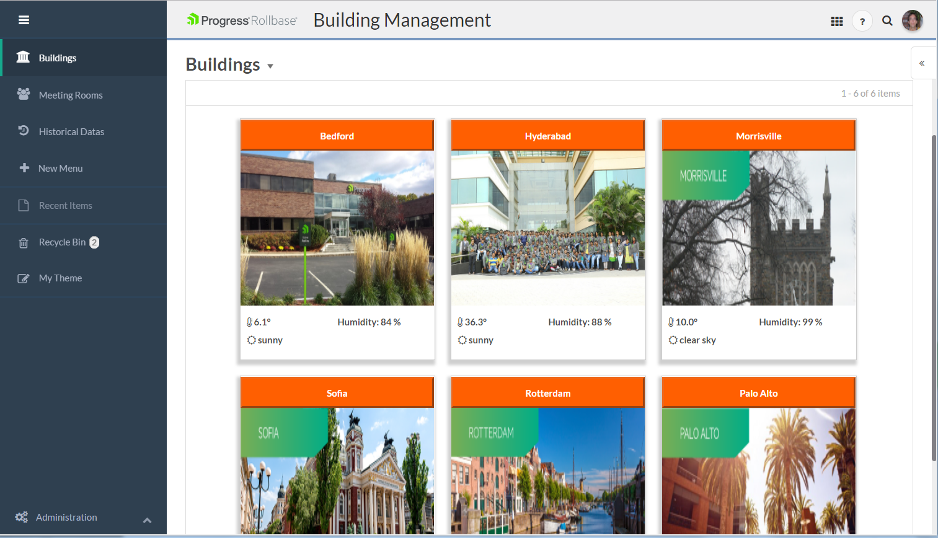

Slide 34
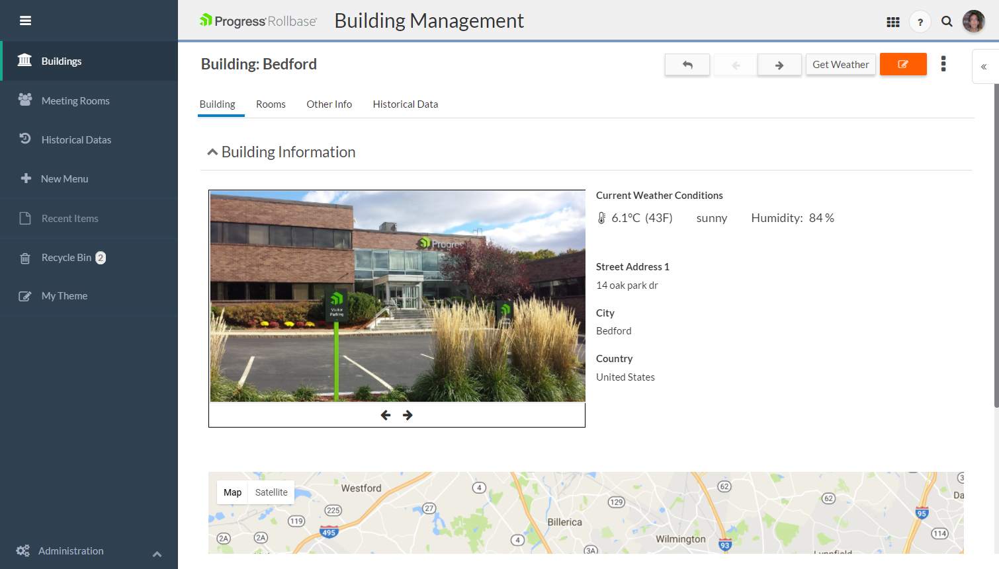

Slide 35
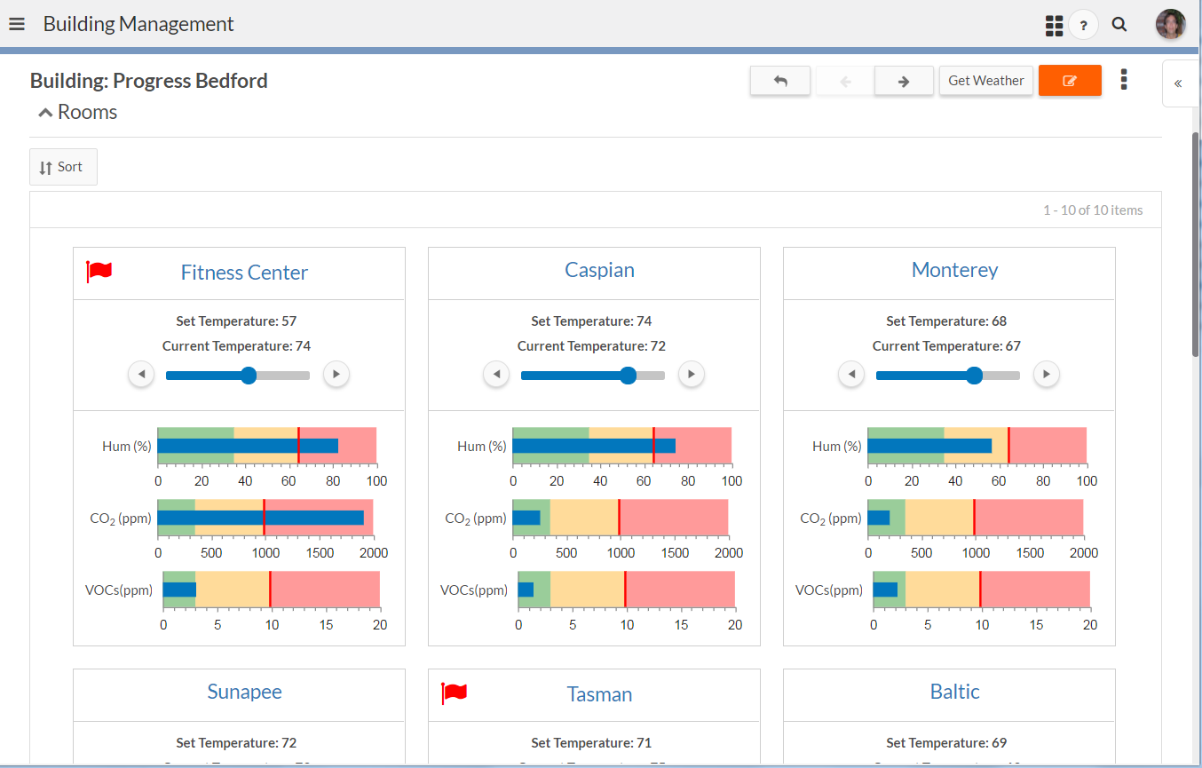

Slide 36
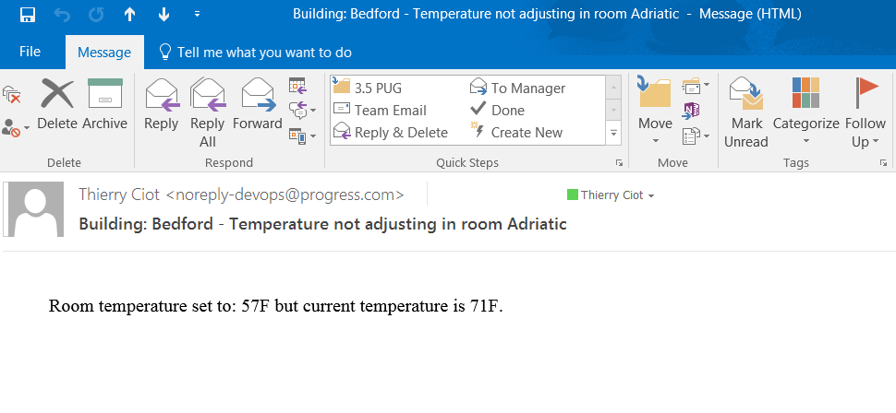
Email Trigger When Temperature is not adjusting

Slide 37
Agenda
Intro
IoT Market
Employees Transportation Management Case Study
Building Management Example
Benefits High-Value/Low-Code Platform
Q&A

Slide 38

Rollbase High Value Services
  Object Model management (1 to 1, 1 to n, n to m)
  Security, permissions, roles and auditing
  Authentication (SAML, ADFS, OpenID Connect, LDAP, Kerberos)
  Workflow engine and workflow editor
  API Access (REST, SOAP)
  Reports – PDF generation – PDF Annotation
  Data integration
  Email-Calendar integration
  UI (responsive, adaptive, charts, widgets, I18N, …)
  Deployment and Monitoring
  Scalability and high availability
  Cloud (private – public – on premise)
More details at blog:
https://goo.gl/hciUu8

Slide 39
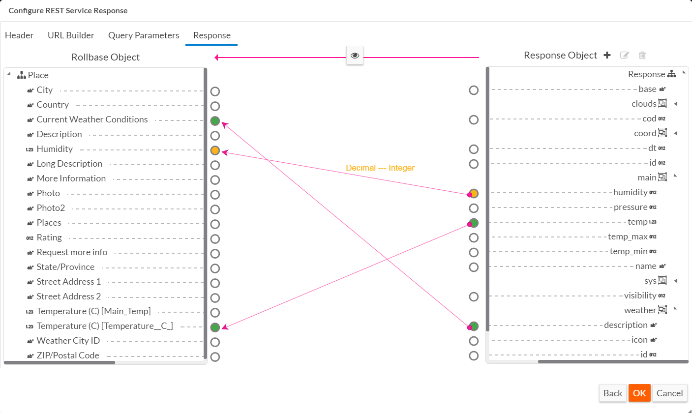
Example – No code REST

Slide 40
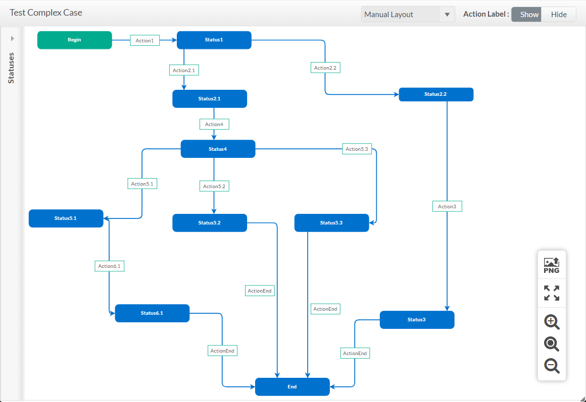
Example – Workflow Designer

Slide 41
Wrap-up
IoT world has opened huge opportunities
Rollbase can help you conquer that world at unprecedented speed
Multiplier effect: Kingslake was very successful and now expending into new markets and potentially new applications.
Allowed Kingslake to open new stream of revenue with different software from Progress

Slide 42
Agenda
Intro
IoT Market
Employees Transportation Management Case Study
Building Management Example
High-Value/Low-Code Platform
Q&A

Slide 43




Try Rollbase for free at
https://www.progress.com/trial-rollbase
@ThierryCiot
tciot@progress.com
Rollbase Blogs
https://goo.gl/Oru5Ia

