Slide 1
Kendo UI Builder
Bob Brennan
First Impressions from a Character Developer

Slide 2
Who Am I
Progress Character Developer est.1990
Web Services SOAP and Rest
Played with GUI
Played with GUI for DotNet
Played with Visual Studio
Tiggzi and OE Mobile
Notes:
Casually connected to all of the various modes and models in use today.
Expert in nothing modern
Failed Project but great learning experience.

Slide 3

Kendo UI Builder
New Dev Tool from Progress
Build Single Page Applications (SPA)
Uses the KENDO UI Components for AngularJS
Attach to Open Edge Data Sources
Notes:
Tool shows great promise
Hopes of March and April lost as we dug into things.
Imprecise language may be used as we get through the talk – Not an expert.

Slide 4
Single Page Web Applications
Web apps that load a single HTML page
Dynamically update that page as the user interacts with the app
Uses HTML5
No (few) page reloads

Slide 5
Single Page Web Applications
Goal of providing a user experience similar to that of a desktop application.
Much of the work happens on the client side using JavaScript.
“Responsive Web Page”

Slide 6
Internet
Global computer network providing a variety of information and communication facilities.
Standardized Communication Protocols
Web, World Wide Web, The Net, Information Super Highway

Slide 7
Typical Web Site
A collection of web pages which are grouped together and usually connected together in various ways. Often called a "web site" or simply a "site."
Standards based approach for sharing data
Browser to Web Server Repeatedly

Slide 8
web page
Complex document
Document Object Model
Rendered by a browser.
Written in HTML (Hyper Text Markup Language)

Slide 9
HTML
Hyper Text Markup Language
Document Model
Tagged Elements and Constructs described as a standard.
  HTML4
  HTML5

Slide 10
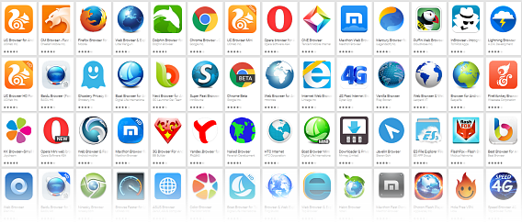
Browser
Client Side Software Program
Render a web page
Implements reactions to specific HTML constructs
Notes:
The browser needs to be programmed to interpret HTML.
If the HTML contains stuff that the browser does not understand – it may bomb or it may simply ignore.

Slide 11

CSS
Cascading Style Sheets
Method of beautifying output
Consistency
Re-usability
Notes:
We are building to make re-use a key feature are we get to Single Page Apps and Angular.

Slide 12

J-Query
Query is a fast, small, and feature-rich JavaScript library.
HTML document traversal and manipulation
Event handling
Easy-to-use API that works across a multitude of browsers.

Slide 13

Angular JS
Structural framework for CRUD Type Apps
Use HTML as your template language
Extends HTML syntax
Data Binding and Dependency Injection eliminate much of the code you would otherwise have to write.

Slide 14
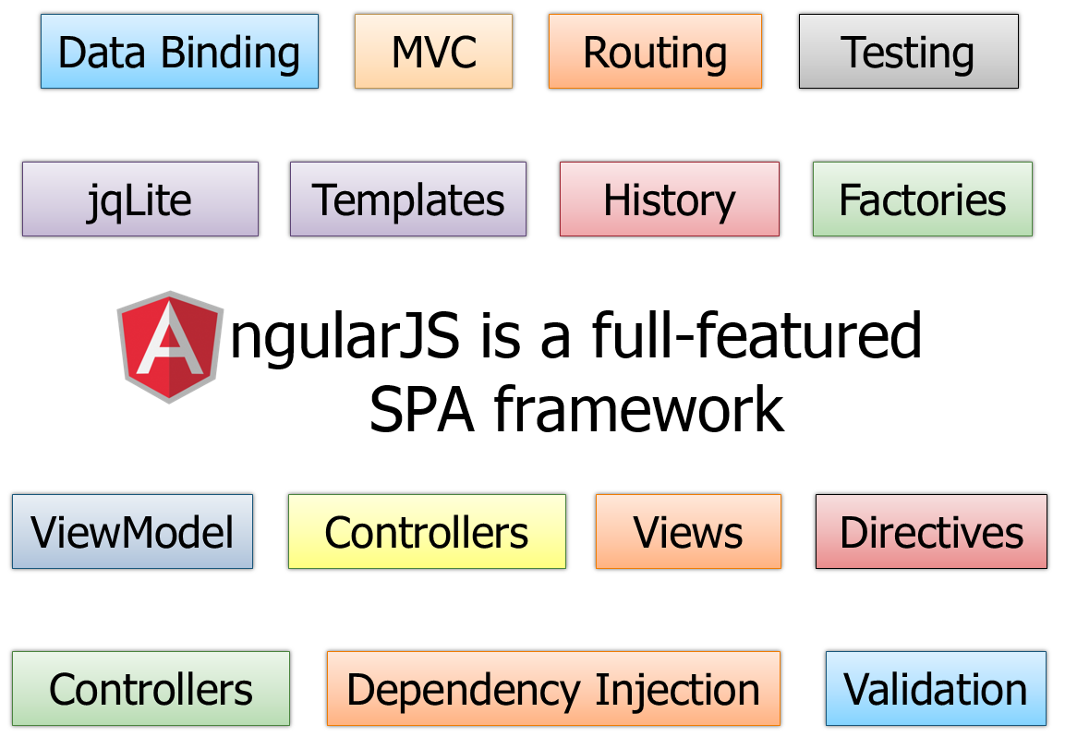
Notes:
Model – View – Controller (Whatever) ((Scope))
Directives – extensions to HTML
Dependency Injection – Code Substitution – like an include file – Sub routine.

Slide 15
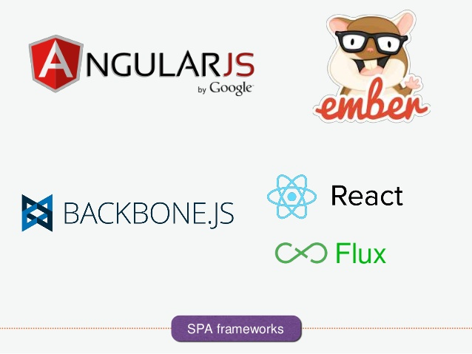
Single Page Frameworks
Notes:
There are many
Nothing is pure – they all borrow from what came before.

Slide 16
What did angular borrow.
jQuery - an industry standard library for DOM manipulation and AJAX.
  Angular includes a jQuery-like API with jqLite
Handlebars - one of the top templating libraries. Handlebars is derived from Mustache, which provides logic-less templates.
  Angular templates use syntax similar to Handlebars.
Notes:
Not sure if KUIB includes JQuery or they rely on the jqLite that is built into AngularJS

Slide 17
Client / Server – What to Know
CLIENT
Single Page Application
HTML(5)
CSS
Javascript
JQuery
AngularJS
Kendo UI Components
SERVER
PASOE
Java Script Data Object (JSDO)
URI - Uniform Resource Identifier
Catalogs
JSON
Notes:
Open Edge Developer Studio

Slide 18
Learning about Angular JS
Introduction to Angular.js in 50 Examples
https://www.youtube.com/watch?v=TRrL5j3MIvo
Curran Kelleher March 2014
U-Mass Lowell CS Lecture
Learn and Understand Angular JS
https://www.youtube.com/watch?v=ejBkOjEG6F0
Tony Alicea October 2014
Udemy Academy – 7 hour course

Slide 19
<html>
<head>
<meta charset="utf-8">
<title>HTML Starter</title>
</head>
<body>
Name:<input type="text"/>
Hello world!
</body>
</html>

Slide 20
<html>
<head>
<meta charset="utf-8">
<title>HTML Starter</title>
</head>
<body>
Name:<input id="textInput" type="text"/>
Hello world!
<script>
var textInputElement = document.getElementById('textInput');
textInputElement.addEventListener('keyup', function(){
var text = textInputElement.value;
console.log('New text is "' + text + '"');
});
</script>
</body>
</html>

Slide 21
<html>
<head>
<meta charset="utf-8">
<title>DIY One-way Data Binding with jQuery</title>
<script src="//code.jquery.com/jquery-2.0.3.min.js"></script>
</head>
<body>
Name:<input id="textInput" type="text"/>
Hello <span id="nameDiv"></span>!
<script>
$('#textInput').on('keyup', function(){
$('#nameDiv').html($('#textInput').val());
});
</script>
</body>
</html>

Slide 22
<html ng-app>
<head>
<meta charset="utf-8">
<title>Angular.js Example</title>
<script src="//cdnjs.cloudflare.com/ajax/libs/angular.js/1.2.1/angular.min.js"></script>
</head>
<body>
Name:<input ng-model="name" type="text"/>
Hello {{name}}
</body>
</html>

Slide 24
Training/support/On Boarding
Documentation
Samples for commercial apps not demos
Programmer Reference
Methodology for translating Kendo to KUIB
Formal Support Channel (Edsel and Ricardo)
Focus on the Platform not just the tool.

Slide 25
Working Together
Product Management is ready and eager to engage.
Mike Marriage

Slide 26
Thank You
Bob Brennan
Integrated Manufacturing Systems, Inc.

