Slide 1
Introduction to OpenEdge
Change Data Capture
June 5, 2017
  Rakhi Grover, Rama Murthy, Garry Hall

Slide 2
Agenda
Introduction - Change Data Capture
Overview - OpenEdge Change Data Capture
OpenEdge Change Data Capture Policies
Tracking changes and capturing change data
Configuring Capture detail
Configuring CDC using OpenEdge Management
ABL APIs
Processing Captured Changes (ETL)
Q&A

Slide 3
Introduction - Change Data Capture
Why do we need to capture changed data?
  Data Warehousing
    Consolidated repository of data from various sources
    Used for making strategic business decisions
  Bulk load of all data to data warehouse is time consuming and data is irrelevant to business needs
  A tailored approach is needed that allows businesses to capture data that is changed and is of interest
Data sources
Data Files
load
Data Warehouse
OLTP
Source tables
load
OLAP analysis
Reporting
Data Mining

Slide 4
Introduction - Change Data Capture
Change Data Capture
  Acquisition of modified data from OLTP sources from tables of interest
  Data changes may be stored in logs or relational tables
  Optional ETL (Extract, Transform, Load) tool can transform captured data further
Capture Process
  Trigger based
  Transaction log
  Delta file
Data source
OLTP
Source
Tables
Data Warehouse
ETL
Capture process
Process
Changed Data
OLAP analysis
Reporting
Data Mining

Slide 5
OpenEdge Change Data Capture
Trigger-based capture
Capture policies
Change Tracking and Change Data Capture
ETL languages – SQL and ABL
Requires feature enablement
OLTP
Record operation
Source
Tables
CDC Database triggers
Change Tables

Slide 6
OpenEdge Change Data Capture - Overview
Enable CDC on source table
Source Table (Customer)
User Data
Record operations:
create, update, delete
_Cdc-Table-Policy, _Cdc-Field-Policy
CDC Policies Cache
CDC Internal Database Triggers
Change Tracking Table
(_Cdc-Change-Tracking)
Change Table – (Customer)
CDC_Customer(captured data)
Staging Area - ETL process
Data Warehouse

Slide 7
OpenEdge Change Data Capture – Schema
Source tables – user tables that need to be enabled for change data capture
Change Data Capture Policy tables – store CDC policies
  Change data capture Table Policy table - _Cdc-Table-Policy
  Change data capture Field Policy table - _Cdc-Field-Policy
Change Tracking Table - _Cdc-Change-Tracking
Change Table - One change table for each source table
Store change tracking information and captured data.

Slide 8
Change Data Capture – Policies
Policies define what information will be tracked and captured against a source table
CDC Policies:
  CDC table policies
  CDC field policies
Policies are created and modified through OpenEdge Management and ABL API
Table policies are stored in policy tables
  CDC table policy table _Cdc-Table-Policy
  CDC field policy table _Cdc-Field-Policy

Slide 9
Change Data Capture Policy table (_Cdc-Table-Policy) and its indexes
_cdc-Table-Policy
_Policy-Id | _Policy-Name | _Policy-Desc | _Policy-State | _Policy-Instance | _Source-File-Recid
_Area-Ianum | _Area_Index-Ianum | _Change-Tablename | _ObjectId | _Identifying-Fields | _Level
_Change-Table-Owner | _Encrypt-Policy | _Last-Modified | First-User-Field | _Misc
_Policy-Id(Unique,Primary)
_Policy-Id
_Policy-Name(Unique)
_Policy-Name
_Policy-Source-recid
_Source-File-Recid | _Policy-Instance

Slide 10
Change Data Capture – Field Policies
Change Data Capture Field Policy table (_cdc-Field-Policy) and its indexes
_cdc-Field-Policy
_Policy-Id | _Field-Position | _Identifying-Fields | _Field-Recid | _Misc
_Policy-Id (Unique,Primary)
_Policy-Id | _Field-Position
_Identifying-Field (Unique)
_Policy-Id | _Identifying-Field
_Field-Recid (unique)
_Policy-Id | _Field-Recid

Slide 11
Table Policy – Field policy relationship
Customer (Source Table)
2 | 3 | 4 | 5 | 6 | 7 | 8 | 9
CustNum | Name | Address | Address2 | City | State | Country | Phone
Field position #
Table Policies - _cdc-Table-Policy
_Policy-Id | _Policy-State | _Level | _Change-Tablename | _Identifying-Fields
uMzutjNmIrUlFObr2B | 0 | 3 | CDC_customer | 1
Field Policies - _cdc-Field-Policy
_Policy-Id | _Field-Position
uMzutjNmIrUlFObr2B | 2
uMzutjNmIrUlFObr2B | 4
uMzutjNmIrUlFObr2B | 6
uMzutjNmIrUlFObr2B | 8

Slide 12
Change Data Capture Tracking Table - _cdc-Change-Tracking
Change Tracking Table and its indexes
_cdc-Change-Tracking
_Policy-Id | _Tran-Id | _Time-Stamp | _Change-Sequence | _Operation | _Change-Field-Map
_Recid | _Source-Table -Number | Partition-Id | _Tenant-Id | _Version | _Misc
_Sequence-Id (Unique,Primary)
_Source-Table-Number | _Change-Sequence
_Time-Stamp-Sequence (Non-Unique)
_Source-Table-Number | _Time-Stamp | _Change-Sequence
_Part-Rec-Id (Unique)
_Source-Table-Number | _Partition-Id | _Recid | _Change-Sequence

Slide 13
Change Data Capture Tracking Table
_Cdc-Change-Tracking
_Policy-Id | _Tran-Id | _Time-Stamp | _Operation | _Change-Sequence | _Change-Field-Map | _Source-Table-Number
uMzutjNmIrUlFObr2B | 345 | 05/20/2017 | 1 | 1 |  | 1
uMzutjNmIrUlFObr2B | 346 | 05/20/2017 | 2 | 2 |  | 1
uMzutjNmIrUlFObr2B | 367 | 05/20/2017 | 4 | 3 | 1010 | 1
jhgNUluMzTYbrmIr6U | 511 | 05/25/2017 | 2 | 1 |  | 2
jhgNUluMzTYbrmIr6U | 624 | 06/06/2017 | 5 | 2 |  | 2
jhgNUluMzTYbrmIr6U | 629 | 08/26/2017 | 4 | 3 | 111 | 2
Create
Delete
Customer
Update
Order

Slide 14
Change Data capture – change tables
Change table is created when a source table is enabled for CDC (define a policy)
One Change table for each source table that stores subset of source table data
No change table for CDC policy level 0
One record is inserted for each Create, Delete operation. Two records for update operation if policy level is maximum (3)
Change Tables metadata columns and user columns
Change Table – CDC_customer
_Tran_id | _Time-Stamp | _Change-Sequence | _Continuation-Position | _ArrayIndex | _Fragment | Capture Col1 | Capture Col2 | Capture Col3
Meta-data columns
Captured User-defined columns

Slide 15
Change Data Capture – Change Table
Customer
2 | 3 | 4 | 5 | 6 | 7 | 8 | 9
CustNum | Name | Address | Address2 | City | State | Country | Phone
Field position #
Change Table – CDC_customer
_Tran_id | _Time-Stamp | _Change-Sequence | _Continuation-Position | _ArrayIndex | CustNum | Country | Address | City
Table: _cdc-Field-Policy
_Policy-Id | _Field-Position | _Identifying-Field
uMzutjNmIr | 2 | 1
uMzutjNmIr | 4
uMzutjNmIr | 6
uMzutjNmIr | 8 | 2
_Identifying-Index
CustNum | Country | _Change-Sequence
_Change-Sequence-Id (Unique, Primary)
_Change-Sequence | _Operation | _Continuation-Position
_Time-Sequence
_Time-Stamp | _Change-Sequence

Slide 16
How do I configure “Capture detail” ?
Update Customer
Set
Address=“2 Hickory”,
City=“Acton”
where
CustNum=2;
Customer
CustNum | Name | Address | Address2 | City | State | Country
2 | Brooks | 1 Oak dr |  | Hollis | NH | USA
_Cdc-Table-Policy._Level :
0
1
2
3
Change Tracking Table: _Cdc-Change-Tracking
_Policy-Id | _Operation | _Change-Sequence | _Change-Field-Map | . . .
uMzutjNmIr | 4 | 1 |  | . . . .
0011
Change Table: CDC_Customer
_Tran-Id | _Operation | _Change-Sequence | CustNum | Country | Address | City
345 | 4 | 1 |  |  | 2 Hickory | Acton
345 | 3 | 1 |  |  | 1 Oak dr. | Hollis

Slide 17
Configuring Policies

Slide 18
Configuring CDC Policies in OpenEdge
OpenEdge Management/OpenEdge Explorer
Change Data Capture ABL API

Slide 19
Enabling CDC

Slide 20
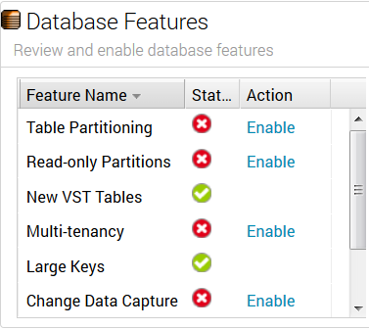
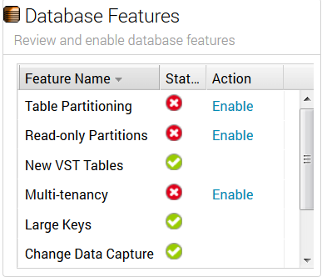
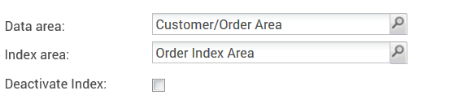
Enabling CDC for a Database
CDC feature can be enabled using Data Administration Console in OEM/OEE
CDC feature can be enabled when Database is online/offline
Before CDC is enabled
After CDC is enabled

Slide 21
Policy Configuration and Governance

Slide 22
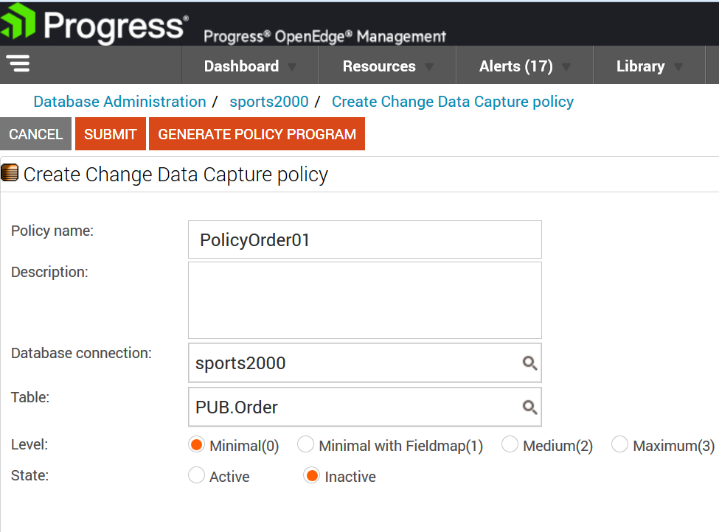
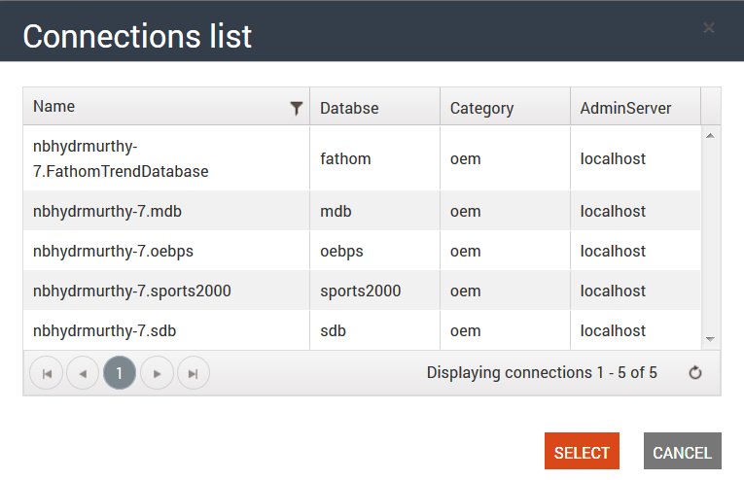
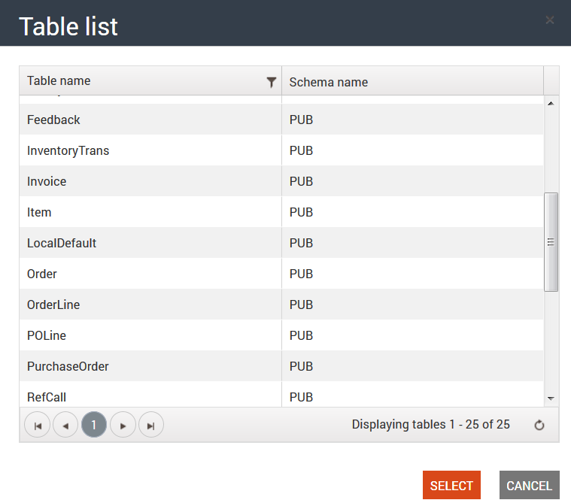
Configuring Level 0 Policy

Slide 23
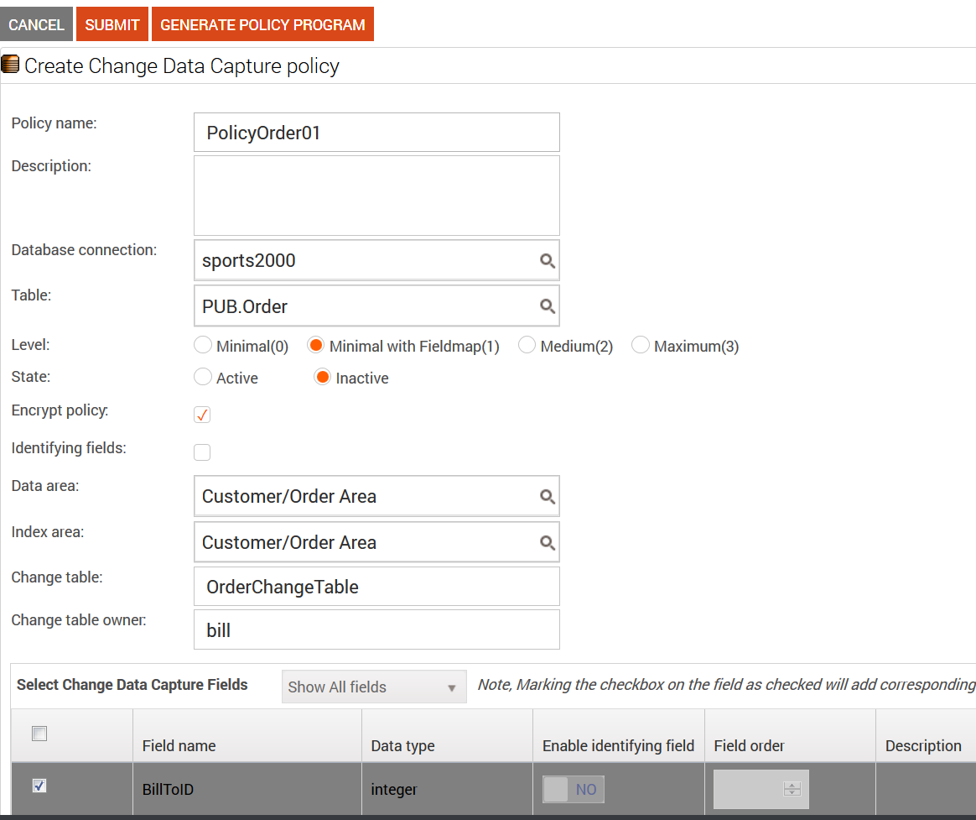
Configuring Level >0 Policies
Change Table Properties

Slide 24
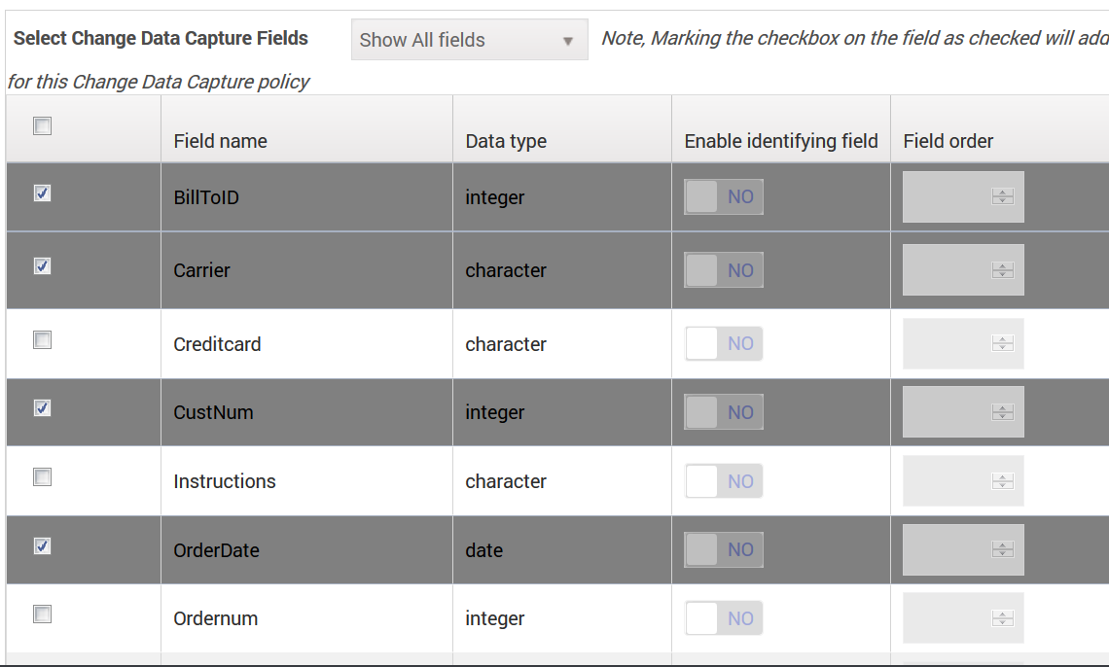
CDC Field Policies
At least one field policy is required
Unlimited field policies are allowed
Change data will be captured only for selected fields

Slide 25
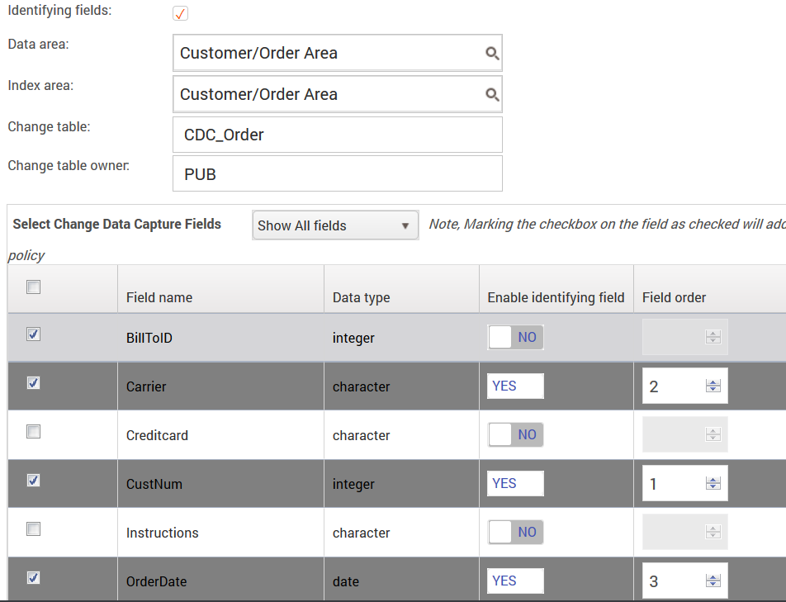
Setting Identifying Fields
Up to 15 Identifying fields are allowed
Provide Field order
Select YES to enable
identifying Field on Field
policy

Slide 26
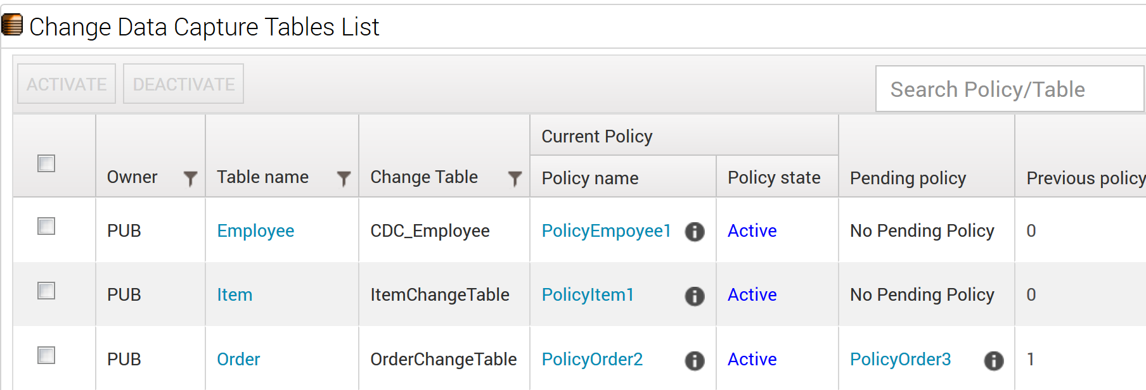
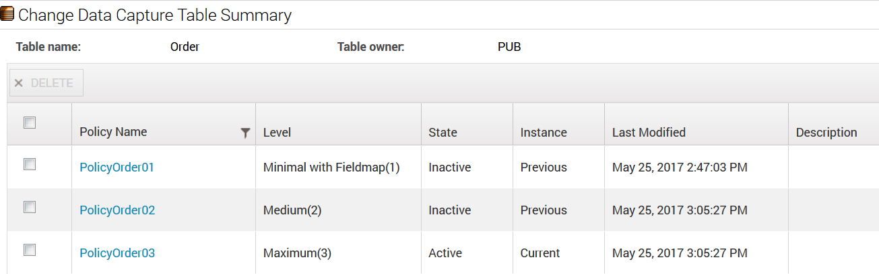
Viewing List of CDC Policies

Slide 27
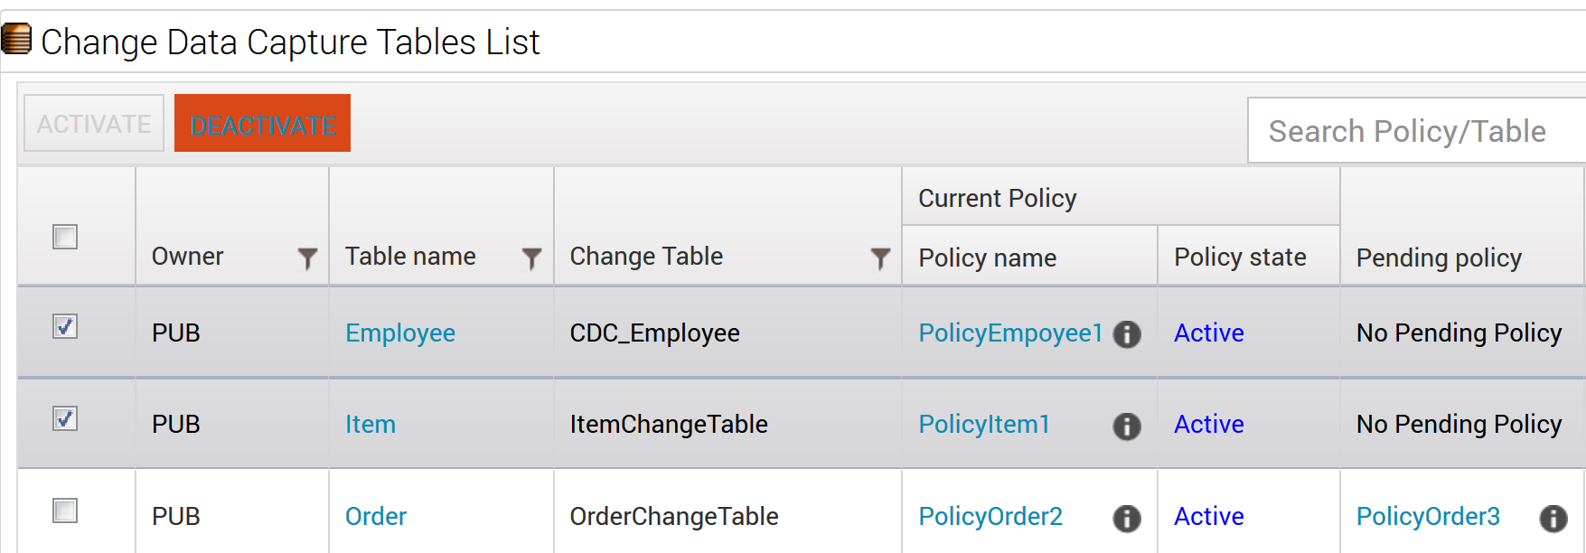
Activate/Deactivate CDC Policies
Policies can be activated/deactivated
  Individually
  In bulk

Slide 28
Generate CDC Policy Program

Slide 29
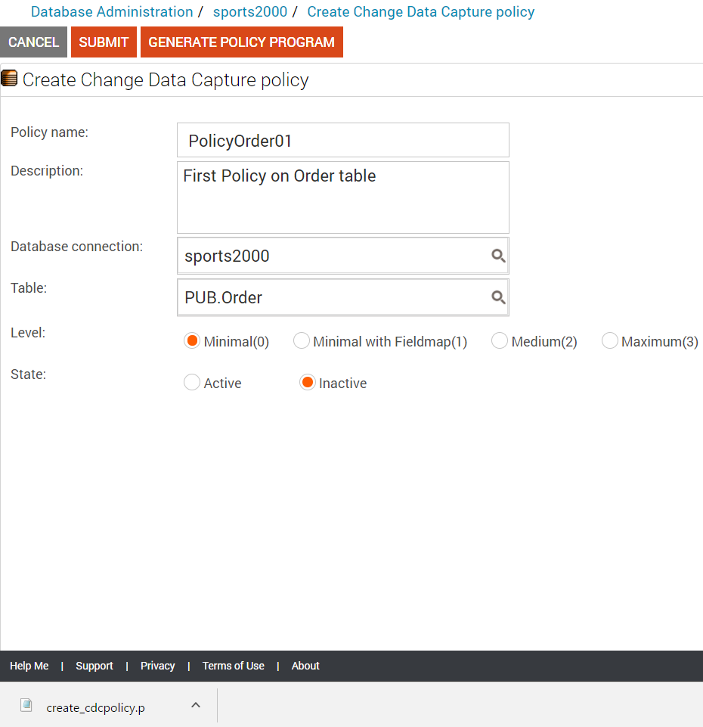
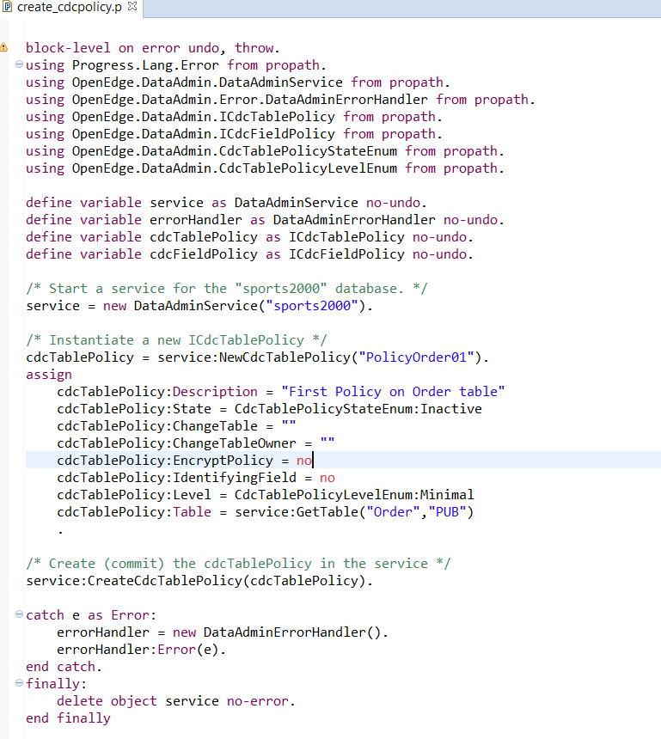
Generating Policy Program
Generates .p file with the supplied CDC details
  It can be done before or after submit

Slide 30
Dump and Load CDC Policies

Slide 31
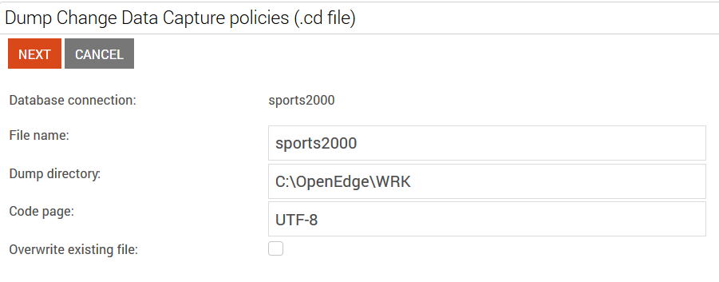
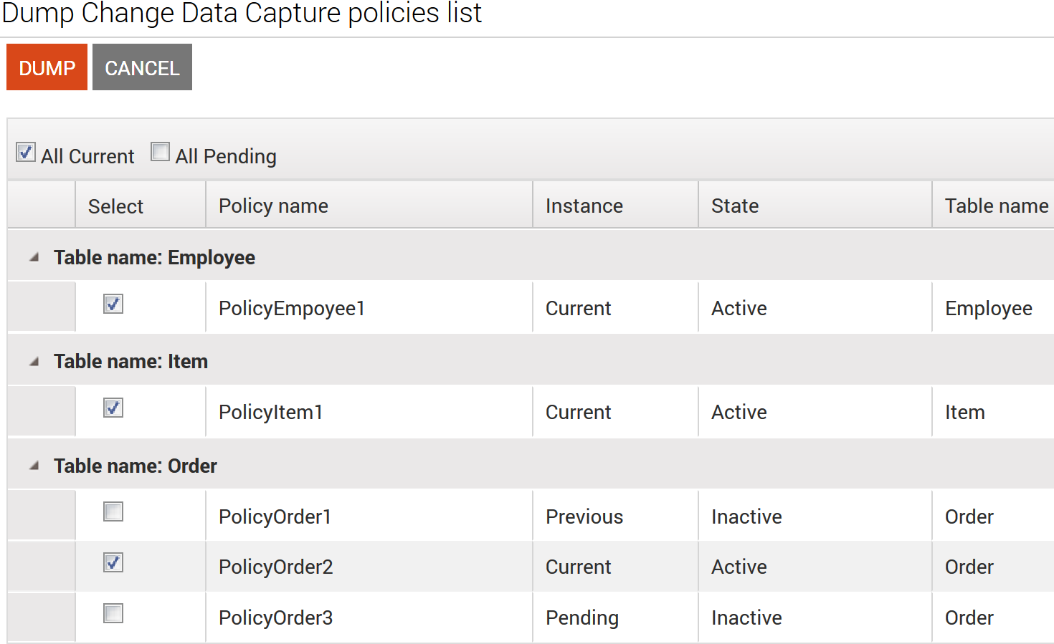
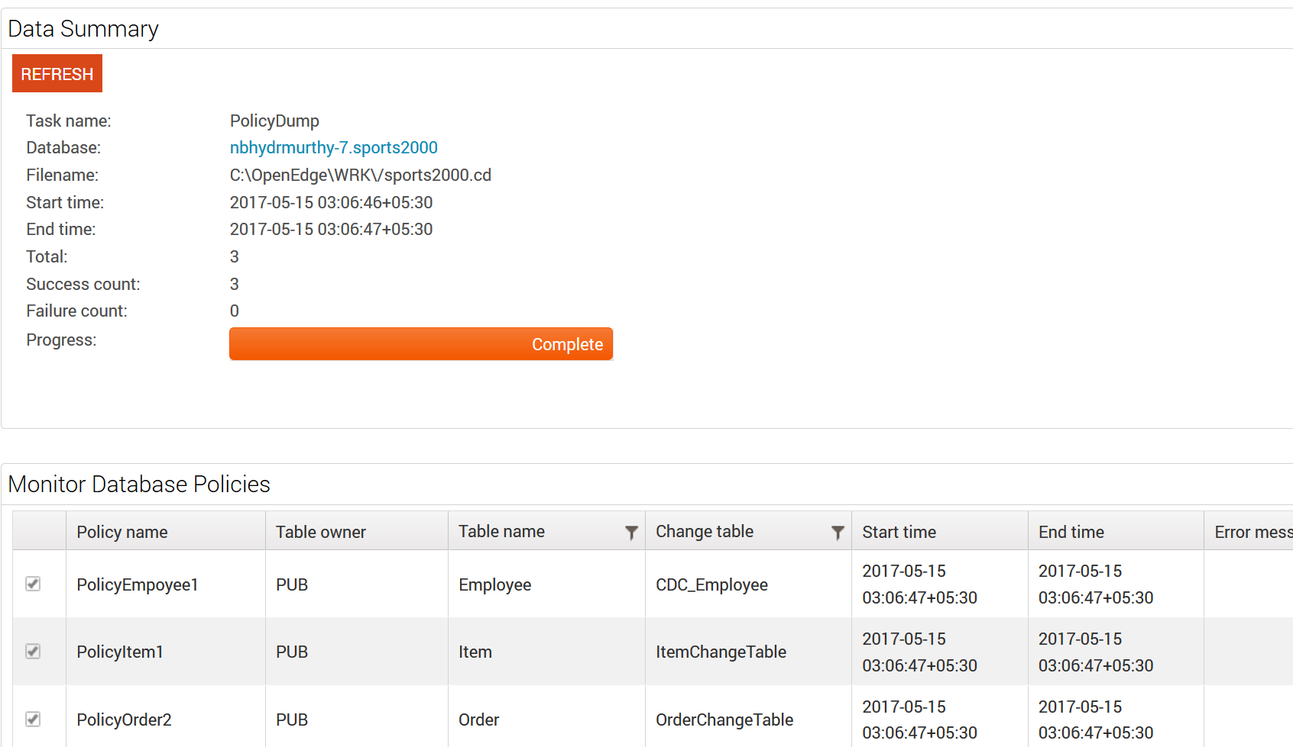
Dumping CDC Policies
List of existing policies can be dumped to a .cd file
Dump status can be monitored

Slide 32
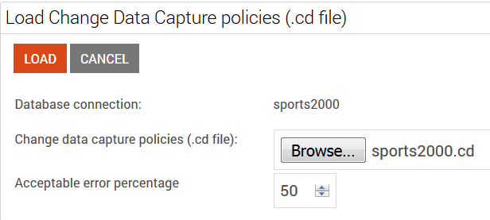
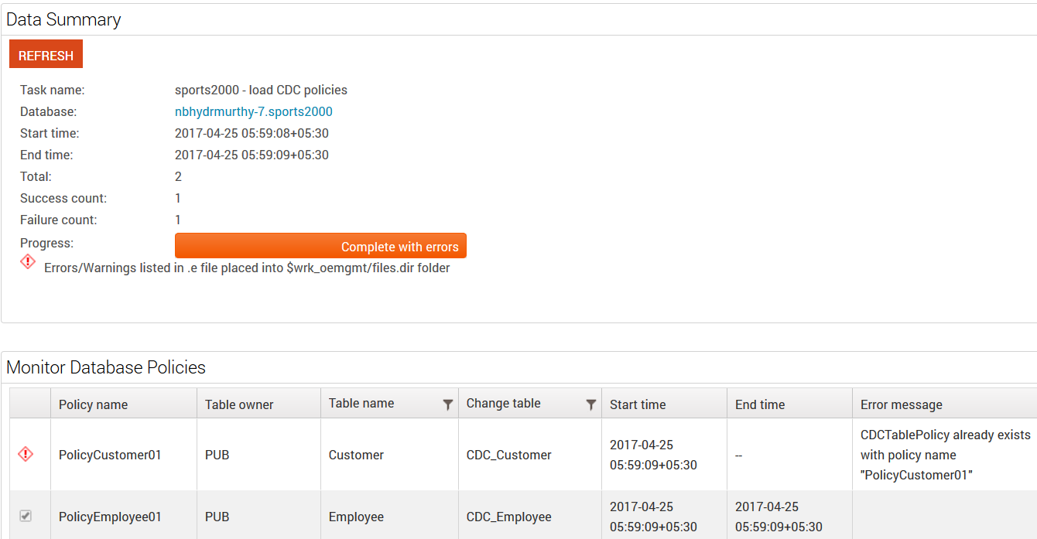
Loading CDC Policies
CDC Policies can be loaded from a .cd file
Acceptable Error Percentage
Indicates an error
while loading
Indicates success

Slide 33
ABL API for CDC

Slide 34
ABL API for CDC
CDC Table Policies
Create
CDC Field Policies
Create
List
Dump & Load CDC Policies
Dump
Load
Edit
Delete
List
Edit
Delete
CDC ABL API Reference Guide: https://documentation.progress.com/output/ua/OpenEdge_latest/index.html#page/dvpin/change-data-capture-abl-references.html

Slide 35
Processing Captured Changes

Slide 36
Processing Captured Changes
ETL (Extract, Transform, Load)
  CDC facilitates the Extraction part of ETL
  Many tools and frameworks for doing ETL/BI
    OpenEdge Analytics 360
An alternative to trigger-based replication
  Pro2 can use CDC
For more information on Analytics 360 or Pro2
  OpenEdge Analytics 360 Integration - Monday 9:45 am, Curriers
  A Holistic View of OpenEdge Pro2 – Tuesday 8:30 am, Curriers
  Or Contact:
    Mike Marriage (mmarriag@progress.com)
    Brian Bowman (bowman@progress.com)

Slide 37
When To Process
How often to extract data
  Determined by business need
When to purge data
  Busy tables will generate a lot of CDC data -> big change tables
  Can purge data during extraction, or mark extracted data for later purging (_User-Misc)
  Monitor your db growth

Slide 38
How To Process
Extraction can be done by ABL or SQL
  Only SQL clients can access SQL change tables
  Driven by _Cdc-Change-Tracking
Extraction should access only committed data
  Provide range in search criteria
    E.g. WHERE _Time-Stamp < LastMidnight
  Prevent dirty reads
    SHARE lock from ABL
    Transaction isolation level stronger than READ UNCOMMITTED from SQL

Slide 39
Extracting Change Data through ABL

Slide 40
Extracting Change Data Through ABL
Write a query against the _Cdc-Change-Tracking table and change table for your given source table
OpenEdge.DataAdmin.Util.CDCTrackingHelper
  ABL helper class to provide convenience functionality
    Reduces need for some boilerplate code
    Converts _Change-FieldMap to an extent of changed field names
    Maps the _Operation to a CDCOperation enum
    Purges all change records associated with a _Cdc-Change-Tracking record
  Uses the current record in a _Cdc-Change-Tracking buffer
  No requirement to use this

Slide 41
ABL Extraction Sample
/* Get the change table record. */
FIND FIRST CDC_Order WHERE
CDC_Order._Change-Sequence =
_Cdc-Change-Tracking._Change-Sequence AND
CDC_Order._Operation =
_Cdc-Change-Tracking._Operation NO-ERROR.
/* perform whatever logic needs to occur for ETL */
DEF VAR ohelper AS CDCTrackingHelper NO-UNDO.
/* Get a CDCTrackingHelper for the Order table, using the default buffer
* of the _Cdc-Change-Tracking table */
ohelper = NEW CDCTrackingHelper("Order", BUFFER _Cdc-Change-Tracking:Handle).
/* Iterate through the change tracking records */
FOR EACH _Cdc-Change-Tracking WHERE
_Cdc-Change-Tracking._Source-Table-Number = ohelper:SourceTableNumber:
IF (ohelper:IsUpdate()) THEN /* handle updates only */
DO:
IF (ohelper:FieldChanged("OrderTotal")) THEN
DO:
/* Get the change table record. */
FIND FIRST CDC_Order WHERE
CDC_Order._Change-Sequence = _Cdc-Change-Tracking._Change-Sequence AND
CDC_Order._Operation = _Cdc-Change-Tracking._Operation NO-ERROR.
/* perform whatever logic needs to occur for the ETL */
END.
END.
_Cdc-Change-Tracking._User-Misc = "PROCESSED". /* mark as processed */
END.
DEF VAR ohelper AS CDCTrackingHelper NO-UNDO.
/* Get a CDCTrackingHelper for the Order
table, using the default buffer of the
_Cdc-Change-Tracking table */
ohelper = NEW CDCTrackingHelper(
"Order",
BUFFER _Cdc-Change-Tracking:Handle).
/* Iterate through the change tracking records */
FOR EACH _Cdc-Change-Tracking WHERE
_Cdc-Change-Tracking._Source-Table-Number =
ohelper:SourceTableNumber:
/* mark as processed */
_Cdc-Change-Tracking._User-Misc = "PROCESSED".
/* handle updates only */
IF (ohelper:IsUpdate()) THEN
IF (ohelper:FieldChanged("OrderTotal")) THEN

Slide 42
ABL Purge Sample
/* purge records in the _Cdc-Change-Tracking
and change table */
ohelper:DeleteChangeTrackingRecord().
/* Alternatively:
FOR EACH CDC_Order WHERE
CDC_Order._Change-Sequence =
_Cdc-Change-Tracking._Change-Sequence:
DELETE CDC_Order.
END.
DELETE _Cdc-Change-Tracking.
*/
DEF VAR ohelper AS CDCTrackingHelper NO-UNDO.
/* Get a CDCTrackingHelper for the Order table, using the default buffer
* of the _Cdc-Change-Tracking table */
ohelper = NEW CDCTrackingHelper("Order", BUFFER _Cdc-Change-Tracking:Handle).
/* Iterate through the processed records */
FOR EACH _Cdc-Change-Tracking WHERE
_Cdc-Change-Tracking._Source-Table-Number = ohelper:SourceTableNumber:
IF _Cdc-Change-Tracking._User-Misc = "PROCESSED" THEN
DO:
/* purge records in the _Cdc-Change-Tracking and change table */
ohelper:DeleteChangeTrackingRecord().
/* Alternatively:
FOR EACH CDC_Order WHERE
CDC_Order._Change-Sequence = _Cdc-Change-Tracking._Change-Sequence:
DELETE CDC_Order.
END.
DELETE _Cdc-Change-Tracking.
*/
END.
END.
/* Iterate through the processed records */
FOR EACH _Cdc-Change-Tracking WHERE
_Cdc-Change-Tracking._Source-Table-Number =
ohelper:SourceTableNumber:
IF _Cdc-Change-Tracking._User-Misc = "PROCESSED" THEN

Slide 43
Extracting Change Data through SQL

Slide 44
Extracting Change Data Through SQL
New scalar functions
  CDC_get_changed_columns - list of changed columns from _Change-FieldMap
  CDC_is_column_changed - whether a column changed

Slide 45
SQL Extraction Sample Query
select ct.”_Change-Sequence”, c.*,
CDC_is_column_changed(pub.CDC_Order, OrderTotal, _Change-FieldMap)
from pub."_Cdc-Change-Tracking" ct
inner join
pub.CDC_Order c on ct."_Change-Sequence" = c."_Change-Sequence"
where ct."_ Source-Table-Number" = <Order table number>
order by ct."_Change-Sequence";

