Slide 1
Database Repair & Recovery
Dan Foreman, White Star Software
Abstract: Despite your best efforts to protect a database from harm, sometimes bad things happen to good databases. So what can you do if your database is damaged or corrupted? The “standard” recovery methods usually require a dump/reload or restoring the database from a backup. However, sometimes there are better alternatives. Learn about the different kinds of corruption and how they can occur. Learn how to verify the extent of the damage. And how, if possible, to repair the database or recover data from a damaged database.

Slide 2
Database Repair & Recovery
Dan Foreman, White Star Software danf@prodb.com
PUG Challenge USA 2017

Slide 3
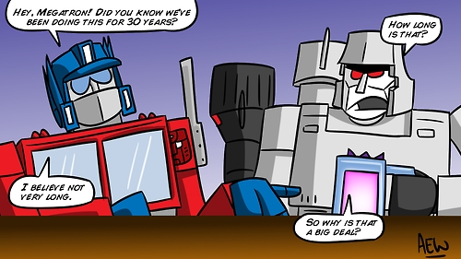
Introduction: Dan Foreman
Progress aficionado since 1984
Notes:
I have been working with Progress since 1987
… and today I am both President of DBAppraise;
The remote database management service…
where we simplify the job of managing and monitoring the worlds best business applications;
and Vice President of White Star Software;
where we offer expert consulting services covering all aspects of Progress and OpenEdge.

Slide 4
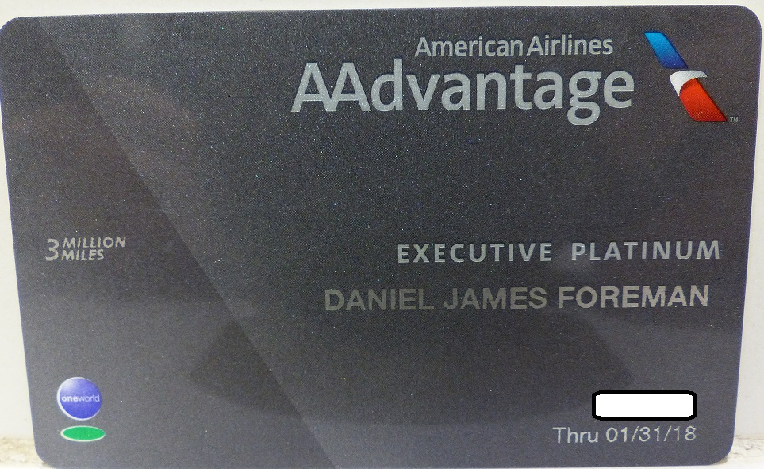

Introduction: Dan Foreman
Psycho Frequent Flier
  3.4 million miles on United Airlines
  3.5 million miles on American Airlines

Slide 5
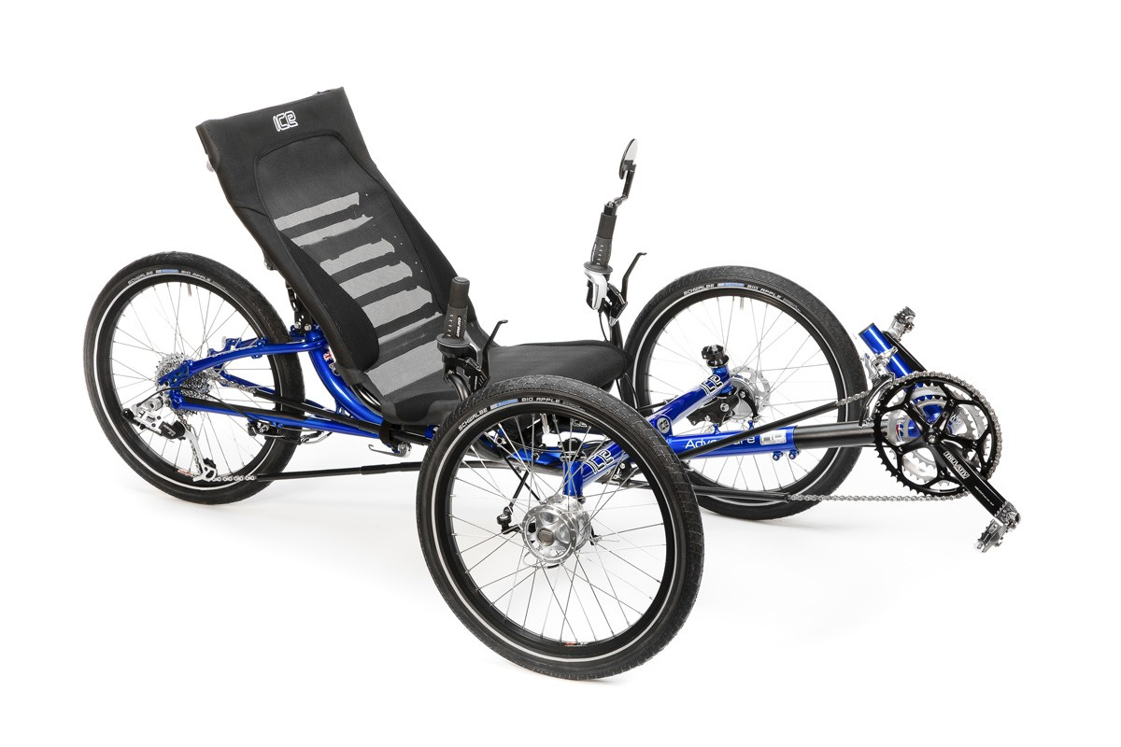

Introduction: Dan Foreman
I enjoy cycling & basketball (not @ the same time)

Slide 6
Introduction: Dan Foreman
Author of several publications
  Progress Performance Tuning Guide
  Progress Database Administration Guide
  Progress System Tables
  Progress Database Best Practices
  Available at: marketplace.mimeo.com/prodb in paper form
  Contact me by email about electronic versions

Slide 7


Someone found an alternative use for my books

Slide 8
Introduction - Audience
Progress Version
  V6, V7, V8, V9,
  V10*
  Early V11: V11.0 to V11.3
  Modern V11: V11.4 to V11.7
DB OS: *ix? Windows?
Largest Single Database?

Slide 9
Introduction - Disclaimer
I gave this presentation in 2014 and it has some content from that session but it’s much different
This is the longest presentation I have ever done so I need to move rapidly
Mobile phones on mute/vibrate please

Slide 10
Introduction - Disclaimer
Is there is documentation for fixing or recovering a broken DB?
I’m not confident it’s possible to produce a generic how-to-fix-it document or YouTube video that could safely be used in an emergency (sort of like trying to become a doctor when you’re sick by looking at WebMD)
Is it possible to teach database brain surgery in a one hour presentation or a YouTube video?
Even Progress wants you to call PTS when using proutil dbrpr to repair a DB

Slide 11
Introduction - Disclaimer
Maybe, but I can probably do a better job of teaching CAS (Collision Avoidance System)
Wikipedia definition: A Collision Avoidance System is an automobile safety system designed to reduce the severity of a collision. It is also known as a precrash system, forward collision warning system, or collision mitigating system.
Note that we have one big advantage that human brain surgeons don’t… do you know what that is?

Slide 12


Slide 13
True Crime #1
Fortune 500 Company (sorry but they would not appreciate us sharing their name)
DB Corruption February 23
Last Good Backup: January 11
Last Good AI Files: January 17
We worked with Progress to facilitate a special version of rfutil that would ignore inconsistencies during the Roll Forward process

Slide 14
True Crime #2
Customer running SCO OpenServer
We had told the customer to move to a more “modern” OS, i.e. Linux
Eventually OS Problem – Can’t mount the Disks; Discovered that backups to tape were not occurring (backup to disk was OK but couldn’t see the disks to use it)
Had to boot using Knoppix to repair things – took forever to reinstall SCO

Slide 15
True Crime #3
Fortune 1000 Company
HP/UX Server
System Admin for the server had been outsourced to IBM
Backups had been outsourced by IBM to a 3d party
3d party stopped doing backups, unannounced, due to payment dispute
DB Corrupted
Restoration impossible

Slide 16
True Crime #4
Database corrupted with multiple #1124 errors
If you don’t know what a 1124 error is…..
SYSTEM ERROR: Wrong dbkey in block. Found <dbkey>, should be <dbkey2> in area <num>. (1124)
HP Server + EMC SAN administered by HP
  Server & HP/UX diagnostics showed no problems
  EMC diagnostics showed no problems
  Cause: Bad SAN Fabric Switch

Slide 17
Basic Disaster Prevention & Planning
Backups (yes, I know you think you have good backups but have you tested one recently?)
After Imaging
Replication of DB and/or AI files
Test your Entire Recovery Plan Frequently

Slide 18
Our Brain Surgeon Advantage
Warm Standby Database
  A database on another machine with a recent copy of the production DB Might also called a DR (Disaster Recovery) Database
  This is relatively easy to do in Progress
Hot Standby Database
  OpenEdge Replication

Slide 19
Disaster Prevention & Response Basics
*ix: don’t logon as root unless you really need to
Use O/S security to protect the DB, BI, and AI files from accidental or casual or intentional deletion
ALWAYS have an up-to-date Structure (.st) file
  Customer suggestion: run prostrct list every time you backup the DB

Slide 20
Disaster Prevention – After Imaging
Who is currently not using AI?
If not, why not?
Is public flogging and/or humiliation required?

Slide 21
After Imaging - Why Use It?
True Horror Story #1
  “We don’t need AI, we have disk mirroring”
  A DBA (logged on as root) FTP’d a test database into the directory where the production database resided... unfortunately they had the same name
  Disk Mirroring worked just fine…..
  After Imaging would have probably saved the day

Slide 22
After Imaging - Why Use It?
True Horror Story #2
  A user ran an archiving program on live data that wasn’t ready to be archived
  Once again the mirroring performed perfectly
AI might have improved the situation as it is possible to Roll Forward to a specific point in time

Slide 23
After Imaging - Why Use It?
True Horror Story #3 – Part 1
BI file hit the V8 2GB limit @ 1600 on a busy day (300+ users)
Large Production Database was corrupted
Progress Support Recommendation: dump & load or restore from backup which meant substantial down time or data loss

Slide 24
After Imaging - Why Use It?
True Horror Story #3 – Part 2
Fortunately the customer called me and I was able to temporarily patch the database until a D&L could be performed
Irony: I had recommended AI to this customer over one year prior to this event

Slide 25
After Imaging - Why Use It?
Mitigate probkup online issues
  Transaction Activity is Frozen while the BI File is Backed Up
    probkup online <db> <media> bibackup active
  The I/O Overhead of disk/tape backup
Possible Solution
  Use AI to maintain a Warm or Hot Spare DB
  Backup the Replicated Database

Slide 26
After Imaging - Validation
Important if you move AI files around
rfutil <db> -C aiverify [ full | partial ]
-a <AI file name>
or
-ailist <list of AI files>

Slide 27
Disaster Prevention - Essential DB Monitoring
Purpose: to make sure you don’t have hidden or unreported corruption
Two types:
  Continuous
  Periodic

Slide 28
Disaster Prevention - Continuous Monitoring
Continuous, realtime Corruption Checks
  -MemCheck (minimal overhead)
  -DbCheck (approx 5%)
  -AreaCheck (approx 5%)
  -IndexCheck (approx 5%)
  -TableCheck (approx 5%)
These are all Database Startup Options
Can also be turned off/on in promon > R&D > #4 Admin

Slide 29
Disaster Prevention – Periodic Monitoring
Periodic Corruption Checks
  proutil dbanalys probkup/procopy
  proutil dbrpr proutil dbscan
  proutil idxfix dbtool
Each option has it’s own limitations
Record how long it takes to run as that info might be useful during a crisis

Slide 30
Option | OnLine | Granularity | What Does It Check
dbanalys | Yes | Area | Block & Record validation.
idxfix | Yes | Single Key | Key-to-Record and Record-to-Key validation.
probkup | Yes | Entire DB | Block validation.
dbtool | Yes |  | SQL Width issues. Database Blocks. Record Validation & fixup.
dbrpr | No | Various | Chain repair. Delete record fragments. Reformat a block to a Free Block. Fix Bad Blocks. Delete Bad Records.
dbscan | No | Various | Similar to dbrpr but designed to run non-interactively. Not documented. Does not repair or fix anything.

Slide 31
Essential DB Monitoring – DB Log File
Check the Database log (.lg) file for errors DAILY (or better yet continuously but that can be expensive).
Look for words such as:
kill* drastic warn* error system dead fatal abnormal exceed* fail* wrong unexpected* invalid died damage* overflow* violation insufficient missing disappear* corrupt* allow* attempt* cannot enough illegal beyond impossible increase unknown unable stop*
Note that this is not a comprehensive list

Slide 32
Prevention – BI Disk Space – Part 1
Do Not run out of BI disk space especially if there is no surplus space elsewhere
To perform Crash Recovery (a part of the proutil truncate bi process), the BI file will grow; sometimes 2X or more
If there is no space for the BI file to grow, Crash Recovery is not possible

Slide 33
Prevention – BI Disk Space – Part 2
If Crash Recovery partially completes but then crashes, the next Crash Recovery will create an even larger BI file!!!
Force Access (-F) is the only option (if you don’t have AI enabled)
Even having AI enabled is problematic
  Crash Recovery Notes are also written to the AI logs
  You can’t do rfutil aimage empty during Crash Recovery!!
This is why the –bithold parameter is so important

Slide 34
Prevention – BI Disk Space – Part 3
Always use the -bithold parameter as an extra safeguard
Set to a maximum of 25-50% of available BI Disk Space
V9 and above supports Terabyte sized BI Files but extent sizes are still limited to 2gb unless you use the EnableLargeFiles option on proutil and the file system must be Large File Enabled too

Slide 35
Iceberg! Dead Ahead!
Is it truly a disaster?
  What is your definition of disaster?
  What is the business’s definition of disaster?
  Is an “Outage” the same as a “Disaster”?
  Everyone in the organization needs to be on the same page with regard to the definitions of:
    Unscheduled Interruption
    Outage
    Disaster
  How-To documentation to respond to each type of event
  What are the business’s priorities?

Slide 36
Ok, Time to get to work

Slide 37


Slide 38
Damage Report (from DB perspective)
Is the DB Really Down?
  Is everyone locked out/frozen/etc ?
  Are entries still being written to the DB log?
  Could it be an AI Stall (-aistall) or BI Stall (-bistall)?
  Can I promon into the DB?
    If promon hangs, try promon <dbname> –NL
    If that doesn’t work, try promon <dbname> -F
    If either of those options are successful, gather as much data as possible (i.e. screen shots) because the ship is probably going to sink no matter what you do

Slide 39
Initial Steps – Preserve the Crime Scene
Backup the DB using a non-Progress utility or split mirror backup
  Not enough disk space for the backup?, shame on you!
  Hint: allocate a large void DB to “reserve” emergency space
A backup gives you some time to formulate a plan-of-action (i.e. find your existing plan) and marshal the necessary resources
If the business deems that it’s more important to take some other action, that needs to be part of the response plan mentioned previously… stressful moments are not the time to make decisions that may have significant consequences

Slide 40
Initial Steps – Preserve the Crime Scene
Make a copy of the DB log (might be overwritten if DB is restored from backup)
Preserve other logs that might be overwritten by log cleanup utilities… have a list (or better yet a script) handy so you don’t forget any
Structure (.st) file, if it’s not already up-to-date, shame on you

Slide 41
Initial Steps
Make sure only one person is driving the process that touches the database
  Air France Flight #447 crashed in the Atlantic because the Pilot & Co-Pilot were performing cancelling actions
  www.popularmechanics.com/technology/aviation/crashes/what-really-happened-aboard-air-france-447-6611877
Stop Automated Tasks via cron or the Windows Scheduler
Inform the business/user community (it’s better to have someone else do that…if you get slain, you won’t be able to accomplish much)

Slide 42
Initial Steps – BI Truncation
Don’t truncate the BI as an autonomic, reflexive response
Don’t try to truncate the BI file unless you are 100% sure there is enough disk space available to complete Crash Recovery
Don’t truncate with –F until the crime scene is backed up; too often people come to us after using -F

Slide 43


Slide 44
Who Ya Gonna Call?
Unfortunately I don’t think Ghost Busters knows anything about Progress
If you don’t have adequate security permissions (i.e. root or Administrator), get in touch with someone who does
If the backup is stored off-site, dispatch someone to get it
  If it’s stored off-site but not accessible 24/7 that’s just wrong
  One customer had their DR server in the IT Manager’s basement; IT manager went on vacation and there were issues accessing the DR server

Slide 45
Who Ya Gonna Call?
If there are some idle hands available, assign someone to take notes about:
  The steps being taken
  The sequence of the steps
  The Success or Failure of the each step
  Changes being made to the system without the benefit of Change Control
  Recommendations received from 3rd parties and who those parties were
These notes are for the post-mortem process

Slide 46
Who Ya Gonna Call?
Get someone or something (bodyguard, mercenary, X-Men, crime scene tape, etc.) to shield you from repetitive, time wasting questions like “when is the system going to be back up?”
But conversely make sure you (or a designated spokesperson) updates the business periodically

Slide 47
Who Ya Gonna Call?
Open a Conference Call Bridge
Get a Webex, Goto My PC, or similar session fired up
Open a Support call with Progress Tech Support (PTS)
Open a Support call with your Application Vendor
Open a Support call with your Hardware Vendor
Open a Support call with your SAN Vendor
See if Dan Foreman or Tom Bascom, et al are available – you can get my contact info on a refrigerator magnet
Locate & open up this presentation ☺

Slide 48
Time Constraints
Time required to restore from Backup & Roll Forward versus fixing the problem
Important bits of knowledge:
  Do you know how long a restore + Roll Forward takes?
  Do you know how long it takes to failover to Replicated DB?
  Do you know how long it takes to fail back from the Replicated DB?
  Do you know how long it takes to run some of the Progress scanning/repair utilities?

Slide 49
Time Constraints
Can some activities be performed in parallel?
  Multiple databases being restored
  Overlapping steps
    Restore & Roll Forward
    Failover to Replicated DB
    Fix the DB
  Do you have enough hands (and brains) to safely multi-task? Very Dangerous!!

Slide 50
Database Status
The App is not working for anyone
The App is working for some users e.g. reporting users (no trx)
Things to do:
  Review DB Logs
  Some log entries might come from a different DB than the log of the one you are looking at
  Review AS, WS logs
  Try connecting to the database directly (self-service client), i.e. not using the App

Slide 51
Database Status
DB is Down and the Broker won’t start
  Try prostrct list – very lightweight (only reads .db & Schema Area), read only operation
  Try connecting to the DB with a 4GL Client session in Single User Mode
  If the Single User Client won’t connect, try using Read Only (-RO)
  If the Client still can’t connect, truncate the BI file and try again
DB Broker starts but DB is corrupted
DB is gone – entirely or parts

Slide 52
Corruption
What kind of corruption?
  Internal (Block, Record, Index, Chain, etc.)
  Missing or damaged extents
  Logical (e.g. broken parent/child links)
Is “simple” recovery sufficient?
  Restore from Backup + Roll Forward
  Fail over to a Replicated Database

Slide 53
Database Status
Startable (i.e. multi-user) but corrupted
Single user (or utility) can access but not multi-user
No utility or client can access – Game Over… maybe

Slide 54
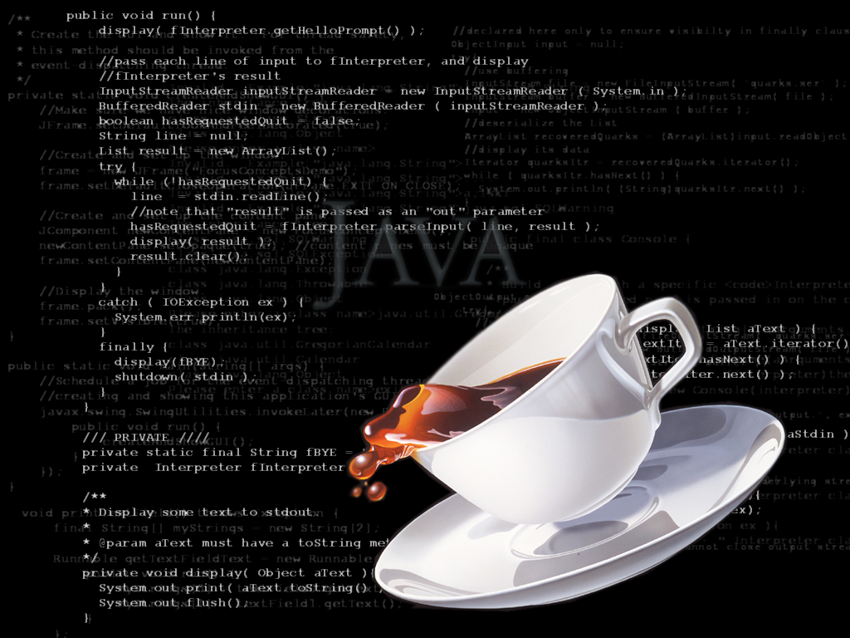
Remove Java from the Equation

Slide 55
Remove Java from the Equation
If a DB is normally started with dbman or OE Management try starting it from the command line…if you don’t know how, learn now…it’s an essential skill to have
Try proserve <dbname>
If proserve fails, try _mprosrv <dbname>

Slide 56
Restart Impossible - Time to Restore
Can’t start or access the DB
Restore from backup
Apply AI Files
Backup the restored DB
Re-enable AI
Sounds simple right?

Slide 57
And……
Bzzzzt!
Simple Recovery not Possible!
Debugging the recovery process is beyond the scope of this session
So now are options are:
  Repair the DB
  Salvage whatever data we can

Slide 58
Loss of AI Extents – Option 1
Disable After Imaging with rfutil aimage end
Fix the problem that caused the loss of the AI file(s)
Backup the database
Re-enable After Imaging

Slide 59
Loss of AI Extents – Option 2
Disable After Imaging with rfutil aimage end. You may get an error regarding the missing AI Extent but typically AI is still disabled
Truncate the BI file with proutil truncate bi. You may get an error regarding the missing AI Extent but typically the BI file is still truncated
Remove all AI Extents with prostrct remove. If that doesn't work, use an operating system command
Recreate the original AI Extents with prostrct add
Backup the database
Re-enable After Imaging

Slide 60
Loss of BI File
Remove all the BI extents (if any) with an OS command
Re-create the extents with prostrct unlock <db> -extents
Force access with proutil <db> -C truncate –F
The DB Tainted Flag is set but access should be possible
The extent of the damage is unknown unless the BUSY AI file at the time of the problem is available to scan with:
rfutil <db> -C aimage scan verbose –a <extent-name>

Slide 61
Loss of DB Extents
Control Area (.db file)
  prostrct builddb
Schema Area (.d1)
  Probably out of luck
Empty Extent (i.e. above the High Water Mark)
  prostrct unlock –extents
If you follow the Bascom method (single variable extent) recovery is more difficult than multiple fixed extents

Slide 62
Loss of DB Extents that contain Data
Extent “Transplant”
Restore an earlier backup into an identically sized structure
Copy the missing/damaged extent(s) from the restored DB over the broken DB
Use prostrct unlock to synchronize the extent timestamps
Note: if the lost extent contained the Area High Water Mark and the Area was actively growing then recovery may not be possible

Slide 63
Limited Corruption – A small number of blocks
Index Area
  proutil idxfix
  Rebuild the indexes for that Area (proutil idxbuild area <area-name>)
  This is why keeping data & indexes in separate Areas is important

Slide 64
Limited Corruption – A small number of blocks
Data Area
  Proutil dbrpr
DATABASE SCAN MENU
------------------
1. Report Bad Blocks
3. Fix Bad Blocks
4. Report Bad Records
5. Delete Bad Records
6. Dump Records to RM File
7. Rebuild Free Chain
8. Rebuild RM Chain
9. Rebuild Index Delete Chain
10. Change Current Working Area
11. Fix Cluster Chains in Type II Area
A. Apply scan to all areas

Slide 65
Limited Corruption - Block Surgery
Dump Block with proutil dbrpr > 4. Dump Block
Make a backup copy of the dumped block (.dmp text file)
Edit the Block
Load the edited Block with proutil dbrpr > 5. Load Block
You will need to know the DBKEY (i.e. address) of the Block
Also the location of the data to be edited within the block
A similar repair might be done by performing a “Block Transplant” from a healthy database

Slide 66
Limited Corruption - Block Surgery – Example
BI Cluster size accidentally set to a larger than expected value
The BI Truncation (i.e. crash recovery) ran out of space and there was not enough space to run again
Edited DB Master Block
  Changed the Cluster Size to a proper value
  “Told” the DB that the BI file is currently truncated
Load the edited Master Block
Got caught by Big/Little Endian the first time

Slide 67
Large Amount of Corruption
Dbrpr
Idxfix
Idxbuild
For more detail please refer to
  Rich Banville’s presentation titled: Database Corruption given during PUG Challenge USA 2013
  Link http://pugchallenge.org/downloads2013/251_DBCorruption.pptx

Slide 68
Can’t Repair the DB so must Recover Data
Conventional Dump & Load?
It is unlikely that a dump & load will succeed completely but at least you will know what tables have problems
How long will it take? Do you know?
Hint: have a list of tables that don’t needed to be dumped or can be dumped at a later time
  Scratch tables
  Unused tables

Slide 69
Dump Options
Indexless Binary Dump (-index 0) – works with Type 2 Areas only
4GL TABLE-SCAN option – also for Type 2 Areas only
  TABLE-SCAN does work with T1 Areas but uses an index
Problem: an indexless dump won’t guarantee the ordering of the data so when you hit the inevitable problem you won’t know where in the table the corrupt record lies…

Slide 70
Binary Dump Limitations
Binary dump – can’t use text utilities to review the output data
NOTE: A binary dump & load can sometimes (albeit rarely) transport corrupted data without error during the dump/load/index rebuild process
A multi-threaded Binary Dump is not possible if the Broker won’t start

Slide 71
Dump Options
Custom 4GL dump process avoids the corrupt data
  4GL WHERE Phrase (do you have a 4GL license that supports this?)
  Run till it crashes, edit the .d file, and start from the other “end”
Dump using a non-primary index
Recid Dump – Slowwwwww……
Read Only (-RO) 4GL/ABL Dump
Ultra Radical: truncate the Area(s) that are causing the dump processes to fail (good reason to have nothing in the Schema Area)

Slide 72
Post Mortem
Assuming that you’re still employed, document the incident
  Actions taken & the sequence of those actions (that’s why a note taker is useful)
  What actions worked
  What actions didn’t (so they doesn’t get repeated in the future)
  Incident numbers issued by any support organizations that were involved
  Resources required
    Disk space, etc.
    People, permissions, access

Slide 73
How Can We Avoid This Happening Again?
Enhanced monitoring
Better logging
Better documentation
Newer version of Progress
A bigger budget for:
  More disk space & better storage management tools (i.e. split mirroring)
  Disaster Recovery Server & Required Licenses
  Better maintenance agreements (shorter SLA) or agreements with more competent resources
Etc.

Slide 74
Resources
Dan Foreman’s Progress Database Administration Guide
Dan’s Mobile: +1 541-908-3437
Email: danf@prodb.com

Slide 75
THANK YOU!
Don‘t forget your Evaluations!
Don’t forget to thank the conference organizers!

Slide 76

Questions?
Notes:
And now we have some time for questions…

