Slide 1
Dockerize OpenEdge
Srinivasa Rao Nalla

Slide 2
Agenda
Introduction to Docker
Docker Essentials for OpenEdge deployment
  Leveraging Docker for OpenEdge deployment
  Demo

Slide 3
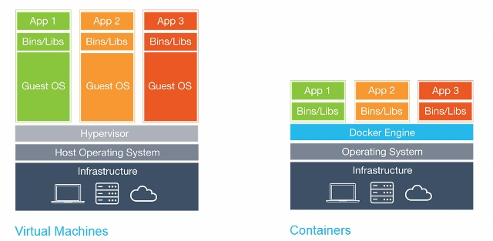
Introduction to Docker
Docker – is an open source software for deploying applications using containers
Container – self sufficient software is packaged together to work in isolation
  Independent of each other
  Contains all required libraries
  Shares the same operating system

Slide 4
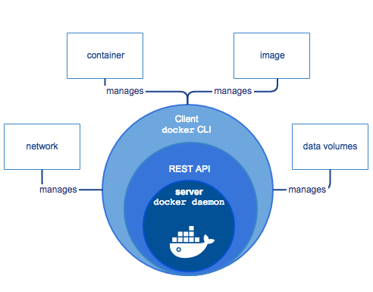
Introduction to Docker (Contd….)
Autonomy of Docker Engine
  Network
  Container
  Image
  Data Volumes
Docker CLI
  Provides command line interface to communicate with Docker Daemon
  Uses REST API for communication
Docker daemon
  Manages Docker containers

Slide 5
Docker Essentials for OpenEdge Deployment - Docker Volumes
Container writable layer
  Changes are written into this layer by using copy-on-write process
  By default this layer is not persistent
Persistence can be achieved either by using
  Docker Volumes
    Container level
    Host level
    Shared Storage
  Data Containers
Writable layer
Centos image
Kernel

Slide 6
Docker Networking modes
Host mode
Bridge mode
No Networking
Host Networking namespace is shared with the container
Container in it’s own network stack
Forwards packets between any of the network interfaces attached to it
Container mode
One container makes use of network namespace of another container

Slide 7
Docker Essentials for OpenEdge Deployment – Docker Swarm(Clustering)
Swarm Manager
Swarm Node
Swarm Node
Swarm Node
Native clustering solution for forming cluster of Docker hosts running the containers
Provides high availability and failover
  Continuously checks the health of the Docker daemon hosts
  Automatically rebalances by moving and re-starting Docker containers from failed hosts to new ones
Enterprises of different sizes can leverage scalability by using Docker Swarm
  Provides flexible container scheduling

Slide 8
Docker Essentials for OpenEdge Deployment – Docker Control Groups
Cgroups provide a way to allocate resources at a more granular level
Example to set CPU shares
  docker run -d --name='test' --cpu-shares=30 busybox
Cgroup | Explanation
Memory | Enforce memory limits maximum memory for a container swap space and kernel memory
CPU | Set certain constraints on the usage limits of Host’s CPU cycles CPU quota CPU shares
BLK IO | Measuring and limiting Block I/O
Net_cls and net_prio | Tagging and traffic control

Slide 9
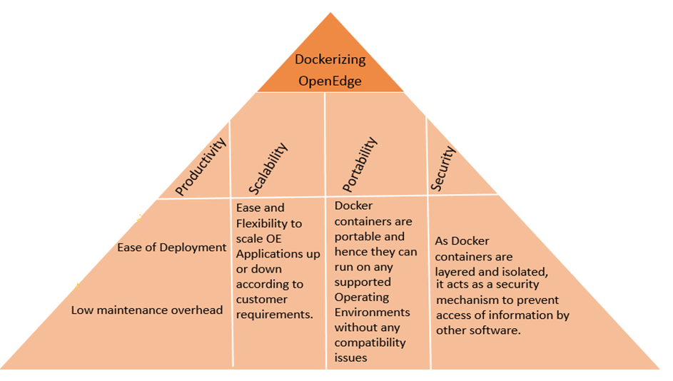
Advantages of Using Docker for OpenEdge

Slide 10
Leveraging Docker for OpenEdge

Slide 11
Potential Use cases from OE Perspective
Simplified Upgrade
Customers with multi-site deployment can leverage Docker solution to deploy OpenEdge
Time to deploy OpenEdge gets reduced drastically
Working with multiple versions of OE
Does not have to move the entire thing to latest – few components can be on older version and then they can slowly migrate to latest
Scalability
Scale up and down the containers based on requirements using appropriate Docker Orchestration tools

Slide 12
OpenEdge Image Creation
Couple of ways(options) to organize OE components while creating images
  Create image on per component basis
  Create image(s) by grouping relevant components together
  Image Creation
  Broadly classified into two stages
    Pre-image creation
      Identify default options
      Allow a way to specify the values to these options
    Post-image creation
      Publish the image to Docker Repository

Slide 13
Factors to be considered while creating images for OE Deployment
Underlying file system
  Explore the compatibility of supported file systems when using Docker containers
Networking
  Choose appropriate mode for Docker networking
Security
  User management (root and non-root users) for OE interactions (such as Database, AppServer) at Docker container level needs to be exercised and addressed
  Multiple instance creation
    Configuration and sharing of resources needs to be addressed while running multiple instances

Slide 14
Factors to be considered while creating images for OE Deployment
Persistent considerations
  WRK directory, Property files, and Database must be persisted
  Health of the Containers
    A mechanism must be in place to handle the container failure and/or error conditions.
    Possible solution(s) is to use Docker Swarm or develop custom scripts to check the health of the container and handle it accordingly

Slide 15
Known Limitations
Some of the components will not be able to provide container level information
  Features such as OEM which are designed for host level deployment will not provide granular information at the container level
  Add components is invalid in container environment
    Docker images are fixed in nature, Add components is not valid in container environment and hence they would not be available
  IP networking requires customization to make OE components work with Docker.
  Docker is still evolving
    Not supported on all OE platforms

Slide 16
Error Logging and Monitoring
Error logging differs from traditional host/machine level error logging
  Exhibits different view levels such as host, container, application and cluster. As the existing implementation is not aware of these view levels, the corresponding logging information is not available.
Instance monitoring differs from traditional host/machine level monitoring and exhibits the same view level as Error logging. The existing implementation does not has the support for these view levels

Slide 17
Migration Paths
Migrating from standalone deployment to Docker deployment for the OE same release
    Update configuration/properties files (may use import/export feature)
    OpenEdge Application files
    Choose Data Volume/Containers
    Progress.cfg
  Migrating from standalone deployment to Docker deployment for a different OE release
    Update configuration/properties files (may use import/export feature)
    OpenEdge Application files
    Convert the DB to the target version and appropriately place the DB in the target volume/container
    Progress.cfg
New deployment of OpenEdge with Docker OpenEdge containers

Slide 18
Typical OE deployment using Docker
Pull a Docker Image
Specify the required configuration parameters
Identify the required volumes
Starts a new Docker instance by pointing to appropriate progress.cfg file
Start consuming the services of new Docker instance

Slide 19
Demo

Slide 20
What’s new in Docker
New versioning
Multi-Stage Builds
Specify target on build
Swarm mode improvements
Runtime
Docker system subcommands added
Rollback action in fail over mode

Slide 21
Popular Orchestration Tools
Mesosphere
  Provides multiple features such as self healing, scheduling and fault tolerance. It can also be used to launch long running applications
Swarm
  Provides native clustering solution of clustering. It provides features such as High Availability, fail over and scalability
Kubernetes
  Handles scheduling and manages workloads based on user-defined parameters
  CoreOS Fleet
    Cluster management tool which extends the Systemd to work with cluster. It provides fault-tolerance, scheduling hints and constraints

