Slide 1
Accessible Business Rules
5 June 2017
David Atkins, Progress

Slide 2
Agenda
What are Business Rules
How do Corticon Business Rules enhance your application
Introductory Corticon demo – order pricing
Modes of use
Parameterized Rules Demo – rebate management
Deployment for ‘multi-tenancy’
Q & A

Slide 3
Business Rules are application logic that pertain to the business domain

Slide 4
Business Rules in OpenEdge Applications
Client Logic
(ABL)
Application Logic
(ABL)
Abstract Schema
(ProDataSet / Temp-Table)
Physical Schema
(Tables)
Infrastructure
Logic
(ABL)
Business
Logic
(ABL)

Slide 5
Busines Rules Management Systems (BRMS) separate business rules from core application code

Slide 6
Corticon enables you to make the Right Decision at the Right Time with Business Agility

Slide 7











The Solution: Progress Corticon BRMS
Separate decision logic from code
Empower business analysts
Increase transparency of decision logic
Enable fast, safe changes
Model Rules
with Integrity
Execute as
Open Standards
Decision Services
Decision Modelers
(Biz Analysts & Developers)
Enterprise Systems
Enterprise Data Sources
Notes:
The same decision service can be deployed and executed in a number of technical architectures:
It can be run in the native process of the application, directly in Java or .NET
It can be called as a step in a transaction process or workflow as a SOAP Web Service
It can run in a high performance batch process, directly against a database
It can be triggered by our CEP engine, upon identification of a relevant event

Slide 8

Choosing Between ABL and Corticon
Is the business logic changed frequently?
Is the business logic customized for different end users?
Is the business logic relatively complex?
Is greater transparency into the operation of the business logic required?
Is correctness of the business logic critical?
The more “yes” answers, the better the fit for Corticon!
Notes:
Is the business logic the result of relatively complex decisions? Are there many IF-THEN-ELSE blocks and/or CASE statements in the code, relating to setting relatively few, or even just a single, flag or field value(s)?
Is the business logic customised per customer or tenant (in a multi-tenant model), and who determines the changes in the business logic? If changes are made on a per-industry basis (eg. income tax tables, for example) it’s more likely that all customers of an application would require an update; if changes are made per-customer (eg. life insurance risk weightings) then the scope of the changes required are limited to that customer.
How frequently are changes required to the application’s business logic, particularly relative to the application vendor’s release schedule? If business logic changes are relatively infrequent, and releases are relatively frequent, then customers may benefit from the vendor’s development and testing expertise, and not have to perform those actions themselves.
Business analysts and/or business domain experts are readily available at a customer site, but are non-technical.

Slide 9
Volatility in OpenEdge Applications
Client Logic
(ABL)
Application Logic
(ABL)
Abstract Schema
(ProDataSet / Temp-Table)
Physical Schema
(Tables)
Infrastructure
Logic
(ABL)
Business
Logic
(ABL & Corticon)
Volatility:
Low
Med
High

Slide 10
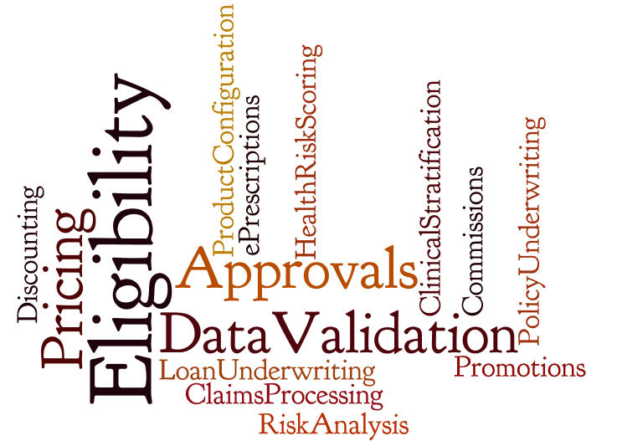
Typical Corticon Use Cases

Slide 11
Agenda
What are Business Rules
How do Corticon Business Rules enhance your application
Introductory Corticon demo – order pricing
Modes of use
Parameterized Rules Demo – rebate management
Deployment for ‘multi-tenancy’
Q & A

Slide 12
Why Corticon?
Productivity
  Model Driven: faster for complex scenarios
  Rule Integrity Checks: completeness, ambiguity, looping
Transparency
  Rules models more intuitive then application code
  Self-documenting
Reliability
  Rule Integrity Checks
Accessibility
  Rule Modeling accessible to Biz Analysts AND Developers
  Business domain experts can own appropriate rules

Slide 13
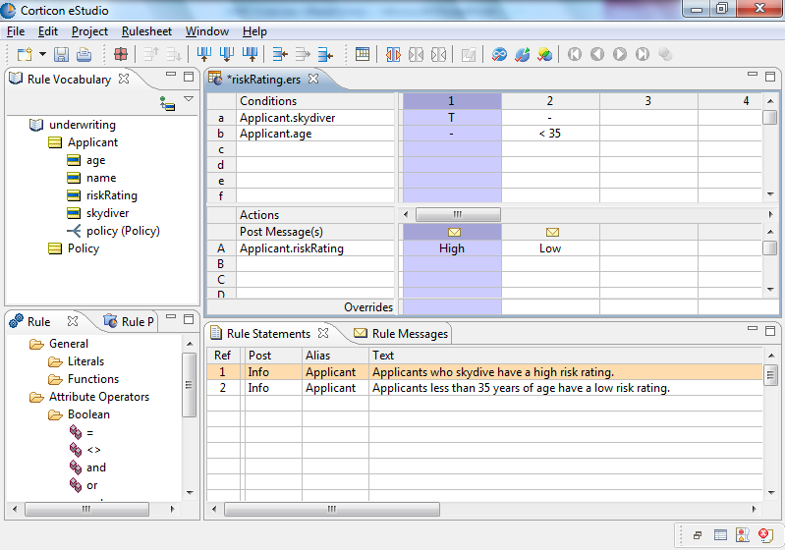
Why Corticon#1: Model-Driven Rules Development
Vocabulary consists of your business objects/terms
Out-of-the-box
ready for use by
Business Analysts
IT Professionals
Patented Excel-like modeling tool
No programming
Business friendly
Simple deployment
Rules are constructed with drag-and-drop ease
Rule Statements provide rule documentation and traceability
Comprehensive, extensible library of operators (akin to Excel functions)
Proven with the most sophisticated business problems

Slide 14
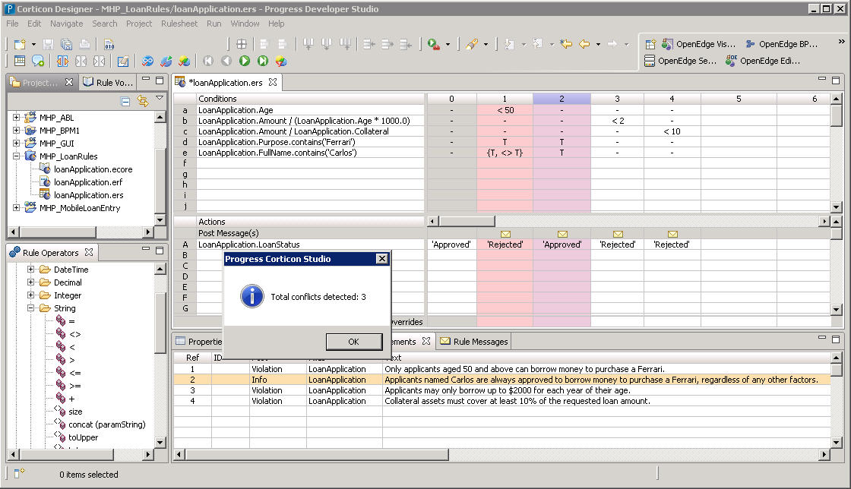
Why Corticon #2: Guaranteed Rule Integrity
Built-in integrity checks ensure creation of accurate, complete & robust rules

Slide 15
Model-Driven Rules Development
Traditional Approach
Often contains errors and performance issues
Specify
Design
Templates
Test
Integrate
Deploy
Code
Reduce development
and change cycles
by 90%
Corticon
Approach
Model
Integrate
Deploy
Higher quality, higher performance, agility
Requires Technical Resource

Slide 16
Why Corticon #3: Easy and Productive OpenEdge Integration
Design-time Meta-data integration
  Create Corticon vocabulary from existing TempTables and ProDataSets
Simple, fast ABL API
  Simple API that hides most invocation complexity & abstracts transport
  Allows ABL apps to reuse existing data structures as inputs/outputs (ProDataSets, Temp Tables)
  Productivity macros: BR-CONNECT, BR-INVOKE and BR-GETMSG
Run-time code-free database integration using Corticon Enterprise Data Connector
  Enrich request data with dynamic OE DB lookup
  Add or update data in OE DB direct from Corticon decision service
  Supports OpenEdge DB directly & OpenEdge AppServer (via Progress OpenAccess)
Part of the OERA: Corticon complements OpenEdge BPM, Rollbase, Sitefinity

Slide 17
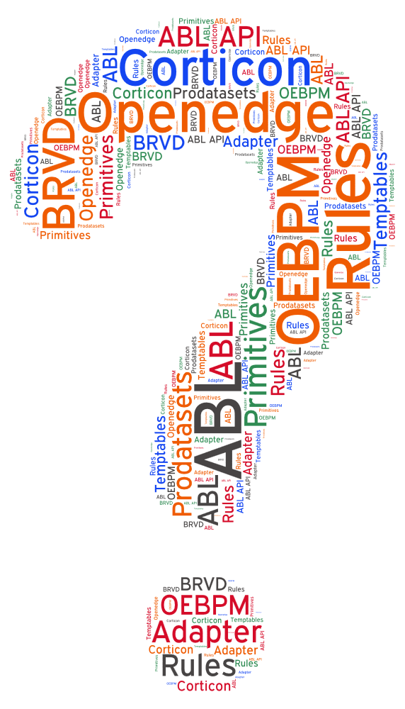

Slide 18
Corticon Terminology and Rule Modeling Workflow
Corticon Studio
Corticon Server
Vocabulary
RuleFlow
Domains
Entities
Attributes
Decision
Service
v1.0
Schema
Rulesheet 1
RuleTest
. . .
RuleSheet
Decision
Service
v2.0
Conditions
Filters
Actions
Messages
Rulesheet N
Dashed line: optional step
Notes:
First let’s consider the high level workflow when modeling and deploying rule logic with Corticon.
- start by defining the data on which the decision or calculation will be based, in Corticon this is termed a Vocabulary. It can be hand-crafted or imported from existing metadata such XML Schema Definitions or Database schema
- then rules are modeled in RuleSheets and Integrity Checks are applied to them to ensure completeness and lack of conflicts
- RuleTests are then created to confirm each rules’ implementation is accurately reflecting the intended logical behavior (note that because of the integrity checks applied at the rule modeling step, it is not necessary to craft test cases to detect incompleteness or unwanted ambiguity/conflict between rules)
- RuleSheets can then be assembled into RuleFlows
- RuleFlow are then deployed as executable Decision Services

Slide 19
Agenda
What are Business Rules
How do Corticon Business Rules enhance your application
Introductory Corticon demo – order pricing
Modes of use
Parameterized Rules Demo – rebate management
Deployment for ‘multi-tenancy’
Q & A

Slide 20
Agenda
What are Business Rules
How do Corticon Business Rules enhance your application
Introductory Corticon demo – order pricing
Modes of use
Parameterized Rules Demo – rebate management
Deployment for ‘multi-tenancy’
Q & A

Slide 21
Ways Corticon can be used in an ISV application
“Internal Use”
Maintaining volatile common logic
(using Corticon Studio)
  Lowers costs and speeds time-to-market
  Developers, business analysts (BAs)
  Complete flexibility for metadata, rule complexity, design patterns and deployment
Customizing end-user specific logic
(using Corticon Studio)
  Faster, cheaper customizations
  May enable greater degree of customization
  Developers, BAs, implementation consultants
  Complete flexibility for metadata, rule complexity, design patterns
  May influence deployment (more on this later!)
End-user use
Self-service custom rule management
(using Corticon Studio)
  Reduces burden on ISV resources
  Requires trained end-user developers / BAs
  Typically constrained to certain rules and ISV-defined meta-data
  Lifecycle and deployment governance can be challenging, constrains viable use cases
Self-service mgt of constrained custom rules
(using custom web/mobile/desktop UI)
  Enables end-user independence
  ‘Rules’ managed via web interface
  Non-technical users make the changes
  Only applies to well-constrained scenarios

Slide 22
Ways Corticon can be used in an ISV application
“Internal Use”
Maintaining volatile common logic
(using Corticon Studio)
  Lowers costs and speeds time-to-market
  Developers, business analysts (BAs)
  Complete flexibility for metadata, rule complexity, design patterns and deployment
Customizing end-user specific logic
(using Corticon Studio)
  Faster, cheaper customizations
  May enable greater degree of customization
  Developers, BAs, implementation consultants
  Complete flexibility for metadata, rule complexity, design patterns
  May influence deployment (more on this later!)
End-user use
Self-service custom rule management
(using Corticon Studio)
  Reduces burden on ISV resources
  Requires trained end-user developers / BAs
  Typically constrained to certain rules and ISV-defined meta-data
  Lifecycle and deployment governance can be challenging, constrains viable use cases
Self-service mgt of constrained custom rules
(using custom web/mobile/desktop UI)
  Enables end-user independence
  ‘Rules’ managed via web interface
  Non-technical users make the changes
  Only applies to well-constrained scenarios

Slide 24
Agenda
What are Business Rules
How do Corticon Business Rules enhance your application
Introductory Corticon demo – order pricing
Modes of use
Parameterized Rules Demo – rebate management
Deployment for ‘multi-tenancy’
Q & A

Slide 25
Agenda
What are Business Rules
How do Corticon Business Rules enhance your application
Introductory Corticon demo – order pricing
Modes of use
Parameterized Rules Demo – rebate management
Deployment for ‘multi-tenancy’
Q & A

Slide 26
Deployment options for ‘multi-tenant’ Customization Rules
Corticon Server
Corticon Servers
Corticon Server
DS1
DS
DS
DS2
DS
DS3
Shared Corticon Server & server configuration
Single Decision Service (DS)
Simplest app integration
RuleFlow conditionally branches by tenantID
Tenant-specific RuleSheets
TenantID in request
Low tenant independence
Shared Corticon Server & server configuration
Decision service per tenant
App invokes tenant’s DS
Still reuse common RuleSheets
No TenantID in request
Medium tenant independence
Corticon Server & server configuration per tenant
Decision service per tenant but with common name
App invokes tenant’s Server OR
Proxy routes to tenant’s Server
No TenantID in request (unless for Proxy routing)
Tenants are fully independent

Slide 28
David Atkins 617-372-2155 datkins@progress.com

Slide 29
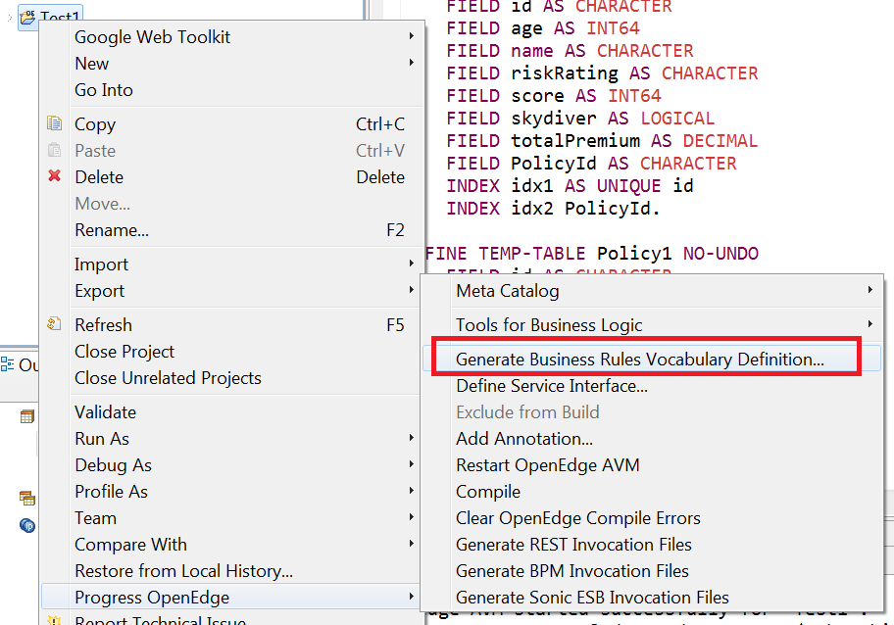
OpenEdge Integration #1a: Design-time Meta-data
Integrated development experience
  Shared Definition of Vocabulary that rules operate on:
  import Schema definitions, ProDataSets & Temp tables as Corticon vocabulary Entities
Export Temp Table or
Prodataset
to create a
Corticon vocabulary
from Progress Developer
Studio

Slide 30
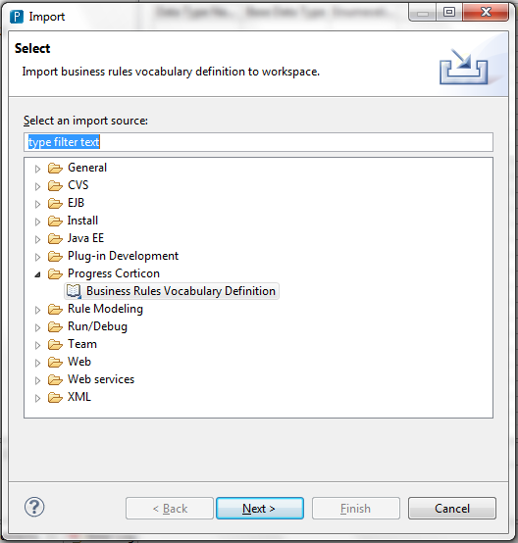
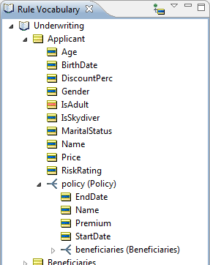
OpenEdge Integration #1b: Design-time Meta-data
Integrated development experience (continued)
In Corticon Studio
import the .brvd file.
This will create your
Corticon vocabulary.

Slide 31
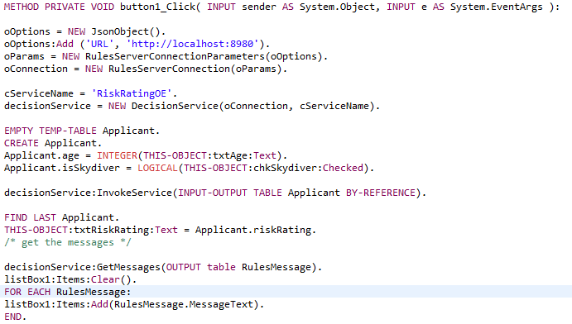
OpenEdge Integration #2: Native ABL API
Establish connection with decision service
Call decision service
Work with the rule execution messages

Slide 32
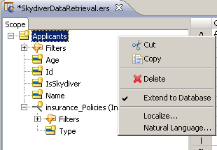
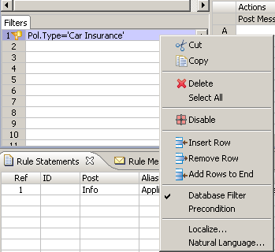
OpenEdge Integration #3: Run-time Code-free Database Integration
Access to OpenEdge data and services
  Corticon EDC (Enterprise Data Connectivity) enables dynamic interaction with OpenEdge DB
Bind your Corticon
vocabulary to your
OE database tables
Conditionally retrieve
data and optionally
persist results whilst
processing rules
without SQL coding!

Slide 33
4. Corticon is Integral to OERA and “Modernization”
Open Client Access
ANY PLATFORM, ANY DEVICE, ANY CLOUD
Security
User Interface
Service Interfaces
Mobile
Desktop
Web
Tools
Management
Developer Studio
Process and Policy
Business Processes
Business Rules
Application
Community Frameworks
Adv. Business Language
Integration
Application Server
Data
RDBMS
Replication
DataServers

