Slide 1
Build Your Own Luck
Adam Backman
Chief Cat Wrangler – White Star Software
adam@wss.com

Slide 2
About the speaker
Partner – White Star Software
  A leader in the Progress OpenEdge services sector for over 30 years
  Home of ProTop™ – The leading free OpenEdge monitoring tool
  Managed database services backed up by experienced Progress OpenEdge professionals
30 years of Progress OpenEdge experience
  Support
  Training
  Consulting (Database and System configuration, management and tuning)

Slide 3
Agenda
Difference in luck
Luck vs. Skill
Planning to change luck
Know your enemy – sources of problems

Slide 4
Lucky person?

Slide 5
Now what do you see?

Slide 6
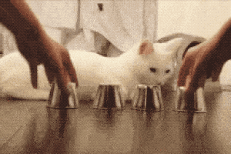
This is skill not luck

Slide 7
Ultimately, luck is a matter of planning
As we will see, planning is the key to being lucky
Software planning – good design, implementation and testing
Hardware planning – redundancy, good partners and cost effective spending

Slide 8
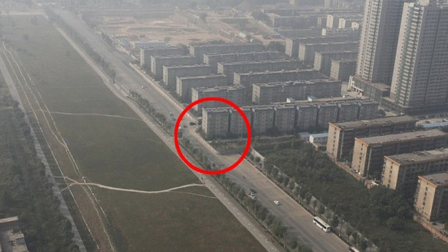
Planning is the key to success

Slide 9
Sources of system problems
Human errors
More human errors (really)
Hardware/software system failures
Man-made disasters
Natural disasters

Slide 10
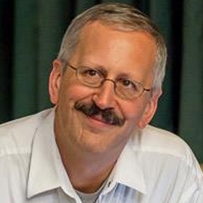
The REAL source of system problems

Slide 11
Cost of downtime
Cost of lost business
Cost to rekey/lost data
Cost to switch to other (manual) system
Cost to reputation

Slide 12
Goals of building reliable systems
Eliminate “human” element
Eliminate single points of failure
  Hardware redundancy
  Infrastructure redundancy
  Application redundancy
  Operational redundancy
Don’t spend more than the cost of the problem

Slide 13
Eliminate the human element
Automation of all tasks
Reporting on all outcomes
Alerting on all variances

Slide 14
Eliminate the human element
Must have been the hair

Slide 15
Building reliable solutions (software)
Standards
  Naming standards
  Source code control
Standard release process
  Separate development, test and production environments
Testing
  Manual and automated testing

Slide 16
Process
Look at the problem
Document a solution
Review the solution
Build solution to the document
Automate all tasks and sub-tasks
Test, and test again
Then deploy and hope you did everything right

Slide 17
Look at the problem
Understand the problem fully from multiple perspectives
  End user
  Company
  Outside vendors
  Others?
Is the problem worth solving

Slide 18
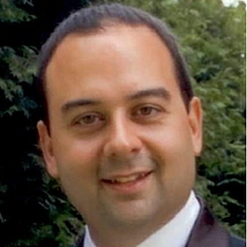
Look at the problem

Slide 19
Document the problem and the solution
Everyone hates documenting things
Good first indicator of whether the problem is worth solving
Nothing fancy but must be complete
Effect of the problem on various user communities
Proposed solution(s)
  Once a solution is selected then it must be thoroughly documented

Slide 20
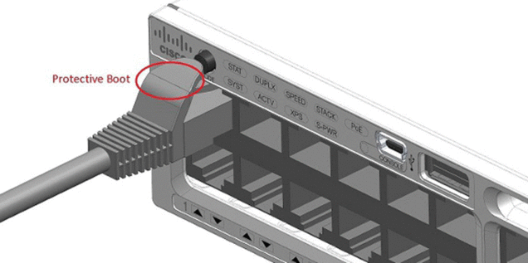
Importance of Peer Review

Slide 21
Build to the documented solution
Documenting solutions is hard
  Why much outsourcing fails
Documentation of solution could and will cost more time and effort than building the solution
Building to a specification and having deviations reviewed prior to implementation is imperative
Developers cannot work in a vacuum

Slide 22
Building a solution
Build a frame (outline of the solution)
Build individual components
Test individual components
Link components together
Test end to end
Automate testing and do a user acceptance tests

Slide 23
Notes about testing
Test environments should match production
  Size of the database
  Similarity in hardware
  Application should be installed as in production
  Supporting applications
Avoid sharing environments (even development and Test)

Slide 24
Architecting reliability (hardware)
Fault tolerance
Redundancy
Reliable partners

Slide 25
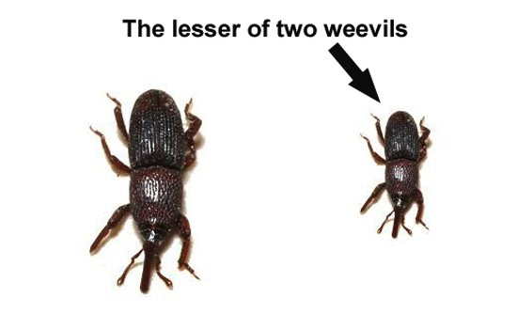
Picking the best solution

Slide 26
Hardware trends
Virtualization
  More hosts on a single piece of hardware
SAN (Storage Area Network)
  Most hosts on a single storage solution
Vendor hosted solutions
  More variables between you and the solution

Slide 27
Components of the hardware
CPU
Memory
Storage
Fans
Power

Slide 28
CPU/Memory
Most reputable vendors will support a single CPU failure without crashing provided there are more sockets filled in the machine
Multi-core does NOT mean multi-socket
Avoid interleaved memory unless it is mirrored

Slide 29
Disks
So many bad ideas so little time
  NAS
  Physical spinning disks
How about RAID 5 now?
Local vs. SAN
How about something crazy

Slide 30
No backup, you are out of luck
Sound recovery strategy
  Complete
  Hardware, infrastructure, facilities
The business needs to look up to the world to running as usual
Backup
  Database, system and application backups
  After imaging
  OpenEdge replication

Slide 31
Luck is a matter of perspective
Plan and build to solve a specific problem
Plan for the unexpected
Have written recovery procedures for the most likely events
Testing code before is goes into production

Slide 32
Lucky people
People who plan properly
People who include peers in the process
People who view the problem and it’s solution from different perspectives
People who test their plans and solutions
People who continue to test over time

Slide 33
?
Questions

Slide 34
Thank you for your time! adam@wss.com http://www.wss.com

