Slide 1
A deep dive into SPRING security
June 6th 2017 – Frank Hilhorst

Slide 2
The laws of SPRING configuration
1st law
  Until you’ve got everyting right, nothing will work
2nd law
  When it doesn’t work you will be kept in the dark as to why it doesn’t work
3rd law
  Until you are authenticated you shall be treated as an intruder

Slide 3
Some information about me
Started working with PROGRESS in 1992
Principal Software Architect of JAZZ application
  Billing application for Hospitality (300 installs serving 1500 hotels)
Started Progressive Consulting in 2006
Specialize in integration projects
  JAVA
  Messaging (JMS, RABBIT MQ, ACTIVE MQ, etc)
Yoga teacher

Slide 4
What this session will cover
Understanding security SPRING security basics
SpEL – The Spring Expression Language
OpenEdge Implementation of SPRING security
Configuration specifics for
  OpenEdge Realm based security
  LDAP based security
Customizing the login/logout
Closing the back door

Slide 5
Understanding security threats

Slide 6
The two dimensions of System Security
Authentication
  Identifying the user as an authorized user
  Limiting the time the user can operate in the system before re-identifying himself
  Securing that all requests for the duration of the session come from the identified user
Authorization
  Constraining the operations the logged in user can perform in accordance with his assigned roles

Slide 7
With regards to security threats
The bottom line is
In the 4GL we are ill equipped to deal with these threats
Therefore
Lets hand the management of these risks over to a separate security layer

Slide 8
SPRING security basics

Slide 9
What is SPRING?
A JAVA Framework for defining an application as an assembly of interchangeable components
An assembly component is called a JAVA bean
Assembly defined in spring.xml file

Slide 10
Example of bean configuration in spring.xml
<preauthHandler ref="preauthAuthProvider" />
<b:bean id="preauthAuthProvider"
class="security.OEPreAuthenticatedAuthenticationProvider">
<b:property name="rolePrefix" value="ROLE_" />
<b:property name="enabledAttrName" value="ATTR_ENABLED" />
<b:property name="lockedAttrName" value="ATTR_LOCKED" />
<b:property name="expiredAttrName" value="ATTR_EXPIRED" />
</b:bean>

Slide 11
Examples configurable SPRING components
<authentication-manager ref=“..”/>
<authentication-provider ref=“..” />
<access-denied-handler ref=“…" />
<authentication-success-handler-ref=“…“>
<authentication-failure-handler-ref=“…“>

Slide 12
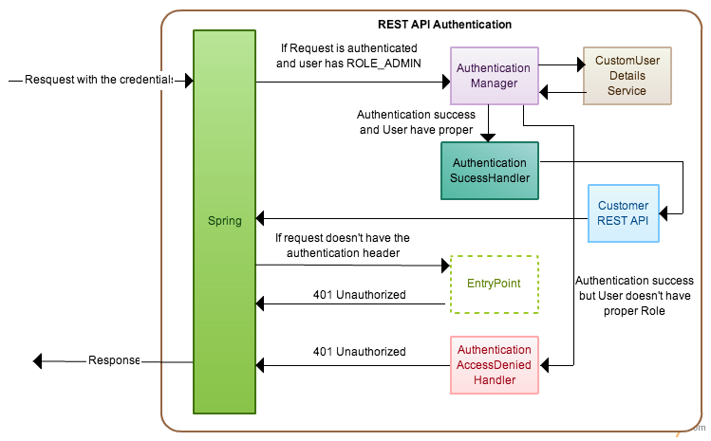
The SPRING Security Model

Slide 13
Authentication Models Supported in Spring Security
No | Security Model | Supported in OpenEdge
1 | JDBC Based Authentication | Good luck, you are on your own
2 | LDAP | Yes
3 | OpenID | No
4 | Client Certificate Authentication | Yes on the server side No on the client side
5 | Single Sign On with Central Authentication Service | yes
6 | Container based security (Use Tomcat user authentication) | yes
7 | Custom authentication | Yes (by customizing the HybridRealm class)

Slide 14
Authorization Models Supported in Spring Security
No | Authorization Model | Supported in OpenEdge
1 | Url based security | Yes
2 | Annotation based security | No
3 | Dynamic URL filtering | No
4 | Access Control Lists | No

Slide 15
SpEL – The Spring Expression Language

Slide 16
The basic directory (URL) structure of a REST webapp
./static
./static/auth
./static/error
./static/images
./static/webspeed
./WEB-INFO (REST)

Slide 17
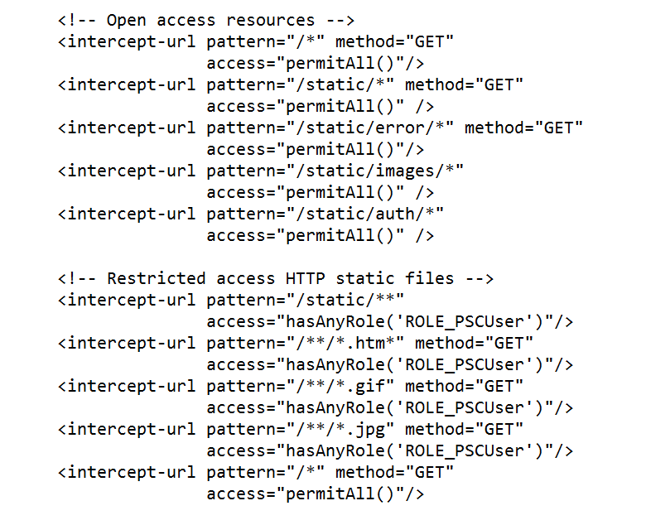
The definition of an intercept URL

Slide 18
The SpEL (SPRING expression language) verbs
Verb | Arguments | Description
hasRole(…) | Role Name | Permit access only users with the specified role
hasAnyRole(…) | Comma separated list of roles | Permit access only to users who have at least one of the roles specified in the comma separated list of roles
permitAll() | none | Give access to everybody
denyAll() | none | Give access to nobody
isAuthenticated() | none | Give access to all users who are authenticated. Deny access for request by users who have not been authenticated
isFullyAuthenticated() | none | Give access to users who have been authenticated by logging in. Deny access to users who have been authenticated by way of the remember me feature

Slide 19
The SpEL pattern matching
pattern | SpEL verb | Allows | Denies
/Static/* | permitAll() | /static/main.htm | /static/view/view1.htm
/static/** | permitAll() | /static/main.htm /static/view/view1.htm
/static/* /static/** | permitAll() hasRole(...) | /static/main.htm | /static/view/view1.htm
/static/*.json /static/* /static/** | hasRole(...) permitAll() hasRole(…) | /static/main.htm | /static/catalog.json /static/view/view1.htm
/static/*.htm /static/**.js /static/** | permitAll() permitAll() denyAll() | /static/main.htm /static/main.js /static/view/view1.js | /static/main.jpg /static/view/view1.htm

Slide 20
Classifying OpenEdge web applications
(by technology)
Technology
  Cgi script
  Speedscript
  Static HTM pages using AJAX calls
    SOAP
    REST
    CGI scripts
  KENDO/JSDO/REST

Slide 21
Classifying OpenEdge web applications
(by target audience)
Target audience
  Private
    Appication runs on a VPN or LAN
  Public with ..
    Secured access
    Anonymous access
    Both Anonymous and secured access

Slide 22
Best practices
Create a URL map of
  The static resources of your application (i.e static HTML pages)
  The dynamic resources (SOAP, REST, Cgi scripts)
When using speedscript identify the business logic that cannot be identified with a url map
In the resulting URL map identify which url pattern can be accessed by which roles
  For static resources identify which dynamic resources they use
    Make sure to protect both the static and the correlated dynamic resource consistently
Identify the back doors (e.g. http:/localhost:8080/apsv)
  Close the back door
    I

Slide 23
OpenEdge Implementation of SPRING security (prior to version11.7)

Slide 24
Configuration files involved
File name | location | Notes
web.xml | webapps/[app-nm]/WEB-INF | Compare to progress.ini file
oeablSecurity[basic/form][auth model].xml | webapps/[app-nm]/WEB-INF | Is one of oeablSecurity-anonymous.xml oeablSecurity-basic-ldap.xml oeablSecurity-basic-ldap-ext.xml oeablSecurity-basic-local.xml oeablSecurity-basic-oerealm.xml oeablSecurity-basic-saml.xml oeablSecurity-container.xml oeablSecurity-form-ldap.xml oeablSecurity-form-ldap-ext.xml oeablSecurity-form-local.xml oeablSecurity-form-oerealm.xml oeablSecurity-form-saml.xml

Slide 25
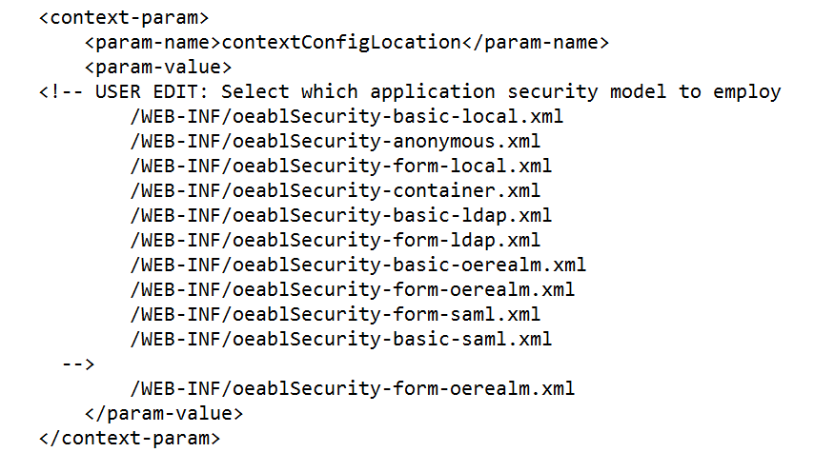
The basic steps for implementing an authentication model
In the WEB-INFO/web.xml
  Select a security configuration file
  Customize parameters in the selected security parameter file
  Perform additional configuration operations

Slide 26
OpenEdge Implementation of SPRING security (as of version 11.7)

Slide 27
Configuration files involved
File name | location | Notes
oeablSecurity.properties | Webapps\[app-nm]\WEB-INF | All authentication models are configured by way of name value pairs
oeablSecurity.csv | Webapps\[app-nm]\WEB-INF | Defines intercept url’s in csv format

Slide 28
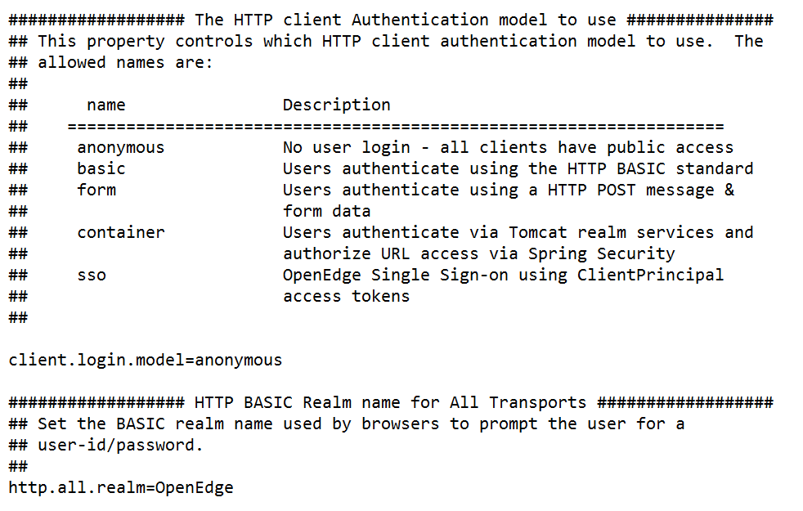
Changes to security configuration in OpenEdge version 7
All security related configuration defined in one file
  oeablSecurity.properties

Slide 29
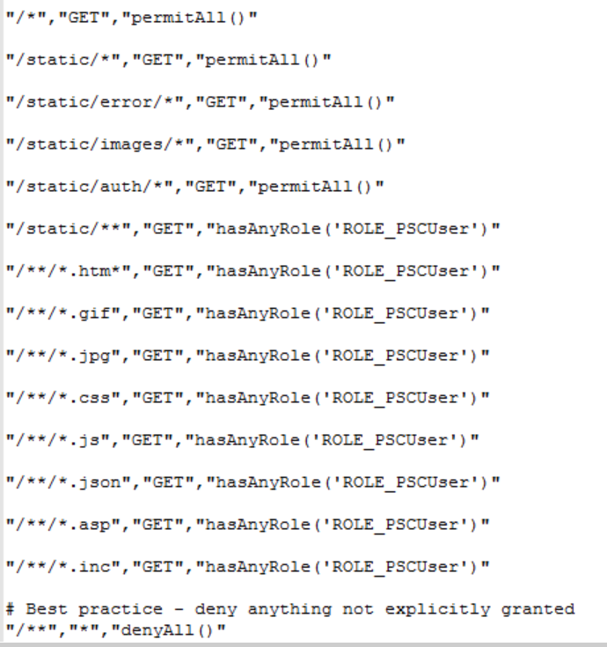
Changes to security configuration in OpenEdge version 7
All security related configuration defined in one file
  oeablSecurity.csv

Slide 30
How to configure OERealm based security

Slide 31
Basic steps in setting up OEREALM security
(prior to 11.7)
In the web.xml file
    Select /WEB-INF/oeablSecurity-form-oerealm.xml as the security model
Create a client principal token file (optional)
Configure and deploy security properties file
Make a copy of the %DLC%\src\samples\security\OpenEdge\Security\Realm\HybridRealm.cls
  Configure users, domains and roles in the data administration
    Or
  Customize HybridRealm.cls to use your own user, domain and roles implementation
Deploy HybridRealm.cls, Properties.cls & properties file
Edit properties in /WEB-INF/oeablSecurity-form-oerealm.xml

Slide 32
Edit the web.xml file
(prior to 11.7)

Slide 33
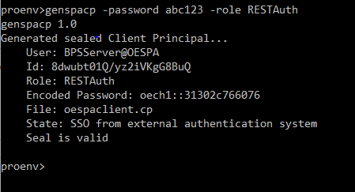
Generate a client principal file
From proenv type a genspacp command
  Example
    genspacp -password abc123 -role RESTAuth
  Deploy oespaclient.cp in [catalina-base]/conf

Slide 34
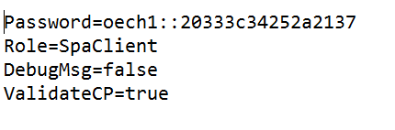
Configure security properties file
Sample properties file is stored in
  %DLC%\src\samples\security\spaservice.properties
Contents of properties file
Set the password to the password created by genspacp
Deploy security properties file in
  [CATALINA-BASE]/webbapps/[AppName]/WEB-INFO/openedge

Slide 35
Customizing the HybridRealm.cls (1)
The JAVA SPRING layer makes Java OpenClient calls to 3 methods in the HybridRealm class
  ValidateUser
    Input - UserName (decrypted)
    Returns:: - UserId (Unique integer ID for the user)
  ValidatePassword
    Input - UserId (integer), Password(character)
    Returns - True /False
  GetAttribute 4 times for ATTR_EXPIRED, ATTR_LOCKED,ATTR_ENABLED, ATTR_ROLES
    Input - Userid(integer)
    Returns - AtributeValue (character)
By default within each of the above methods a call is made to this-object:ValidateClient()
  Validates if method was called with a valid sealed client principal object

Slide 36
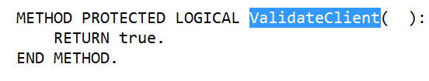
Customizing the HybridRealm.cls (2)
The default implementation of the HybridRealm class uses the OpenEdge security tables
  _sec-authentication-domain
  _User
  _Sec-role
  _sec-granted-role
However you can customize the realm class to use your application user tables
Make sure that
  The constructor of the HybridRealm.cls loads the properties file correctly
    spaProps = NEW Properties("spaservice.properties").
For testing first disable client principal validation by modifying HybridRealm.ValidateClient()

Slide 37
Edit properties in
/WEB-INF/oeablSecurity-form-oerealm.xml
Bean ID | Property Name | Example | Notes
OERealmUserDetails | realmClass | auth.HybridRealm | Point to deployed HybridRealm.cls You can deploy either under [CATALINA-BASE]/[Service]/WEB-INFO/openedge [CATALINA-BASE]/[openedge
 | realmUrl | http://localhost:8080/apsv internal://nxgas | The url of the appserver that is going to handle the hybridRealm authentication
 | realmTokenFile | oespaclient.cp | Should point to where the client principal is deployed By default tomcat looks in [CATALINA-BASE]/conf
OERealmAuthProvider | key | oech1::31302c766076 | Set to the key returned when we created the client principal file
OEClientPrincipalFilter | key | oech1::31302c766076 | Set to the key returned when we created the client principal file

Slide 38
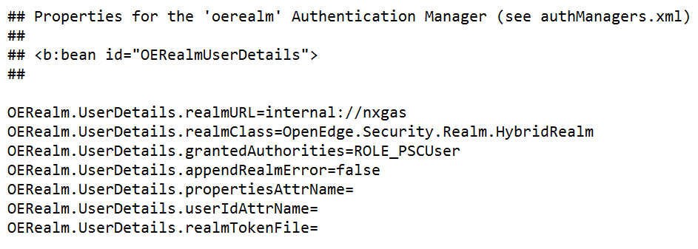
Configuring the OERealm Security
Openedge version 11.7 and up
All properties defined in oeablSecurity.properties
Principle
  Select bean to use
  Define properties

Slide 39
Customizing the login/logout

Slide 40
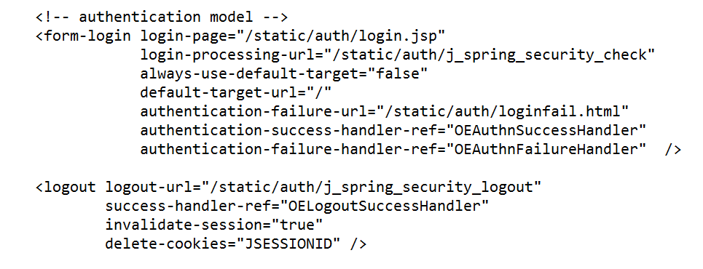
How SPRING security defines where to go when the login succeeds of fails

Slide 41
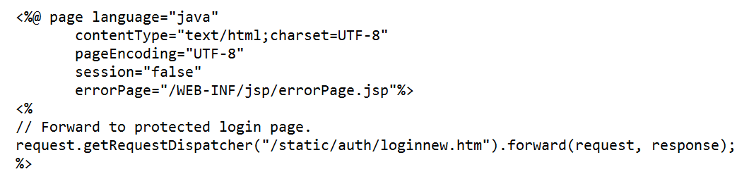

What the login.jsp looks like

Slide 42
Rules for creating a custom login page
Must have a form that posts to “j_spring_security_check”
  <form name='login' action="j_spring_security_check" method='POST'>
Must have an input field for the user name with a name attribute of j_username
  <input type='text' name='j_username' value=‘’’>
Must have an input field for the password with a name attribute of j_password
  <input type=‘password' name='j_password' value=‘’’>
Must have an input field for the password with a name attribute of j_password
  <input name="submit" type="submit" value="login" style="width:100%"/>

Slide 43
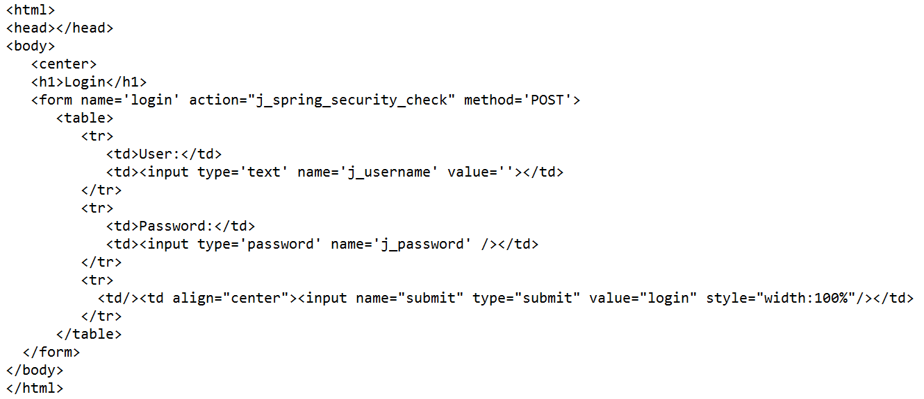
Example of a custom login page

Slide 44
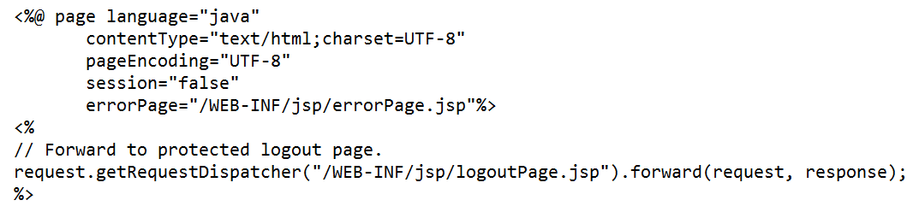
What the logout.jsp looks like
Logout is redirected to this logout page.
Which we can customize

Slide 45
Closing the back door

Slide 46
A Security Perimiter is only as strong as its weakest link

Slide 47
Identifying the weakest link in the security perimiter
The front door
  Your web application
The back doors
  Another web application hosted on the same tomcat instance
  Appserver access
  GUI Application
  Procedure editor access
  Access to the file system

Slide 48
A few general recommendations
Protect access to webapps/ROOT
Protect access to the appserver
  http://localhost:[port_no]/apsv
For access to the authentication module (HybridRealm.cls)
  If hosted on the same Tomcat instance
    Use internal access only
      internal://nxgas
Protect file system access to the tomcat configuration files
Protect access to user and role configuration

Slide 49
Questions?

