Slide 1
What’s new in PDS for OE11.7 and a sneak peek into the future of (Cloud) IDEs
Nischal Y
5th June 2017

Slide 2
Agenda
What's new in PDS for OE 11.7
A cool new tool for ABL developers (ABL Dojo)
Peek into the future of (cloud) IDEs

Slide 3
Agenda
What's new in PDS for OE 11.7
A cool new tool for ABL developers (ABL Dojo)
Peek into the future of (cloud) IDEs

Slide 4
What's new in PDS for OE 11.7
PDSOE
PASOE Debugger
Ant tasks for CI/CD workflow
Log viewer
Other improvements
ABLUnit Debugger

Slide 5
PDS Debugger
ABL Debugger
ABL Standalone Debugging
Appserver Debugging
Remote Debugging
ABLUnit Debugging
PAS Debugging

Slide 6
PAS Debugger
PDSOE
PASOE Debugger
Ant tasks for CI/CD workflow
Log viewer
Other improvements
ABLUnit Debugger

Slide 7
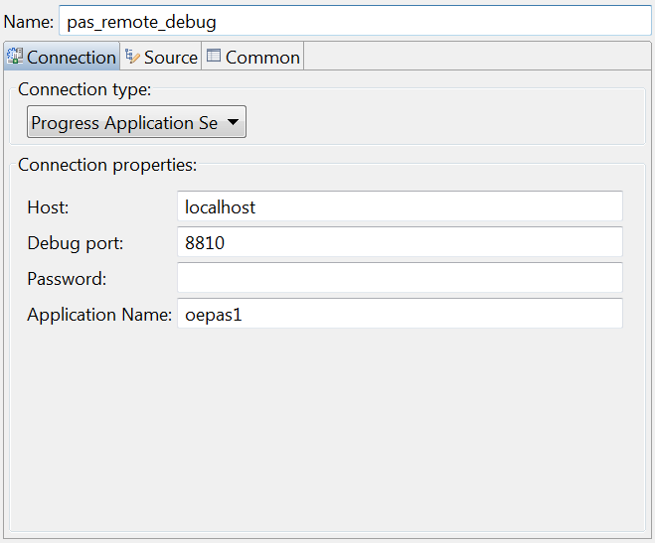
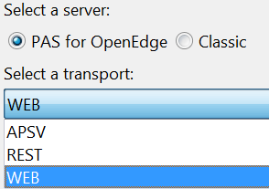
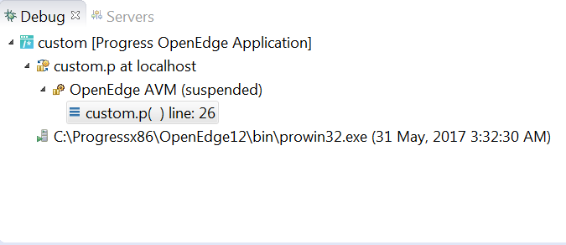
Progress Application Server Debugger
Debug PAS applications
APSV
REST
Debugging features
Breakpoints
Watch expressions
Remote PAS instances
Variables view
Remote debugging
WEB
Etc..

Slide 8
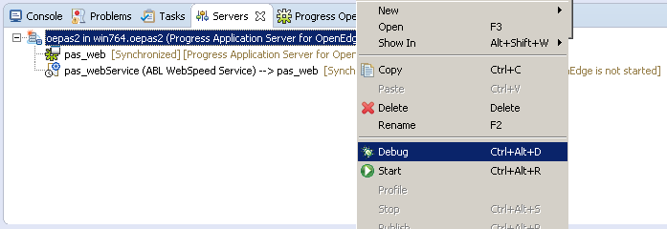
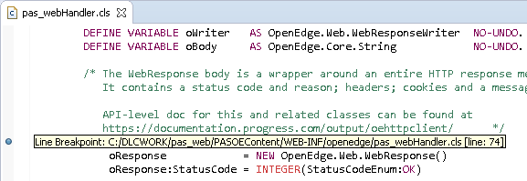
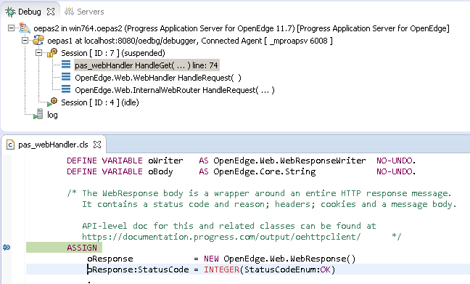
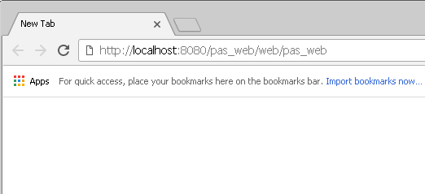
Debugging PAS application
Add Breakpoints
Start in Debug mode
Debug the source
Access URI/Resource

Slide 9
Lets see it in action!

Slide 10
ABLUnit Debugger
PDSOE
PASOE Debugger
Ant tasks for CI/CD workflow
Log viewer
Other improvements
ABLUnit Debugger

Slide 11

What do you do when your test case fail?
You Debug!

Slide 12
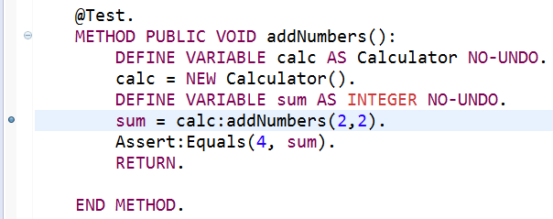
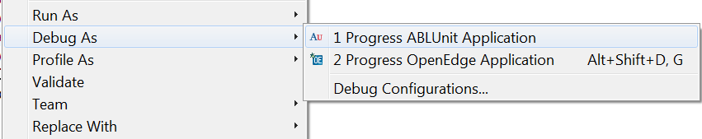
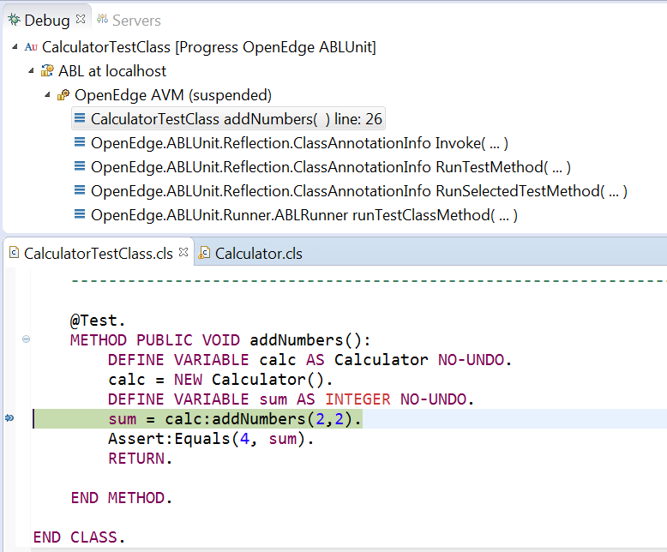
ABLUnit Debugging
Launch in debug mode
Add break points
Debug the source

Slide 13
Lets see a short demo

Slide 14
PAS Ant tasks for CI/CD workflow
PDSOE
PASOE Debugger
Ant tasks for CI/CD workflow
Log viewer
Other improvements
ABLUnit Debugger

Slide 15
Development Process with CI/CD
Commit
Build
Test
Deploy

Slide 16
CI/CD with PAS application
Commit
Build
Test
Deploy

Slide 17
PAS Ant tasks for CI/CD workflow
Project type | Ant task name | Description
ABL Web App | <ABLWebAppPackage /> | Package ABL Web Application as WAR or ZIP
 | <ABLWebAppDeploy /> | Deploys WAR/ZIP file onto a PAS instance
 | <ABLWebAppUndeploy /> | Undeploys an application
 | <CatalogGeneration /> | Generates the catalogue for a DataObject service
 | <PaarGeneration /> | Packages REST services
Web UI | <WebUiPackage /> | Packages a Web UI Application as a WAR file
 | <WebUiDeploy /> | Deploys the WAR file on PAS instance
 | <WebUiUndeploy /> | Undeploys an application
Appserver (APSV) | <AppServerDeploy /> | Deploys Appserver content on PAS instance
 | <AppServerUndeploy /> | Undeploys Appserver content from PAS instance

Slide 18
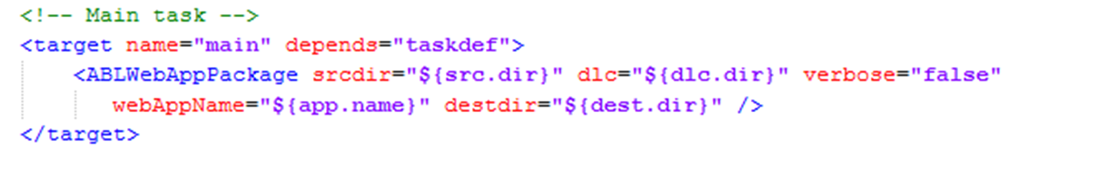
Packaging with <ABLWebAppPackage /> task
Source directory
of project
DLC
location
Generates WAR file
Name of the
Application
(optional)
Destination
directory
(optional)

Slide 19
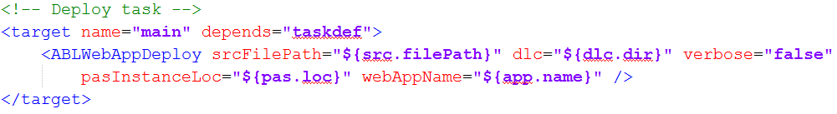
Deploying with <ABLWebAppDeploy /> task
WAR file
location
DLC
location
Deploys the WAR file
Name of the
Application
(optional)
PAS
location

Slide 20
Log viewer
PDSOE
PASOE Debugger
Ant tasks for CI/CD workflow
Log viewer
Other improvements
ABLUnit Debugger

Slide 21

Where are my log files?
Agent log
(oepas1-oepas1.agent.log)
Admin server log
(admserv.log)
Oemanager log
(oepas1-oemanager.log)
Tomcat log
(oepas1-catalina.log)
Session manager
(oepas1-oepas1.log)

Slide 22
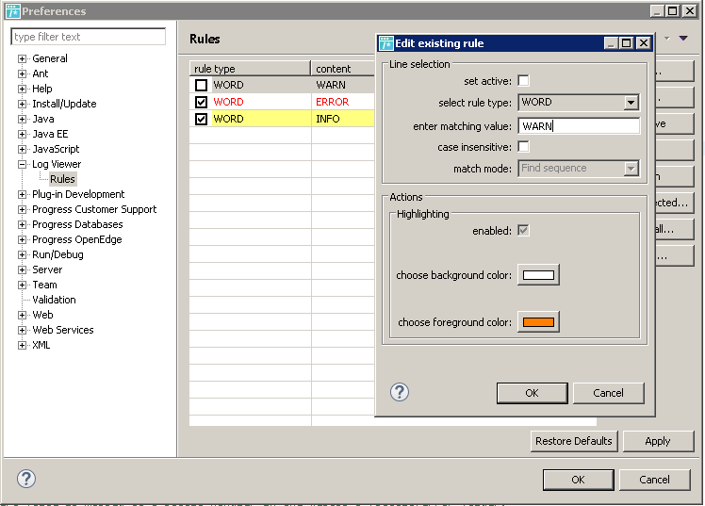
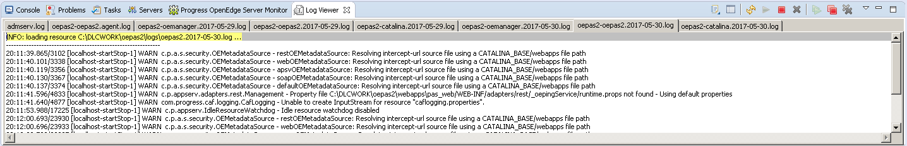
Log viewer (for PAS)
Log viewer is a centralized, configurable and tailing log view to view your log files
Centralized
Configurable
Color coding rules
Tailing

Slide 23
Lets see a short demo

Slide 24
Other improvements
PDSOE
PASOE Debugger
Ant tasks for CI/CD workflow
Log viewer
Other improvements
ABLUnit Debugger

Slide 25
Other improvements
Idea section in communities
Title
Stop inserting TABs in PDSOE when 'Insert spaces for tabs' option is active
Startup option -strict to reject abbreviated keywords / file / field references
Create REST without Progress developer studio
Make PDSOE scratchpad respect the Eclipse workspace's default text file encoding
ABL Scratchpad - editor preferences Make the PDSOE Scratchpad view use the same background colour as the Editor views
ABL Scratchpad - Tabbing
Debugger: allow it to stop on the statement that is throwing a run time error(19)
Add "ABL Enum" wizard to Developer Studio
Debugging ABLUnit
Notes:
https://community.progress.com/community_groups/products_enhancements/i

Slide 26
Agenda
What's new in PDS for OE 11.7
A cool new tool for ABL developers (ABL Dojo)
Peek into the future of (cloud) IDEs

Slide 27
ABL Dojo
Write
Run
and Share
from your Browser

Slide 28
What is ABL Dojo?

Slide 29
What is ABL Dojo?
ABL Dojo is an interactive website and a developer utility that lets you write, run, and share Progress OpenEdge Advanced Business Language (ABL) code from your web browser.

Slide 30
Demo

Slide 31
Why ABL Dojo?

Slide 32
Why ABL Dojo?
New Users
Reduces entry barrier for new user
Existing Users
Can be used as Scratch Pad editor
Sharing Code
Explore Snippets
Makes sharing code snippets easy
Explore existing code snippets

Slide 33
https://abldojo.services.progress.com

Slide 34
Agenda
What's new in PDS for OE 11.7
A cool new tool for ABL developers (ABL Dojo)
Peek into the future of (cloud) IDEs

Slide 35
Peek into the future of (cloud) IDEs

Slide 36




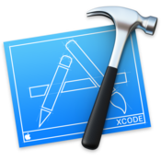







Brief history of IDEs
Emacs
Turbo C++
Vim
MS Visual Studio
1976
1990
1991
1997
Xcode
Notepad++
Eclipse
Jet Brains
2003
2003
2001
2000
Sublime
Atom
VS Code
Eclipse Che
2008
2014
2015
2016

Slide 37



Cloud IDEs
Eclipse Che
Cloud 9
SourceLair
Dirigible
Many more..

Slide 38
Problems with current IDEs
Continuous delivery demands rapid contributions and agility
Only accessible on localhost
Setting up environment more than once is a rework
Cannot separate environments for different projects
Workspaces are not shareable
Manual, error-prone and time consuming (day or even weeks)
Configuration is constant and pervasive, costing organizations time and money.
Workspace configuration
Accessibility
Not repeatable
Not shareable
Separation of environments/concerns
Not Agile enough
Error prone and time consuming

Slide 39
Eclipse Che
Zero config workspaces
Instant and consistent environments
Separation of environments
Easy workspace sharing
Workspaces Without Maintenance
Eclipse Che
One-Click developer onboarding
Instant Code Review & Run
Workspace snapshots

Slide 40
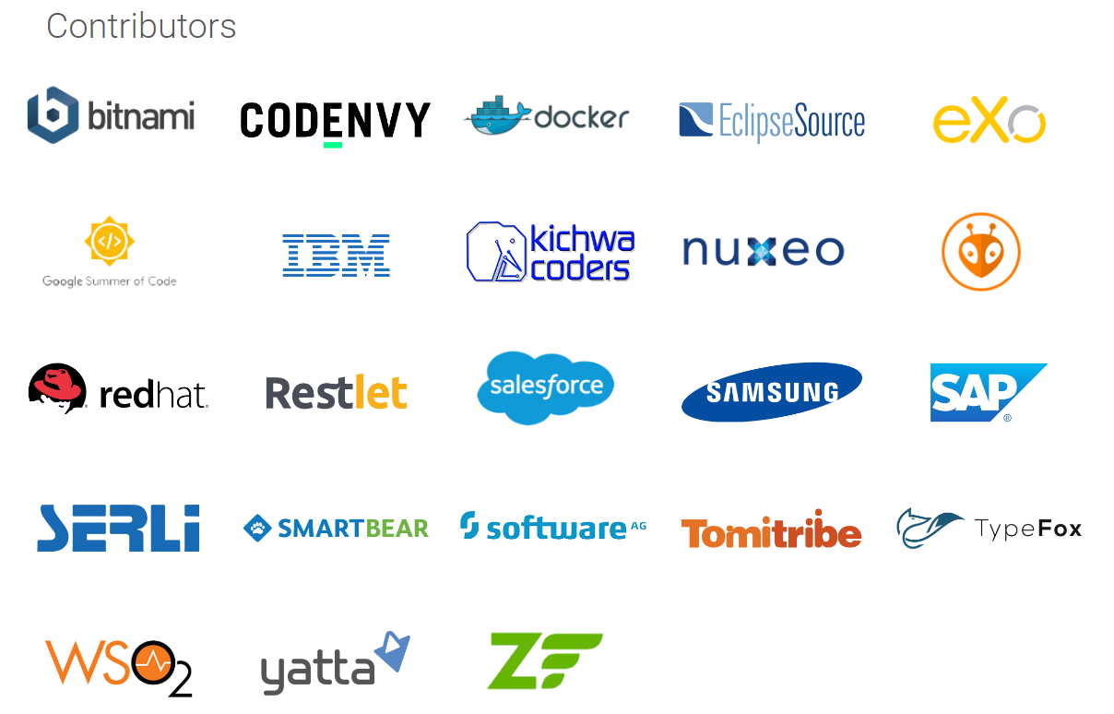






Current status
Initial release September 2016 (~8 months ago)
Current stable release April 2017
GitHub
Who’s using

Slide 41
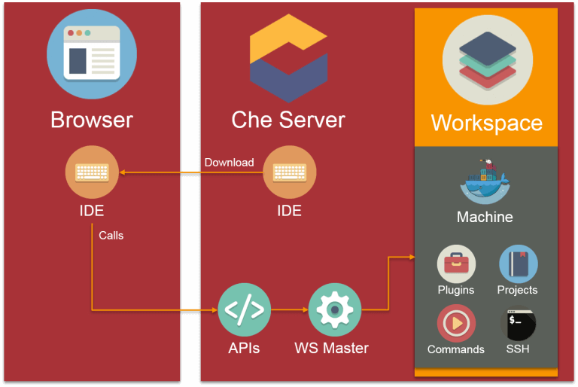
Eclipse Che Architecture

Slide 42
Demo

Slide 43
Conclusion
Web IDEs are still pretty new
Consolidating
Web IDE is something that we are actively looking at (for future)
More feedback about your environments and use cases will help us

Slide 44
Q&A

Slide 46
ABL Dojo FAQs

Slide 47
ABL Dojo FAQs
Where does my code run?
Is the environment safe?
Is the environment shared between users? Will other users see my CRUD operations?
When is the environment (docker container) deleted?
When does browser session expire?
How long are shared snippets available?
Why am I not able to create classes with packages?
General limitations:
  Interactive input statements (PROMPT-FOR, UPDATE) not supported
  Packages not supported
  No GUI (.NET winforms, Appbuilder etc)
Notes:
There were lot of questions on ABL Dojo in communities, so I have compiled this faq so that it will be easy for first time users. You can find the discussion on ABL Dojo in this communities thread:
https://community.progress.com/community_groups/openedge_development/f/19/t/33510
Where does my code run?
Each user session will get a dedicated docker container (linux) with OpenEdge runtime in it, all code you run will be executed inside this docker container and result will be returned to the browser.
Is the environment safe?
Yes, since each user session will get a dedicated docker container, if user tries to alter (or hack) the environment, it will be limited to the docker container assigned to his user session
Is the environment shared between users? Will other users see my CRUD operations?
Since each user gets a dedicated docker container, all changes will be local to his containers, so other users wont see any changes.
When is the environment (docker container) deleted?
The docker container will be deleted after the user session expires
When does user session expire?
User session expires after 10 minutes of inactivity
How long are shared snippets available?
Atleast for initial version the snippets will not be deleted and will be available as long as ABL Dojo is up and running
Why am I not able to create classes with packages?
For initial release packages are not supported, please create classes with default packages
General limitations:
Interactive input statements like PROMPT-FOR, UPDATE etc are not supported
Packages are not supported
GUI like winforms, appbuilder ui etc. are not supported

