Slide 1
277: Everyday OOP made easy
June 6, 2017
Chad R. Thomson
Senior Principal Consultant
Progress Software

Slide 2
Speaker BIO
Over 20 years of overall industry experience favoring reality over formality
Over 16 years in services focus with Progress Software (BravePoint)
Specializing in vendor-neutral, cross-platform application and service integration
Passionate technology advocate
Only those who have the patience to do simple things perfectly will acquire the skill to do difficult things easily

Slide 3
Agenda
What are we talking about here?
Why Bother with OOP?
Setting up for Success
Basic OOP Primer
Procedural vs OOP Comparison
Every day use walk-through
What to expect
Next Steps

Slide 4
Disclaimers
11.6.3 Examples
  Corelib and Netlib not available prior to 11.5.1 (Netlib introduced 11.5.1)
  Updates for the better in 11.7.X
No Metrics will be shown
  Metrics are gift-wrapped lies
Soft metrics regarding efficiency
  you will get a better sense earlier if your code will work
  you will run into less run-time errors
  You are more efficient
*Extremely* basic examples are ahead
  Please don't judge too harsh :(

Slide 5
What are we talking about?
OOP and the OpenEdge Corelib/Netlib Libraries

Slide 6
What and Where are the OpenEdge Corelib and Netlib Libraries?
Back story
  Requirement to implement PUSH notifications
  Needed an HTTP client library -- went a little overboard
Where are the libraries found?
  In OpenEdge installation folder
    src/OpenEdge.Core.pl
    src/netlib/OpenEdge.Net.pl
    Extract and add to project propath
  In OpenEdge tools src
    Available on communities web site (11.6.3)
      https://community.progress.com/community_groups/openedge_general/w/openedgegeneral/2877.ade-openedge-11-6-3-development-tools-source-code
Generated ABL Doc is available
  https://documentation.progress.com/output/oehttpclient/oe116/index.html

Slide 7
Why Bother with OOP?
OOP will enforce method and type checking during compilation
  Doesn't fix code/logic, but mitigates opportunity for failure
  Even the most experienced developers still run into run-time errors when procedure signatures don't match
Class and object caching are at-least as fast* as their equivalent procedural counter-parts
  Garbage collection limits the amount of clean-up concerns
  Please, pick-up after yourself, though
Inheritance and static classes become the scaffolding for application architecture
  reduces the amount of traditional "framework" management code
    run, persistent, make super, handle locate, repeat
* no metric, see disclaimer

Slide 8
… but OOP is difficult
It doesn't have to be
  It can be as simple or complicated as you want or need it to be
Don't get caught-up in the academics of it all
  Design Patterns
    Static Singleton Factory Provider Pattern
    Inversion of Control, Dependency Injection
    Polymorphism
    Wait, what?
Start with small, simple tasks
  Global functions
  Logging
  Messaging
Slowly mix-in OOP to your procedural code

Slide 9
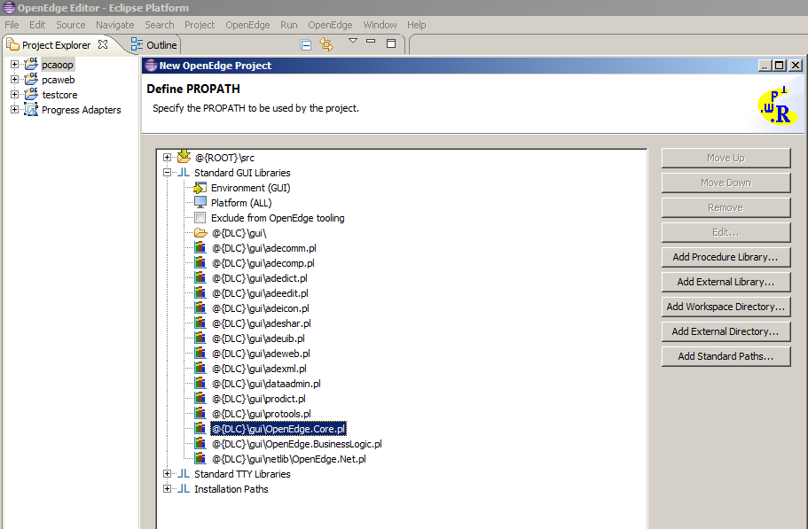
Setting up for success
Use PDSOE for projects
  Corelib and Netlib libraries are already included in PROPATH

Slide 10
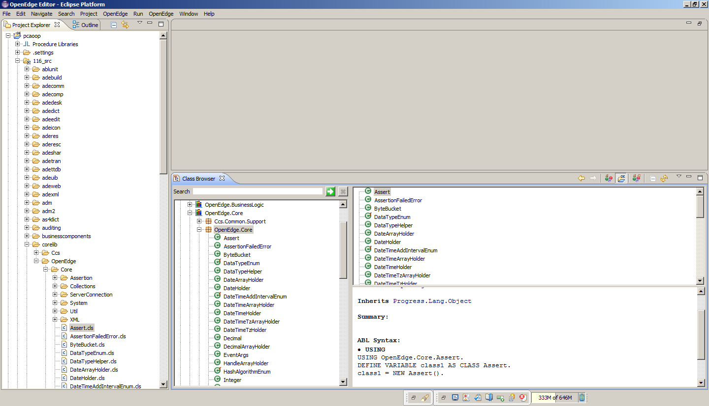
Setting up for success
Link in OE Dev Tools Source
Use the Class Browser

Slide 11
Basic OOP Primer

Slide 12
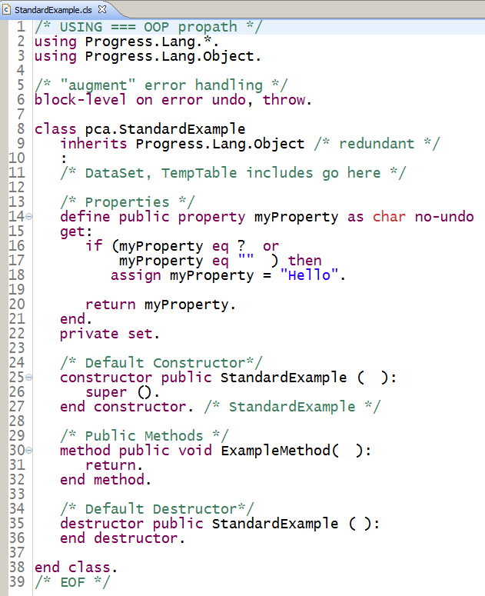
A Brief Anatomy of a Class
"using" === OOP Propath
  Replace "." with "/" to find Class
  r-code
  Exception "Progress.*"
Term "Package" or "Namespace"
  refers to a path
Inherits "Object" by default
Variables, Datasets, etc
  Called: Members
Properties
  Variables with built-in logic
Accessibility modes
  Public, Private, Protected
Constructor, Destructor are optional

Slide 13
Error Handling: Catching, Handling and Throwing
Very convenient to use THROW, CATCH, FINALLY
  Fewer lines of 'if .. then … else'-style error processing logic
  Change your mindset, let errors happen and handle them vs test for them
FINALLY
  Runs as the very last line of executable code prior to procedure exiting
  A good place for 'clean-up' logic
Use of these error handling methods is a requirement when using Assertions (later)

Slide 14
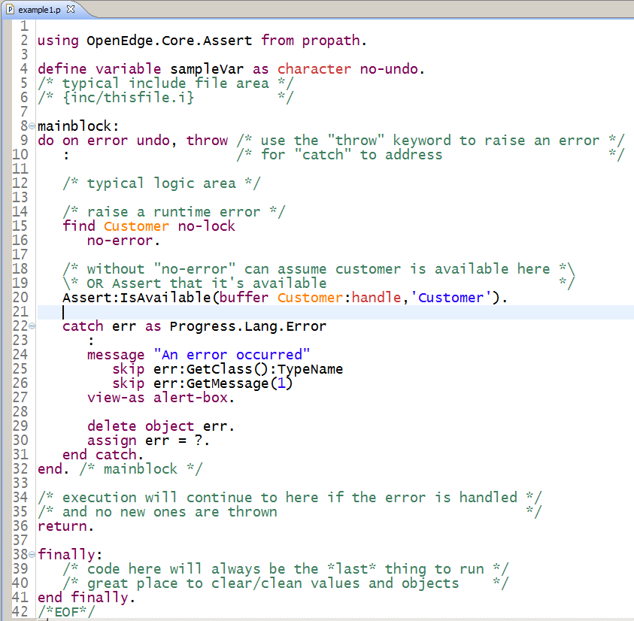
Procedure with Error Handling Mixed-in
Throw
  Added to blocks
  Creates error object
Catch
  Passed error object for handling
Finally
  LAST block to execute
    Even after 'return' statement
  Convenient place to clean-up objects, handles, etc
Notes:
Demonstrate mixed-use procedure
Visually highlight a procedural-style file with interlaced OOP aspects

Slide 15
Procedural vs OOP Comparison

Slide 16
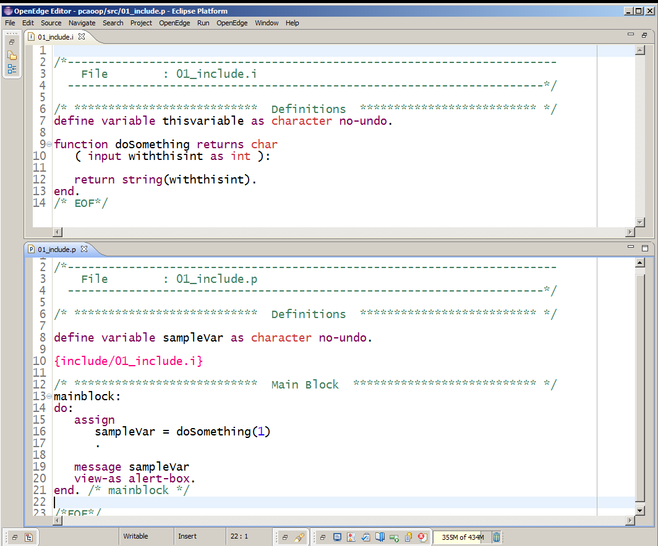
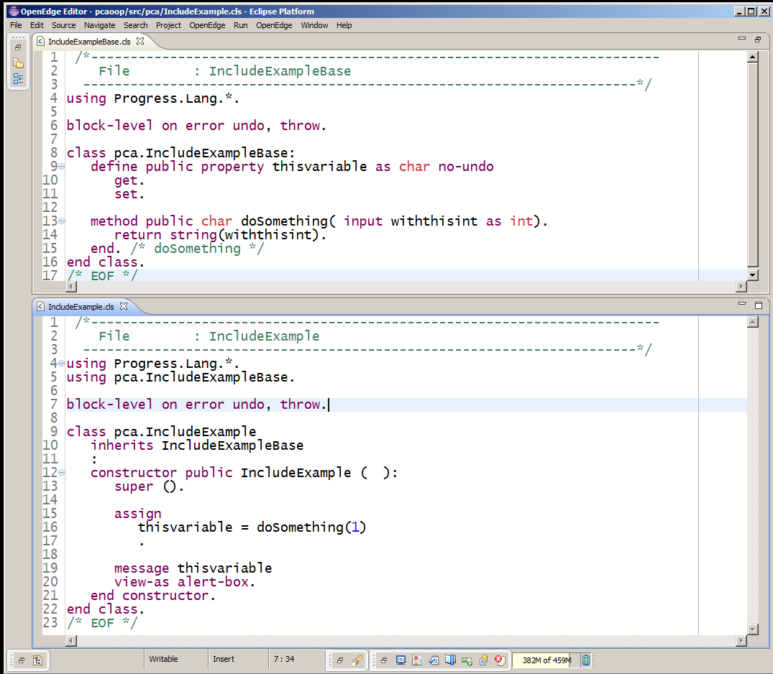
Procedural vs OOP Structural Comparison: Include vs Inherits
Procedural Include
OOP Inherits

Slide 17
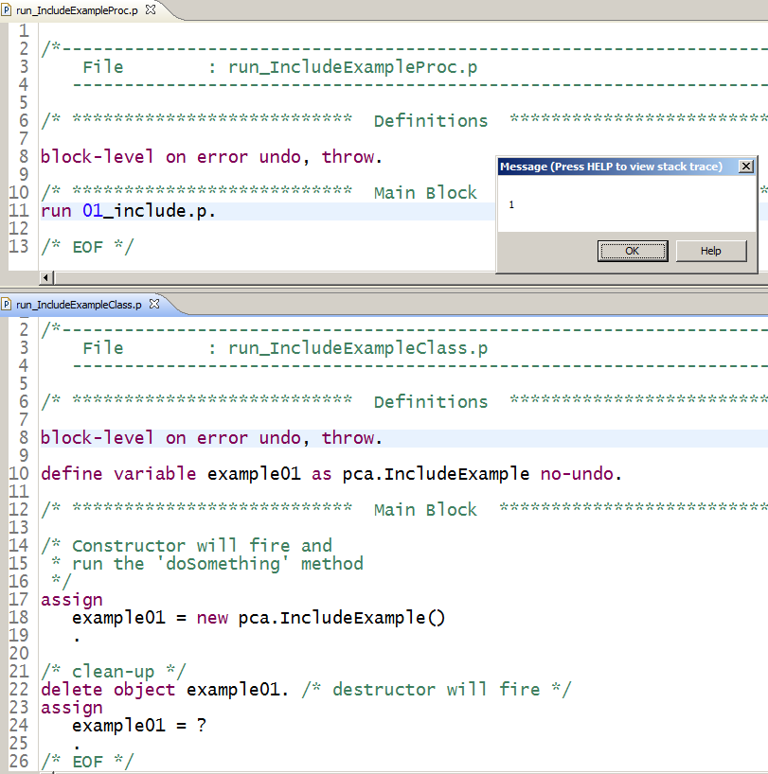
Procedural vs OOP Structural Comparison: Run it!
Procedural
  Use "run" statement
OOP create a NEW "instance"
  Be sure to delete your object
  Apples-to-apples example
    Better to call "logic" in a method
    eg: "<charvar> = example01:doSomething(1)"

Slide 18
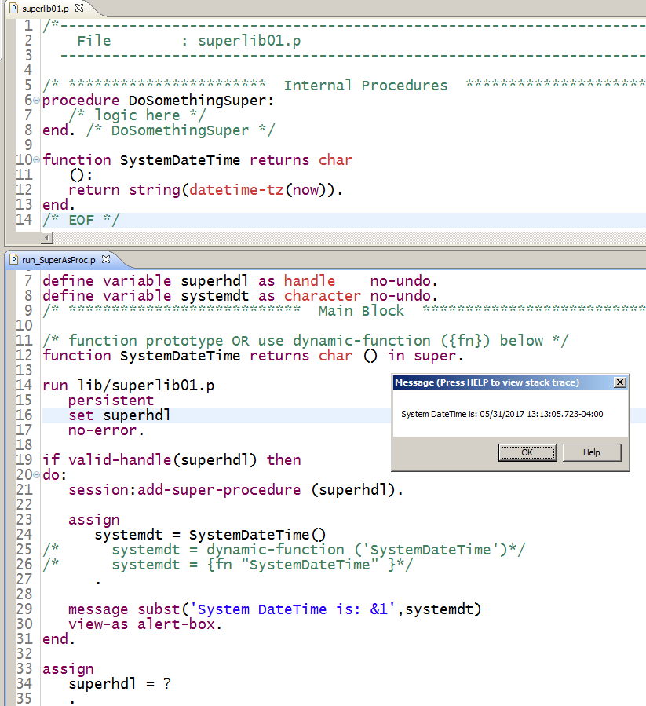
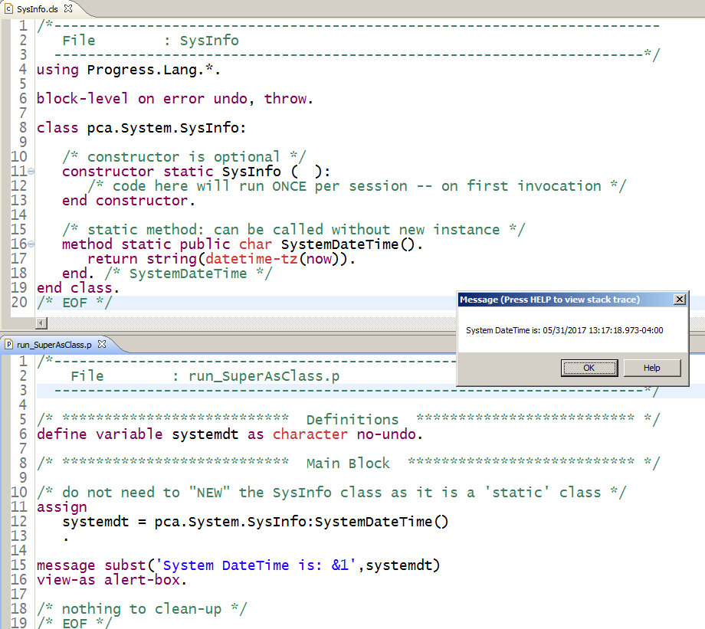
Procedural vs OOP Structural Comparison: Super vs Static
Procedural Super
OOP Static

Slide 19
Every day use walk-through

Slide 20
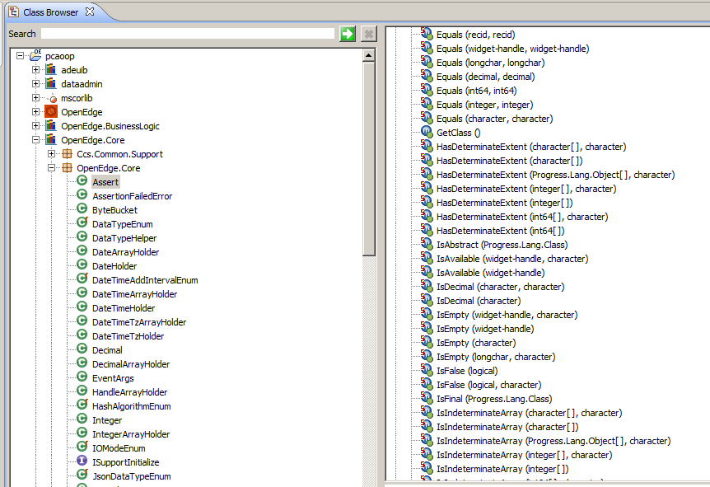
Start Using Corelib: OpenEdge.Core.Assert
Easily the most versatile class
Static methods
  Covers many every-day use-cases

Slide 21
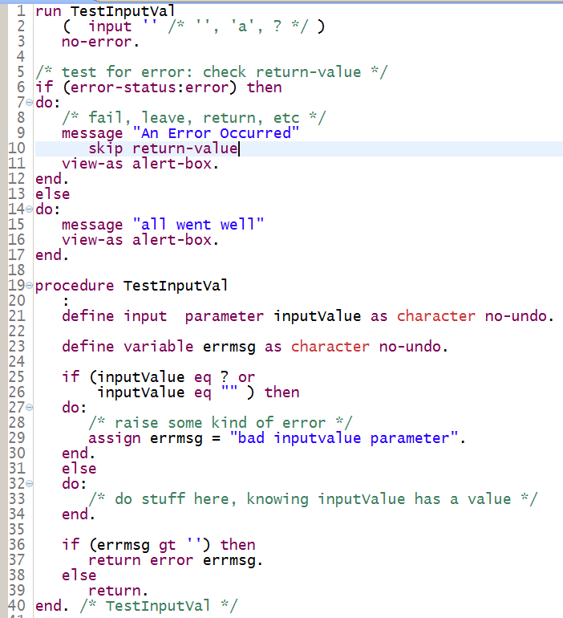
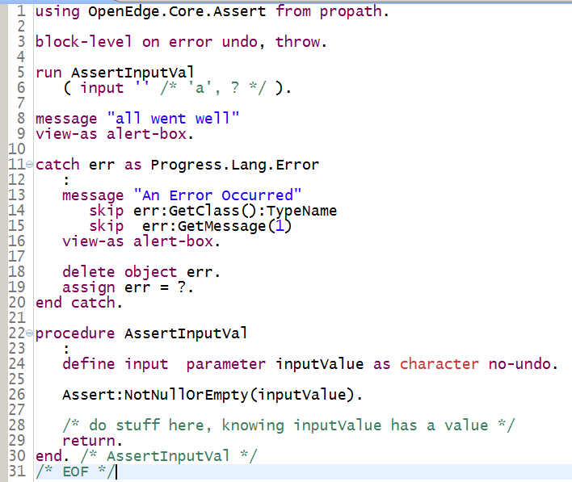
Start Using Corelib: OpenEdge.Core.Assert
Procedural Validation
OOP Assertions

Slide 22
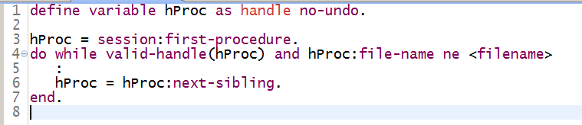
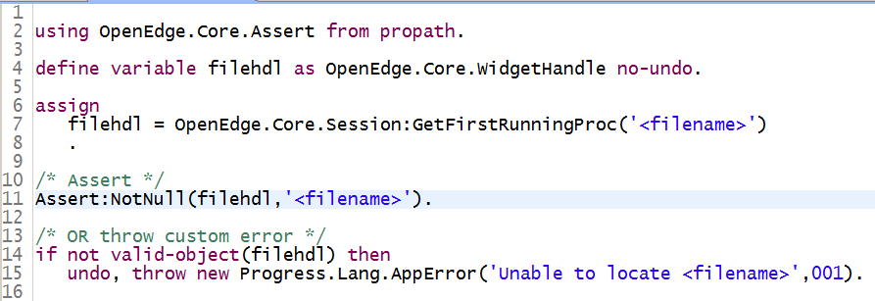
Start Using Corelib: OpenEdge.Core.Session
Procedural Session
OOP Session

Slide 23
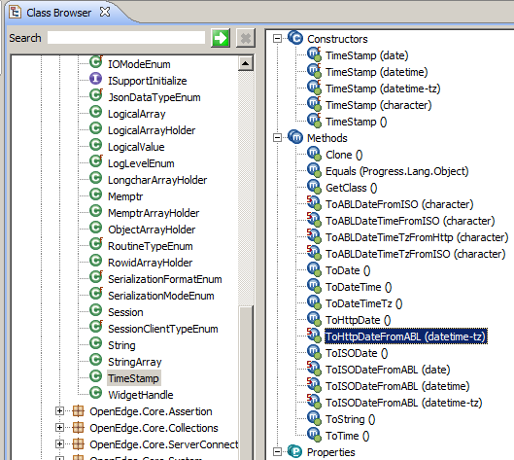
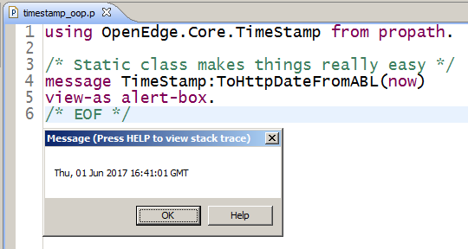
Start Using Corelib: OpenEdge.Core.TimeStamp

Slide 24
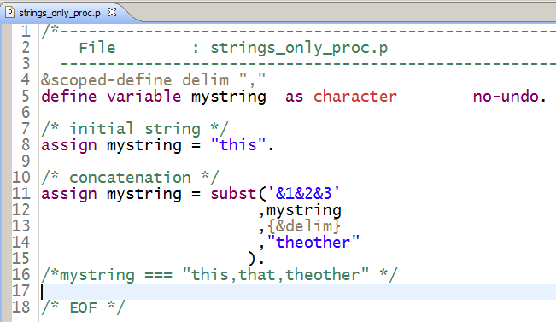
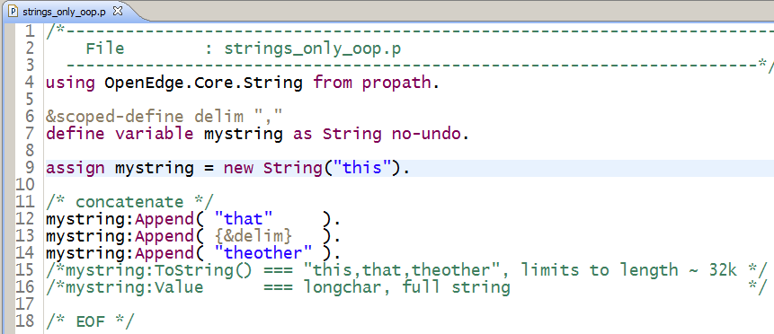
Start Using Corelib: OpenEdge.Core.String
Procedural Strings
OOP Strings

Slide 25
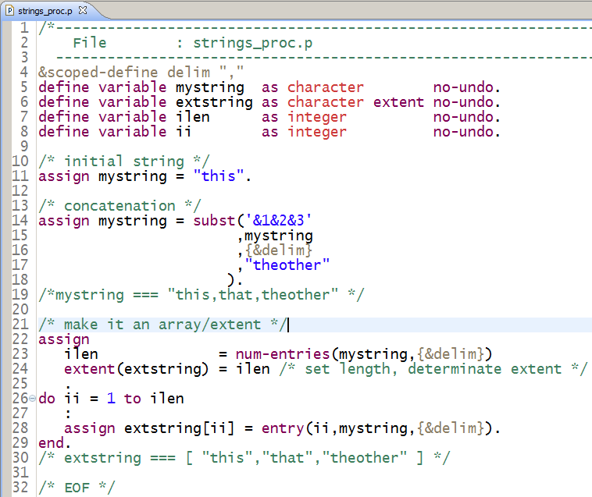
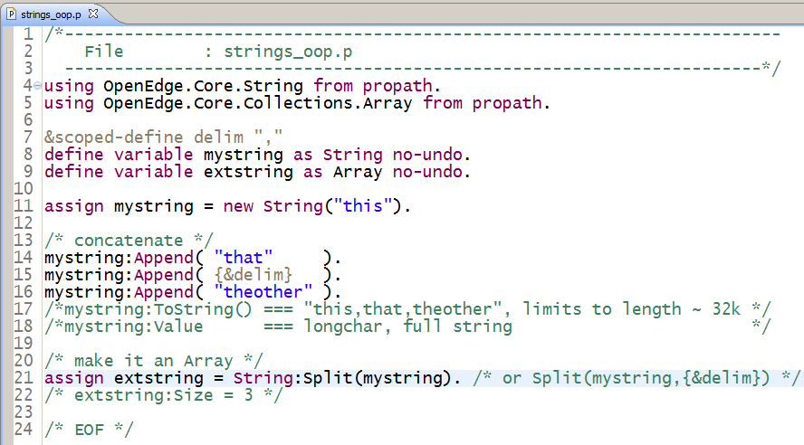
Start Using Corelib: OpenEdge.Core.Collections.Array
Procedural Array/Extent (variable len)
OOP Array

Slide 26
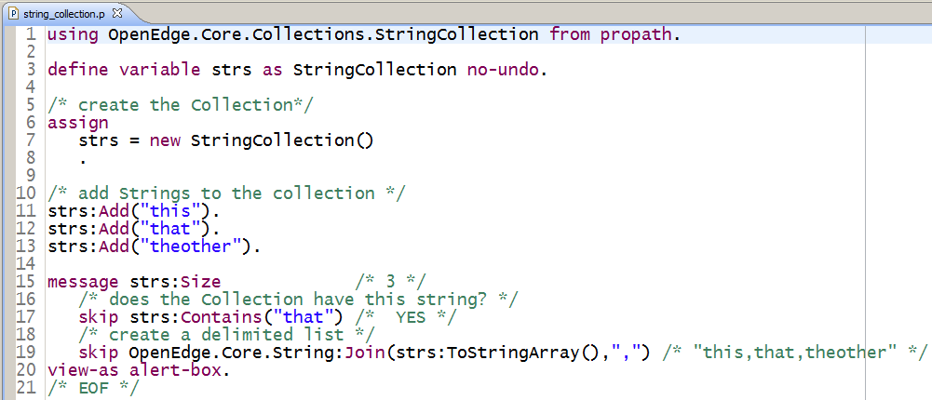
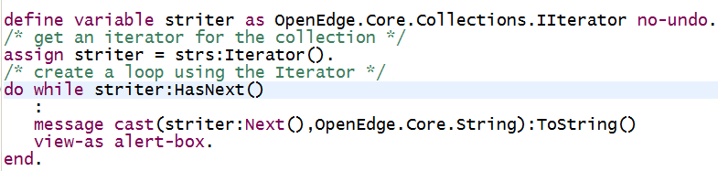
Start Using Corelib: OpenEdge.Core.Collections.StringCollection
A Better Way to build a list of Strings
Consider it a temp-table of typed-objects
Use Iterator to loop entries

Slide 27
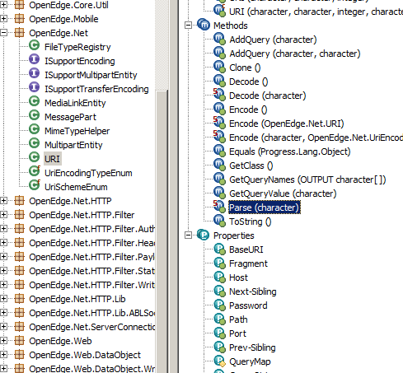
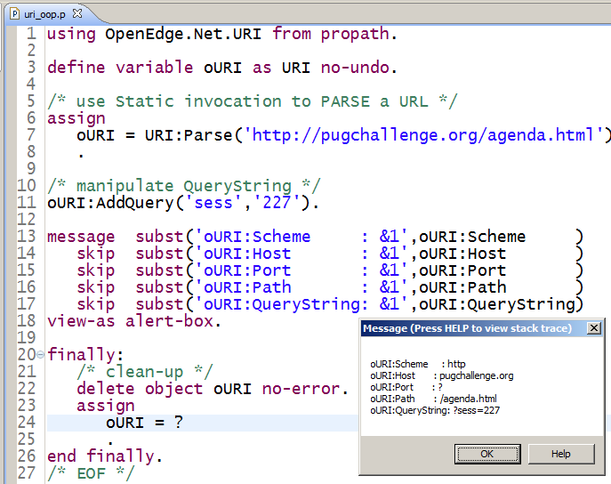
Start Using Netlib: OpenEdge.Net.URI
Traditional parsing of URIs can be hit-or-miss
URI has both Static and Instance methods

Slide 28
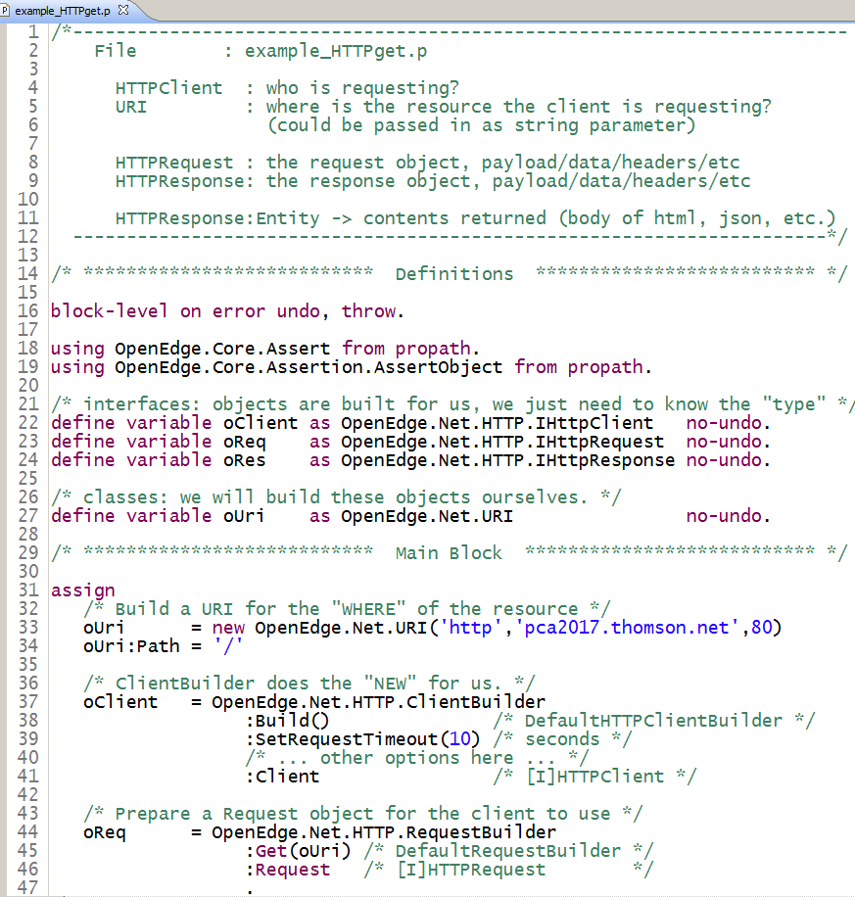
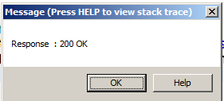
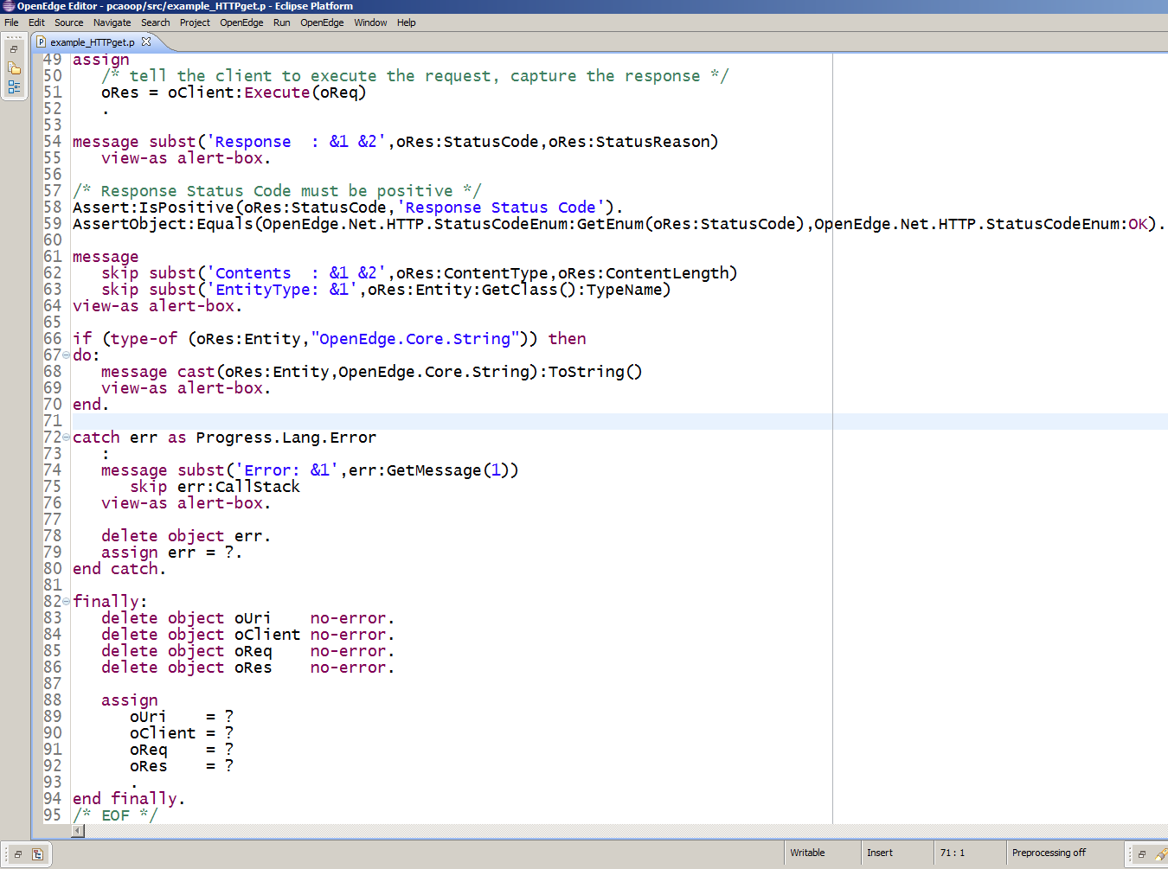
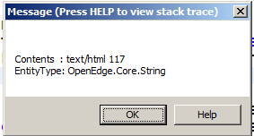
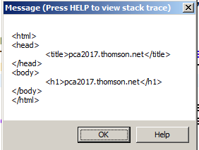
Start Using Netlib: OpenEdge.Net.HTTP.*

Slide 29
What to expect
Adopt PDSOE for your IDE
  The auto-complete and class-viewer are invaluable tools
  At minimum, use an IDE that performs color-coding and syntax checks
Move at a comfortable pace
  Too much, too soon can really turn you off OOP
  Start simple
Shared variables will need to be handled carefully
  (2014) 930: How I Stopped Using Shared Variables and Learned to Love OO, Tom Bascom, White Star Software
Reference libraries will change between versions
  Acquire the source and actually look at it
  Compare the source between versions
    Compilations will let you know if things are *broken*, you will want to confirm the behavior hasn't changed beyond your expectations

Slide 30
Next Steps
Create your own custom override classes
  Explore use of overloads to simplify call signature
Interfaces, Abstract classes
JSON
  Progress.JSON.*
Enumerators
  Progress.Lang.Enum
  OpenEdge.Core.*Enum

Slide 31
Next Steps
DataAdminlib
  OpenEdge.DataAdmin.*
  Managing database objects (tables, fields, policies, etc.)
ServerAdminlib
  OpenEdge.ApplicationServer.*
  OpenEdge.ServerAdmin.pl
  PASOE AppServer Agent information and management
Next-level OOP design patterns
  CCS Samples: https://github.com/consultingwerk/CCS_Samples
  IOC, Dependency Injection: https://github.com/PeterJudge-PSC/InjectABL
  AutoEdge, The Factory: https://github.com/PeterJudge-PSC/autoedgethefactory

Slide 32
Questions?

Slide 33
Reference
544: An OO Code Generator, Tim Kuehn
(2016) 806: OO-Oh
  Mike Fechner, Consultingwerk Ltd.
(2014) 930: How I Stopped Using Shared Variables and Learned to Love OO
  Tom Bascom, White Star Software
OE 11.6 Corelib and Netlib Documentation
  https://documentation.progress.com/output/oehttpclient/oe116/index.html
OE Dev Tools Source (11.6.3)
  https://community.progress.com/community_groups/openedge_general/w/openedgegeneral/2877.ade-openedge-11-6-3-development-tools-source-code
PUG Challenge Americas, 2016
  http://pugchallenge.org/downloads2016.html

