Slide 1
242: Get Your Head in the Cloud!
Roy Ellis
ellis@progress.com

Slide 2
Agenda
What is the experiment?
ATM
Test Driver
Progress Application Server (PAS) for OpenEdge
AWS
Process

Slide 3
What is the experiment?

Slide 4
What is the experiment?
Create a web application
Convert it to use PAS for OpenEdge
Use AWS to auto-scale the environment to handle 10,000 users

Slide 5
ATM

Slide 6

ATM
A database performance test
  Based on the transactions of an Automated Teller Machine (ATM)
  Available for OpenEdge for more than 15 years
  Written by Gus Bjorklund to test database transactions
History
  Originally used from client directly to database
  Later modified to run through the OpenEdge “Classic” AppServer
  Modified again for this test to run as a web application

Slide 7
ATM - continued
3 considerations to modify a Classic AppServer based application to a web app
Re-write completely to a REST application with a Business Entity
Re-write completely to the new WebHandler application
Re-use existing code but use the DataObjectHandler for Progress WebSpeed in PAS for OpenEdge (PASOE)

Slide 8

ATM - continued
DataObjectHandler for WebSpeed in PASOE
A class already written for WebSpeed for PASOE
Using a “map” file converts a REST string to parameters used by 4GL code
Set hander1=OpenEdge.Web.DataObject.DataObjectHandler: /rest/uri/
Write a procedure to handle rest call and turn into input parameters
Call the existing ATM Classic AppServer code

Slide 9
ATM - continued
PASOE openedge.properties
  handler1=OpenEdge.Web.DataObject.DataObjectHandler: /atm/{theAccount}/{theTeller}/{theBranch}/{delta}
  handler2=OpenEdge.Web.DataObject.DataObjectHandler: /atm/
This tells the WEB transport to:
  Read the URI
  And call the DataObjectHandler class
  Which calls the “map” file
  And eventually calls the application code

Slide 10
ATM - continued
The “map” file
{ "services": {
"atm": {
"version": "1.0.0",
"operations": {
"/": {
"GET": {
"contentType": "application/json",
"statusCode": 200,
"file": "$CATALINA_BASE/webapps/$oepas-webapp/static/atm.json"
}
},

Slide 11
ATM - continued
The “map” file
"{theAccount}/{theTeller}/{theBranch}/{delta}": {
"GET": {
"contentType": "application/json",
"entity": { "name": "AtmCaller",
"type": "CLS",
"function": "UpdateAccount",
"arg": [ { "ablName": "theAccount",
"ablType": "INTEGER",
"ioMode": "INPUT",
"msgElem": {
"type": "NONE",
"name": theAccount

Slide 12
ATM - continued
AtmCaller.cls
class AtmCaller:
method public decimal UpdateAccount( input txid as integer,
input theBranch as integer,
input theTeller as integer,
input theAccount as integer,
input delta as decimal):
define variable theBalance as decimal no-undo.
run srvrAtmSmall.p (txId, theBranch, theTeller, theAccount, delta, output theBalance).
RETURN theBalance.
end method.
end class.

Slide 13
ATM - continued
srvrAtmSmall.p
  No change from Classic AppServer code
  Adds the “delta” to the account
  Adds the “delta” to the branch
  Adds the “delta” to the teller
  Creates a history of the transaction
    The history is used to capture performance in the database
    We did not use the history for this test, but created the records anyway

Slide 14
Test Driver

Slide 15
Test Driver
JMeter
  Apache Web Application Load Testing and Analyzing Tool
  Version 3.2 r1790748
Configuration
  Launch multiple drivers with AWS plugin
  Random numbers generated for all variables
  “Think Time” added
    Random variable of 1 to 3 seconds of wait between requests

Slide 16
Progress Application Server for OpenEdge (aka PASOE)

Slide 17
PASOE
Progress Application Server for OpenEdge
  New AppServer for OpenEdge
  Designed for web applications
  First released in 11.5
  WebSpeed added in 11.6

Slide 18
PASOE
Based on Tomcat instances
  Include Tomcat web server
  Security built-in with Spring Security
  All transports available by default (SOAP, REST/Mobile, APSV, WEB)
  Multi-session agent
    Handles many sessions in a single process
    Better CPU and Memory utilization
  Easy migration from Classic to PASOE
  WebSpeed WebHandler in 11.6
  Specifically built for web applications

Slide 19
Architecture: Sample
Classic AppServer Components
PAS for OpenEdge Components
Client
AIA WSA
WebSpeed
REST/Mobile
Client
AdminServer
NameServer
PAS for OpenEdge
APSV (AIA)
SOAP (WSA)
REST/Mobile
WebSpeed
State-Aware
Stateless
State-Free
Rest/Mobile
AppServer
AppServer
AppServer
Session Manager
50 Agents
50 Agents
50 Agents
MSAgent
Agent
(1 ABL Session)
Agent
(1 ABL Session)
Agent
(1 ABL Session)
Agent
(1 ABL Session)
Agent
(1 ABL Session)
Agent
(1 ABL Session)
Agent
(1 ABL Session)
Agent
(1 ABL Session)
Agent
(1 ABL Session)
150 ABL Sessions
1 ABL Session
1 ABL Session
1 ABL Session
1 ABL Session
Notes:
CLASSIC
Must have an AdminServer
- AdminServer starts NameServer and AppServer
- then the AdminServer is just used to monitor and manage
Client connects to NameServer (optional) and is then redirected to the AppServer
If the Client needs to connect through the internet (HTTP/HTTPS)
- you must install and configure separate and distinct adapters AIA/WSA/REST/Mobile
PAS for OE
Start the PAS for OE instance
Client connects using HTTP/HTTPS always
+ AdminServer is not necessary (except for running OEMgmt on the same machine or publishing)
+ There is NO NameServer (load balancing and fault tolerance are handled another way)

Slide 20
AWS

Slide 21

AWS
Amazon Web Services (AWS) is a secure cloud services platform, offering compute power, database storage, content delivery and other functionality to help businesses scale and grow.

Slide 22
AWS - components
EC2
  Elastic Compute Cloud
Instances
  A running virtual server
AMIs
  Amazon Machine Image, an image of a machine for deployment
ELB
  Elastic Load Balancer
Auto Scaling Groups
  Configuration to automatically launch and trim instances based on a metric

Slide 23
AWS - Instances
Compute Optimized - Current Generation
c4.large | 2 | 8 | 3.75 | EBS Only | $0.1 per Hour
c4.xlarge | 4 | 16 | 7.5 | EBS Only | $0.199 per Hour
c4.2xlarge | 8 | 31 | 15 | EBS Only | $0.398 per Hour
c4.4xlarge | 16 | 62 | 30 | EBS Only | $0.796 per Hour
c4.8xlarge | 36 | 132 | 60 | EBS Only | $1.591 per Hour
c3.large | 2 | 7 | 3.75 | 2 x 16 SSD | $0.105 per Hour
c3.xlarge | 4 | 14 | 7.5 | 2 x 40 SSD | $0.21 per Hour
c3.2xlarge | 8 | 28 | 15 | 2 x 80 SSD | $0.42 per Hour
c3.4xlarge | 16 | 55 | 30 | 2 x 160 SSD | $0.84 per Hour
c3.8xlarge | 32 | 108 | 60 | 2 x 320 SSD | $1.68 per Hour
Different sizes of:
CPU
Memory
Disk
Network performance
Price

Slide 24
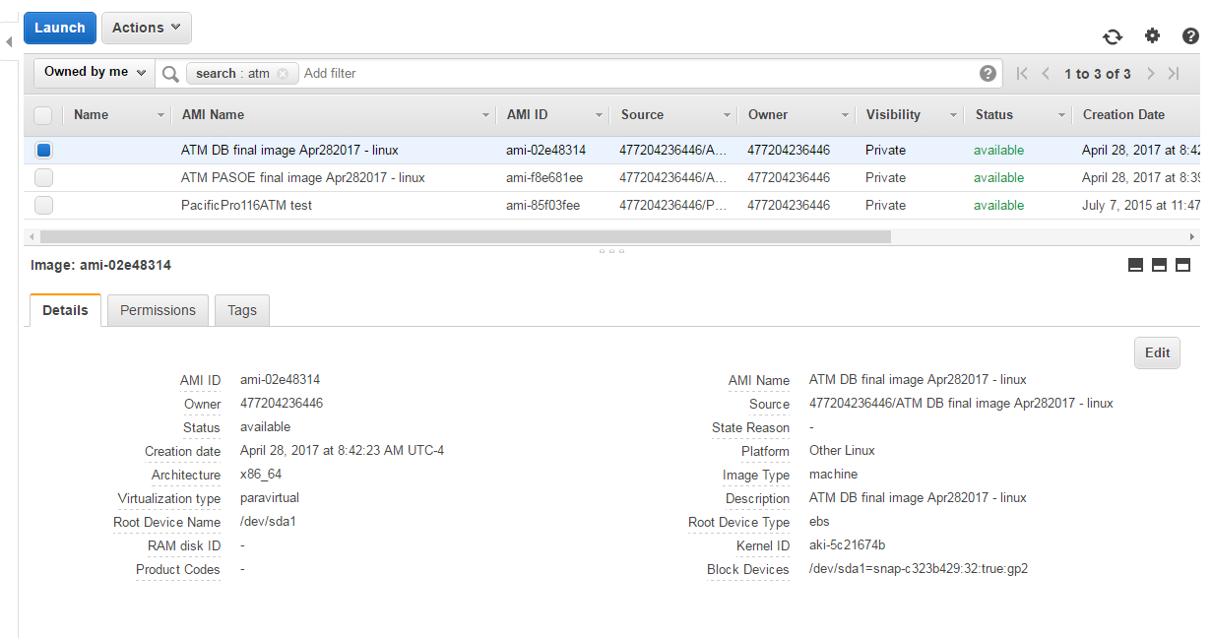
AWS - AMIs

Slide 25
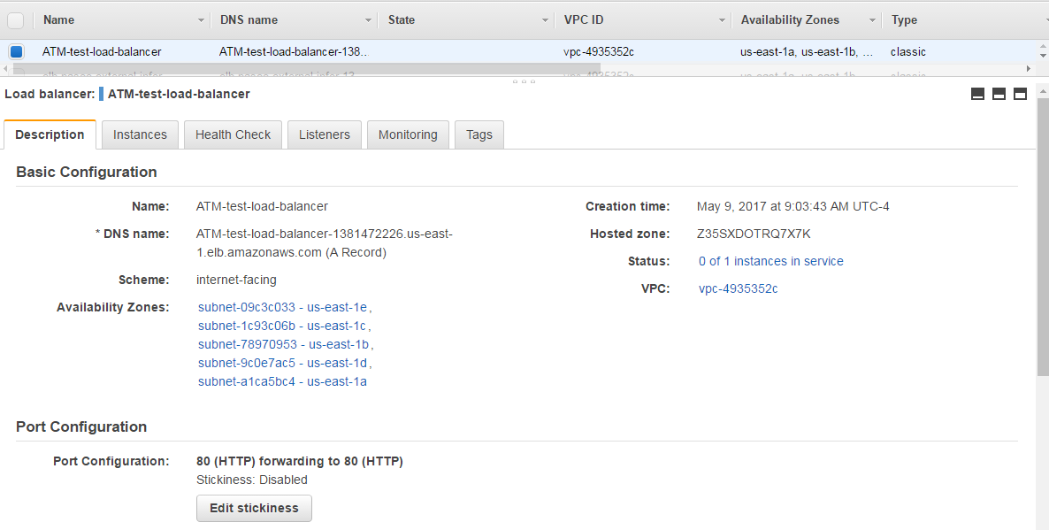
AWS - ELB

Slide 26
AWS – Auto Scaling Group
Group
  Instances organized into a group
Launch configurations
  Definition of the instances to be launched
Scaling plans
  When and how to scale instance (both up and down)

Slide 27
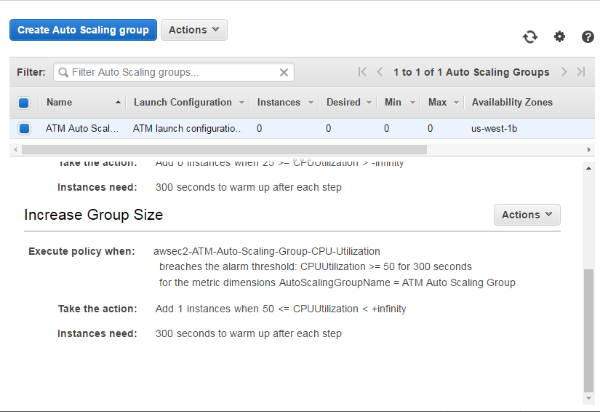
AWS – Auto Scaling Group

Slide 28
Process

Slide 29
Process
Convert the ATM to a web application
Set up a database instance and make an AMI
Set up a PASOE instance and make an AMI
Start sizing the instance for the test

Slide 30
Process
Sizing – How To
  Run the test check these metrics
    Round Trip Time - JMeter
    CPU - Top
    Memory -Top
    Load - Top
    Transactions – jmxquery (available soon)

Slide 31
Process
Considerations for ATM instance size
  Micro instances
    Small (CPU and memory)
    low network bandwidth
  C3 – instances designed for high compute cycle needs
    ATM uses very little memory
    CPU the biggest concern
Sizing vs Cost
  C3.large – 40 concurrent clients - $0.105/hour
  C3.xlarge - 125 concurrent clients - $0.21/hour

Slide 32
Process
Problems
  Database
    Starting default server ports (set min/max ports)
    Max users (-n)
  ATM
    Max connections per agent
  JMeter
    Think time
    Random (not so random)
  AWS
    ELB – default HealthCheck timeouts
    Launch Configuration – can’t change AMI, have to create a copy and make changes

Slide 33
Process
Auto Scaling Groups
PASOE
E
L
B
Launch
Configuration
DB
PASOE
PASOE
PASOE
PASOE
PASOE

