Slide 1
Application Auditing Made Easy
Simon L. Prinsloo
simon@vidisolve.com

Slide 2
Introduction
Simon Prinsloo
Vidisolve in Pretoria
Working with Progress since v.7 in 1996
Worked on various commercial systems
Mostly focused on CASE tools and implementing new functionality in legacy projects

Slide 3
Agenda
Why Auditing?
About this case study
Preparation for auditing
Deployment of auditing
Audit context
AUDIT-CONTROL System Handle
Reporting
Examples

Slide 4
Why Auditing?
Business requirements
Legal requirements

Slide 5
About this case study
Replace traditional auditing
Replace traditional record history tracking
Enhance visibility with context

Slide 6
Preparation for auditing
Implement user authentication
        Preferably using CLIENT-PRINCIPAL
Add audit areas to database(s)
Enable auditing with proutil
        Offline ☹
Set up audit security
Setup audit policies
Add audit context and events (Optional)
Create audit reports

Slide 7
Deployment of auditing
Add audit areas to database(s)
Enable auditing with proutil
        Offline ☹
Set database identification
Set up audit security
Import audit policies
Periodically archive audit data

Slide 8
Audit Context
Client Login Session (Client Principal)
Application Context (Developer)
Application Context (Developer)
Audit Event Group (Developer)
Audit Event Group (Developer)
Database Transaction
Database Transaction
Database Transaction

Slide 9
Audit Context
Client Login Session (Client Principal)
Audit Event Group (Developer)
Audit Event Group (Developer)
Application Context (Developer)
Application Context (Developer)
Database Transaction
Database Transaction
Database Transaction

Slide 10
AUDIT-CONTROL system handle
Methods
Properties
SET-APPL-CONTEXT( )
CLEAR-APPL-CONTEXT( )
BEGIN-EVENT-GROUP( )
END-EVENT-GROUP( )
LOG-AUDIT-EVENT( )
APPL-CONTEXT-ID
EVENT-GROUP-ID

Slide 11
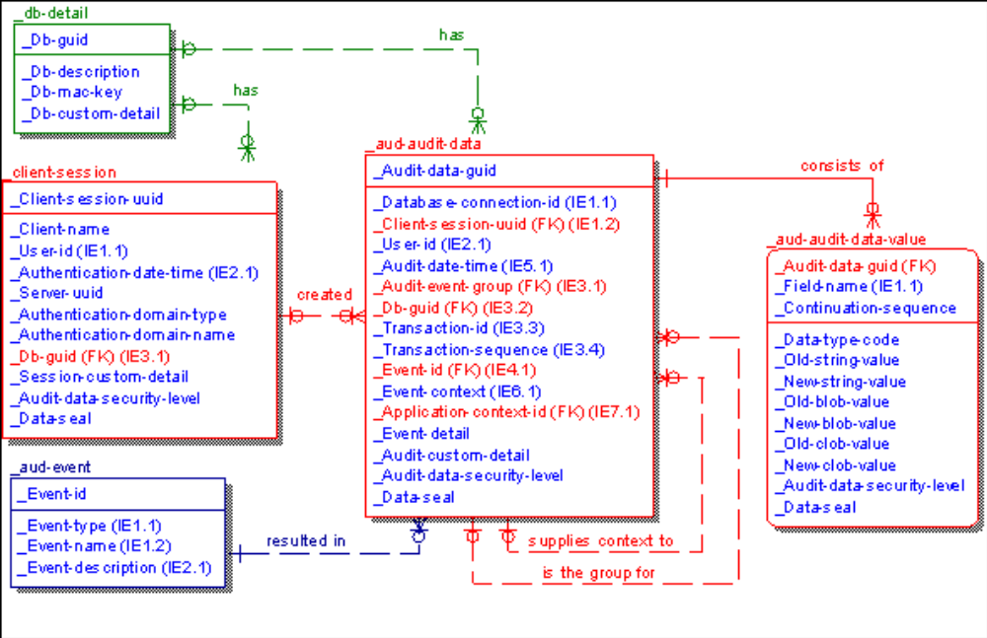
Reporting

Slide 12
Examples
Add audit areas to database(s)
# Audit.st
d "AuditData":90,64;512 .
d "AuditIndex":91,64;512 .
proenv>prostrct add Koine ..\audit.st
OpenEdge Release 11.7 as of Mon Mar 27 10:21:54 EDT 2017
Formatting extents:
size area name path name
512 AuditData C:\Projects\Koine\Databases\Koine\Koine_90.d1 00:00:00
512 AuditIndex C:\Projects\Koine\Databases\Koine\Koine_91.d1 00:00:00
proenv>

Slide 13
Examples
Enable auditing with proutil
proenv>proutil Koine -C enableauditing area "AuditData" indexarea "AuditIndex"
OpenEdge Release 11.7 as of Mon Mar 27 10:21:54 EDT 2017
Auditing has been enabled for database Koine. (12479)
proenv>

Slide 14
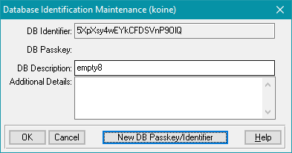
Examples
Setup database identification

Slide 15
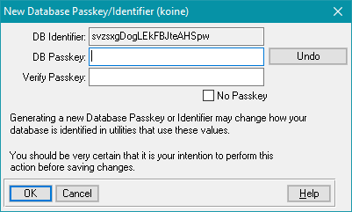
Examples
Setup database identification

Slide 16
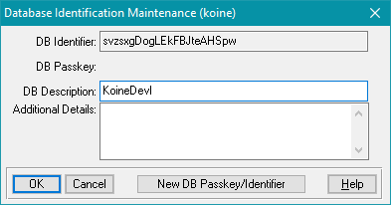
Examples
Setup database identification

Slide 17
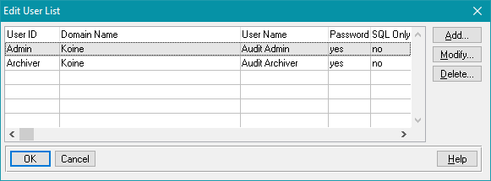
Examples
Setup audit security

Slide 18
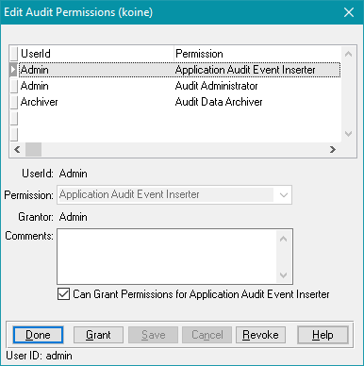
Examples
Setup audit security

Slide 19
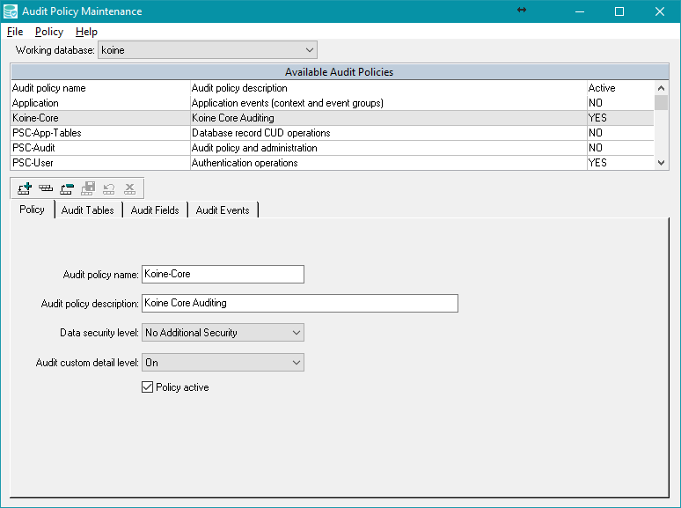
Examples
Setup audit policies

Slide 20
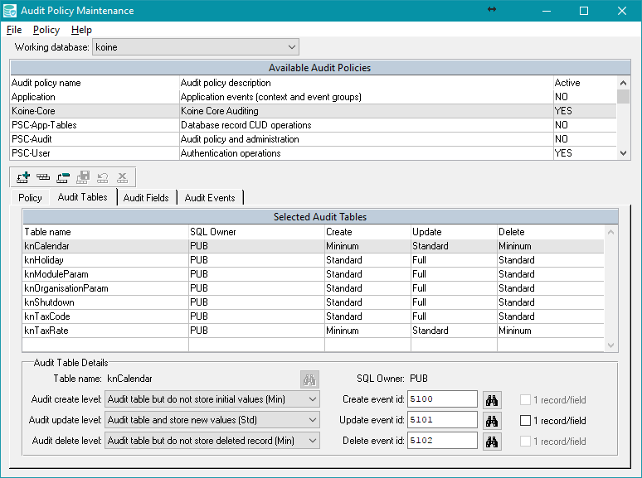
Examples
Setup audit policies

Slide 21
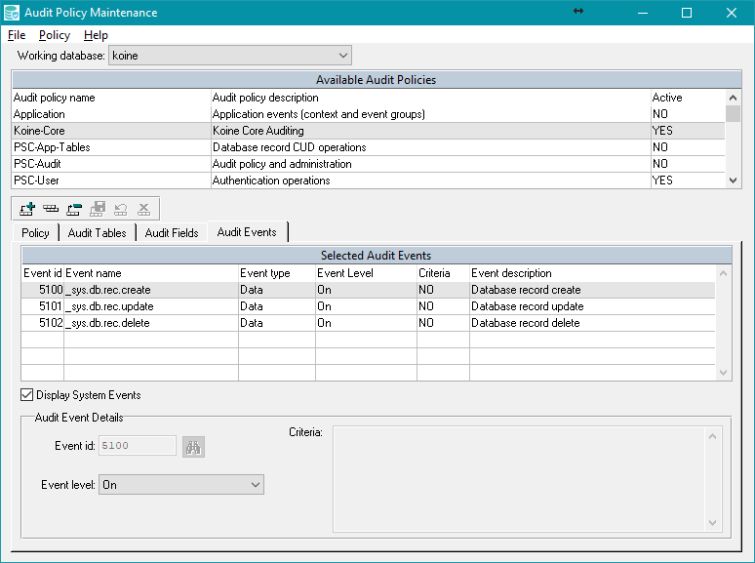
Examples
Setup audit policies

Slide 22
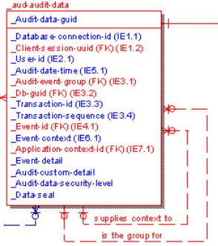
Reporting on audit data

Slide 23
Separators used in the data
DEFINE PUBLIC STATIC PROPERTY Field AS CHARACTER NO-UNDO INIT "~006" GET.
DEFINE PUBLIC STATIC PROPERTY Record AS CHARACTER NO-UNDO INIT "~007" GET.
DEFINE PUBLIC STATIC PROPERTY Array AS CHARACTER NO-UNDO INIT "~010" GET.
Remember the code works in octal, watch out for CHR(8)!

Slide 24
Some code

Slide 25
Questions?

Slide 26
Feedback welcome
Simon Prinsloo
simon@vidisolve.com

