Slide 1
Dude, Where’s My Log File?
Making the Most of Progress OpenEdge Log Files
Michael Banks
Principal Software Engineer, OpenEdge
Progress Software

Slide 2
Why Log Files?
  Troubleshooting
  Security
  History

Slide 3
Introduction
Many components
Diverse technologies
Some common
  OpenEdge AppServer, WebSpeed, Progress Application Server for OpenEdge
  Servlet container hosted components (adapters mainly)
  ubroker.properties and openedge.properties configuration

Slide 4
Goals for This Session
Where should I look?
What is in the log file?
How can I control type and amount of messages?

Slide 5
Progress OpenEdge Database
Database Log
<dbdir>/<dbname>.lg
Location cannot be changed
Startup parameter settings
Date/time startup and shutdown
User login/logout
System error messages
Utility and maintenance activity
SQL server startup/shutdown

Slide 6
Progress OpenEdge Database – Log Format
[2017/04/16@15:25:45.022-0400] P-13259 T-47842003425760 I DBUTIL : (451) prostrct create session begin for mbanks on batch.
[2017/04/16@15:25:45.508-0400] P-13267 T-46980969695680 I BROKER 0: (333) Multi-user session begin.
[2017/04/16@15:25:45.509-0400] P-13267 T-46980969695680 I BROKER 0: (15321) Before Image Log Initialization at block 0 offset 0.
[2017/04/16@15:25:45.622-0400] P-13267 T-46980969695680 I BROKER 0: (452) Login by mbanks on batch.
[2017/04/16@15:25:46.640-0400] P-13267 T-46980969695680 I BROKER 0: (4234) Progress OpenEdge Release 11.5ALPHA build 1061 on Linux devlinux15 2.6.18-164.el5 #1 SMP Sun Apr 16 15:51:48 EDT 2017 x86_64.
[2017/04/16@15:25:46.642-0400] P-13267 T-46980969695680 I BROKER 0: (15824) Multi-tenancy enabled: 1
[2017/04/16@15:26:02.886-0400] P-14974 T-373326608 I PASOEADM5: (452) Login by mbanks on batch.
[2017/04/16@15:26:08.393-0400] P-15051 T-47803371640656 I ABL 6: (15914) Usr 6 set tenant-id to 0, tenant-name to Default
[2017/04/16@15:25:45.022-0400]
P-13259 T-47842003425760
I BROKER 0
(452) Login by mbanks on batch.
Notes:
[yy/mm/dd@hh:mm:ss.uuushhmm] P-nnnnnn T-nnnnnn S name nnn: (nnnnn) Message
Date, Time zone relative to gmt
Process id, Thread id
Severity level, Username, user number
Message number, Message

Slide 7
Progress OpenEdge Database
Trim the database log
  prolog database-name [ -online ]
  Removes all but the most recent entries
  Online parameter allows truncating online database
  Back it up first if you want to save it!
Database Diagnostics
  Rich Banville session later today
Notes:
Database log doesn’t automatically roll over

Slide 8
Progress OpenEdge Database – Troubleshooting
Look for words like:
abnormal
warn
system error
error
fatal
unexpected
invalid
unknown
violation
cannot
Notes:
Obvious ones to look for, error, warrn
Less obvious, unexpected, unknown, cannot

Slide 9
SQL Logging
Connection Log
<dbdir>/SQL_connection_<serverid>_<threadid>_<date><time>.lg
SQL Server Log
<dbdir>/SQL_server_<serverid>_<date><time>.lg
Turn on with special SQL statements
SET PRO_CONNECT LOG [ ON | OFF ] [ WITH ( { STATEMENT, QUERY_PLAN } ) ];
SET PRO_SERVER LOG [ ON | OFF ] [ WITH ( { STATEMENT, QUERY_PLAN } ) ];
STATEMENT (default) – dumps client request info for each SQL statement
QUERY_PLAN – additionally dumps query plan to log
Log gets big fast! When log hits max, starts logging to alternate ‘…_A.log’
Notes:
About our sql logging which is sql specific, there are 2 flavors of this - (1) logging for the current client connection, and (2) logging for all connections to the sql server. Both of these log the same info (see below).
Sql logging is turned on by special sql statements, which can be issued by a DBA. These statements are executed by using any sql client,
such as the simple command line tool SQL Explorer that we ship.

Slide 10
36 years.

Slide 11
Progress Application Server (PAS) for OpenEdge
Session Manager Log
<catalina_base>/<instance>/logs/<application>.<date>.log
Agent Log
<catalina_base>/<instance>/logs/<application>.agent.log
Agent log has information about ABL execution
Session manager log has information about messages to/from PAS for OpenEdge

Slide 12
Progress Application Server (PAS) for OpenEdge
<instancedir>/webapps/<instancename>/WEB-INF/logging.xml
Uses slf4j
Default is WARN
  <root level="WARN">
  <appender-ref ref="SIFT" />
  </root>
Can be overridden (list of possible values is in the logging.xml)
Example:
<logger name="com.progress.appserv.Session" level="INFO"/>
Possible levels TRACE, DEBUG, INFO, WARN and ERROR

Slide 13
Progress Application Server (PAS) for OpenEdge
openedge.properties | [AppServer.SessMgr]
agentLogFile | Location and name of log file
agentLoggingLevel | 0 - No log file written 1 - Error only 2 - Basic 3 - Verbose 4 - Extended
agentLogEntryTypes | 4GLTrace, DB.Connects, DynObjects.DB, DynObjects.XML, DynObjects.Other, DynObjects.UI, FileID, QryInfo ProEvents.UI.Char, ProEvents.UI.Command, ProEvents.Other, SAX, UBNet (See OpenEdge Development: Debugging and Troubleshooting)

Slide 14
Apache Tomcat Logging (also PAS for OpenEdge)
Console Log
Server Log
<tomcat>/logs/catalina.out
<tomcat>/logs/catalina.<date>.log
Access Log
<tomcat>/logs/<host>_access_log.<date>.txt
Manager Logs
<tomcat>/logs/host-manager.<date>.log
<tomcat>/logs/manager.<date>.log
severe
warning
info
config
fine
finer
finest
<tomcat>/conf/logging.properties

Slide 15
Progress Application Server (PAS) for OpenEdge
Reading Log Files
[17/04/28@19:23:47.997+0200]
P-023528 T-022700 2 AS-7 4GLTRACE
[17/04/28@19:23:47.997+0200] P-023528 T-022700 2 AS-7 AS Starting MSAS Session for oepas1.
[17/04/28@19:51:43.350+0200] P-022048 T-005128 1 AS-7 -- Log entry types activated: ASPlumbing,DB.Connects,4GLTrace
[17/04/28@19:51:43.350+0200] P-022048 T-005128 2 AS-7 AS Starting MSAS Session for oepas1.
[17/04/28@19:51:43.350+0200] P-022048 T-005128 2 AS-7 AS MSAS Session Startup. (5473)
[17/04/28@19:51:43.407+0200] P-022048 T-005128 1 AS-Aux-0 MSAS Worker Thread exiting. Number: 4, Status: 0
[17/04/28@19:52:57.138+0200] P-022048 T-009396 3 AS-7 AS requestID= v6EVHgo+0JgkFBbx7PLZxQ
[17/04/28@19:52:57.138+0200] P-022048 T-009396 3 AS-7 AS -- TRACE: Non-PERSISTENT Procedure 'SimpleServer.p' START. (5498)
[17/04/28@19:52:57.143+0200] P-022048 T-009396 3 AS-7 4GLTRACE Return from Main Block "you sent >It beeped!!!< to the PAS server" [SimpleServer.p]
[17/04/28@19:52:57.156+0200] P-022048 T-009396 3 AS-7 AS -- TRACE: Non-PERSISTENT Procedure END SUCCESS. (8397)
Starting MSAS Session for oepas1.
AS-7 4GLTRACE Return from Main Block "you sent >It beeped!!!<
to the PAS server" [SimpleServer.p]
Notes:
[06/10/31@14:07:15.892-0400] P-002702 T-002867 2 4GL DYNOBJECTS
Where:
• 06/10/31 is the date in yy/mm/dd format
• 14:07:15.892 is the time in hh:mm:ss.mls
• 0400 is the time zone, expressed as the number of hours relative to GMT
• 002702 is the process ID
• 002867 is the thread ID
• 2 is the logging level associated with this log entry
• AS-7 is the session
• 4GLTRACE is the logentrytype

Slide 16
Progress Application Server (PAS) for OpenEdge
ABL Application Problems - <application>.agent.log
[17/05/01@18:14:20.270+0200] P-017000 T-017456 1 AS-6 -- Log entry types activated: ASPlumbing,DB.Connects,4GLTrace
[17/05/01@18:14:20.270+0200] P-017000 T-017456 2 AS-6 AS Starting MSAS Session for oepas1.
[17/05/01@18:14:20.285+0200] P-017000 T-017456 2 AS-6 AS MSAS Session Startup. (5473)
[17/05/01@18:14:31.621+0200] P-017000 T-005300 3 AS-6 AS requestID= v6EVHgo+0JglFCkf9cpdtw
[17/05/01@18:14:31.622+0200] P-017000 T-005300 3 AS-6 AS -- TRACE: Non-PERSISTENT Procedure 'ds_getcustomer.p' START. (5498)
[17/05/01@18:14:31.624+0200] P-017000 T-005300 1 AS-6 -- Unknown database name test1. (855)
[17/05/01@18:14:31.625+0200] P-017000 T-005300 1 AS-6 -- Unknown or ambiguous table customer. (545)
[17/05/01@18:14:31.625+0200] P-017000 T-005300 1 AS-6 -- ** C:\OpenEdge\WRK\117\oepas1\webapps\ROOT\WEB-INF\openedge\ds_getcustomer.p Could not understand line 24. (196)
Notes:
Database not connected

Slide 17
Progress Application Server (PAS) for OpenEdge
Session Manager Issues (<application>.<date>.log)
13:44:51.276/1762 [localhost-startStop-1] INFO c.p.appserv.adapters.apsv.Management - Registering APSV Transport for Application [ ROOT ]
13:44:55.344/5830 [localhost-startStop-1] INFO com.progress.appserv.Agent - Prestarting 1 agents
13:26:31.372/7752 [localhost-startStop-1] ERROR com.progress.O4gl.Trace - CONNECT write IOException: java.net.SocketException: Connection reset
13:26:31.383/7763 [localhost-startStop-1] ERROR com.progress.O4gl.Trace -
com.progress.open4gl.broker.BrokerException: General Error: Connection reset
13:26:32.389/8769 [localhost-startStop-1] ERROR com.progress.O4gl.Trace -
com.progress.open4gl.broker.BrokerException: General Error: Connection refused: connect
13:44:55.344/5830 [localhost-startStop-1] INFO com.progress.appserv.Agent - Prestarting 1 agents
13:44:55.702/6188 [localhost-startStop-1] INFO com.progress.appserv.Agent - startAgent(xcZ69XrLTHi9qYbXstyP4Q,B50Io__4T8yR0c2uN_BHVg,A5Au49W3RMiRYKQ5dXhQEA) OK : PID= 10812 TOKEN= KQ0v9YuURNqzcVxuvl1s6w
13:44:55.702/6188 [localhost-startStop-1] INFO com.progress.appserv.Agent - Prestarted 1 agents OK
Notes:
Agent didn’t start. Problem connecting to agent.
(in this case it was a directory permission problem)

Slide 18
Progress Application Server (PAS) for OpenEdge
Tomcat Problems (<tomcat>/logs/catalina.<date>.log)
01-May-2017 14:42:26.944 INFO [main] org.apache.coyote.AbstractProtocol.init Initializing ProtocolHandler ["http-apr-8810"]
01-May-2017 14:42:26.993 SEVERE [main] org.apache.coyote.AbstractProtocol.init Failed to initialize end point associated with ProtocolHandler ["http-apr-8810"]
java.lang.Exception: Socket bind failed: [730048] Only one usage of each socket address (protocol/network address/port) is normally permitted.
01-May-2017 14:42:27.000 INFO [main] org.apache.coyote.http11.AbstractHttp11Protocol.configureUpgradeProtocol The ["https-openssl-apr-8811"] connector has been configured to support negotiation to [h2] via ALPN
01-May-2017 14:42:27.000 INFO [main] org.apache.coyote.AbstractProtocol.init Initializing ProtocolHandler ["https-openssl-apr-8811"]
01-May-2017 14:42:27.043 INFO [main] org.apache.catalina.startup.Catalina.load Initialization processed in 1852 ms
Notes:
Another server running on the same port

Slide 19
Progress Application Server (PAS) for OpenEdge
General approach for troubleshooting:
Check the agent log for errors (problems with your ABL application)
  →May need to change logging level, logEntryTypes in openedge.properties
Check the session manager log (problems with request, session, transport)
  →May need to increase logging level for loggers in logging.xml
Check the Tomcat logs (catalina.<date>.log, localhost.<date>.log)
  → May need to increase logging level for loggers in logging.properties
Check Tomcat access log (<host>_access_log.<date>.txt)
  → Request is not there, then it has not been processed by Tomcat.
  You need to look elsewhere (e.g. at your firewall).

Slide 20
140,000 organizations.

Slide 21
Progress OpenEdge Classic AppServer
AppServer Agent Log
<workpath>/<broker>.server.log
AppServer Broker Log
<workpath>/<broker>.broker.log
Similar to PAS for OpenEdge
  Agent log has information about ABL execution
  Broker log has information about messages to/from the AppServer

Slide 22
Progress OpenEdge Classic AppServer – Configuration
ubroker.properties | [Ubroker.AS]
srvrLogFile | Location and name of log file
srvrLoggingLevel | 0 - No log file written 1 - Error only 2 - Basic 3 - Verbose 4 - Extended
srvrLogEntryTypes | 4GLTrace, DB.Connects, DynObjects.DB, DynObjects.XML, DynObjects.Other, DynObjects.UI, FileID, QryInfo ProEvents.UI.Char, ProEvents.UI.Command, ProEvents.Other, SAX, UBNet (See OpenEdge Development: Debugging and Troubleshooting)

Slide 23
WebSpeed
WebSpeed Agent Log
<workpath>/<broker>.server.log
WebSpeed Broker Log
<workpath>/<broker>.broker.log
Messenger Log
<workpath>/msgr.log
Agent and Broker logs are essentially the same as the Classic AppServer
Messenger log has start and end of the request, and the values of the CONTENT_LENGTH, PATH_INFO, and QUERY_STRING variables, and environment variables.

Slide 24
WebSpeed Messenger – Configuration
ubroker.properties | [WebSpeed.Messengers]
logFile | Location and name of log file
loggingLevel | 0 - No log file written 1 - Error only 2 - Basic 3 - Verbose 4 - Extended
logEntryTypes | MsgrTrace, BrkrMsgr, AgntMsgr, BrkrConDisc, MsgrAll (See OpenEdge Development: Debugging and Troubleshooting)

Slide 25
WebSpeed – Troubleshooting
Agent and broker issue debugging similar to Classic OpenEdge AppServer
Typically, server log first
Messenger log for request variables

Slide 26
Progress OpenEdge NameServer
Name Server Log
<workpath>/<instance>.ns.log
Start and stop
Load balancing status
Register and unregister of brokers
Client requests (log level 3)
Communication between name server and brokers

Slide 27
Progress OpenEdge NameServer – Configuration
ubroker.properties | [NameServer]
srvrLogFile | Location and name of log file
loggingLevel | 0 - No log file written 1 - Error only 2 - Basic 3 - Verbose 4 - Extended
logEntryTypes | NSPlumbing (See OpenEdge Development: Debugging and Troubleshooting)

Slide 28
Progress OpenEdge AdminServer
Admin Server Log
<workpath>/admserv.log
Start and stop
Communication status

Slide 29
Progress OpenEdge AdminServer
Increase the logging level by adding
–DLogLevel=5
in properties/AdminServerPlugin.properties file under AdminServer plugin section

Slide 30
180 countries.

Slide 31
REST Adapter
Rest Adapter Log
<tomcat>/webapps/<service>/WEB-INF/adapters/logs/<service>.log
Parameters passed as part of request
Response parameters
Procedures invoked
Also need to check
  <restbroker>.broker.log
  <restbroker>.server.log

Slide 32
REST Adapter – Configuration
In WEB-INF/adapters/runtime.props
  serviceLoggingLevel (4 is highest, 2 is default)
  serviceFaultLevel (4 is highest, 2 is default)
  serviceLogEntryTypes (uses OpenClient logEntryTypes)
In /webapps/<service>/WEB-INF/classes/log4j.properties
  Logging level defaults to ERROR
  Can change to INFO, DEBUG, TRACE
  log4j.logger.com.progress.rest.security=DEBUG, <service>

Slide 33
Web Services Adapter (WSA)
WSA Log
<workpath>/<service>.wsa.log
Properties
Broker client conversation
SOAP request/response
SOAP faults

Slide 34
Web Services Adapter – Configuration
ubroker.properties | [WSA]
logFile | Location and name of log file
loggingLevel | 0 - No log file written 1 - Error only 2 - Basic 3 - Verbose 4 - Extended
logEntryTypes | 4GLProvider, AdminProvider, BrokerClient, DynamicApi, MsgDebug, PoolMgmt, Properties, PoolMgmt, RunProcs, SessionPool, SOAPProc, WSA, WSAObject, WSAObjPool, WSDLDoc, WSADefault
logMsgThreshold | Limit of SOAP info in log. Value of -1 is no limit. Positive number specifies number of characters

Slide 35
AppServer Internet Adapter (AIA)
AIA Log
<workpath>/<instance>.aia.log
Version information
Connection pool information
Instance properties
GET and POST commands sent by the client
Response back to the client
Broker communication (even binary dump with log level 3)

Slide 36
AppServer Internet Adapter (AIA) – Configuration
ubroker.properties | [AIA]
logFile | Location and name of log file
loggingLevel | 0 - No log file written 1 - Error only 2 - Basic 3 - Verbose 4 - Extended
logEntryTypes | AiaMgmt, AiaProp, AiaRqst, AiaUBroker, AiaDefault (See OpenEdge Development: Debugging and Troubleshooting)

Slide 37
AppServer Internet Adapter (AIA) – Troubleshooting
2 AIA AiaMgmt AIA_HTTPS is licensed in this configuration.
2 AIA AiaRqst Start: doGet()
2 AIA AiaRqst Requested URL: http://pcspot/aia/Aia
2 AIA AiaRqst Request information:
2 AIA AiaRqst Request method : HEAD
3 AIA AiaUBroker readMsg()
3 AIA AiaUBroker mark() : markpos=0
3 AIA AiaUBroker readubhdr
3 AIA AiaUBroker appUserid=
3 AIA AiaUBroker arbString=
3 AIA AiaUBroker appService= asbroker1
2 AIA AiaUBroker processConnect() urlhttp://localhost:5162/asbroker1
3 AIA AiaUBroker [SC-000001] nameserverLookup() : brokerhost= 172.16.108.180
brokerport= 3090
3 AIA AiaUBroker [SC-000001] wrote UBRQ_CONNECT to (172.16.108.180:3090)

Slide 38
Client Logging
Write error and warning messages to the specified log file.
  pro –clientlog <logname> -logentrytypes <types> -logginglevel <level>
You can use the MESSAGE statement with the VIEW-AS ALERT-BOX option to write application specific information to the screen and the log file
Example:
prowin32.exe -clientlog mylog.lg -logginglevel 2 -logentrytypes 4GLTrace
(See OpenEdge Development: Debugging and Troubleshooting)

Slide 39
Tools

Slide 40
LOG-MANAGER System Handle
Limited set of capabilities to access the logging settings for the current ABL runtime session
LOG-MANAGER [ :attribute | :method ]
ENTRY-TYPES-LIST | HANDLE | INSTANTIATING-PROCEDURE
LOG-ENTRY-TYPES | LOGFILE-NAME | LOGGING-LEVEL
LOG-THRESHOLD | NUM-LOG-FILES | TYPE
CLEAR-LOG( ) | CLOSE-LOG( ) | WRITE-MESSAGE( )
LOG-MANAGER:WRITE-MESSAGE("Got here, x=" + STRING(x), "DEBUG1").
Notes:
Shows up in what log? Client log, or server log for AppServer and WebSpeed, or agent log for Progress Appserver

Slide 41
OpenEdge.Logging.*
New in OpenEdge 11.7
Alternative to LOG-MANAGER
  Addresses some of the limitations
  Adds multiple log files, per-application logging levels, etc.
ABL API Based on SLF4J
  Logger configuration is stored in a JSON file named logging.config which must be somewhere in PROPATH.

Slide 42
OpenEdge.Logging.* - Simplistic Example
using OpenEdge.Logging.ILogWriter.
using OpenEdge.Logging.LoggerBuilder.
define variable logger as ILogWriter no-undo.
// 1. A type-based request for a logger
logger = LoggerBuilder:GetLogger(get-class(Company.Module.DoesWork)).
// 2. You can also use strings that aren't class/type names.
logger = LoggerBuilder:GetLogger('MyApp.Component.Feature.SubFeature').
logger:Debug('hello logger!').
catch e as Progress.Lang.Error:
// LoggerBuilder:GetLogger MAY throw errors
// logger:Debug() NEVER throws errors
end catch.

Slide 43
Progress OpenEdge Management
Manage logging properties
Create a log file monitor
  Monitor local and remote log files
  Monitoring Plans
    Schedules
    Rules (search criteria, severity)
    Alerts
    Some predefined plans for OpenEdge products

Slide 44
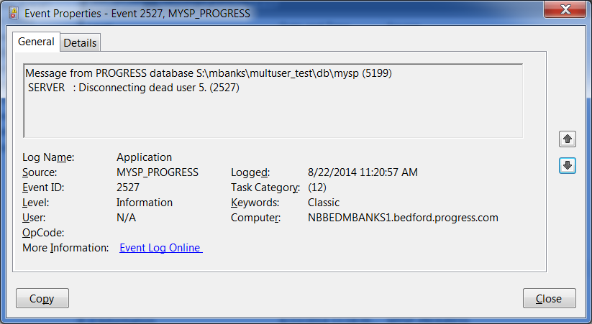
Progress OpenEdge Database – Windows Event Viewer
Windows event log
  Env. Variable (EVTLEVEL)
  or
  Startup param
  (-evtlevel)
Values: None, Brief, Normal, Full
Use Windows Event Viewer

Slide 45
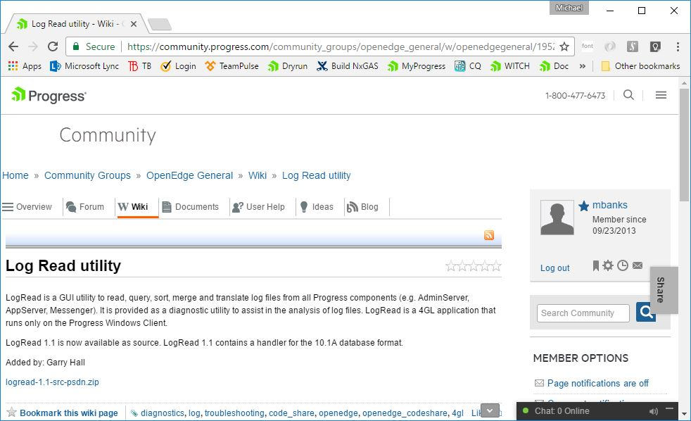
LogRead
Log files (can) produce a lot of data
  Not always easy to read
GUI utility for log files
  View, manipulate, filter, sort
  merge & translate
ABL (source available)
Extensible: Add custom handlers
Unsupported

Slide 46
Conclusions
Debugging issues may involve multiple log files
  Example: Tomcat, Progress Application Server for OpenEdge, Database
Increasing log levels may hurt performance
Increasing log levels may make logs grow very large
Increasing log levels may make it hard to find what is important
Logging level too low may make it hard to debug problems

Slide 47
Q&A

