Slide 1
Who, What, Where, When, Why and How
Adam Backman
Bon Vivant – White Star Software

Slide 2
About the Speaker
Adam Backman – adam@wss.com
  President – White Star Software
  Vice President – DBAppraise
  Author – Progress Expert Series
  Cat Herder

Slide 3
More About the Speaker
  Using Progress OpenEdge for way too long
    I know that Progress supported Lantastic
    I know that the Fortune computer keyboard looked like bozo threw up on it
    I know that Progress supported the Ediza computer
      Ediza said it was the IBM of Brazil
      I thought the IBM was the IBM of Brazil
    I know how bad version 7 was better than most
    I worked in Progress’ Tech Support right after Clyde was supporting customers and said: “You are too stupid to use Progress…” Right then, Tech Support was formed
  This is my 20th year with White Star Software

Slide 4

Warning: This can be a charged subject and if you ask 10 different people you will get 11 different answers and some of them will be right

Slide 5
Agenda
Who
  Who does the dump and load
What
  What to dump? Everything or just specific tables
Where
  Do you have the disk capacity to do this?
    Space
    Throughput capacity
When
  Is this a regular event, if so how often?
Why
  What are the reasons, real or imagined for dumping and reloading your data

Slide 6
Agenda
How
  What is the best way to dump and reload your data?
    Multi-threaded or single threaded
    ASCII
      Dictionary
      Bulk loader
      Custom programs
    Binary
      Build indexes
      Index rebuild at the end

Slide 7

Who Does the Dump and Load?
You are looking at the person responsible
You should never have come to this session

Slide 8
Who Does the Dump and Reload?
“Congratulations you are now responsible”
  But…
Coordination with the business is essential
  Chance for the business to explain the pain of the outage and corresponding cost for the the lost time
  Chance for the technical team to explain the benefits and risks of the process to the business
  This is the time that you show that you have a sound plan with a fallback position
It really should be a team effort with cross checks with both the business and technical people working together

Slide 9
What are Your Options
Offline
  Many options within this option that will explore in this presentation
    ASCII
    Binary
Semi-online
  Customized process where changes are logged
  Changes are applied in a few short outages
Online
  Table partitioning method (description in Mike Furgal’s presentation “We have found nirvana with online dump & load)

Slide 10
What Do You Dump and Load?
Whole database
  Moving from Type I to Type II storage areas(*)
  Moving to a 8-k blocksize - mandatory
  Changing records per block (*)
  Table partitioning (*)
Partial database
  Moving tables not tablemove
  Changing records per block
  Moving to Type II
  * = other non-whole db options are available

Slide 11

What You Want to Migrate

Slide 12



What Users Want You to Migrate

Slide 13
When Migrating Systems
What do you need
  Accounting rules
  Application functionality
  Outside factors (audit, compliance, industry norms, …)
Remember your application is more than just your database
  Application objects and support files
  Output reports (Can some be archived?)
Other application data and support files
Archiving “old” data to archive database or to flat files
  The data will still be available. We know they don’t use it but they will say they need everything so provide everything just make some stuff be accessible in different ways

Slide 14
System Migration Strategies
This may be the only chance you get to cleanup your system
Better to spend the time now and get all of the benefit you can as you will need to test everything anyway
Implement standards
  User limits
  Archive policy
  Naming conventions (/db vs. /This/Is/Our/Database/Directory)
  Get rid of unneeded system mounts
  Cleanup scratch files and directories (build scripts to keep these clean)

Slide 15
What Do You Dump – Commonly Forgotten Items
Commonly forgotten files
  Sequences – Dump sequence values from dictionary
  Users – Dump user table contents from dictionary
  SQL Stuff – views, security, …
Commonly forgotten items when moving systems
  Printers
  Configuration, parameter and properties files
  Setting new system to support all of your users
    PTY’s
    ssh sessions
  User home directories and application output directories

Slide 16
Where to Dump Your Data
Think about disk capacity
  Storage capacity – is there enough space
  Throughput capacity – Can the disk perform well
RAID 10 vs. RAID 5
  FillTime = CacheSize/(RequestRate - ServiceRate)
  Both RAID levels will exhaust cache but RAID 10 will continue to perform better after the cache is filled
  I will not beat the RAID 5 horse anymore(*)
Dumping to NFS, Samba share,… is BAD
The main takeaway from this is that you are going to create a bunch of I/O and your system needs to be built correctly to support it.
  * = Oh yes, actually, I will continue to beat this horse until everyone is on SSD

Slide 17
When Will You Do a Dump and Load
Time-based
  Annual dump and load just to keep things nice
  Long weekend/Plant shutdown
  Once a decade whether we need it or not
Metric-based
  We monitor our storage efficiency so we will know when it is needed (scatter, fragmentation, application timings, …)
  We have someone else monitor our system and they will let us know
Changing platforms
  Some platform changes do not require a dump and load

Slide 18

Which Metrics Indicate When a Dump and Load is a Good Idea
Notice I did not say “will improve performance”
Database Analysis
  Look for high scatter (kind of a indicator)
  Look for high record fragmentation
  Record per block set poorly (very poorly)
Database statistics
  Historical timings and statistics
  Be careful – metrics can indicate more than one thing
  Database read to record read varies over time
    Could be index utilization of queries

Slide 19
Why do a dump and load in any case
Poor initial setup
  Wrong block size (1k was default for a long time)
  Records per block
  Type I vs. Type II areas
Need table partitioning
Database corruption with no viable backup
  For shame, DBA, for shame
Poor performance – Historical data is key
We haven’t dumped and loaded since version 9
  Look, Version 9 was released nearly 20 years ago (1998). It may be time to let go of your old database
Platform change (Ex: Windows to Linux)

Slide 20
How to avoid doing a dump and load
Index compact
  Sometimes just a simple index compact of critical indexes can turn the performance from unacceptable to acceptable
Dump and load only critical tables
  This provides reasonable benefit for minimal outage time
Table migration (creative)
  Requires application code support
  Abandon historical data
Alternate buffer pool
  Perfect for fairly static rapidly read tables
  Update SQL statistics

Slide 21
Goals of dump and load
Decrease fragmentation of data
  The process itself plus
  Moving to type II
  Moving to the appropriate block size
Decrease scatter of data
  Use an appropriate records per block setting
Don’t forget operating system stuff
  Use the largest block size you file system will support
  Choose the appropriate file system type
  If lean on memory, limit OS buffers
  RAID10 vs. RAID5

Slide 22

You need to Dump and Load, What Now?
Test
Test
Test again
You only want to do the live migration once and you want to get ALL the benefits for the cost of an outage so test

Slide 23
So Testing Sounds Great, Lets Build a Plan
Existing hardware or new hardware
Do we have enough physical storage capacity on fast storage. Plan on 3 times the size of your database and we need high-speed storage for all of this requested capacity
Isolated or shared hardware
  Only have one system – people will be sharing
  Virtualized environment – generally frowned upon for the best performance. Bare metal always outperforms virtualization.
  Virtualized – no over commitment of resources
  Storage – direct attached storage, if not what are the options. SAN storage, if built and managed properly can provide good database performance. You end up looking at the SAN like you would look at direct attached

Slide 24
Hardware is Done. Lets Really Build a Plan
What to test
  Multi-threaded binary dump (multiple runs to find the best mix)
  Build the target database
    8K, Type II, Large BI cluster size
    Remember odd files (_seq.d _sqlviews.d, _user.d)
    Areas sized appropriately
    Edited .df file
  Once target database is built
  Test true single-threaded binary load
  Test multi-threaded load with page writers

Slide 25
Dump and Load Options
Offline
  ASCII dump and load
    Dictionary
    Bulk loader (Not really)
  Binary dump and load
    Binary dump
      With buildindexes
      With index rebuild at the end
  Custom
    Partially online – with a few small outages
    Table multi-threading
    Virtually unlimited options

Slide 26
Performance – The “best” solution may be surprising
What we originally thought
  A multi-threaded (per area) load with an index rebuild would be fastest
  What we tested
    Everything single threaded
    Everything multi-threaded several different mixes tested
    Some things single threaded and others multi-threaded
    Both binary and ASCII were tested
    Tried single user and a single client on a DB opened with a broker
Eliminated primary material environmental factors
  Disks
  CPU

Slide 27

What Was Fastest?
Science knows no master and after the initial testing we knew that multi-threaded binary dumps were the best option for the dump phase by far
Index rebuild at the end was better than -buildindexes
We found that little things can make a huge difference
  Read-only reporting killed load times and slowed dumps
We eliminated hardware as a bottleneck for the most part
The load times were not so easy to pin down

Slide 28

Stack the Decks in Your Favor
Weasel every bit you can
Hardware
  CPU – fewer faster CPUs are better than many slower CPUs
  Disk – Did not do anything silly
    Used a specialized storage technology (FusionIO)
    Eliminated NetApp (This was huge)
  Had more than enough memory
  This configuration provided us with Progress as our only potential bottleneck.
OS
  Used large block size on the file system (2MB on ext4)

Slide 29
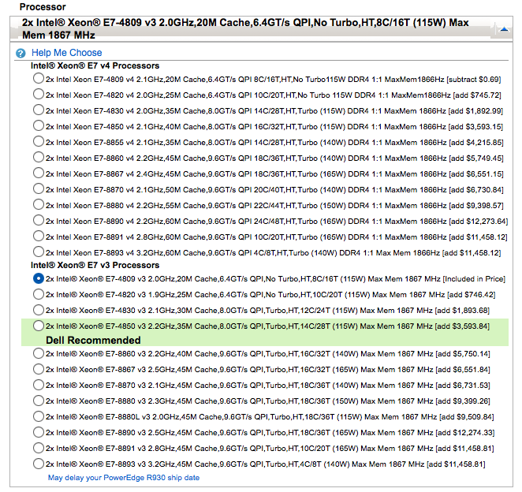

Slide 30
CPU Example
You are buying a machine with 2 sockets
You have a choice of:
  Intel Xeon E7-8893 3.2Ghz 4 cores/8 threads
  Intel Xeon E7-8891 2.8Ghz 10 cores/20 threads
The better choice for most people would be the 3.2Ghz chip. With both sockets filled you would have 8 cores/16 threads which would be more than enough for most environments and all single threaded processes would be significantly better off.

Slide 31
Stacking the Decks
Progress
  Large bi cluster size
  Spin on dump was tested optimal at a value between 2000 and 10000 (7500)
  8k DB block size and 512 blocks per cluster for Type II
Process
  Start loads while the long table dumps are still running
  Eliminate all other system activity when possible

Slide 32
Fastest Method For This Configuration
A balanced multi-threaded binary dump with a single threaded (single user) load ending with an index rebuild
The sweet spot for the number of dumps to do in parallel is easy to determine. For most, this would end up being a mix of a few single large table threads and then combining the remaining tables into an additional thread
Moving from multi-threaded load to single-threaded (single user) load eliminated the shared memory contention and thus provided faster throughput
The overhead latching even with no competing processes was greater than the benefit of page writers or other multi-user features

Slide 33
Well It’s Fast, But How Do You Know If Your Process Works?
Do a database analysis before and after and make sure the record counts match
Accurate (perfect) is more important than fast
More testing provides a more accurate estimate of elapsed time
Every method that I have seen requires at least a short outage some require long outages
Know the cost/benefit of doing the dump and load
  Is the outage time worth the benefit to the business?

Slide 34
Rules to remember
Dump
  Multi-threaded binary dump is universally faster
  Choosing a small index or no index if the source data is in type II storage areas can improve performance
Load
  Use a single-user binary load session for optimal performance
  Rebuild the indexes at the end using the off-line index rebuild utility. You get higher quality indexes in less elapsed time.
  Start loading as soon as you can. Do not wait for everything to finish dumping to start loading
System
  Fast storage is critical (no NetApp, no NFS, …)
  Fewer faster CPUs are better. People tend to choose quantity over quality. Fewer higher speed cores are generally a better choice.

Slide 35


Questions, Comments, …

Slide 36
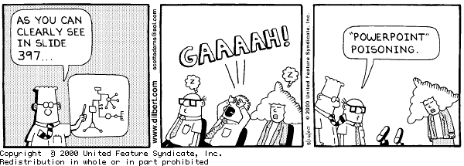
Thank you for your time
THANK YOU

Slide 37
Thank You for Your Time
Adam Backman
White Star Software
adam@wss.com

