Slide 1
Fantastic Web Apps in 11.6
WebSpeed in the Pacific AppServer for OpenEdge
Edsel Garcia
Shelley Chase

Slide 2
We Need Your Participation
Who Wants To Be a “Millionaire”
Question displayed with 4 possible answers
Please vote for one answer
We will show the correct answer
Some answers will be accompanied by a demo
No $money$ - the prize is all the fun we will have ☺

Slide 3


Slide 4
WebSpeed Features and Functionality

Slide 5
Question

Slide 6
What is new for WebSpeed in 11.6?
^{A)} WebSpeed Messenger moved to PAS for OE
^{B)} Automatic URL mapping to ABL code
^{C)} Object-Oriented model running in PAS for OE
^{D)} Nothing new – WebSpeed is perfect already

Slide 7
What is new for WebSpeed in 11.6?
^{A)} WebSpeed Messenger moved to PAS for OE
^{B)} Automatic URL mapping to ABL code
^{C)} Object-Oriented model running in PAS for OE
^{D)} Nothing new – WebSpeed is perfect already

Slide 8
Question

Slide 9
What is a WebSpeed Handler?
^{A)} A procedure run on Session activation
^{B)} A class method mapped to a URL
^{C)} A subclass of Progress.Web.IWebHandler
^{D)} (b) and (c)

Slide 10
What is a WebSpeed Handler?
^{A)} A procedure run on Session activation
^{B)} A class method mapped to a URL
^{C)} A subclass of Progress.Web.IWebHandler
^{D)} (b) and (c)

Slide 11

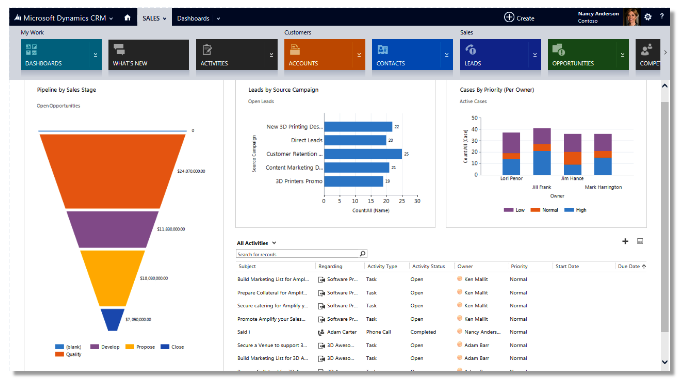
Simple Demo : Web Handler

Slide 12
Question

Slide 13
What types of Clients can
PAS for OE support?
^{A)} ABL
^{B)} Web and Mobile
^{C)} ABL, Web and Mobile
^{D)} Any client using APSV, HTTP, REST, SOAP

Slide 14
What types of Clients can
PAS for OE support?
^{A)} ABL
^{B)} Web and Mobile
^{C)} ABL, Web and Mobile
^{D)} Any client using APSV, HTTP, REST, SOAP

Slide 15
Question

Slide 16
What HTTP request data is available in WebSpeed?
^{A)} Header, Cookies, Body and Query Parameters
^{B)} Header and Cookies
^{C)} Cookies and Body
^{D)} Header and Body

Slide 17
What HTTP request data is available in WebSpeed?
^{A)} Header, Cookies, Body and Query Parameters
^{B)} Header and Cookies
^{C)} Cookies and Body
^{D)} Header and Body

Slide 18
Demo - Dynamic Access to Data

Slide 19
WebSpeed Deployment PAS for OpenEdge

Slide 20
Question

Slide 21
What is the best number of PASOE Agents for WebSpeed?
^{A)} 1
^{B)} 5-10
^{C)} 10-20
^{D)} 50

Slide 22
What is the best number of PASOE Agents for WebSpeed?
^{A)} 1
^{B)} 5-10
^{C)} 10-20
^{D)} 50

Slide 23
Question

Slide 24
How many OS processes are needed for 50 concurrent requests?
^{A)} 1
^{B)} 5
^{C)} 10
^{D)} 50

Slide 25
How many OS processes are needed for 50 concurrent requests?
^{A)} 1
^{B)} 5
^{C)} 10
^{D)} 50

Slide 26
WebSpeed Compatibility

Slide 27
Question

Slide 28
JSON payloads are typically what fraction of an XML payload?
^{A)} 50%
^{B)} Same size
^{C)} Double
^{D)} You cannot measure the size of text responses

Slide 29
JSON payloads are typically what fraction of an XML payload?
^{A)} 50%
^{B)} Same size
^{C)} Double
^{D)} You cannot measure the size of text responses

Slide 30
Question

Slide 31
Do I need to change my existing WebSpeed code in PAS for OE?
^{A)} Nothing - all code will run seamlessly
^{B)} You must hire Progress Consulting
^{C)} Convert your web-disp.p to a Web Handler
^{D)} (a) or (c)

Slide 32
Do I need to change my existing WebSpeed code in PAS for OE?
^{A)} Nothing - all code will run seamlessly
^{B)} You must hire Progress Consulting
^{C)} Convert your web-disp.p to a Web Handler
^{D)} (a) or (c)

Slide 33
Demo - Calling Business Entities from WebSpeed

Slide 34
In Summary
F
AN
T
A
S
T
I
C
an of WebSpeed
single AppServer for both Web Streams and RPC.
ew, but also a better version of the Old WebSpeed
otal control of the HTTP response
dvanced Business Language
treaming model
omcat built-in
mproved model / [Web] Interface / Integrated
PU efficient - improved performance

Slide 36
Question

Slide 37
What type of content cannot be served by WebSpeed?
^{A)} HTML and CSS files
^{B)} JavaScript files
^{C)} Images and PDF files
^{D)} X Files

Slide 38

What type of content cannot be served by WebSpeed?
^{A)} HTML and CSS files
^{B)} JavaScript files
^{C)} Images and PDF files
^{D)} X Files

