Slide 1
Kendo UI Builder
A tool to modernize OpenEdge Apps
June 2016
Shelley B. Chase

Slide 2
Future Direction - CAUTION

Slide 3
Modernize Existing Applications
Build App using a prescriptive application framework
Client:
  Kendo UI Components
  AngularJS 1.5 for Single Page Applications
  Bootstrap Responsive UI
  JSDO Data Source on Client
Server:
  ABL for all business logic and data management
  Service interface for Progress Data Objects (Business Entities)
Automate the modernization as much as possible
  Pre-defined UI templates using modern controls
  Data-driven Views (based on JSDO catalog)
  Built-in authentication and session management

Slide 4
Many Starting Points
CHARACTER
GUI
ADM and ADM2
Dynamics
WebSpeed
GUI for .NET
…To One Destination
Simple to use design tool
UI Definition stored in meta-data (future-proof)
Automated UI Generation
  App Template defines the framework technologies
  UI Component Templates define the Views
Proven data model for business applications

Slide 5
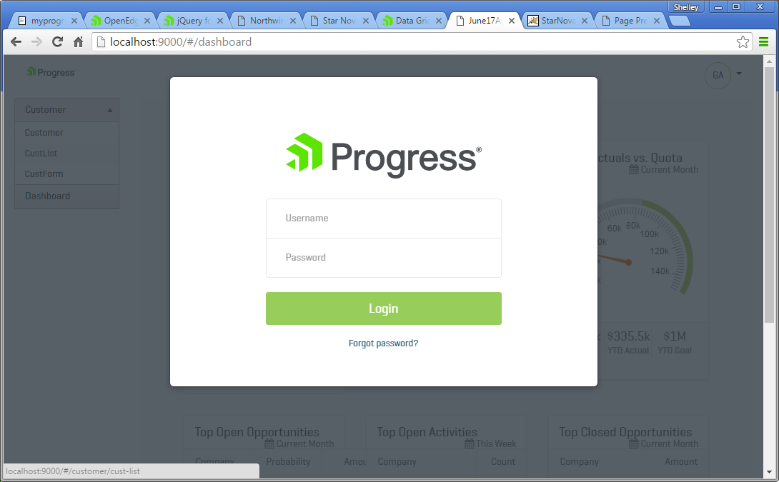
Modern Web Application – Login

Slide 6
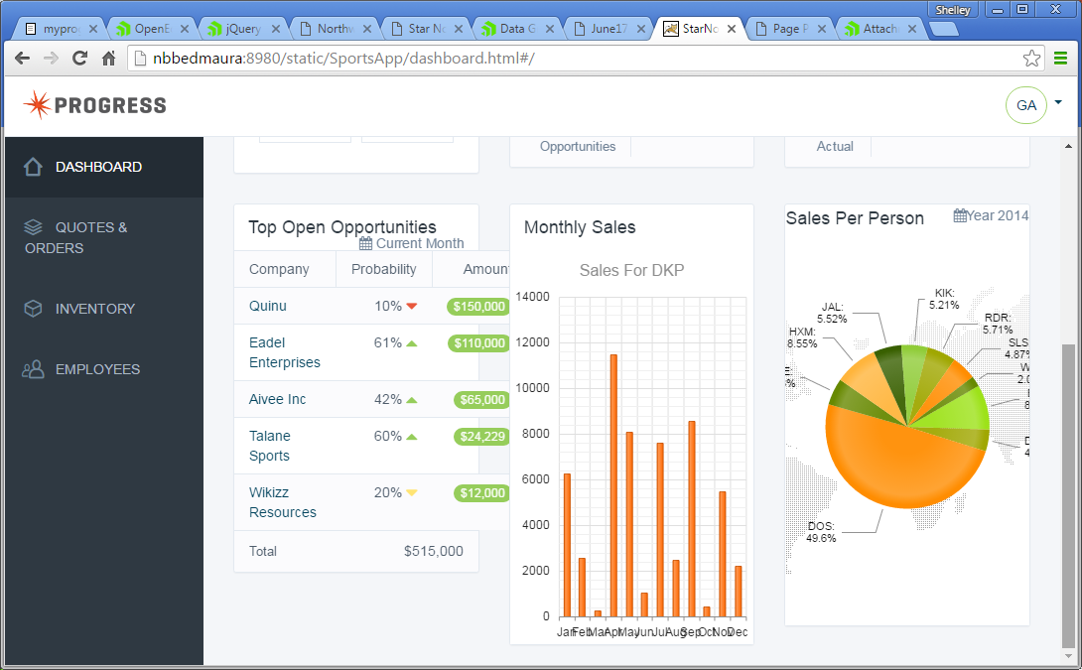
Modern Web Application – Modules
Modules are:
Functional Components
Share single user context
Loaded on demand
  Required
  Optional - can be sold as add-ons
Dashboard applies to all modules

Slide 7

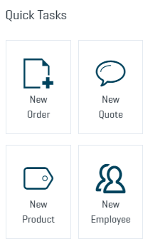
Modern Web Application – Dashboard

Slide 8
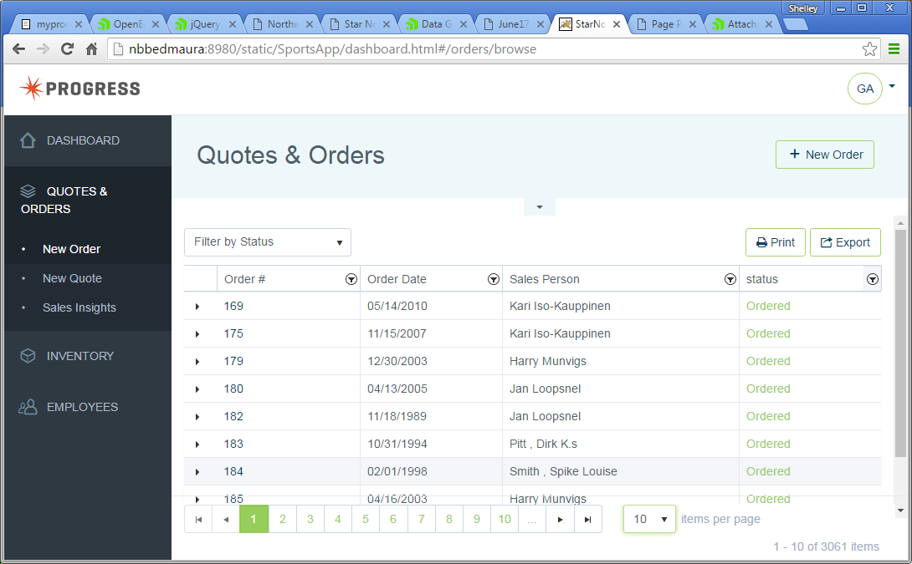
Modern Web Application – Grid View

Slide 9
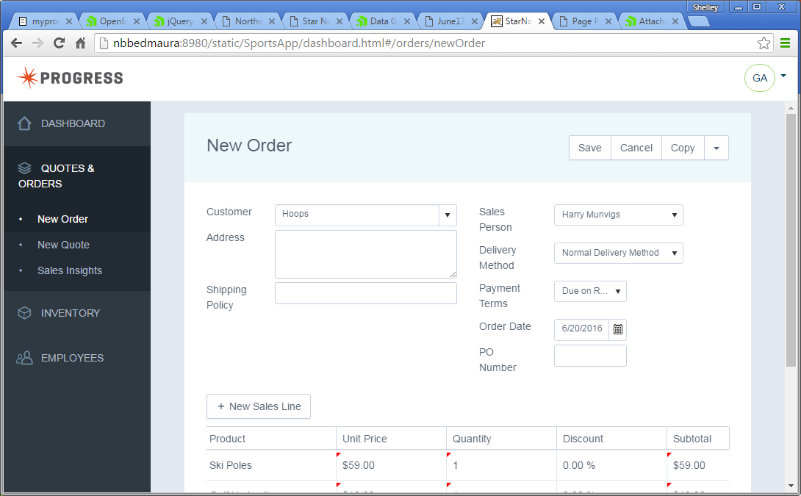
Modern Web Application – Form

Slide 10
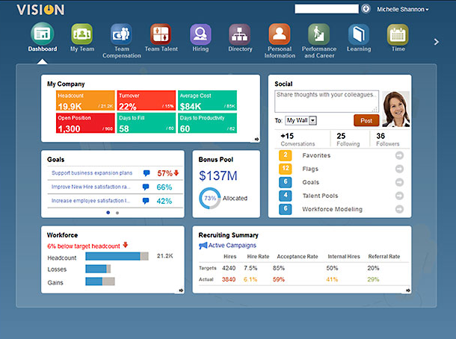
Modern Web Application – Tablet Style

Slide 11
The JavaScript Data Object and OpenEdge

Slide 12
Server-side Business Entities
Encapsulate data and data transactions
  Prescriptive method signatures (REST)
    Read-only
    CRUD (Create, Read, Update, Delete)
    CRUD + Submit
  Business logic with free-form signatures (REST RPC)
    Invoke
Define Service Interface
  Source code Annotations
    Define the Resource and data model
    Specify the methods to expose

Slide 13
Business Entity Annotations
File Level: Resource
@progress.service.resource FILE(name="Customer", URI="/Customer", schemaName="dsCustomer", schemaFile="Sports/AppServer/customer.i").

Slide 14
Business Entity Annotations
File Level: Resource
@progress.service.resource FILE(name="Customer", URI="/Customer", schemaName="dsCustomer", schemaFile="Sports/AppServer/customer.i").
Method level: CRUD +Submit +Invoke
@progress.service.resourceMapping(type="REST", operation="read", URI="?filter=~{filter~}", alias="", mediaType="application/json").
@progress.service.resourceMapping(type="REST", operation="invoke", URI="/CheckCredit", alias="", mediaType="application/json").

Slide 15
Semantic Type
Defines what a field means within common field types
  CHARACTER could be Text, Email, Password, URL…
UI framework agnostic
ABL DataType | Semantic Type
BLOB | Image or File (TBD)
CHARACTER | Text
CLOB | RichText
DATE | Date
DATETIME or DATETIME-TZ | DateTime
DECIMAL | Number
INT64 or INTEGER | Integer
LOGICAL | Boolean
Additional Semantic Types
Currency
Email
Internal
Password
Percent
Phone Number
URL

Slide 16
Semantic Types
Temp-table Field
FIELD Balance AS DECIMAL INITIAL "0" LABEL "Balance"
Data Object Catalog
"Balance": {
"type": "number",
"ablType": "DECIMAL",
"default": "1500",
"title": "Available Balance",
"semanticType":{
type: "Number", "min": 0, "max": 5000
}
}

Slide 17
Business Entity Annotations
File Level: Resource
@progress.service.resource FILE(name="Customer", URI="/Customer", schemaName="dsCustomer", schemaFile="Sports/AppServer/customer.i").
Method level: CRUD +Submit +Invoke
@progress.service.resourceMapping(type="REST", operation="read", URI="?filter=~{filter~}", alias="", mediaType="application/json").
@progress.service.resourceMapping(type="REST", operation="invoke", URI="/CheckCredit", alias="", mediaType="application/json").
Data level: Field
@openapi.openedge.entity.field.property (field="EmailAddress", name="semanticType", value="Email").

Slide 18
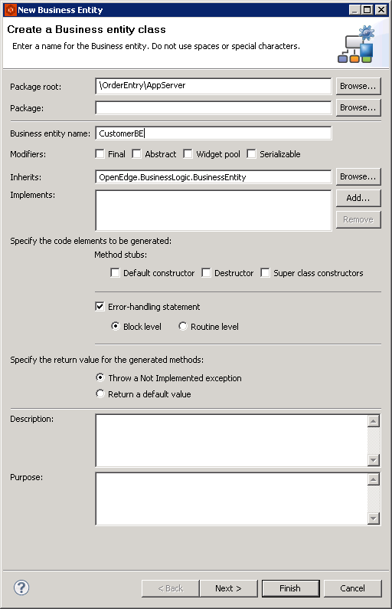
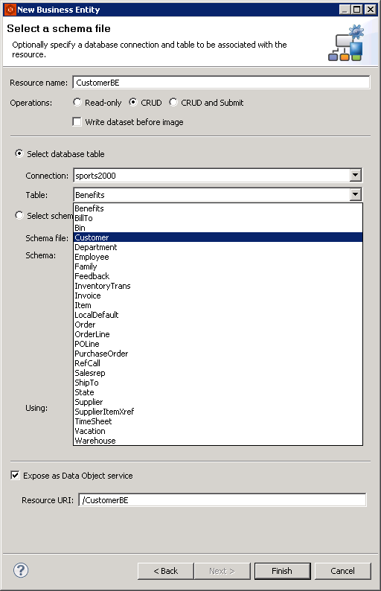
Demo – Business Entities

Slide 19
Demo – New Business Entity

Slide 20
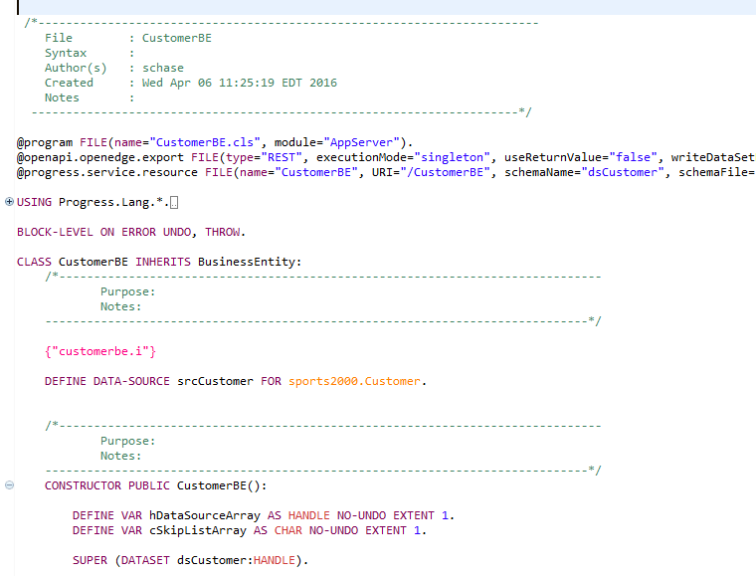
Demo – New Business Entity

Slide 21
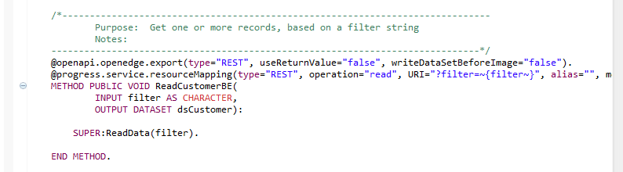
Demo – New Business Entity

Slide 22
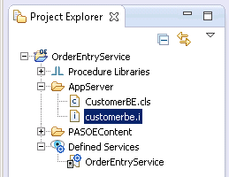
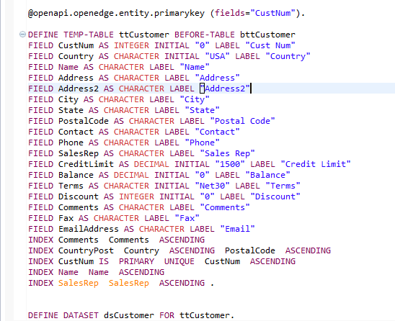
Demo – Business Entity Schema

Slide 23
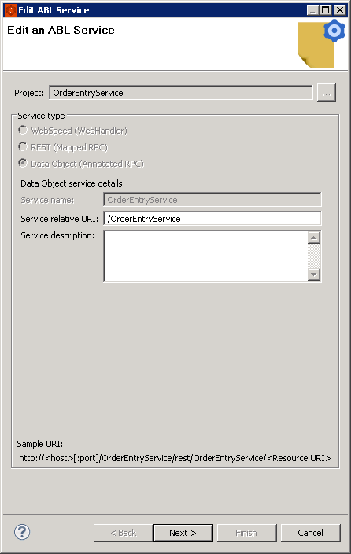
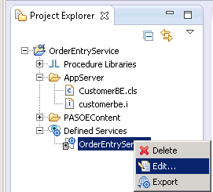
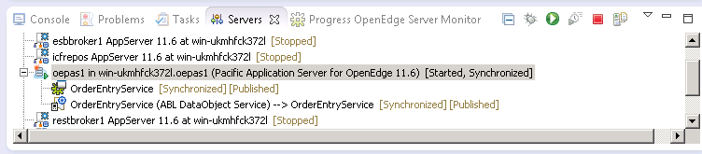
Publish the Data Object Service

Slide 24
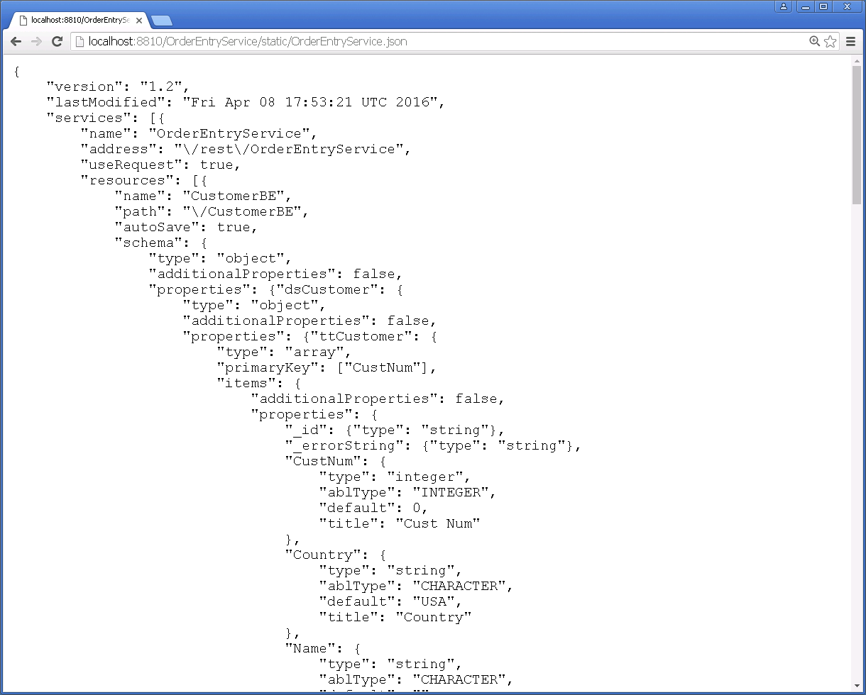
Data Service Catalog
http://localhost:8810/OrderEntryService/static/OrderEntryService.json

Slide 25
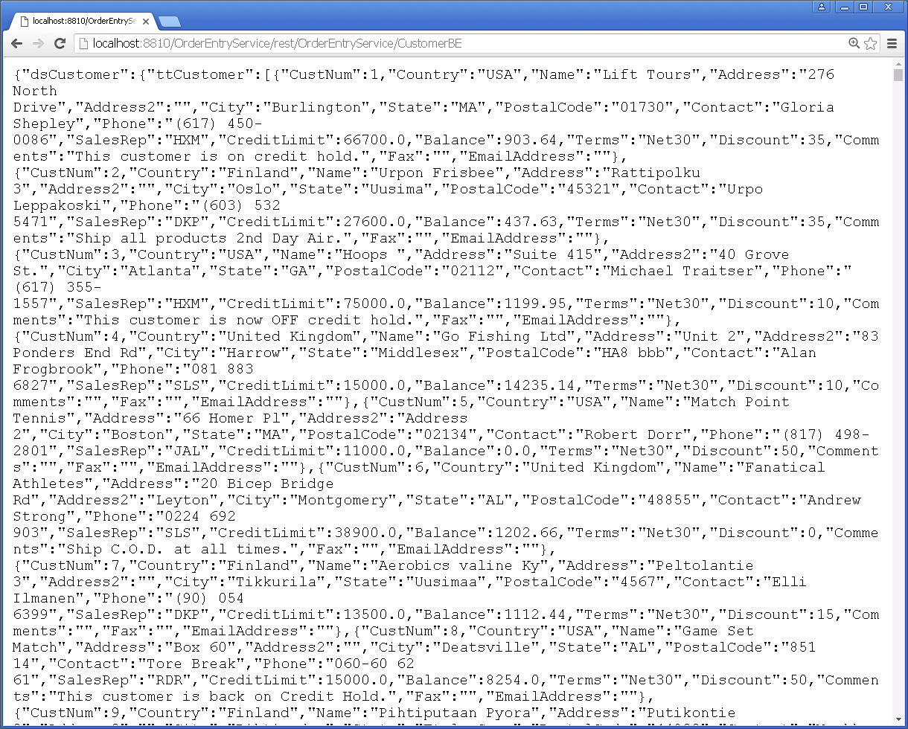
CustomerBE Records
http://localhost:8810/OrderEntryService/rest/OrderEntryService/CustomerBE

Slide 26
Web Application Model

Slide 27







Modern Web Design
Web Application
Login View Custom
Order JSDO
View1 Custom
Salesperson JSDO
Employee View FORM
Customer JSDO
Customer View GRID
CRM Module
Dashboard Module
Dashboard View Custom
Kendo Grid
Reports JSDO
View2 Custom
Kendo Grid
Items JSDO
Button, Image
HR Module
Application Module
Text, Text, Button
App / user context
Kendo Grid
Modular – logical units of functionality
  Dashboard module
  Application module
  User-defined modules for product functional areas: ERP, Finance, HR
    Loaded on-demand; Can be sold as add-ons
Responsive UI
  For browser and tablet form factors
Angular

Slide 28
Modern Web Design: Data-driven View
Web Application
Login View Custom
Order JSDO
View1 Custom
Salesperson JSDO
Employee View FORM
Customer JSDO
Customer View GRID
CRM Module
Dashboard Module
Dashboard View Custom
Kendo Grid
Reports JSDO
View2 Custom
Kendo Grid
Items JSDO
Button, Image
HR Module
Application Module
Text, Text, Button
App / user context
Kendo Grid
Data-driven Views (80% use case)
UI Modernization based on JSDO catalog definition
  Built-in prescriptive CRUD view templates: GRID, FORM
  JSDO data schema drives UI definition; Semantic data types map to display types
Angular

Slide 29
Modern Web Design: Custom Views
Web Application
Login View Custom
Order JSDO
View1 Custom
Salesperson JSDO
Employee View FORM
Customer JSDO
Customer View GRID
CRM Module
Dashboard Module
Dashboard View Custom
Kendo Grid
Reports JSDO
View2 Custom
Kendo Grid
Items JSDO
Button, Image
HR Module
Application Module
Text, Text, Button
App / user context
Kendo Grid
Hand-built Views
Kendo UI drag-and-drop designer
  User-defined layout and content: Dashboard, dialogs, custom screen layouts
  JSDO can be used as a data source for Kendo UI controls
Angular

Slide 30
Modern Web Design
Web Application
Login View Custom
Order JSDO
View1 Custom
Salesperson JSDO
Employee View FORM
Customer JSDO
Customer View GRID
CRM Module
Dashboard Module
Dashboard View Custom
Kendo Grid
Reports JSDO
View2 Custom
Kendo Grid
Items JSDO
Button, Image
HR Module
Application Module
Text, Text, Button
App / user context
Kendo Grid
Angular

Slide 31
Data Model

Slide 32
Data Sources
Data Provider = Data Object Service
  Web App Service URI
  PAS for OE or Classic AppServer
  Contains one or more Resources
  Resource = ProDataSet or Temp-table
Data Source = Temp-table
  Schema: Fields
    Label
    Editor Type – defaulted from Semantic Type
  Operations: CRUD + Submit + Invoke

Slide 33
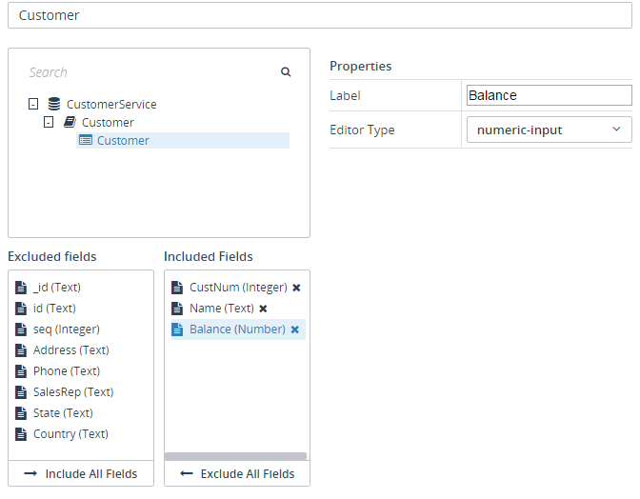
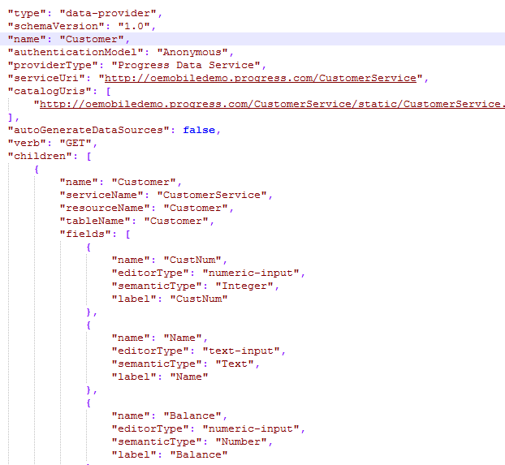
Data Source Definition and Meta-data

Slide 34
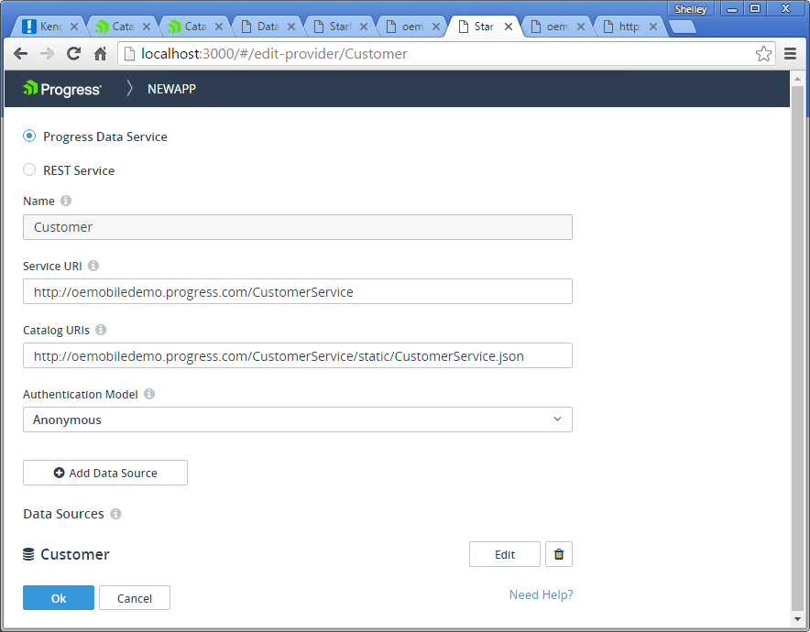
Kendo UI Builder Demo – Data Sources

Slide 35
Views

Slide 36
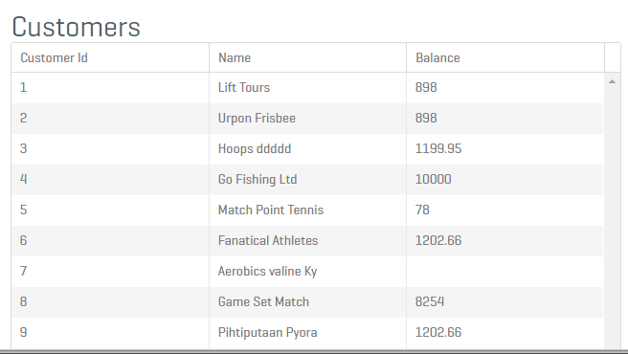
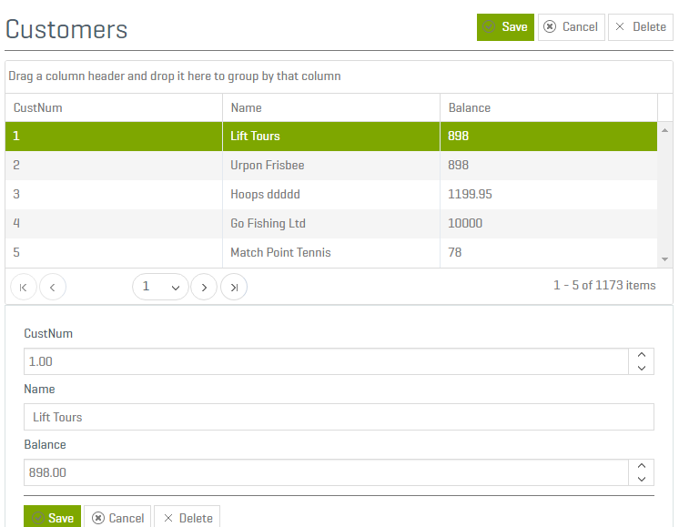
Built-in View Templates
Data Grid
  Data-source driven
  Read-only
Data Grid Form
    Data-source driven
    CRUD

Slide 37
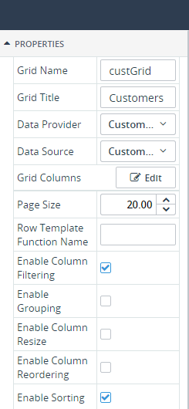

Data Grid
Data
  Data Provider
  Data Source
  Grid Columns
Grid
  Page Size
  Row Template
  Enable *
Events
  Custom Behavior
    Invoke operations
    Formatting
    Validation

Slide 38
Data-driven Views
Meta-data
  Field list defined in Data Source
  Field order defined in Data Source
  Field “Editor” defined in Data Source
    In-the-box Editors for Kendo UI
    Custom Editors
Template
  In-the-box template for Kendo UI, Angular 1.x
    HTML/CSS defines look and feel
    Controller defines behavior

Slide 39
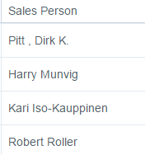

View Metadata
"fields": [{
"type": "field",
"name": "Ordernum",
"navigateTo": "detail"
},
{
"type": "field",
"name": "OrderDate"
},
{
"type": "field",
"name": "SalesRep“
“label”: Sales Person
“displayType” : “Text”
},
{
"type": "field",
"field": "OrderStatus“
“label”: “status”
“displayType”: “ColoredText”
}],
...
}]
}
{
"type": "page",
"module": "orders",
"name": "browse",
"header": [{
"type": "form",
"components": [{
"type": "text",
"text": "Quotes & Orders” },
{
"type": "action“,
"navigateTo": "newOrder"
}]
}, {
}],
  "components": {
  "type": "dataBrowse",
  "dataSource": "OrderDS",
  "name": "saleOrders",
  "filterable": true,
  "edit": "detail",
  "destroy": true,

Slide 40
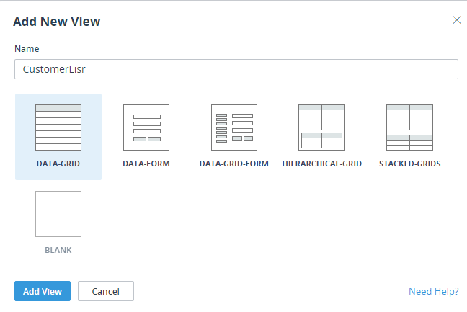
Kendo UI Builder Demo – Views

Slide 41
Additional View Templates
More Data-driven Views
  Data Form
  Nested Data Grids
  Stacked Data Grids
Drag and Drop View
  Blank (Free-form Kendo UI)
  Kendo UI Controls

Slide 42
Development Experience

Slide 43
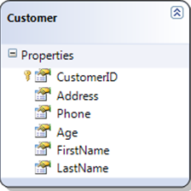
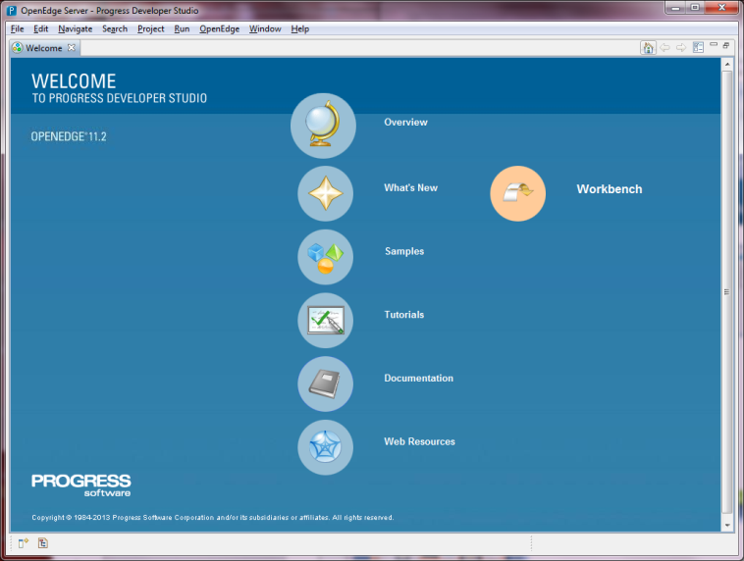
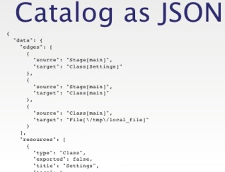
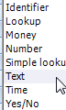
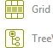
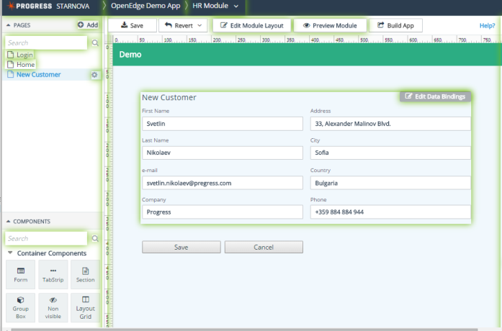


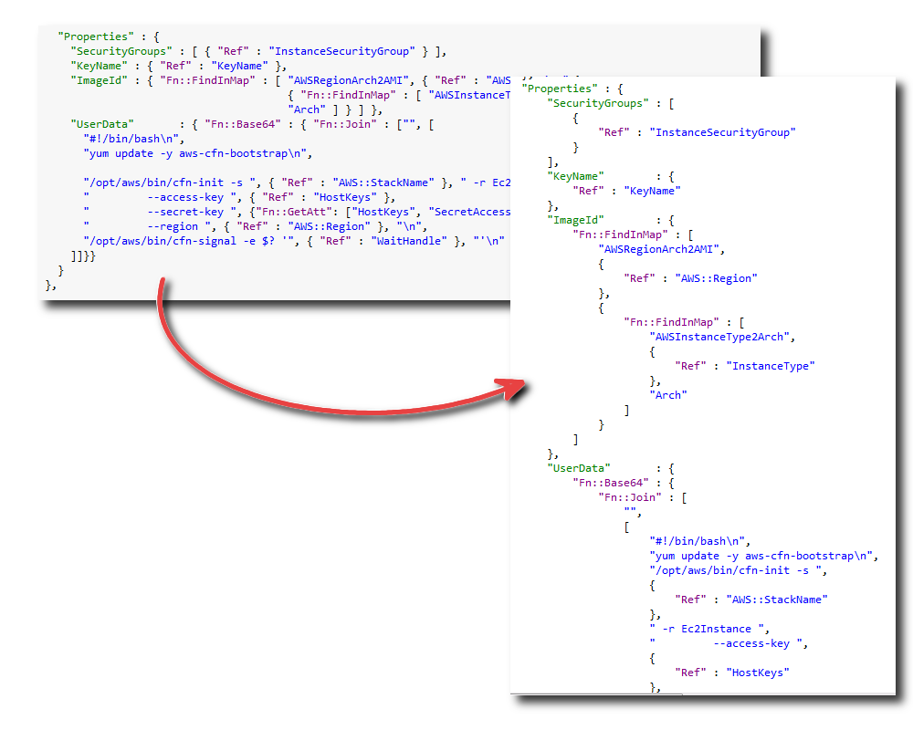


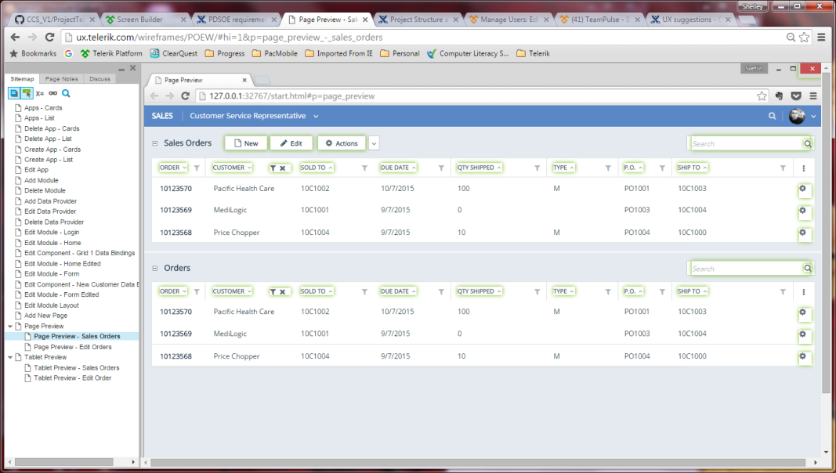

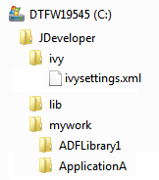


Building a Modern Web App – Full User Flow
1. Create ABL Service; Generate Catalog
Business Entities
PDSOE
2. Define UI and Data Sources; Generate Metadata
Visual Designer (Kendo UIB)
Controls
Views
Project
3. Generate Web App Files; Generate HTML, JS, CSS
Web App in Browser
Data Source Metadata
Views/Controls Metadata
JSDO
4. Preview Web App in browser
Builder/ Generator (Kendo UIB)
Angular
Yeoman Templates

Slide 44
Deployment and Runtime

Slide 45

Web UI Runtime Architecture
Data
PAS for OE WebSpeed
PAS for OE REST
Classic A/S REST
UI
PAS for OE Web Server
Web Server
JSDO
JSDO
JSDO
PAS for OE
PAS for OE
PAS for OE
Spring Security
Spring Security
Spring Security
…/web/Cust
…/web/Order
…/rest/Employee
…/static
AVM
AVM
JSDO WebHandler
Business Entity
Business Entity
Business Entity
OEDB
Notes:
C:\Progress\116\wrk\oepas1\work\SportsApp
[1/12/2016 11:29 AM] Edsel Garcia:
C:\Progress\116\wrk\oepas1\work\SportsApp

Slide 46
Next Steps
Insure your business logic is accessible (PAS for OE or Classic AppServer)
  Data Object Services (Mobile)
  REST
  WebSpeed
Sign up for ESAP2 with Ankur Goyal
  Early access to product
  Design input
Share your Web Application UX with Shelley
  Share “typical pages” to be considered as View templates
  Share your semantic data types

Slide 48
Built-in Views for V1
Data Grid View (read-only) | Read-only Data Grid mapped to single data source (JSDO table).
Data Form View (read-only) | Read-only Data Grid mapped to single data source (JSDO table).
Data Form View (read-only) with Edit Form View | Read only Data Form "screen" with editable Data Form as a separate "screen”. Fields map to a single data source.
Data Grid (read-only) with Data Form View | Data Grid and Data Form on a single page. The Data Grid uses the first 1/3 of the layout and the Data Form on right 2/3 of layout. Same data source is used for grid and form fields.
Data Grid View (read-only) with separate Edit Data Form View | Data Grid “screen” with separate edit Data Form “screen”. Same data source is used for grid and form fields.
Empty View | Empty view, use drag-n-drop or hand coded in external html and javascript files.

Slide 49
Kendo UIB :
Modern Web Applications for OpenEdge Systems of Record
Business Application with one or more modules
  Modules define product functional areas: i.e. ERP, Finance, HR
  All server-side logic and UI customization done in ABL
  UI can be static pages and/or PAS for OE WebSpeed
Modules, Pages, Views and Controls
  Responsive layout designed for Browser and Tablet form factors
  Default AppModule for custom pages, dialogs, etc.
  Custom modules are SPA with two types of views
    Data driven Views are dependent on the data provider definition
    Custom Pages/Views are visually built using drag-n-drop designer with controls
Data Sources
  Angular.js data-binding to ABL Services (WebSpeed, Data Service/JSDO) and REST
  Session management (SSO support by PAS for OE)

Slide 50
Kendo UIB: Summary
WebApp
  An application that is composed of modules, pages and data providers and runs in a browser.
Module
  Functional components of a large application that share stateful services and app context. A module is made up of a group of pages related to a single product feature. Modules are implemented as single-page applications (SPA).
Data Provider
  An ABL Service (JSDO ) or REST Service providing access to a backend service. Data Providers are defined at the WebApp level so they can be shared across Modules.
AppContext
  User and session information for the WebApp and shared across Modules. Can be used for SSO.

Slide 51
Visual Designer Flow
* New in Kendo UIB
Progress Developer Studio
  Define Service Interface for each Business Entity and generate JSDO catalogs with Semantic data types*
Visual Designer
  Create WebApp
  Define Data Providers: Progress Data Services (JSDO catalog) or REST
  Define App-level pages: Dashboard, login page, dialogs, etc.
  Create Modules: Define page header and footer
    Create Views: Data driven - Select UI template and Data source(s)
    Create Views: Custom UI - Build using drag-n-drop designer
  Generate meta-data
Generator
  Combine angular yoeman templates and UI metadata to create Web App content files: HTML, CSS, JS

Slide 52
New Web App - Design Flow
1. Create ABL Service for Business Entities – Generate Catalog
View Templates
Control Templates
Business Entities
PDSOE
2. Define UI and Data Sources – Generate Metadata
Visual Designer (New)
Project
Views/Controls Metadata
Data Source Metadata
3. Generate Web App Files – Generate HTML, JS, CSS
Web App in Browser
Builder/ Generator (New)
JSDO
JSDO
Angular Templates

