Slide 1
Progress System Tables
Dan Foreman
Progress Wackaloon

Slide 2
Introductions – Dan Foreman - Progling
Progress User since 1984 (Version 2, there never was a commercial V1)
Presenter @ Progress Conferences Worldwide since 1988
Author of:
  Progress Performance Tuning Guide
  Progress Database Administration Guide
  Progress System Tables
  Progress DBA Best Practices
  ProMonitor – used by the Progress Managed DBA Practice to monitor over 1,000 databases worldwide
  Pro Dump&Load – used to dump & load the worlds largest DB (12TB) with only 2 hours of downtime

Slide 3
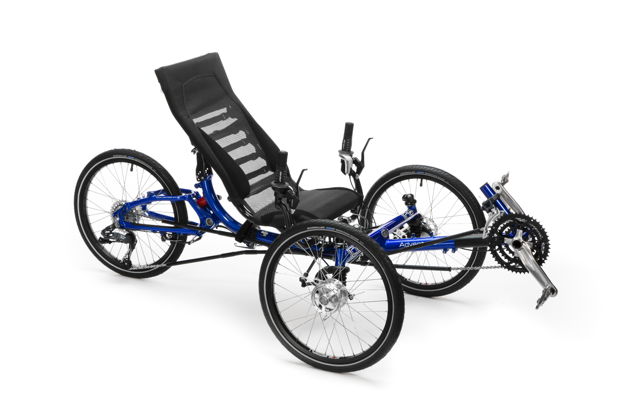
Introductions – Dan Foreman- Cyclist

Slide 4

Introductions – Dan Foreman- Basketball Zealot

Slide 5
Introductions - Audience
Progress Version (end users only please)
  V11.6
  V11.anythingelse
  V10
  V9
  V8
  V7
  Pre-V7

Slide 6
Introductions - Audience
Who is new to Progress in the last 2 years?
Database Operating System
  AIX
  Linux
  Windows
  Solaris
  HP/UX

Slide 7
Introductions - Audience
Largest Individual Database
  > 10TB
  > 1TB
  > 500GB
  > 100GB

Slide 8
Let’s Get Started

Slide 9
System Table Categories
Schema
SQL
System Info
Virtual

Slide 10
Schema Tables
In all versions of Progress
_File
_Field
_Index
_Index-Field

Slide 11
Schema Tables - Latecomers
_Db (V5 or V6)
_Sequence (V7)
_File-Trig (V7)
_Field-Trig (V7)

Slide 12
_File._Category
Added by Gus in V11
Value | Description | Examples
AUDIT | Auditing | _Client-Session
AUTH | Authentication | _User, _Tenant, _Sec-Role
DS_SCHEMA | Data Server Schema | _Constraint
LOG | Event Logging | _KeyEvent
PHY_ST | Physical Storage | _Area, _AreaExtent, _StorageObject, _Partition*
SCHEMA | Meta Schema | _File, _Field, _Index, _Db, _Sequence
SQL89 | Old (Deprecated) SQL89 | _View
SQL_* | SQL92 Tables | _SysDbAuth, _SysProcedures
VST | Virtual System Tables | _Connect, _Trans, _Lock

Slide 13
Practical Use – Find Redundant Indexes
Index A: Fld1 + Fld2 + Fld3
Index B: Fld1 + Fld2 + Fld3 + Fld4
Index A might be redundant

Slide 14
Practical Use – Find Tables with No Defined Indexes
For each _index no-lock where _index-name = “default”,
_file of _index no-lock:
Display _file-name
This is important because the “default” index is stored in the Schema Area (by default) and the Schema Area is a Type 1 Storage Area

Slide 15
SQL Tables
Permissions (GRANT, REVOKE)
Constraints
Views
Stored Procedures
Query Optimizer Data

Slide 16
System Info Tables
_Area (V9)
_AreaExtent (V9)
_StorageObject (V9)

Slide 17
Practical Use – Table/Index Mixing
_storageobject
Also
  -B2 Objects
  LOBs

Slide 18
Virtual System Tables
First introduced in V8.2
Each VST represents a snapshot of various Shared Memory structures
VSTs are Schema Tables
They do not interfere with Application tables and Indexes
Are included in the V9/V10/V11 empty Database
Can be seen in the Dictionary (must view ‘Hidden’ tables)

Slide 19
Virtual System Tables - Enabling
Some new tables and fields are not in the “native” empty DB unless the VST structure is updated with:
  proutil –C updatevst is run
Example: New fields were added to existing VSTs in V10.2B SP6

Slide 20
Virtual System Tables - Enabling
A particular feature must be enabled:
  Auditing: proutil enableauditing
  TDE (Data Encryption)
  Multi-Tenancy
  Table Partitioning
  OE Replication

Slide 21
Virtual System Tables - Limitations
promon and the VSTs are not always in sync; Examples:
  _TableStat & _IndexStat (V8.3)
  _AreaStatus (V9 and later)
VSTs can lag behind:
  _Startup
Some data isn’t available in Shared Memory (i.e. promon and VSTs)…for example most of the info reported by rfutil aimage list

Slide 22
VST Performance & Overhead
For most VSTs there is no performance penalty for accessing VSTs
There are a couple exceptions that will be covered later
VSTs take up no additional disk space except for the VST schema which is trivial

Slide 23
VST Performance & Overhead
VSTs normally only take up a small amount of memory to cache the additional schema
But –tablerangesize & -indexrangesize can increase the amount of Shared Memory allocated by the DB Broker by a surprising amount if you have a large Connect Table (-n)
 | With *rangesize | Default
-B 1000 -L 1000 -Mn 100 -n 500 -tablerangesize 1000 -indexrangesize 3000 | 117mb | 12mb
-B 1000 -L 1000 -Mn 100 -n 1000 -tablerangesize 1000 -indexrangesize 3000 | 208mb | 15mb
-B 1000 -L 1000 -Mn 100 -n 2000 -tablerangesize 1000 -indexrangesize 3000 | 390mb | 22mb
-B 1000 -L 1000 -Mn 100 -n 4000 -tablerangesize 1000 -indexrangesize 3000 | 754mb | 36mb

Slide 24
VST Performance & Overhead
Remote Client Performance is slower when Statement Caching is enabled

Slide 25
VST Access
Whenever a record is requested, the table is checked to see if it’s a VST table
VSTs have table numbers starting at -16385 to -16432
The check is simple arithmetic so it’s very efficient
If a requested record is a VST record, the fields are populated from shared memory structures instead of from a database record

Slide 26
VST Schema
Each VST has one, unique “index” on the ‘Id’ field which is a ‘virtual’ RECID (with some exceptions)
  The index doesn’t really act like a normal index
  VST Data is accessed by walking the shared memory structure in what ever order it happens to be
Each VST record is numbered starting at 1 and continues sequentially (with some exceptions)
It is not possible to add new indexes, fields, or triggers to the VSTs

Slide 27
VST Record Counts
Some VST Record Counts are controlled by startup parameters
_connect -n + -Mn + 2
_LockReq -n + -Mn + 2
_UserIO -n + -Mn + 2
_UserLock -n + -Mn + 2
_UserStatus -n + -Mn + 2
_Trans Varies based upon Progress version
_Servers -Mn + 1
_Lock -L rounded to a multiple of 32

Slide 28
VST Record Counts
_tablestat -tablerangesize
_indexstat -indexrangesize
_usertablestat (-tablerangesize * (-n + -Mn + 2))
_userindexstat (-indexrangesize * (-n + -Mn + 2))
VST Record Counts

Slide 29
VST Record Counts
The tables on the last slide are created at Database Broker startup time
The empty slots/records typically have “?” values
To avoid displaying the empty slots:
  FOR EACH _connect WHERE _connect-usr <> ?
The <> operator doesn’t cause a performance problem since VSTs are not really ‘indexed’

Slide 30
VSTs and Multiple Database Connections
If a Progress Client is connected to multiple Databases, the VST data will be based upon the Current Working Database

Slide 31
Updateable VSTs
The _DbParams table was added in V11.5; it can be used to change the following parameters online:
-bwdelay
-lruskips
-lru2skips
-nap
-napmax
-prefetchDelay
-prefetchFactor
-prefetchNumRecs
-prefetchPriorit
-pwqdelay

Slide 32
Updateable VSTs
-pwqmin
-pwsdelay
-pwscan
-pwwmax
-recspacesearchdepth
-spin
-DbCheck
-MemCheck
-Nmsgwait
-TXERetryLimit
-TXESkipLimit

Slide 33
VST Potential Performance Problems - _Lock
Semi-Workaround:
FOR EACH _lock WHILE _lock-recid <> ?
But even this “workaround” can miss Locks
Performance is much better in V11.4 (see next slide)
Don’t use the WHILE trick in V11.4 and above; go back to using “WHERE _lock-recid <> ?” or similar

Slide 34
VST Potential Performance Problems - _Lock
Measurement | V11.3 | V11.4
Time to Read _Lock (-L 100,000) | 175 seconds | .2 seconds
LKP Latches | 2,612,600,022 | 22
Lock Hash Table (LHT) Latches | 1,306,400,064 | 128
Total Lock Table Related Latches | 3,919,000,086 | 150

Slide 35
VST Quirks
_UserLock
  Several arrays of 512 entries
  Overhead of DO loops of 512 iterations for (potentially) each record
_Block (V8)
  Useless VST in V9/V10/V11
  Had the potential to be used to populate the –B cache for specific records

Slide 36
Other Miscellaneous Issues
Too Much Data for One Window
  _Block-block x(1024)
  _UserLock-* Several arrays of 512
Stale Data
  _Lock (total # of locks) compared to _DbStatus-NumLocks
“Missing” Record (on rare occasions)
  _DBStatus
Numeric VST fields were typically defined as INTEGERs which limits the maximum value to about 2 billion prior to V10.1B
Documentation is sparse

Slide 37
New VSTs in V11.5
New Table: _DbParams
New Fields:
  _Servers._Server-Broker-Pid
  _Servers._SrvParam-Desc
  _Servers._SrvParam-dtype
  _Servers._SrvParam-Is-Default
  _Servers._SrvParam-Is-Modifiable
  _Servers._SrvParam-Msg-Num
  _Servers._SrvParam-Name
  _Servers._SrvParam-Value

Slide 38
New VSTs in V11.6
New Tables:
  _DbServiceManagerObjects
  _DbServiceManager
  _Repl-AgentActivity
  _Repl-AgentControlActivity

Slide 39
New VSTs in V11.6
New Fields: There are too many new fields to briefly list here. So only the tables that have new fields are listed.
  _CheckPoint
  _Connect
  _UserLock
  _Repl-Agent
  _ReplAgentControl
  _Repl-Server

Slide 40
New VSTs in V11.7
DISCLAIMER
TOP SECRET
GAG ORDER

Slide 41
Practical Use – Index Analysis
Use _IndexStat to identify unused indexes
COMPILE/XREF is only good for finding indexes that are defined but not used in the code; COMPILE/XREF isn’t very helpful for Dynamic Queries
COMPILE/XREF can falsely report WHOLE-INDEX

Slide 42
Practical Use – Locks & Transactions
Can view the lock status for an individual record
_Lock VST shows all active locks and who has the lock
We can easily find the Table name of the record being locked by doing a join to the _File table
_Trans VST shows all active transactions as well as transactions that are in BEGIN (V11.4+) or ALLCATED (pre-V11.4) state

Slide 43
Practical Use – Locks & Transactions
Deadly Embrace (Deadlock) Detection
  _Lock
  _Connect
“Delinquent” Active Transactions that grow the BI File to an abnormally large size or cause record locking problems
  _Connect
  _Trans

Slide 44
Practical Use – Code Efficiency
Improve code efficiency by measuring:
  User DB Accesses, Reads, etc.
    _UserIO
  Reads, Updates, Creates, Deletes (CRUD) by Table
    _TableStat
    _UserTableStat

Slide 45
Practical Use – Code Efficiency
Improve code efficiency by measuring:
  Unused indexes; Logical Scatter Factor
    _IndexStat
  Candidates for the Alternate Buffer Cache (ABC)
    _ActBuffer

Slide 46
Practical Use – Before Image Size
Monitoring the BI High Water Mark
_DbStatus._dbstatus-bisize
Available in V8.3 and later
Warning – the value isn’t exactly what you might expect
  V8: BI Size in Bytes
  V9 & later: BI Size divided by BI Block Size

Slide 47
Practical Use – Database Growth
Monitoring Database Size
promon doesn’t have the High Water Mark info for individual Storage Areas
_AreaStatus
  _AreaStatus-AreaName
  _AreaStatus-HiWater
  _AreaStatus-TotBlocks
  _AreaStatus-LastExtent
  _AreaStatus-Extents

Slide 48
Practical Use – Record Fragmentation
Record Fragmentation
  _Record._Record-RecRead
  _Record._Record-FragRead
dbanalys/tabanalys only shows how many Fragments exist, not how often the Fragments are accessed
Unfortunately these numbers don’t make sense sometimes

Slide 49
Practical Use – What Program is Running Now
Called Client Statement Caching (CSC)
What Client is running what Program
_Connect-Cache* fields in the _Connect Table
Also the Line# for 4GL Code
For SQL Clients the actual SQL Statement is reported
Added in V10.1C but has some significant bugs until very, very recent versions
  Recommend not specifying the entire Stack but just the current statement (1-Single instead of 2-Stack)

Slide 50
Practical Use – Table I/O for a Client
_UserTableStat
CRUD Activity
  Create
  Read
  Update
  Delete
Since V10.1B
Typically requires –tablerangesize on DB Startup to be useful

Slide 51
Thanks
If you are enjoying the conference, please take a moment and give some appreciation to the organizers….it’s a thankless job with hundreds of details that can derail a session or worse
I would like to say thanks for not scheduling this years conference on my birthday as it has been for the past several years!

Slide 52
Questions?
danf@prodb.com

