Slide 1
Captain, Where should I go? What should I do?
Avoiding Paralysis when things go Wrong (with your Database)
Dan Foreman
Progling

Slide 2
REQUEST FOR ASSISTANCE
Does anyone have a Lenovo X1 Power Supply that I can borrow for the next hour?

Slide 3
Introductions – Dan Foreman
Progress User since 1984 (V2.1)
Presenter at every PUG Challenge USA since inception
Author of
  Progress Performance Tuning Guide
  Progress System Tables
  Progress Database Administration Guide
  Progress DBA Best Practices
  ProMonitor – used by the Progress Managed DBA Practice to monitor over 1,000 databases worldwide
  Pro Dump&Load – used to dump & load the worlds largest Progress DB (12TB) with only 2 hours of downtime

Slide 4
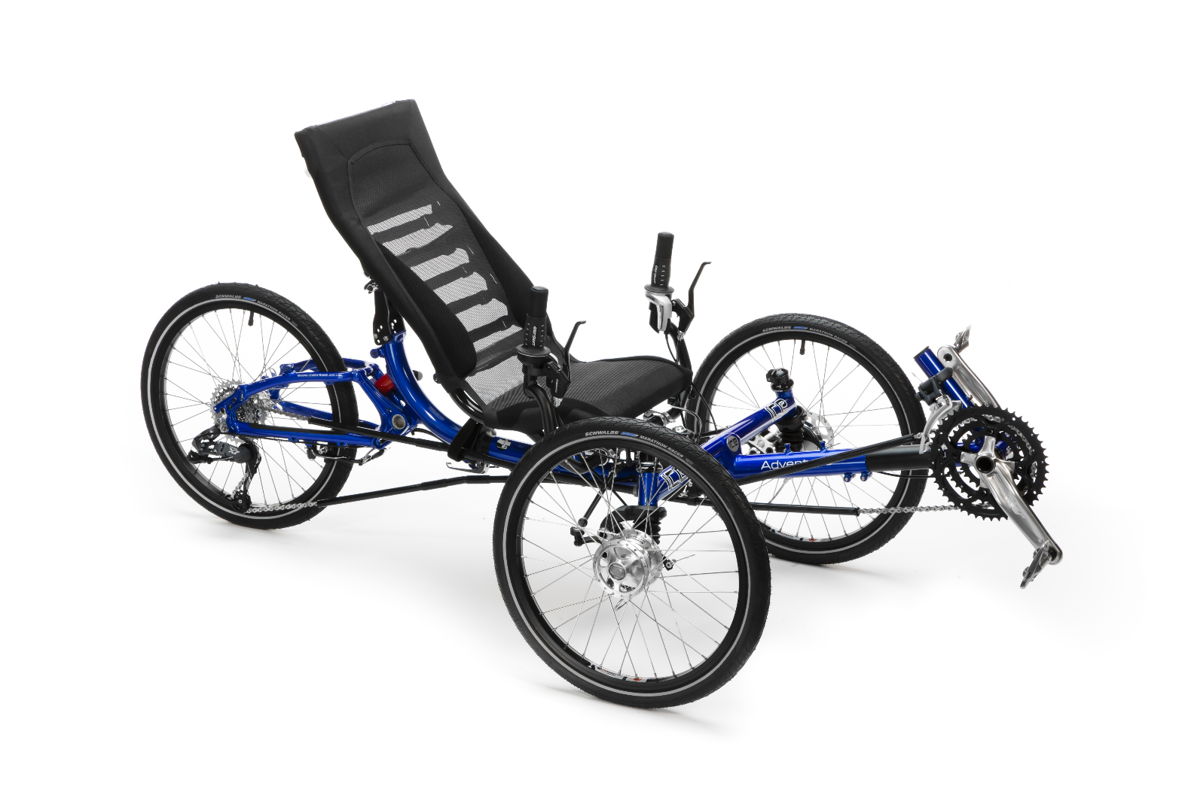
Introductions – Dan Foreman
Avid Cyclist

Slide 5
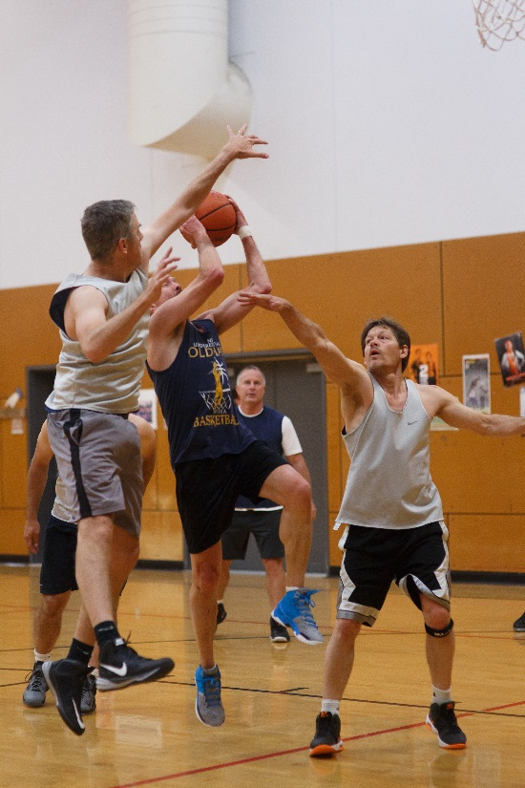
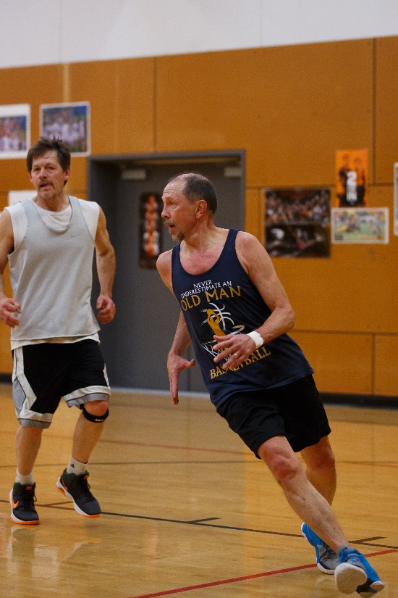
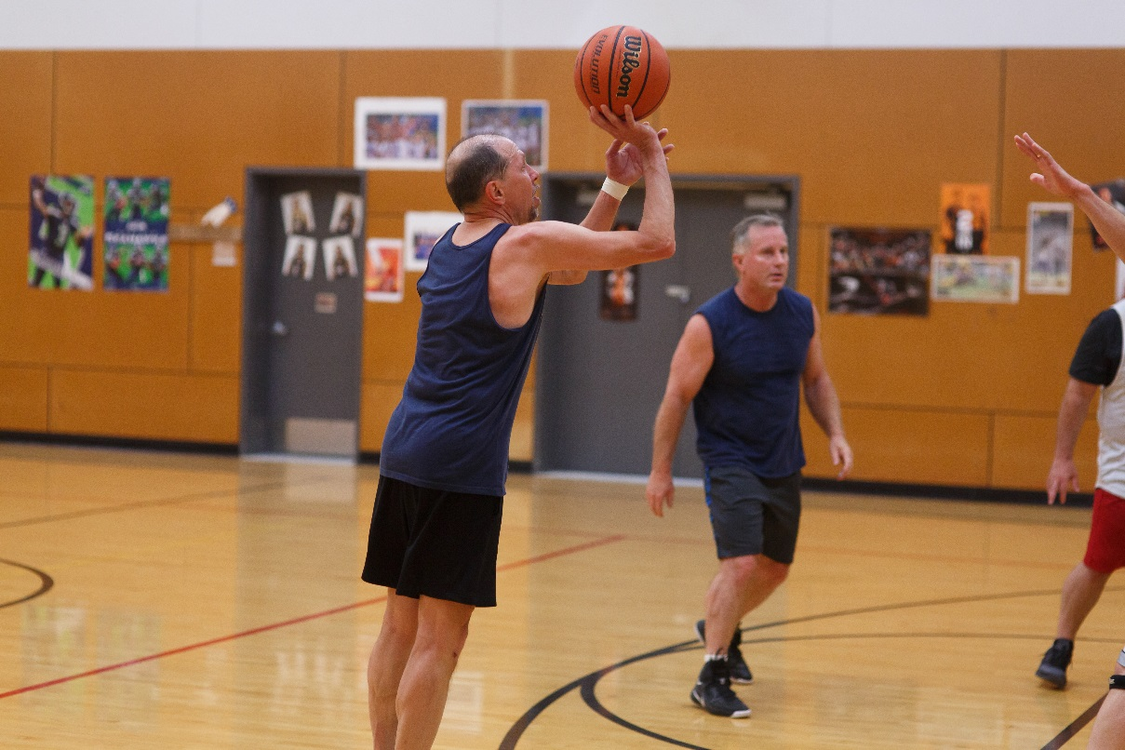
Introductions – Dan Foreman
Avid Basketball Player (with frequent visits to the ER)

Slide 6
Introductions - Audience
Progress Version (end users only please)
  V11.6
  V11.anythingelse
  V10
  V9
  V8
  V7
  Pre-V7

Slide 7
Introductions - Audience
Who is new to Progress in the last 2 years?
  Welcome to our small, quirky community
DB Operating System
  AIX
  Linux
  Windows
  Solaris
  HP/UX

Slide 8
Introductions - Audience
Largest Individual Database
  > 10TB
  > 1TB
  > 500GB
  > 100GB

Slide 9
http://jamescameronstitanic.wikia.com/wiki/Edward_John_Smith
When the water was coming onto the boat deck, Smith stood by and watched Officer Lightoller trying to launch Collapsible B. A third class passenger with her baby tried to ask Smith what they should do, however, Smith remained silent and walked towards the bridge to await his fate. He walked onto the bridge and opened the door to the wheel house. He closed the doors to the wheel house, and stood there looking at the rising water engulfing his ship.

Slide 10

Wish I hadn’t put off scheduling that DB Health Check

Slide 11
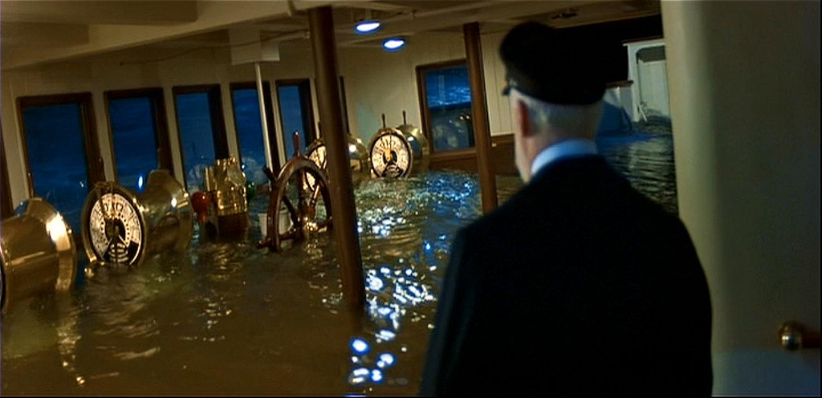
How am I going to find those After Image files now?

Slide 12
Let’s Get Started

Slide 13
Identify the Symptoms
Server is down – that’s (usually) easy to understand
Alerts are flooding in – more on Alerts in a few slides
Users are wailing:
  Can’t log in
  My screen is frozen
  I’m locked up
  Or – see next slide

Slide 14
User Dialog
User:
  I had an error message on my screen that said something about “@$#%$^$^%**(*(&”
DBA:
  Did you write it down or capture the screen?
User:
  No, <insert some stupid excuse>
DBA (what they would like to say):
  Did you expect me to magically figure out what the message said?

Slide 15
Starting Place
Alerts from Monitoring Processes
Is the the Databases Accessible?
Can New Client Sessions Start?
Are Existing Client Sessions having issues?
Progress Java Processes Accessible?
Is the Operating System Accessible?

Slide 16
Alerts from Monitoring Processes – DB Related
Can’t connect to the DB
BI Growth & BI Stall
AI Growth & AI Stall
Connection Table (-n) Limit
Remote Client Server Limit (-Mn, -Mpb)
Lock Table (-L) Limit

Slide 17
Alerts
Alert Fatigue
Nuisance Alerts
The Blame Machine: Why Human Error Causes Accidents by R. B. Whittingham

Slide 18
Are the Databases Accessible?
promon
promon hangs?
  Try –NL ?
  Try –F ?
  If one of the above options is required, it usually indicates the DB is not operating normally and will probably need to be shutdown or subjected to a controlled crash
  If you can make it into promon with one of the two options above, screen capture all ‘wait’ related screens
    R&D > Status > Processes/Clients > Blocked Clients
    Debghb > 5, 6, 11, and 15
Crashed DB? That will be covered later

Slide 19
Client Connections
Try connecting without the Application code being involved, i.e. the Progress editor
4GL SELF Service Client
  Read Only: -RO
Remote Client
  Loopback Remote Client instead of using the LAN
  -H <IP Address> instead of DNS Name
  Spawn a new Secondary Login Broker (proserve –m3) and try using a different port#
  Ping & Netstat are your friends
Can a SQL Client connect?

Slide 20
Are the Progress Java Processes Queryable?
Admin Server?
Name Server?
AppServer Brokers?
  What is the status of the AppServers, i.e. is the number AVAILABLE > zero?
WebSpeed Broker?
  What is the status of the Agents, i.e. is the number AVAILABLE > zero?
If the proadsv/nsman/asbman/wtbman process hangs or fails, try the Java Virtual Machine Process Status Tool (jps command)

Slide 21
Operating System
Is it possible to login?
  Direct attached Console?
  Remotely? SSH versus Telnet
  Can the box be pinged with IP address and/or Host Name?
OS Stats
  CPU
    High? Compared to what?
  Memory
    High? Compared to what?
  Disk
    High? Compared to what?

Slide 22
Check the Logs
Database Log
AppServer / WebSpeed Logs
Admin Server Log
Name Server Log
OS System Logs
Logs created by scripts

Slide 23
Specific Symptoms – Periodic DB Freezes
Online backup with large BI File
  DB Transaction Activity is frozen during this portion of the backup
  Client doesn’t receive any messages
  Solution: V11.3 probkup backups active BI clusters only
Quiet Point (proquiet)
  Client doesn’t receive any messages

Slide 24
Specific Symptoms – Periodic DB Freezes
Checkpoint Duration
  Buffers Flushed
  Sync Call
  DB Buffer Scan
AI Stall (-aistall)
  Client doesn’t receive any messages
BI Stall (-bistall)
  Client doesn’t receive any messages

Slide 25
Response
Make sure that the AI files are being archived properly (in case things get bad suddenly)
Turn up the logging level on AppServers & WebSpeed Agents
Start running gather.sh (or similar) Script
Client Logging
Statement Caching
If problem is not I/O related….try the opposite, is it Record Lock or Blocked Client related
Have a super-script to automate all this stuff….the peak moment of a problem/crisis is not the time to be searching the manuals and other unproductive activities
Update your Resume or CV

Slide 26
Miscellaneous Things to Check
Change Control
Things not always covered by change control:
  Configuration changes made in the application
  Scheduling changes
  Hardware changes
    Even seemingly safe & trivial stuff like a Firmware upgrade on the SAN

Slide 27
Miscellaneous Things to Check
Things not always covered by change control:
  Network activities
    New hardware in the infrastructure
    New routes
    DNS changes
    Firewall changes
  Good things with bad consequences
    Virus Scanners
    Port Scanners

Slide 28
Miscellaneous Things to Check
Increase in load
  Seasonal
  New business acquisition
DB License File – recent increase in connections?
Files getting larger than normal
  DB Extents
  Backup Files
  Log Files

Slide 29
DB Crash
Suspected corruption? Do an OS backup because probkup might fail if there is corruption and that can result in a big waste of time
  A backup gives you time to look at things deliberately & carefully
DO NOT automatically assume that you need to force access with –F option

Slide 30
DB Crash - Restart Problems
Won’t restart using Explorer or dbman? Try a simple proserve as that (sort of) removes Java from the list of possibilities
Does Single user work? (pro command)
Utility Access? (proutil truncate bi, dbanalys, prostrct list/statistics, rfutil aimage list)
Preserve the AI Files!
Preserve the DB Log files – some DB startup scripts truncate the log without saving a copy first

Slide 31
Getting Help
Refrigerator magnet with contact info of a trustworthy source of help
Don’t wait until a problem occurs to wish you had a document/wiki with contact info for:
  Progress
  Application(s)
  Hardware
    Server
    SAN
  OS (if from a different vendor than hardware)
  3d Party stuff
  Network
    Internal
    External (e.g. WAN)
  When you do your periodic disaster test, make sure this document is up-to-date

Slide 32
Getting Help
Open a Conference Call Bridge and/or GoToMeeting/Webex or similar
Delegate
  Note taker, screen image grabber
  Make coffee, get pizza
  Keep the buzzards away
  Coordinate the call bridge
Have you practiced? Some companies practice a full blown disaster but not outages that are severe but less than disaster intensity

Slide 33
Human Factors
Remain calm
Tell the “vultures” to go away
Assign blame later

Slide 34
Problem Avoidance
Periodic Progress Health Checks
Adherence to DBA Best Practices
Monitoring (which is a subset of Best Practices)

Slide 35
Post Mortem
Full Definition of postmortem according to Merriam-Webster
  done, occurring, or collected after death
  following the event
Document everything while it’s fresh in everyone’s mind

Slide 36
Thanks
If you are enjoying the conference, please take a moment and give some appreciation to the organizers….it’s a thankless job with hundreds of details that can derail a session (e.g. projector or audio malfunction), a meal, or worse (heavy rain at an outside event)
To the organizers I would like to say thanks for not scheduling this years conference on my birthday as it has been for the past several years!

Slide 37
Questions?
danf@prodb.com

