Slide 1
DBA Best Practices
Paul Koufalis – White Star Software

Slide 2
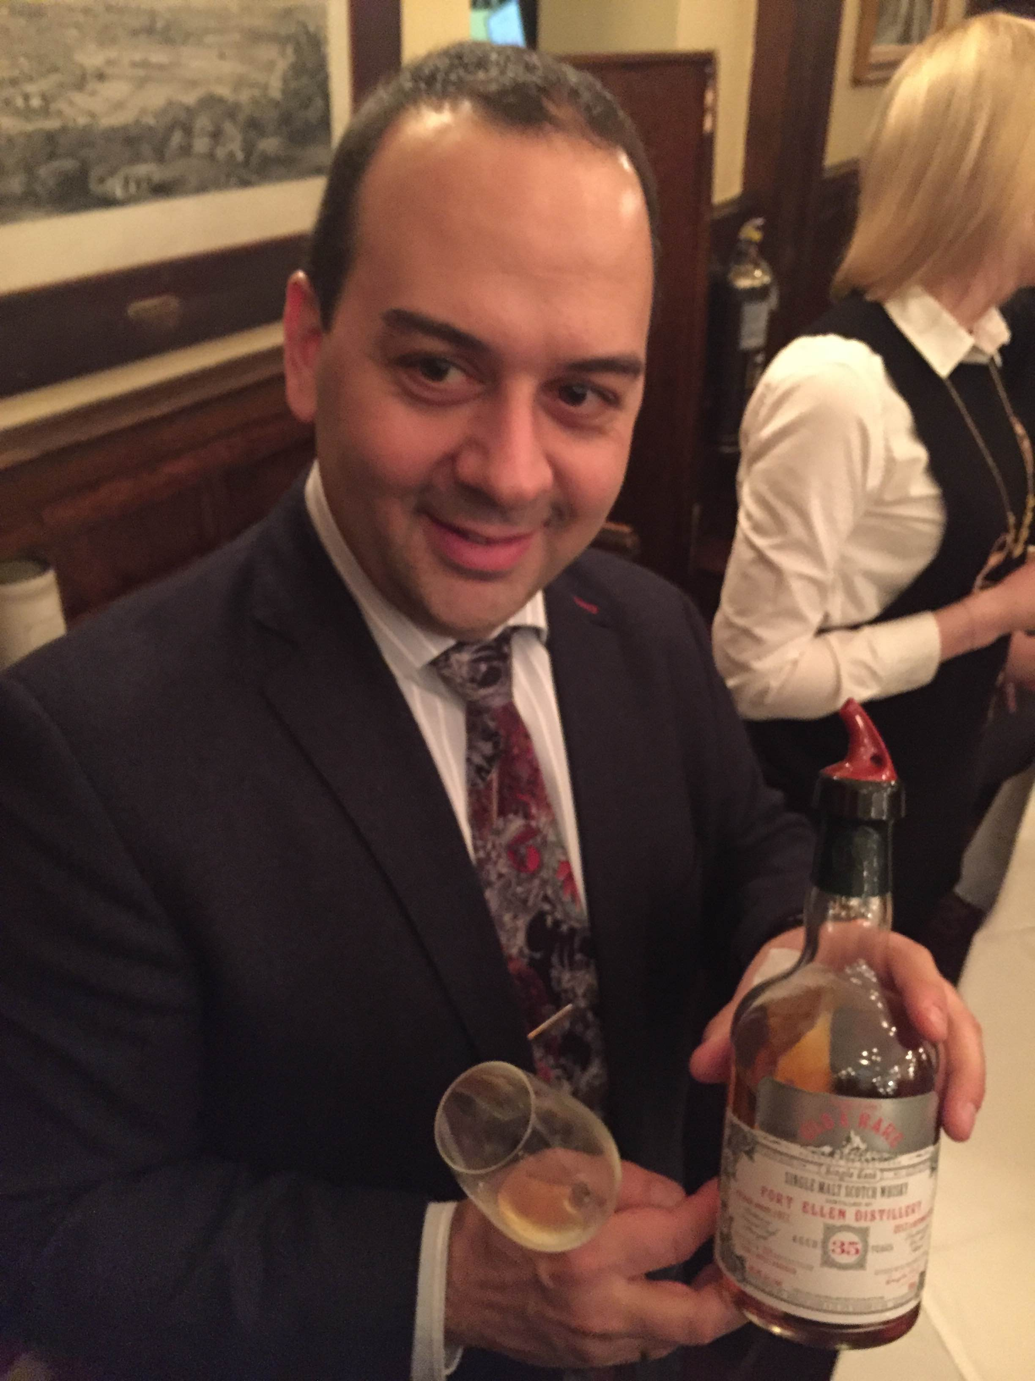
Why listen to me?
pk@wss.com
Progress DBA and UNIX admin since 1994
Expert consulting related to technical aspects of Progress and OpenEdge
Wide range of experience
Small 10 person offices to 2500+ concurrent users
AIX, HPUX, Linux, Windows…if Progress runs on it, I’ve worked on it
Single malts and American bourbons

Slide 3

The oldest and most respected independent DBA consulting firm in the world
Four of the world’s top OpenEdge DBAs
Author of ProTop, the #1 FREE OpenEdge Database Monitoring Tool
  http://dashboard.dbappraise.com

Slide 4
Agenda
DBA Best Practice Stuff
More DBA Best Practice Stuff
Yup…You Guessed it…
I’m going to keep talking until I run out of time

Slide 5
ymmv
These are general best practices that apply to 90-something % of you
Some of these recommendations may not apply to you at all or may be…well…bad
This is not The Gospel According to @oeDBA
YOU MILEAGE MAY VARY – TEST TEST TEST TEST

Slide 6
db startup parameters
-spin pi * DBA year of birth (h/t Dan Foreman)
-lruskips 100
-aibufs 50 –bibufs 50
-B something –B2 something –L something
-tablerangesize #Tbl++ -indexrangesize #Idx++
-omsize (select count(*) from _StorageObject)++
-pinshm
-pica something big if using OE Replication
-prefetchDelay –prefetchNumRecs 0 –prefetchFactor 100
-aistall –bistall –bithold something
-n # conx (NOT # users!!)

Slide 7
c/s startup parameters
-S port# –minport port# -maxport port# -Mi 1 –Ma # -Mpb #
-ServerType 4gl|sql
Segregate 4gl connections from sql connections
Segregate “regular” users from “special” users like AppServers
  -Mi 1 –Ma 5 is probably good for regular users
  -Mi 1 –Ma 1 is probably better for busy users
-Mn = SUM(All –Mpb) + # brokers + a good buffer
Haven’t yet decided on the “-S on primary broker” question yet…

Slide 8
aistall/bistall/bithold
Assume the bi will grow to 2-3 X –bithold and assign accordingly
I.e. if 25 GB of free disk space, set –bithold to 10,000 MB
HAVE A WRITTEN PLAN!!
Nice to have –bistall –bithold 10000 but do you know what to do when it happens?
  And what happens when you’re on vacation?
Same for aistall: do you know what to do if/when the DB stalls?

Slide 9

after-imaging
If I hear one more person tell me “the business can lose one full day of data” …
Please enable AI and the AI File Management Daemon
Please
  _rfutil db –C aimage begin
  _rfutil db –C aiarchiver enable

Slide 10
oe replication
This is a GREAT product – works as promised
The transition configuration can be a little tricky
  Test and simulate A LOT. Then do it again
  Or get professional help. I’ve done this a gajillion times

Slide 11
help me please
Start all the helper processes: APW, BIW, AIW, WDOG
99.9% of you only need ONE APW
There is still an old “best practice” out there that says “one APW per physical disk + 1”
NO NO NO NO – You need ONE.

Slide 12
physical db
DB Blocksize: 4K on Windows and Linux, 8K on UNIX
  prostrct create db –blocksize 4096
AI and BI blocksize = 16 KB and BI Cluster size = 16 MB
  _proutil db –C truncate bi –biblocksize 16 –bi 16384
  _rfutil db –C aimage truncate –aiblocksize 16
Enable large files
  _proutil db –C enablelargefiles

Slide 13
physical db
Use variable length extents everywhere
  AI, BI, D*
Yes I know there is a supposed “performance hit”
For most of you it is not measurable to the business
Data extents: not measurable
AI extents: measurable (+/- 5%) but still noise to the business
  EXCEPT for databases with VERY high create/update/delete
Mike Furgal disagrees vehemently

Slide 14
physical db – storage areas
Use type two storage areas exclusively
For everything except the schema area
No single answer on how to segregate tables
Generally:
  Tables, indexes and LOBS don’t mix in the same storage area

Slide 15
log files
Please please please truncate your log files regularly
I love going to a customer and seeing 4 GB db.lg files!
Archive a copy of the log to db.lg.<weeknum or monthname>
Next year you will overwrite the file
You have a trailing year of log files
We have asked Progress to enhance the logging subsystem to separate login/logout, DB startup/config/maint and error messages in separate log files

Slide 16
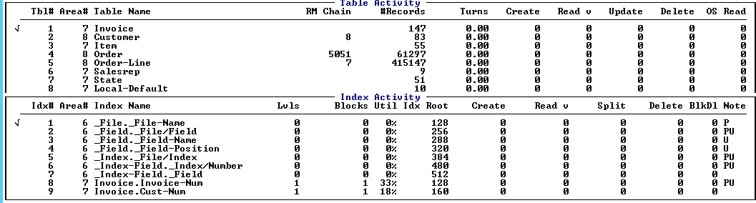
db analysis
Run db analysis monthly and keep a year or more
Handy for growth analysis and other similar trending activities
11.x has some cool new parameters for creating CSV files
Don’t forget to copy the db analysis output to $PROTOP/dbanalys
  Table and index information can be shown alongside CRUD metrics

Slide 17
backups
CHECK the integrity of your backups
We hear backup horror stories far too often
On Windows, a failed backup will still update the timestamp of the file
Backup bug in 11.3 and 11.4 – use bibackup all for online backup
Restore the backup regularly (Ex.: refresh test)
Run prorest –vp
Monitor the real backup date/time in ProTop, promon or VST

Slide 18
business continuity plan
The “get regular exercise” of the database world
  No time today – I’ll do it tomorrow
How many of you test your DRP/BCP regularly?
  NOT in financial services?
BCP is not just for a hurricane. It’s for a bad power supply too.
Keep your plan up-to-date

Slide 19
sql
Don’t let the sql demons into your DB
  Like cockroaches, once in you can never get rid of them
They don’t care about your performance – just theirss
Ok – there are justifiable uses. But please control them
Use OE Repl target if you have one for SELECT

Slide 20
sql continued
You have to run UPDATE STATISTICS regularly
  Not necessarily on the whole DB
Watch out for bugs in pre-10.2B08
Run dbtool to fix sql width issues
Automated and in real-time in 11.6

Slide 21
security
This is a talk in of itself
At the very least:
Don’t use root for everything
  Careful: things like OE Management don’t work well as non-root
Add some file-level security to the DB files
  Owner “prodba” and perms 664
  Setuid bit on executables will allow users to connect
  Will prevent accidents
If paranoid, restrict permissions on $DLC executables
  Don’t change setuid and root ownership unless you really know what you’re doing

Slide 22
killprosession
Stop using kill -9
What I really mean is stop crashing your DB with “User died holding shared memory …”
Killprosession automates a safer way to kill shared memory clients
  Careful: No process is foolproof
  We have very big clients using killprosession regularly for years and years without incident
Email me to get a free copy

Slide 23
ancient progress versions
Upgrade to something semi-recent please
At least 10.2B08 but preferably 11.x
No I don’t care if your vendor only “supports” 10.2B03. That’s ridiculous
No reason to be on 11.0/11.1/11.2

Slide 24
raid 5
Do I really have to go here?
This topic has been done and redone. It’s dead Jim
Understand one thing: SANs are made for management, NOT for performance
As the disks move away from the machine, things get slower
Magic RAID levels and automagical use of flash/SSD/fibre/SATA disks – all marketing
As my friend Tom likes to say: “There is no such thing as a high-performance SAN”

Slide 25
licensing
The Progress SAM team is auditing EVERYONE
Do an internal audit
  You can buy missing licenses with a little bit of negotiating leverage
Whatever they catch will cost you double
  Back maintenance
  Reinstatement fees

Slide 26
monitoring and alerting
You all know that we sell the ProTop Monitoring and Alerting Service
It monitors everything and is waaaay cheaper than trying to write your own
OE Management just doesn’t work. It doesn’t monitor anything useful
  Sorry to my friends @Progress but it’s true
If you do feel compelled to write your own, look at ProTop Free for inspiration
At the very least, monitor the super important stuff:
  DB up/down
  BI / long transaction
  AI subsystem status and AI files
  OE Replication status

