Slide 1
Benchmarking Network Data Transfers
Paul Koufalis – White Star Software

Slide 2

Why listen to me?
pk@wss.com
Progress DBA and UNIX admin since 1994
Expert consulting related to technical aspects of Progress and OpenEdge
Wide range of experience
Small 10 person offices to 2500+ concurrent users
AIX, HPUX, Linux, Windows…if Progress runs on it, I’ve worked on it
Single malts and American bourbons

Slide 3

The oldest and most respected independent DBA consulting firm in the world
Four of the world’s top OpenEdge DBAs
Author of ProTop, the #1 FREE OpenEdge Database Monitoring Tool
  http://dashboard.dbappraise.com

Slide 4
Agenda
a little theory
tweakables
stupid programming tricks
numbers

Slide 5
a little bit of theory
Two basic database connection types
  Shared memory or self-service
  Client server
Shared memory is always going to be faster
  Self-service clients reach into shared memory and get the data themselves
  C/S clients have to ask a proxy process to do this for them
    AND transport the data across a slow connection
Most legacy Progress code was written back in the ChUI days
  All shared memory
  Doesn’t necessarily port well to C/S

Slide 6
the (simplified) process
Progress 4GL client connects to the database broker through a service port (_mprosrv)
The broker assigns the client to a new or existing server (_mprosrv –m1)
Client submits query to server
Server executes query
  A server is a fancy shared memory client
Server returns data to client
Client does post-processing on data
  Ex.: Filtering and sorting
Data becomes available to program/user

Slide 7
the 4gl server process
OK – a little more than just a fancy shared memory client
Single-threaded process
Uses a polling mechanism to determine which connected clients need servicing
Uses a round-robin allocation algorithm to determine which client to service
Note: _sqlsrv2 is multi-threaded

Slide 8





tweakable parameters
MTU
-Mm
-Mm
-Mm
-Mm
-Mm
-Mm
-Mm
-prefetch*

Slide 9
new –prefetch* parameters
No-lock queries
Forward only or scrolling
10.2B06 + and 11.1+
-prefetchPriority: server defers poll for other requests while filling message
  Current suggested value 100 records added before next poll
-prefetchDelay: Fills first message. By default first message contains one record
  In theory this is better. In practice the difference is not significant
-prefetchNumRecs : How many records are stuffed in a message
  100 records is a good start (default is 16)
-prefetchFactor: How full (%-wise) to fill a message
  90-100%

Slide 10
message buffer size (-Mm)
Default 1024 is too small
Max 32600 doesn’t seem to be warranted
8192 is a nice sweet spot
Pre-11.6: clients and databases all had to have the same –Mm
11.6+: Client uses –Mm from database server: i.e. no more client-side –Mm required

Slide 11
maximum transmission unit (MTU)
A network parameter set at the NIC level
Enable on the routing infrastructure
Default is 1500
“Jumbo Frames” is 9000 bytes
The advantage lies in the relative size of network header data
  1500 byte MTU: 1460 byte payload / 1538 byte total = 95% efficient
  9000 byte MTU: 8960 byte payload / 9038 byte total = 99% efficient
Use ping to test
  Windows: ping –l 8900 –f <ip address>
  Linux: ping –s 8900 –M do <ip address>

Slide 12
Mm – MTU interaction
Progress generates a message of size –Mm
The message is submitted to the TCP/IP stack
Stack breaks the message up into MTU-sized bytes to ship across the network
Even if the originating NIC has an MTU of 9000, every switch and router between the client and server must support jumbo frames
  Otherwise the jumbo frame will be broken down into 1500 byte (or whatever MTU-size) packets

Slide 13
other parameters
-Mi / -Ma: min/max users per server
The more users per server, the less time the server can dedicate to any one user
-Mi 1 -Ma 5 is a good start
-Mi 1 -Ma 1 if you have heavy duty users
  AppServer agents
Note: _sqlsrv2 is multi-threaded

Slide 14
stupid programming tricks
Field lists: fields that are sent to the client
Why send the whole record if you don’t need it
  for each order fields (order-num terms) no-lock:
  for each order except (instructions) no-lock:
No-lock is the most important part of this
Without “no-lock” the server returns one record per message

Slide 15

stupid programming tricks
Thank <insert favourite deity> Progress doesn’t send the LOB across the wire unless you ask for it
The LOB field is really a separate entity to the record
The real record only contains a pointer to the LOB
The LOB may be in another storage area (and should be)
When you access the LOB, the client requests it from the
server

Slide 16
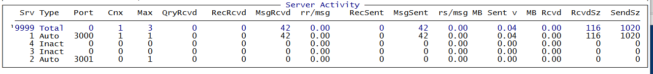
Monitoring Server Messages
_ActServer VST
  Key: _server-ID
  Interesting fields: _Server-ByteSent, _ServerMsgSent, _ServerRecSent
  Calculate send size (Bytes sent / messages sent) and compare to –Mm
Bug: When a record is larger than –Mm, only the first msg is counted
  I.e. if you send a 4K record and –Mm is 1024, only 1 msg and 1024 bytes sent recorded
  Blobs sent in 32,000 byte chunks – each chunk increments msgSent by 1 and byteSent by -Mm
ProTop Free:

Slide 17
enough already – you promised some numbers!
A little info about the test DB:
Order table: 61K records (142K fragments) w/ mean size 5500 bytes
  Most of it in the instructions field
Customer table: 83 records w/ mean size 174 bytes
  Field custPDF is a 4.7 MB blob (a pdf)

Slide 18
baseline
_mprosrv sports –S 5000 –B 250000 –Mi 1 –Ma 15 –Mn 2 –Mpb 1
  All users on the same server
  -B big enough so that all data is in memory – i.e. disk does not come into play
10 concurrent _progres connections running “for each customer” 10K times
Our goal is to minimize network messages
Using ProTop Free to monitor server activity (http://dashboard.dbappraise.com)

Slide 19
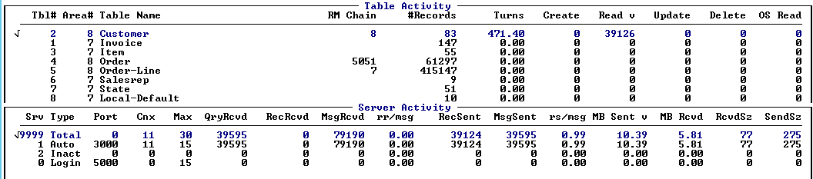
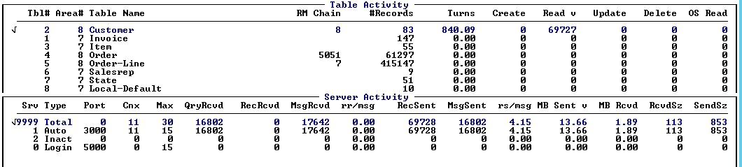
baseline
for each customer: 3m30s
for each customer no-lock: 2 min

Slide 20
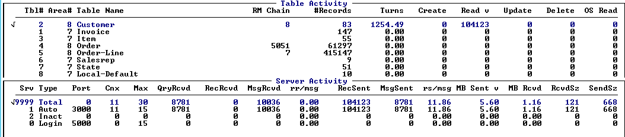
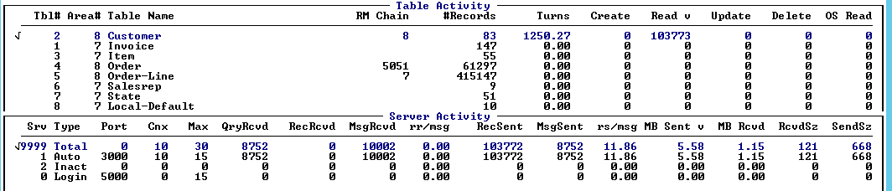
Using field lists
for each customer fields (cust-num name) no-lock: 1m15s
-Mm 8192: 1m15s

Slide 21
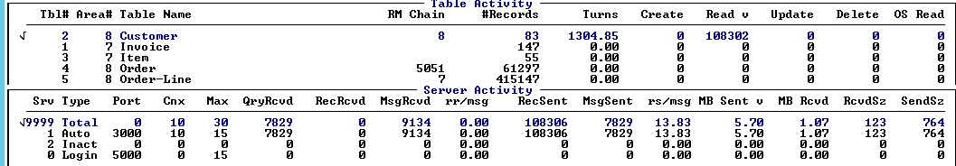
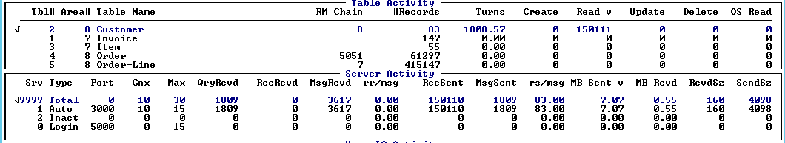
adding prefetch
-prefetchDelay: 1m15s
+ -prefetchNumRecs 100: 55s

Slide 22
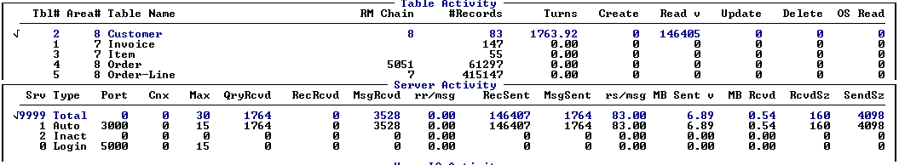
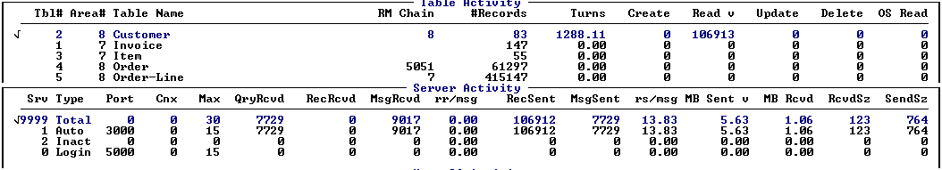
…prefetch
-prefetchNumRecs 300: 55s
-prefetchFactor 100 –prefetchNumrecs 16: 1m15s

Slide 23
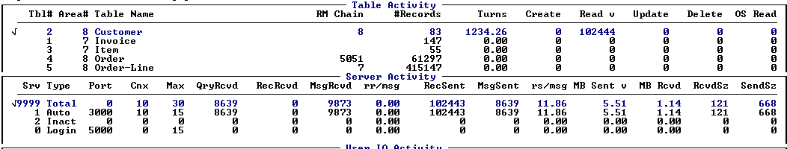
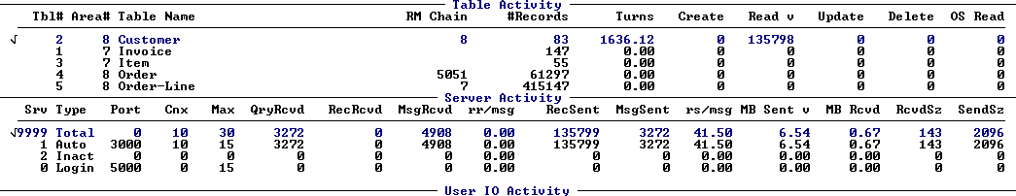
increasing -Mm
-Mm 16384 (no prefetch params): 1m15s
-prefetchNumRecs 100: 59s

Slide 24
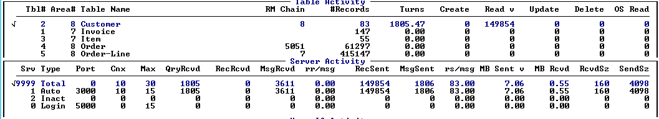
adding prefetchDelay
+ -prefetchDelay
Notice the reduced message count: 3272 msg/sec vs. 1806 msgs/sec
  Why?
So why didn’t average message size change with –Mm ?

Slide 25
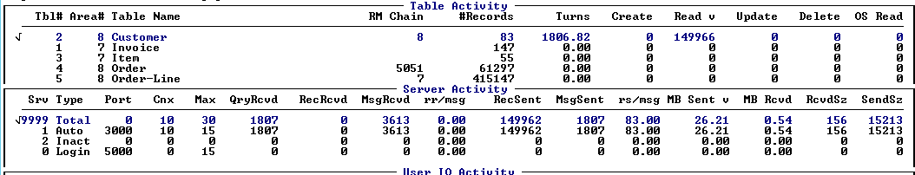
send the whole 174 byte record
Same 57 seconds:
But now sending 15K per message
83 records X 174 bytes = 14.5K

Slide 26
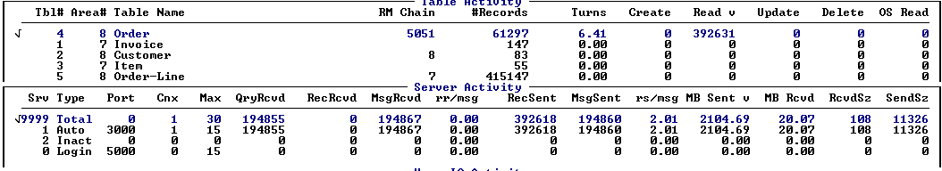
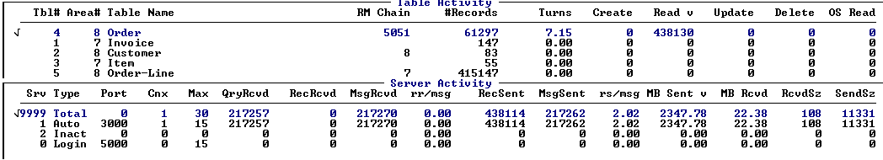
using order (61K records)…
No prefetch
One single user running “for each order no-lock …” 10 times
29 sec
With prefetch: 29 sec – WAIT ? WHAT ?

Slide 27
lobs
-Mm makes a difference for lobs
Send 83 customer lobs @ 4.7 MB each
-prefetchDelay –prefetchNumRecs 100
-Mm 1024: 11 sec
-Mm 16384: 4 sec
-Mm 32600: 3.5 sec
With lobs, the prefetch params didn’t make much difference
  Server sends 32000 bytes at a time

