Slide 1
Facing the Challenges of modernizing legacy Open Edge ABL code and its concurrency control
Presenter: Oscar Perez Cedron
Date: June 26 2016

Slide 2
Modernization – A Simple Matter of Survival
Without starting from scratch on new development, modernizing legacy software allows organizations to maximize the use of their existing application assets and investments. It’s a simple matter of survival.

Slide 3

Agenda
Story of Apero’s Progress ERP Solution
  Where we came from
New Emerald GUI Application Framework Strengths
Challenges and Things to watch out for
Emerald Framework in Action
  Emerald Architecture
  Future Roadmap
Recommendations

Slide 4
Apero Solutions Inc.
Based in Edmonton, Alberta, Canada
  Employee group in Edmonton, Calgary, Vancouver and Toronto
    Offshore partner development team
  Legacy ERP Solution written in Progress
    Roots in the early 1980’s Progress development platform
    Small Solution provider to mid / large size hard goods distributors
    Over 30 years of functional development & business logic
    Global customer based with demands for continued support as well as new development in functionality, services and integration to 3rd party products

Slide 5
Apero Solutions Inc.
  New Company Apero Solutions formed 2011
  Problems Facing the New Company
    Old Legacy ERP was dated and next to impossible to promote in today’s marketplace
    Large existing customer base which required a definitive migration path
  Goals
    Ability to allow users the choice of the traditional interface or new browser/mobile based interface – supporting both environments for some period into the future.
    Future proofing our modernization efforts so we don’t have to start from scratch as new technology emerges
    Leveraging years of business logic development in the core ERP with minimal re-development

Slide 6
Apero’s Solution
Options:
  Start New Development
  Modernize our existing application
Decision
  Move core business logic from the traditional Progress legacy code to service-orientation
    Progress Web and Rest Services in Progress Open Edge
  Same services to be called from multiple UI platforms
    Browser / Mobile / Web Store
    But maintaining integrity of CHUI (character) Interface
  Use the standard Progress Application Server Technology
  Develop a new rich UI based on .net and Browser delivery

Slide 7
Legacy Application Framework
ERP Trax product was developed on an Application Framework “workbook”
  The “culture” for our development team was always based on essential software design principles defined by “workbook” - an early version of our application framework
  Allowed for consistent character user interface
  Organized Application Structure
  Generally Kept re-usable business logic “free” of UI code
    Example “getPrice”, “getAFS”
  Code Generation for basic CRUD operations and master table list and printing
  Generic way to pass dynamic parameters among shared application code and includes.

Slide 8
Elements & Goals for the New Application Framework “Emerald”
Apero Recognized an application framework in the new development environment was crucial
“Emerald” application framework designed to support:
  Browser based graphical user interface (GUI)
    Sencha EXT JS framework for JavaScript
  Progress Web Services and REST services calls
  More flexible and configurable data inquiries that can include richer GUI widgets
  More solid application-security control now expanded up to data-field levels.
  Transaction control and record locking for data modifications in the newly stateless environment.

Slide 9
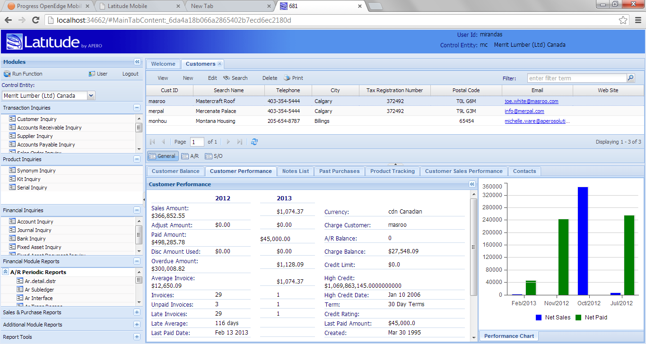
New Emerald GUI Application Framework Strengths
Consistent UI
Standard side bar menus, search options, lookup of tables, display format of individual records, insert of new records, edit of existing records, etc.
UI controlled by Emerald and not individual programmer

Slide 10
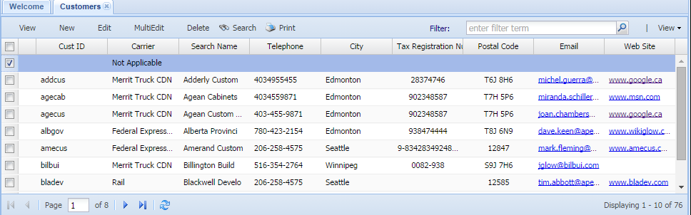
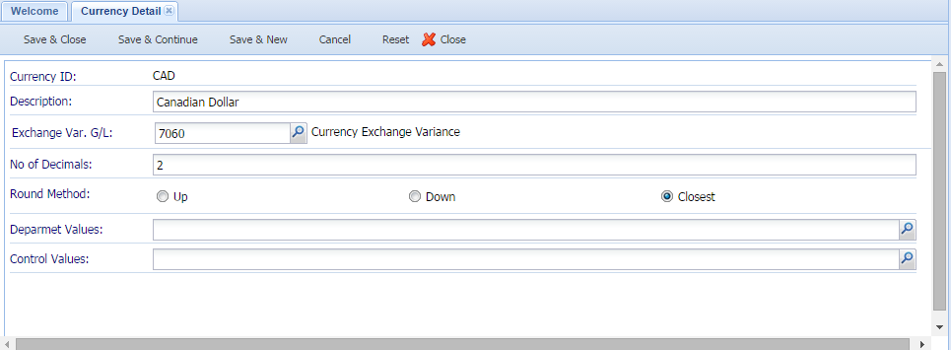
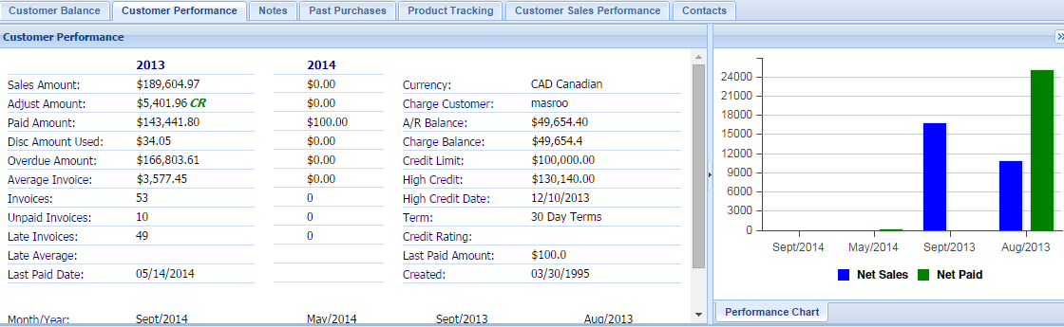
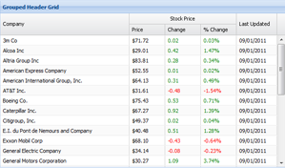
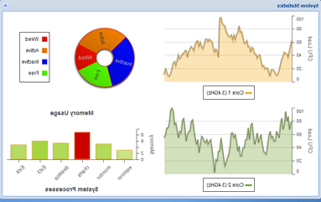
New Emerald GUI Application Framework Strengths
Consistent UI
Component-Type Definition
Selecting a Component type
Each type of component offers specific functionality
Home
Viewport
lookup
Setup
Free-form
Customer
lookup
SO
search
AR
balance

Slide 11
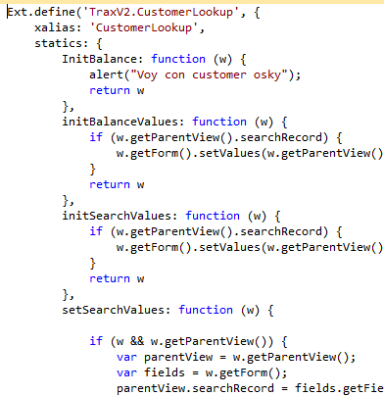
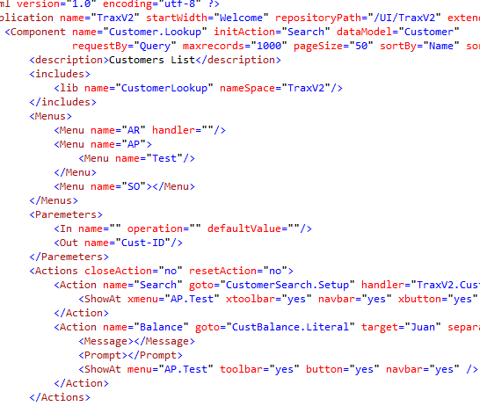
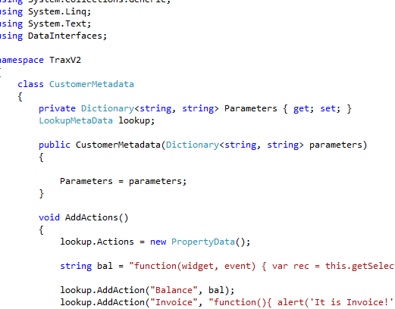
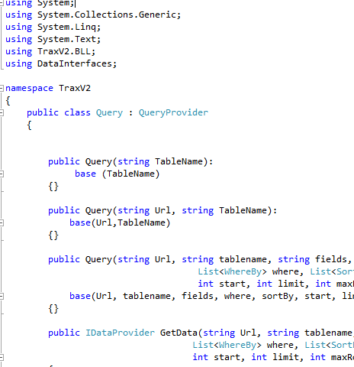
New Emerald GUI Application Framework Strengths
Consistent UI
UI based on XML Definition
Component configuration
( XML )
Component code
actioN implementations
( EXTJS-Json )
View provider implementation
( C#, JSON, Component-config )
Data provider implementation
( C# )

Slide 12
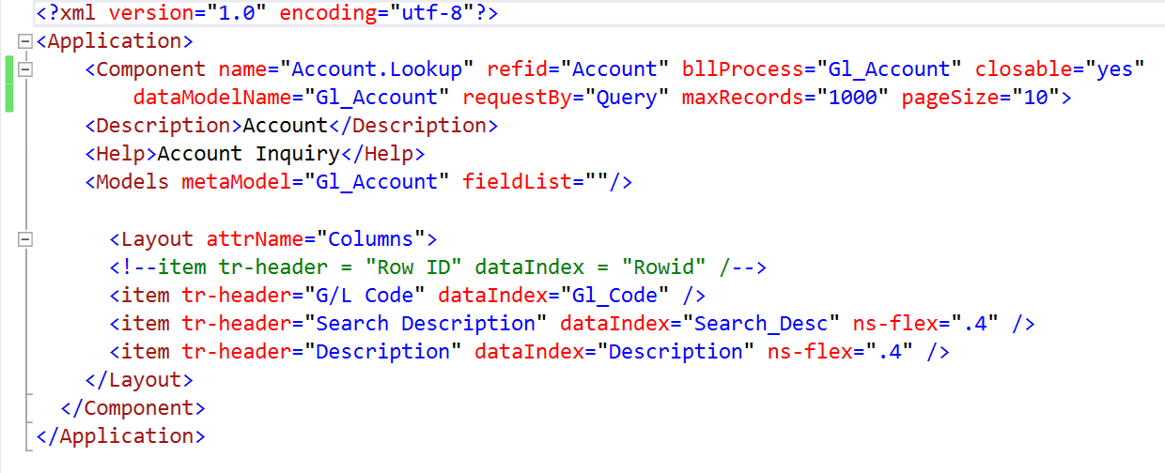


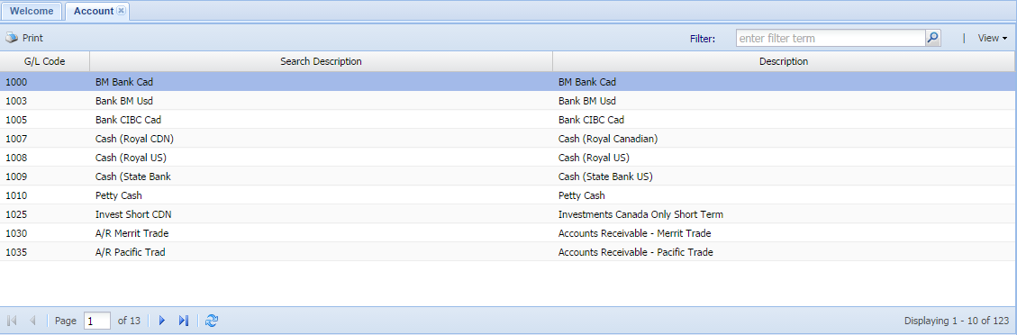
New Emerald GUI Application Framework Strengths (Consistent UI)
App Framework
Ui controller
Data controller
RenderLookup.ascx
QueryProvider.ascx

Slide 13
New Emerald GUI Application Framework Strengths
Organized Application Structure
Java Script Library
Dot.net MVC Framework
UI Rendering Engine
Presentation Layer
REST and SOA Services
OE Pacific APP Server
Business Servicing Layer
OE RDBMS
Data access Layer

Slide 14
New Emerald GUI Application Framework Strengths
Client Requests
Generic Business Layer
Security
Enterprise Services
Share Memory Context
RPC Calls
CRUD Calls
Data Query Calls
Generic Business Classes
RPC Classes
Business Objects
Pacific App Server
Application Business Rules
Legacy
Legacy ABL Includes (.i)
Legacy ABL Procedures (.p)
Data
RDBMS
Triggers
Db Integrity Rules

Slide 15
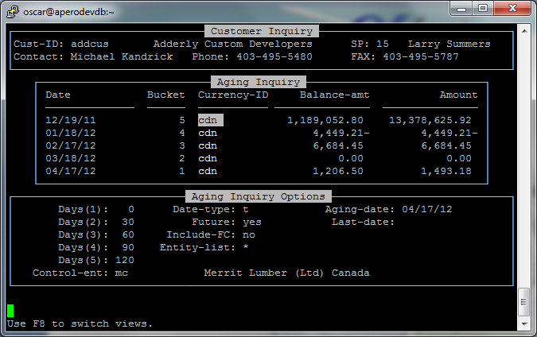

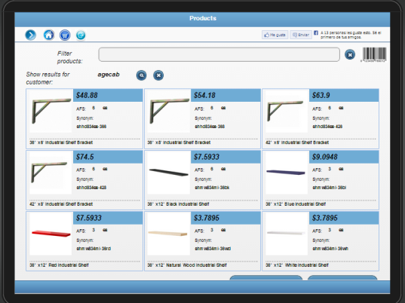

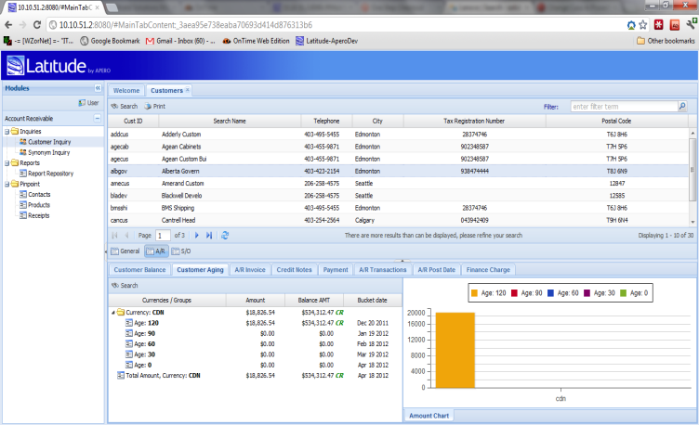
New Emerald GUI Application Framework Strengths
Reuse our legacy business rules code
OEMobile/ JS
SO.entry
(Trax)
SO-Trans (BO)
Before Update
Rest/GerOrd.p
After Update
rest/AddLine.p
Character Code
Mobile App
After Read
so/EditHeader.p
Rest Services
Do Actions
so/EditLine.p
Dot.Net / JS
ws/GerOrd.p
3rd Party Applications
Common Code
so/GerPrice.p
ws/AddLine.p
So/TaxCalc.i
Web Services
Rich Web App

Slide 16
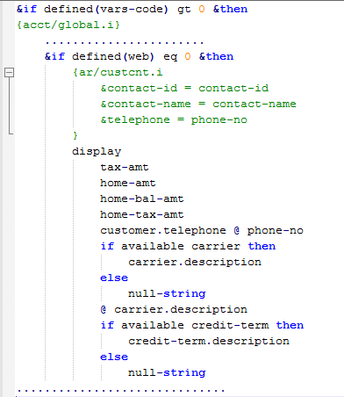
Challenges Apero Faced in Development
Development Issues
Extracting embedded Character UI from existing legacy “workbook” framework and legacy business rule code is not always an easy task.
  Sometimes it is better to start with a fresh design
Customer Credit Limit Calculation
Include File: ar/cstcrlkc.i

Slide 17
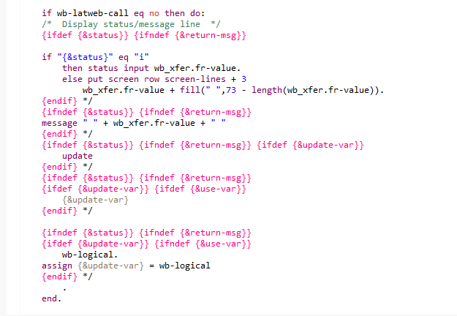
Challenges Apero Faced in Development
Development Issues
Factorizing Legacy Messaging and Notification Utility.

Slide 18
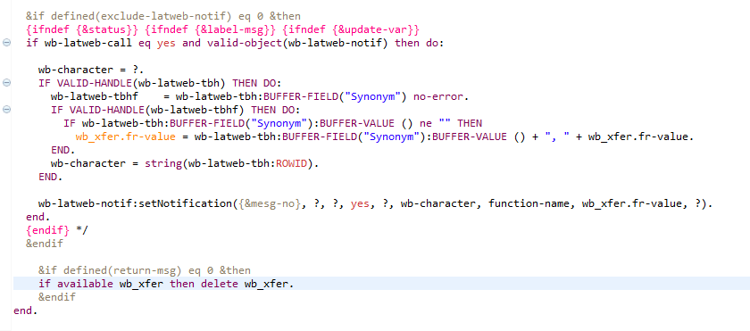
Challenges Apero Faced in Development
Development Issues
Factorizing Legacy Messaging and Notification Utility.

Slide 19
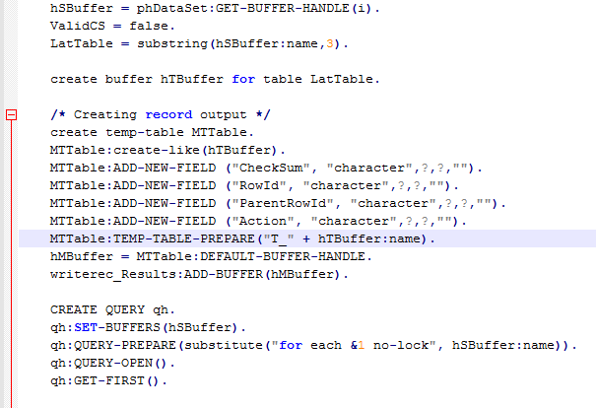
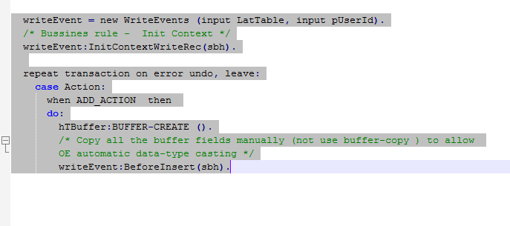
Challenges Apero Faced in Development
Creating Open Edge generic and dynamic code to receive CRUD-type call from clients
Event Driving Calls to Business Rules
(Implemented using OOP)
Use of Dynamic Temp-Tables and Queries

Slide 20
Challenges Apero Faced in Development
Development Issues
Reusing legacy code that uses include files (.i) with shared variables
Provide good performance not only for data retrieval through web calls but also to the Rich UI screen rendering.

Slide 21
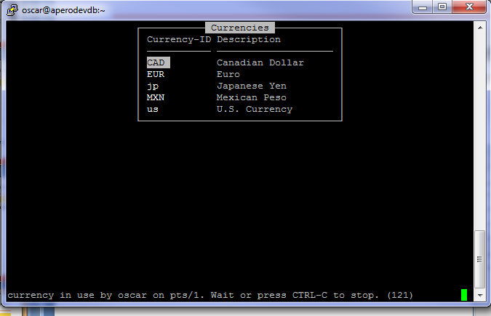
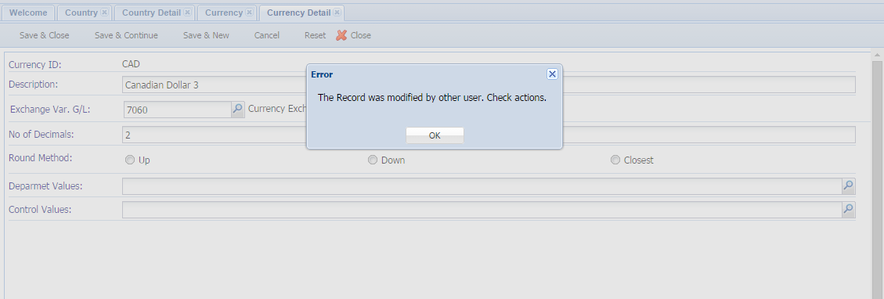
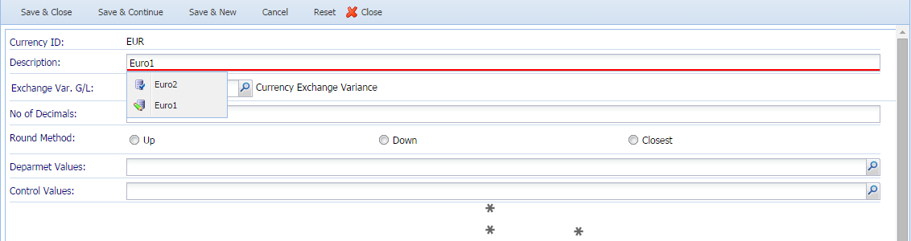
Challenges Apero Faced in Development
Development Issues
Supporting both types of application UI, Character and Graphical/web, adds complexity to:
  Implementation of transaction-control scope
  Implementation of record locking control to support both environments.
Pessimistic Record Locking
Optimistic Record Locking

Slide 22
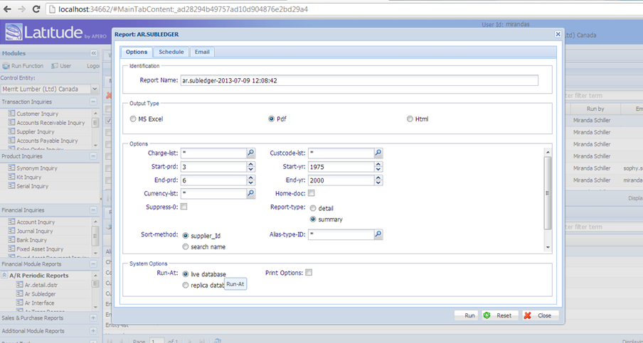
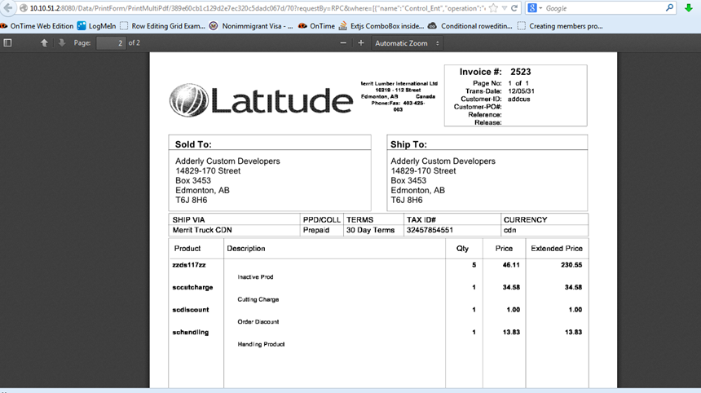
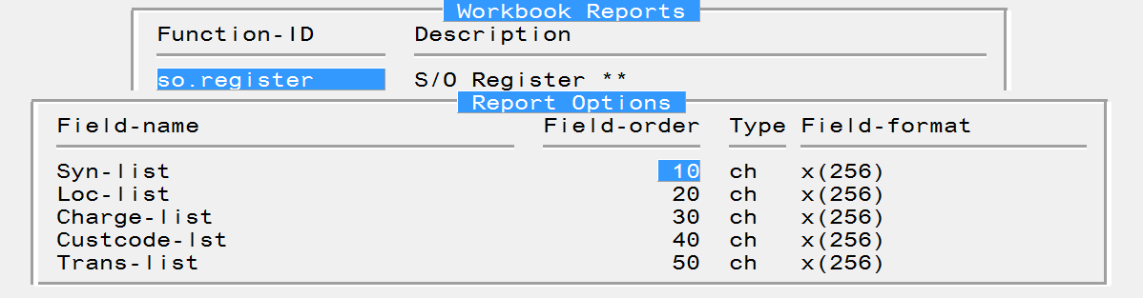
New Emerald GUI Application Framework Strengths
Leverage our existing form printing and report engine
Modern reports and forms are created from existing character reports without requiring a code re-write.
  ASC file from the character report is run through a screen scrapper (mapping) to create Postscript output, which is used to create a PDF file.
Output automatically formatted as PDF or Excel
Database report option records automatically render in browser UI

Slide 23
The Benefits
Modernization - Why It’s Worth the Effort
Richer User Interface / Experience
Utilizing New Technology
Opening the re-usable business logic layer to multiple UI platforms (mobility)
Increased compatibility with 3rd party products
Allows your Progress Application to be:
  Easier to market
  Easier to demo
  Easier to sell
  Easier to support

