Slide 1
OpenEdge Tools & Language
Info Exchange

Slide 2
Gathering Requirements

Slide 3
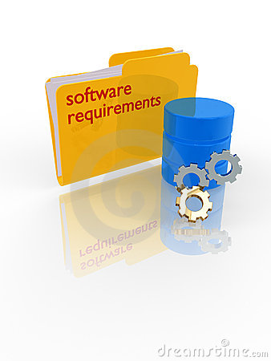
Source Of Enhancement Requests
OpenEdge Community
  Ideas section on Progress Communities (https://community.progress.com/community_groups/products_enhancements/i/openedge)
  Executive Briefing Center- face-to-face meetings at Progress Bedford
  Customer site visits & discussions
  Events: PUG Challenge, Exchange, etc.
  Requests via Technical Support calls
Market Trends & Competition
Internal Technical Experts
Etc.

Slide 4

Selecting Features To Implement
Product Management narrows down the backlog to a working list based on release themes and priorities
11.x backlog
PM and Dev assign H/M/L and rank by component area
1
Preliminary pool of release requirements (1,000’s)
Review recent results from Info Exchanges, Community voting, customer meetings, TSAMs, etc.
Latest set of requirements in the Backlog
50
~150
~80 requirements
15 components
Working list of requirements
~50
Short list, ranked by component area
Candidate Requirements
Sorted by component area

Slide 5
Community Input Process
Approximately 20% of development resources allocated to address prioritized needs of the community
Voting done on Progress Communities, Ideas area
Highest voted items given priority
All “Idea” contributions reviewed- the vast majority are added to the product backlog
  Selection for implementation as previously described
  Given 9-12 month release cycles, some requests may not be addressed for a significant period of time
  Given the volume of requests, some may never be addressed

Slide 6
Time For Your Input!

Slide 7
Enhancement Requests (H-M-L)
(M) Find exclusive lock – programmatic way to get the user holding the lock; maybe even with stack trace from user holding the lock
(H) Compile with XREF to identify when indexes are used incorrectly/inefficiently. Maybe new switch.
(L) PDSOE on Linux
(M) Export method on dynamic TT, PDS and BUFFER
(M) Lists and dictionaries of Objects – now just arrays or TT
(M) Compiler switch to build automatic FIELDS list on foreach into r-code
(H) Improve performance of code completion especially for .NET classes in PDSOE
(H) Add method argument name and type to code completion in PDSOE
(BUG) PL files aren’t included in code completion in PDSOE
(BUG) Code completion for TT – need to hit ctrl-space twice

Slide 8
Enhancement Requests (H-M-L)
(M) PDSOE macros defined by user are hard to export/import during upgrade
(H) Access to substitution values used in SysError message separate from the formatted message.
(H) ++ and -- operators; +=
(L) Programmatic access to each buffer’s query string; i.e. “prepare string” by buffer
(H) Release focusing on optimizing the performance of the ABL
(L) Tenant based temp-tables – automatically show records only for current tenant
(M) Compiler optimization of complex queries
New, slim, optimized language
(L) Full refactor in PDSOE like renaming
(L) Regex support for Linux
(H) Clean support for Multi-project and large project workspaces that have gotten very slow

