Slide 1
How We Did It: A Review of OE, Systems and PCI for a Mid-Size Catalog Retailer
Tim Alten – AmeriMark Direct June 2016

Slide 2
Agenda
Disclaimer
Background
The story.....

Slide 3
Disclamer
The information presented is based on 1 man’s recollection and data collection
Some inaccuracies may be present especially on past memories ......
While you should get some value or at least be entertained by this presentation YMMV if you apply any concepts or ideas to your environment
This information isn’t supported by AmeriMark Direct, Progress Software or anyone else

Slide 4
Company Overview
AmeriMark Direct LLC is a consumer goods retailer advertising through mailed catalogs, email campaigns , Ecommerce sites and various print media.
Primary catalog titles include Anthony Richards, Healthy Living, FeelGoodStore, TimeForMe, Beauty Boutique, Windsor Collection, Essentials and Complements.
Products include apparel and accessories, shoes, health products, small home goods, cosmetics, jewelry, AsSeenOnTV items, etc.
Lots of value oriented product – some higher end in certain catalogs
Customers are mostly women – generally mature demographic
Typical orders 2 -3 items totaling $30 - $70 dollars

Slide 5
Order Channels
Today customers order via mail form (40+%) , call center (30+%) and web (20+%)
Ecommerce sites:
www.amerimark.com First site launched 2000/2001 covers multiple title’s products
www.timeformecatalog.com Features TimeForMe catalog items
www.beautyboutique.com Features BB catalog items
www.feelgoodstore.com Features FeelGoodStore catalog items
Some items also sold on Amazon

Slide 6
Presenter
Tim Alten – IT Infrastructure Mgr / Sr Systems Analyst
Why I might have something to say:
Renaissance man - hands on:
Programming 1990 – approx. 2001
IT and Datacenter Infrastructure: 1996 – Present
Sr DBA – 1990 - Present
Networking and firewall guy....
Sysadmin, OE installations and configuration
Architecture and design....
Responsible for PCI Compliance......

Slide 7
The story: Once upon a time......

Slide 8
Stork-Kit
Started 1969
Products for babies
Marketed to new parents
What’s a computer ????

Slide 9
TransAmerica Mailings
Anthony Richards catalog started
Early 1980’s – first computer system
Tandem computer – Cobol application
MOMS – Mail Order Management System
Many “washing machine” drives plus refrigerator sized cabinets
Data stored in flat files – no RDBMS
Lots of “hard-coded” tables

Slide 10
1990 Enter Progress Software
Midwest Solutions contracted to build and implement modern system to replace MOMS
Hardware chosen: Sequent S27, Fujitsu Wren disk drive cabinets
Six Intel i386 20Mhz procs 160 MB RAM
Dynix/ptx Unix OS
Progress Software v5 database and character application
Key data all table driven – not hard coded
Single translive database
130 Wyse 50 terminals for users

Slide 11
1991 New application rollout begins
Areas covered: Order Entry, Customer Service functions, Shipping processes, Purchasing and Receiving, Inventory
Updated to Progress V6

Slide 12
1991/1992 Problems and Solutions
Problem - Shipping processes too slow to catch up post data conversion
Solution – Split portions of shipping process up based on data ranges to allow multiple processors to be used. Add some additional i386 procs

Slide 13
1991/1992 Problems and Solutions
Shipping and other processes still too slow......
Disk IO too high , cache hit ratio could be higher , faster proc for single threaded shipping processes would help

Slide 14
1991/1992 Problems and Solutions
Solution:
Upgrade to next Sequent model with 2 25Mhz i486 procs in addition to i386 procs
Assign processor affinity to batch processes so they use i486 and leave i386 for user screens
Use Progress V6 multi-database capability – single app connects to multiple databases
Split master files out of single translive database to create transmain database
Separate buffer caches keep master file data in memory for read instead of being flushed by large volume batch reports and processing – HUGE !!!

Slide 15
1992-1996
Minor application tweaks
Adequate processing performance
Ongoing V6 upgrades – TransAmerica Mailings a beta site for DB performance enhancements working with Progress
V7 rocky with spacetaking Wyse 50 terminals – need to replace with non-spacetaking Wyse 60 and later Wyse55+

Slide 16
1996
Next Sequent upgrade
4 GB SCSI disk drives, FC connected controllers, more memory
All i486 procs, 50Mhz ???

Slide 17
1996-1999
Development efforts increase – more marketing and forecasting functions
Still all character, but now Century TinyTerm terminal emulation on PCs in addition to Wyse terminals using TCPIP based telnet
Company sold – became TransAmerica Holdings
Total sales ballpark $40 million
More databases split out to enhance maintenance and backup/restore operations

Slide 18
1999 Last Sequent upgrade
S2000 system with Pentium 66Mhz procs
9 GB SCSI disks
Quantum DLT tape drives for backup – POOR DURABILITY AND SUPPORT FROM QUANTUM
Progress V8 – (last version available for Dynix/ptx Unix)

Slide 19
2000/2001 We need an Ecommerce web site
IT doesn’t want a separate system with kludgy data synchronization issues – should work directly with our databases
Contract with USI (who became Bravepoint, now acquired by Progress) to help build Ecommerce site www.amerimark.com
USI builds external portion, internal IT develops new tables to support new functions along with separate database for web state and shopping cart data
Contract signed May 2000, site operational with soft launch October 2000
Site advertised in catalogs Jan 2001

Slide 20
2000/2001 We need an Ecommerce web site
Progress V9 Webspeed on RedHat 6 with Apache
Client server database connections to Sequent databases
Single web server (Pentium III?) able to handle 1200 orders per day
No V9 available for Sequent so Webspeed/Appserver functions run on webserver
Site used early FreeFramework setup from USI
Site reliable and efficient
Basic Ecommerce web site
** site rewritten by Bravepoint a couple years later to make displays more dynamic based on DB tables, etc.

Slide 21
Things learned – websites -2000s
Webspeed agents fast and efficient
Agents can be taken out of service by unpredictable external interactions
DONT HAVE AGENTS SEND OUT ORDER CONFIRMATION EMAILS
Instead use DB records and separate cycling batch program on PPS to formulate and send emails
Try to make 3rd party calls for web displays separate, initiated from client using Javascript where it makes sense instead of using Webspeed agents

Slide 22
Early 2000s – Character not enough
Marketing needs ability to view and update large amounts of mailing information in a grid / table format
While a thin web client would be nice for deployment learning curve would be high and not sure it would lend itself to power user interface
Solution – Use OE for Windows to build fat client, client-server application for marketing
Local GUI client readily lends itself to direct export in to MS Excel – WIN !

Slide 23
Early 2000s – Glad to have socket communications
Socket communications enable http API calls to customer name and address standardization app
Improved data quality reduces duplicated customer accounts
$ savings on mailings and more accurate sales tie to individuals

Slide 24
2002 – First AIX system – p620 - AMD5
IBM had purchased Sequent for IP and knowledge and ceased selling servers that competed with it’s own RISC AIX servers
Power 4 system with 4 750Mhz procs AIX 5.1
36 GB SCSI disks, Ethernet based terminal servers
Progress V9?? LTO tape backup

Slide 25
First AIX system - Observations
Processing fast enough to have batch programs overwhelm IO
CPU Utilization during batch processing:
10% system
20% user processes
60% waiting IO – OUCH!
10% idle
Big opportunity for better performance
Need fast – consistent response for ecommerce web sites to work well

Slide 26
2005 – 2nd AIX PPS (Primary Production System) – P550 – AMD6
4 core 1.65Ghz Power 5 procs 16 GB RAM AIX 5.1
4 local 73 GB U320 SCSI disk drives
Separate Non IBM FC connected storage array with 4 disk trays – FC connected drives
7 146 GB 10Krpm 2GB FC drives + 28 36GB 15Krpm 2GB TC drives
Solid Data Systems SD3000 with 40GB RAM storage connected with 1GB FC $100,000
Progress 10.0A ?????

Slide 27
AMD6 Performance
Used 40 GB SolidData storage for transmain DB, hot portions of translive1 DB and user temporary files and temp tables
Result:
SD 3000 latency .15 ms vs 3 – 5+ ms for traditional disk GAME CHANGER
With heavy batch processing CPU utilization is now:
20% system
60% user
12% waiting IO
8% idle
BATCH JOBS ARE FLYING ! user performance fast and consistent

Slide 28
2007 – More fast storage for AMD6
July - add 100GB Solid Data Systems SD3000X2 RAM based solid state
Now $100,000 for 100 GB
Acquisition of Dr. Leonards Healthcare causes need for more fast storage
Dec – add another 100GB SD3000X2 RAM based solid state to support DRL DB

Slide 29
Pain points – amd6
Storage array with many FC drive connections susceptible to FC communication storms that make storage unavailable and are very difficult to trace – never again!
Solution – Replace with new 3rd party storage array where array is FC connected but drives are now SAS connected
Need to respect speed of processing with solid state – can get in to trouble quickly relative to space consumption – lots of overflow to spinning rust to protect databases – DB areas, BI , AI , etc.

Slide 30
2009 3rd AIX PPS – P550 - AMD7
8 4.2 Ghz Power 6 cores – 64 GB RAM – AIX 6.1
6 146GB 15K SAS drives in main chassis
34 300 GB 15K rpm SAS drives across 4 expansion chassis
Dual SAS attached LTO4 tape drives
Progress 10.2 ???
Migrate over two existing 100GB SolidData units and software mirror for redundancy
Put AI files and temporary user activity on those
Add six more 100GB SolidData units behind ATTO FC RAID controllers to create 500 GB usable RAID 5 array – Desire more low latency db storage!

Slide 31
AMD7 – Sometimes the bear....
Recent memory chip production quality had slipped – Solid Data units only had single bit error correction – Result – Last 6 units have reliability issues – IO errors
But we have raid 5 so we can fix and rebuild right .......
If any bad bits hit on any other of the 5 units rebuild fails due to IO errors detected and ATTO controller takes whole array OFFLINE!!!!!!!!
Partial solution – use extra space on spinning disk to move DB to temporarily (prostrct repair...)
Eliminate ATTO controller and raid 5 – configure as 6 hdisks and mirror pairs in AIX making 3 separate FS. Reduce rebuild issues after HW repairs
Usable space now 300 GB instead of 500 GB
**** While running DB on disks instead of solid state batch jobs 3-5X slower

Slide 32
AMD7 – When the bear attacked....
AIX development system AMDEV1 has online copies of production databases restored nightly for ad-hoc query purposes
Bring over AI files from unaffected filesystems on AMD7 and roll forward to point in time on databases
Meanwhile repair hardware on AMD7
Backup rolled production copies on dev system and restore on AMD7
Downtime kept to 8 hrs

Slide 33
Let’s do OE replication
Use prior AMD6 system and hard drives along with 40 GB Solid Data system as replication target
AMD6 IO performance cannot support replicating all DBs without filling replication queues so only replicate key current info databases
Yes – we maxed out –pica setting to provide maximum protection against throttling of PPS due to “back pressure”

Slide 34
PCI Compliance – the beginning
Begin working on 2010?? 2009??
Four levels of merchant – We are level 2 with 1 million – 6 million transactions per year on any 1 card brand – ex. VISA
Level 1’s require certified PCI audit – rest can self-assess
Evolutionary – continuous adjustment process
First passing self-assessment June 2011 v1.0

Slide 35
PCI Compliance - Initial changes / needs
Separate CC related zones from other stuff with firewall zones to protect and minimize scope
Open public accessible access must stop in DMZ – no direct access to internal zones
First focus on servers and CC database storage
Step 1 - separate PPS / PPS DR in to separate zone

Slide 36
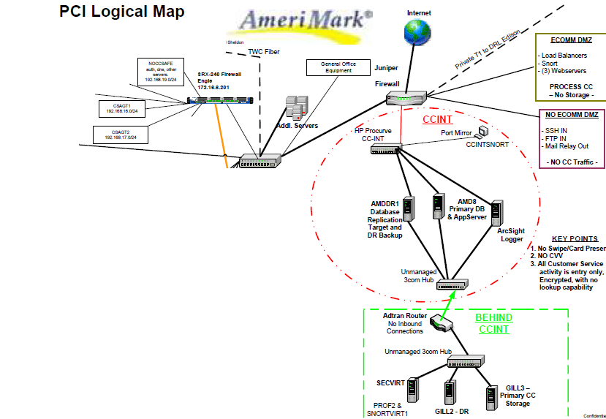

Slide 37
Initial PCI changes - continued
Want to move CC out of order header table on PPS to protect it
Also need to encrypt with industry standard encryption ex. AES
OE DB TDE doesn’t exist yet, but language has AES encryption recently added
Discussed ideas with Mike Jacobs PSC
Add BehindCCINT network zone
Install firewall that only allows traffic out from BehindCCINT
Add network connections from PPS / PPSDR to private subnet connecting to firewall

Slide 38
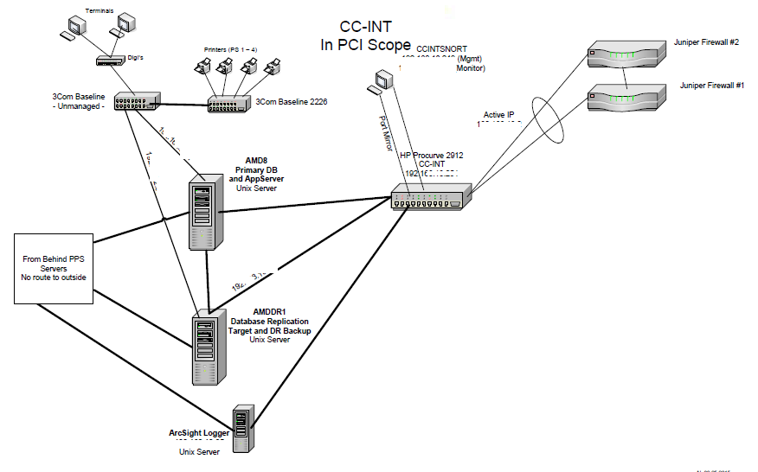

Slide 39
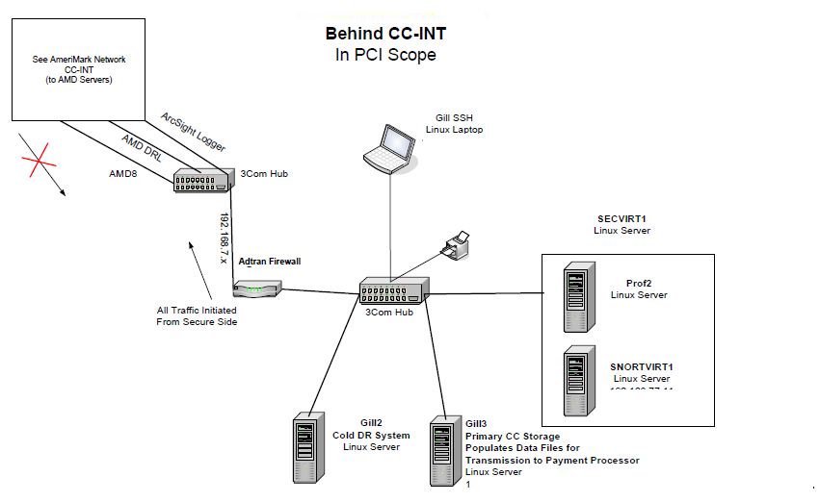

Slide 40
Initial PCI changes - continued
Add Linux system with OE databases – GILL
data database has table with AES encrypted CC # , tie-id ex. order #, shopcart # , encryption key id - users include IT Operations
key database has table with key-id, AES encrypted encryption keys
encryption keys are encrypted using human entered passphrase as encryption key
human passphrase is split knowledge – 3 IT staff know 1st half, 3 IT staff know 2nd half

Slide 41
Initial PCI changes - continued
On PPS create new database for momentary CC storage – limited users – restricted OS security
momentaryCC db table has AES encrypted CC and tie-id ex. order-no
set up appservers to accept CC# and tie-id and store in records in momentaryCC db table
change local character OE to pass entered CC to Appserver
change Ecomm web servers to pass CC over to SSL encrypted Appserver
batch program on GILL connects to databases there locally and client-server SSL to momentaryCC db on PPS – continuously scans for momentary CC records, pulls data over to GILL and deletes momentary CC record
momentary CC record AES encrypted with hard-coded keys known to Appserver programs and GILL batch programs

Slide 42
Initial PCI changes - continued
Result – CC are immediately separated from customer info making tying data together way more difficult
No network connectivity in to long term storage system – firewall prevents incoming traffic
New encryption keys can be created periodically and instituted for proper key rotation
Use database trigger to create audit record to record when long term record is read, by what program and user

Slide 43
Initial PCI changes - continued
How to use CC data ?
PPS creates bank file for batch processing with sanitized XXXX1234 version of credit card, customer information and tie-id ex. order #
Computer Operations logs on to GILL system, runs scripts/programs to pull over bank file, read file look up CC using order # , rewrite file with full CC# , encrypt file with bank’s public GPG/PGP key and push file back over to PPS
Computer Operations logs on to PPS and SFTPs file using script to bank, script removes populated bank file from PPS
For answers back from bank file is GPG/PGP encrypted with our public keys – file is pulled to GILL – decrypted with our private key – processed to sanitize CC# - pushed back to PPS
lots of use of SUDO and shell scripts !

Slide 44
Initial PCI changes - continued
All employees get ID badges – Computer room access controlled by ID badge swipe
Employees handling CC need background check, IT background + credit check
Multiple video cameras monitor computer room, recordings not under IT control
Added SNORT listeners in DMZ, CCINT, BehindCCINT to meet requirements for IDS
Use Tripwire Enterprise Server to monitor select files on PPS, Webservers, Development systems, etc. for FIM (File Integrity Management)
Need a SIEM to collect logs, automate alerts and provide clean store for 1 yr retention – Add Arcsight logger with PCI module
Send logs from PCI systems, firewalls, switches, etc. to Arcsight
Do quarterly Nessus scans with Nessus Professional ($1200/yr -1 laptop) on all PCI zones

Slide 45
Initial PCI changes - continued
Have McAfee Secure perform quarterly ASV scans on external IPs for security issues
Daily McAfee scans also find input sanitization issues, cross-site scripting, etc.
Hire local firm – Hurricane Labs to do periodic internal and external pen testing
If pen testers don’t find creative, meaningful issues GET NEW PEN TESTERS !

Slide 46
2011 / 2012 Time for Solid Data Systems to go......
Need more solid state capacity to keep up with growth and new demands
Reliability still a problem with the 6 most recent Solid Data units
Solution – pair of Texas Memory Systems 710 units – all flash arrays
1U units hold 1 – 5 TB of SLC NAND modules – internal raid, hot spare capability, direct FC connections up to 8 GB
2 units with 1.25 TB of NAND each and warranty approx. $130,000
Mirror units from PPS host so have total redundancy
Move data extents over from Solid Data units to TMS units, prostrct repair.......

Slide 47
April 2012 – Next AIX development system – p710 – AMDEV2
4 core 3.0 Ghz Power7 proc – 16 GB RAM
1 SAS connected LTO5 tape drive
2 146GB 15K SAS drives for rootvg
FC connected Nexsan storage array 12 450GB 15K SAS drives hardware RAID 10 set as 3 four drive arrays/LUNs for optimal performance – 3 hdisk to AIX vs 1 hdisk
System approx. $20K with 3yr maint, Nexsan approx. $20K w 3 yr maint

Slide 48
2013 – Why we can be paranoid.....
Dual mirrored TMS710 units off PPS
No hardware issue, but firmware bug causes 1 unit to think it has a problem and take itself offline in the middle of the day.......
Love AIX mirroring – don’t miss a beat
Update firmware to fix bug – bring back online and rebuild mirror
NOTE – Texas Memory Systems purchased by IBM to give them all flash array capabilities!

Slide 49
2013 – You thought PCI was bad before......
MasterCard requires Level 2 merchants have full audit in addition to Level 1
PCI versions now on V2.0 with more requirements
AMK hires Halock Security to help with formal risk assessment and do PCI audit – cost approx. $40,000
Lots of work on more formal policies, standards, procedures
Tighten up all over.........

Slide 50
2013 - Current Power 7+ PPS – AMD8 - no more spinning rust
IBM p740 with AIX 7.1 Progress V11.3
12 4.2 Ghz processor cores 96 GB RAM
8 local 387GB SSDs in main chassis: 2 for rootvg sw raid 1, 6 for HW raid 10 mainvg
SAS connected EXP30 – 1U expansion with dual 6GB SAS raid controllers – room for 30 1.8” 330GB SSD drives
We have 8 387GB SSD drives in creating 1 HW raid 10 disk on EXP30
2 FC cards – Each one connects to separate TMS710 flash array brought over from prior system
Increased capacity of TMS710 units from 1 TB + spare card each to 2 TB + spare card each
Dual SAS attached LTO5 tape drives in external 1U unit
BIG power savings vs prior system with non-SSD drives

Slide 51
AMD8 – Performance and reliability
TMS710s split in to 100 GB LUNS to minimize “hdisk” contention
LUNS/hdisks/volumes on TMS710s software mirrored between units – Can lose an adapter, cable or TMS unit without losing data or having unplanned downtime
Created separate JFS2 filesystems on each mirrored data volume to reduce FS contention
Spread BI files from most databases around on TMS volumes to reduce contention
Carve hdisk from EXP30 in to multiple volumes to reduce contention
DB data and index areas from 12 databases spread around on TMS and EXP30 volumes
AI files located on volumes on mainvg local volume group in main chassis so available even if lose external SAS or FC storage

Slide 52
AMD8 - Performance
AIX amd8 1 7 00F89C9D4C00 06/22/16
System configuration: lcpu=48 drives=29 mode=Capped
17:24:48 device %busy avque r+w/s Kbs/s avwait avserv
17:25:03 hdisk2 1 0.0 65 1314 0.3 0.5 ** mainvg 6 local SSDs hardware raid 10
hdisk0 0 0.0 19 91 0.5 0.3
hdisk1 0 0.0 16 68 0.6 0.3
hdisk8 0 0.0 11 55 0.0 0.1 ** exp30 8 SSDs SAS connected hardware raid 10
hdisk3 0 0.0 0 5 0.0 0.1
hdisk7 80 0.0 3309 26634 0.0 0.2 *** one of many TMS710 luns
hdisk12 0 0.0 9 177 0.0 0.2
hdisk14 0 0.0 51 341 0.0 0.1
hdisk10 5 0.0 213 1823 0.0 0.2
hdisk18 0 0.0 12 94 0.0 0.2
hdisk16 0 0.0 33 262 0.0 0.2

Slide 53
AMD8 - Performance
Wed Jun 22 17:32:28 EDT 2016 amd8 *** PCHECK ***
USER PID TIME ELAPSED COMMAND
chris_c 16843244 00:01:49 13:44:33 /bin/ksh /usr/bin/AMD/aimonitor
custserv 16908702 00:01:06 13:42:01 /usr/dlc/bin/_progres -b -p sendcorr.
custserv 16580682 00:03:56 13:41:50 /usr/dlc/bin/_progres -b -p sendeapi.
tim 13566128 00:00:00 13:48:45 /usr/dlc/bin/_progres -b -p temrccnt.
paula_p 45285822 00:06:43 55:46 /usr/dlc/bin/_progres -b -p brig-csv.
paula_p 22937836 00:01:36 02:41 /usr/dlc/bin/_progres -b -p meran1.p
paula_p 21496114 00:02:37 04:21 /usr/dlc/bin/_progres -b -p merlstC.p
paula_p 46727408 00:15:07 25:25 /usr/dlc/bin/_progres -b -p merlstC.p
paula_p 32571860 00:00:04 15:41 /usr/dlc/bin/_progres -b -p nocallmt.

Slide 54
AMD8 - Performance
Topas Monitor for host:amd8 EVENTS/QUEUES FILE/TTY
Wed Jun 22 17:34:59 2016 Interval:2 Cswitch 21786 Readch 57.4M
Syscall 90169 Writech 1745.1K
CPU User% Kern% Wait% Idle% Reads 19543 Rawin 80
Total 16.9 2.4 1.7 79.0 Writes 4431 Ttyout 15048
Forks 5 Igets 2
Network BPS I-Pkts O-Pkts B-In B-Out Execs 4 Namei 334
Total 3.14M 6.01K 4.11K 1.78M 1.36M Runqueue 4.00 Dirblk 0
Waitqueue 0.5
Disk Busy% BPS TPS B-Read B-Writ MEMORY
Total 2.8 29.4M 3.47K 28.6M 762K PAGING Real,MB 94720
Faults 5474 % Comp 35
FileSystem BPS TPS B-Read B-Writ Steals 7530 % Noncomp 6
Total 1.16M 1.10K 1.10M 58.3K PgspIn 0 % Client 6
PgspOut 0
Name PID CPU% PgSp Owner PageIn 7416 PAGING SPACE
_progres 21496114 5.1 5.62M paula_p PageOut 83 Size,MB 8192
_progres 46727408 5.1 5.62M paula_p Sios 7500 % Used 2
_progres 22937836 5.0 5.21M paula_p % Free 98
_progres 45285822 1.1 7.07M paula_p NFS (calls/sec)
_progres 32571860 0.3 3.29M paula_p SerV2 0 WPAR Activ 0
_progres 16580682 0.3 5.55M custserv CliV2 0 WPAR Total 0
_mprosrv 8847870 0.3 2.07M root SerV3 0 Press: "h"-help

Slide 55
AMD8 – Performance – One master file database
Activity - Sampled at 06/22/16 17:40 for 14:08:25.
Event Total Per Sec Event Total Per Sec
Commits 20025413 393.4 Undos 5414 0.1
Record Updates 4098044 80.5 Record Reads 2431845459 47772.2
Record Creates 214561 4.2 Record Deletes 198841 3.9
DB Writes 177247 3.5 DB Reads 3564284 70.0
BI Writes 191091 3.8 BI Reads 997 0.0
AI Writes 176561 3.5
Record Locks 28592052 561.7 Record Waits 52 0.0
Checkpoints 85 0.0 Buffs Flushed 0 0.0
Rec Lock Waits 0 % BI Buf Waits 0 % AI Buf Waits 0 %
Writes by APW 100 % Writes by BIW 56 % Writes by AIW 98 %
Buffer Hits 100 % Primary Hits 100 % Alternate Hits 0 %
DB Size 24 GB BI Size 5273 MB AI Size 887 MB
FR chain 115 blocks RM chain 13 blocks
Shared Memory 2039M Segments 1
35 Servers, 196 Users (139 Local, 57 Remote, 21 Batch),2 Apws

Slide 56
Life with all solid state storage – plusses and minuses
Batch jobs scream – CPU time of process can be 75% of elapsed time
Users generally see screaming performance
BUT ...
Uncle Ben Parker says “With great power comes great responsibility”
Processes run so fast that if the train comes off the rails it’s all bad........
The output file shows we’ve changed / deleted a lot more records than we expected......
My users all paused and my DB .lg says something about pausing - no AI extents available...
My batch export went crazy and just filled a filesystems and jobs started crashing.....
Users are calling about pausing, but my massive delete job is running great....

Slide 57
Life with all solid state storage – plusses and minuses
How do we cope:
Almost all really large updating jobs have a programmatic clean stop capability – periodically check for a unique named disk file and if found cleanly stop giving totals and stopping point to allow proper continuance or recovery later
Almost all really large updating jobs have a programmatic throttle – after a set number of records processed pause for a set amount of time – ex. 1 second after 500 records – Count and pause time in DB record for ability to tune while job running – job rereads record during the run – pause helps avoid IO hogging by low CPU – high IO jobs
Most DBs have multiple fixed 1.8 GB BI extents + 1 variable
Most DBs have 10 – 20 variable AI extents
Automatic scripts warn if AI extents running out, BI % used crosses preset limit or final variable BI extent begins to grow
Long transactions can be a PITA !

Slide 58
Life with all solid state storage – plusses and minuses
System design is trickier
In the past you needed lots of disk spindles so there was usually plenty of space available
Some wasted space relative to DB extents or lots of extra in filesystems not a big issue – “Disk is cheap......”
Good solid state not cheap (yet....)
Good planning to avoid wasting space for migrations, etc. important
Lots of use of known fixed extents so file systems can be filled to max with little wasted space
Regular monitoring of area space utilization, online index compaction when needed are important for efficiency

Slide 59
2013,2014 More PCI changes
Protect Order Entry / Customer Service reps with network segregation behind firewall
Create NOCCSAFE zone for key control/auth servers ex. DNS, NTP, AD for CS, WSUS patch server, Sophos AV server

Slide 60
2015 – More PCI and security turmoil
V3.0 spec out – LOTS more documentation required
SSL3 not safe – Implement OE 11.3.3HF013 internally on PCI systems and switch internal OE encrypted communications to TLS1.0 – no more SSLv3
TLS1.0 needs to be replaced by TLS1.2 soon

Slide 61
2016 Finally OE 11.6
Switch internal OE TLS connections to TLS1.2 only

Slide 62
Thanks for attending !
Hope you enjoyed !
Questions ??

