Slide 1
DB and Deployment Info Exchange
Progress

Slide 2
Agenda
Requirements Gathering
Setting Expectations …
Open Floor
Where do we go from here…

Slide 3
Database
Replication (+)
Platforms
AdminServer
TDE
OEDK
OEE/OEM
Installation
MT/TP
SQL
Analytics360
PSDN
Pro2*
DataServers
Data Admin.
Reporting
HA / DR

Slide 4
Requirements Gathering

Slide 5
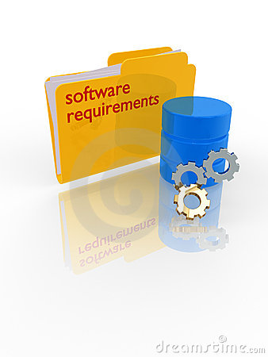
Source Of Enhancement Requests
OpenEdge Community
  Ideas section on Progress Communities (https://community.progress.com/community_groups/products_enhancements/i/openedge)
  Executive Briefing Center- face-to-face meetings at Progress Bedford
  Customer site visits & discussions
  Events: PUG Challenge, Exchange, etc.
  Requests via Technical Support calls
Market Trends & Competition
Internal Technical Experts
Etc.

Slide 6
Community Input Process
Approximately 20% of development resources allocated to address prioritized needs of the community
Voting done on Progress Communities, Ideas area
Highest voted items given priority (when realistic)
All “Idea” contributions reviewed- the vast majority are added to the product backlog
  Selection for implementation as previously described
  Given 9-12 month release cycles, some requests may not be addressed for a significant period of time
  Given the volume of requests, some may never be addressed

Slide 7

Selecting Features To Implement
Product Management narrows down the backlog to a working list based on release themes and priorities
11.x backlog
PM and Dev assign H/M/L and rank by component area
1
Preliminary pool of release requirements (1,000’s)
Review recent results from Info Exchanges, Community voting, customer meetings, TSAMs, etc.
Latest set of requirements in the Backlog
50
~150
~80 requirements
15 components
Working list of requirements
~50
Short list, ranked by component area
Candidate Requirements
Sorted by component area

Slide 8

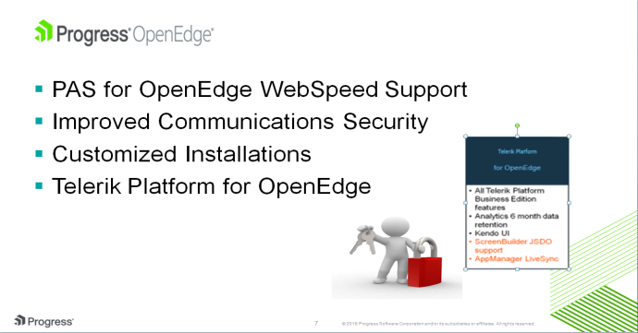
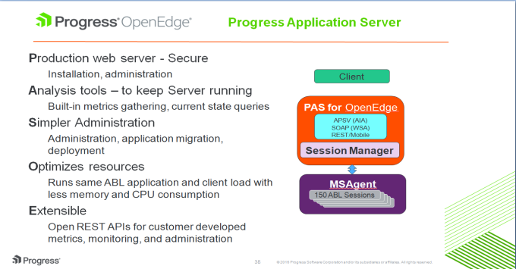
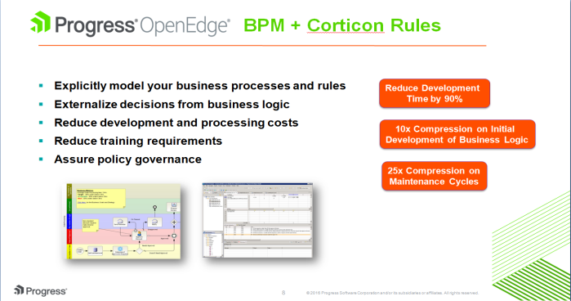
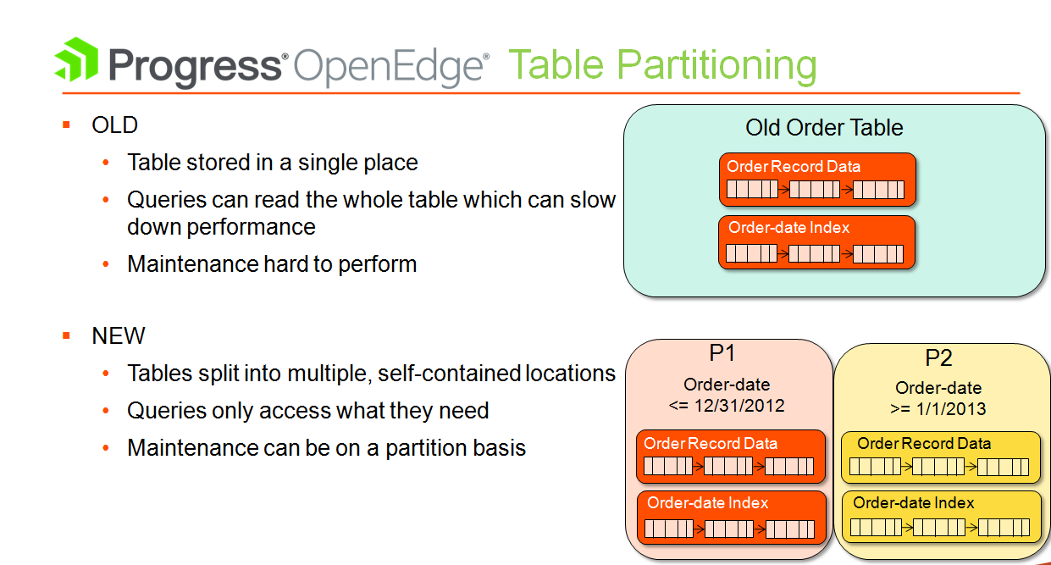
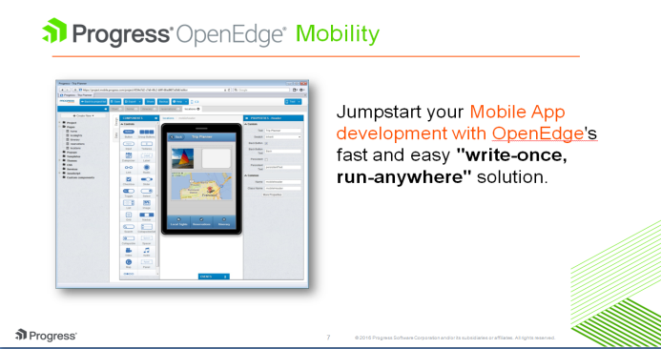
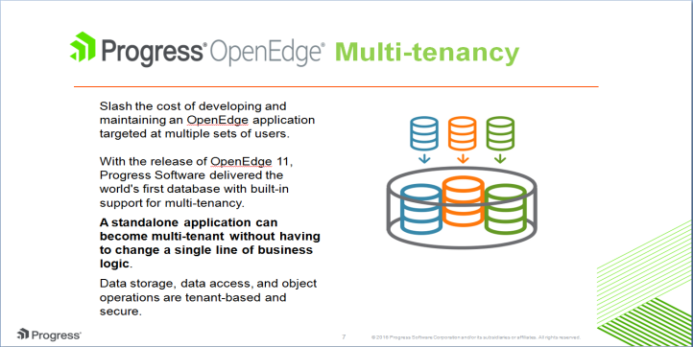
Progress OpenEdge: Continuous Innovation
Version 11.6
Version 11.5
5 Years
7 Releases
7 Service Packs
Version 11.3
Version 11.4
Version 11.2
Version 11.0/11.1
Notes:
11.0 – DEC 2011
11.1 – JUN 2012 – MT
11.2 – NOV 2012 – OE Mobile
11.3 – JUL 2013 – OE BPM + Corticon
11.4 – AUG 2014 – TP
11.5 – DEC 2014 – PAS for OE
11.6 – OCT 2015 – WebSpeed + Telerik Platform for OE
Last 5 years – 7 Releases, 7 Service Packs

Slide 9
Requirements for the Future

Slide 10
Disclaimer
This discussion is for informational purposes only, and the reader is hereby cautioned that actual product development may vary significantly from roadmaps
This discussion may not be interpreted as any commitment on behalf of Progress, and future development, timing and release of any features or functionality described in this discussion remains at our sole discretion

Slide 11
Setting Expectations – Some things will never get implemented
Too expensive
Great idea – not the direction we want to take the product…
Great for you – nobody else will ever use it…
That’s a Really Really Bad Idea…

Slide 12
Startup Questions…
What do you want us to do with log files?
Do you have a performance problem?
How much would you pay for a MAC Port?

Slide 13
Open Floor…
Log files
  (40) Rotation – by size and time
  (3) Option to have them processed by another tool we supply
    Something to parse out ‘non essential’ messages; filter out things such as login/out/switch user; keep errors – things that affect operation; better/more granular weights
    Sumo? Tool
    Some log files growing by 1G/day
  (1) Separate log files split by message type
  (1) On certain event have separate action taken

Slide 14
Open Floor (2)…
Documentation (KB too) isn’t keeping up with new versions
  References to old OE versions, old 3rd party (eclipse, java) versions
  Examples too classroom simplified
  KB search by (date/)version; include date/last update in entry
(9) Real compression option for backup
(15) Multi-threaded backup/restore; not for Enterprise only

Slide 15
Open Floor(3)…
(in the plan) Enable/change online
  PICA, mn, -n, add AI extents
  Table size, index size, OM size
(1+Rich) Extend extent project
(bug?) If you don’t have another AI extent, and you’re on variable; don’t keep logging that it’s trying to switch
  Message looks like crisis; tone it down – not fatal
(OE12.0) Improve defaults (e.g. OM size)
  OEM give tool tip on upper/lower limit

Slide 16
Open Floor(4)…
(6) Online upgrade OE version (SP, HF) w/o bouncing DB
(fix KB) 11.5 to 11.6 – don’t require rebase of Replication; doc bug? says you can’t do this
(15) Maintenance mode so DBA can be in; broker running; like DB restrict in DBA mode
(11) VM awareness for DB; amazon flips to new VM, large DB results in inconsistency. Need to proquiet manually now. Don’t want to shut everyone out.
  Vmotion / VSS, HyperV support

Slide 17
Open Floor(5)…
(6) Automatic SQL statistics update
(14) Install: auto/scriptable w/o human intervention (Docker?)
(4) Changing licenses: add/del/upd progress.cfg painful
  Expiration, product, user account…
  Not Windows-only; must be scriptable
  Telerik’s AppManager
(3) Build simple text file containing control codes; use as cmd line input
  Download cfg? Would need to be editable; generate cfg with a select set of products; then custom build just those

Slide 18
Open Floor(6)…
(just do it) AI scan verbose; timestamp only to second - request millisec
(JDI) Index rebuild; can’t do single index easily
Anyone using Chef? Is there a progress recipe?
(in plan) Verifying backup w/ vp (partial verify) didn’t work; how else to verify?
  Ability to run –vf while DB is running?
Code signing - only allow signed code to run

Slide 19
Where do we go from here…
Community
PUG Challenge EMEA October 2016
PUG Challenge Americas 2017
And the party…

