Slide 1
Table Partitioning
Workshop
Presenter: Richard Shulman
June 26, 2016

Slide 2
Notes to Presenter
On the terminology slides please pull the visuals out of the orange spark ppt template and place directly on the slide. Also, recommend highlighting the word and definition in a color block to help accentuate. See slide 12 as an example. Capitalize Terminology in the heading of these slides and add space between OpenEdge and Table.
Consider adding bullets to slide 28

Slide 3
Agenda
What is Table Partitioning?
Common Terminology for OpenEdge Table Partitioning
Types of OpenEdge Table Partitions
How can I implement table partitioning against an existing database?
How can I implement table partitioning for a new table in the database?
Common Maintenance Operations with Table Partitioning
Where and when can I gain performance from table partitioning?

Slide 4
What is Table Partitioning?

Slide 5
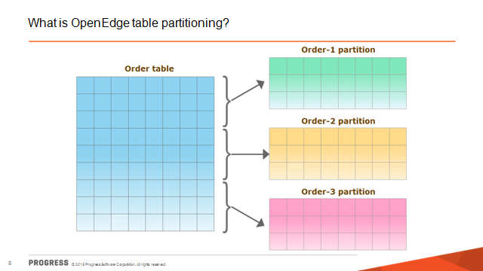
What is Table Partitioning?
Basically table partitioning is making one big table into multiple little tables.
Little tables are organized based on key fields of the original table.
All data is still accessible.
Transparent to applications.
Table partitions do not have to live within the same storage area/disk.
Indexes associated with partitioned tables can also be partitioned. These are known as local indexes.
Table Partitioning cannot be applied to a Multi-Tenant Table or vice versa.
Notes:
Applications that access non-partitioned tables can access partitioned tables with little or no changes required.

Slide 6
Where does Table Partitioning Fit Best?
Large tables.
High number of concurrent users performing insertions, updates, and deletions.
Tables where periodic maintenance is necessary and maintenance windows are small.
Tables contain data that have to be spread across different storage devices and RAID isn’t available.
Tables contain historical data and you need to periodically archive the old data as new data is added.
Tables contain geographical or organizational groups of data.
Tables contain numeric or timestamp-based groups of data.
Tables contain data that is frequently queried using TABLE-SCAN instead of an index.

Slide 7
Where does Table Partitioning not fit so well?
Small tables.
Tables where the type of data is too variable.
Users primarily performing reads or very small count of users.

Slide 8
Performance Benefits of Table Partitioning
Noticeable gains for performance when more than 25 users concurrently creating / deleting records within partitions.
Maintenance operations may be performed against a partition instead of the entire table which allows parallel maintenance operations.
Some maintenance operations can now be performed online with the addition of table partitioning.
Notes:
Little Read Performance gains regardless of number of users or type of partitioning

Slide 9
Are There Any Performance Costs for Table Partitioning?
Yes, if incorrect columns are chosen for the partitioning there may be additional overhead to constantly be moving data from partition to partition.
Notes:
Little Read Performance gains regardless of number of users or type of partitioning

Slide 10
Common Terminology for OpenEdge Table Partitioning

Slide 11
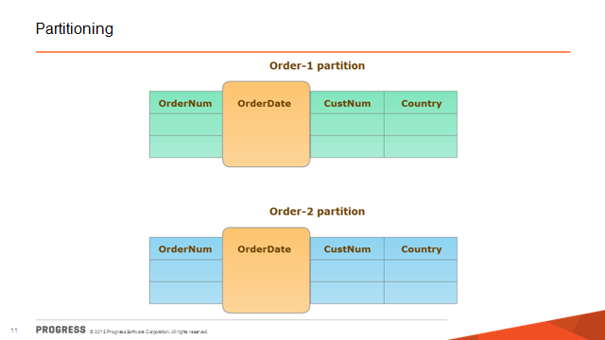
Common Terminology for OpenEdge Table Partitioning
Partitioning -- uses one column to uniquely identify each partition. You can partition by range (ranges of column values) or by list (list of distinct column values).
Notes:
Little Read Performance gains regardless of number of users or type of partitioning

Slide 12
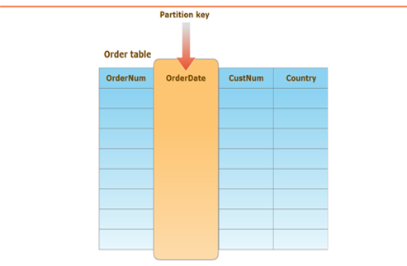
Common Terminology for OpenEdge Table Partitioning
Partition key: A column(s) that uniquely identify each partition of a partitioned table.
Partition columns must meet the following requirements:
1) Partition columns must always be the leading component of an index. Only indexable data (except RECIDs and ROWIDs) can be partitioned.
2) Partition columns must have known values. OpenEdge table partitioning does not support the UNKNOWN “?” value in partition columns.
Notes:
Little Read Performance gains regardless of number of users or type of partitioning

Slide 13
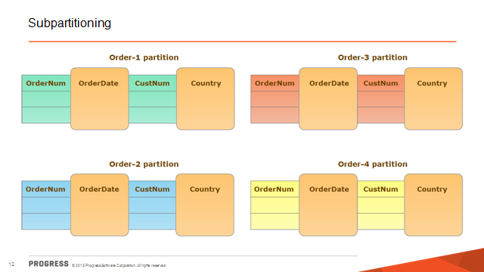
Common terminology for OpenEdgeTable Partitioning
Subpartitioning -- uses two or more columns to uniquely identify each partition.
  Up to 15 columns can be used to subpartition data.
Notes:
Little Read Performance gains regardless of number of users or type of partitioning

Slide 14
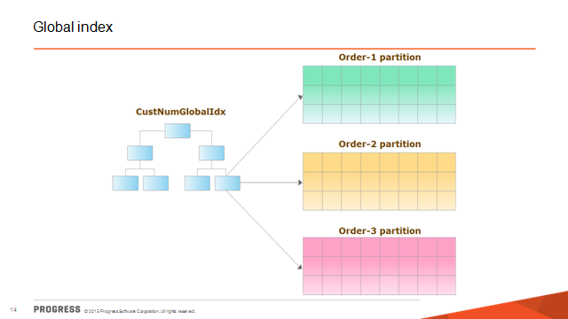
Common terminology for OpenEdgeTable Partitioning
Global index -- an index that contains index entries for all the rows across all the partitions of a table. Global indexes are the same as indexes in non-partitioned tables.
  Use global indexes to enforce uniqueness across partitions or to sort data based on non-partitioned columns.
  A global index does not have to use an existing partition key. It can be based on other data that exists within the table. It does not have to be unique.
Notes:
Little Read Performance gains regardless of number of users or type of partitioning

Slide 15
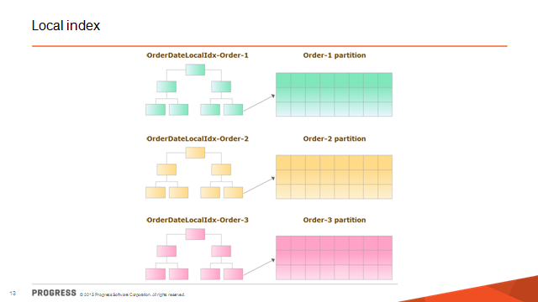
Common terminology for OpenEdgeTable Partitioning
Local index -- An index that is based on the same partition key as the table but is contained within a specific partition and applies only to the records of that partition.
  A local index can also be based on other columns in the same table. Note that the partition key must be the leading component of a local index.
  When a local index is defined for any partition of a table, OpenEdge automatically creates a local index for each table partition.
Notes:
Little Read Performance gains regardless of number of users or type of partitioning

Slide 16
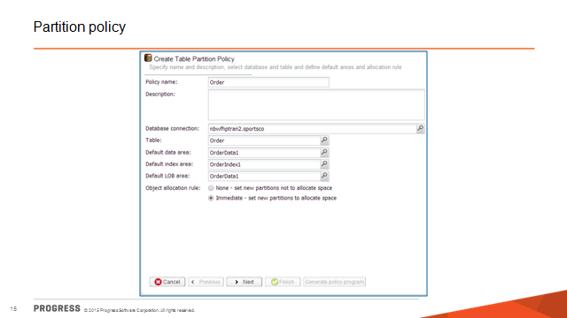
Common terminology for OpenEdgeTable Partitioning
Partition policy -- is a database meta-schema record that defines how a table is partitioned.
  It contains information such as policy name, table, storage areas for data, indexes, and LOB (large object) fields, object allocation rules, and partition type.
  Every table that is partitioned must have a partition policy.
  Only one partition policy can be defined for each table being partitioned.
Notes:
Little Read Performance gains regardless of number of users or type of partitioning

Slide 17
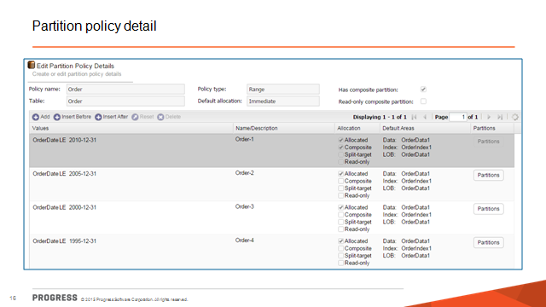
Common terminology for OpenEdgeTable Partitioning
Partition policy detail -- is a database meta-schema record that defines the values for the columns defined in the partition policy. It contains information such as policy detail name, a specific column value or range of column values, and storage areas for objects (data, index, and LOB).
Each partition policy detail record defines one partition in a table.
You can have up to 32,765 partitions per table.
Notes:
Little Read Performance gains regardless of number of users or type of partitioning

Slide 18
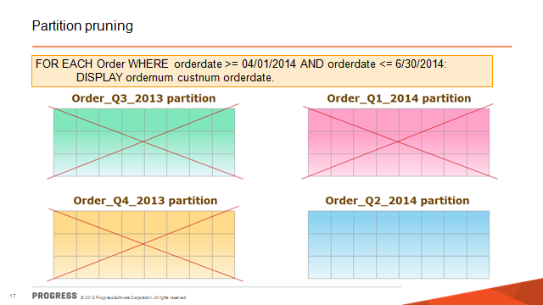
Common terminology for OpenEdgeTable Partitioning
Partition pruning -- The runtime process in which OpenEdge RDBMS parses a CRUD statement and examines only the partitions that contain relevant data—in effect, pruning or eliminating the partitions that are not required.
  OpenEdge RDBMS prunes partitions whenever the WHERE clause is used to filter data. Partition pruning is where some of the performance benefits are gained.
Instead of scanning the entire table the where clause forces the code to look in the smaller partition instead.
Notes:
Little Read Performance gains regardless of number of users or type of partitioning

Slide 19
Types of OpenEdge Table Partitions.

Slide 20
Types of Partitions
There are two types of table partitioning:
  List -- A table based on a list of distinct column values in a single column. The column must be of character, date, datetime, datetime-tz, decimal, integer, int64, or logical data type.
  Range – A table based on ranges of column values in a single column. The column must be of character, date, datetime, datetime-tz, decimal, integer, int64, or logical data type. Range is the most common type of table partitioning.
Up to 15 columns can be used for sub-partitioning.
When using a mix of list and range partitions the Range component MUST be the last component of the subparition columns.
When using range partitioning, only the upper bound of each partition must be set. OpenEdge RDBMS automatically creates a set of non-overlapping partitions for the table.
Notes:
Little Read Performance gains regardless of number of users or type of partitioning

Slide 21
How to Pick Columns for Sub Partitioning
The partition column represents the best way to partition the table data.
The partition column is frequently used as a filter criterion in most of the queries run against the table. This takes advantage of partition pruning.
The partition column contains values that are relatively static over time. This reduces the need to move rows to a new partition when their column values are changed—an expensive internal operation.

Slide 22
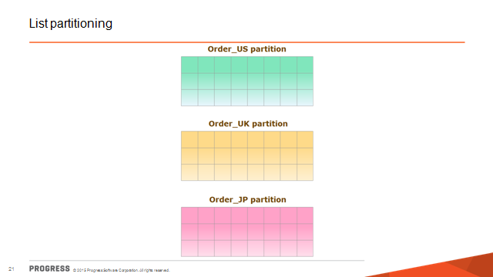
Common Use for List
List partitioning is frequently used to orient data by region, state, province, sales rep, or similar grouping common to the table data.

Slide 23
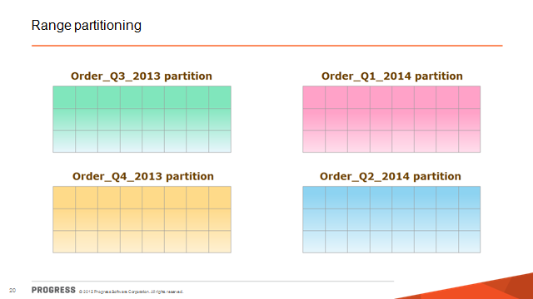
Common Uses for Range
Range partitioning is frequently used to orient data by time period or range of data values A-D, E-J, etc.

Slide 24
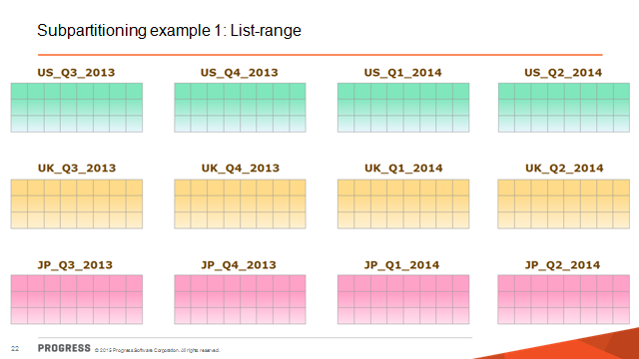
Common Sub-Partition Examples
List - Range partitioning is used to orient data by list (ex. Region or sales rep) then by range (dates or quarters).

Slide 25
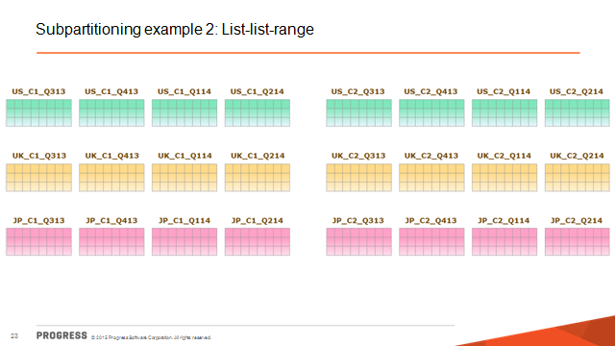
Common Sub-Partition Examples

Slide 26
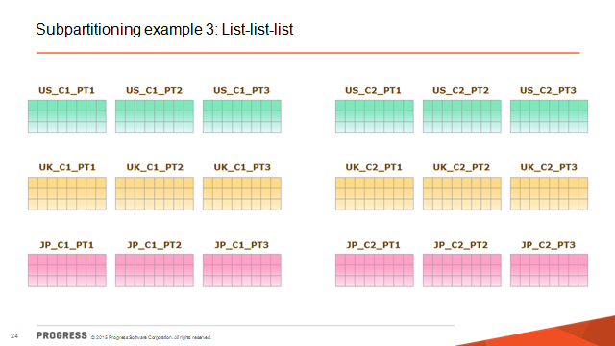
Common Sub-Partition Examples

Slide 27
How can I implement table partitioning for a new table in the database?

Slide 28
Pre-Requisites for Table Partitioning
Tables and indices for tables must live in a Type II area to be enabled for table partitioning.
If necessary use proutil with the tablemove option to migrate data from a Type I to a Type II area.
Or dump and load data to a newly created and partitioned table.
Table Partitioning must be enabled.
The OpenEdge Management interface can be used to enable table partitioning or proutil <dbname> - C enabletablepartitioning.
Both the above require the Table Partioning license.
Both can be performed while the database is online.
Notes:
One option is to use proutil <dbname> -C tablemove “<area for data>” [“<area for indices>”].
Tablemove may trigger significant growth in the BI file depending on the amount of data in the table.
Another option would be to dump the table definition of the table.
Dump the data contents of the table either with the Data Admin / Data Dictionary tool or using proutil dump or dumpspecified commands.
Add new Type II areas.
Modify the table definition that was previously dumped.
Edit the .df and for the ADD table statement adjust the AREA listed and set it to the new Type II area.
Repeat step 3 for each index associated with the table. Each index may be assigned to a different area than the table data.
Just make sure all indices are appropriately configured to point to a Type II area.
Drop the exist table.
Load the modified .df file from step 3.
Load the data back into the database, it will be correctly directed to the areas defined within the .df edited in step 3.

Slide 29

Lab 1, Setting Up a Database (approximate duration 25 minutes)

Slide 30
Pre-Requisites for Table Partitioning
The OpenEdge Management interface can be used to define table partition policies and to make template code.
The Data Dictionary / Administration tool can also be used to define table partition policies.
SQL Code can be used to define table partition policies.

Slide 31
Lab 2 – Defining Partitions - Approximate Duration 50 Minutes

Slide 32
How can I implement table partitioning against an existing database?

Slide 33
Guidelines when choosing partitioning keys
1) Look for “modest diversity”.
  Column values should have a small amount of diversity to distinguish what data goes into different partitions. Data which is evenly distributed across partitions will likely yield better performance.
2) Look for “well-known” values.
  The columns should appear the most in queries or maintenance operations.
3) Look for “static” values.
  The values of the key should be known at creation time or change infrequently. This will avoid potential data movement due to partition change.
4. Sub-partitioning offers versatility to suit different customer needs.
  Although up to 15 levels of columns are supported by OpenEdge Table Partitioning, a partitioning key that is too deep may reduce the flexibility, complicate the manageability, and slow down performance. It also has the potential to exhaust partition numbers much quicker.
6. Plan / Test Ahead of Roll Out to Production
  Performance tests should be constructed on a smaller set of data to examine the performance impacts from different partitioning strategies. The right strategy then can be applied on a large scale.
Notes:
The following are guidelines and recommendations to consider
when choosing partitioning keys:
1. Selecting a partitioning key and storage layout that will result in performance wins via table partitioning requires understanding
the access patterns of the applications using the database tables. For instance, for an application inserting stock trades into a large table for
many different trade symbols, and reports are frequently done based on queries for a particular stock symbol, partitioning by stock symbol
and spreading the partitions across many storage areas could result in significant performance benefits. However, if 90 percent of the
queries and trades are for a single symbol, it is likely there will not be a significant performance benefit with this partition strategy. So, it is
important that to analyze the access patterns as much as possible.
For DBAs without a lot visibility into the access patterns of the application, the proposed partition strategy should be discussed with
those who do, for example, the developers of the application using the database.
2. Look for “well-known” values. The columns should appear the most in queries or maintenance operations. For example,
“cust-name” may be used most often when querying the “Customer” table; “order-date” in the “Order” table may be used to generate sales
reports; or “order-num” in the “Order” table may be used to spread out data evenly.
3. Look for “static” values. The values of the key should be known at creation time or change infrequently. This will avoid potential
data movement due to partition change. Using the “Order” table as an example, “order-date” is obviously a better candidate than “ship-date,”
because the latter may not be known at the time the record is created.
4. Sub-partitioning offers versatility to suit different customer needs. Although up to 15 levels of columns are supported by
OpenEdge Table Partitioning, a partitioning key that is too deep may reduce the flexibility, complicate the manageability, and slow down
performance. It also has the potential to exhaust partition numbers much quicker.
5. To improve performance, choosing a partitioning key so that data will be distributed evenly is a critical success factor.
Another factor is to avoid or at least spread out the “hot” partitions.
In other words, work load on each partition should be balanced.
6. As a best practice, preliminary performance tests should be constructed on a smaller set of data to examine the
performance impacts from different partitioning strategies. The right strategy then can be applied on a large scale.

Slide 34
Lab 3 – Defining Partitions - Approximate Duration 40 Minutes

Slide 35
Common Maintenance operations with table partitioning.

Slide 36
Common Maintenance Operations
1) Indexbuild “online” now possible with partitioned tables
2) Adding partitions
3) Splitting and renaming partitions
4) Merging partitions
5) Making partitions read-only
6) Moving partitions
7) Dumping partitions
8) Truncating partitions
9) Deleting partitions

Slide 37
Common Maintenance Operations
proutil db-name -C partitionmanage split table table-name
  { partition table-partition-name | composite initial }
  [ useindex index-name ] [ recs numrecs ]
proutil db-name -C partitionmanage merge table table-name
  partition table-partition-name partition table-partition-name
  [ partition table-partition-name ] [ useindex index-name ] [ recs numrecs ]
proutil db-name -C partitionmanage truncate table table-name
  { partition table-partition-name | composite initial }
  [ recs numrecs ] [ deallocate ]
proutil db-name -C partitionmanage view
  [ table table-name [ partition table-partition-name | composite initial ]]
  { list | state | status }

Slide 38
Lab 4 – Managing Partitions - Approximate Duration 25 Minutes

Slide 39
Common Maintenance Operations
1) Indexbuild “online” now possible with partitioned tables
2) Adding partitions
3) Splitting and renaming partitions
4) Merging partitions
5) Making partitions read-only
6) Moving partitions
7) Dumping partitions
8) Truncating partitions
9) Deleting partitions

Slide 40
Lab 5, Online IDXBUILD for Partitions (approximate duration 20 minutes)

Slide 41
Where / when can I gain performance from table partitioning?

Slide 42
Performance gains and losses
Performance gains observed more commonly for insert, update, and delete operations when moderate number of concurrent users accessing the table(s).
Performance losses when data shifts from partition to partition due to primary key value changes.

Slide 43
Discussion of Performance Testing with Table Partitioning
A performance test was run by Rich Banville and Dapeng Wu.
The run was designed to examine the performance impact of different partitioning strategies on a database system.
The test was configured to measure performance for record READ, WRITE and DELETE operations on the “Order” table, then results were
compared when the table partitioning was enabled and disabled.
Two partitioning strategies were used when the table is partitioned:
1. Range partitioning using “order-date” as partitioning key
2. Sub-partitioning using “region” and “order-date” as partitioning keys
For each partitioning strategy, a non-Table-Partitioning test will be
used as the baseline for comparison. The performance changes are
calculated with differences between partitioned and non-partitioned
configurations. Various numbers of concurrent users are included in
the test to show the performance changes along with work load.

Slide 44
System Configuration for Testing
Physical Characteristics of Database used for Testing:
• Type II Areas
  - Data and index separated
  - 8 Kb block size with cluster sizes of 512 (data) and 64 (index)
  - All partitions in separate areas
  - Areas of proportional fixed sizes with matching database extents
• Data
  - Average record size 257, all same RPB (32)
  - 50,000 records to 10,000,000 per run (base on # users)
  - 3 Global indexes and 2 local indexes
• Recovery
  - 8 KB block with 128 MB cluster size

Slide 45
System Configuration for Testing - Continued
Server Parameters:
  • Buffer pool: -B 50000 -lruskips 250
  • Lock table: -L 100000 -lkwtmo 3600
  • Transaction: -TXERetryLimit 1000
  • BI: -bibufs 4000 -bwdelay 20
  • Latching: -spin 50000 -napmax 10
  • Page writers: 1 BIW 3 APWs
  Machine Configuration for Testing:
  - 16 sparcv9 processor operating at 3600 MH
  - Memory size: 32768 Megabytes

Slide 46
Methodology for Testing
Testing Performed:
• Scale users
  - 1, 2, 5, 10, 25, 50, 100, 200
  - Avoid application side conflicts
  - Monitor internal resource conflicts
• Operations executed: Basic Create, Read, Delete
• Vary transaction scope: 10, 100, 500 records per transaction
• Vary partitioning scheme
  - No partitioning
  - Range partitioning on {order-date}
  - Sub-partitioning on {region(9), order-date}
• Dbanalys performed before and after each activity
• Database recreated with same .st file for each run
• Variation across runs: ±1%

Slide 47
TEST RESULTS
Two partitioning strategies have been used to measure performance changes between a partitioned and a non-partitioned configuration.
The first strategy is to use sub-partitioning on the “Region” and “Order-date” columns;
the second is to use range partitioning on the “Order-date” column.
In both strategies, WRITE, READ and DELETE operations are performed on the “Order” table, and the time to complete each operation is used to measure performance of this
operation.
Then, the time values are compared to the ones from the non-partitioned configuration to show the performance difference.
Different numbers of users are used for each configuration and tested
to show the performance impact on system scalability.

Slide 48
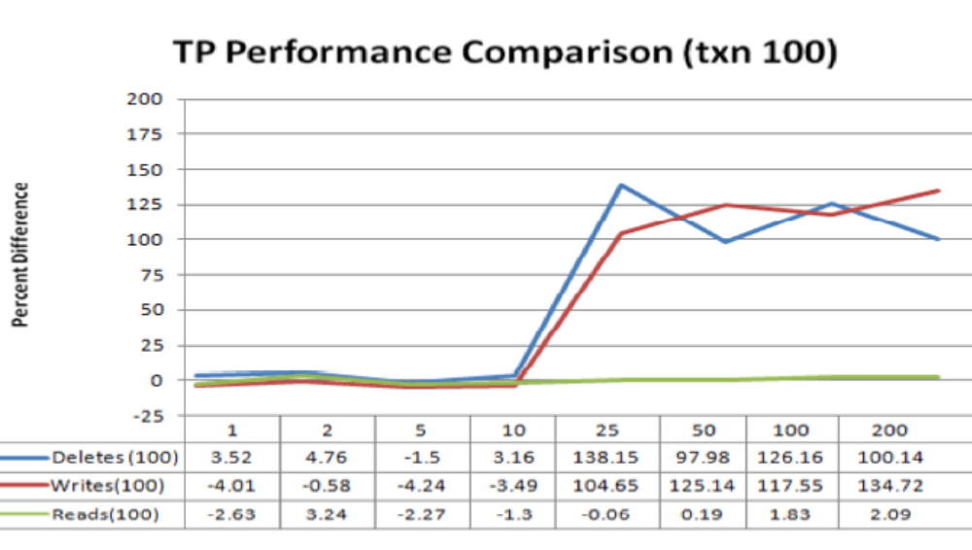
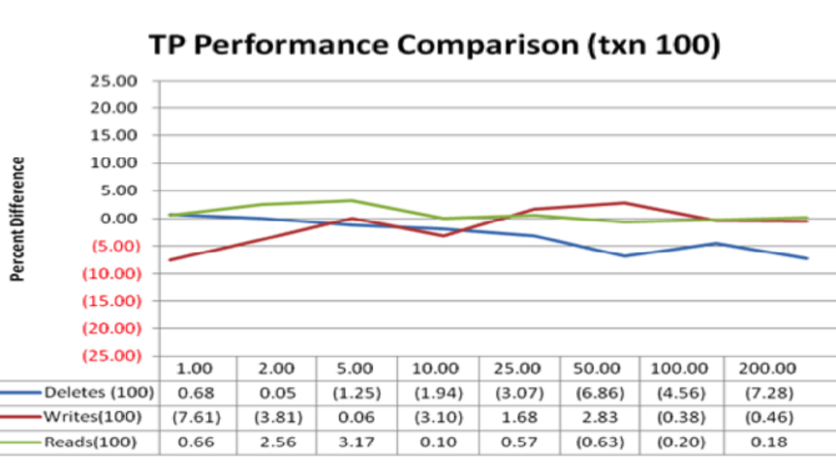
100 transaction test comparison between two partitioning schemes.
Picking the right partitioning scheme can make a significant difference in performance.
In the test example when using first a region then a date range the performance is dramatically improved (~138%) when 25 or more users are concurrently making changes to the data.
As compared to when only a date range is used and there is almost no change or in some cases a degradation in performance.
Sub-partitioning on region AND order-date
Range partitioning on order-date only
Notes:
Figure 1 (on the left) is the comparison of partitioning by sub-partitioning “region” and “order-date” versus the non-partitioning baseline.
As shown in the chart, the performance differences (the y-axis) of all three operations stay flat when user number (the x-axis) is less than 10.
The performance of CREATE and DELETE starts to improve dramatically when the user number is greater than 25.
The performance of “READ” operations shows little to no difference.
Another partitioning strategy using range partitioning shows different results, as illustrated in Figure 2 below:
Figure 2 (on the right) is the comparison of partitioning by range partitioning “order-date” versus the non-partitioning baseline. As shown in the
chart, there is barely any improvement in performance from all three operations. And in most cases, the partitioned version is even slightly
slower than the non-partitioned one.

Slide 49
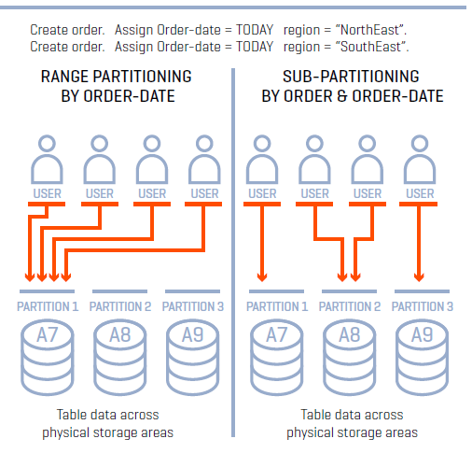
Where is the improvement coming from?
Notes:
What is causing the big difference in performance when using different partitioning strategies? Load balancing, a technique to
distribute workload and increase concurrency, contributes the most to the performance gains in the sub-partitioning scheme. As shown
in Figure 3 below, when “Order” table is partitioned by “order-date,” all newly created records will usually go to the same partition because
their “order-date” values are close to each other.
This makes partition A7 the only “hot spot” in the table, with no difference from the non-partitioning configuration.
When the table is partitioned by “region” and “order-date,” even though the “order-date” values in two records may still be close to each other,
they may be created into two different partitions, because they belong to different “regions.” In this configuration, data access may happen
to all three partitions: A7, A8, and A9. This makes the workload more balanced and less “hot.”

Slide 50
Questions?

