Slide 1

Customer Case Study:
Moving Progress DBs and environment to the Microsoft Azure Cloud
By: Michael Guerra -- Senior Programmer/analyst
Wolters Kluwer | Health Learning, Research and Practice

Slide 2
Our company provides lifelong learning, research and practice information solutions for healthcare practitioners, researchers and students.
We provide high-quality content, precision search and point of care tools to build competency in education and practice to improve care.

Slide 3
Objective
Move existing Progress development environment from
Dell Services to Microsoft Azure
Environment at Dell Services
3 - VM Microsoft Windows Servers
  Database/AppServer/Webspeed
  Citrix Server used for Development with Progress Developer Studio (PDS)
  IIS and Webspeed Messenger
* Storage-area Network (SAN)
Notes:
Dell has a Data Center in Plano Texas

Slide 4
Environment at Microsoft Azure
3 - VM Microsoft Windows Servers
  Database/AppServer/Webspeed
  Citrix Server used for Development with Progress Developer Studio (PDS)
  IIS and Webspeed Messenger
* Trust between Dell and Azure managed setup by other business unit
Total Savings of $1,870.00+ per month

Slide 5
What is Microsoft Azure?
a cloud computing platform and infrastructure created by Microsoft for building, deploying, and managing applications and services through a global network of Microsoft-managed data centers.

Slide 6
What is common between All Businesses?
Operating System
Network Infrastructure
Storage
Scale
Hardware No Longer on premises but in a data center somewhere in the world

Slide 7
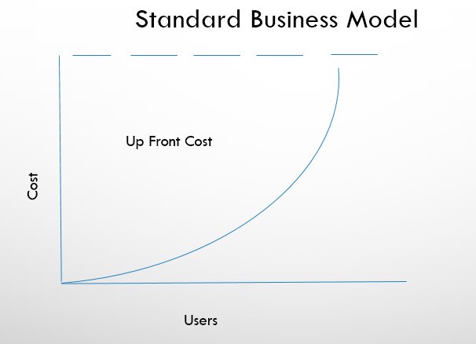
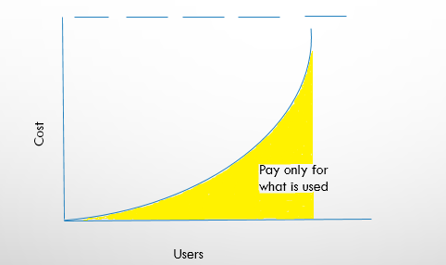
Microsoft Azure Business Model

Slide 8
How to set up a Server on Azure?

Slide 9
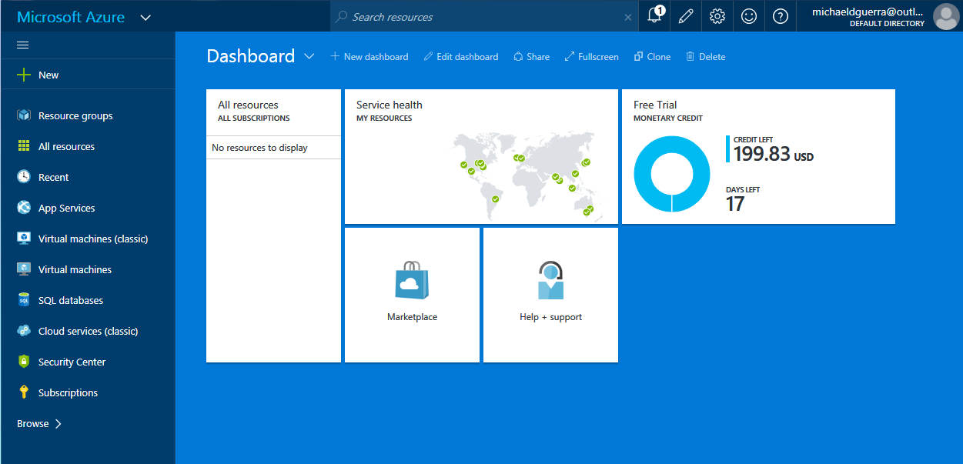
Notes:
https://portal.azure.com

Slide 10
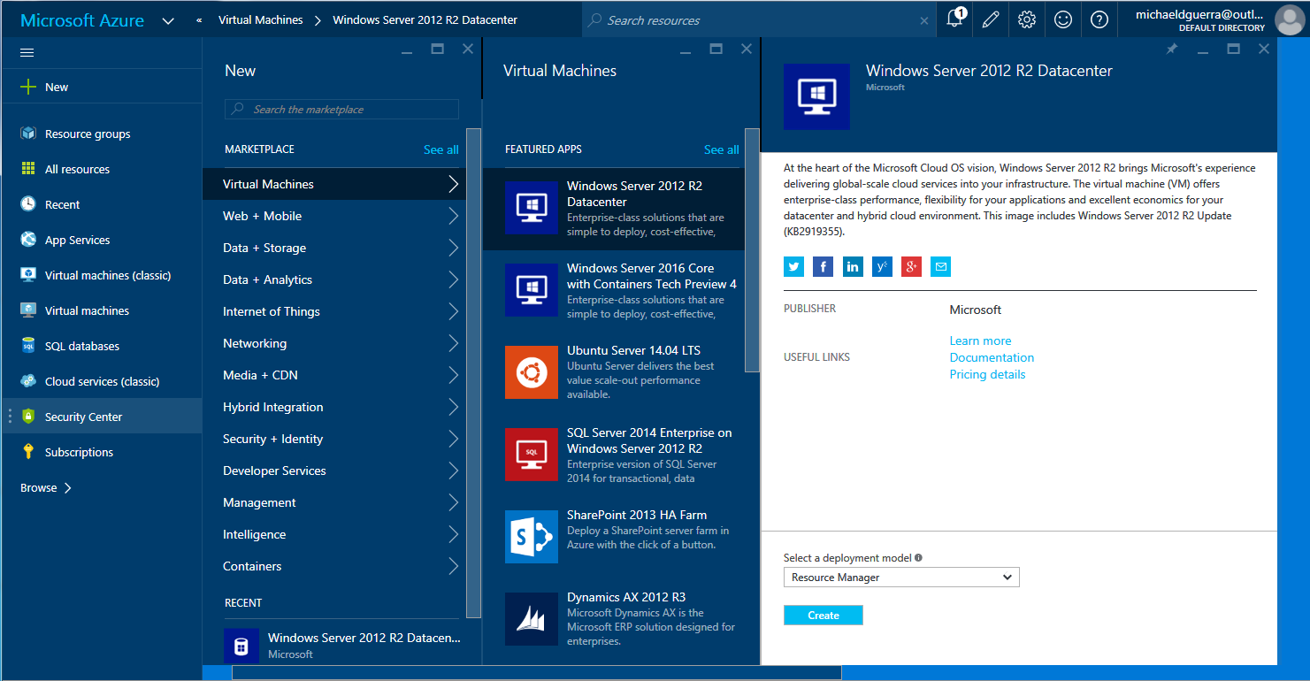

Slide 11
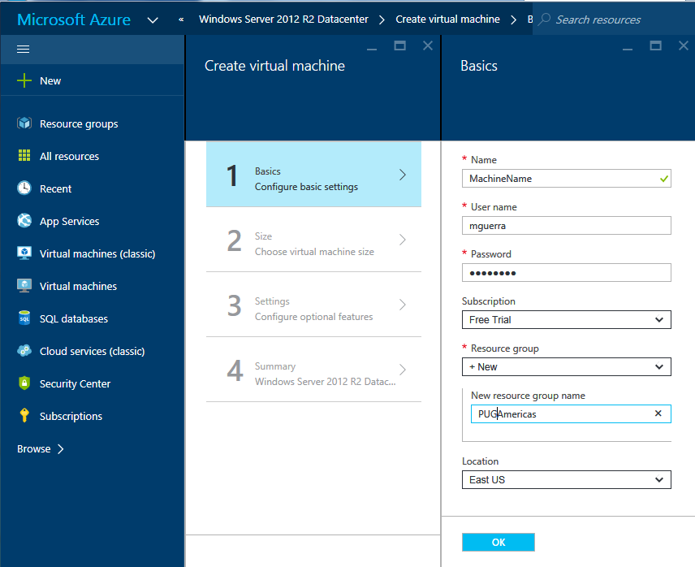
Notes:
Name is the actual VM Machine Name
User Name is the Local Admin for the VM Machine
Subscription is how are you paying for the usage (Free Trial in my case)
Resource Group, you can think of it is the domain where your components (VM Server/Security/Network) will reside

Slide 12
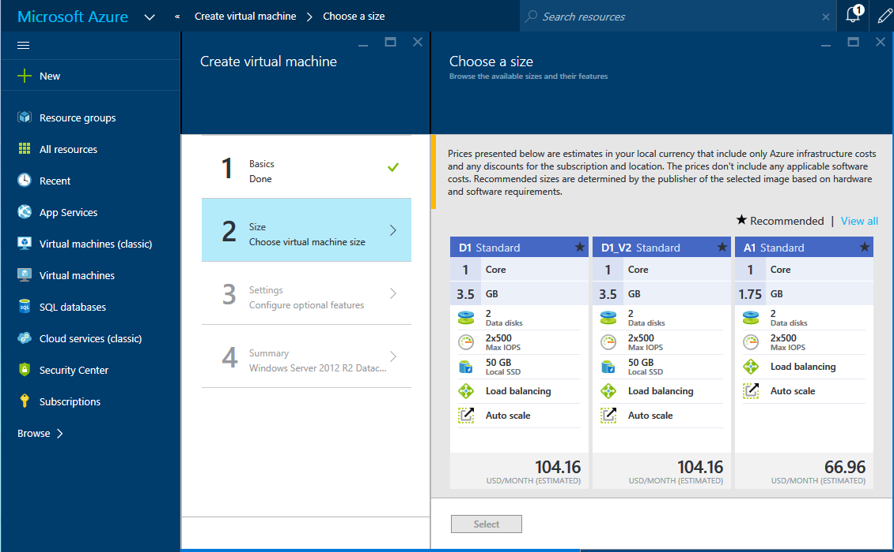
Notes:
Size and Type of machine that you want.
Cores, Memory, Data Disks and IOPS
Cores -- # of CPU
Memory -- Amount of Memory allocated
Data Disk – Maximum drive that you can have
IOPS --

Slide 13
Available Server Configuration Series
A-Series – Standard Tier
An economical option for development workloads, test servers, and other applications that don't require load balancing, auto-scaling, or memory-intensive virtual machines.
D-Series and DS Series– 60% faster than A-series, more memory, and local SSD drive
Variant of the D-series sizes called “DS” that are specifically targeted for Premium Storage. The pricing and billing meters for the DS sizes are the same as D-series. SSD storage included in D-series VMs is local temporary storage. For persistent storage, use DS VMs instead and purchase Premium Storage separately.
D V2-Series – 35% faster than D-series, latest generation of CPU
F-Series and FS-Series – Even Faster CPU New
The F-series is based on the 2.4 GHz Intel Xeon® E5-2673 v3 (Haswell) processor, which can achieve clock speeds as high as 3.1 GHz with the Intel Turbo Boost Technology 2.0. These VMs are suitable for scenarios like batch processing, web servers, analytics and gaming.
G-Series and GS-Series – Biggest and Fastest New

Slide 14
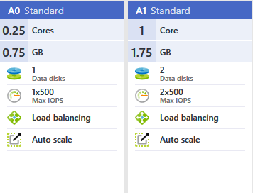
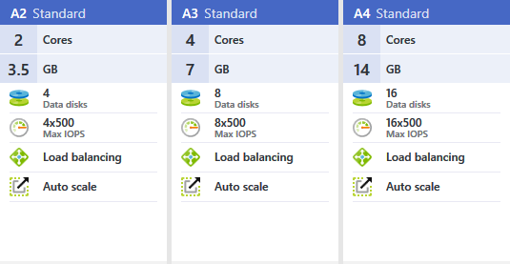
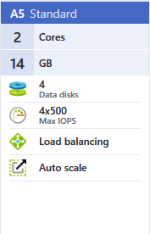
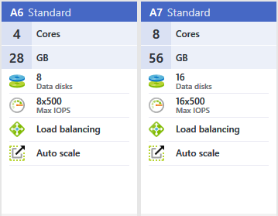
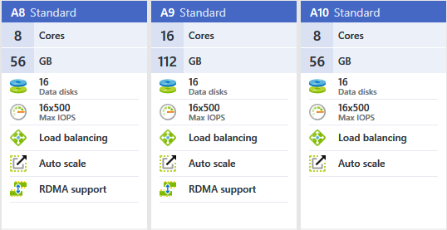
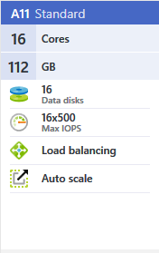
Standard Storage Configurations
Notes:
MSDN Subscription

Slide 15
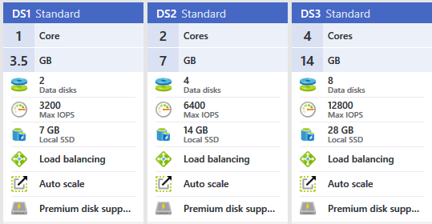
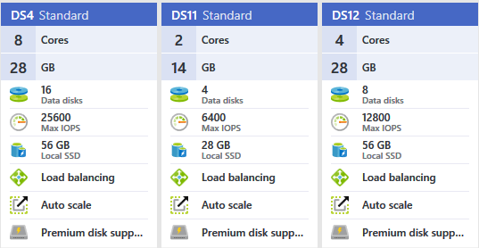
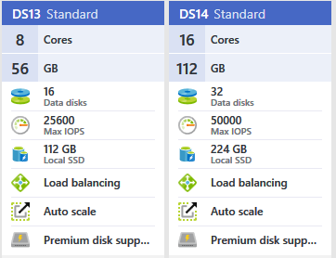
Premium Storage Configurations
Notes:
1600 per Max IOPS per disk

Slide 16
What are the Major Difference between Standard vs Premium Storage Configurations?
Standard storage
  You only pay for the space used no matter how much allocated
  Slow but inexpensive
Premium - SSD based but not very fast
  Not local to server
  You pay for the space you allocate not how much used
  Faster but can cost $$$

Slide 17
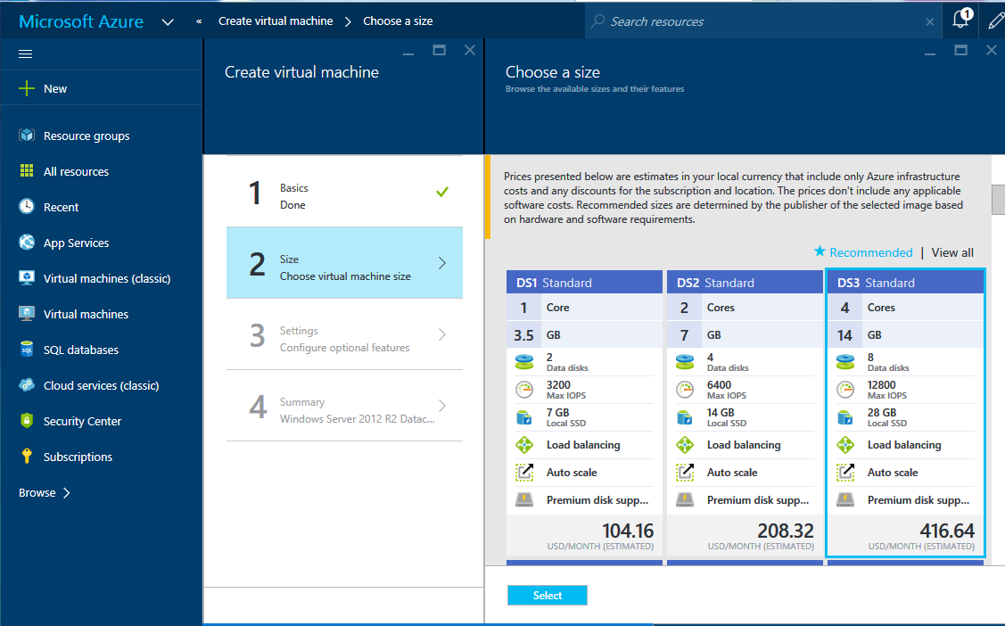

Slide 18
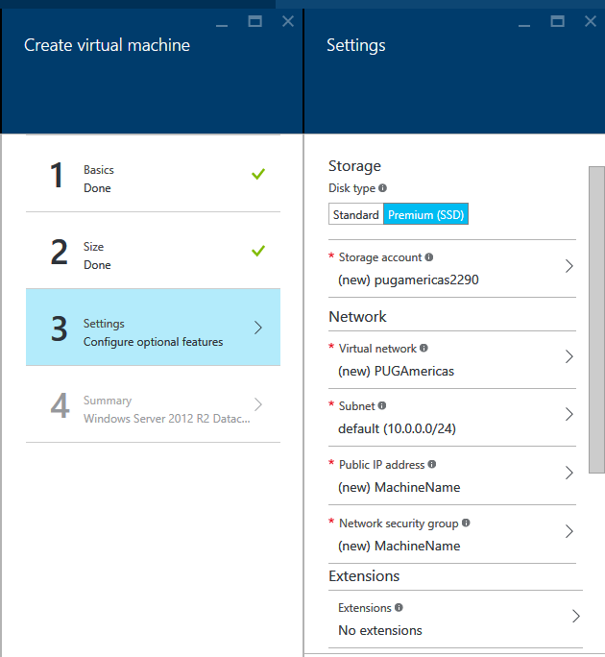
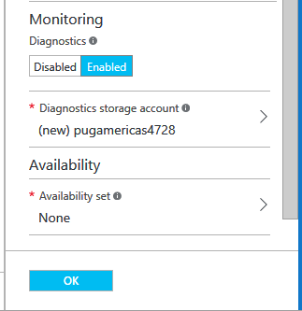

Slide 19
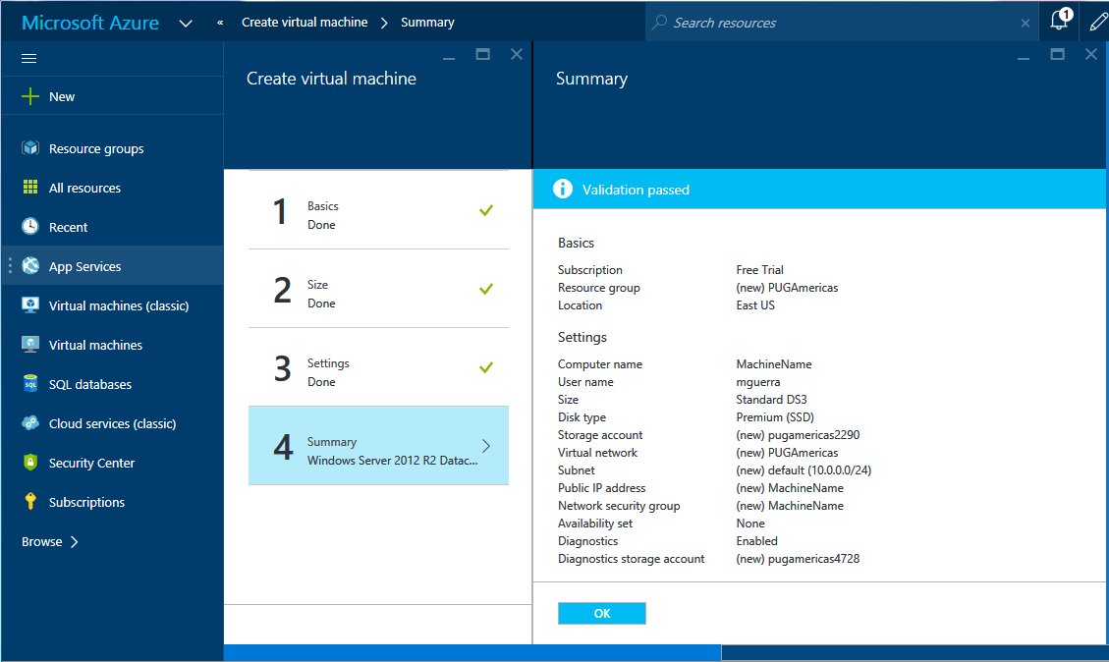

Slide 20
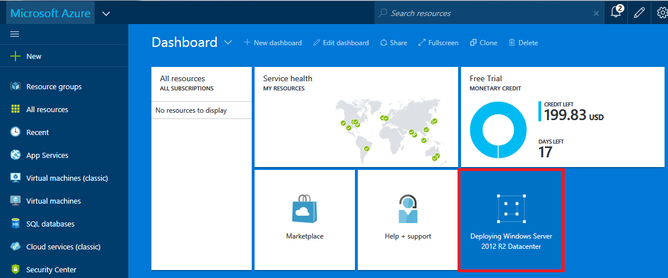

Slide 21
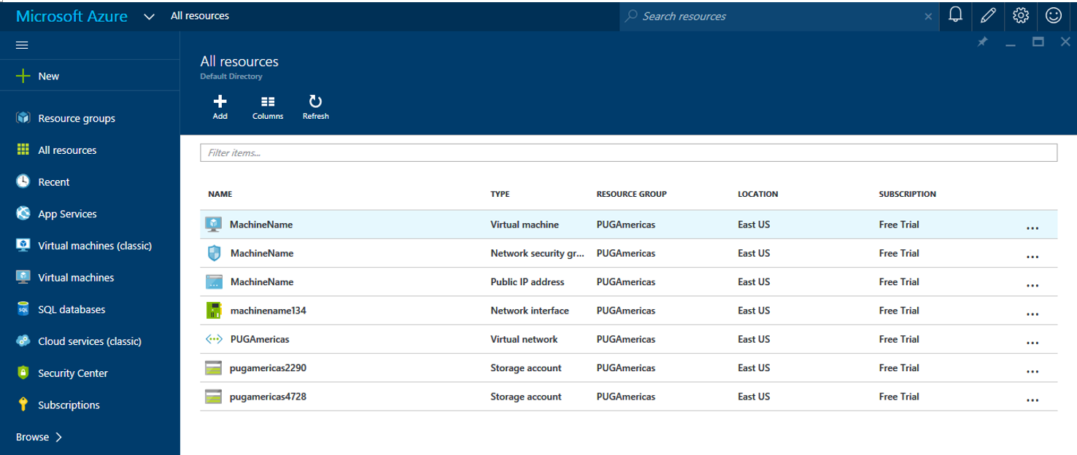

Slide 22
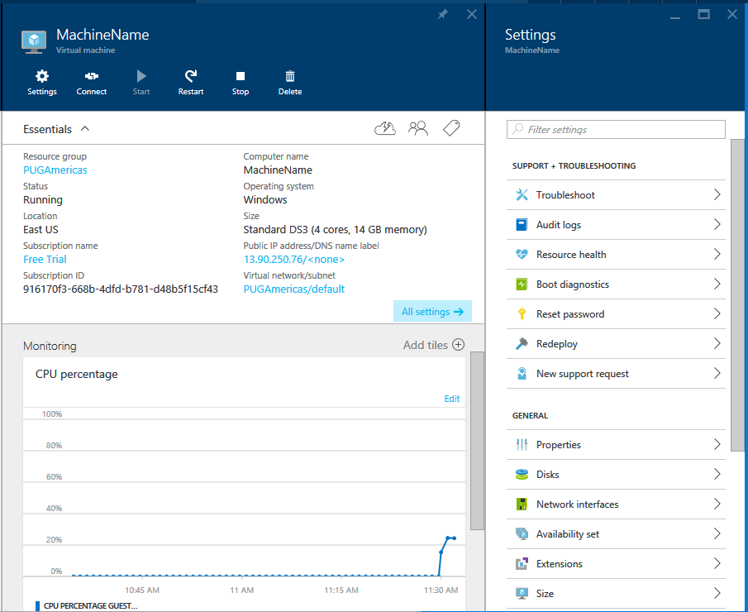

Slide 23
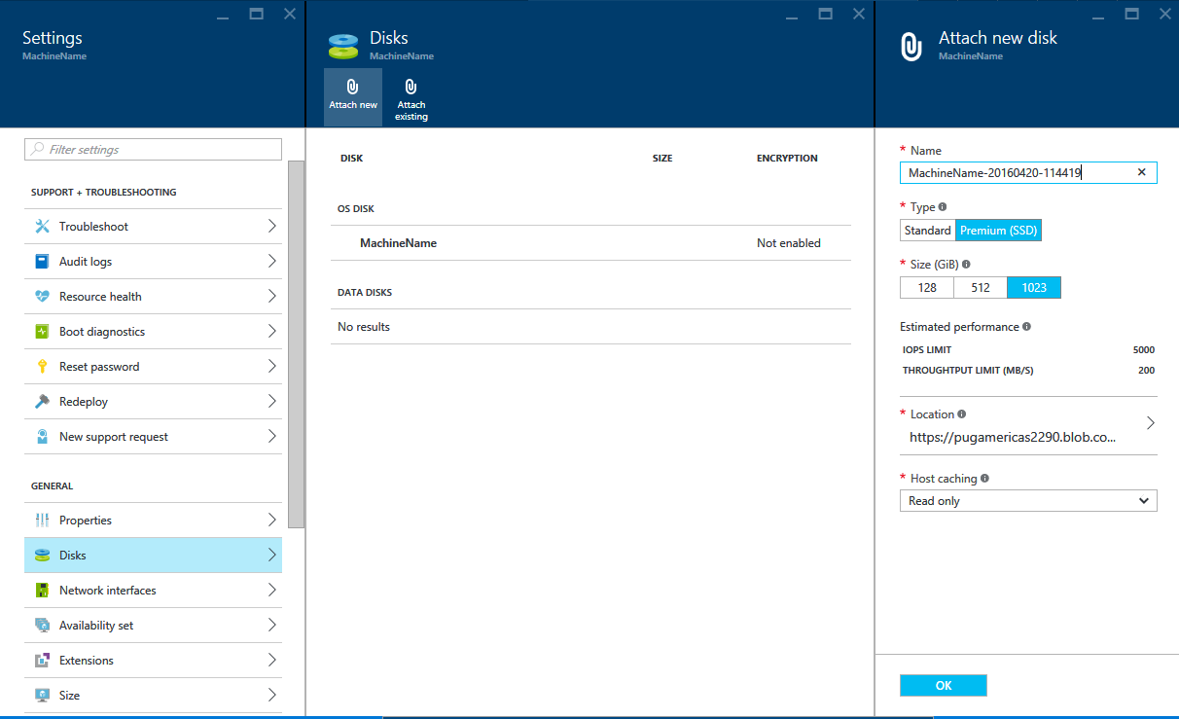
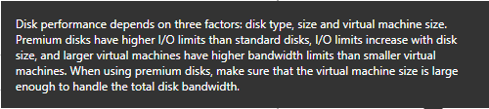

Slide 24
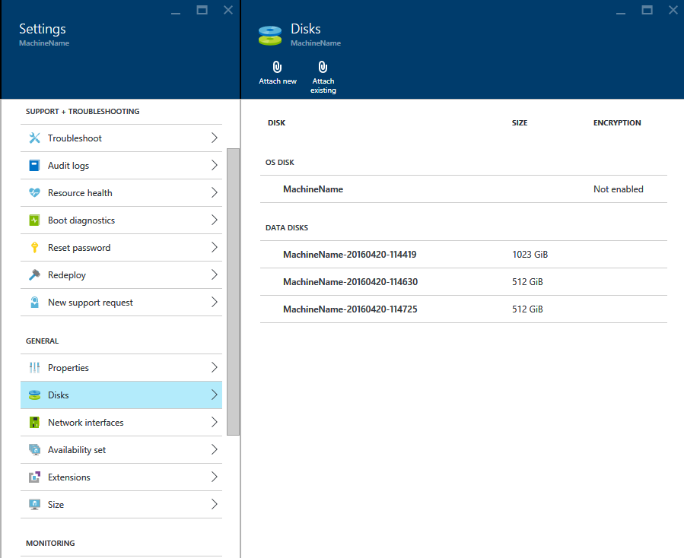

Slide 25
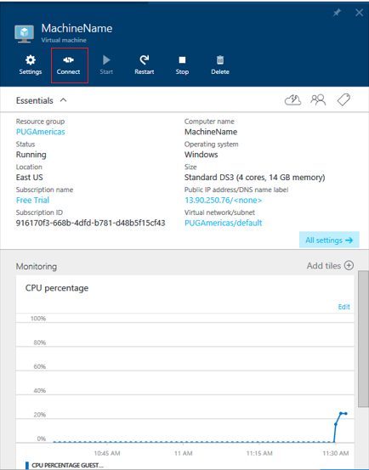
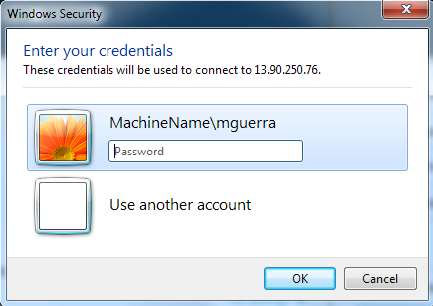
Accessing New VM Server

Slide 26
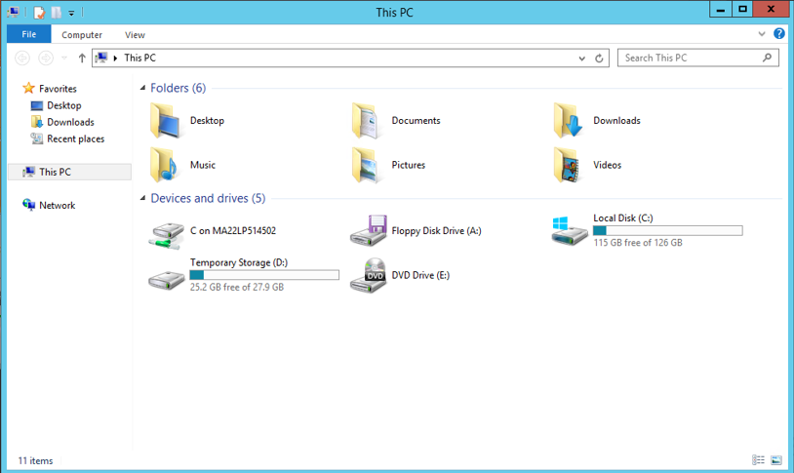
After you log on you will see that the
additional drives are not visible

Slide 27
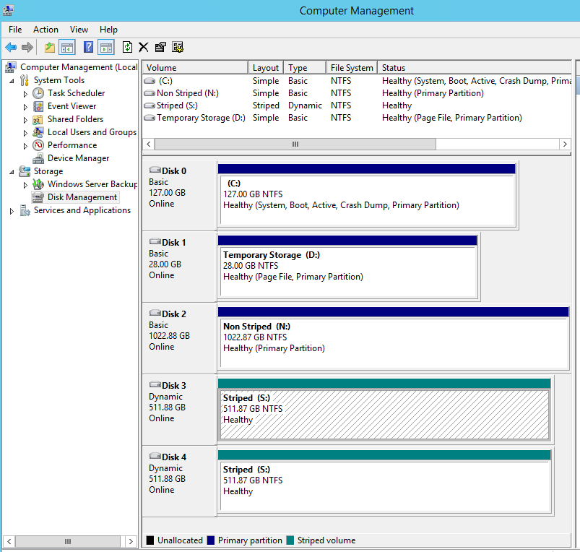
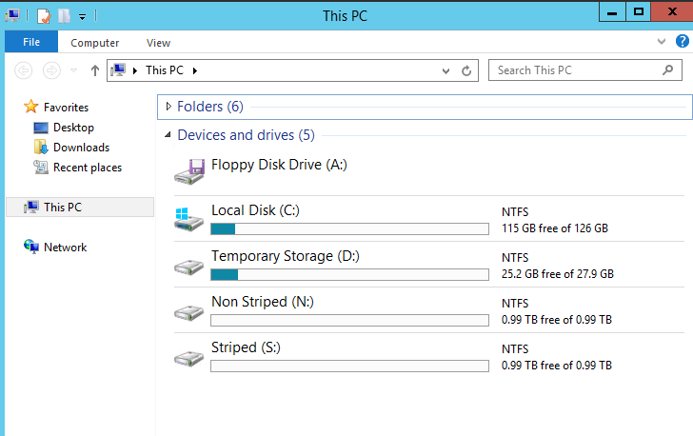
Use Computer Management to create stripe
or allocate drives

Slide 28
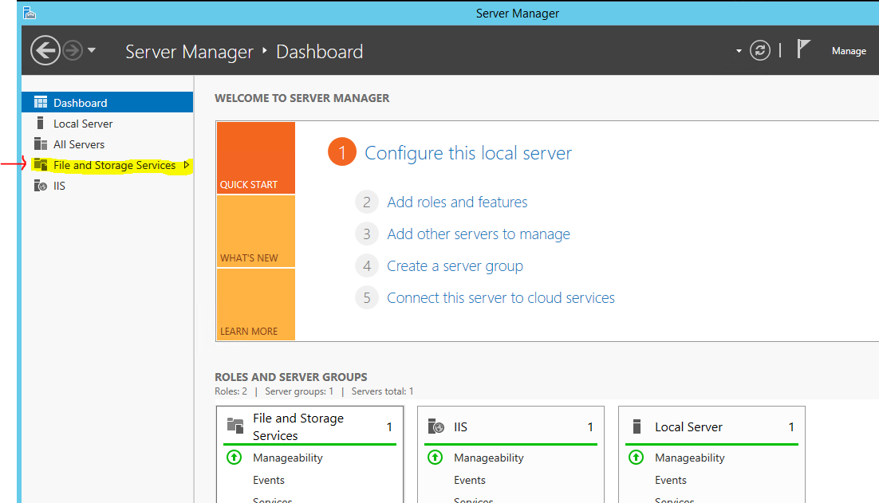
Use Server Manager to Configure drives

Slide 29
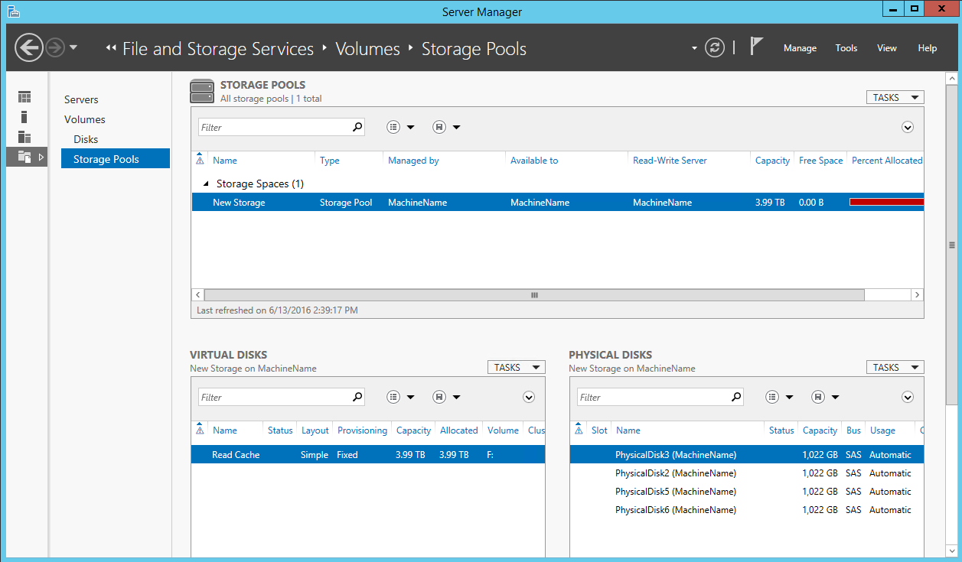

Slide 31
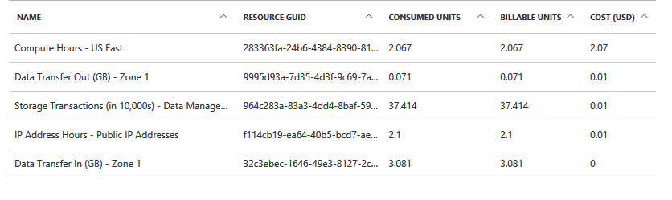
Sample Billing

Slide 32
Performance Tests…

Slide 33
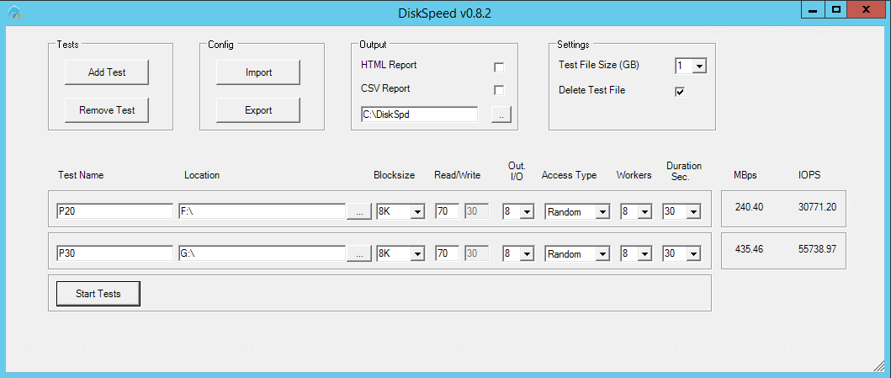
Used DiskSpeed to test IOPS and MBps
Command: DiskSpeed.ps1 (run in Windows PowerShell)
Example:
DS14 with Premium Storage
  4 – 512GB Drives Striped (P20)
  4 – 1 TB Drives Striped (P30)
Note: Disk formatted with 8K BlockSize

Slide 34
Results using DiskSpeed to test IOPS and MBps
 | 4 -- 512 GB Drive Stripped (P20) 4 -- 1 TB Drive Stripped (P30)
Server Configuration |  |  | MBps | IOPS | Disk Format Blocks | Max Server IOPS from Specs sheet
DS3 |  | P20 | 123.63 | 15,824 | 4K | 12,800
 |  | P30 | 123.63 | 15,824 | 4K | 12,800
DS3 |  | P20 | 127.48 | 16,317 | 8K | 12,800
 |  | P30 | 127.47 | 16,315 | 8K | 12,800
DS4 |  | P20 | 240.29 | 30,756 | 8K | 25,600
 |  | P30 | 254.81 | 32,616 | 8K | 25,600
DS14 |  | P20 | 240.4 | 30,771 | 8K | 50,000
 |  | P30 | 435.46 | 55,738 | 8K | 50,000
A7 |  | 4 – 1 TB Drives Only | 20.54 | 2,629 | 8K | 4* 500

Slide 35
Prorest Test
Command: prorest <DB Name> <Backup File Name>
Note: Sample DB size was 1.91G, with 3 areas (Schema, Data and Index)
Dell Server
7.99s
DS3 Server
P20s (F:\) | 18.00s
P30s (G:\) | 18.18s
DS4 Server
P20s (F:\) | 10.89s
P30s (G:\) | 11.40s
DS14 Server
P20s (F:\) | 11.16s
P30s (G:\) | 10.89s
A7 Server
(F:\) | 30.95s
Notes:
45

Slide 36
Prorest Test on ActuaL DB
Command: prorest <DB Name> <backup file>
DB ~160G (3 areas Index, Data, Schema)
Dell Server
42 Mins
DS14 Server
48 Mins
DS4 Server
56 Mins
A7 Server
3 Hours +

Slide 37


Slide 38
Websites
https://portal.azure.com
http://social.technet.microsoft.com/wiki/contents/articles/15200.storage-spaces-designing-for-performance.aspx
https://azure.microsoft.com/en-us/pricing/details/virtual-machines/?b=16.18
https://www.youtube.com/watch?v=poDRw_Xi3Aw

