Slide 1
OpenEdge ABL:
Productivity through Code
Why a Domain Specific Languages for Transactional Database Applications Just Makes Sense
Bill Wood and Alan Estrada
Americas PUG Challenge 2016
June 2016
Version 0.5

Slide 2
Progress and OpenEdge
  “It has one overriding purpose –
  to make it easy for people to manage
  information with a computer.”
  Progress Version 1 User’s Manual (circa 1983)

Slide 3
Agenda
What is a
Domain Specific
Language (DSL)?
Why Redundancy
and
Readability Matter?
I really wanted to
write 4GL here!
ABL
Language can help
Small Teams Deliver
High Quality Code:
Quickly and Durably
What is Needed for
Transactional Database
Applications?

Slide 4
Domain Specific Language
A domain-specific language (DSL) is a computer language specialized to a particular application domain.
Design Goals of a DSL:
  Much more expressive in their domain.
  Exhibit minimum redundancy*.
  Generally, less comprehensive.
  Redundancy of a program is defined as the average number of textual insertions, deletions, or replacements necessary to correctly implement a single stand-alone change in requirements.
Source: Wikipedia: http://en.wikipedia.org/wiki/Domain-specific_language
Notes:
Note that

Slide 5
In other words…
OpenEdge ABL lets you write:
  Very compact (small) programs,
  That do a lot without relying on lots of code, objects, or utilities.
Code is:
  Easy to read (self-documenting)
  Hard to make errors (related to the domain of transactional database applications)
  Small group of programmers can create complex systems
  New programmers can look at 20+ year old code and understand original ‘intent’

Slide 6
Why We Love ABL
Readable
Compact
Monoglot
1
One simple, expressive syntax for all constructs:
persistent & temporary data + local variables
2
Tight data binding means easy access to data
3
Data in database is in memory -> direct access
4
Transparent & automatic scopes:
record, transaction, error

Slide 7
ABL
https://github.com/progress/WhyABL/blob/master/BasicQuery/example.p
def var repname like Customer.SalesRep
init "GPE".
for each Customer where
SalesRep = repname and
Balance > CreditLimit:
Balance = Balance * 1.05.
end.
Notes:
1 = one language for query, update

Slide 8
ABL
1
2
def var repname like Customer.SalesRep
init "GPE".
for each Customer where
SalesRep = repname and
Balance > CreditLimit:
Balance = Balance * 1.05.
end.
2
1
3
3
4
Notes:
1 = one language for query, update

Slide 9
Demo:
How would this look in…
C#
…
Python

Slide 10
A summary (in Java)

Slide 11
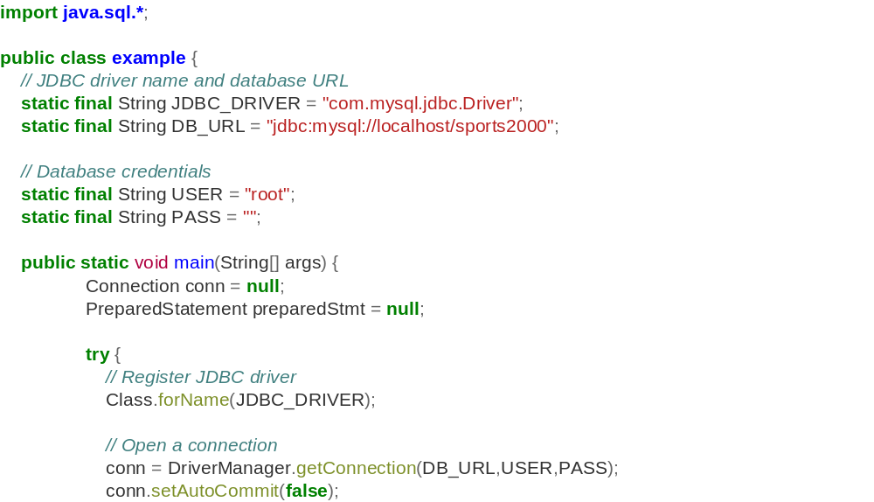
Java JDBC Example (p.1)
https://github.com/progress/WhyABL/blob/master/BasicQuery/example.java
All ‘boilerplate’
Connection explicit: Language does not ‘know’ about DB.
(continued)

Slide 12
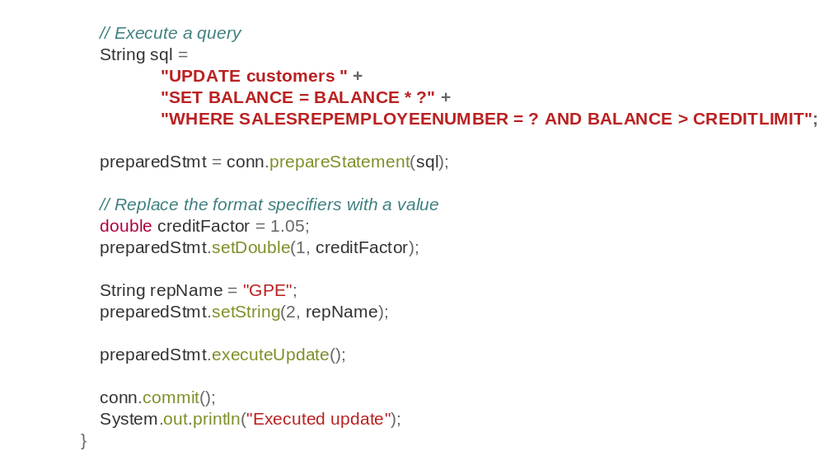
Java JDBC Example (p.2)
All ‘work’ of the program is in SQL, not in Java (or C#, or Python)
(continued from above)
SQL Expression formed from Java Strings:
Operators in program line are sometimes Java and sometimes SQL
16-table JOINS are common in ERP and business systems.
SQL sometimes goes 2-3 pages
(continued)
Hard to debug.

Slide 13
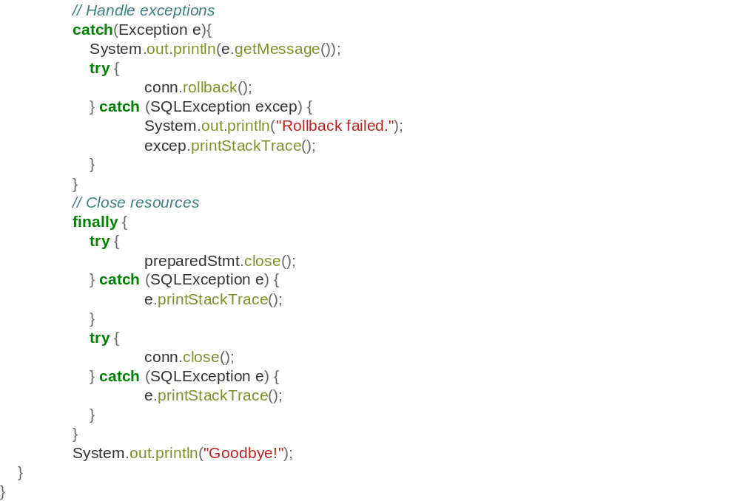
Java JDBC Example (p.3)
(continued from above)
Transactions not special so error handling ‘general purpose’.
Transactions not special so error handling ‘general purpose’.
Resource cleanup

Slide 14
Monoglot vs Polyglot: Out-of-Band Knowledge
SQL Statements are ‘outside the 3GL language’.
Developer is working in two worlds.
Developer personally has to connect the two worlds .
Coexisting, but Separate
What about Coexisting but Interacting?
String sql =
"UPDATE customers " +
"SET BALANCE = BALANCE * ?" +
"WHERE SALESREPEMPLOYEENUMBER = ? AND BALANCE > CREDITLIMIT";

Slide 15
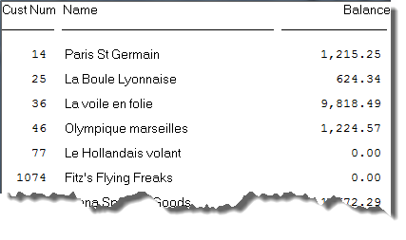
ABL
https://github.com/progress/WhyABL/blob/master/OperateOnResults/example.p
for each Customer where SalesRep = “DOS“:
display CustNum Name Balance.
end.

Slide 16
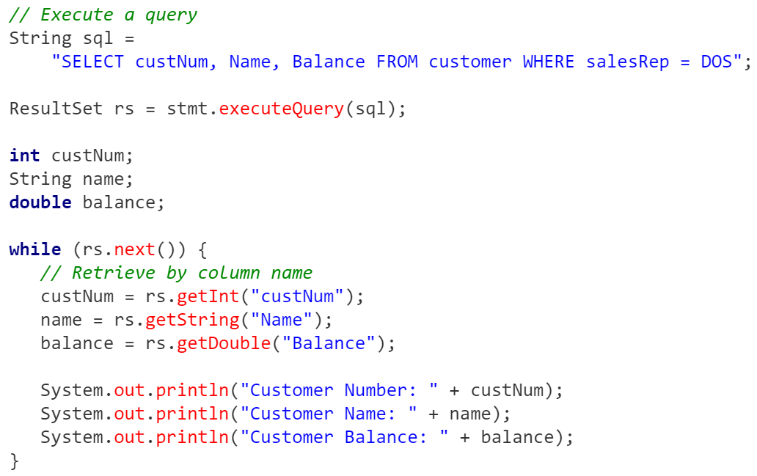
Java JDBC Example
Need to know the type that you define, cast to, and store….
…and they need to match

Slide 17
Java JDBC Example
Need to know what SQL returned (by name or position)

Slide 18
Java JDBC Example
Same concept “name” referred to 3 ways: (SQL, ResultSet, var)
4 ways: if you count labels

Slide 19
Out-of-Band Knowledge
In previous example, it was simple enough to keep things on one page, and we used one naming convention.
Quality can suffer when:
  Variables defined far away from the SQL.
  Database changes happen to match ‘implicit’ type conversion.
  Names are not exact matches.
  Type Definition and Type Access methods differ
None of these are checked by the compiler (except in ABL)
Note: A common solution is an ORM. We will discuss that later...

Slide 20
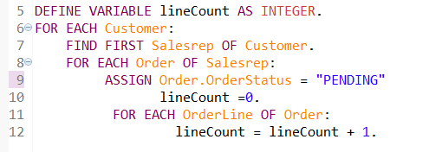
The Longer the SQL, The Harder to Debug
But let’s look at:
Most SQL embedded in other languages is not so simple.
For ERP Applications, 10-16 table joins is common.
Often, you update a handful (transactionally).
ABL can reference very complex relations ‘easily’
String sql = "SELECT CustNum, Name, Balance FROM Customer";
Multi-table relations
Updates to some Tables
Works with Debugger: can set Breakpoints

Slide 21
SQL for ERP Applications: A “Simple” Case
  SELECT (dsRegnskapstall_0.Yr + dsRegnskapstall_0.Pr) as myPeriod , dsRegnskapstall_0.AcNo, dsKonto_0.Kontonavn, dsKontoGruppe_0.KontoGruppeNavn, dsHovedgruppe.HovedGruppeNavn, dsAvdeling_0.AvdelingNr, dsAvdeling_0.Avdelingnavn, dsOmraade_0.OmraadeNavn, dsSelskap_0.SelskapNavn, dsRegnskapstall_0.Resultat, dsRegnskapstall_0.Balanse
  FROM DATASTORE.PUB.dsRegnskapstall dsRegnskapstall_0, DATASTORE.PUB.dsKonto dsKonto_0, DATASTORE.PUB.dsKontoGruppe dsKontoGruppe_0, DATASTORE.PUB.dsHovedGruppe dsHovedGruppe_0, DATASTORE.PUB.dsAvdeling dsAvdeling_0,
  DATASTORE.PUB.dsOmraade dsOmraade_0,
  DATASTORE.PUB.dsSelskap dsSelskap_0
  WHERE dsRegnskapstall_0.dsAvdelingObj = dsAvdeling_0.dsAvdelingObj AND dsKonto_0.AcNo = dsRegnskapstall_0.AcNo
  AND dsKonto_0.dsKontoGruppeObj = dsKontoGruppe_0.dsKontoGruppeObj
  AND dsHovedgruppe_0.dsHovedGruppeObj = dsKontogruppe_0.dsHovedGruppeObj
  AND dsOmraade_0.dsOmraadeObj = dsRegnskapstall_0.dsOmraadeObj
  AND dsSelskap_0.dsSelskapObj = dsRegnskapstall_0.dsSelskapObj

Slide 22
Other Real Examples
UPDATE PUB.“RECORD" SET recordIndexed = 2 WHERE “scancode" in (
'000000034439805',
'000000034412710',
'000000034418992',
'000000034412386',
'000000034441247',
'000000034439376',
'000000034442298',
'000000034412337',
'000000034400916',
<500 values in total>
'000000034412710',
'000000034418992',
'000000034412386',
'000000034441247',
'000000034439376',
'000000034442298',
'000000034412337',
'000000034400916',
'000000034439639',
'000000034439685',
'000000034442410',
'000000034419241',
'000000034413595',
'000000034398492'
);
select
PERSTAMM.PSEINDAT, PERSTAMM.PSAUSDAT, PERSTAMM.FIRMA, PERSTAMM.PSNR
from PUB.BENSTM, PUB.PERSTAMM
where BENSTM.FIRMA = PERSTAMM.FIRMA
AND
((BENSTM.BSTPESTM = 'N')
OR
( ( ( (BENSTM.KSTACCEPT ='N')
OR
(PERSTAMM.KSTNR IN
(SELECT KSTNR FROM PUB.BSKOSTEN
WHERE BSKOSTEN.FIRMA=BENSTM.FIRMA
AND BSKOSTEN.BENNR=BENSTM.BENNR
AND BSKOSTEN.ZULASSEN='J'))
)
AND ((PERSTAMM.KSTNR NOT IN
(SELECT KSTNR FROM PUB.BSKOSTEN
WHERE BSKOSTEN.FIRMA=BENSTM.FIRMA
AND BSKOSTEN.BENNR=BENSTM.BENNR
AND BSKOSTEN.ZULASSEN='N'))
)
AND ((BENSTM.PGRPACCEPT ='N')
OR
(PERSTAMM.PGNR IN
(SELECT PGNR FROM PUB.BSPERGRP
WHERE BSPERGRP.FIRMA=BENSTM.FIRMA
AND BSPERGRP.BENNR=BENSTM.BENNR
AND BSPERGRP.ZULASSEN='J') )
)
AND ((PERSTAMM.PGNR NOT IN
(SELECT PGNR FROM PUB.BSPERGRP
WHERE BSPERGRP.FIRMA=BENSTM.FIRMA
AND BSPERGRP.BENNR=BENSTM.BENNR
AND BSPERGRP.ZULASSEN='N'))
)
AND ((BENSTM.SHIFTACCEPT='N')
OR
(PERSTAMM.SPLSNR IN
(SELECT SPLANS FROM PUB.BSSPLANS
WHERE BSSPLANS.FIRMA=BENSTM.FIRMA
AND BSSPLANS.BENNR=BENSTM.BENNR
AND BSSPLANS.ZULASSEN='J'))
)
AND ((PERSTAMM.SPLSNR NOT IN
(SELECT SPLANS FROM PUB.BSSPLANS
WHERE BSSPLANS.FIRMA=BENSTM.FIRMA
AND BSSPLANS.BENNR=BENSTM.BENNR
AND BSSPLANS.ZULASSEN='N'))
)
AND ((PERSTAMM.PSNR NOT IN
(SELECT PSNR FROM PUB.BSPERSTM
WHERE BSPERSTM.FIRMA=BENSTM.FIRMA
AND BSPERSTM.BENNR=BENSTM.BENNR
AND BSPERSTM.ZULASSEN='N'))
)
AND ((BENSTM.KSTACCEPT ='J')
OR
(BENSTM.KSTDENY ='J')
OR
(BENSTM.PGRPACCEPT ='J')
OR …………………………………
(BENSTM.SHIFTACCEPT ='J')
OR
(BENSTM.SHIFTDENY ='J') ) )
OR
((PERSTAMM.PSNR IN
(SELECT PSNR FROM PUB.BSPERSTM
WHERE BSPERSTM.FIRMA=BENSTM.FIRMA
AND BSPERSTM.BENNR=BENSTM.BENNR
AND BSPERSTM.ZULASSEN='J')))
)
)
This example intentionally unreadable as an illustration

Slide 23
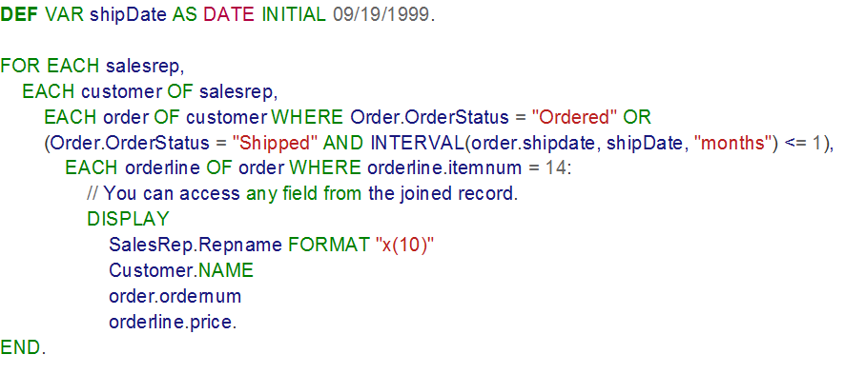
ABL
https://github.com/progress/WhyABL/blob/master/ComplexQuery/example.p
Notes:
1 = one language for query, update

Slide 24
Demo:
What would this look like in
Python

Slide 25
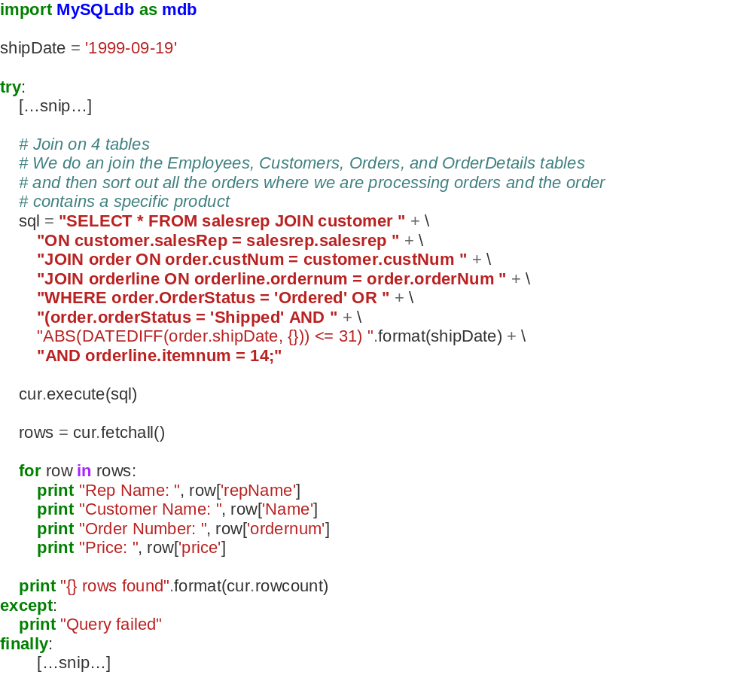
Python Example
https://github.com/progress/WhyABL/blob/master/ComplxQuery/example.py
Cannot Debug.
Error Prone: No ‘semantic’ support in compiler (or editor)
“Dates” and other types need to be converted from ‘local’ 3GL to SQL.
… but Python is at least more compact than Java/C#

Slide 26
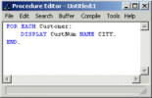



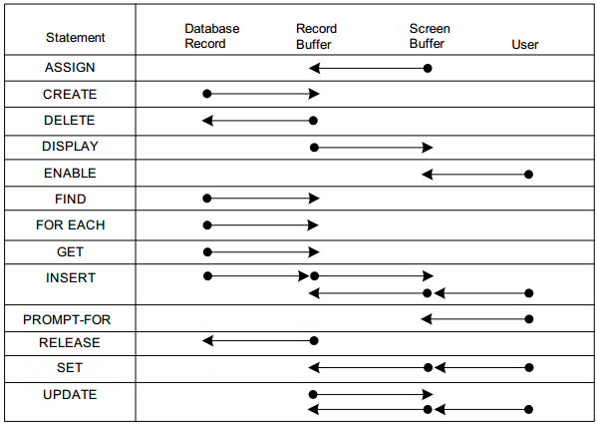
Eskimos have 35 words for “Snow”:
Notes:
You don’t NEED each of these, but they each have their uses.
They make code more readable.

Slide 27
Transaction Scope and Data Handling and Movement
Compactness is great in ABL.
Expressiveness of ABL for transactional applications is it’s most impressive feature:
  “Eskimos have 15 words for snow.”
  ABL developers have 15 ways to move data values beween Screen, Record Buffers, and Database.
Data Manipulation works ‘transparently’ with Transaction Scoping.

Slide 28
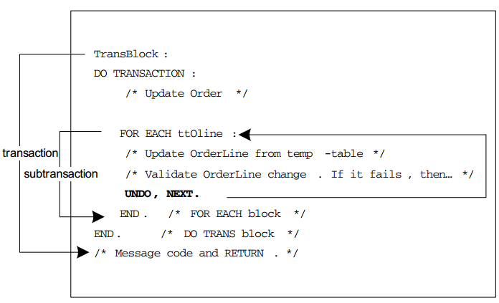
Automatic Transaction Scoping in ABL

Slide 29
Key Points
ABL does a great job ‘naturally’ handling the various combinations of:
  Data Transfer / Manipulation Semantics; and
  Transaction Semantics
Does the ‘right thing’ almost all the time, but you can override it.
Not only the Database is ‘transacted’
  You have programmatically defined tables and datasets
    Temp-Tables
    ProDataSets
  You can have primitive variables
    DEF VAR I AS INTEGER
All are equally transactional

Slide 30
Why this Matters: Code Quality!
With ABL, it is harder to make ‘subtle’ mistakes.
User Errors, Datatype Exceptions, Null values happen regularly, and exeception handling normally is based on throws and catches.
  These don’t always reset ‘work-in-progress’ values to the correct values in order to continue work.
  You can end up with:
    Holes in continuous sequences.
    Subtotals and Totals that do not add up.
    Copying values from one record (that failed to update) into another.
These errors are harder to do in ABL.

Slide 31
In ABL: Temp-Tables and Datasets
Works efficiently for ‘real’ database problems
  Build for large sets, indexes, joins, and complex problems.
Automatically scales
  Expands memory to disk
Works seamlessly with database
  Access like data
  Can join to database
  Can participate transctionally

Slide 32
An Example Problem
I have just done a ‘reorg’ of my sales team
I have a list of my “Prime” Customers (their IDs) and their new sales rep
  Provided by an external system (API, REST, flat file, or whatever)
Case 1: Generate a report of the affected customers
  Perhaps to notify them.
Case 2: I want to find all the Salesreps who now have responsibilities in Massachusetts
  I want to talk to this team specifically
Case 3: Update the old salesrep to the new one
  Drive my changes in the database

Slide 33
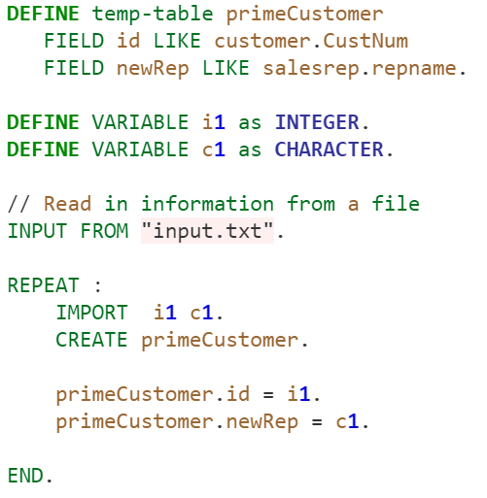
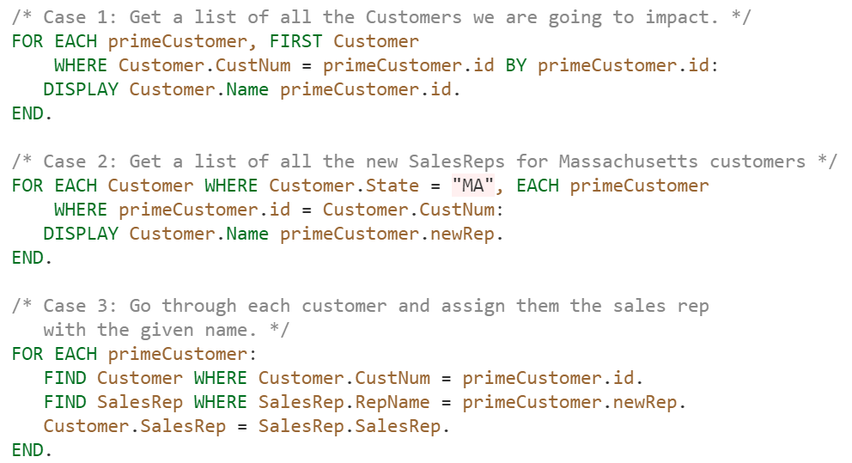
ABL Solution: Create a Temp-Table and use the ABL
https://github.com/progress/WhyABL/blob/master/DbAndStructures/example.p
Load Data file into Temp-Table
Act as if it is ‘another’ table

Slide 34
Demo:
Working with Data and Structures together:
Python

Slide 35
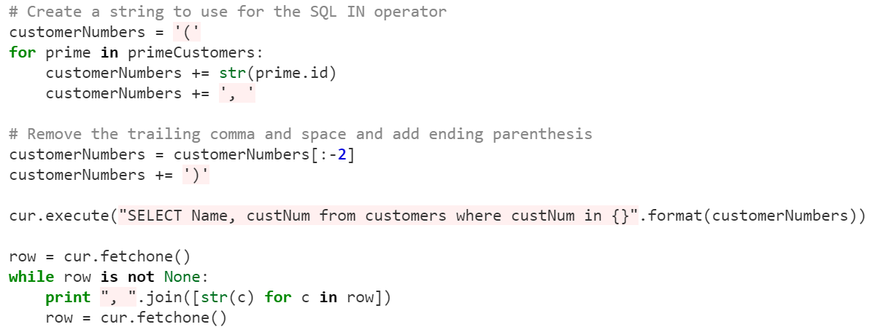
Case 1: Python (Find Affected Customers)
https://github.com/progress/WhyABL/blob/master/DbAndStructures/example.py
Goal: Query the Database for a long list of customer numbers.
Trick: Need to create a long “IN {id1, id2, id3}” to have the SQL Engine return all customers in one go (vs making 100’s of individual requests.
Sure… it works…. But is this going to be clear to everyone. I could be clearer (but less efficient) if I made 100’s of individual SELECTS

Slide 36
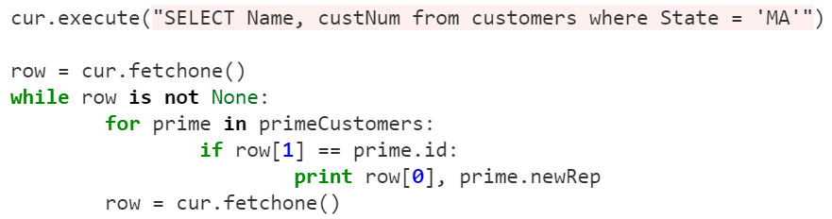
Case 2: Python (Find New Salesreps that now have “MA” customers)
https://github.com/progress/WhyABL/blob/master/DbAndStructures/example.py
Goal: Find all members of our list whose customer is listed in Database as STATE EQ “MA” .
One Option: Get all customers in MA, then see if they are in ‘the list’
But is it better to find only return customers in the list that are in “MA…?
Who is responsible for query efficiency?

Slide 37
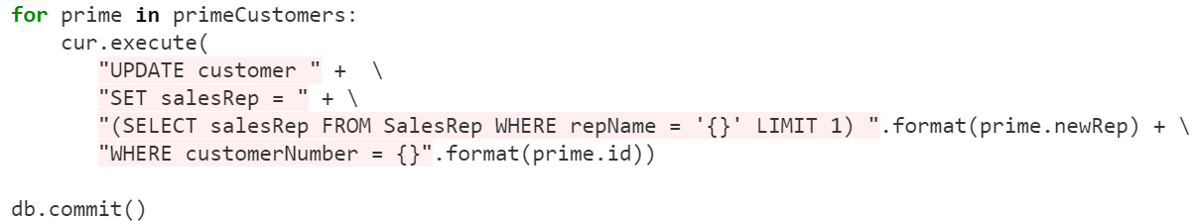
Case 3: Python (Update Customers with New Salerep ID)
https://github.com/progress/WhyABL/blob/master/DbAndStructures/example.py
Goal: Query the Database for a long list of customer numbers, and pass a list of new values.
Trick: Need to create a second long “IN {id1, id2, id3}” to have the SQL Engine do some clever substitution
We have shown we can be clever:
- but we are mixing our languages
- relying on ourselves (not tool) to write good SQL
Arguably being ‘too’ clever

Slide 38
In Summary
The OpenEdge ABL lets you write:
  Very compact (small) programs.
  That do a lot without relying on lots of code.
This leads to Code that is:
  Easy to read
  Error-Adverse (Not error-prone)
  Enables small teams to do great things
  Stands the test of time

Slide 39
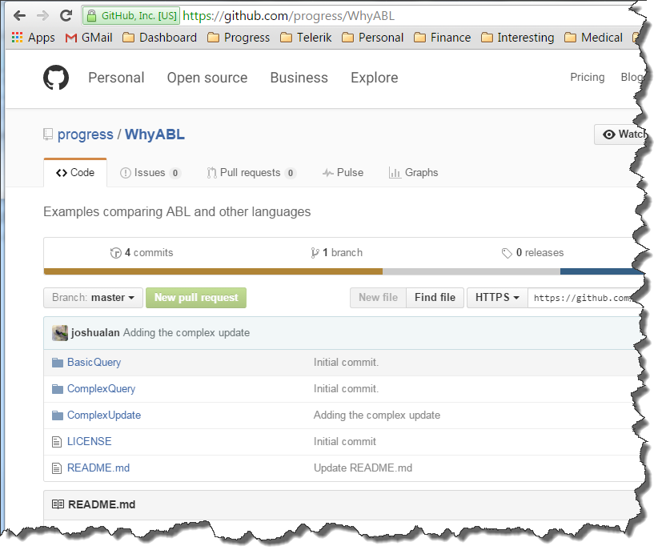
For More Information
Presentation:
  http://pugchallenge.org/downloads.html
Code Samples:
  https://github.com/progress/WhyABL

Slide 40
Would Like to Thank the following WebSites that made all this possible…
http://hilite.me/ -- Source Code Highlighting (includes ABL)
https://github.com/progress/WhyABL -- “The” place for source code

Slide 42

BACKUP SLIDES:
The following slides are HIDDEN and part of the normal presentation.

Slide 43
What is Wrong with SQL?
  Most languages lack compatibility with SQL
    There is an "impedance mismatch"
      SQL data types are not supported in most application writing languages
      most application writing languages cannot represent NULL values
      expression syntax in SQL differs from that used by Java, JavaScript, C, C#, C++, etc.
  With SQL you cannot read data without a transaction
    You need a lot of code for the simplest of applications that use SQL.
  One Solution: complex infrastructure "stacks"
    Kludge on top of Kludge on top of Kludge
    (can you say J2EE ?)

Slide 44
What a SQL statement looks like

Slide 45
Some sql statements – queries (small)
SELECT TOP 1000 *
FROM pub."SONIC-LOG"
WHERE ZEIT >= CURDATE() AND TYP = 300
OR TYP = 301 OR TYP = 302 OR TYP = 310 OR TYP = 320
ORDER BY ZEIT DESC WITH (NOLOCK);
Notes:
hagebau Datendienst IT-Service GmbH

Slide 46
Some sql statements – queries (medium)
select afregning1.tur_id
from pub.historik historik1,
pub.tur_historik tur_historik1,
pub.afregning afregning1,
pub.vognmand vognmand1,
pub.selskab selskab1
where historik1.reference_id = 11734
and historik1.reference_type = 11
and tur_historik1.historik_id = historik1.historik_id
and afregning1.afregning_id = tur_historik1.reference_id
and vognmand1.vognmandsnr = afregning1.afregnings_vognmandsnr
and selskab1.selskabsnr = afregning1.selskabsnr
Notes:
Finn Frogne A/S

Slide 47
Some sql statements – queries (large)
SELECT DISTINCT opgohead.knote, opinv.ksubevent
FROM Opgohead opgohead
Left Join Opgohead orderOpgohead
ON orderOpgohead.kco = 7 AND
orderOpgohead.kdoctype = 'S' AND
orderOpgohead.knote = 1012834 AND
orderOpgohead.kmob = opgohead.kordmob
Left Join Opinv opinv
ON opinv.kco = 7 AND opinv.kdoctype = opgohead.kdoctype
AND opinv.knote = opgohead.knote
WHERE opgohead.kco = 7
AND opgohead.korddoctype = 'S'
AND opgohead.kordnote = 1012834
AND ( ( ( (opgohead.kdoctype = 'S' OR opgohead.kdoctype = 'SQ' ) )
OR ( (opgohead.kmob IN
(SELECT MIN ( minOpgohead.kmob)
FROM Opgohead minOpgohead
WHERE minOpgohead.kco = 7
AND minOpgohead.kdoctype = opgohead.kdoctype
AND minOpgohead.knote = opgohead.knote )
) ) ) ) ;
Notes:
Result Group plc

Slide 48
Some sql statements – queries (extra large)
select
PERSTAMM.PSEINDAT, PERSTAMM.PSAUSDAT, PERSTAMM.FIRMA, PERSTAMM.PSNR
from PUB.BENSTM, PUB.PERSTAMM
where BENSTM.FIRMA = PERSTAMM.FIRMA
AND
((BENSTM.BSTPESTM = 'N')
OR
( ( ( (BENSTM.KSTACCEPT ='N')
OR
(PERSTAMM.KSTNR IN
(SELECT KSTNR FROM PUB.BSKOSTEN
WHERE BSKOSTEN.FIRMA=BENSTM.FIRMA
AND BSKOSTEN.BENNR=BENSTM.BENNR
AND BSKOSTEN.ZULASSEN='J'))
)
AND ((PERSTAMM.KSTNR NOT IN
(SELECT KSTNR FROM PUB.BSKOSTEN
WHERE BSKOSTEN.FIRMA=BENSTM.FIRMA
AND BSKOSTEN.BENNR=BENSTM.BENNR
AND BSKOSTEN.ZULASSEN='N'))
) -- Part 1 of 4
Notes:
An extreme case (was a bug of course) from proAlpha.
Caused internal err when node number limit exceeded.

Slide 49
Some sql statements - queries
AND ((BENSTM.PGRPACCEPT ='N')
OR
(PERSTAMM.PGNR IN
(SELECT PGNR FROM PUB.BSPERGRP
WHERE BSPERGRP.FIRMA=BENSTM.FIRMA
AND BSPERGRP.BENNR=BENSTM.BENNR
AND BSPERGRP.ZULASSEN='J') )
)
AND ((PERSTAMM.PGNR NOT IN
(SELECT PGNR FROM PUB.BSPERGRP
WHERE BSPERGRP.FIRMA=BENSTM.FIRMA
AND BSPERGRP.BENNR=BENSTM.BENNR
AND BSPERGRP.ZULASSEN='N'))
)
AND ((BENSTM.SHIFTACCEPT='N')
OR
(PERSTAMM.SPLSNR IN
(SELECT SPLANS FROM PUB.BSSPLANS
WHERE BSSPLANS.FIRMA=BENSTM.FIRMA
AND BSSPLANS.BENNR=BENSTM.BENNR
AND BSSPLANS.ZULASSEN='J')) -- Part 2 of 4
)

Slide 50
Some sql statements - queries
AND ((PERSTAMM.SPLSNR NOT IN
(SELECT SPLANS FROM PUB.BSSPLANS
WHERE BSSPLANS.FIRMA=BENSTM.FIRMA
AND BSSPLANS.BENNR=BENSTM.BENNR
AND BSSPLANS.ZULASSEN='N'))
)
AND ((PERSTAMM.PSNR NOT IN
(SELECT PSNR FROM PUB.BSPERSTM
WHERE BSPERSTM.FIRMA=BENSTM.FIRMA
AND BSPERSTM.BENNR=BENSTM.BENNR
AND BSPERSTM.ZULASSEN='N'))
)
AND ((BENSTM.KSTACCEPT ='J')
OR
(BENSTM.KSTDENY ='J')
OR
(BENSTM.PGRPACCEPT ='J')
OR …………………………………
(BENSTM.SHIFTACCEPT ='J') -- Part 3 of 4
OR
(BENSTM.SHIFTDENY ='J') ) )

Slide 51
Some sql statements - queries
OR
((PERSTAMM.PSNR IN
(SELECT PSNR FROM PUB.BSPERSTM
WHERE BSPERSTM.FIRMA=BENSTM.FIRMA
AND BSPERSTM.BENNR=BENSTM.BENNR
AND BSPERSTM.ZULASSEN='J')))
)
)
and BENSTM.BENNR = 'rude'
and BENSTM.FIRMA = 1; -- Part 4 of 4

Slide 52
Transaction UNDO Example

Slide 53
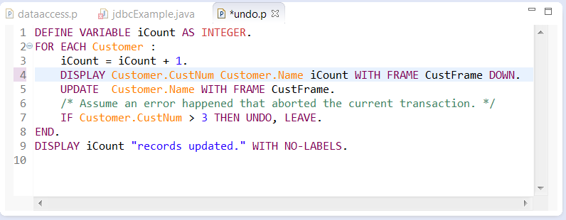
A Trivial Example…. Counting Updates (until an error)
Define a variable and ‘manipulate’ it (increment) as part of your transaction logic.
In ‘normal’ language, the variable retains its value regardless of he transaction:
Increment 4 times…
…then UNDO transaction

Slide 54
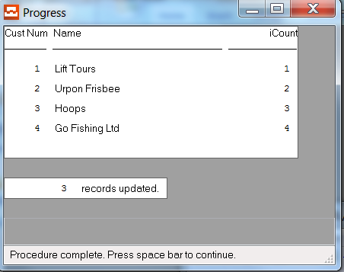
What you see in ABL
Counter DID increment
4
3
But last update was
“rolled back”
A Common Error (in ‘General Purpose Languages’):
Logic works well, when no problems, but ‘subtle’ bugs happen when transactions fail.

Slide 55
Compare to 3GL
Developer conscious of SQL, Variables, and Widget/Controls
ASSIGN count.
  int count = int.Parse(widget.Value.ToString(), NumberStyles.Currency);
DISPLAY temperature.
  widget.Value = Convert.ToString(temperature);
FIND FIRST Employee.
    sql = "SELECT TOP 1 salary FROM Employee;
    ResultSet rs = stmt.executeQuery(sql);
    while (rs != null) {
    float income = rs.getFloat(1);
    acton(income);
    }

Slide 56
Compare to 3GL
FOR EACH Employee: actOn(salary).
    sql = "SELECT salary FROM Employee;
    ResultSet rs = stmt.executeQuery(sql);
    while (rs != null) {
    float income = rs.getFloat(1);
    acton(income);
    }
FOR EACH Employee: salary = computeSalary(empId). END.
    sql = "SELECT salary FROM Employee;
    ResultSet rs = stmt.executeQuery(sql);
    while (rs != null) {
    float income = rs.getFloat(1);
    acton(income);
    }

Slide 57
Commentary
In the above, ABL is just ‘quicker’ and ‘easier to understand.
One namespace for database, buffers, and variables
  All items share transactional semantics.
  You can ‘UNDO, RETRY’ your own variables
  You need to ‘know’ less and define fewer ‘extra’ constructs.
Minimal setup and cleanup.
One set of syntax rules for all lines in the code.
  Especially hard for complex schema.
All checked by the compiler and works with the debugger.

Slide 58
Structured Data:
Temp-Tables and ProDataSets

Slide 59
In other languages….
Use Language Collections:
  Designed for collections of Objects and/or primitives
  Iteration, Filtering, and Sorting mechanisms vary with problem
  BUT some operations are too complex
Use an ORM (Object Relational Mapping)
  Can create custom logic to encapsulate Iteration, Filtering, and Sorting.
  Users of objects isolated from mechanism.
  BUT each mechanism is custom code.
Use an In-Memory Database
  Some problems handled as ‘in-memory’ database.
  Good mapping to ‘real’ database (e.g. offline mobile cases)
  BUT still have SQL-to-3GL impedance.

Slide 60
Working with Data: Temp-Tables and Datasets
Large transactional database applications work with large sets of data.
Sometimes
  the data is in a database
  it is a ‘working set’ in memory; and
  It is a combination
In all cases, a developer might want to:
  Navigate the data
  Filter the current working set
  Sort results for relevancy
In ABL, there is one paradigm for data (whether in database or not)
In 3GL, you need a second paradigm

Slide 61
OpenEdge ABL Structures
Treat Structures as a Database.
  Versus:
    Objects, Collections, ResultSets, Lists
ABL assumes data problems are complex
  Assumes you need rich semantics
  (more importantly, the SAME semantics)
  Data Aware
3GL gives basic primitives
  very efficient for simple cases
  BUT… stretched by “large” or “complex” data problems

Slide 62
ABL Example: Defining Structures
https://github.com/progress/WhyABL/blob/master/Structures/example.p
DEFINE TEMP-TABLE ttitem NO-UNDO LIKE Item.
DEFINE TEMP-TABLE ttorderline NO-UNDO LIKE OrderLine.
/* Create a working set of the ITEM temp-table that fulfill
certain conditions. */
FOR EACH Item:
IF Item.weight >= 2.0 THEN DO:
CREATE ttitem.
BUFFER-COPY Item TO ttitem.
RELEASE ttitem.
END.
END.
FOR EACH OrderLine:
CREATE ttorderline.
BUFFER-COPY OrderLine TO ttorderline.
RELEASE ttorderline.
END.

Slide 63
ABL Example: Navigating Structures
https://github.com/progress/WhyABL/blob/master/Structures/example.p
/* Navigate through the records */
FIND FIRST ttitem WHERE ttitem.minqty >= 5.
DISPLAY ttitem.
FIND LAST ttorderline WHERE ttorderline.itemnum = 14.
DISPLAY ttorderline.
FIND PREV ttorderline WHERE ttorderline.itemnum = 14.
DISPLAY ttoderline.

Slide 64
ABL Example: Sorting Structures
https://github.com/progress/WhyABL/blob/master/Structures/example.p
/* Sort from highest weight to lowest and filter out
items where we have stock less than 5000 */
FOR EACH ttitem WHERE ttitem.onhand > 5000
BY ttitem.weight DESCENDING:
DISPLAY ttitem.
END.

Slide 65
ABL Example: Filtering Structures
https://github.com/progress/WhyABL/blob/master/Structures/example.p
/* Find a subset of items that have been ordered more
than 50 times in a single order. */
FOR EACH ttorderline WHERE ttorderline.qty >= 50,
EACH ttitem WHERE ttorderline.itemnum = ttitem.itemnum:
DISPLAY ttitem.itemname ttitem.itemnum ttorderline.qty.
END.

Slide 66
ABL Example: Accumulating on Structures
https://github.com/progress/WhyABL/blob/master/Structures/example.p
/* Find the number of orders for each item and the total amount it ever
sold. Then, display these alphabetically by ttitem.name. */
FOR EACH ttitem BY ttitem.itemname:
FOR EACH ttorderline WHERE ttorderline.itemnum = ttitem.itemnum:
ACCUMULATE ttorderline.ordernum (COUNT).
ACCUMULATE ttorderline.qty (TOTAL).
END.
DISPLAY ttitem.itemname (ACCUM COUNT ttorderline.ordernum)
(ACCUM TOTAL ttorderline.qty).
END.

Slide 67
Demo:
A comparison to
JAVA

Slide 68
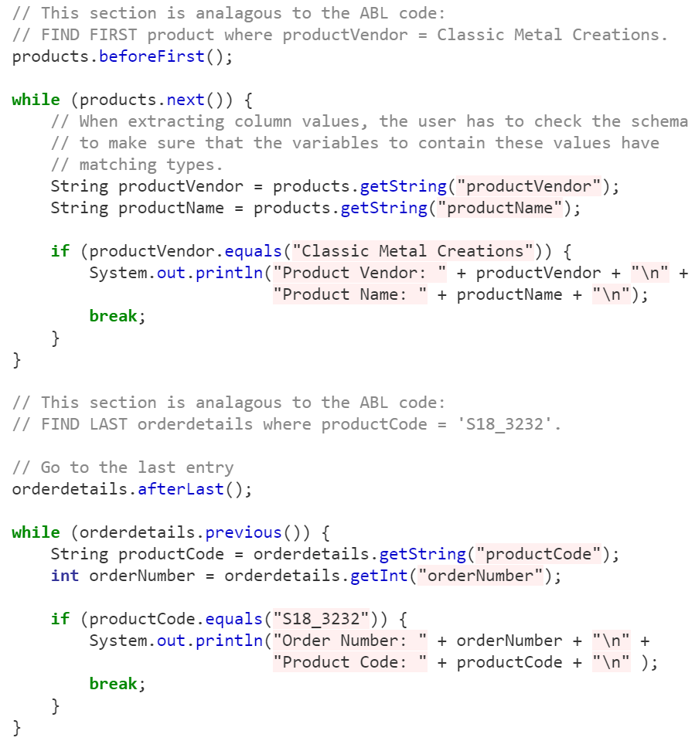
Java Example: FIND and Navigation.
https://github.com/progress/WhyABL/blob/master/Structures/example.java
Linear search with condition
Need to do dereferencing of primary keys

Slide 69
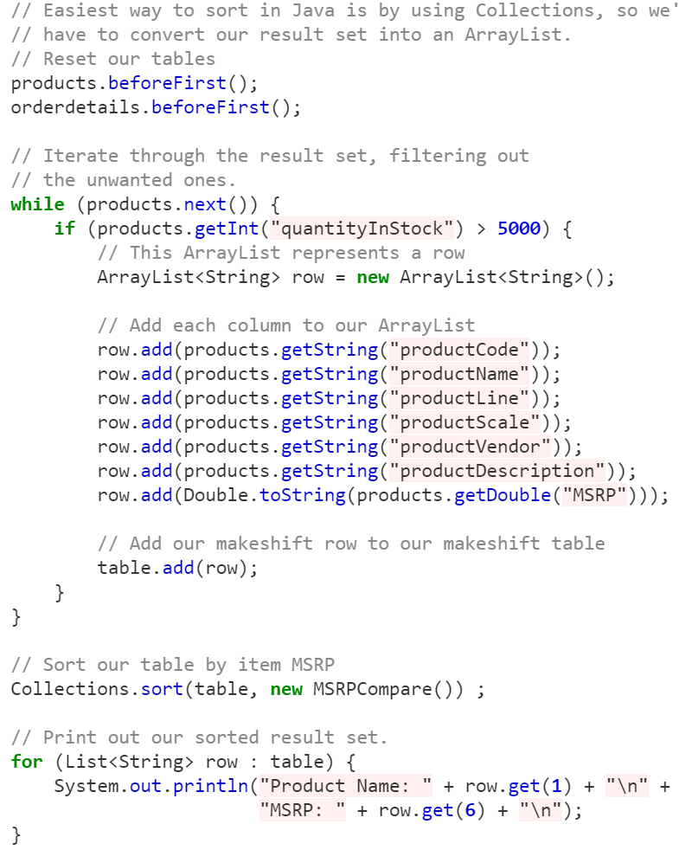
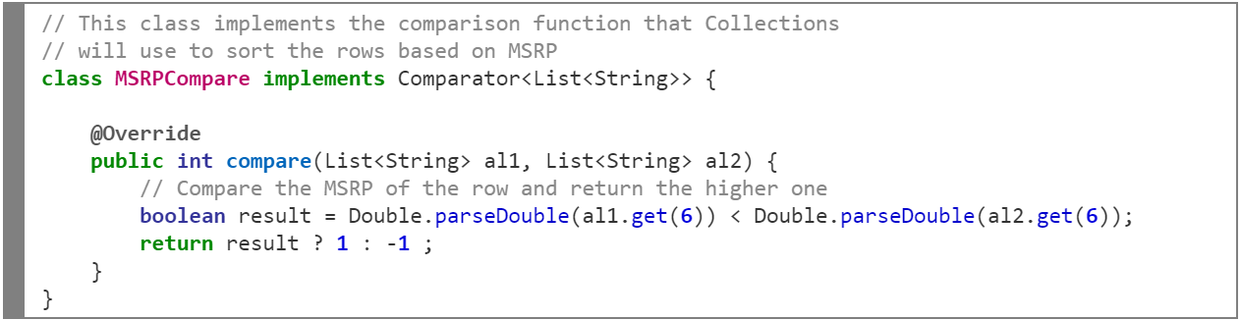
Java Example: Sorting Structures
https://github.com/progress/WhyABL/blob/master/Structures/example.java
Iterator won’t work – so move to Collection (ArrayList)
‘Code’ comparison operator.
Note a new way to ‘iterate’ on result.

Slide 70
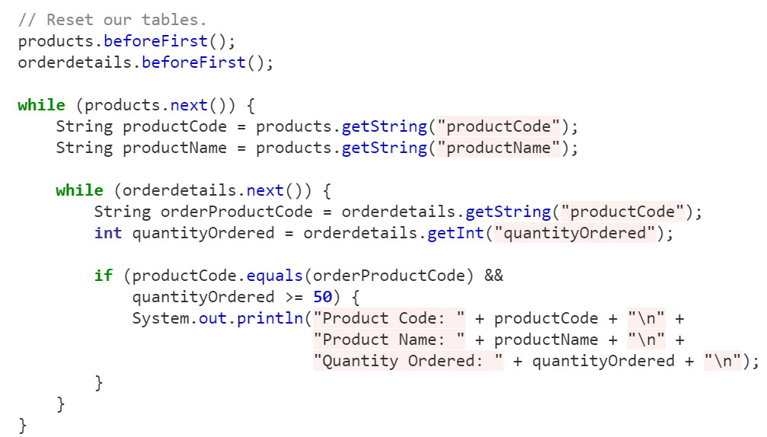
ABL Example: Filtering Structures
https://github.com/progress/WhyABL/blob/master/Structures/example.java
/* Find a subset of items that have been
ordered more than 50 times in one order*/
Certainly Possible… just different (again)

Slide 71
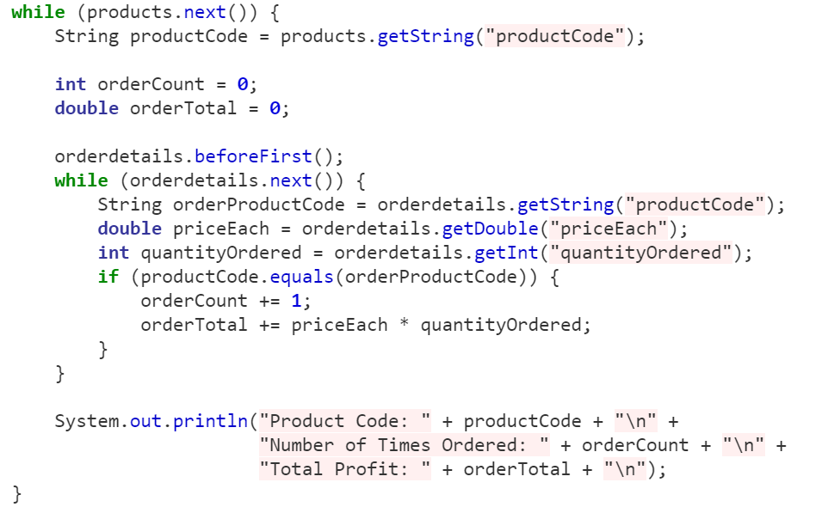
ABL Example: Accumulating on Structures
https://github.com/progress/WhyABL/blob/master/Structures/example.java
Certainly Possible… just different + manual (again)

Slide 72
What we saw in Java!
The demo showed:
  Yes. You can write code and use the features of the language.
  Java, C#, Python all have collections and iterators.
  SQL and ResultSets build on the language primitives
But it also showed.
  You have to think about the problem differently
  Now a collection problem…. Not a data access problem.
  Primutives are just that… primitive
  The code written:
    Is less clear
    Is limited
    Is less consistent (at least if you think about it as a data access question)
    Has a very limited concept of Indices and efficiency

Slide 73
Consistent Query Language: Progress Data Sets
“In-Memory” Operations act on local structures that are, in effect, mini-databases:
  Temporary (non-persistent) Tables
  Data Sets of related Temporary Tables with relationships
In Java/C#/etc, you have:
  ODBC/JDBC Result Sets
  Object Collections created from Relational Mapping (ORMs and Frameworks)
Query, Filter, Index, and Sort in ABL always acts the same way:
  For Database and Tables
  For in-memory structures
Take-away
Complex query and manipulation is done consistently for Persisted and in-memory data structures.
Notes:
NOTE: This is the hardest one to convince people of ‘a priori’.
The counter argument is “but don’t I want to really use the features of the language when I am IN-MEMORY.” The language is optimized to deal with Collections, Sets, Maps, etc.
But this is one of the key points that most ABL developers point to for productivity.

