Slide 1
Pro2SQL: BI and Reporting solution
June 26th – June 29thManchester, NH
Greg White – Sr Consultant
Progress Software

Slide 2
Quick Introduction:
Greg White
  Progress Employee Since 2006
  Progress Consultant Since 1989
  Pro2 Team Since 2006

Slide 3







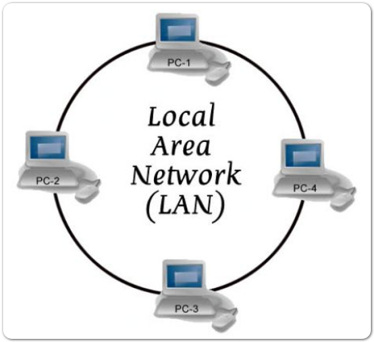



What is the need?
Orders
Oracle
OpenEdge v8.3
WAN
OpenEdge v10
MS SQL
ERP
OpenEdge v9
Dist
OpenEdge v11
OpenEdge

Slide 4
What is the need?
Timely Business Data / Business Intelligence
Alternative Views of Data
Heterogeneous Application Integration
Data Consolidation / Archival
Auditing
Reporting
Local Data for a cloud hosted system
Real-time Replication of Data

Slide 5
Why is this a challenge?
Application-level replication is difficult
  Maintaining connectivity
  Managing different data types and data structures
  Complicated
  Hurts performance
Your replicated data is only as fresh as the last batch
  Disruption of normal business operations
  Poor performance
  Stale or incomplete data

Slide 6
The Solution is Pro2
Real-time data replication
No connectivity limitations
No disruption to normal business operations or risk to your system of record.
Create a channel for transferring Progress OpenEdge data into a target databases
Use your third party reporting solutions and tools
A proactive approach to decision making and managing your business requirements
Notes:
Real-time data replication that provides quick access to your data from your Progress-based system. Pro2 removes connectivity limitations without disruption to normal business operations or risk to your system of record.
You can use Pro2 to create a channel for transferring Progress OpenEdge data into a target SQL Server, Oracle or an OpenEdge database for efficient reporting and analysis.
With your Progress OpenEdge database and target databases virtually in sync, you can use your third party reporting solutions for up-to-date reports, business intelligence, heterogeneous application integration, data consolidation, auditing, and data archival.
The Pro2 Enterprise facilitates a more proactive approach to decision making and managing your business requirements with real-time replication of mission critical information from your enterprise database.

Slide 7
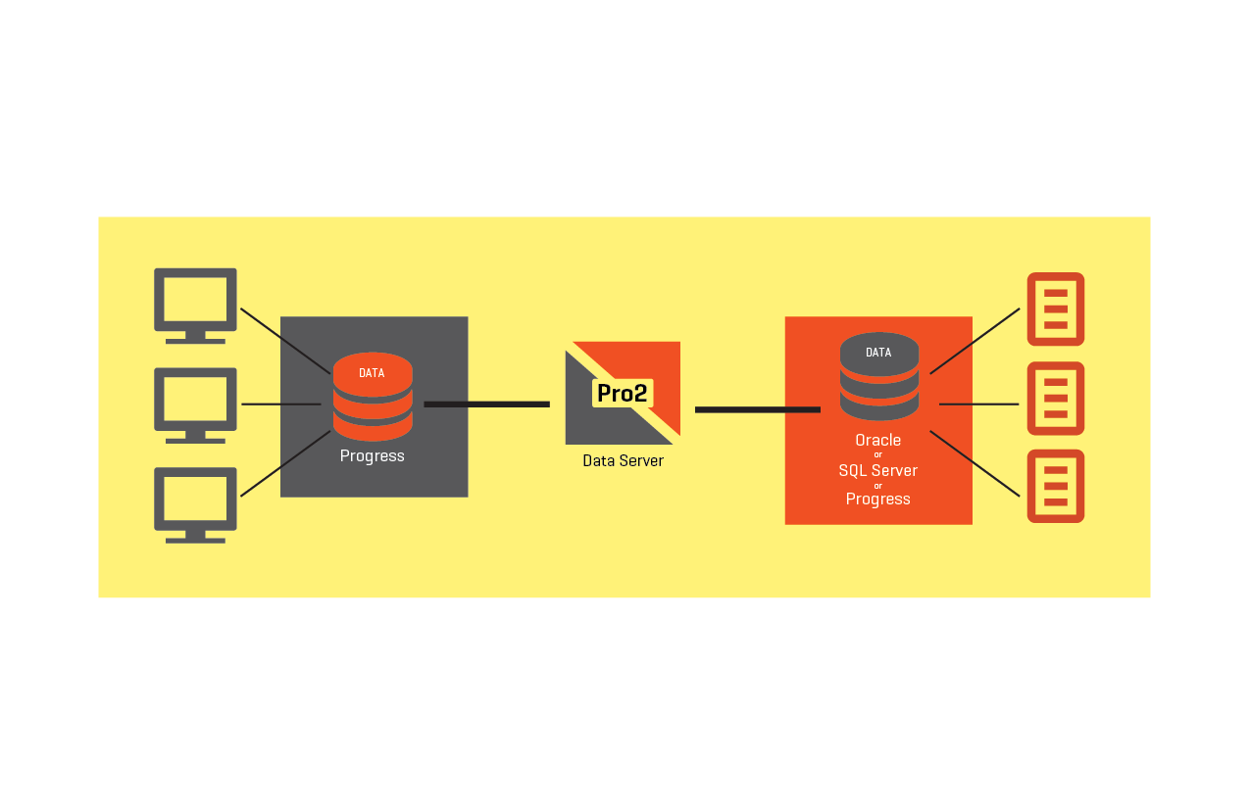
What Is Pro2?
Product for live, near real-time replication of OpenEdge data
to a MS-SQL Server, Oracle or OpenEdge target
Data replication, not disaster recovery

Slide 8
What Is Pro2?
Supports Progress 8.3 – OpenEdge 11.x
Mature Product
Version 1
Version 3
Version 4
Version 4.6
2006 | 2007 | 2008 | 2009 | 2010 | 2011 | 2012 | 2013 | 2014 | 2015
Large install base
  200+/-
  customers worldwide
  600+/- implementations

Slide 9
Network Layout
SOURCE SIDE MACHINE(S)
TARGET SIDE MACHINE(S)
AppServer
Target DB
Source DB
Source DB
Source DB
Source DB
WAN
Repl Embedded
MSSQL ODBC
Oracle Client
4GL Client
Repl DB
9 tables
PRO2 SERVER(S)
Pro2 Software
OpenEdge Client Networking License
OpenEdge DataServer License
Schema Holder DB(s)
4GL connection
GUI client/Server

Slide 10
Pro2 Benefits
Low-impact and scalable
Records ABL and SQL changes
Administration
Alerting
Customizable; Table and field level
Flexible Configuration
Overcome Target Limitations
Target schemas do NOT need to match
Constantly sends “net change”
Notes:
Low-impact and scalable
Replication speeds of 10,000+ rows/minute are typical (LAN environment)
ABL and SQL changes supported
Administrative console will monitor system and allow easy configuration
Alerting via Email or SMS
Customizable
Does not require replication of the entire database nor of an entire table
Custom transformations using ABL supported
Datatype and name transformation
Target side only fields/indexes
Flexible
Supports one-to-one, one-to-many, many-to-one, different target database types
Runtime evaluation of target side limitations
SQL Server – Won’t accept a date with year less than 1753 or greater than 9999
Early versions had issues with NULL BIT fields
Oracle: Won’t accept a date with year 0
Overstuffed source side fields; we use TARGET widths to determine the amount of data to send
Target schemas do NOT need to match
Customers can now add columns/indexes directly to the new target without affecting the source side application
We can update target side only fields for use with downstream data extraction
Constantly sends “net change”
If a new customer is coming from a scenario of a nightly extract/load, the overall footprint of daily activity is considerably smaller than their previous setup
Gives you options for NEAR REAL TIME views of data at the target
Allows for many implementation scenarios
Standard single/multiple sources into single or multiple targets.
Combining multiple source databases into a single target (very popular request).
Separating a single source database into multiple targets.
Cloud or WAN based source side databases to local or “on premise” target databases.

Slide 11
With Pro2 You Can
Provide accurate data in near real-time to support better business decisions
Leverage the value of the data in your system(s)-of-record
Tailor the data to match your specific needs
Overcome technology issues
Make you data available to 3rd parties in a safe controlled manner

Slide 12
Latest Release of Pro2: v4.6.5
Recently released Pro2 v4.6.5
  Auto-re-sequence modification - Detects high sequence value and resets it when in quiet time. Pro2 alerts also now alarms when NextReplNbr is over SEQ_MAX Property
  Improved Oracle target schema and delta-diffs schema generation
  Added property to toggle weather arrays are expanded or collapsed
  Allow for hyphened column names in target
  Improved initial seed of target (bulk-copy). Pro2 App-Server now uses normal bulk-copy process
  Improved Pro2-Admin tool performance
  Many overall stoutness improvements

Slide 13
Real World Pro2 Use Cases
Replicating OE Data to Corporate Data Warehouse

Slide 14
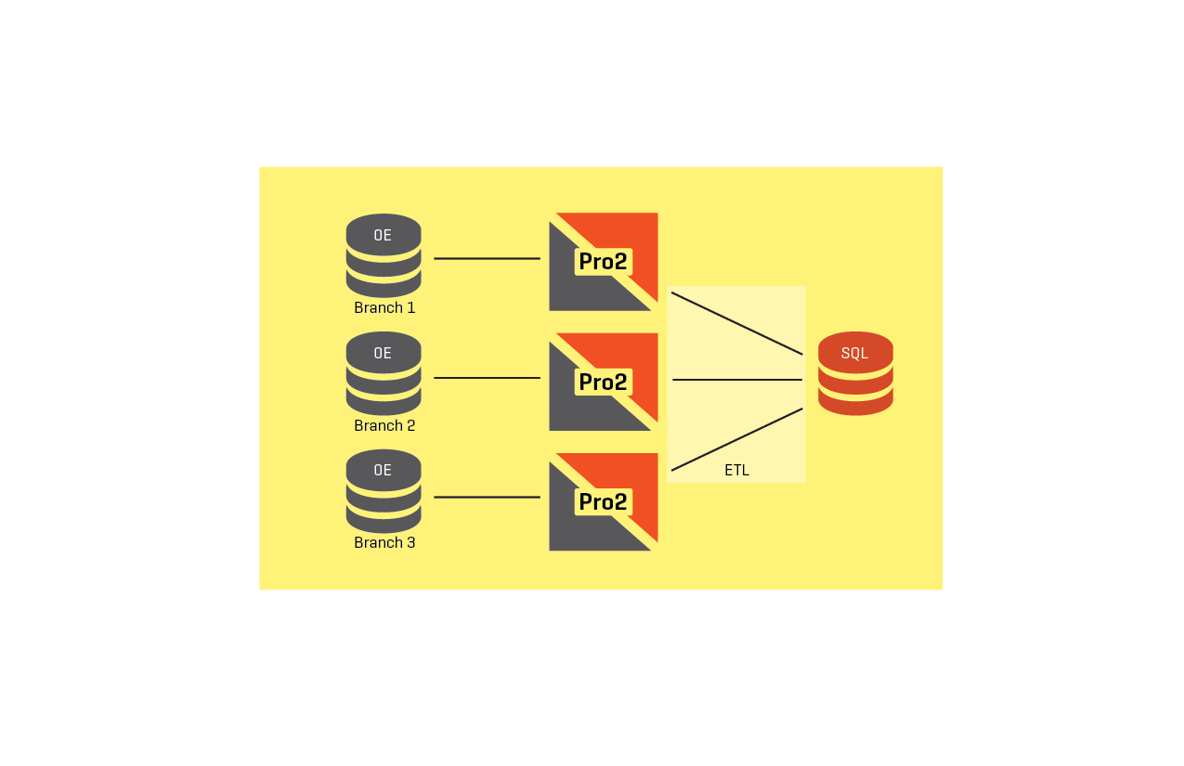
Real World Pro2 Use Cases
Reporting Rollup of OE Data from multiple sites/DBs

Slide 15
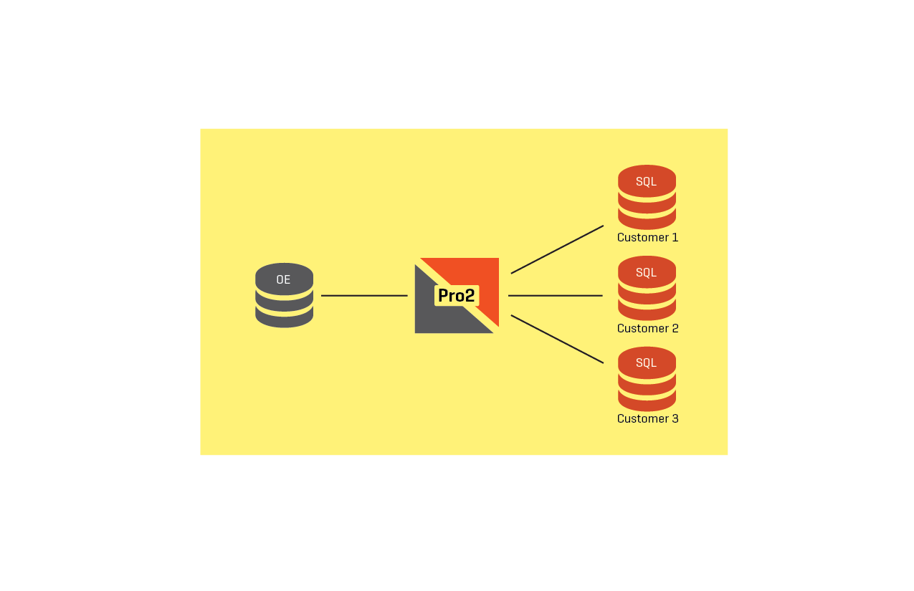
Real World Pro2 Use Cases
Segregating OE data to multiple Data Warehouses

Slide 16
Pro2 – Business Case #1
French Company - Manufacturing
  10 Worldwide QAD/MFGPRO instances
  MANY different Progress versions, 8.3c – 10.1c
  MANY different MFGPro versions.
  Took 1 – 2 weeks to roll worldwide data into the BI structure
  Pro2 was installed across ALL environments in less than 30 days
  BI data warehouse is now current at all times
  Pro2 gave this company near real-time global views of the data for the first time in the history of the company.

Slide 17
Pro2 – Business Case #2
South America – Insurance Organization
  300+ Progress/OpenEdge databases
  MANY different Progress versions, 8.3c – 11.3
  Took 30 days to roll worldwide data into a single reporting database (Oracle)
  Currently in implementation. Started with 1 – v10 source db, 1 – v9 source db and 1 - v8.2 source db
  Proved we could replicate in near real-time many disparate Progress/OpenEdge versions into a single common target
  Removal of “30 day” ETL process and real-time views of the replicated data
Notes:
POC is “currently in implementation”

Slide 18
Pro2 – Business Case #3
USA – Distribution Company
  Wanted to expose ERP data individually to each customer (40+ very large customers)
  Chose SQL Server as the storage platform for the customer interface
  Wanted a separate SQL Server target database for each customer (legal reasons)
  Not possible to give real time views based on ETL strategy.
  Pro2 was installed across ALL environments in less than 30 days
  Pro2 checks a CONO key at runtime and on the fly separates 1 source db into 40+ customer specific target databases.
  Pro2 solved the legal issues with physical separation of data in near real-time

Slide 19




Partners using Pro2
Notes:
Broadridge is a reseller
Skyward ships triggers with their product
DMSI ships triggers with their product
LexisNexis – dynamic normalization of tables

Slide 20















Who Uses Pro2?
Notes:
Bloomberg and ADP are the largest customers

Slide 21
Pro2 – Your Use Case
Source Database(s)
OpenEdge Version(s)
ERP System?
Target Database(s)
Use of Target Data?

Slide 22
Pro2 Demo
Sports DB
  Standard Local Setup
    DB Connections
    Target Schema Generation
    Data-Server schema Image setup
    Mapping Tables/fields
    Code Library Generation
    Triggers deployed
    Triggers activation
    Replication Threads Startup
    Update data watch it pass through replication

