Slide 1
SpeedScript to Stylish UI with PAS for OE WebHandlers
Irfan Pasha Syed
06/26/2016

Slide 2
Agenda
Introduction to Progress Appserver for OpenEdge
Modernization of “WEB”
WebHandlers Overview
Request/Response Objects in WebHandlers
Workshop

Slide 3
PAS for OE - Summary
Secure production web server
  Installation, administration
Simpler
  Administration, scalability , AppServer connection and operating STATEs
Customer Extensible
  Open REST APIs for monitoring and administration
Better analysis tools
  Built-in metrics gathering, current state queries
Faster and optimizes resources
  Runs same ABL application and client load with
  less memory and CPU consumption
PAS for OpenEdge
APSV (AIA)
SOAP (WSA)
REST/Mobile
Session Manager
MSAgent
ABL Sessions
1 ABL Session
1 ABL Session
1 ABL Session
1 ABL Session

Slide 4
Modernization of “WEB”
PAS for OpenEdge
Provide compatibility to run existing Webspeed code
Shares the same Security stack as that of other PAS OE transports
No need for a separate Appserver. Co-exists with PAS OE Applications
Support for Object-Oriented Programming Model
Support all HTTP Standard methods
Ability to control the HTTP Response Object
APSV (AIA)
SOAP (WSA)
REST/Mobile
WEB (Webspeed)
Session Manager
MSAgent
ABL Sessions
1 ABL Session
1 ABL Session
1 ABL Session
1 ABL Session

Slide 5
WebHandlers Overview
“Class”ify your Webspeed

Slide 6
WebHandler Interface
<< Interface >>
IWebHandler
PAS for OpenEdge
HandleRequest() : INTEGER
WEB Transport
implements
ABL Session in
MS-Agent
<< OOABL Class >>
<WebHandler>
HandleRequest() : INTEGER
INTERFACE Progress.Web.IWebHandler:
METHOD PUBLIC INTEGER HandleRequest( ).
END INTERFACE.

Slide 7
Using CustomWebHandler
PAS for OpenEdge
Inherits the abstract class WebHandler which implements the IWebHandler interface.
Dispatching for all standard HTTP verbs.
Provides default behavior for the methods you don’t override.
Uses various ABL Objects to handle the payload and write back to the WEB transport over a WebStream.
WEB Transport
ABL Session in
MS-Agent
<< OOABL Class >>
<CustomWebHandler>
HandleRequest() : INTEGER

Slide 8
Using CustomWebHandler
PAS for OpenEdge
http://localhost:8810/HRWeb/web/mycustomer/1
WEB Transport
  <Custom WebHandler>: Executes user written WebHandler class
ABL Session in
MS-Agent
[oepas1.HRWeb.WEB]
defaultHandler=OpenEdge.Web.DefaultWebHandler
OR
defaultHandler=<Custom WebHandler>
handler1=Customer: /mycustomer/{empid}
<< OOABL Class >>
<CustomWebHandler>
<< OOABL Class >>
<WebHandler>
Request URL Pattern
HandleRequest() : INTEGER
WebHandler class name

Slide 9
Using CompatibilityHandler
PAS for OpenEdge
http://localhost:8810/HRWeb/web/getcustomer.p
  CompatibilityHandler: Executes Classic Webspeed code if no WebHandler is defined
WEB Transport
ABL Session in
MS-Agent
Allows only POST & GET methods
The HandleRequest() method
  Starts web/objects/web-handler.p persistently if not started
  web-handler.p is the new web-disp.p
  runs process-web-request in the handle
<< OOABL Class >>
CompatibilityHandler
[oepas1.HRWeb.WEB]
defaultHandler=OpenEdge.Web.CompatibilityHandler
handler1=Customer: /mycustomer/{empid}
HandleRequest() : INTEGER

Slide 10
Request/Response Objects in WebHandlers

Slide 11
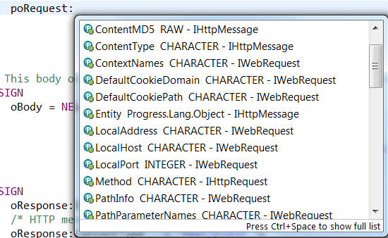
IWebRequest Object
OpenEdge.Web.IWebRequest
  Object that contains the entity,headers,cookies and other HTTP Request payload information.
  METHOD OVERRIDE PROTECTED INTEGER HandleGet( INPUT poRequest AS OpenEdge.Web.IWebRequest ):
properties

Slide 12
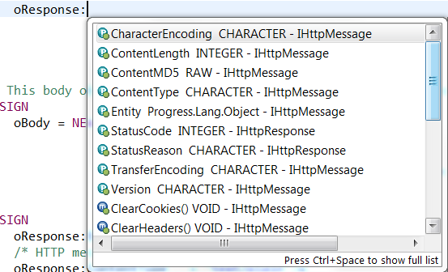
WebResponse Object
OpenEdge.Web.WebResponse
  Initialized to compose a HTTP Response. It contains a status code and reason,headers, cookies and a message body.
  oResponse = NEW OpenEdge.Web.WebResponse().

Slide 13
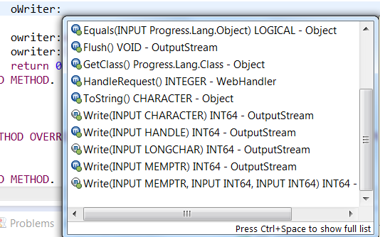
WebResponseWriter Object
OpenEdge.Web.WebResponseWriter
  Writes an HTTP response payload to the WebStream, inherits OutputStream
  oWriter = NEW WebResponseWriter(oResponse).

Slide 14
Build it like “HRWeb”
A PASOE sample to take home

Slide 15
Workshop Essentials
Arcade Instance
Workshop Material
Smart people around you to help out in need

Slide 16
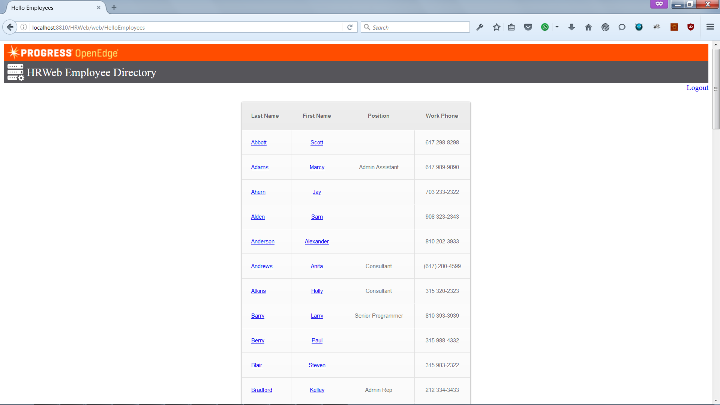
Workshop – Part 1
Develop HRWeb Application
Enable Form-local Security
KendoUI + AngularJS for OpenEdge

Slide 17
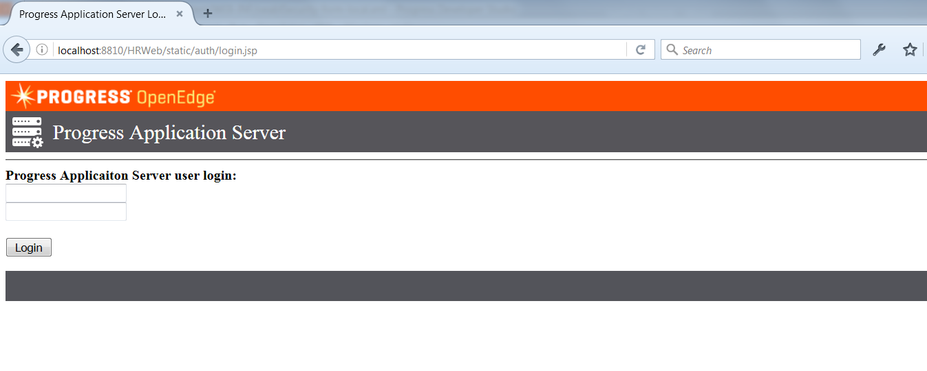
Workshop – Part 2
Develop HRWeb Application
Enable Form-local Security
KendoUI + AngularJS for OpenEdge

Slide 18
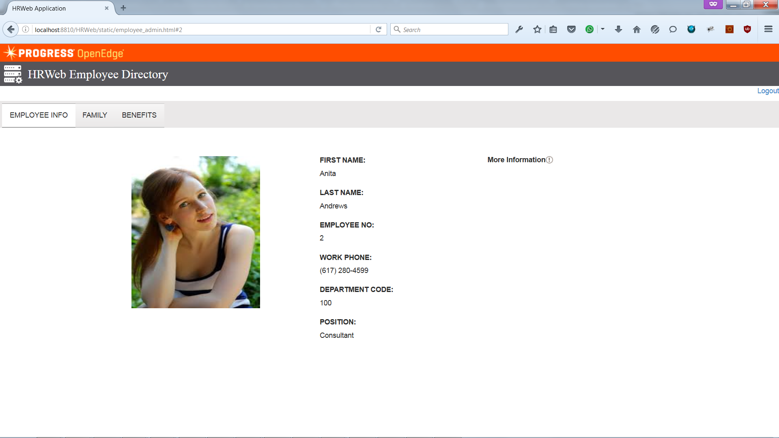
Workshop – Part 3
Develop HRWeb Application
Enable Form-local Security
KendoUI + AngularJS for OpenEdge

Slide 19
Security in PASOE

Slide 20

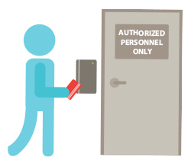

Spring Security - Introduction
Spring Security is a Powerful, flexible security solution for providing comprehensive security services for J2EE based enterprise applications
Protection against attacks like session fixation, cross site request forgery, etc
It provides services for Authentication and Authorization
Who are you ?
We know who you are. Are you allowed ?

Slide 21
Spring Security in OEABL Applications
1
Spring Security
Authentication
PAS for OpenEdge
Authenticate
user credentials
OE ABL1
OE ABL2
OE ABL3
Spring Security
Authorization
2
3
Create a Sealed Client-Principal
Authorize user by ROLE, URL resources, HTTP method etc
MSAgent
4
Sealed Client-Principal available in the MS-Agent
session:current-request-info:GetClientPrincipal()
“n” ABL Sessions

Slide 22
KendoUI + AngularJS for OpenEdge

Slide 23
KendoUI + AngularJS for OpenEdge
KendoUI
  Kendo UI® by Progress is an HTML5 user interface framework for building interactive and high-performance websites and applications.
AngularJS
  AngularJS is a very powerful JavaScript Framework, mostly used to develop Single Page Application (SPA). It extends HTML DOM with additional attributes and makes it more responsive to user actions.
Build Rich UI Applications much Faster
KendoUI + AngularJS

Slide 24
Questions
METHOD OVERRIDE PROTECTED INTEGER HandlePost( INPUT poRequest AS OpenEdge.Web.IWebRequest ):
yourQuestion = String(cast(poRequest:Entity,Memptr):Value).
myAnswer = SendMailto("isyed@progress.com").
if LENGTH (myanswer) > 0 then do:
response:StatusCode = 200. response:StatusReason = "Here is your reply".
end.
else do:
response:StatusCode = 500. response:StatusReason = “Post it in OpenEdge forum".
end.
writer = new WebResponseWriter(response).
writer:Write(myAnswer).
return 0.
END METHOD.

