Slide 1

DBAnalys To The Rescue!
Dmitri Levin
Alphabroder
George Potemkin
Progress Technologies
Version 6
1992
ftp://ftp.progress-tech.ru/pub/Users/george/DBAnalys1_Boston.pptx
ftp://ftp.progress-tech.ru/pub/Users/george/DBAnalys2_Copenhagen.pptx

Slide 2
SAT 2 (version 10+)
and
Block size 8K

Slide 3
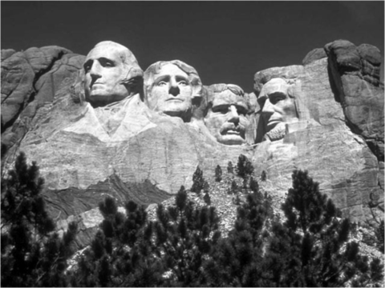
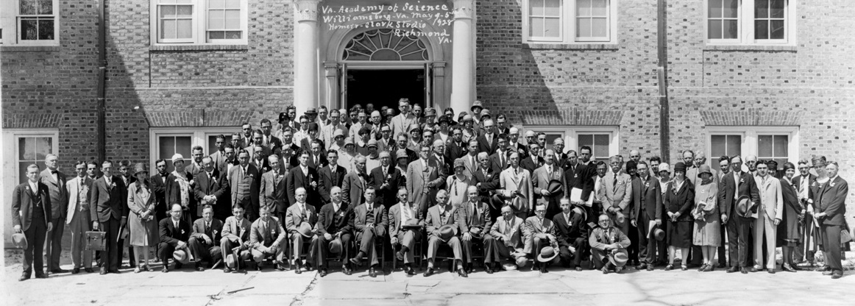
DBAnalys To The Rescue!
Contents
History
Theory
Practice
Synergy
Other Options

Slide 4
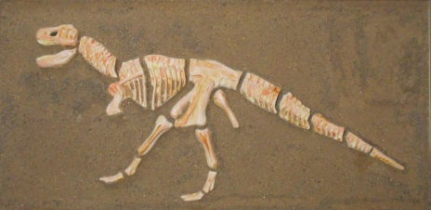
PROGRESS Database Analysis
Database: %s
Options: ixanalys chanalys
Date: %s
FREE CHAIN ANALYSIS
===================
%l block(s) found in the free chain.
RM CHAIN ANALYSIS
=================
%l block(s) found in the RM chain.
BLOCK ANALYSIS
==============
%l RM block(s) found in the database.
%l.%l% of the RM block space is used.
%l index block(s) found in the database.
%l.%l% of the index block space is used.
INDEX BLOCK SUMMARY
% % of all
Index Blocks Bytes Utiliz. Indexes
%s %d %l %l %l.%l %l.%l
V5
1988
No tabanalys option
Manning Road in Billerica, Massachusetts
Notes:
Dbanalys first appears in V5. Back then database did not even have sequences. But unlike V4 it could have multiple extents.

Slide 5

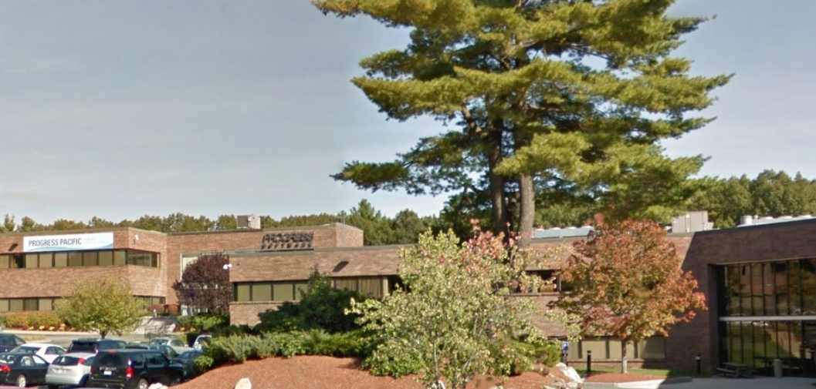
PROGRESS Database Analysis
Database:
Options: tabanalys
Date: Mon Nov 6 18:26:53 1995
BLOCK ANALYSIS (3906)
==============
1 master block(s) found in the database.
RECORD BLOCK SUMMARY (6129)
---Record Size--- ---Fragments--- Scatter
Table Records Bytes Min Max Mean Count Index Index
-----------------------------------------------------------
<329 lines of boring stuff deleted>
Totals: 15021963 642199k 6 1675 43 15275513 1.0 5.3
802392 RM block(s) found in the database.
86.10% of the RM block space is used.
270404 index block(s) found in the database.
400571 free block(s) found in the database.
5 index table block(s) found in the database.
1 sequence block(s) found in the database.
1473374 total blocks found in the database.
V7.3A
Nov, 9 1994
tabanalys option
14 Oak Park in Bedford, Massachusetts
Notes:
tabanalys was added in V7.3A
Please also note that Fragments Index and Scatter Index was later renamed to Fragments Factor and Scatter Factor.

Slide 6

Segments of dbanalys output
msg 3867: 1) PROGRESS Database Analysis
msg 3868: Database: %s
msg 8361: Blocksize: %i
msg 14178: RecSpaceSearchDepth: %d
msg 6172: Options: %s %s %s
msg 3870: Date: %s%r
msg 14179: 2) CHAIN ANALYSIS FOR AREA "%s" : %l
msg 14163: 2.1) FREE CLUSTER CHAIN ANALYSIS
msg 14157: LIST OF FREE CLUSTER CHAIN BLOCKS
msg 14161: %J cluster(s) found in the free cluster chain.
msg 3873: 2.2) FREE CHAIN ANALYSIS
msg 3880: LIST OF FREE CHAIN BLOCKS
msg 14155: %J block(s) found in the free chain of %s object %i
msg 16573: %rNumber of Object Object Partition/Tenant/Group
msg 16574: Blocks Type
msg 3892: 2.3) RM CHAIN ANALYSIS
msg 3897: LIST OF RM CHAIN BLOCKS
msg 14172: %J block(s) found in the RM chain of %s object %i
msg 7269: 2.4) INDEX DELETE CHAIN ANALYSIS
msg 7283: LIST OF INDEX DELETE CHAIN BLOCKS
msg 14176: %J block(s) found in the Index Delete chain of %s object %i
msg 10097: 3) AREA "%s" : %d BLOCK ANALYSIS
msg 3906: 4) BLOCK ANALYSIS (moved to the end at V11)
Notes:
In this slide one can see different types of messages that the current dbanalys is producing. The number infront is a number from the promsgs file.

Slide 7

Segments of dbanalys output
msg 6129: 5) RECORD BLOCK SUMMARY
msg 14212: RECORD BLOCK SUMMARY FOR AREA "%s" : %l
msg 16667: RECORD BLOCK SUMMARY FOR SHARED TABLES
msg 16668: RECORD BLOCK SUMMARY FOR %s %s: %l
msg 16656: Summary for AREA "%s": %l
msg 3921: %J RM block(s) found in the database.
msg 3925: 6) INDEX BLOCK SUMMARY
msg 14225: INDEX BLOCK SUMMARY FOR AREA "%s" : %l
msg 16657: INDEX BLOCK SUMMARY FOR SHARED OBJECTS:
msg 16658: INDEX BLOCK SUMMARY FOR %s: %s
msg 3923: %J index block(s) found in the database.
msg 2314: 7) DATABASE SUMMARY
msg 16666: SUMMARY FOR AREA "%s": %l
msg 16659: SUMMARY FOR SHARED OBJECTS:
msg 16579: 8) DATABASE BLOCK ANALYSIS:
msg 3937: database analysis complete %s%r
msgs 0000-6130 before 8.2A
msgs 7270-9999 8.3A
msgs 9894-10130 9.1D
msgs 14155-14225 10.2B
msgs 16641-17035 11.1
Notes:
By looking at the number of a message we can see when that message was added to the product, i.e. in which version of Progress if first appear. We can see that in the table below.

Slide 8
History of changes
V9.0A
Nov 21, 1998
proutil db-name -C dbanalys [ [area area] area-name ]
proutil db-name -C dbanalys [ [area] area-name ]
proutil db-name -C dbanalys [ [area area area ] area-name ]
proutil db-name -C dbanalys [ [area area area ] “Area Name” ]
V9.0A
Nov 21, 1998
proutil db-name -C dbanalys –Bp 64
V9.1A
Jan 21, 2000
Index Delete Chains / LOCKCHN (bk_frchn 2)
V10.0A
Dec 13, 2003
Free Cluster Chains / CLIST_FREECHN (bk_frchn 3)
Notes:
Though the ability to run dbanalys by area appears in V9, it was documented only in V11.
“Area” keyword is not mandatory. In fact the utility ignores all items after “dbanalys” option except the last one.
Area name (as an “item”) can contain the space if it’s in quotation marks.
Option –Bp (Private Read-only Buffers) is not documented and often forgotten. Dbanalys without –Bp could use all buffer pool. And if we run it online it will probably not a good idea, that is why we need to restrict dbanalys by using –Bp (64 in this example)

Slide 9
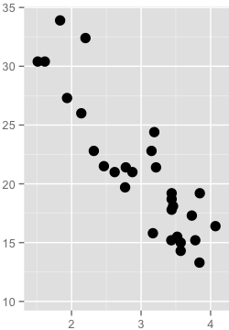
History of changes
V10.1A02
Oct 27, 2006
Algorithm for calculation of Scatter Factor for SAT II tables has changed
Scatter for Type II is reported as a number of blocks occupied
divided by the minimum number of blocks that table could occupy.
Scatter for Type I is reported as log10 of sum of distances between records
in a table, where distance is calculated as the difference between the
RECID values for the two records, divided by minimum distance possible.
In V11 that formula lost the meaning again when the database is
multi-tenant or has partitioning.
Notes:
Scatter Factor is more characteristic of an index then of a table
The changes that we did not mentioned:
Online defragmentation since 10.1A
prostrct statistics dbname
Online: 9.1E04, 10.0B05+

Slide 10
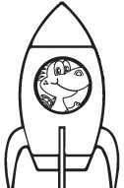

History of changes
V10.1B02
Aug 3, 2007
-recspacesearchdepth
The number of RM blocks to move from the front to the back of the RM chain before allocating a new cluster for data.
Default value is 5. Max value is 100.
Old algorithm: No more than 3 blocks at a time will be examined and moved to the tail end.
V10.1B02
Aug 3, 2007
Full report on chains when running chanalys online.
The following lists will be reported:
LIST OF FREE CLUSTER CHAIN BLOCKS
LIST OF FREE CHAIN BLOCKS
LIST OF RM CHAIN BLOCKS
LIST OF INDEX DELETE CHAIN BLOCKS
Notes:
A new parameter recspacesearchdepth was introduced in OpenEdge 10.1B02 (Richard Banville says 10.1B05, “What’s New in 10.1 RDBMS?” but most likely it’s a typo).
http://knowledgebase.progress.com/articles/Article/P135179
This parameter should not be changed unless Progress Technical Support and Progress Development advise that after analysis, changing the value may correct observed behavior under investigation. Either free space won't be used properly if set too low or if the search is too deep performance will drop. Very few production environments have ever needed this value adjusted from the default since it was first introduced.
The recspacesearchdepth is reported in dbanalys probably as a reminder that it will augment the create/toss limits and will affect the work of chains in the whole database.
Subject: RE: Record free chain search depth factor
Date: Thu, 15 May 2008 09:24:03 -0400
From: "Richard T. Banville" <richb@progress.com>
To: dba@peg.com
<quote>
this was to fix a record space allocation issue where a full cluster minus 3 blocks was being left on the rm chain and a new cluster was being allocated. This resulted in space not being used and the database growing very quickly without adding the data to cause it to grow that quickly.
This was supposed to be release noted with the changes added to 10.0B(something)
This is not something that customers should be playing with unless instructed to due so.
It is a database wide parameter setting.
This parameter determines how deep or how far in the rm chain a search for available record space is attempted before acquiring space from the free chain. The old value of recycling 3 blocks is insufficient for TII areas with large cluster sizes. The value is a factor used in determining this search depth which also takes into consideration the size of the cluster. If a block with enough free space is not found before exhausting the search depth, additional space must be allocated for the object. In the case of TII, that means acquiring a new cluster from the free cluster list. For T1, it means acquiring a new block from the free chain. Either can potentially raise the HWM.
The actual formula used in determining the maximum number of blocks to search before allocating a new cluster or block is not to be documented as it may change without notice.
The valid value range is from 5 to 100.
The default value is 5 (which indicates ~50% of the cluster size)
Since using this default value, I have heard of no customers with space allocation problems so this value should not be changed by the customer unless instructed to do so by Tech Support/Development.
The problem of space not being used can be seen by running a chain analys and looking for large chunks of contiguous blocks on the rm chain with no record spaced used in them. There should only be one of these chunks, not groups of them.

Slide 11
History of changes
dbanalys/tabanalys/ixanalys:
Summary for
Chains, Tables, Indexes
chanalys:
Details for
Every singe block on every chain
(Free, RM, Index-Delete)

Slide 12

History of changes
V10.1B03
Nov 2, 2007
proutil <db> -C chanalys [ -scan ]
  -scan: fewer locks, less consistent
It instructs chanalys to use minimal locking. This may cause the chains report to be incomplete , but it will avoid turning on table locks. Offline chanalys does not use a locking mechanism, the -scan parameter will be ignored.
“area-name” [-scan ]
[Warning] Unable to acquire table lock on object 2. Chain analysis continuing with -scan option. (14167)
LIST OF FREE CHAIN BLOCKS
next
dbkey free
51 52
CTRL-C pressed - exit free chain analysis
Notes:
WHAT IS THE DBANALYS -SCAN PARAMETER USED FOR?
http://knowledgebase.progress.com/articles/Article/P125963
Description in the article is incorrect.

Slide 13

History of changes
10.2B06
March, 2012
Database Analysis (dbanalys) output has changed.
In the past customer's complained that the DBANALYS report widths were not wide enough resulting in a CR after the table name when the table name exceeded the Tablename column width.
Now the tabanalys width is 110 chars.
V11
Dance of the broken lines (the ixanalys width is 86 chars)
INDEX BLOCK SUMMARY FOR SHARED OBJECTS:
--------------------------------------------
Table Index Fields Levels Blocks Size % Util Factor
PUB.theTable
IntField
IntField901234567890123456789012
10 1
IntField-1:3 2 215 1.6M 98.2 1.0
IntField-10:2 2 215 1.6M 98.2 1.0
Notes:
10.2B06 Database Analysis (dbanalys) output has changed
http://knowledgebase.progress.com/articles/Article/000033756
In the past customer's complained that the DBANALYS report widths were not wide enough resulting in a CR after the table name when the table name exceeded the Tablename column width. ie the Table name was on a different line to its associated data.
V11: 5 lines that are highlighted here represent one local index. Is that convenient to read? I do not think so.
Chanalys width in V11 is 112 chars. Ixanalys width is 86 chars.

Slide 14

History of changes
proutil db-name -C dbanalys [ [area] area-name ]
[ tenant tenant-name| group group-name| shared ]
[-csoutput [ -fieldsep sep-value][ -csfilePrefix pref-name ]
[ -verbose ]]
V11.4
Jul 25, 2014
-csoutput
-fieldsep sep-value (default is space )
-csfilePrefix pref-name (default db-name)
-verbose
proutil sports –C dbanalys -csoutput -verbose

Slide 15
Output files
sports.block.txt
sports.ch.txt
sports.ix.txt
sports.tbl.txt
-csfilePrefix
-verbose
V11.4
V11.6
sports.lob.txt
"Time Stamp" "DBUID" "DB name" "Area" "Area #" "Partition Type" "Tenancy"
"Tenancy #" "Partition Policy" "Partition" "Partition #" "Owner" "Table" "Table #"
"Records" "Size" "Min" "Max" "Mean“
2015-04-06T14:59:00.000-4:00 "njVjvK5a8qfvEyE+7KM4WA" "sports"
"Customer/Order Area" 8 "-" "-" 0 "-" "-" 0 "PUB" "Customer"
2 83 12377 118 222 149 83 1.0 1.0
2015-04-06T14:59:00.000-4:00 "njVjvK5a8qfvEyE+7KM4WA" "sports"
"Customer/Order Area" 8 "-" "-" 0 "-" "-" 0 "PUB" "Order"
4 207 11730 53 61 56 207 1.0 1.0
-fieldsep

Slide 16
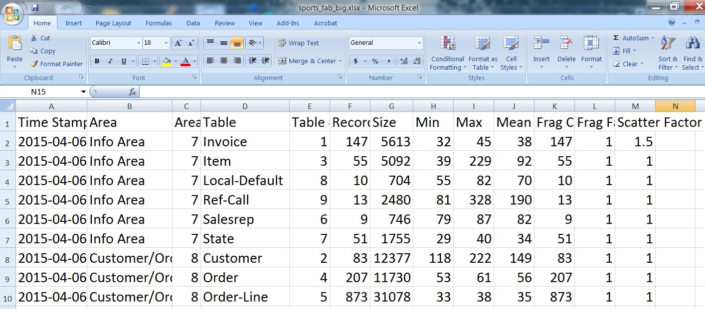
Loading sports.tbl.txt in Excel

Slide 17
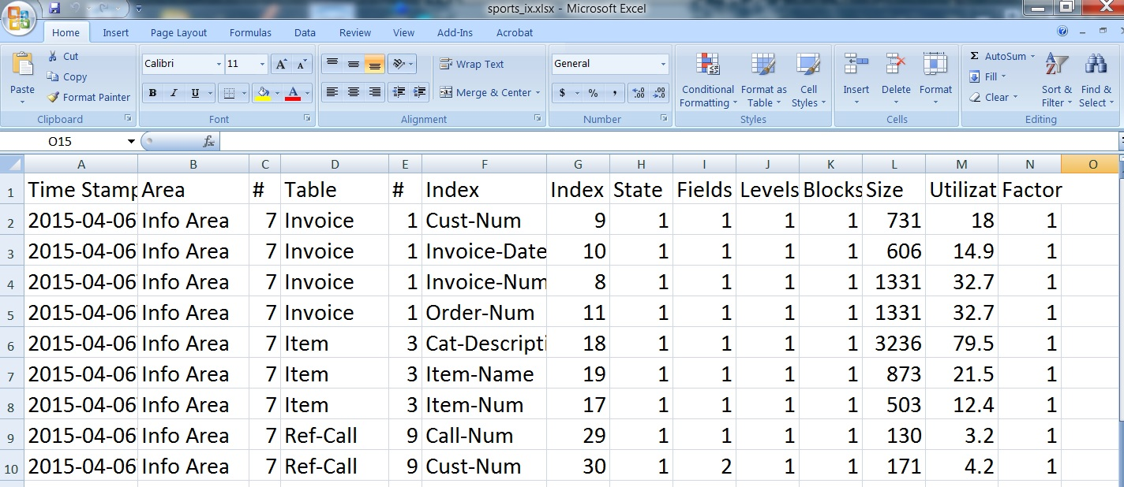
Loading sports.ix.txt in Excel

Slide 18

History of changes
11.6
Oct 26, 2015
LOB support in PROUTIL DBANALYS
The PROUTIL database analysis utilities are enhanced to include analysis of LOB data. When LOB data is found in an area, a “LOB Summary” follows the “Record Block Summary” in the output, and LOB data is included in the combined summary. LOB data is also written to a new *lob.txt file when the -cscoutput parameter is used on the analysis command line.

Slide 19

DBAnalys To The Rescue!
Contents
History
Theory
Practice
Synergy
Other Options

Slide 20
Chains and Limits
block
Default
Create Limit 150
Toss Limit 300

Slide 21
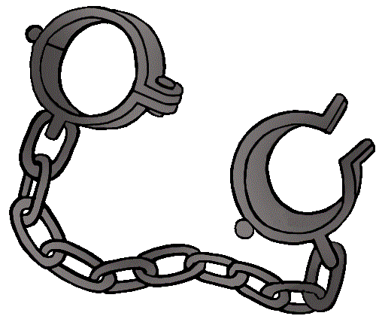
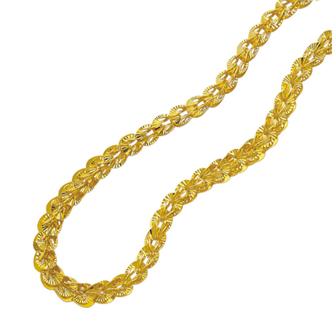

Chain Types
1. Cluster chains
2. Block chains
Cluster Chains
1. Area Control Clusters
2. Data Object Clusters
3. Free Cluster Chains
Block Chains
1. Free Chains
2. RM Chains
3. Index Delete Chains
Notes:
Sometimes “RM chains” are called “record block free chains”.

Slide 22
Block Chains
proutil db –C chanalys “Area Name” –scan
LIST OF FREE CHAIN BLOCKS
next
dbkey free
7026440 7026439
2046268 block(s) found in the free chain of Index object 22
LIST OF RM CHAIN BLOCKS
next
dbkey Block
804512704 2372 49 0
8534342 block(s) found in the RM chain of Table object 4
LIST OF INDEX DELETE CHAIN BLOCKS
dbkey Block
722 2499
3 block(s) found in the Index Delete chain of Index object 33
Notes:
The blocks of all types of areas could make three types of chains. They are a singly linked list of the blocks.
“Free chains” sounds like “fragile aqua” ;-)
No free blocks chain for table objects.
Idxbuild rebuilds free chains.
Blocks are added by the whole clusters to RM chains in the SAT II. That cluster is taken either from the free cluster chain, it that chain is not empty or by the changes of HWM. All blocks of the cluster are formatted as RM blocks. That way the head of RM chain could have completely free blocks, i.e. blocks that does not have neither records nor recid placeholders.
During the formatting of the cluster block only one recovery note is created (RL_BKCHAIN_NEXT).
Richard Banville wrote: “Blocks within a table object’s cluster are formatted as Rm blocks and chained together as opposed to made free blocks and put on the free chain. This is done as one action in the database so fewer notes are written to format the same number of blocks. This boosts performance by lowering bi usage.”
The clusters are added by the process which did not find a place for the new record inside the database or inside a fragment. Only one block from that cluster is put inside a buffer pool.
Ix del block are associated with unique indexes and are blocks that contain index delete placeholders.

Slide 23
Date RM Chain TossLimit
-------------- -------------- ---------
01/25/15 1,363,348 300
01/30/15 1,366,650 300
02/05/15 1,369,854 300
02/15/15 1,365,736 800
02/20/15 1,309,925 800
02/25/15 1,314,147 800
03/05/15 1,340,165 800
RECORD BLOCK SUMMARY
FOR AREA "Order Area" : 9
------------------------------------------------
Table Size Min Max Mean
PUB.order 32.2G 450 13519 767
05/30/15 1,366,545 800
06/05/15 1,368,363 1000
06/10/15 1,368,823 1000
RM Chain
04/25/16 1,443,551 1000
04/30/16 1,445,920 1000
05/05/16 1,447,339 1000
05/10/16 1,448,688 1000

Slide 24
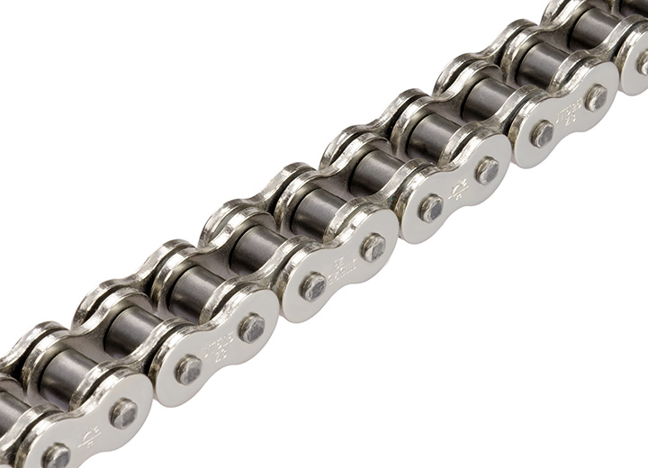
RM Chain
block
block
block
block
block
block
block
head
head
tail
-recspacesearchdepth
2 conditions:
Free space > toss limit
# slots used < RPB

Slide 25
Toss Limit
proutil db -C chanalys “Order Area” -scan
RM CHAIN ANALYSIS
-----------------
LIST OF RM CHAIN BLOCKS
free # free
dbkey space slots hold
58719520 1337 5 0
58719536 8124 16 0
58719552 8124 16 0
...
58718960 682 5 0
58719456 449 5 0
1313186 block(s) found in the RM chain of Table object 362
Head
Tail

Slide 26

Life of a block on a chain ( RM chain)
Date posision db-key free-space
05/29/16 809506 58719456 449
05/30/16 809314 58719456 449
05/31/16 793381 58719456 449
06/01/16 790931 58719456 449
06/02/16 789560 58719456 449
06/03/16 788841 58719456 449
06/04/16 788049 58719456 449
06/05/16 788049 58719456 449
06/06/16 787844 58719456 449
06/07/16 786831 58719456 449
06/08/16 786027 58719456 449
2 years

Slide 27


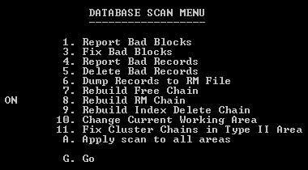
Long RM chain
proutil db-name -C dbrpr
dbanalys before dbrpr
1313186 block(s) found in the RM chain of Table object 362
Scan Backward (Yes/No)?
Scan of Order Area extent 1 10% complete
Scan of Order Area extent 1 20% complete
Scan of Order Area extent 1 30% complete
Scan of Order Area extent 1 40% complete
Scan of Order Area extent 1 50% complete
Scan of Order Area extent 1 60% complete
Scan of Order Area extent 1 70% complete
Scan of Order Area extent 1 80% complete
Scan of Order Area extent 1 90% complete
Scan of Order Area extent 1 100% complete
dbanalys after dbrpr
120813 block(s) found in the RM chain of Table object 362
Notes:
How to rebuild the RM Chain and Free Chain of a Progress Database
http://knowledgebase.progress.com/articles/Article/P14857
<quote>
You will now receive the following prompt:
Scan Backward (Yes/No)?
Answer yes and press return.
</quote>
Answer NO!

Slide 28
Create Limit. The “Light Breathing” Space
proutil db -C chanalys "item-summary Area" –scan
RPB 16
LIST OF RM CHAIN BLOCKS LIST OF RM CHAIN BLOCKS
free free # free free free # free
dbkey space1 space2 slots dbkey space1 space2 slots
36597840 8036 8035 -1 15 35558848 7678 7669 -9 14
36597872 8037 8037 0 15 35558864 6879 6882 +3 12
36597968 7705 7675 -30 12 36235728 7674 7674 0 15
36597984 8124 8124 0 16 36235744 7975 7976 +1 15
36598016 8000 8000 0 14 35558880 7436 7453 +17 13
36598064 8054 8054 0 15 36235760 7223 7223 0 12
36598160 7934 7919 -15 14 35558896 6539 6540 +1 10
36598192 8124 8124 0 16 36235776 7213 7206 -7 13
36598208 7990 7960 0 15 35558912 6597 6664 +67 10
36598336 7935 7874 -61 14 36235792 6506 6498 -8 11
36598432 8124 8124 0 16 35558928 7535 7558 +23 13
36598448 6711 6711 0 13 36235808 7247 7244 -3 14
Notes:
Comparing two fragments of RM chains after one day of database activity.
It’s just a simple example how to measure the changes of the free spaces.
The space variations are smaller than the default value of the create limit - there are no needs to change the limit.
This is an example of the “light breathing” space.

Slide 29
Create Limit. The “Heavy Breathing” Space
proutil db -C chanalys “Order Area" –scan
RPB 16
LIST OF RM CHAIN BLOCKS
free free
dbkey space space
day_1 day_2
78831984 947 709 238
78832096 630 442 188
78832112 1737 1558 179
78832336 884 594 290
78833520 2209 2009 200
78834160 1497 1223 274
78834560 1128 878 250
78835024 976 648 328
Create Limit 150
Fragmentation
Notes:
This is an example of the “heavy breathing” space. Create Limit should be increased from default value of 150 to 250 or 300.

Slide 30
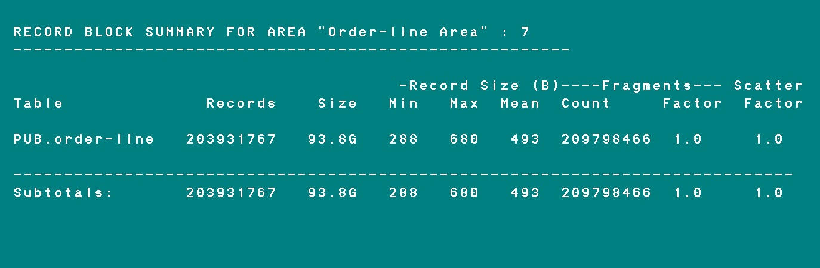
Create Limit
A better solution would be reported in dbanalys
Average size of fragments

Slide 31
Create/Toss limits
proutil db -C dispTos[sCreateLimits] area*
proutil db -C setAreaCr[eateLimit] area* limit
proutil db -C setBlobCr[eateLimit] lob* limit (deprecated in V11)
proutil db -C setLobCre[ateLimit] lob* limit
proutil db -C setTableCr[eateLimit] table limit
proutil db -C setAreaTo[ssLimit] area* limit
proutil db -C setBlobTo[ssLimit] lob* limit (deprecated in V11)
proutil db -C setLobTos[sLimit] lob* limit
proutil db -C setTableTo[ssLimit] table limit
[ tenant tenant-name| group group-name| shared ]
* - For an area in V11 you can specify either the name or the number. And in V10 only the area number could be specified. And the same for LOBs. For a table only the name could be specified in any version.
Proutil updates:
_StorageObject._Create-Limit
_StorageObject._Toss-Limit
Notes:
setAreaTossLimit and setAreaCreateLimit update all _StorageObject records for the specified area. New objects in the area will be created with the default values. These options do not set the default toss/create values for area itself. The same is true for SAT1. But Progress should pick up only one _StorageObject record. The different utilities choose the different _StorageObject records in SAT1. It’s a bug. It’s better not to use SAT1. If you use this area type then don’t change create/toss limits.
The names of the proutil’s options can be abbreviated.
The toss limit specifies the minimum amount of free space needed in a block for it to remain on the free chain
(tossLimit > 0) && (tossLimit < (block size – 128))
The create limit specifies the minimum amount of free space required in a block to allow creation of a new record starting in the block.
(createLimit > 32) && (createLimit < (block size – 128))

Slide 32
Display Create and Toss limits
for each _StorageObject no-lock where _StorageObject._Object-type = 1
and _StorageObject._Area-number > 6 /* to hide system tables */
/* and ( _StorageObject._Toss-Limit <> 300 or _StorageObject._Create-Limit <> 150 ) */
by _StorageObject._Area-number:
find _Area where _Area._Area-number = _StorageObject._Area-number
no-lock no-error.
find _File where _File._File-number = _StorageObject._Object-number
no-lock no-error.
display
_StorageObject._Area-number format ">>9" column-label "Area"
_Area._Area-name format "x(28)" column-label "Name"
_File._File-nam format "x(28)" when available _File column-label "Table"
_StorageObject._Toss-Limit format ">>>9" label "TossLim"
_StorageObject._Create-Limit format ">>>9" label "CreaLim".
end.

Slide 33
Chain Types
1. Cluster chains
2. Block chains
Cluster Chains
1. Area Control Clusters
2. Data Object Clusters
3. Free Cluster Chains
Block Chains
1. Free Chains
2. RM Chains
3. Index Delete Chains
Notes:
Sometimes “RM chains” are called “record block free chains”.

Slide 34
Index Delete chain
Index
Object
Block
Free
Block
Free
Block
Free
Block
Free
Block
Ixdel
Block
Ixdel
Block
Ixdel
Block
Ixdel
Block
(Unique Indexes only)
20731 block(s) found in the Index Delete chain of Index object 622
proutil db-name -C idxcompact item-tax.item-group
0 block(s) found in the Index Delete chain of Index object 622
Notes:
Index Delete Chains are less known. So we will elaborate on them a bit more.
That chains could exist only for unique indexes:
In a unique index, a transaction deletes an index entry by replacing it with an "index entry lock" so that another transaction cannot create an entry with the same key value until the deleting transaction commits. This is necessary to ensure that the deleting transaction will be able to restore the original entry if it rolls back.
When the last index key in the leaf index block will be changed to the note "index entry lock" (note RL_BKREPL) the block will be added to the Index Delete chain. But that block stays in of the index tree, i.e. the intermediate block still references it. Regardless of that the idxblockreport utility does not show blocks belonging to the Index Delete Chain.
Can we conclude that the blocks from the Index Delete Chains do not have real index keys?
No, that is not a true statement. That is because when the transaction is rolled back the index key will be restored, but the block will not be deleted from Index Delete Chain. To remove a block from an Index Delete Chain the block should be in the head of the chain, but that is not always the case in undo of a transaction.
Any process that changes a unique index will also check one block from Index Delete Chain, i.e. the first block in the head of the chain. So to speak, each session has one bullet to shoot one block from that chain. The exception is idxcompact utility. It has a machine-gun belt and the first thing utility will do is going to "destroy" all blocks from Index Delete Chain and only after that it will be doing a compaction of index blocks in index tree. It would be nice to have an option to run idxcompact utility with pfactor 0 for only removing blocks from Index Delete Chains, but unfortunately the developers of Progress for some reason require that the value of that parameter is not less then 50%
After a massive purge of records from the database the usage of unique indexes for reading could lead to a serious performance implications. Of course, one could run idxcompact at the same time as the purge, but that is difficult to do frequently. There is also a programming solution, but it is not an ideal either.
After Image (AI) extents are switching rapidly when adding 15,000 new records to a table.
http://knowledgebase.progress.com/articles/Article/P154260
When records are deleted, index-trees are not rebuilt. The entire B-tree is left intact. During a transaction, when a record is deleted, if there is a unique index, a delete place holder is put in the place of the RECID for the deleted record. Index blocks that contain these deleted place holders appear on the index delete chain. Every time an index entry is about to be added, the index delete chain will be checked. If there are blocks on the chain, one block will be removed and processed for deleted entries. Over time as records are being added to the table, index blocks containing these deleted place holders will be processed and written out to disk.
Database abnormally shuts down due to a delete chain inconsistency
http://knowledgebase.progress.com/articles/Article/P175646
SYSTEM ERROR: No blocks on free chain number 2. (759)
Index Delete chain count inconsistancy. (7273)
The object block indicates 6 blocks on the index delete chain. (7272)
The actual number of Index Delete blocks = 0 (7271)
VST's to monitor space in a Type II storage area?
http://knowledgebase.progress.com/articles/Article/P118007
Idxcompact does not release empty blocks back into the general pool. They are still tied to the index being compacted. When the indexes are in a TYPE II area, then the blocks associated are in clusters and these are managed by the cluster manager (0). So while the b-tree is truncated during the idxcompact routine, the blocks are still available for use in the cluster for THAT index only.

Slide 35
Index Delete chain
Ver 9 or 10: grep "Index Delete chain" dbanalys.file | sort -n
28 block(s) found in the Index Delete chain of Index object 2235
138 block(s) found in the Index Delete chain of Index object 1357
7573 block(s) found in the Index Delete chain of Index object 580
–csoutput
Ver 11: not that easy.
Format for Index Delete chain was changed.
Load chain report db_name. ch.txt into Excel.
Notes:
Unique indexes only, and after massive delete.

Slide 36
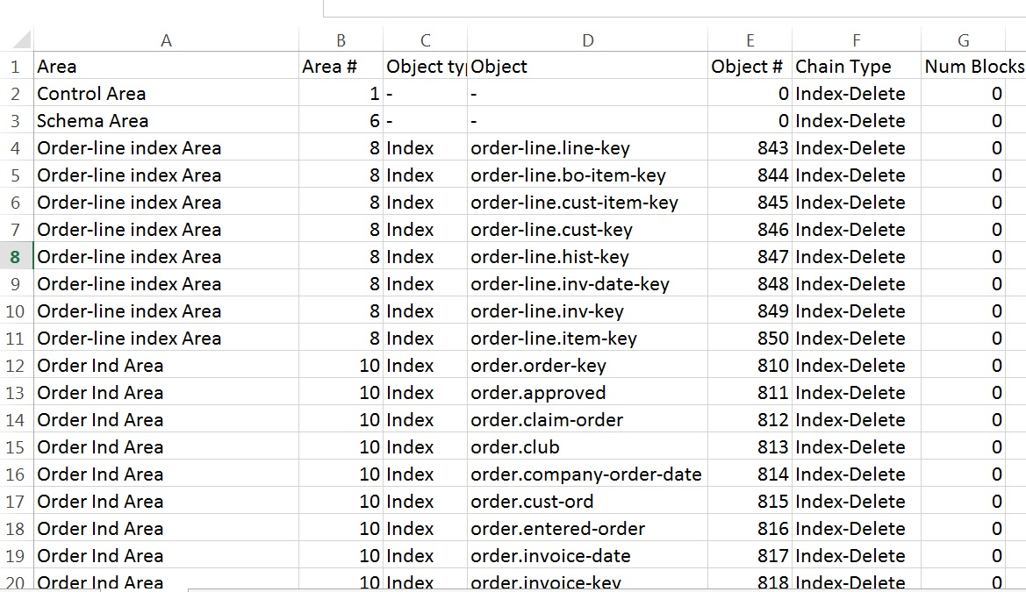
Index Delete chain db_name. ch.txt into Excel

Slide 37
Summary
5 rules for existing databases
If there is no Long RM chain then no need to change toss limit
If there is Long RM chain set toss limit = average record size + 10%
If there is no fragmentation then no need to change create limit
If there is fragmentation set create limit < toss limit and based on chanalys (for the lack of better method )
If there are non zero Index delete chains run idxcompact

Slide 38


DBAnalys To The Rescue!
Contents
History
Theory
Practice
Synergy
Other Options

Slide 39
Before Version 11.4
V11.4 → proutil sports –C dbanalys -csoutput -verbose
LoadDbanalys.p by George Potemkin
ftp://ftp.progress-tech.ru/pub/Users/george/Programs/LoadDbanalys.p

Slide 40
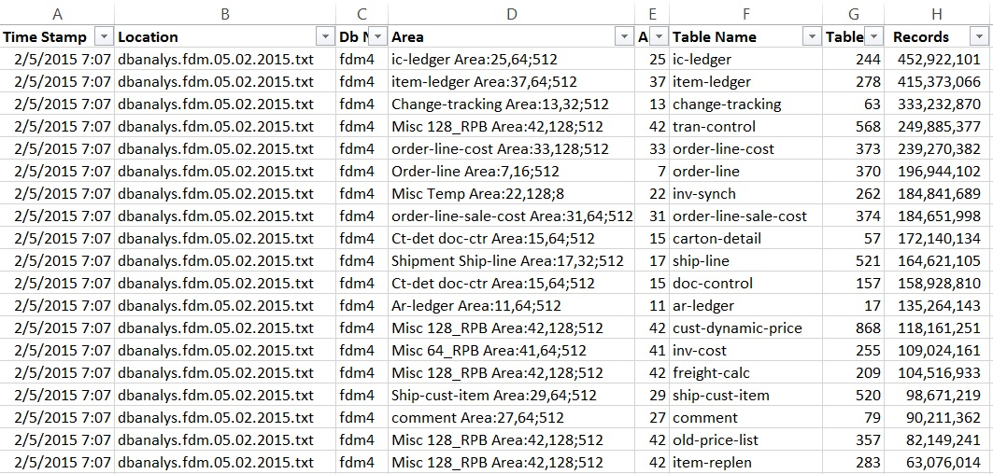
LoadDbanalys.p by George Potemkin
Notes:
It supposes to process a bunch of the dbanalys files at once (for the
different databases, for the similar databases from the different branches,
for the same database from the different times);

Slide 41
LoadDbanalys.p by George Potemkin
ftp://ftp.progress-tech.ru/pub/Users/george/Programs/LoadDbanalys.p
1. Creates the output files that are similar to the -csoutput in 11.4
2. Processes a bunch of the dbanalys files at once
3. Analyses the difference between database structures
4. Creates the LOB report
5. Has additional columns for convenience of analyses
6. Tested with 10.2B but could be used with rather wide range of Progress versions.

Slide 42
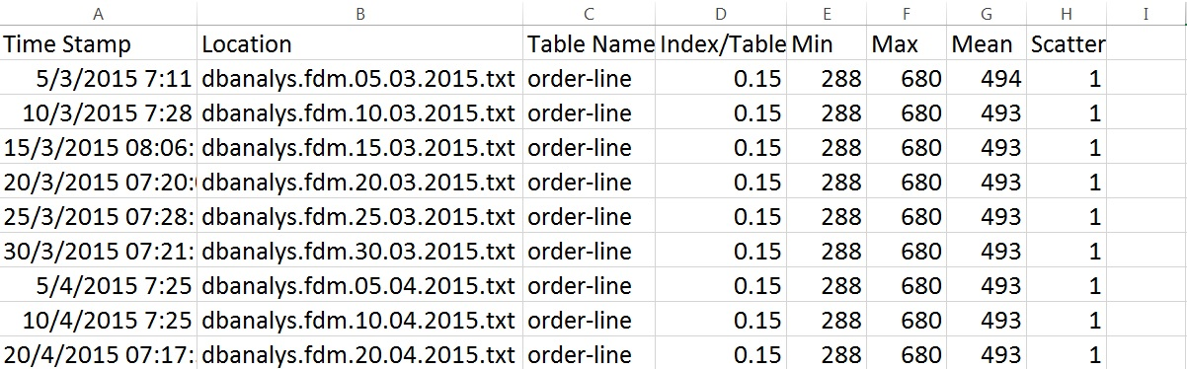
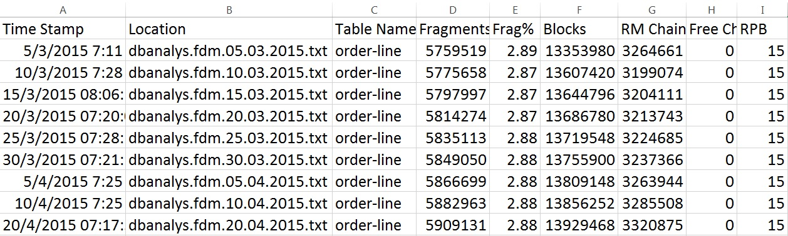
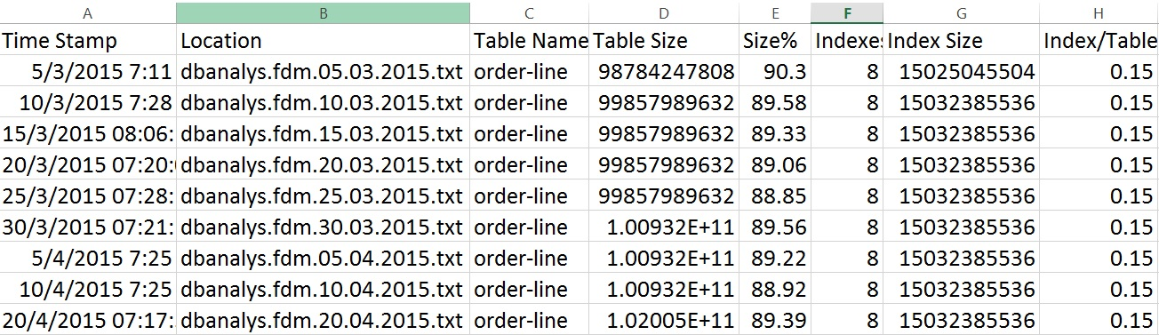
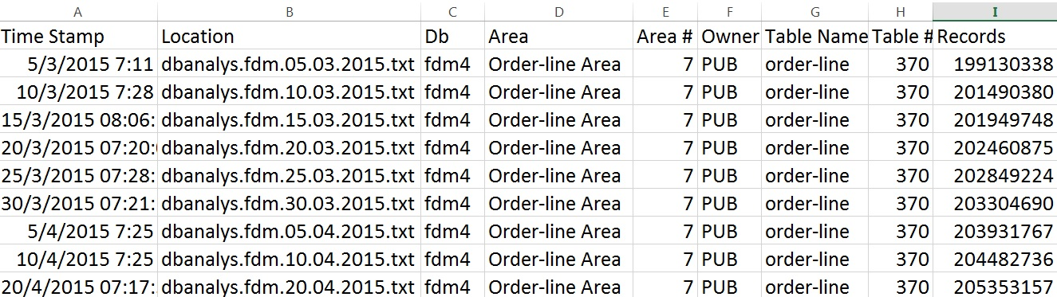
LoadDbanalys.p by George Potemkin
Notes:
It supposes to process a bunch of the dbanalys files at once (for the
different databases, for the similar databases from the different branches,
for the same database from the different times);

Slide 43
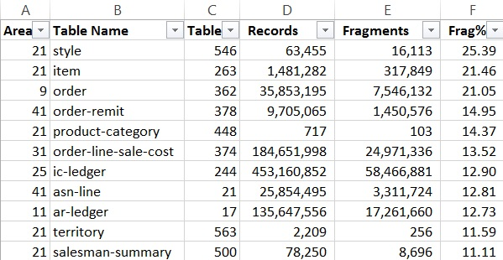
Fragmentation %

Slide 44
Dbanalys

Slide 45
Fragmentation %

Slide 46
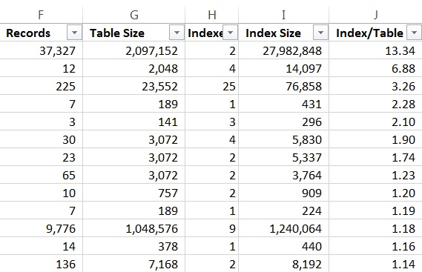
Index / Table Ratio
Normal Ratio 0.1 or 0.2

Slide 47
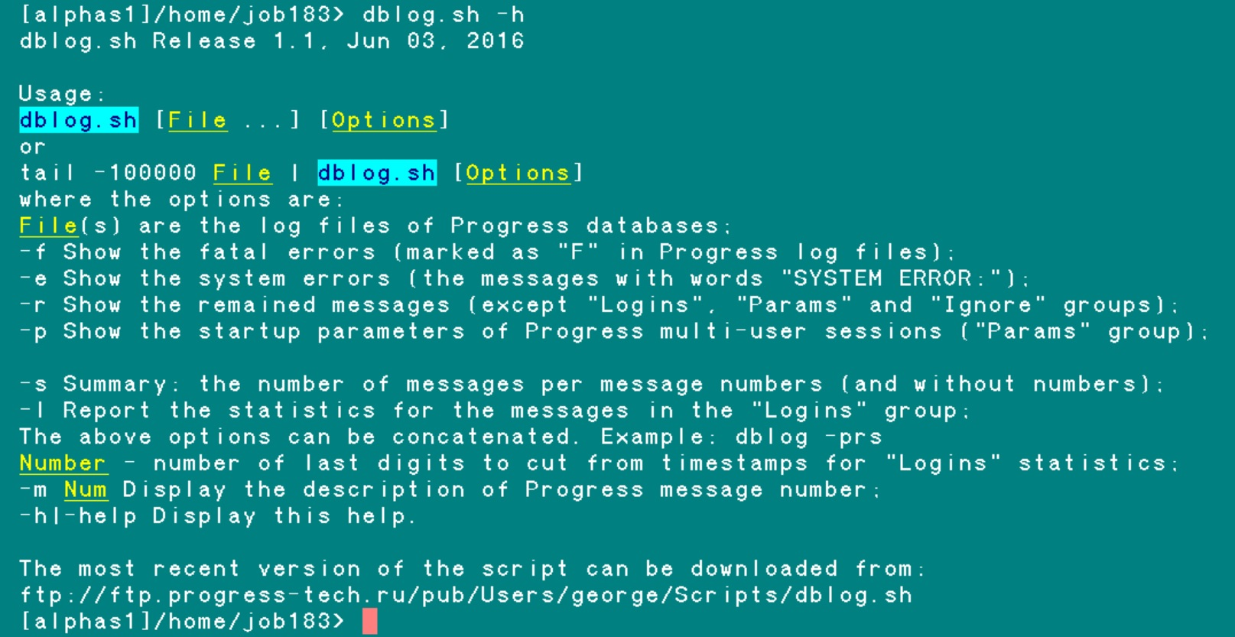
dblog.sh

Slide 48
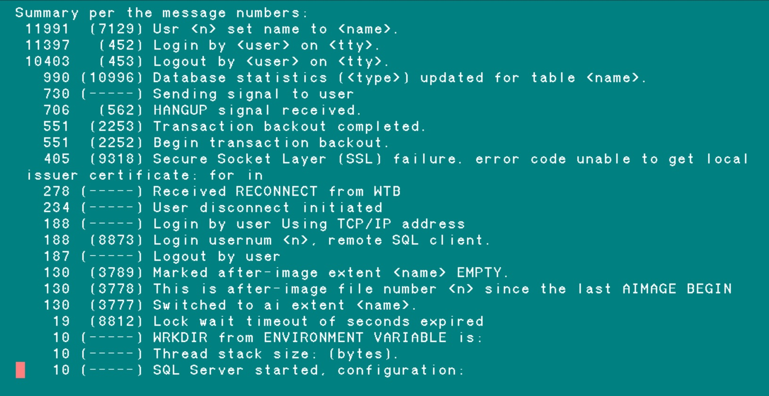
dblog.sh -s sports.log

Slide 49
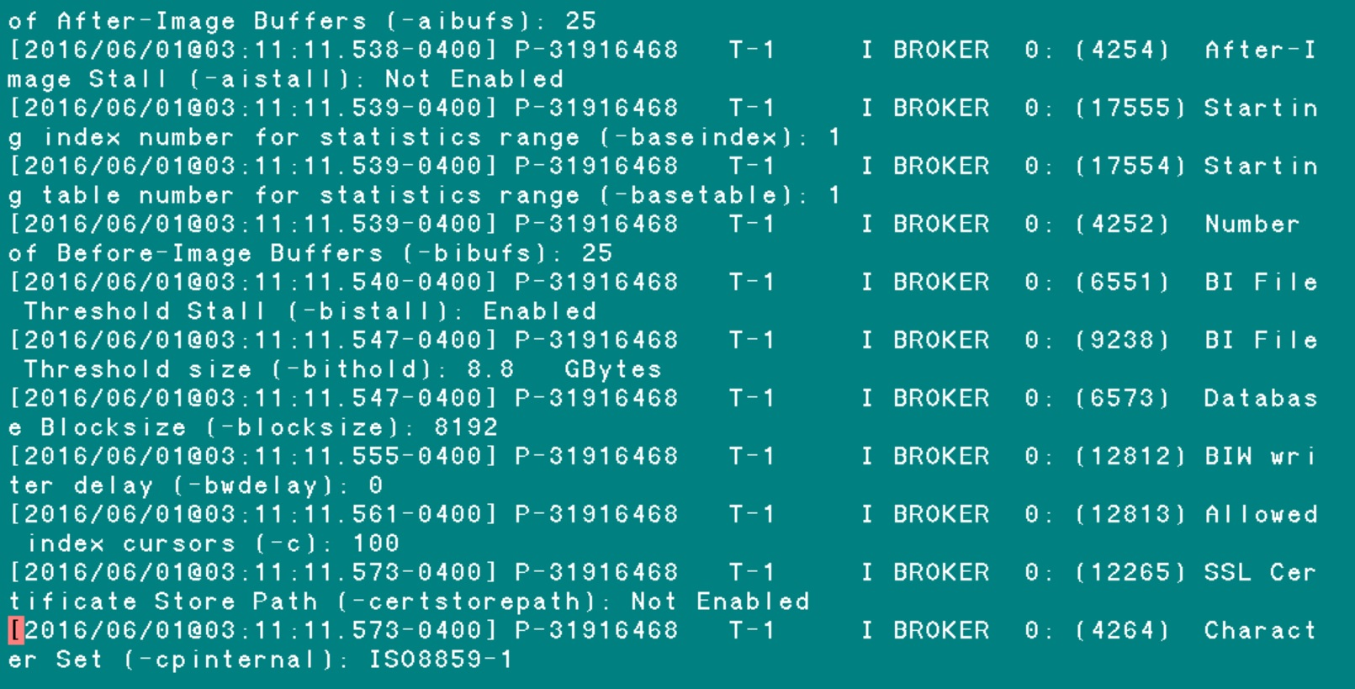
dblog.sh -p sports.log

Slide 50
VST _DbParams ( V11.5+ )
for each _DbParams no-lock by _DbParams-Msg-Num:
disp
/* _DbParams-Id format ">>9" label "id"*/
_DbParams-Name format "x(20)"
_DbParams-Value format "x(30)"
_DbParams-Is-Default label "Default"
_DbParams-Is-Modifiable label "Modify"
_DbParams-Msg-Num format ">>>>9" label "MSG"
/*_DbParams-dtype label "type"
_DbParams-Desc */.
end.

Slide 51
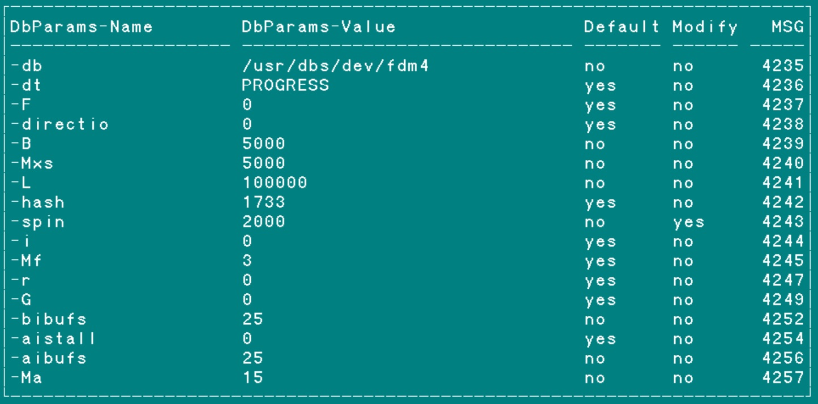
VST _DbParams ( V11.5+ )

Slide 52
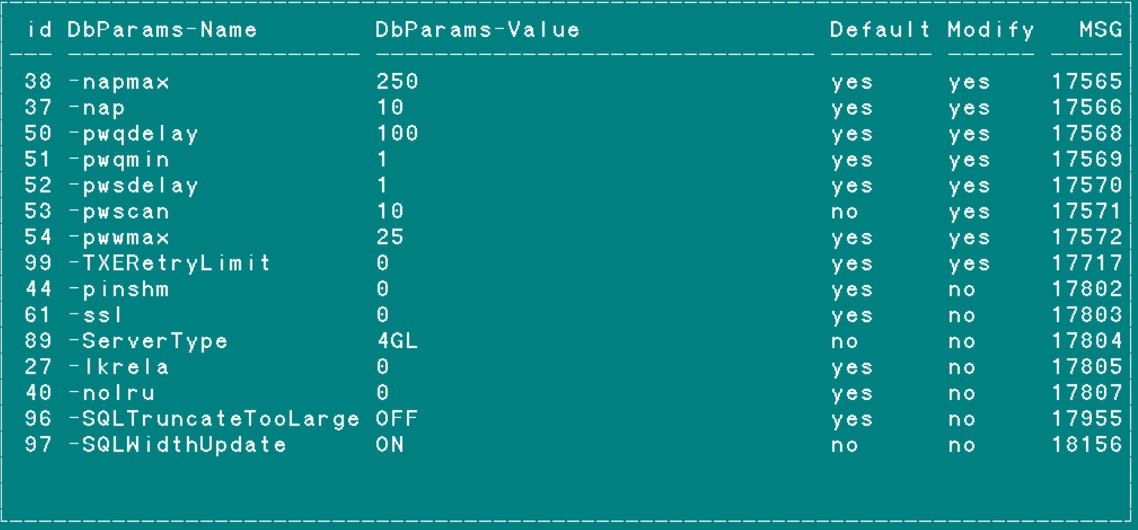
VST _DbParams ( V11.5+ )

Slide 53
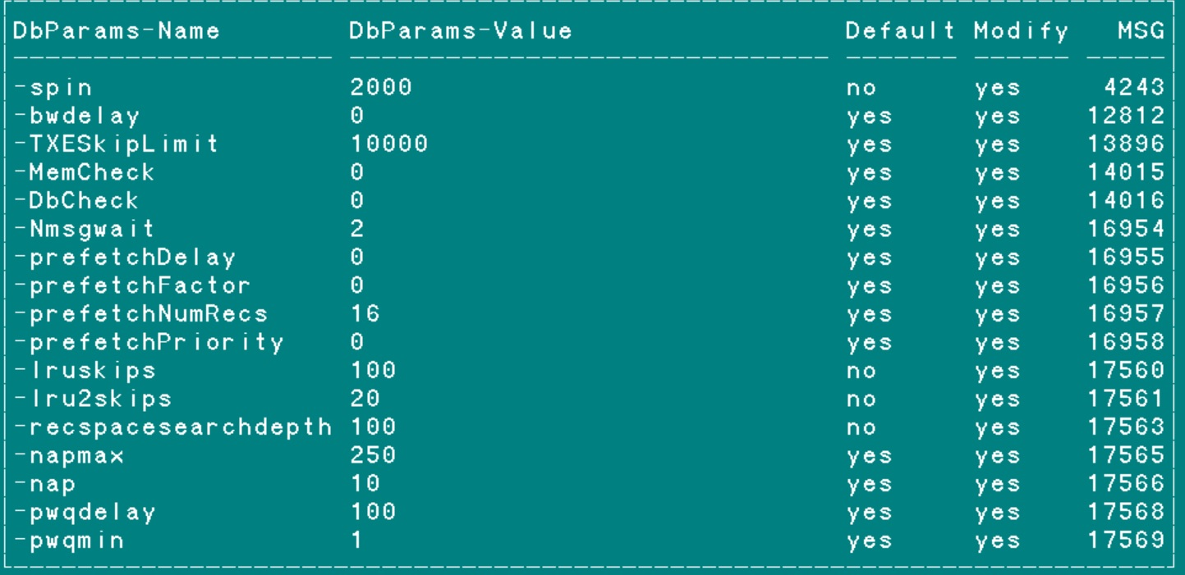
VST _DbParams ( V11.5+ )

Slide 54

DBAnalys To The Rescue!
Contents
History
Theory
Practice
Synergy
Other Options

Slide 55
_TableStat
_IndexStat
Dbanalys
_TableStat
_IndexStat

Slide 56

synergy

Slide 57
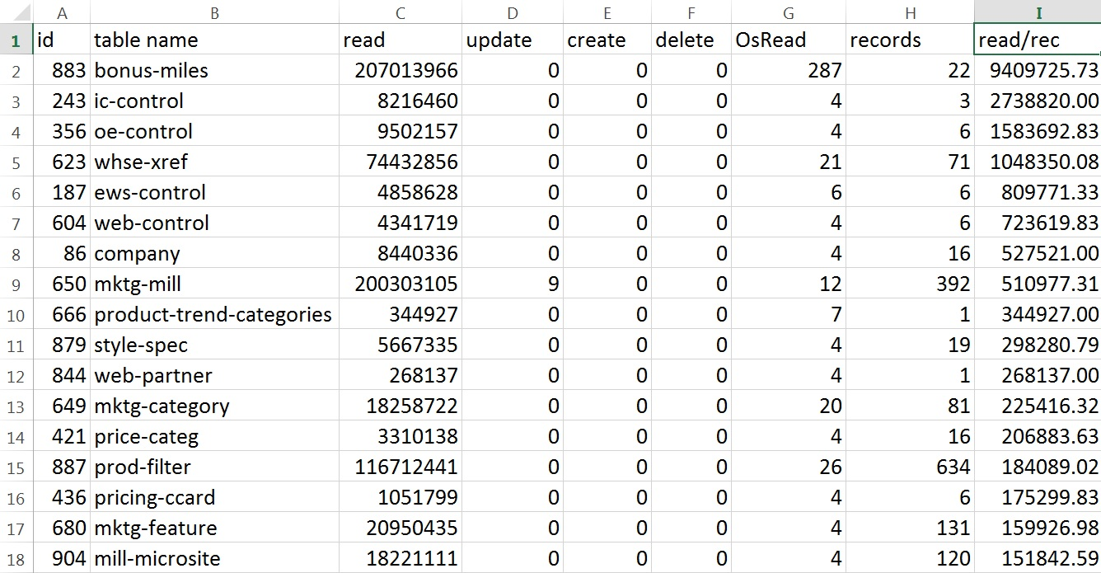
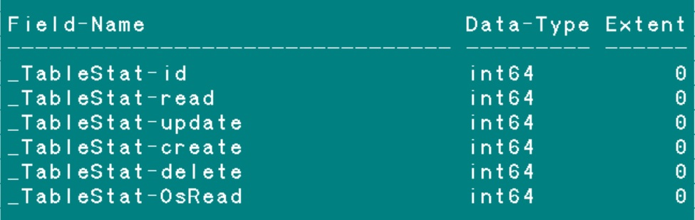

synergy

Slide 58
synergy

Slide 59
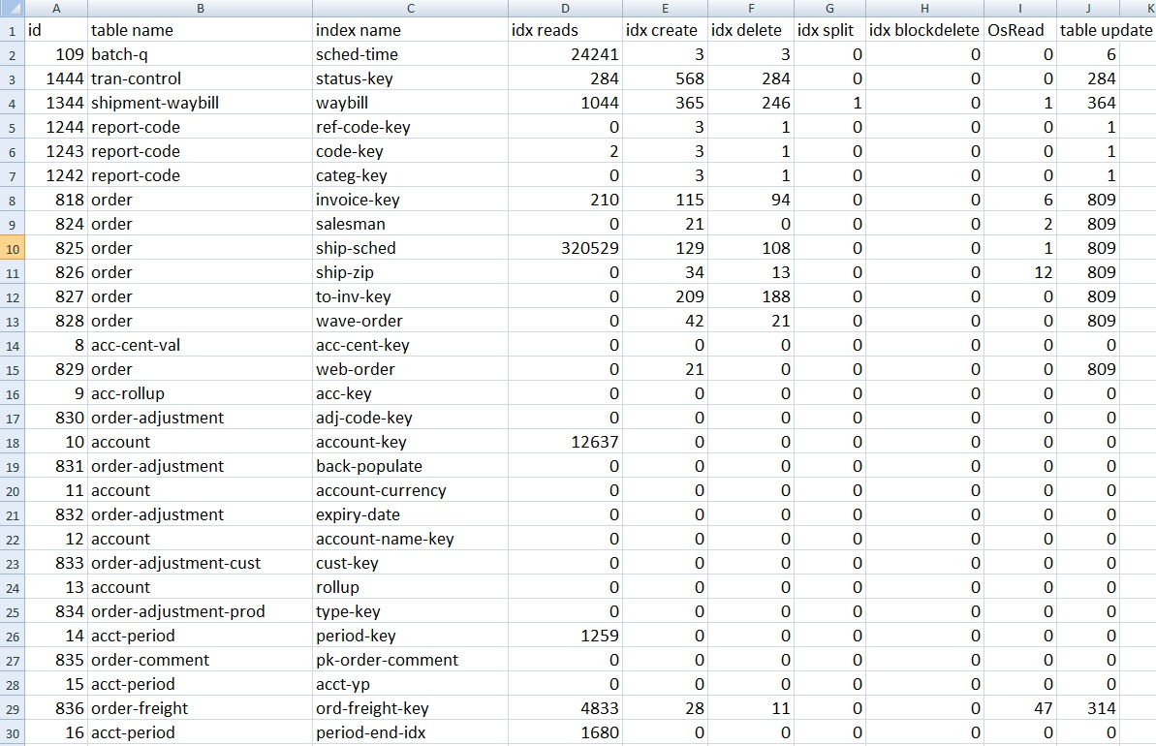
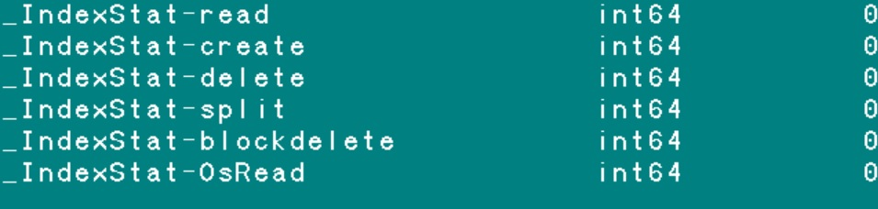

synergy

Slide 60
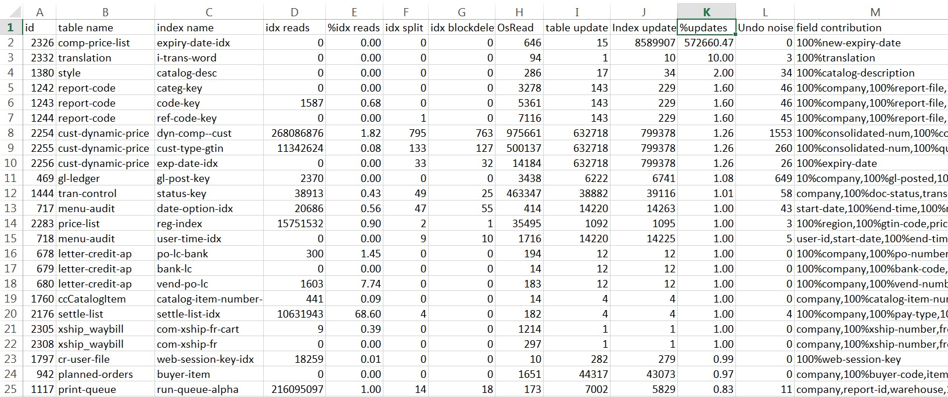

synergy
Notes:
In theory both calculations of Index update, through creates and deletes, should give the same results. But in practice they do not. The difference between them is reported in “Undo noise” column. For example, when a record is deleted _TableStat-delete increases by 1 and _IndexStat-delete increases by 1, but if that transaction is rolled back then _IndexStat-create is adjusted the same way by 1 as _IndexStat-delete was, but _TableStat-creates does not change. That is why we have a discrepancy.

Slide 61
synergy
do transaction:
_TableStat-create | _TableStat-delete | _IndexStat-create | _IndexStat-delete
1 | 0 | 1 | 0
create <record>.
undo, return.
_TableStat-create | _TableStat-delete | _IndexStat-create | _IndexStat-delete
1 | 0 | 1 | 0
do transaction:
delete <record>.
_TableStat-create | _TableStat-delete | _IndexStat-create | _IndexStat-delete
0 | 1 | 0 | 1
undo, return.
_TableStat-create | _TableStat-delete | _IndexStat-create | _IndexStat-delete
0 | 1 | 1 | 1
Notes:
When a record is deleted _TableStat-delete increases by 1 and _IndexStat-delete increases by 1, but if that transaction is rolled back then _IndexStat-create is adjusted the same way by 1 as _IndexStat-delete was, but _TableStat-creates does not change. That is why we have a discrepancy.

Slide 62

synergy
Notes:
In theory both calculations of Index update, through creates and deletes, should give the same results. But in practice they do not. The difference between them is reported in “Undo noise” column. For example, when a record is deleted _TableStat-delete increases by 1 and _IndexStat-delete increases by 1, but if that transaction is rolled back then _IndexStat-create is adjusted the same way by 1 as _IndexStat-delete was, but _TableStat-creates does not change. That is why we have a discrepancy.

Slide 63
synergy
Notes:
On this slide we see a huge number of “%updates” column, i.e. IndexUpdates / _TableStat-Update.
That is due to a bad index, i.e. index with long Index-Delete chain.
Yet an other way to find an index that need to be compacted or rebuilt.

Slide 64

DBAnalys To The Rescue!
Contents
History
Theory
Practice
Synergy
Other Options

Slide 65

AreaDefrag.p
Version 2.0 (“Precision weapon”)
1. Works online (4GL)
2. Defrags only records that are fragmented
3. Defrags one area at a time
4. Allows to specify a range of blocks
5. Could be multi-threaded
6. Could be interrupted
Notes:
ftp://ftp.progress-tech.ru/pub/Users/george/Programs/AreaDefrag/

Slide 66
Testing results
for each <table> no-lock use-index <small-index>:
end.
Before defrag.p : 2 hr 19 min or 139 min
After defrag.p : 22 min or more then 6 times faster
proutil -C dump index 0
Before defrag.p : 102 min
After defrag.p : 10 min or more then 10 times faster

Slide 67
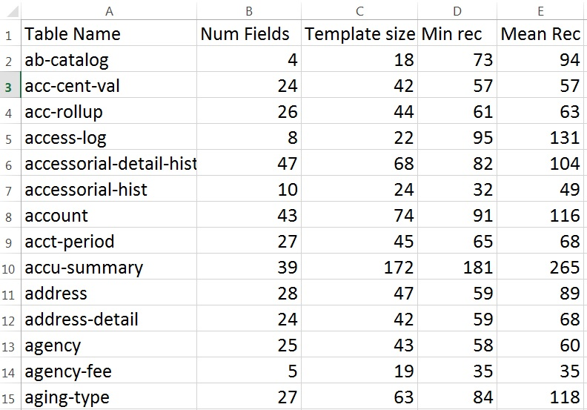
Min Record Length

Slide 68
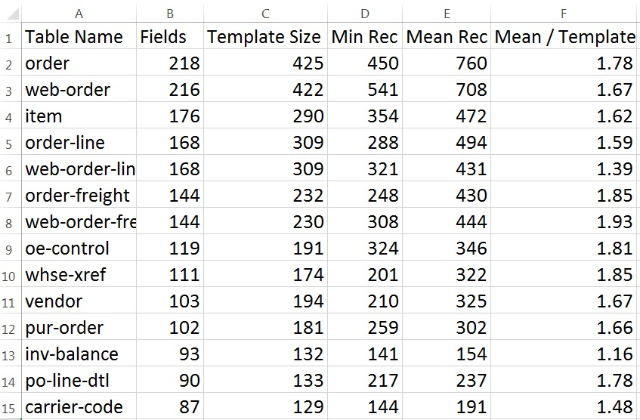
Mean Record Length
Notes:
When developing the schema of future database table, if there is not data, pay attention at template size and use it for estimation of mean record size

Slide 69



kill -9 user-PID
kill -9 user-PID
A kosher way to kill Progress sessions. Safely.

Slide 70

Thank you for your time!
George potemkin@progress-tech.ru
Dmitri d_levin@hotmail.com

