Slide 1
Integration with organizational and personal workflow:
Case study of
a mature application
Arthur Fink
arthur@arthur fink.com

Slide 2
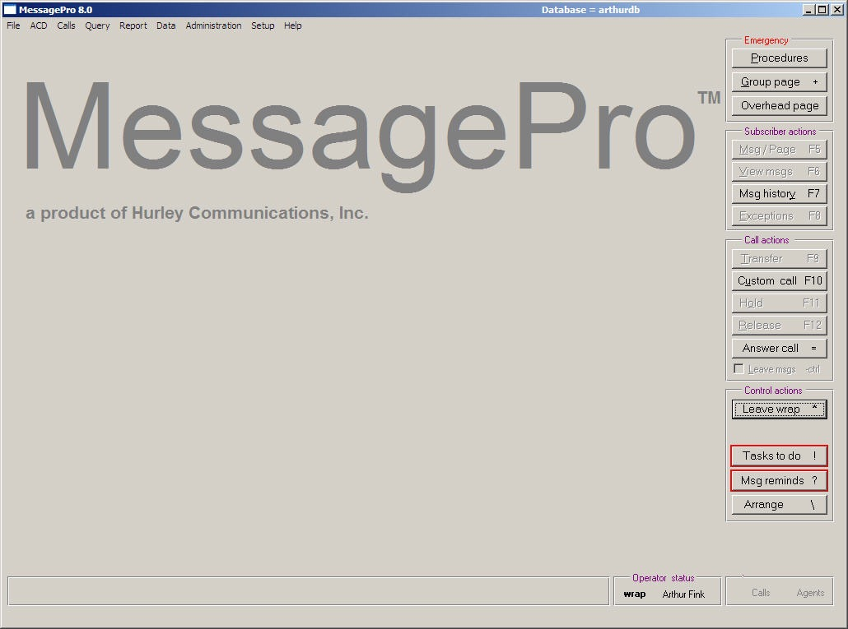
The application:
      The client: Hurley Communications
  www.HurleyCommunications.com
  Jim Hurley, President and CTO

Slide 3
Successful systems need more than modern technical integration between components. They also need to establish functional integration that mirrors workflow, or that creates new and more successful work patterns.
Rather than seek out just the latest and fanciest technology, we took a practical engineering approach to system design, with primary emphasis on the usability and integrity of the system, to help staff keep patients, callers, and all the medical team members connected as needed, with up to the minute accountability.

Slide 4
Today, Arthur is talking about usability, users, etc.
What day is today?

Slide 5
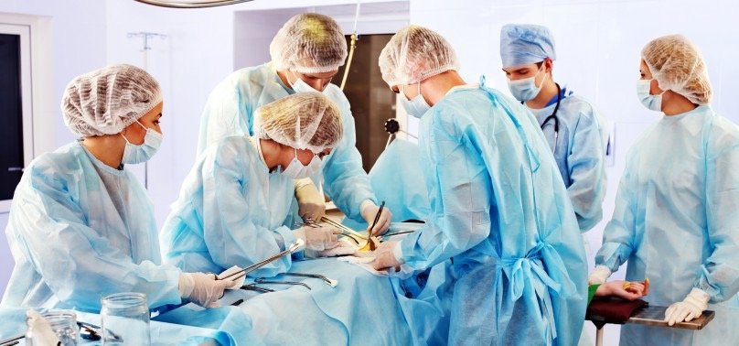

Slide 6
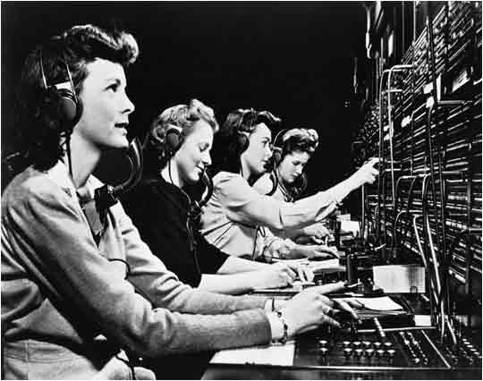

Slide 7
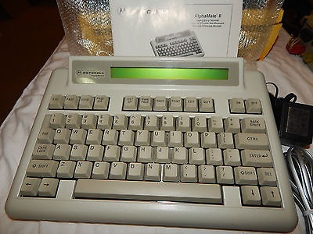

Slide 8
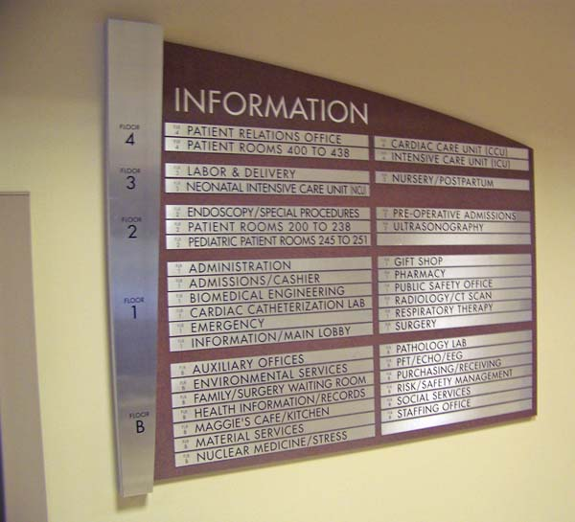

Slide 9
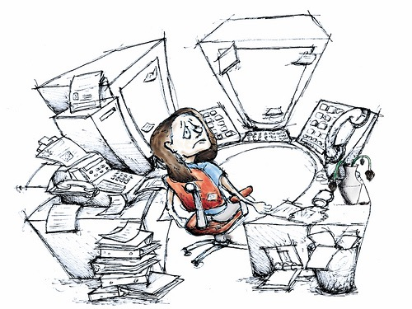

Slide 10
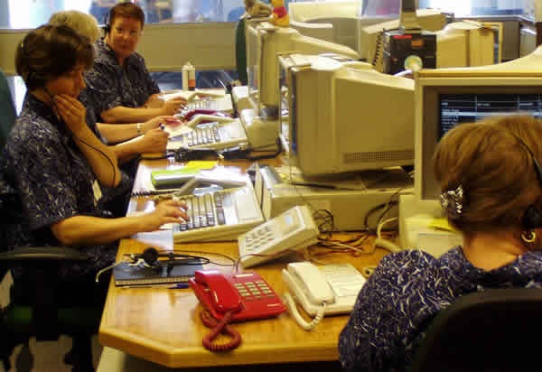

Slide 11


Slide 12


Slide 13
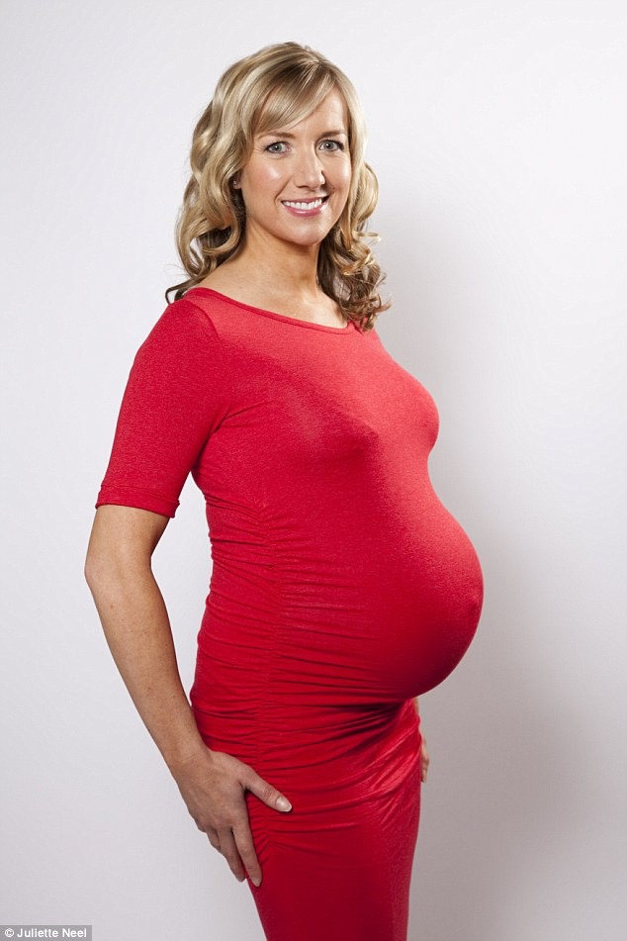

Slide 14
Database =
          model of
          our world

Slide 15


Slide 16
What makes a model useful
?

Slide 17
What makes a model less useful
?

Slide 18
It leaves almost everything out
It leaves almost everything out

Slide 19
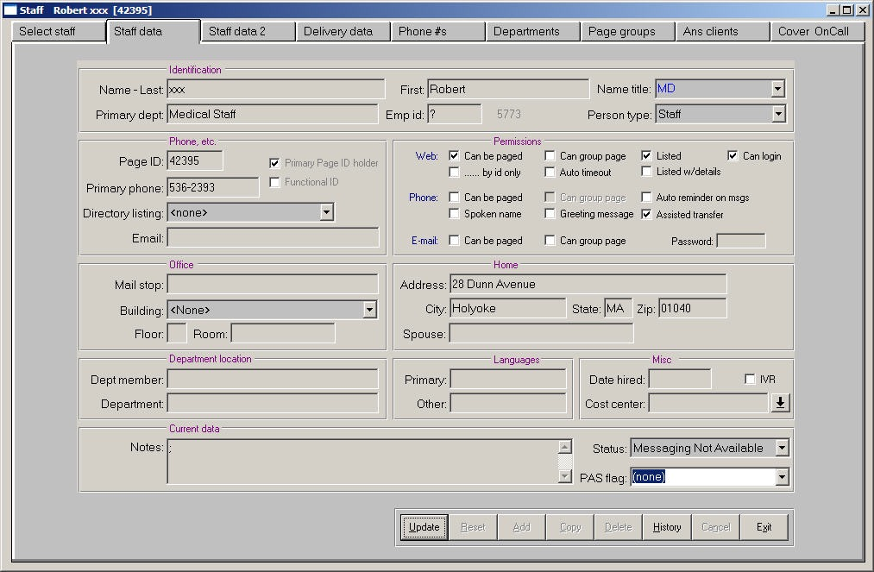

Slide 20
06/19/16 Arthur Fink Consulting Data Dictionary Report Page 3
Person Table [continued]
============
* Phonetic_last_name Format: x(30)
================== Type: char
Desc: A phonetic translation (soundex or metaphone) of the last name
of this person. Not initially being used. (S, P, T)
* Phonetic_first_name Format: x(30)
=================== Type: char
Desc: A phonetic translation (soundex or metaphone) of the first name
of this person. Not initially being used. (S, P, T)
* Name_title Format: X(14)
========== Type: char
Desc: (S)
Position_title Format: x(30)
============== Type: char
Desc: No longer used! Was to be dept_title for primary dept for this
staff person. Now, get that record from the data. (S)
Phone_directory_listing Format: x(30)
======================= Type: char
Desc: Standard phone directory listing, using person categories (e.g.
medical staff. admin staff intern, etc.) (S)
Phone_number Format: x(16)
============ Type: char
Desc: Primary phone number for staff or students. (This is redundant
with the phone_number entry for this person that is marked with
'primary_phone = yes'). For patients this is usually not set,
but when it is this number is used to call the patient (instead
of the regular number in the patient's room, found via
room_bed). (P, S, T)
Default_call_back_number Format: x(16)
======================== Type: char
Desc: Default call back number for this person, used on messages, etc.
It may be different than the person's primary phone number. (P,
S, T)

Slide 21
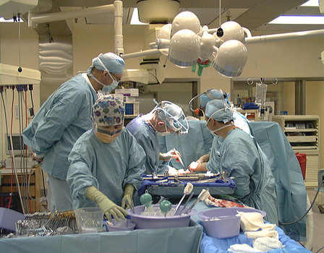
Assembling the team - Individually, or as a group?

Slide 22
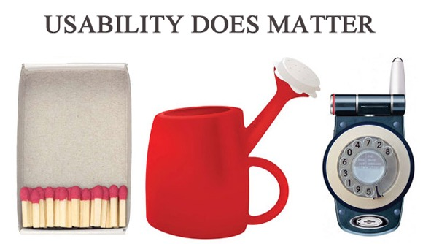

Slide 23
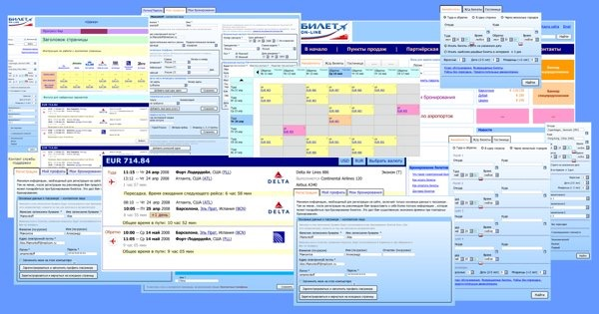

Slide 24
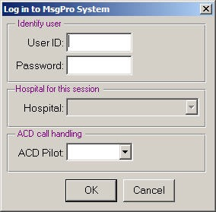
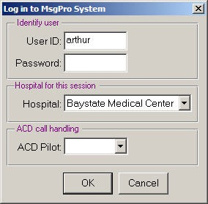
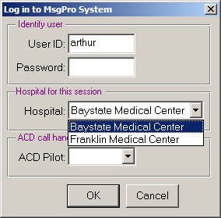

Slide 26
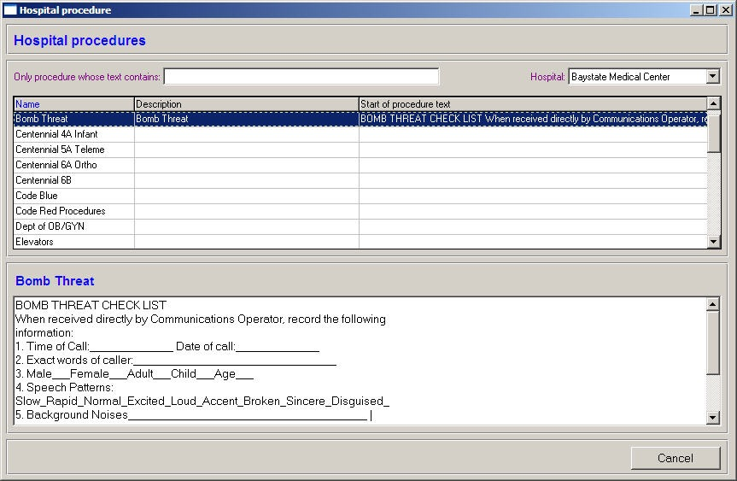

Slide 27
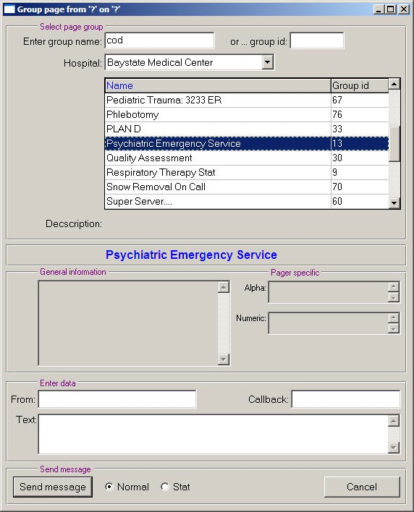

Slide 28
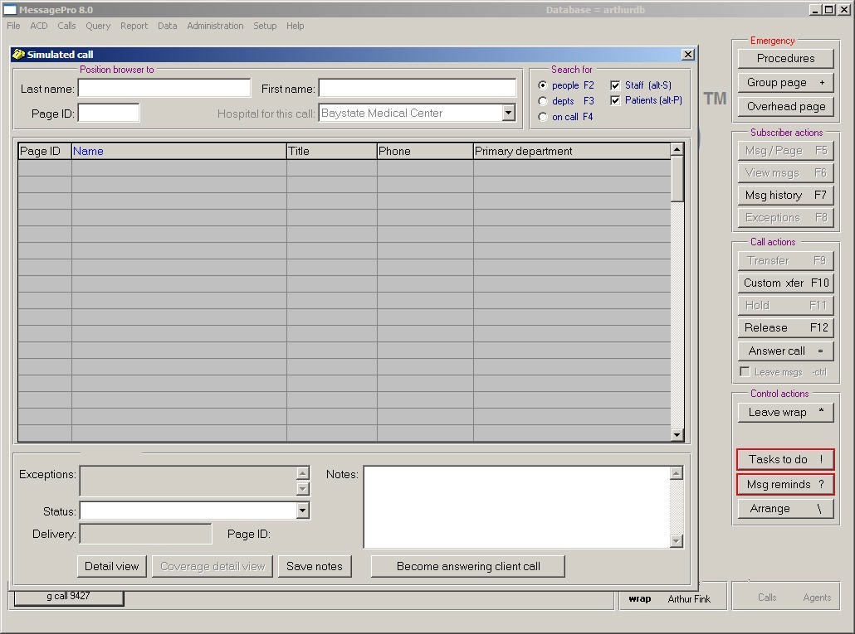

Slide 29
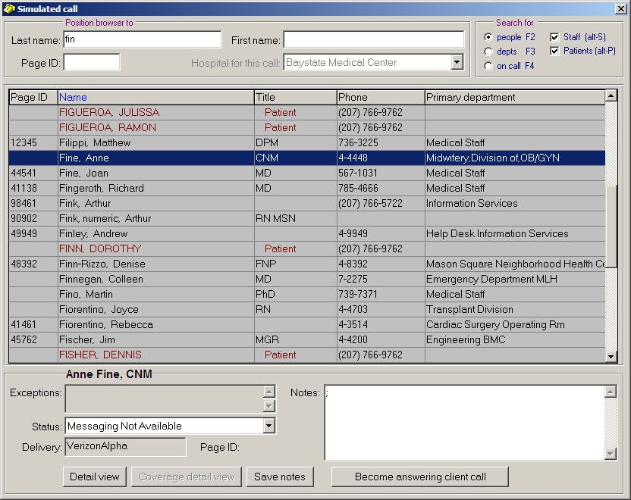

Slide 30
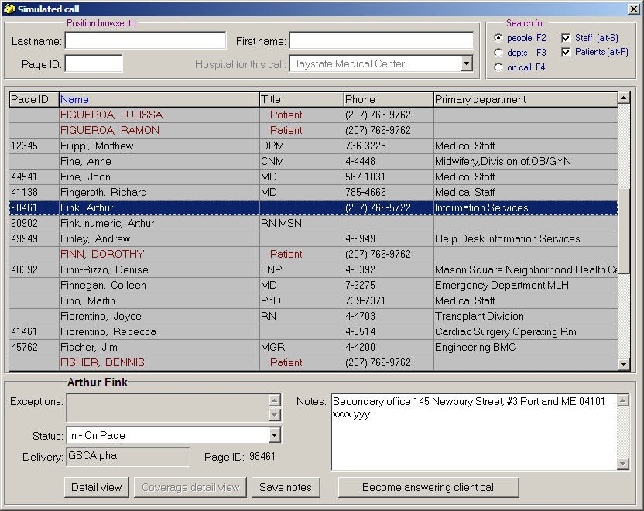

Slide 31
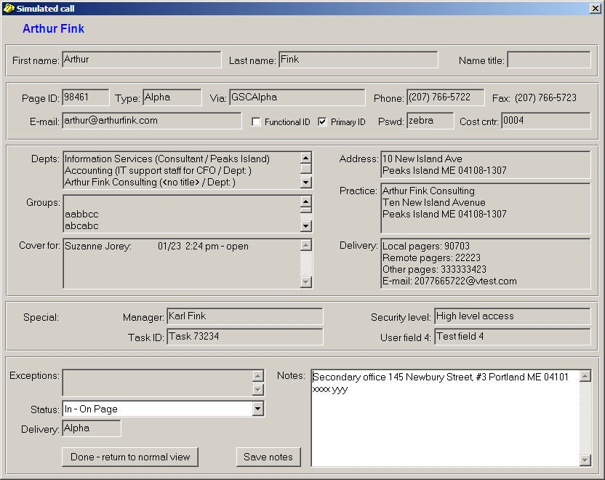

Slide 32
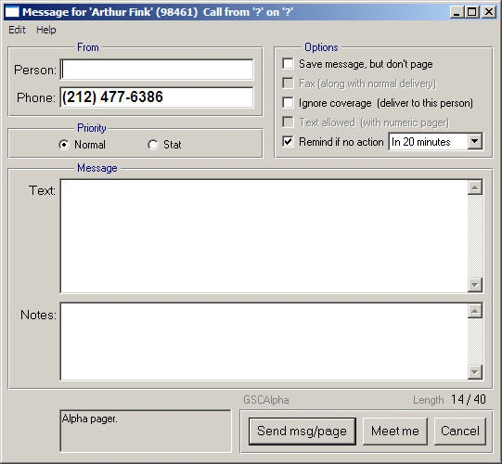

Slide 33
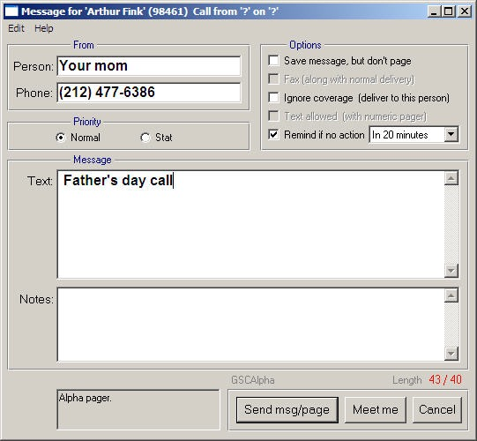

Slide 34
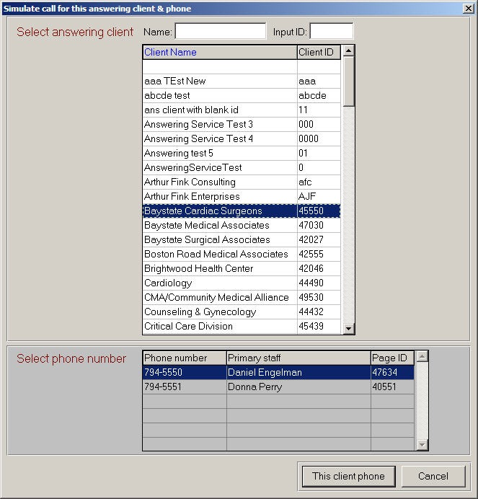

Slide 35
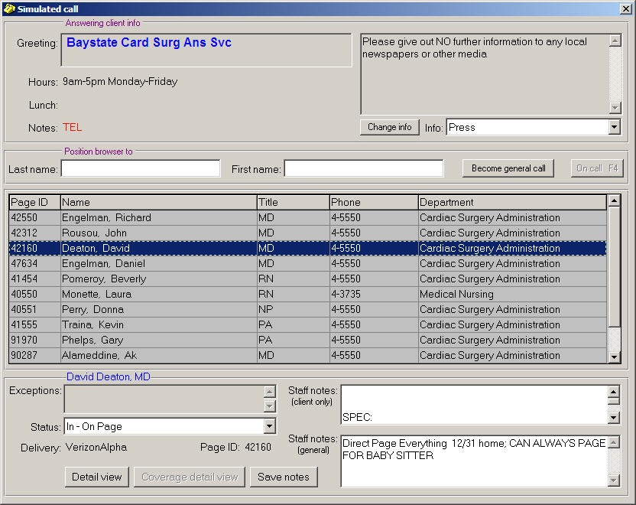

Slide 36
Can the users understand and “own” the overall system paradigm? [household / person paradigm]
Does the system support the current, or perhaps a more functional, user workflow?
Do the users understand each data element that is updated or displayed?
Is there an “uups” facility to easily back out of any “mistakes” (or to move forward with corrections)?
Are the “affordances” clear (e.g. does the system feel natural and easy to use)?

Slide 37
What if the user does something “wrong”? Is it easy to recover?
Is there enough system integrity so that external or internal failure will not stop urged operations?
Does the system embody the user’s core concepts, and not just today’s technology or methods?
Are all the stakeholders well served? (Here these include patients, families, other medical staff, etc.)
Is there enough structure and documentation that the system can be well maintained, and upgraded as needed, even by new staff?

Slide 38
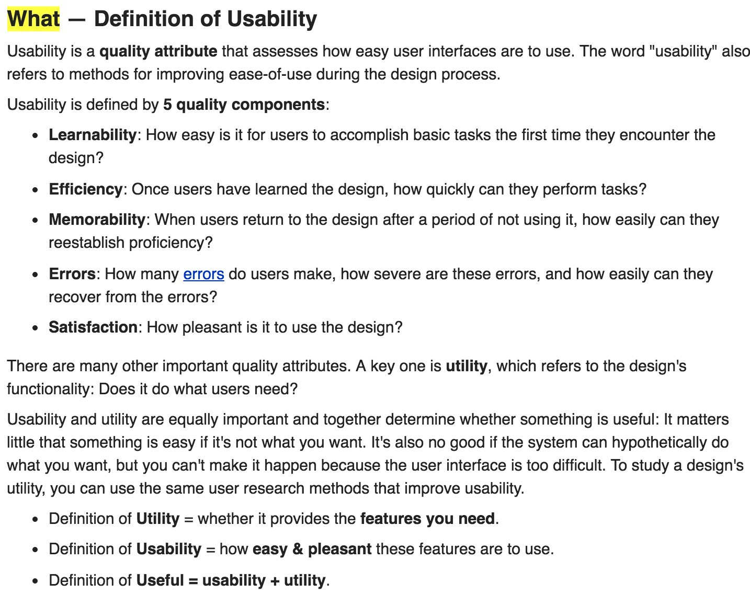
                — From “Usability 101: Introduction to Usability” by the Nielsen Norman Group

Slide 39
Questions
Observations
Concerns
Arthur Fink arthur@arthurfink.com
207 615 5722
?

