Slide 1
Telerik Analytics:
OpenEdge.NET SDK
Bill Wood
March 9, 2016
Bill Wood
Version 0.4

Slide 2
Agenda
What is Analytics?
OpenEdge and Telerik Analytics: A Quick and Easy Demo
What We Saw
Deeper Dive: Inside Telerik Analytics
Best Practices
Where to go to get Telerik Analytics

Slide 3
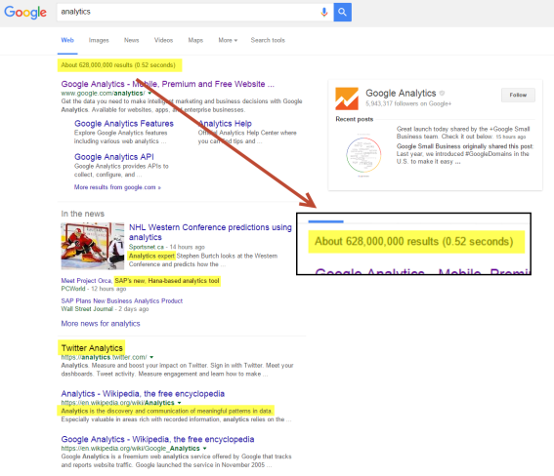
What is Analytics? Google says….

Slide 4
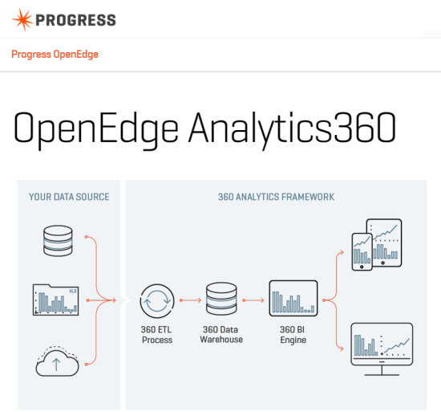
What is Analytics? OpenEdge says….

Slide 5
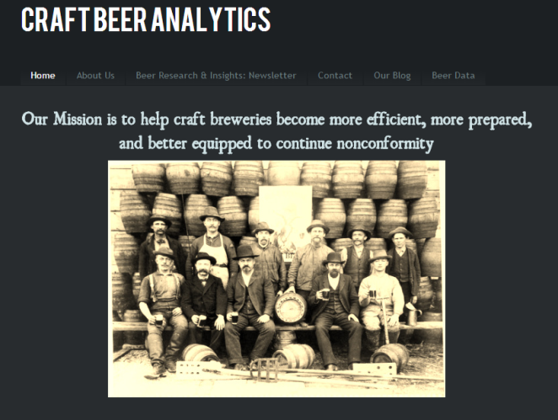
What is Analytics? Let’s discuss over a beer!

Slide 6
Time for a Demo

Slide 7
What we just saw!

Slide 8
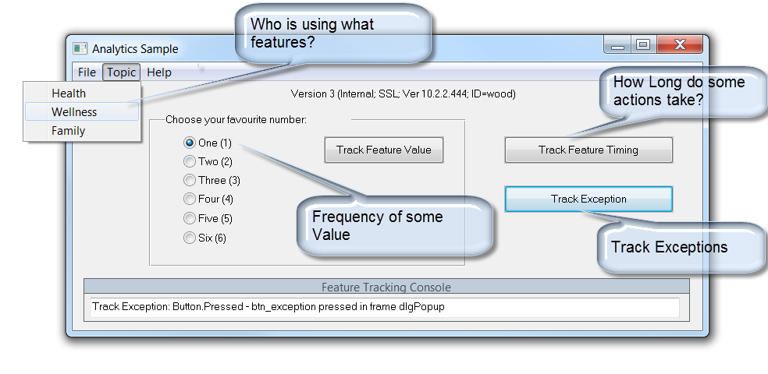
Telerik Analytics Can Instrument Your ABL Code (using the .NET SDK)

Slide 9
Simple ABL Code: Using .NET Objects
…
USING EQATEC.Analytics.Monitor.*.
…
// Initialize the Monitor
DEFINE VAR monitor AS IAnalyticsMonitor.
monitor = AnalyticsMonitorFactory:CreateMonitor("ac655448f8fdc7be7fc").
monitor:START().
…
// Use the Monitor
monitor:TrackFeatureValue(p_feature, p_value).
…

Slide 10
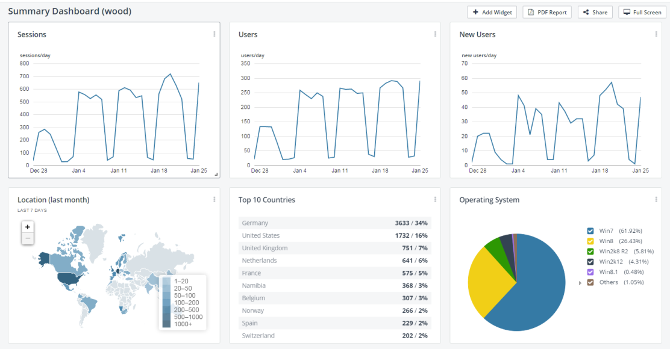
Summary Information: Usage, Versions, Geography, Environment

Slide 11
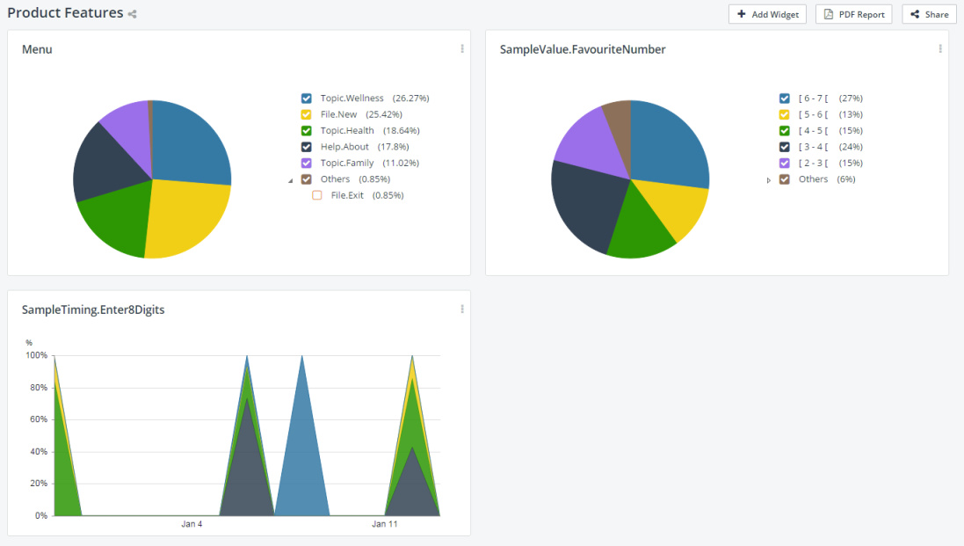
Summary Information: Usage, Versions, Geography, Environment

Slide 12
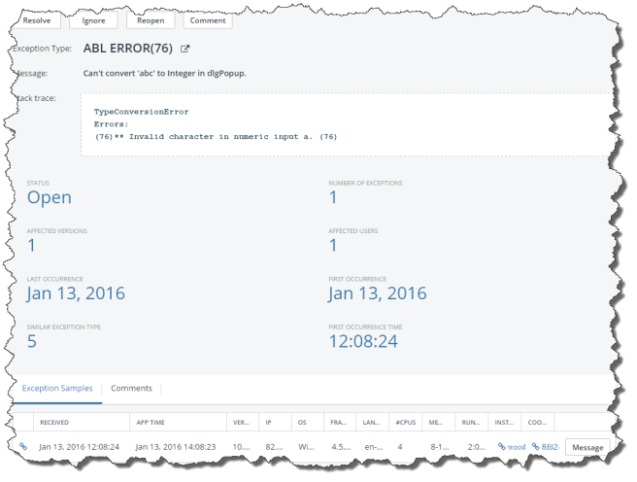
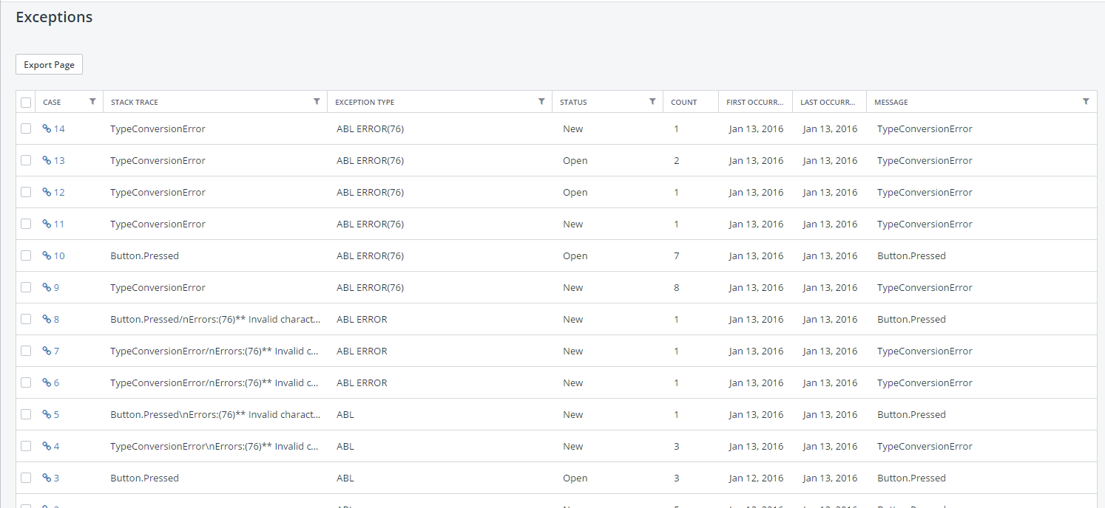
What is Going Wrong?

Slide 13
Telerik Analytics and OpenEdge: .NET SDK
.NET SDK works with OpenEdge GUI clients (on Windows)
  Can also use the JavaScript SDK (for tracking WebSpeed, Star*Nova, Web/Mobile)
  … or Java and .NET SDK for Open Client apps
Can monitor:
  Features Used
  Timing (how long an action takes)
  Distribution for Feature/Value pairs
Easy to get Started:
  Need Telerik Platform Enterprise edition (to enable .NET SDK)
  Talk to your sales rep for evaluation
  AnalyticsSample.w
See:
  http://www.telerik.com/platform/analytics

Slide 14
Some FAQs
Can I use this on an Application Server or PASOE?
  Key Answer: Analytics is really for monitoring individual users, not servers.
    This is it’s use case.
  Technical Answer: Yes, if on Windows.
Can I track a user across multiple devices (mobile, desktop, etc.)?
  Answer: No. Each project type is independent.
Can I do advanced correlations or queries? (Graph Feature Use vs Memory)
  Answer: This is not currently supported, but is on the roadmap.

Slide 15
Telerik Analytics:
Deep(er) Dive
(Code examples, data formats and more)

Slide 16
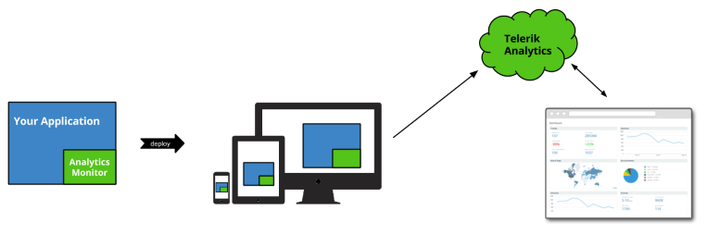
How does it work?

Slide 17
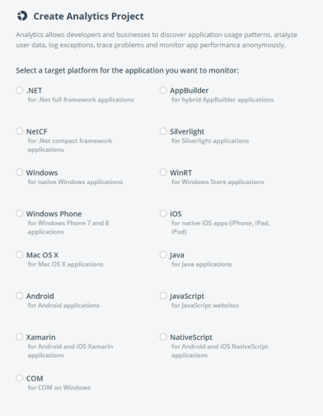
Development Platforms Supported - Monitors
Application types:
Mobile (native, hybrid, web)
Desktop
Web
Implementations:
C++
C# (.NET)
Java
JavaScript
API
Uniform for all platforms
Small footprint and very low performance impact
Supports off-line data collection

Slide 18
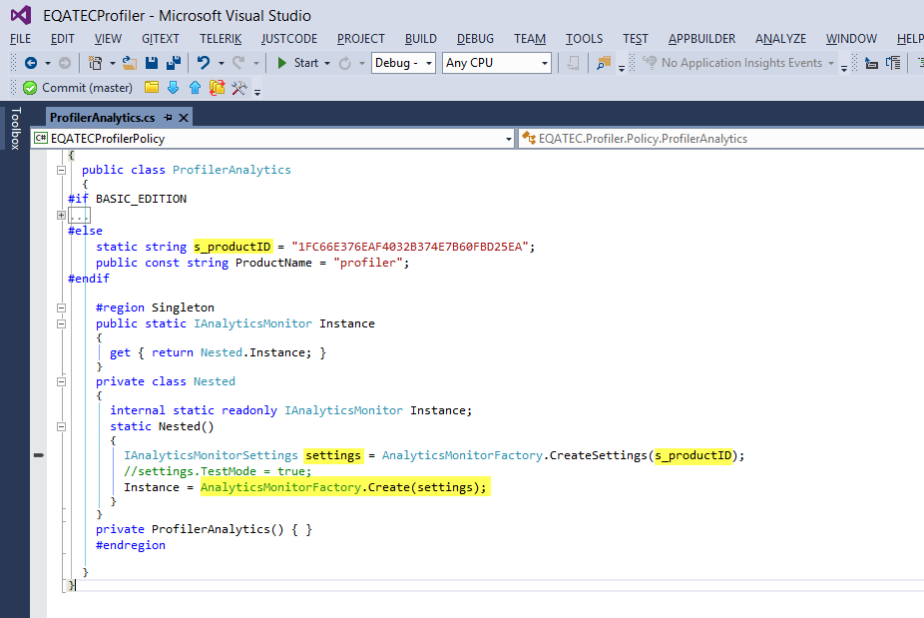

Many SDKs: JavaScript, Java, .NET, C (and C# below)

Slide 19

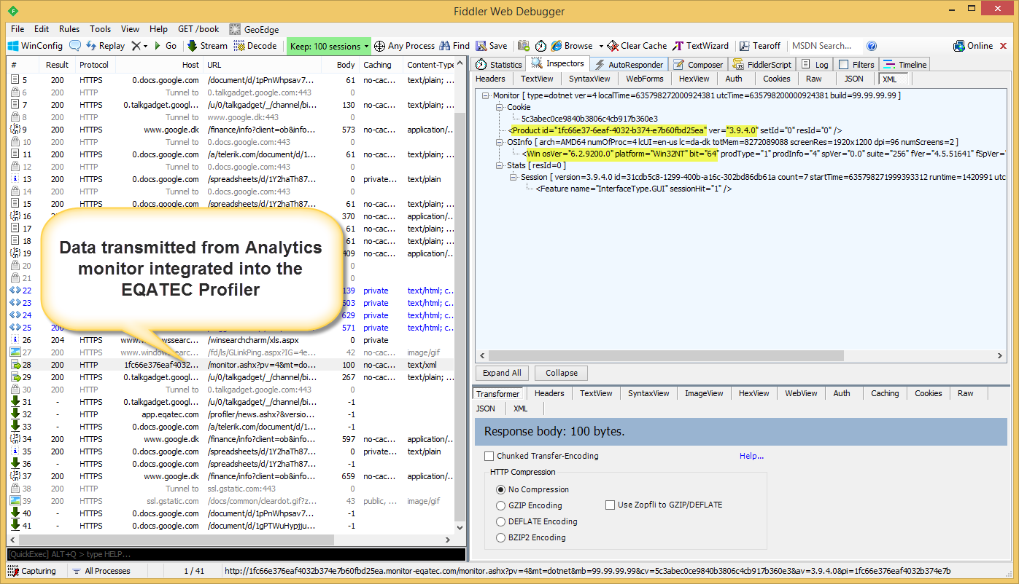
Data on the Wire

Slide 20
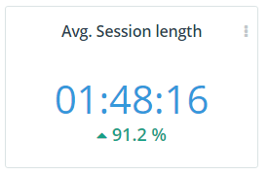
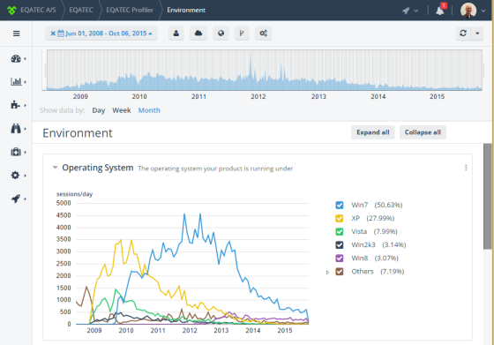
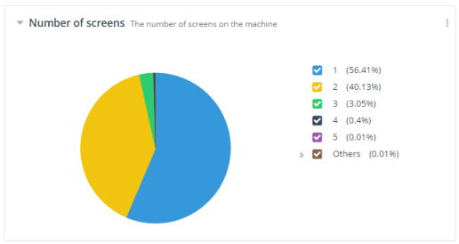
Examples of default monitor data collected

Slide 21

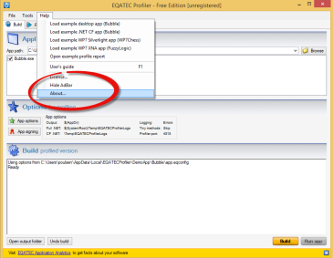
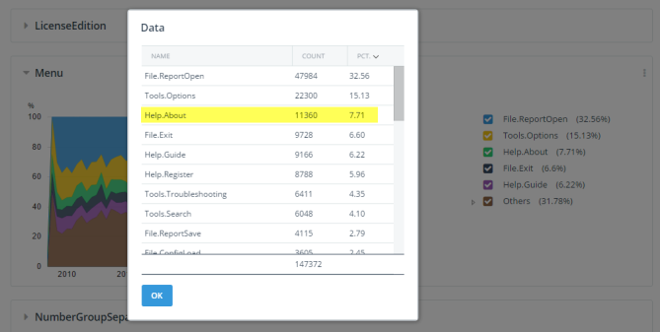
Tracking custom metrics – Feature Usage

Slide 22
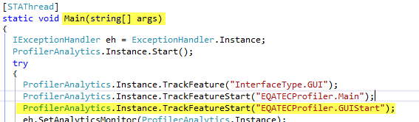
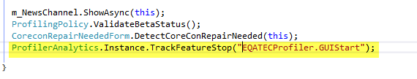
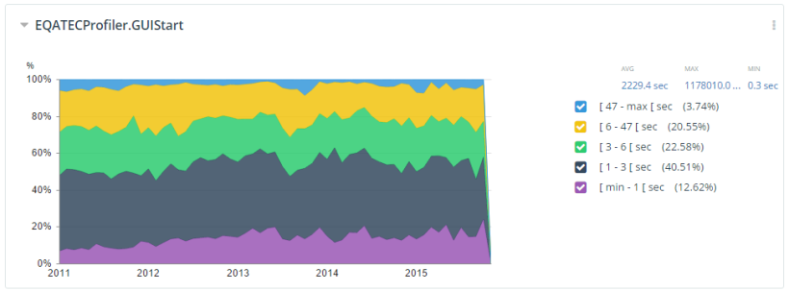
Tracking custom metrics – Feature Timing
End of method “MainForm_shown”

Slide 23
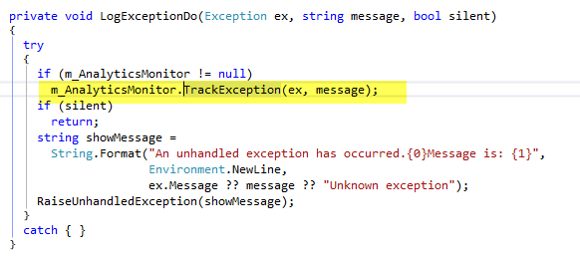
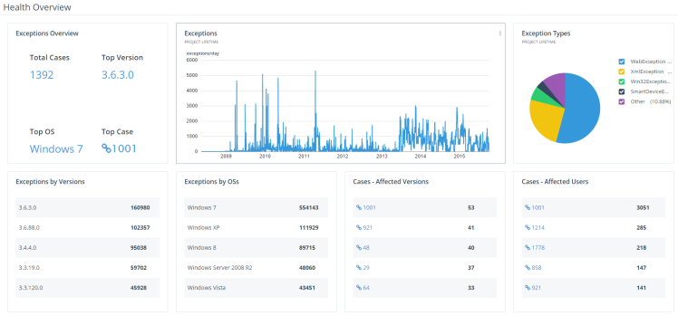

Tracking exceptions

Slide 24
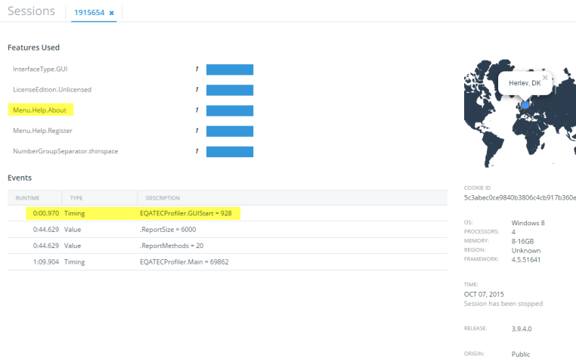
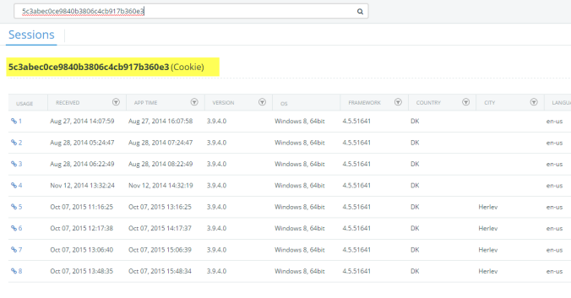
Session details

Slide 25
Customer Success Stories

Slide 26

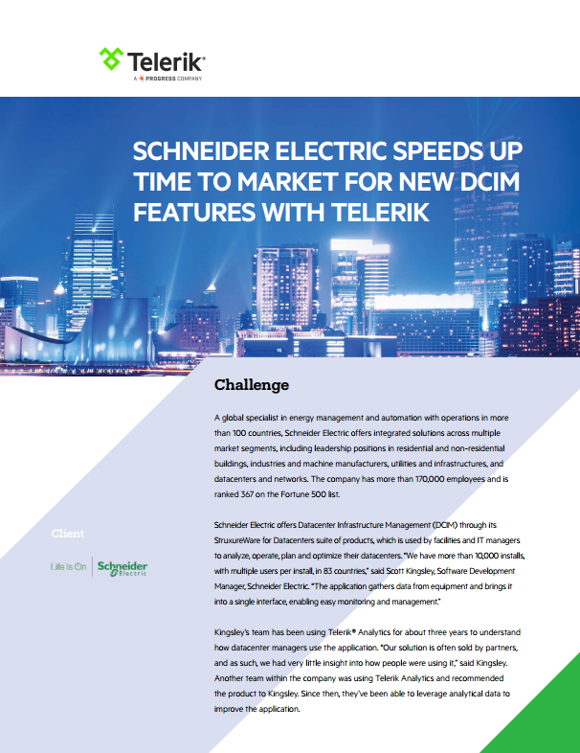
Customer Success
“Telerik Analytics paints a picture for us of what features are of highest value to our users, so we can make smart decisions about what to include in our product and how to present the features in the interface.”
Scott Kingsley, Software Development Manager,
Schneider Electric
Download: www.telerik.com/about/success-stories/analytics
* Not an OpenEdge Customer

Slide 27


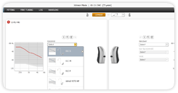
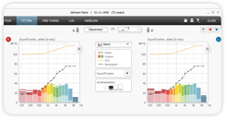
Customer Case Study
One of the world’s leading hearing aid manufacturer
monitoring 93,000 hearing clinic PC apps.
Before Telerik Analytics:
Planned to re-implement a 75 man-year legacy application
With Telerik Analytics:
Exact feature usage measurements uncovered that
25% of application was very seldom used
Result:
25% of a 75 man-year project eliminated
$3.4 million (US) in savings

Slide 28
“We are using Telerik Analytics mainly to view exceptions that are occurring onsite and to improve the stability of our software. We really like the ability to view environmental information and the portal is really simple and easy to use. Another really useful feature is the fact that we can view information by version. We will expand our use to track features in the future.”
Aleksandar Mitrović, Software Engineer,
Kimley Horn & Associates, Inc.

Slide 29
Time for Another Demo
Example Dashboards

Slide 30
Some Best Practices

Slide 31
Best Practices
Be upfront about collecting data.
Collect data to improve the product.
  This is not a compliance or licensing tool.
Think about what you are collecting, and how it will be used.
Have two projects:
  One to test (try new features or heirarchies) – a ‘disposable’ project
  One for ‘final’ deployment
Remember, data does not go away.

Slide 32
Ask yourself a few question…
What do you personally know about your end-users and customers?
  Facts?
  Second-hand information?
  Gut-feelings?

Slide 33
Best Practices: Customer Experience
Opting Out on “Paid Product”
  It is good practice for a ‘paid’ product to ask permission when users first use the product.
  It is also best practice to phrase this as an “Opt Out” (default is to let you collect feedback)
  You should make the option settable in preferences. You should not hide it, but you really want to only ask the question ‘once’ explicitly and early in usage.
  Be honest about what you are collecting and why (“anonymous usage metrics to improve Customer Experience”)
  Say you are doing “anonymous” collection.
  Say also what you are not collecting “e.g No personally identifiable information”)
  It is also good practice to say that you are not affecting performance
For ‘free’ products/demos/examples:
  Here it is acceptable to just add the information to a EULA.
  You still should be honest, and you should not hide that you are collecting information.
  You can even let users see what data you are collecting.
    Telerik Analytics supports the ability to make a ‘public’ dashboard anyone can see.

Slide 34
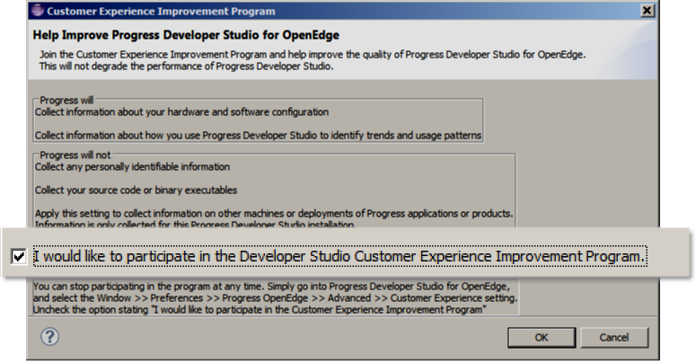
2015: PDSOE 11.5

Slide 35
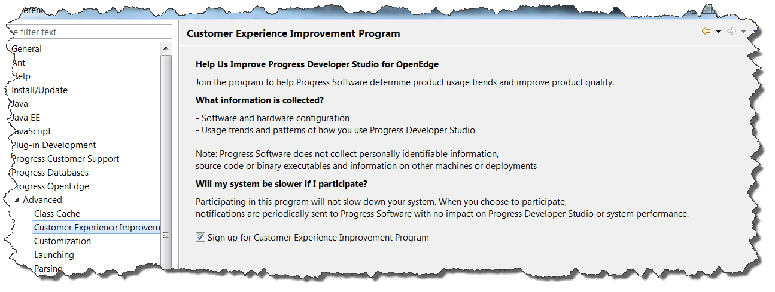
Customer Experience Improvement Program

Slide 36
For Telerik’s own use of Analytics on other Sites
(From http://www.telerik.com/company/privacy-policy)
In order to help us improve your experience with the Telerik Properties, we use Telerik Analytics to monitor and identify trends and usage statistics. Telerik Analytics may collect certain information during a Product download, during a Product installation or update, while you are using certain Products and/or SaaS Products, Product demos, or applications on our Sites, and while you are using the Services. Such information may include, without limitation, how often different features are used, how often different buttons and menu items are clicked, execution time for different operations, error reports, download location, software version, platform information, application/Product usage, features usage, exception tracking, OS information, and Product and SaaS Product logs. The information will be transmitted to and stored by Telerik and its service providers on its and their servers. Telerik does not use Telerik Analytics to collect any information which personally identifies you. The collection of this non-personally identifiable information will cease once your use of the Telerik Properties has ceased. However, the information collected may be retained, accessed, and used by Telerik as long as necessary for the purposes described herein.
For more information on Telerik Analytics, please visit: http://www.telerik.com/analytics

Slide 37
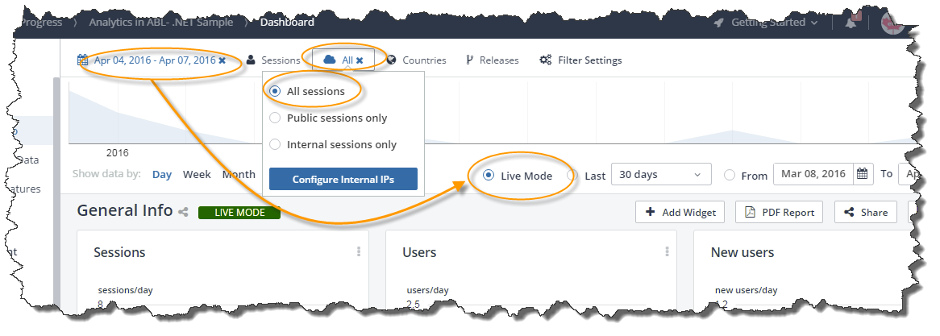
Some Gotchas
Here are some common issues people have when they first use it.
Seeing “live” data:
  Normally, you see data that is collated overnight.
  To see live data
  There is still a 5 minute delay.
Check for ALL Sessions
  In testing you might not be using Public IP Addresses.
  Set this for All Sessions

Slide 38
Gotcha’s: Go “Live” and See “All”

Slide 39
How can you try Analytics?

Slide 40
Modernization – Two questions
How to modernize?
PUG Challenge 2016 hopefully has provided you with many good suggestions and shared experience.
What to modernize?
Everything?
      Probably quite expensive…
Which parts then?
      Use Telerik Analytics to measure what is most used
Start with those parts

Slide 41
For those developing in ABL….
Telerik Platform Mobile apps can be instrumented.
You can get Java and .NET clients (for Open Client apps)
We currently support OE/ABL GUI with Analytics (.NET SDK)
Any Web Application (JavaScript) with OpenEdge backend:
  WebSpeed
  PASOE / WebSpeed or REST Adapters
  Your own Servlet/JSP
  Your own ASP.NET
Talk to your Sales Rep for Evaluation

Slide 42
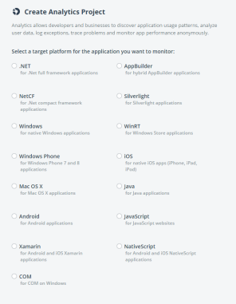
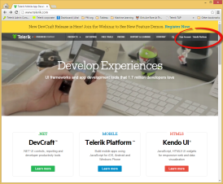
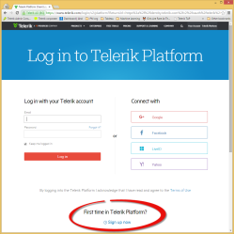
For those developing in ABL (.NET), Java, C#, JavaScript, etc.
Go to www.telerik.com
Click Telerik Platform
Mobile only: Sign up to a free trail
Other SDKs: simply write to sales@telerik.com and ask for a Telerik Analytics trial account
This page subject to change
Pricing and Evaluation are being revised for OpenEdge

Slide 43
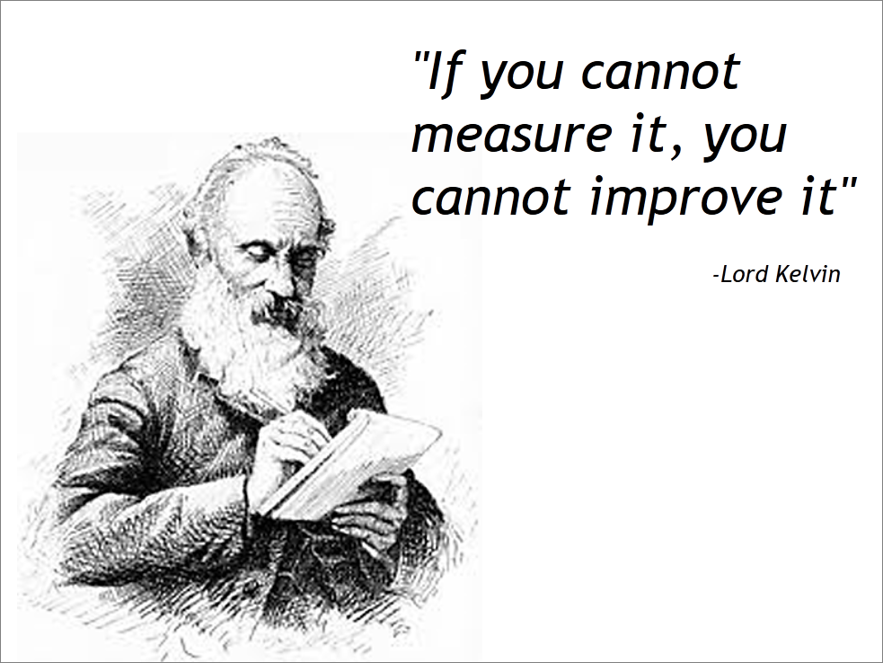

Slide 45
BACKUP SLIDES: HIDDEN
(will be removed before PUG)

Slide 46
What is Analytics?

Slide 47
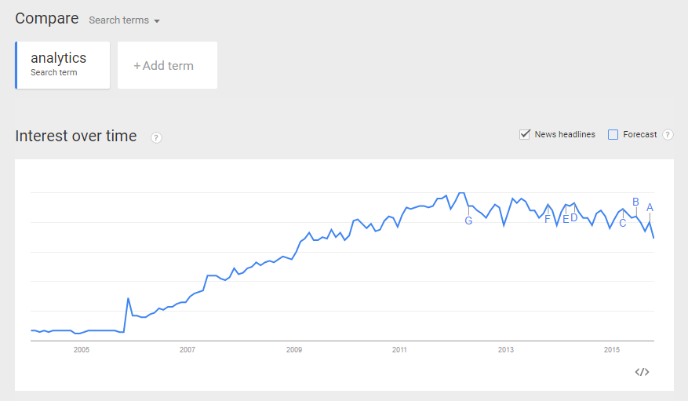
Google Trends data

Slide 48
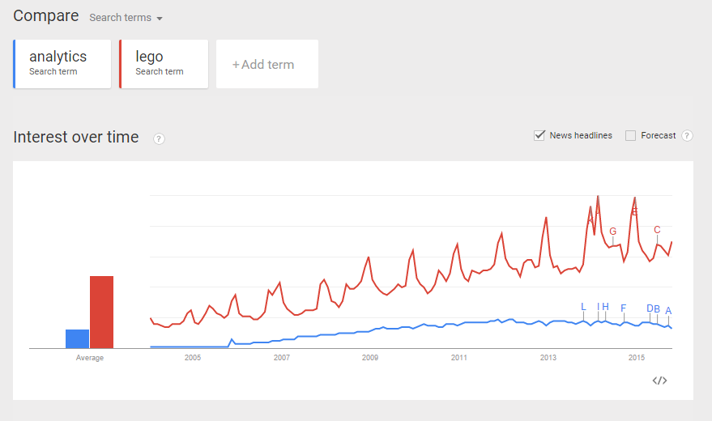

Google Trends data continued

Slide 49
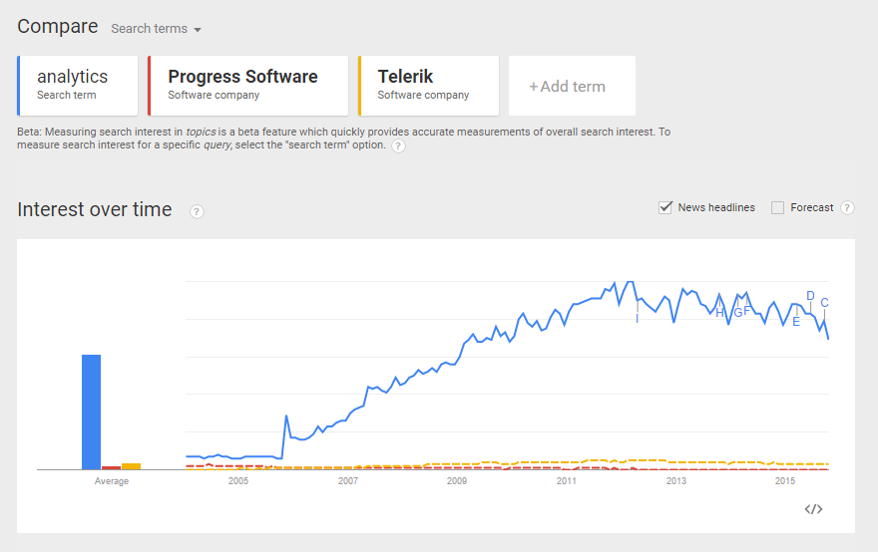
Google Trends data continued

Slide 50
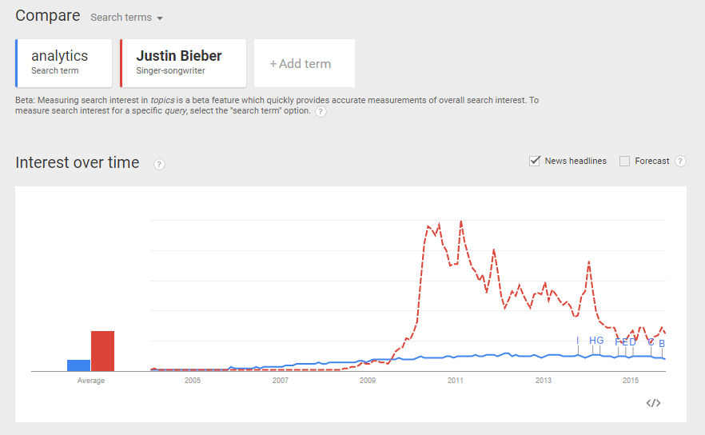

Google Trends data continued

Slide 51
The History of Telerik Analytics
What are “Application Analytics”?

Slide 52
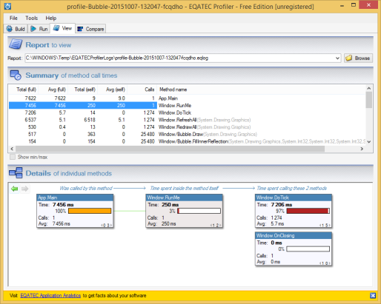
EQATEC: our problem back in 2008
Did our users like the product?
Limited information sources:
Support questions
The occasional “fan” email
Basically we knew nothing – so what to do?

Slide 53
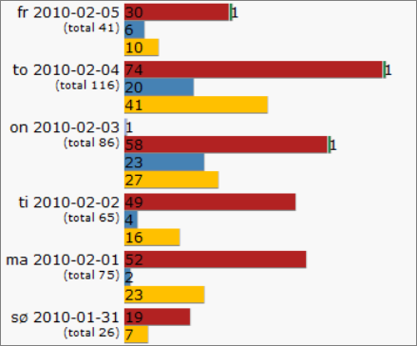
2008: application analytics v. 0.1
Red: usage (app execution)
Blue: downloads
Yellow: registrations
“F5 addictiveness”
Little information but much better than nothing

Slide 54
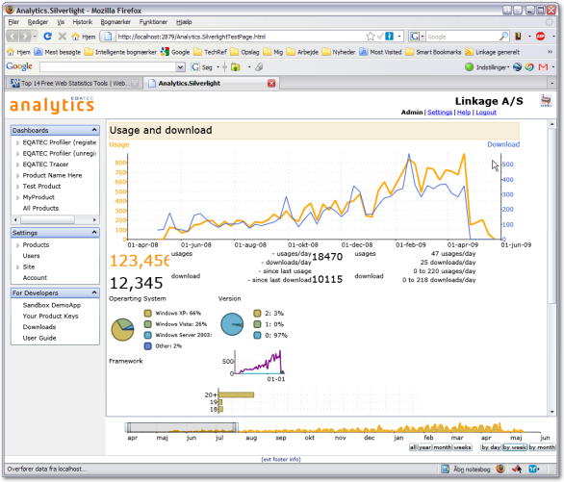
2009: A new analytics market?
Nov 2005: Google Analytics
Very few did application analytics for thick clients
So we decided to fill the gap

Slide 55


Feb 2013 – Telerik acquires EQATEC

Slide 56
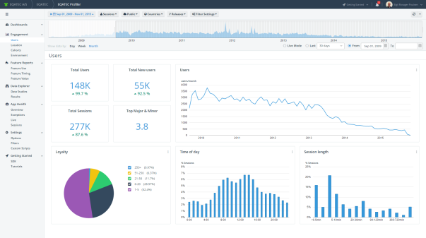
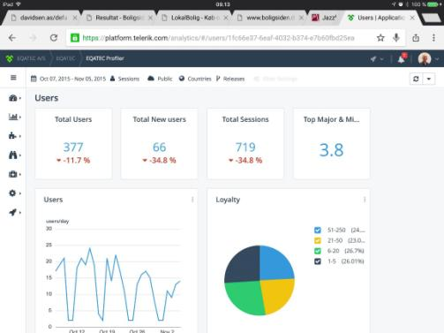
2015: Telerik Analytics today
HTML5
Kendo UI controls

Slide 57
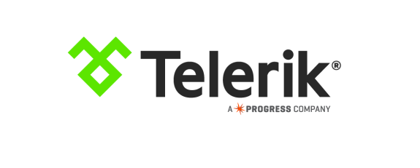

December 2014 – Progress acquires Telerik

Slide 58
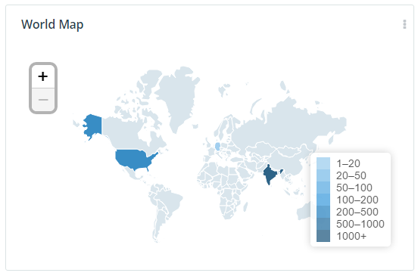
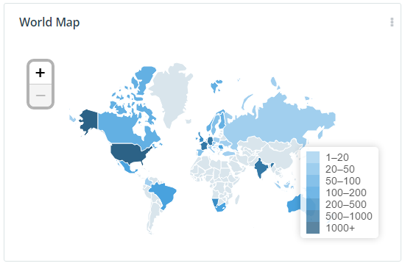
PDSOE & Telerik Analytics
May 2015
October 2015

Slide 59
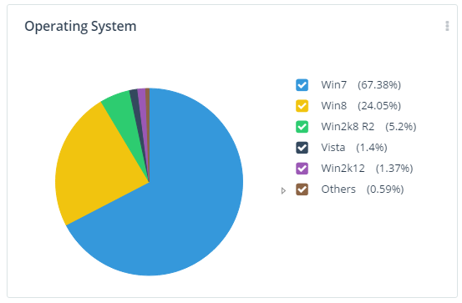
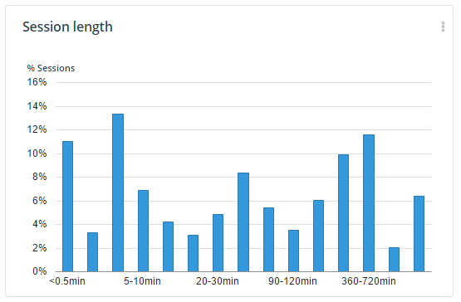
PDSOE & Telerik Analytics

Slide 60
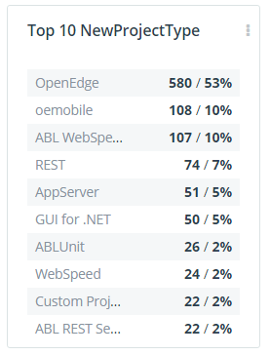
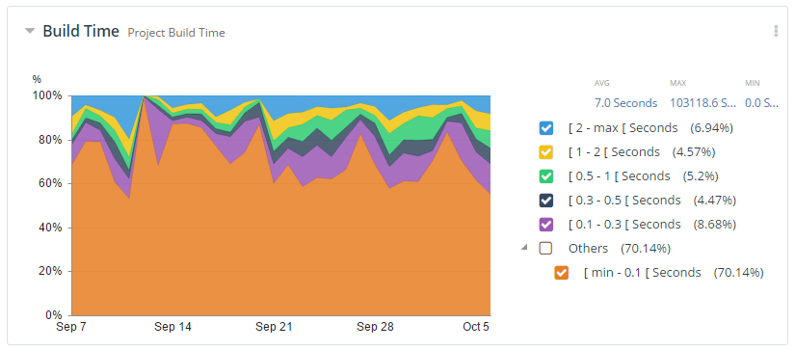
PDSOE & Telerik Analytics

Slide 61
For Example, OEDK Classroom has this in the EULA
7. Feedback / Data Usage.
a. While You are not required to do so, You may from time to time provide feedback to PSC with regard to the functionality and performance of the Software and/or Program Materials including, without limitation, identifying potential errors and improvements (“Feedback”). Feedback You provide may be used by PSC to improve or enhance the Software and/or Program Materials, and You hereby grant PSC a non-exclusive, perpetual, irrevocable, royalty-free, worldwide right and license to use, reproduce, disclose, sublicense, modify, make, have made, distribute, sell, offer for sale, display, perform, create derivative works, permit distribution and otherwise exploit such Feedback without restriction.
b. The Software may use tools to identify trends and bugs, collect activation information, usage statistics and track other data related to Your use of the Software, and send that to PSC. PSC may use this information to provide services and to improve its products and services, in accordance with PSC’s Privacy Policy located at http://www.progress.com/privacy. Your use of the Software operates as Your consent to these practices.
NOTE: this not only covers “automatic” usage collection, but invites the user to casually shared feedback with us ‘from time to time’. (Perhaps over tea and biscuits)

