Slide 1
Why Progress Application Server for OpenEdge?
Roy Ellis
ellis@progress.com

Slide 2
Agenda
Introduction
Architecture
Configuration
Administration
Migration
New in 11.6
Why PASOE?

Slide 3

PASOE is different from the Classic Application Server!
Text goes here
Notes:
This slide can have any image that explains that PASOE is different from Classic AppServer.
Many of the problems we have handled with early adopters is people thinking, “I did it this way in Classic AppServer so it should work the same way in PASOE”.

Slide 4
Introduction to PAS Platform

Slide 5





Progress Application Server Platform
A single delivery platform for all Progress Web-based products
A standard deployment for web applications
Architected for secure operation
  Spring Security Framework included

Slide 6
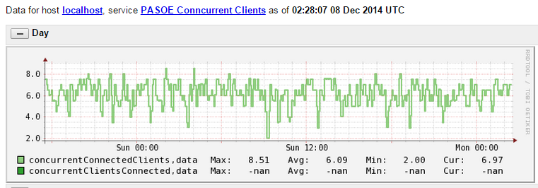
Progress Application Server Platform
Easy management
  Common set of enhanced management tools
  No Tomcat knowledge necessary
Open monitoring
  JMX console/scripting
  Use any third party Tomcat monitoring tools

Slide 7
Architecture

Slide 8
Architectural Drivers
Security
  Spring Security
  Production license
Simplicity
  Administration, scalability, application migration, deployment
  AppServer connection and operating STATEs
Better monitoring and management
  Built-in metrics gathering, current state queries
Performance
  Runs same ABL application and client load with less memory and CPU
WebSpeed
  Runs classic code but also new OOABL WebHandler

Slide 9
Architecture: Components
Classic AppServer Components
PAS for OpenEdge Components
Client
AIA WSA
WebSpeed
REST/Mobile
Client
AdminServer
PAS for OpenEdge
NameServer
APSV (AIA)
SOAP (WSA)
REST/Mobile
WebSpeed
AppServer
Session Manager
Agent
(1 ABL Session)
MSAgent
Agent
(1 ABL Session)
Agent
(1 ABL Session)
Agent
(1 ABL Session)
1 ABL Session
ABL Sessions
1 ABL Session
1 ABL Session
1 ABL Session
1 ABL Session
Notes:
CLASSIC
Must have an AdminServer
- AdminServer starts NameServer and AppServer
- then the AdminServer is just used to monitor and manage
Client connects to NameServer (optional) and is then redirected to the AppServer
If the Client needs to connect through the internet (HTTP/HTTPS)
- you must install and configure separate and distinct adapters AIA/WSA/REST/Mobile
PAS for OE
Start the PAS for OE instance
Client connects using HTTP/HTTPS always
+ AdminServer is not necessary (except for running OEMgmt on the same machine or publishing)
+ There is NO NameServer (load balancing and fault tolerance are handled another way)

Slide 10
Architecture: Session Models
Classic Appserver | PAS for OpenEdge
AppServer sets connection state State-aware, State-reset, Stateless State-free | PAS for OE has no connection state
Client must connect to AppServer with expected state | Client controls ABL session model via CONNECT –sessionModel Stateful: -sessionModel Session-Managed Statefree: -sessionModel Session-Free

Slide 11
Architecture: Sample
Classic AppServer Components
PAS for OpenEdge Components
Client
AIA WSA
WebSpeed
REST/Mobile
Client
AdminServer
NameServer
PAS for OpenEdge
APSV (AIA)
SOAP (WSA)
REST/Mobile
WebSpeed
State-Aware
Stateless
State-Free
Rest/Mobile
AppServer
AppServer
AppServer
Session Manager
50 Agents
50 Agents
50 Agents
MSAgent
Agent
(1 ABL Session)
Agent
(1 ABL Session)
Agent
(1 ABL Session)
Agent
(1 ABL Session)
Agent
(1 ABL Session)
Agent
(1 ABL Session)
Agent
(1 ABL Session)
Agent
(1 ABL Session)
Agent
(1 ABL Session)
150 ABL Sessions
1 ABL Session
1 ABL Session
1 ABL Session
1 ABL Session
Notes:
CLASSIC
Must have an AdminServer
- AdminServer starts NameServer and AppServer
- then the AdminServer is just used to monitor and manage
Client connects to NameServer (optional) and is then redirected to the AppServer
If the Client needs to connect through the internet (HTTP/HTTPS)
- you must install and configure separate and distinct adapters AIA/WSA/REST/Mobile
PAS for OE
Start the PAS for OE instance
Client connects using HTTP/HTTPS always
+ AdminServer is not necessary (except for running OEMgmt on the same machine or publishing)
+ There is NO NameServer (load balancing and fault tolerance are handled another way)

Slide 12
Architecture: Multi-Session Agent
Multiple client requests at the same time
Supports both Session-Managed and Session-Free request simultaneously
Manages database shared memory connections
Uses much less system resources
Handles multiple times more transactions than the single session AppServer agents

Slide 13
RDBMS Self-service Connections
 | PAS for OpenEdge
 | One connection per DB per Agent process: shared by all ABL SESSIONs
 | Connected on 1st SESSION startup or CONNECT statement
 | Disconnected when last SESSION shuts down or last DISCONNECT
 | PROMON shows one connection per SESSION + 1 Agent (admin) SESSION
 | PROMON disconnects ALL SESSIONs when Agent (admin) SESSION disconnected

Slide 14
PROMON - RDBMS Self-service Connections
User Control: by user number for all tenants
Usr:Ten Name Domain Type Wait Table:Part Dbkey Trans PID Sem Srv Login Time
0 root 0 BROK -- 0 0 0 8068 0 0 04/01/15 19:14
5 root -4 SELF/PASA -- 0 0 0 9596 2 0 04/01/15 19:19
6 root 0 SELF/PASN -- 6 1412160 0 9596 3 0 04/01/15 19:19
7 root 0 SELF/PASN -- 6 924864 0 9596 3 0 04/01/15 19:19
8 root -4 SELF/PASN -- 0 0 0 9596 4 0 04/01/15 19:19
9 root -4 SELF/PASN -- 6 030912 0 9596 4 0 04/01/15 19:19
10 root -4 SELF/PASN -- 6 1427776 0 9596 5 0 04/01/15 19:19
11 root 0 MON -- 0 0 0 1359 5 0 04/02/15 15:10
Notes:
This is a promon output from a database with PASOE connected in shared memory.

Slide 15
PROMON - RDBMS Self-service Connections
User Control: by user number for all tenants
Usr:Ten Name Domain Type Wait Table:Part Dbkey Trans PID Sem Srv Login Time
0 root 0 BROK -- 0 0 0 8068 0 0 04/01/15 19:14
5 root -4 SELF/PASA -- 0 0 0 9596 2 0 04/01/15 19:19
6 root 0 SELF/PASN -- 6 1412160 0 9596 3 0 04/01/15 19:19
7 root 0 SELF/PASN -- 6 924864 0 9596 3 0 04/01/15 19:19
8 root -4 SELF/PASN -- 0 0 0 9596 4 0 04/01/15 19:19
9 root -4 SELF/PASN -- 6 030912 0 9596 4 0 04/01/15 19:19
10 root -4 SELF/PASN -- 6 1427776 0 9596 5 0 04/01/15 19:19
11 root 0 MON -- 0 0 0 1359 5 0 04/02/15 15:10
Notes:
This shows the PASOE administrator user logged into the database.

Slide 16
PROMON - RDBMS Self-service Connections
User Control: by user number for all tenants
Usr:Ten Name Domain Type Wait Table:Part Dbkey Trans PID Sem Srv Login Time
0 root 0 BROK -- 0 0 0 8068 0 0 04/01/15 19:14
5 root -4 SELF/PASA -- 0 0 0 9596 2 0 04/01/15 19:19
6 root 0 SELF/PASN -- 6 1412160 0 9596 3 0 04/01/15 19:19
7 root 0 SELF/PASN -- 6 924864 0 9596 3 0 04/01/15 19:19
8 root -4 SELF/PASN -- 0 0 0 9596 4 0 04/01/15 19:19
9 root -4 SELF/PASN -- 6 030912 0 9596 4 0 04/01/15 19:19
10 root -4 SELF/PASN -- 6 1427776 0 9596 5 0 04/01/15 19:19
11 root 0 MON -- 0 0 0 1359 5 0 04/02/15 15:10
Notes:
This shows the sessions logged into the database.
Big point, if you disconnect the administrator user, all the sessions will also disconnect. So if the agent has 200 sessions and you inadvertently disconnect the administrator, 200 clients will be disconnected.
Be Careful!

Slide 17
PAS for OpenEdge Production versus Development Products
PAS for OE Development | PAS for OE Production
Can compile code | Cannot compile code
Non-secure configuration | Secure configuration
Test server instance in $WRKDIR | No test server instances
Remote administration included Tomcat remote admin enabled OpenEdge remote admin enabled | Remote administration optional Tomcat remote admin optional OpenEdge remote admin optional
Built-in oeabl web application (ROOT) All transport deployed and enabled | Built-in oeabl web application (ROOT) All transports deployed but disabled
Restricted: 5 concurrent requests and 1 agent | Unrestricted: concurrent requests and agents
defaultHandler= OpenEdge.Web.CompatiblityWebHandler | defaultHandler= OpenEdge.Web.DefaultWebHandler

Slide 18
Architecture: NameServer and AdminServer
There is _NO_ NameServer with PAS for OpenEdge
  Load balancing will be handled _before_ the PAS for OpenEdge instance
  Any HTTP/HTTPS load balancing product should work
The AdminServer is _NOT_ required to manage PAS for OE unless:
  you want to PUBLISH from Developer’s Studio (PDSOE)
  you want to manage PAS for OpenEdge using OpenEdge Explorer
  you want to monitor PAS for OpenEdge using OpenEdge Management

Slide 19
PAS for OpenEdge Configuration

Slide 20
Configuration
Create a new PAS for OpenEdge instance
  In the Classic AppServer you created a new AppServer by adding a definition in the ubroker.properties file
  With PAS for OpenEdge you create an working instance of the “read-only” instance in $DLC/servers/pasoe in a new location
$DLC/servers/pasoe/bin/tcman.sh create /psc/115/wrk/oepas1
Start the new PAS for OpenEdge instance
  <pas_instance>/bin/tcman.sh start

Slide 21
Configuration: PAS for OpenEdge at Instance Create and Run-time
$DLC/servers/pasoe
$WRKDIR/oepas1
OS Process
PAS for OE (template)
PAS for OE Instance
PAS for OE Process
lib
bin
*.sh
conf
webapps
common/lib
openedge
extras
*.sh
conf
logs
temp
work
webapps
openedge
lib
bin
*.sh
conf
logs
temp
work
webapps
common/lib
openedge
Copy & tailor
Full copy
( ROOT [ *.war ] )
Full copy
tcman create
tcman start
( CATALINA_HOME )
( CATALINA_BASE )

Slide 22
PAS for OpenEdge Adminstration

Slide 23
Administration: tcman.sh/.bat
TCMAN is your all-in-one administration tool
  tcman extends all Tomcat administration and enables PAS for OE administration
For help with TCMAN: tcman.sh/.bat help
tcman.sh/.bat help action
Server actions
  create
  start
  clean
  feature (on/off)
  plist
Manager actions
  deploy
  enable
  delete
  stop
  clean –A
  env
  config
  undeploy web apps
  disable web apps

Slide 24
Administration: More Command Line Tools…
deployREST.sh(.bat)
  deployREST.sh(bat) <paar-file> <appname>
deploySOAP.sh (.bat)
  deploySOAP.sh(.bat) <wsm-file> <appname>
oeprop.sh (.bat)
  oeprop.sh (.bat) oepas1.ROOT.SOAP.wsaUrl=http://localhost:8888/soap
  oeprop.sh (.bat) +AppServer.Agent.oepas1.PROPATH=.,${WRKDIR}
  oeprop.sh (.bat) ~ AppServer.SessMgr.agentStartupParam="-db sports“
$DLC/bin/pasman(.bat)
  Calls $DLC/servers/pasoe/bin/tcman.sh(.bat)
  Use –I <alias> if running for a specific instance
  Easy location for scripting

Slide 25
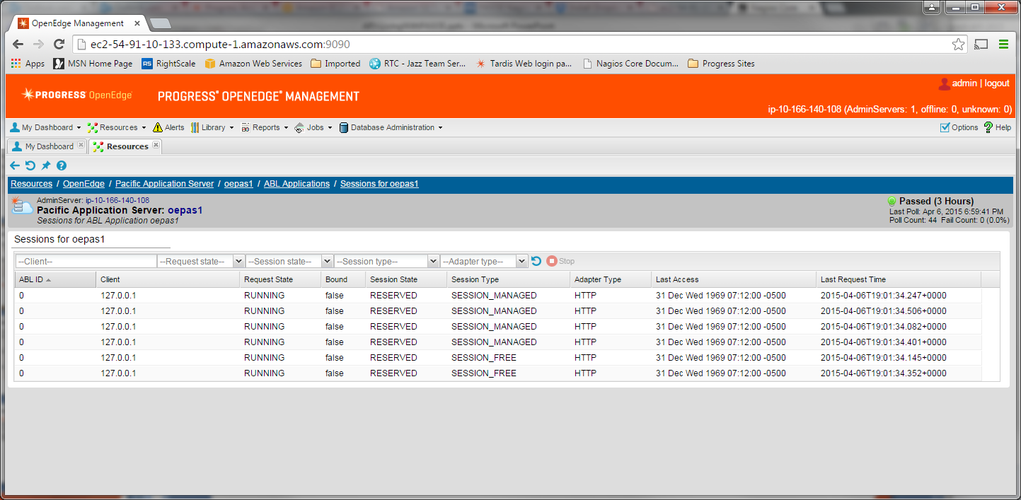
Administration: OpenEdge Explorer and Management
OpenEdge Explorer
  For full management AdminServer must be local
OpenEdge Management
  For full management AdminServer must be local
  Can monitor and alert
  But trending is not available yet

Slide 26
Administration: Where do I find my config and log files?
PAS for OE’s DLC & WRKDIR environment variable definition | $CATALINA_BASE/bin/openedge_setenv.sh
Application’s environment variable definitions | $CATALINA_BASE/bin/<app-name>_setenv.sh
PAS for OE installation path environment variable definition PAS for OE instance’s path environment variable definition | $CATALINA_BASE/bin/{tcman|startup|shutdown|configtest|version}.sh
PAS for OE configuration properties | $CATALINA_BASE/conf/appserver.properties $CATALINA_BASE/conf/catalina.properties $CATALINA_BASE/conf/jvm.properties
Optional deployment files (web applications & other files) | $CATALINA_HOME/extras
PAS for OE & web application log files | $CATALINA_BASE/logs
PAS logging configuration | $CATALINA_BASE/conf/logging.xml (ref Tomcat logging)
PAS for OE session manager & MSAgent logging configuration | $CATALINA_BASE/conf/openedge.properties
oeabl web application logging configuration | $CATALINA_BASE/ROOT/WEB-INF/logging.xml
oemanager remote admin web application loggin configuration | $CATALINA_BASE/oemanager/WEB-INF/logging.xml
Test user accounts and roles | $CATALINA_BASE/conf/tomcat-users.xml
PAS for OE instance registration list | $CATALINA_HOME/conf/instances.unix
JAVA_HOME & JSE_HOME environment variable definition | $CATALINA_BASE/bin/javacfg.sh

Slide 27
Administration: New Monitoring Access!
Classic AppServer tools
asbman –query
OpenEdge Explorer
OpenEdge Management
PAS for OpenEdge
Management REST API
  The “oemanager” application must be installed for access to the REST API
JMX access
  Using Jconsole
  Locally by PID
  Remotely - “tcman.sh/.bat feature JMXLifecycle=on”
Nagios
  3rd party tool recommended by Tomcat for monitoring
  Uses the tools above to monitor, alert and graph
OpenEdge Explorer and Management

Slide 28
PAS for OpenEdge Migration

Slide 29
Migration: Connect Method
REST/Mobile clients: URL still uses ../rest/..
SOAP clients: ../soap/.. instead of ../wsa/..
WebSpeed: ../web/.. Instead of ../cgi-bin/cgii.sh/..
OpenEdge clients URL connection format only
    -URL http://myhost:8810/(appname)/apsv
    No (appname) assumes ROOT -URL http://myhost:8810/apsv
Reference: Connecting to AppServers Using a URL
NOTE: Since all of the old web servlets are now encapsulated in PASOE we use these “transports” to identify the communication: rest, soap, apsv and web

Slide 30
Migration: Configuring and Using AppServer Event Procedures
agentStartupProc & agentShutdownProc
  Executes one time when starting / stopping an MSAgent OS process
PAS for OpenEdge renamed classic AppServer event procedures:
  srvrXxxxx → sessionXxxxx
sessionStartupProc & sessionShutdownProc
  Executes in PAS for OE when the MSAgent starts/stops each ABL SESSION
sessionConnectProc & sessionDisconnectProc
  Same as classic AppServer for all Session-Managed client connections
sessionActivateProc & sessionDeactivateProc
  Executed in classic AppServer on every Stateless & State-Free client request
  Follows traditional Stateless model

Slide 31
Migration: Session state
Some current ABL applications will require no session state changes
  State-free is the same as –sessionModel Session-free
  Stateless is the same as –sessionModel Session-managed (without changes)
However some ABL applications will require changes in the:
  sessionStartupProc & sessionShutdownProc
  While using the –sessionModel Session-managed
    State-Aware requires “binding a session” in PASOE
    State-Reset requires State-Aware and a QUIT in the shutdown to cleanup

Slide 32
New in 11.6

Slide 33
New in 11.6
  APSV
    Chunking
      Performance as fast as DirectConnect
      Faster than all other connections
    Session-Context support
      Cookies, JSESSIONID
      Enabling load balancing
    Load Balancing support
      Tested and documented
      Apache Proxy LB, Tomcat LB, and AWS ELB
    Multiple Applications in a single PASOE instance
      Ability to run different applications with different
        Environment Variables
        PROPATH

Slide 34
New in 11.6
  WebSpeed!
    Fully integrated into PASOE
      No messenger
      No separate broker or agent from AppServer
    Compatibility Mode
      Runs Classic WebSpeed code
      Small print:
        Doesn’t support Mapped Objects
        May need to modify iWebHandler for web-disp.p changes
    New WebHandler design
      OOABL OpenHTTP Classes
      JSON output
      Easily integrates with Kendo UI
    Better design for REST applications?

Slide 35
New in 11.6
  WebHandler Design
    Allows you to design you URL naming first and then write the ABL code
    Handler#=Class-to-run: /<reference-url>
    [oepas1.ROOT.WEB]
    handler1=handlers.HelloEmployees: /HelloEmployees
    handler2=handlers.ImageHandler: /image/updateimage/{custid}
    handler3=handlers.EmployeeHandler: /employee/{empid}

Slide 36
New in 11.6
OOABL
CLASS handlers.HelloEmployees INHERITS WebHandler:
METHOD OVERRIDE PROTECTED INTEGER HandleGet( INPUT poRequest AS OpenEdge.Web.IWebRequest ):
DEF VAR response AS WebResponse NO-UNDO.
DEF VAR writer AS WebResponseWriter NO-UNDO.

Slide 37
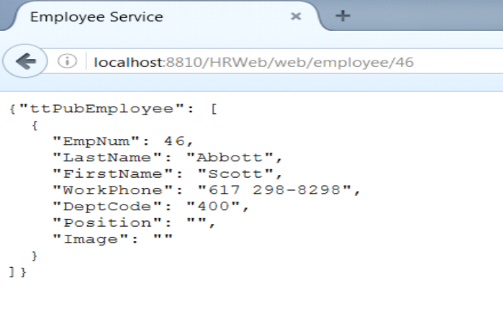
New in 11.6
JSON output

Slide 38
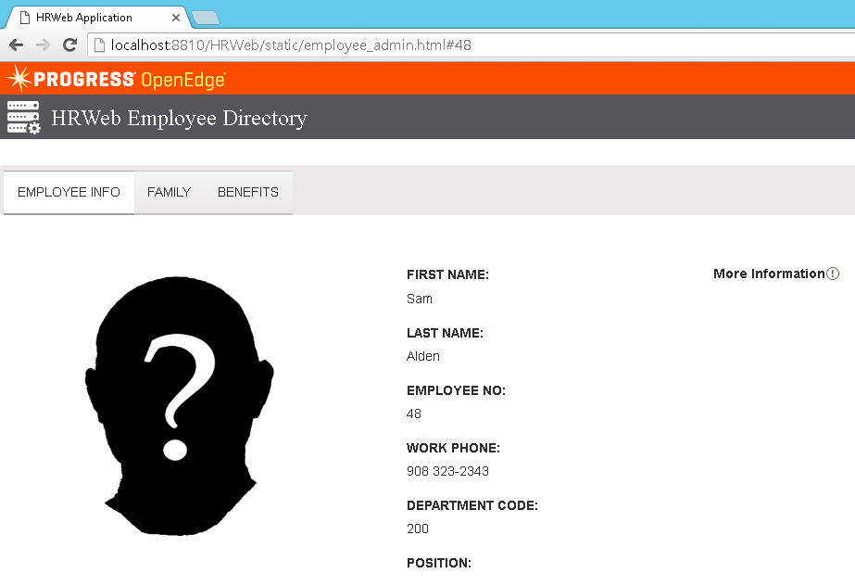
New in 11.6
Kendo UI

Slide 39
Performance and Scalability

Slide 40
Performance and Scalability Improvements
Multi-Session Agent
  Single process supports multiple, concurrent, ABL sessions
  Sessions share resources
  Manages shared memory connects
Session Manager integrated with Tomcat
  No separate Java processes for Ubroker, NameServer nor AdminServer (optional)
  Removes one network copy in stack
HTTP Chunking for APSV transport

Slide 41
Resource Sharing in Initial Release
Shared | Not Shared (yet)
Self-service OpenEdge database connections | Temp-tables / ProDatasets
Procedure libraries | Sockets (including SOAP and AppServer connections)
R-code | Network OpenEdge database connections
Promsg files | LBI & DBI files
OS threads | ABL session memory

Slide 42
Progress Application Server for OpenEdge - Performance
 |  | Classic | PAS for OE | Improvement
Scalability
 | Client connections | 221 | 1312 | 493%
Server Resources
 | CPU | 10 CPUs | 5.2 CPUs | 192%
 | Memory | 2.1 GB | 670 MB | 313%
 | Transactions | 203 tps | 1698 tps | 736%
Client performance
 | OpenEdge |  |  | YMMV
WebSpeed performance
 | Round trip |  |  | YMMV
Notes:
Linux OS
24 CPUs
8 GB memory
Shared memory database connections
ABL clients
ATM database test used for performance #s
Using Statefull ABL application model

Slide 43
Why PASOE?

Slide 44
Why PASOE?
Less Complex
Performance
  Less resources
Web Applications
WebSpeed
Notes:
Less Complex
easy to deploy and replicate
each instance is self contained, can include all of the configuration and code
Performance
less memory
less CPU
multi-session agent in shared-memory configuration very fast
Web Application
PASOE written for web applications
if you are moving to web applications you need PASOE
security designed for web applications
WebSpeed
New and improved!
Replacment for REST?

Slide 45
Q&A

