Slide 1
Have You Seen OpenEdge Management Lately?
Roy Ellis
ellis@progress.com

Slide 2
Agenda
Introduction
What is OpenEdge Management?
What is OpenEdge Explorer?
What’s Changed Lately?
Why OpenEdge Management?

Slide 3
Introduction
Notes:
Let’s start with a video. As you can see OpenEdge Management, which started out as Fathom Management, is so old it was in black and white! ;-)

Slide 4

Twilight Zone

Slide 5
Introduction
OpenEdge Management is now a teenager!
  Fathom 2.0A was released in 2002
  It was a separately installed product that had to be “glued” to Progress Version 9 or Version 10 install
  To support remote monitoring you had to stop both the Fathom Management process and the remote AdminServer and configure the remote install
  Fathom became OpenEdge Management in 10.2B
    OpenEdge Management now installed with all other OpenEdge products
    OpenEdge Explorer (a subset of Management) was added to replace Progress Explorer
  Release 11.2 OpenEdge Management transformation began

Slide 6
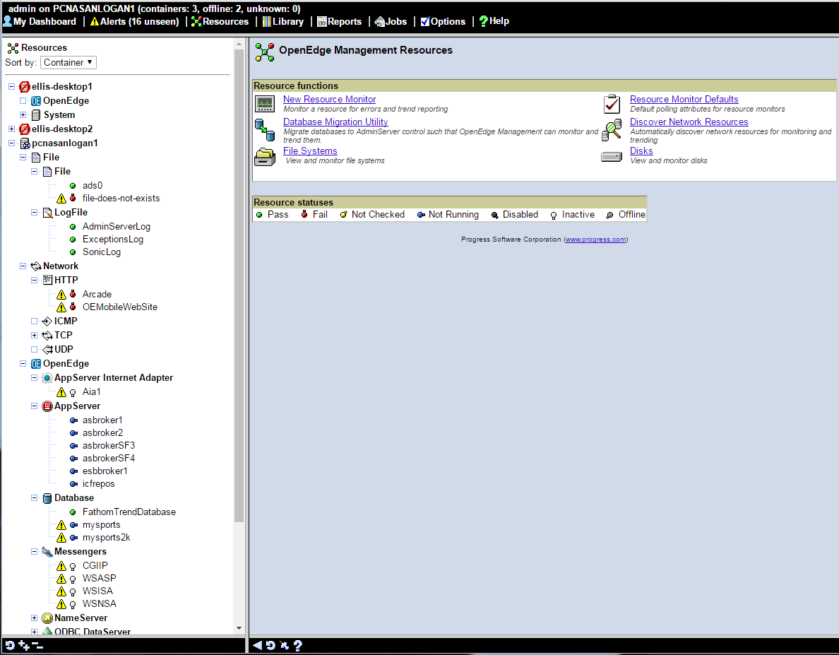
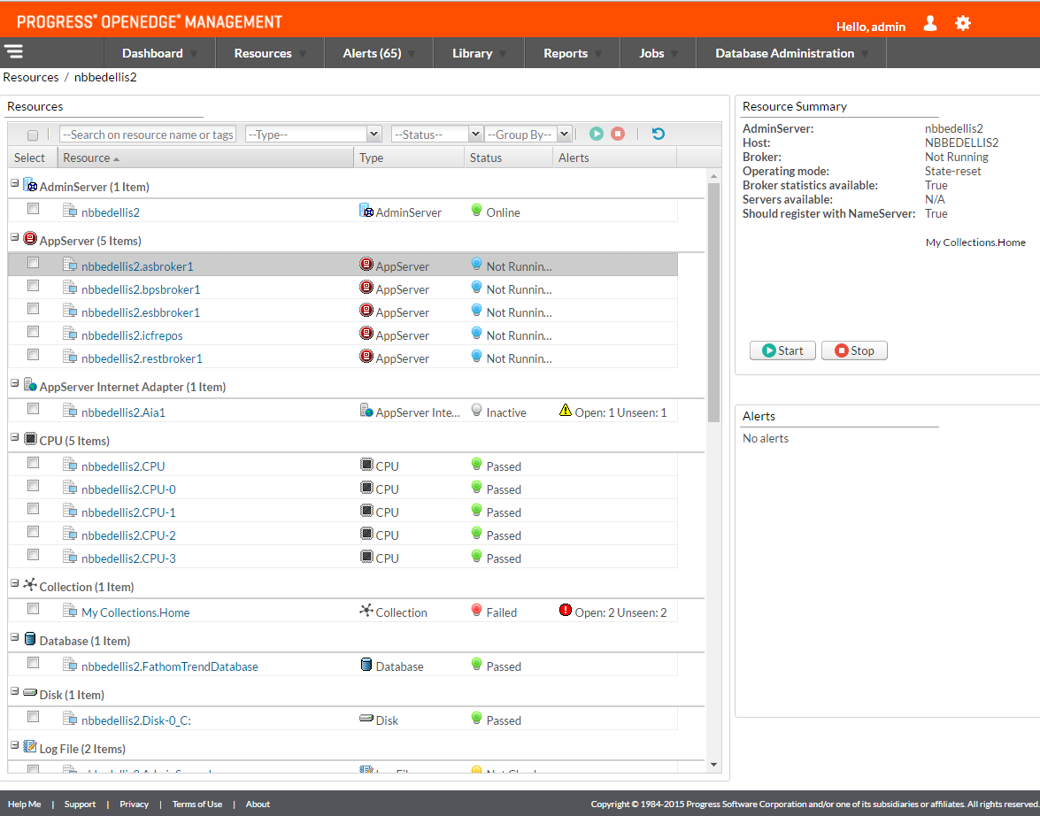
Introduction
OpenEdge Management changes over 14 years
Notes:
Fathom/OpenEdge Management started with html frames in the early millennium.
If this first picture is it’s baby picture then the next is it’s 8th grade graduation picture!

Slide 7
What is OpenEdge Management?
Notes:
Good time to ask:
Who has seen OpenEdge Management?
Any of you using OpenEdge Management now?
Who uses OpenEdge Explorer?

Slide 8
What is OpenEdge Management?
A web-based management and monitoring tool not only for all OpenEdge products but also system and network resources.
It provides visibility, analysis and proactive monitoring for your OpenEdge Application
Auto-detects all OpenEdge components and system resources
Manages and monitors local and remote resources
Collects data for detailed problem analysis and proactive planning
It is a key component to high availability.

Slide 9
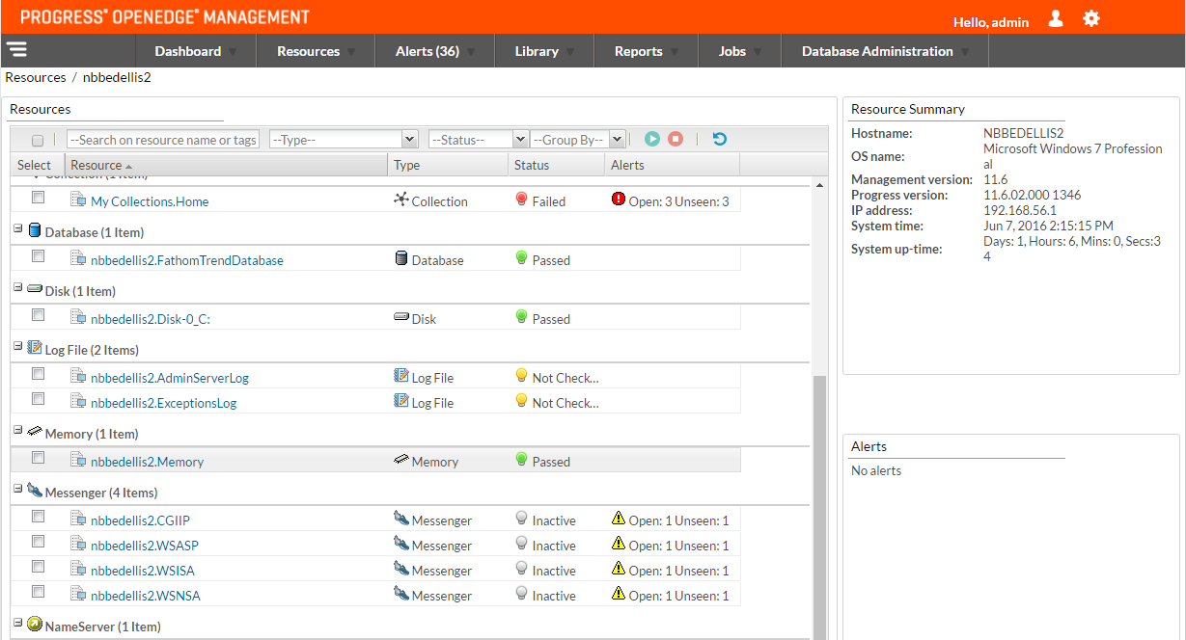
Resources
Resources are anything you can monitor
  OpenEdge
    AdminServer, AppServers, AppServer Internet Adapter, Databases, Messenger, NameServer, PAS for OpenEdge, Rest Web Server, SonicMQ Adapter, WSA, WebSpeed
  System
    CPU, Disk, Log File, Memory, Network
  Auto-detect and configuration

Slide 10
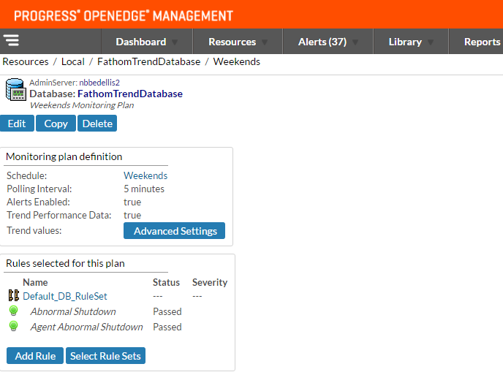
Monitor and Rules
Monitors do just that
  Monitoring Plans
Rules
  Rules test a limit
  If limit is exceeded an alert is set
  Rule Sets make adding common rules easy

Slide 11
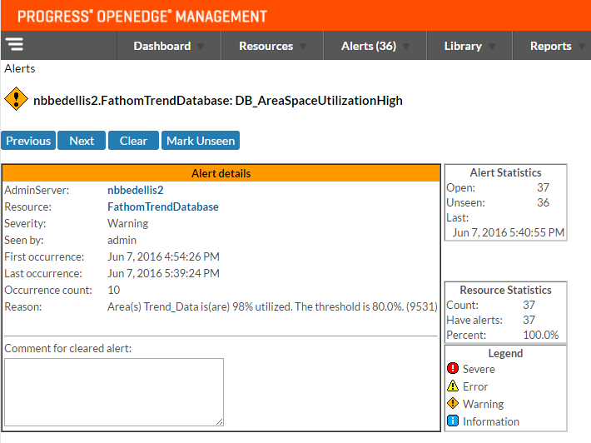
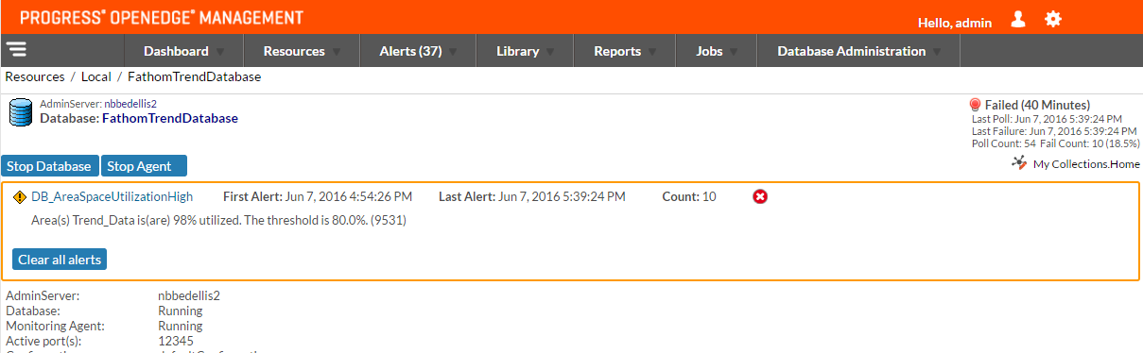
Alerts
Alerts fire whenever a rule limit is exceeded
Alerts show on: Resource, Alert and Dashboard pages
Alerts can send: email, SMS text, pager
Alerts can run any job, add to a log, and send SNMP Traps

Slide 12
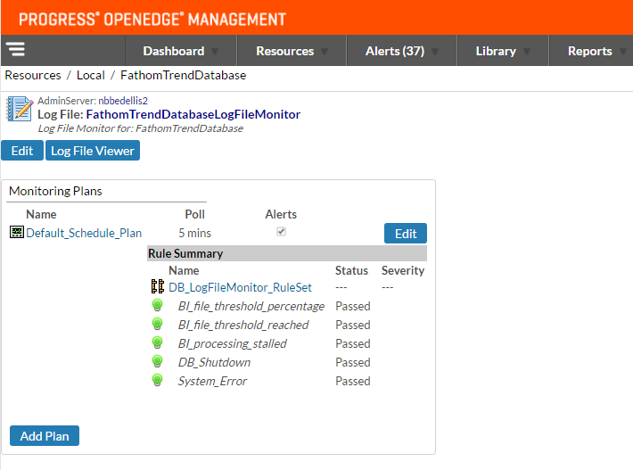
Log File Monitor
Log File Monitor
  Created automatically for all OpenEdge Resources
  Default Rule Sets
  Can define custom log file monitoring expressions and rules

Slide 13
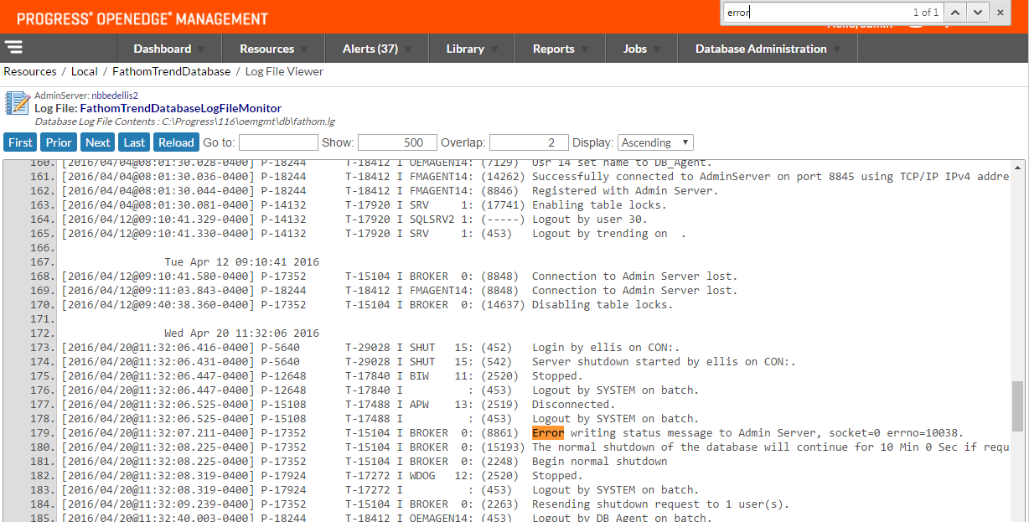
Log File Viewer
Log File Viewer
  For all Log Files Monitored
  Can view the log files by: first, last, prior, go to line number
  Can search using browser FIND

Slide 14
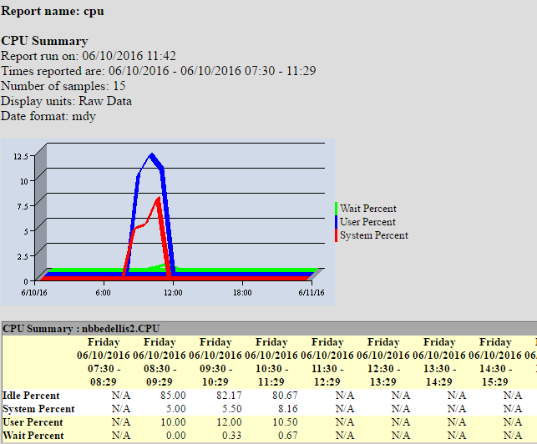
Trending
By default all monitored resources are trended
  Saved to an OpenEdge Database
Report templates are included
Reports are ABL code and source is also included
Trending allows you to review the past to plan the future
Schedule reports or Run Now

Slide 15
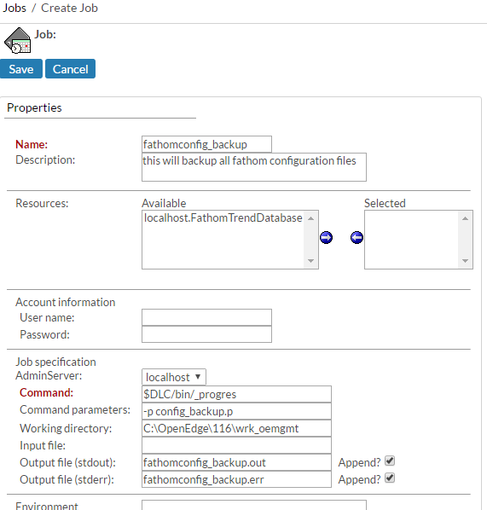
Jobs
Run any job
Schedule the job
Throw an alert if the job fails
Run a job as an action on an alert

Slide 16
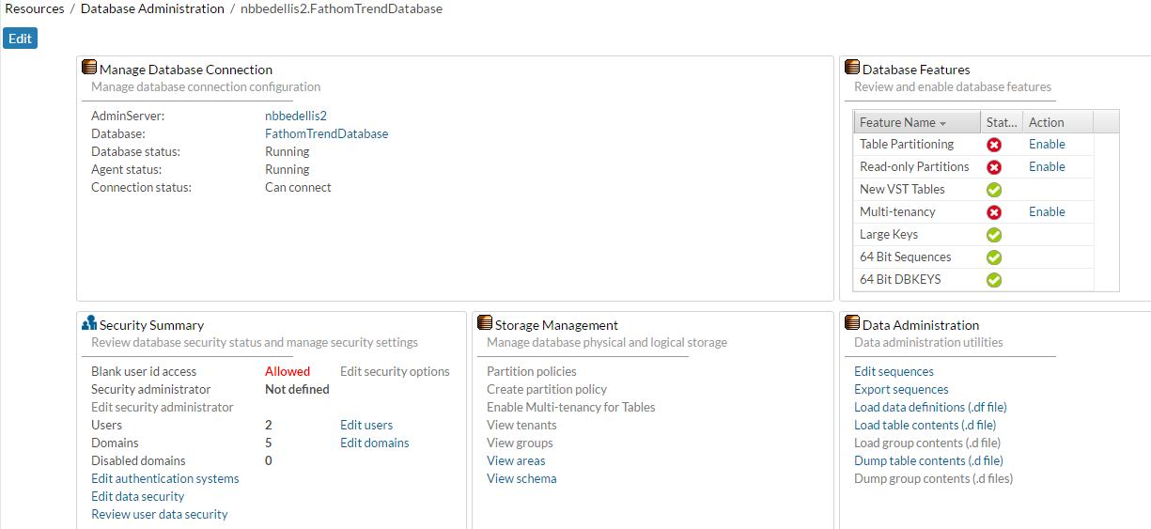
Database Administration Console

Slide 17
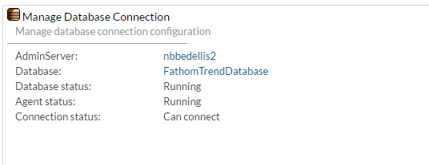
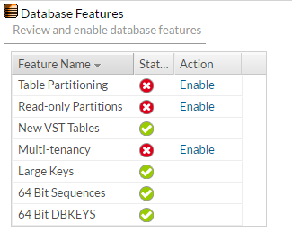
Database Administration Console
Notes:
Manage Database Connection – does just that, how to connect to the database with what userid
Database Features – no only shows you enabled features but allows you to enable them

Slide 18
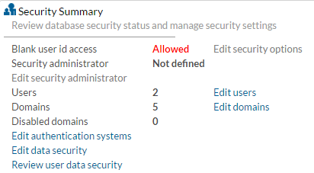
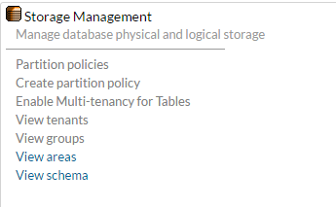
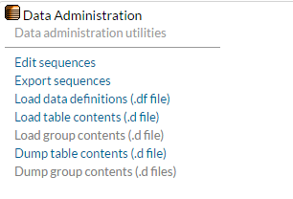
Database Administration Console
Notes:
Security Summary – again gives you quick information but allows you to configure users, domains and authentication
Storage Management – allows you to modify Partitions, Multi-tenancy, tenants, groups, areas, schema
Data Administration – has many tools only available through the ABL before being OpenEdge Management

Slide 19
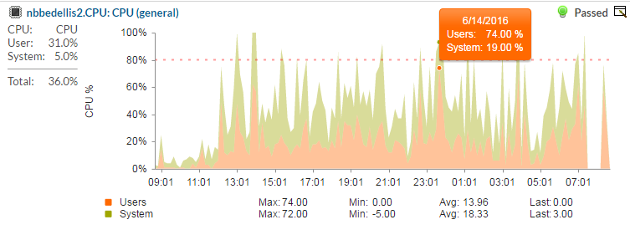
Graphs
Notes:
Graphs allow for quick overviews of resources. Hovering over a section of the graph returns actual data.

Slide 20
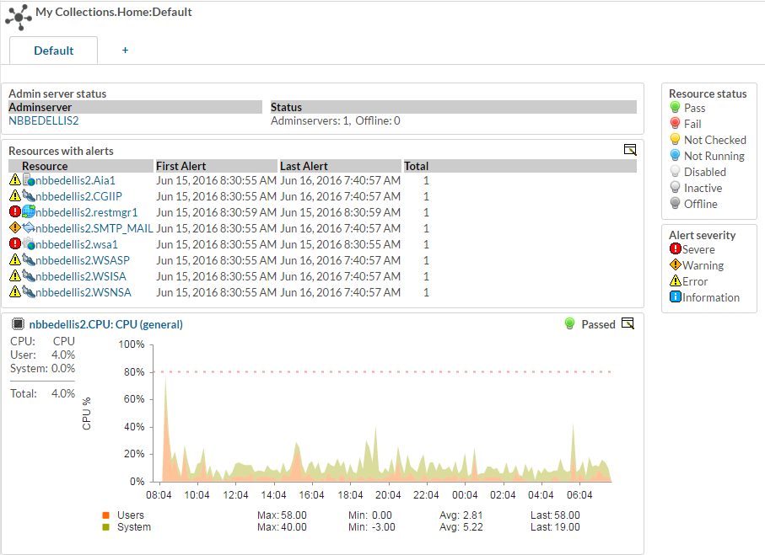
Collections
Notes:
Collections allow you to add any set of resources and alerts to a single dashboard. You can create several collections. With collections you can add all the components to an Application and get an overall status of your Application in a single glance.

Slide 21
What is OpenEdge Explorer?
Notes:
How many people are familiar with or using OpenEdge Explorer now?

Slide 22
What is OpenEdge Explorer?
It is a free Management and Configuration subset of OpenEdge Management
  Included with many products
    Databases, Developers Studio, AppServers, NameServer
  Allows web-based configuration of all OpenEdge products
  Allows web-based management of all OpenEdge products (start, stop, status)
  Includes the Database Administration Console
It does _NOT_ have
  Monitoring
  Alerting
  Jobs
  Scheduling
  Trending
  Graphs
  Collections

Slide 23
What’s Changed Lately?

Slide 24
What’s changed lately?
UI
  Better, cleaner, more modern
  New Resource Grid
  Kendo UI
  New options page
Bread crumbs
  a.k.a. Navigational links
Notes:
The most obvious change is the UI. It has really grown up lately, being more modern, cleaner and easier to navigate

Slide 25
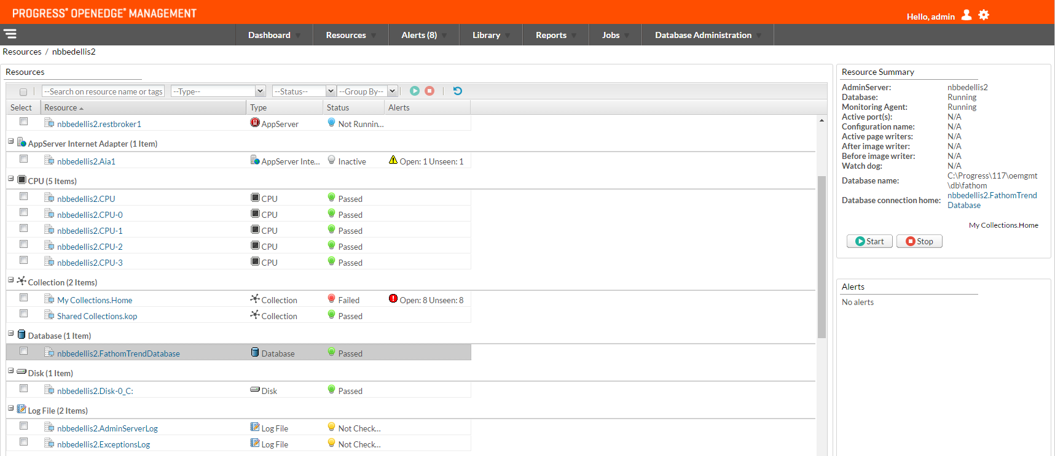
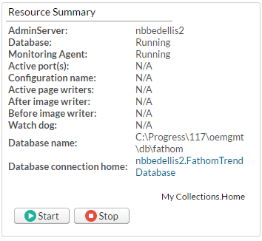
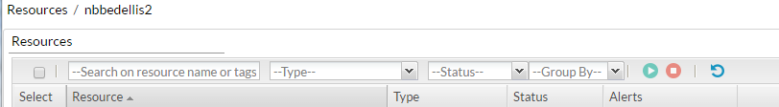
What’s changed lately?
New Resource Grid
Notes:
The New Resource Grid has many advantages
easily scroll through resources
easily group resources
start and stop multiple resources
start and stop a single resource from the summary page

Slide 26
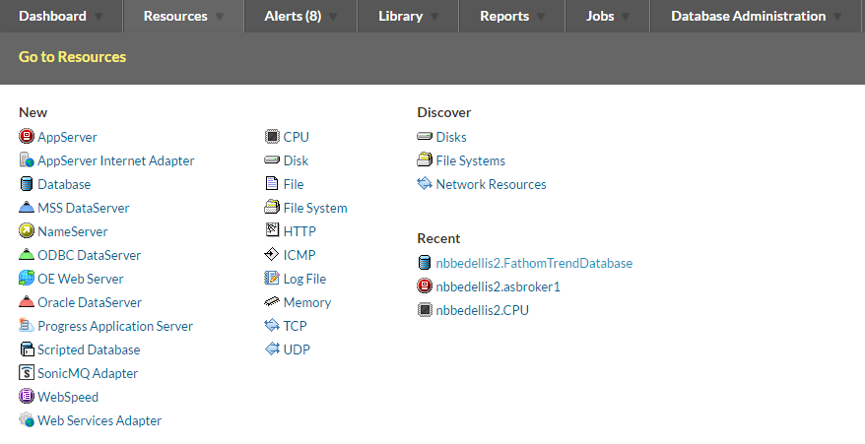
What’s changed lately?
Notes:
The tabs give more information
You can quickly add or discover new resources, but you also have a recently visited list for quicker navigation

Slide 27
What’s changed lately?
Security
  JaaS → Shiro
New OpenEdge Management configuration and graph databases
  PSEPro → orientDB
New Remote monitoring framework
  SonicMQ →ActiveMQ, Camel, Spring, Shiro
New SNMP
  SNMP Zoho Adapter → snm4j
New Graphing
  JavaGraphs → Kendo UI
Notes:
Security – more modern, simpler/cleaner login, dual authentication configuration (form-based + HTTP-basic), ability to timeout, ability to logout, user information encrypted with stronger salted hashes
New OE Management Configuration Database – designed to scale to billions of documents, lightweight, very popular with a large group of contributors
Remote Montioring – old SonicMQ was very heavy weight and complex. To set up remote monitoring you had to stop both OE Mgmt and the remote AdminServer, disrupting your Application.
ActiveMQ – provides reliable, secure, authenticated connections and reliable async messaging
Camel – allows addressable services using camel routes and RPC over JMS
Spring – provides hosting and is required for Camel
Shiro – security
SNMP – new package supports version 3 SNMP
Graphing – with Kendo UI graphing, much lighter, more dynamic, more configurable

Slide 28
What’s changed lately?
Data Administration Console
  Multi-tenancy
  Table partitioning
  Dump and load of tables and schema
  Security Administration
  datadmin.pl (yes you can re-use or change)
  (In 11.7 Change Data Capture)

Slide 29
What’s changed lately?
REST API
  Help built-in
  http://hostname:port/oem/api
key: "localhost:resource.database.local.FathomTrendDatabase",
status:
{statusSeverity: "6",
status: 5,
description: "",
formattedDisplayName: "nbbedellis2.FathomTrendDatabase",
enabled: true,
detailUrl: "/database/dbinsthome.jsp?key=localhost:resource.database.local.FathomTrendDatabase",
editUrl: "/database/dbproperties.jsp?key=localhost:resource.database.local.FathomTrendDatabase",
container: "nbbedellis2",
resrc_Type: "DATABASE",
alerts:
{worseCaseSeverity: -1,
worseCaseSeverityIcon: "/images/propgood.gif",
totalCount: 0,
unseenCount: 0
Notes:
With a small amount of work you can get almost all the information OpenEdge Management uses

Slide 30
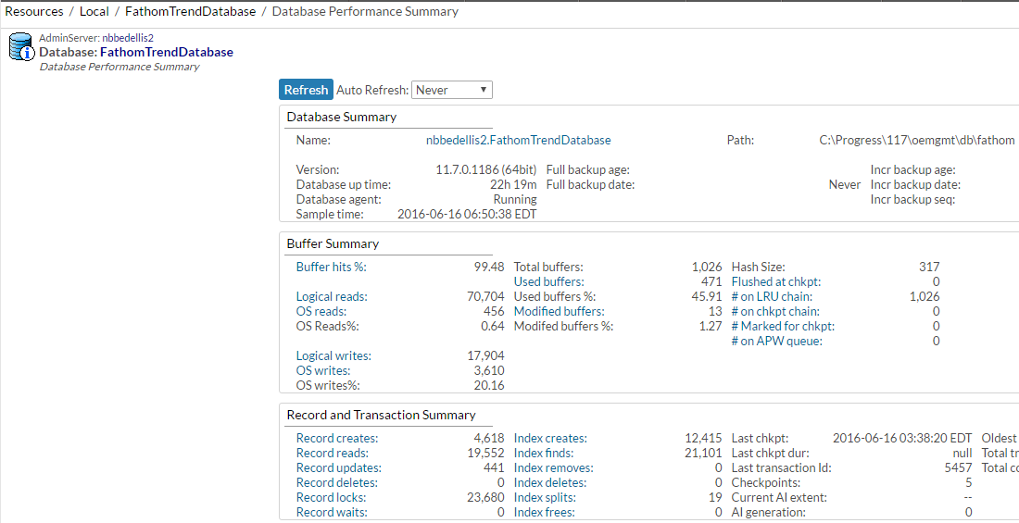
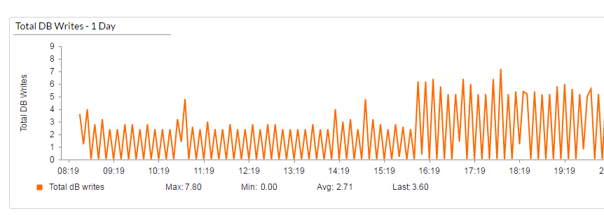
What’s changed lately?
Database Performance Summary Page
Notes:
The Database Performance Summary page is completely reworked
Before you used to get just a snap shot of the data on this page, but now you can:
Quickly see current data and click a link to see a graph of recent data

Slide 31
Why OpenEdge Management?

Slide 32
Why OpenEdge Management?
Advantages of Openedge Management
  Auto discovery at startup
  Has 90% of what you need configured and available
  Only tool to give you procedure statistics for AppServer
  Alerts that can start jobs
Included in the Advance Enterprise Edition Database Product
  Multi-tenancy
  Table Partitioning
  Transparent Data Encryption
  Database Replication
  High Data Availability
Notes:
Although OpenEdge Management is not free like many tools out there (Cacti and Nagios). It works right out of the box!
I have used Nagios and it does work, but it is a lot of work. And it did not have Alerts that can start jobs. Tools like Nagios could take you weeks or months to get the most of the monitoring and alerting tools.
My understanding is that Advanced Enterprise Edition breaks even at any 2 components.

Slide 33
Q&A

