Slide 1
Customizing PDS OE as per your needs
Date: 28 June 2016
Presenter: DivyaTheja Pachipula

Slide 2
Focus of the session
Demo
Brief Introduction to PDS OE
Need for customization
Customizations

Slide 3
Need for Customizations
Different Environments
Different Personas

Slide 4

PDS OE – Introduction
Configure
Develop
Build
Publish
Test
PDS OE

Slide 5







SAMPLE APPLICATION
AppServer
(Remote Machine)
Application
Client UI
GUI for .NET
Source Control
(Subversion)
Business
Logic
Developers

Slide 6
CONFIGURE
Configure
Develop
Build
Publish
Test
PDS OE

Slide 7

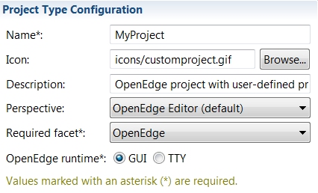
CONFIGURE
Install/Uninstall Tools to/from your IDE
  Uninstall unwanted features
  Install third party plugins
    SCM, Mylyn, etc.,.,
Custom Project Types
  Add your own
      Folder layout
      Libraries to PROPATH
      Code generation templates

Slide 8
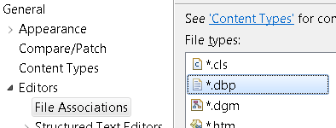
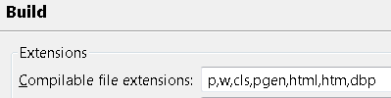
CONFIGURE
File Types
  Editor Choice
  Make it compliable
File Templates
  Override
  Create New
File Types: General → Editors → File Associations
Build: Progress OpenEdge → Editor → Build
File Templates: OpenEdge → Tools → Customization Editor

Slide 9
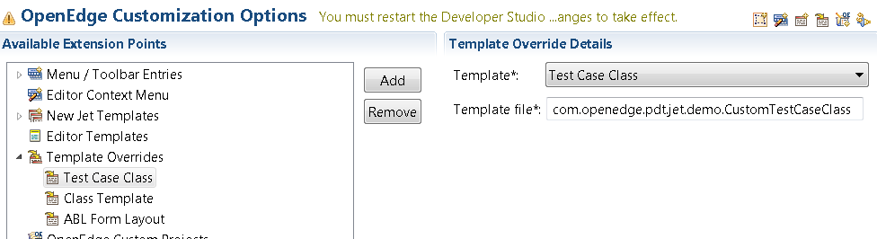
CONFIGURE
File Templates require JET
Enable JET
Enable Java Emitter Templates for your project
Add Dependencies
Add jars to build path
Write JET template
Copy to project
Register
Register in Customization Editor
Oe_common_services.jar
Progresside.jar
Template
Generator skeleton
Change template
Dependency | Location
oe_common_services jar | <DLC>\oeide\eclipse\plugins\com.openedge.pdt.core_<version>
progresside jar | <DLC>\oeide\eclipse\plugins\com.openedge.pdt.text_<version>
ablunit jar | <DLC>\oeide\eclipse\plugins\com.openedge.pdt.ablunit_<version>
Templates List | <DLC>\oeide\eclipse\plugins\com.openedge.pdt.text_<version>\templates
ABLUnit File Templates List | <DLC>\oeide\eclipse\plugins\com.openedge.pdt.ablunit_<version>\templates

Slide 10
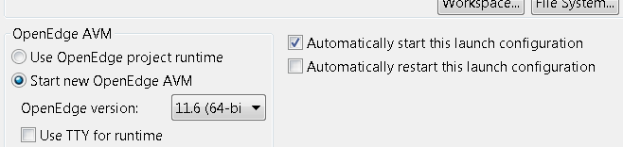
CONFIGURE
Make your ABL code
  Run from a menu in PDS OE
  Run on specific event
    Use ABL API
      _oeidestartup.p
      oeideservice.i
    Use Run Configuration
Menu: OpenEdge → Tools → Customization Editor

Slide 11
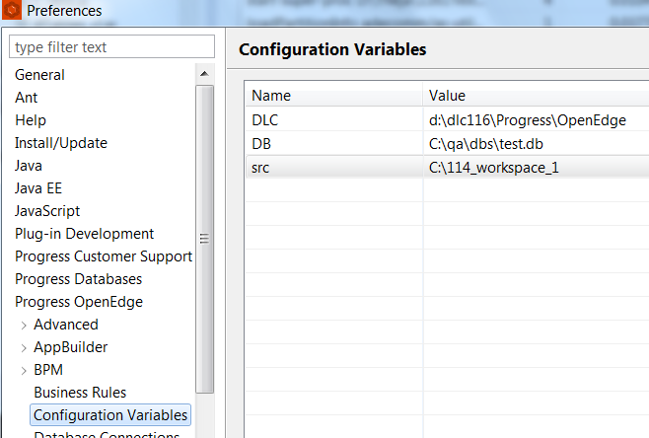
CONFIGURE
Configuration Variables [11.6]
  Use PATH variables
Preference: Progress OpenEdge → Customization Variables

Slide 12
DEVELOP
Configure
Develop
Build
Publish
Test
PDS OE

Slide 13

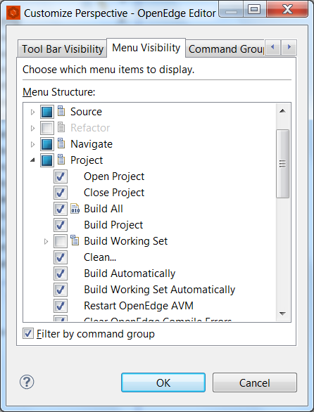
DEVELOP
Adjust layout to your work habits
  Menus
  Perspectives
Working Sets
  Work on preferred set of files

Slide 14
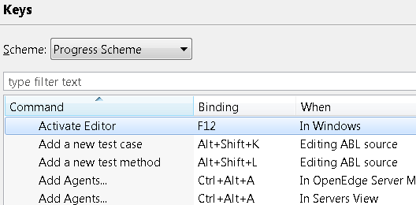
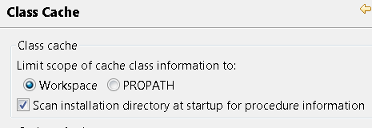
DEVELOP
Shortcut Keys
  Create you own shortcuts
Customize
  Class Cache settings
  OpenEdge Tooling
Preference: General → Keys
Preference: Progress OpenEdge → Advanced → Class Cache

Slide 15
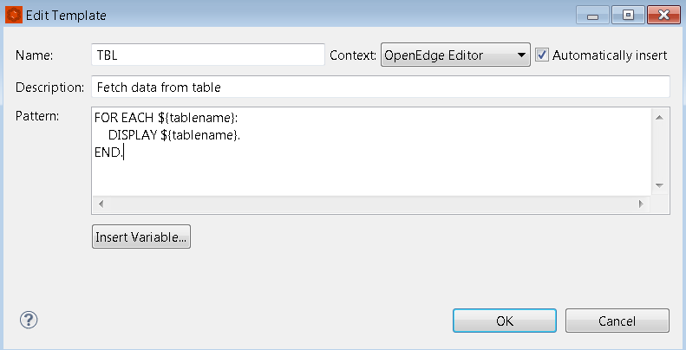

DEVELOP
Macros
  Editor Templates
Templates: Progress OpenEdge → Editor → Templates(macros)

Slide 16
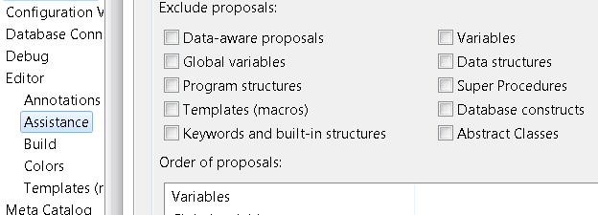
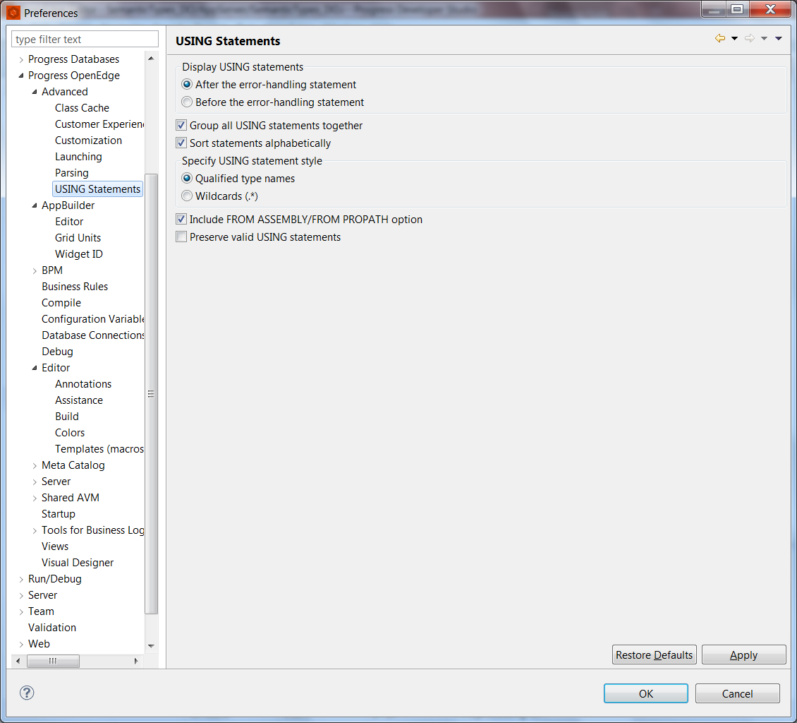
DEVELOP
Adjust settings for
  Code Completion
    Include/Exclude proposals
    Choose when to show proposals
  Formatting
  Casing
  Organize USING Statements
    Group
    Sort
Editing: Progress OpenEdge → Editor
USING Statements: Progress OpenEdge → Advanced → USING Statements

Slide 17
BUILD
Configure
Develop
Build
Publish
Test
PDS OE

Slide 18




BUILD
  Mark file extensions to be compilable
  Working Sets
  Exclude files from build
  Automatically
    On Save
    On Run
    On Debug
    On modifications
  Choose your destination
What to build?
When to build?
Where to build?

Slide 19
PUBLISH
Configure
Develop
Build
Publish
Test
PDS OE

Slide 20

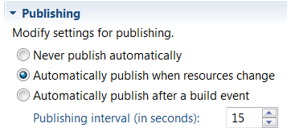
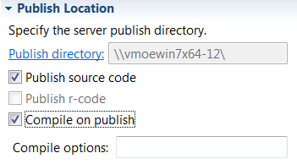
PUBLISH
What to publish
Set Server Modules
Add Filters
When to publish
On modification
On build
Where to publish
Never
Local directory
On remote Server
Only Source

Slide 21



PUBLISH – ABL Documentation
Custom Parser
Custom Serializer
HTML
PDF
Text File, etc.,
Document your own tags in ABL code comments
Write ABL document to your own format
ABL Documentation
ABL
Code

Slide 22
TEST
Configure
Develop
Build
Publish
Test
PDS OE

Slide 23
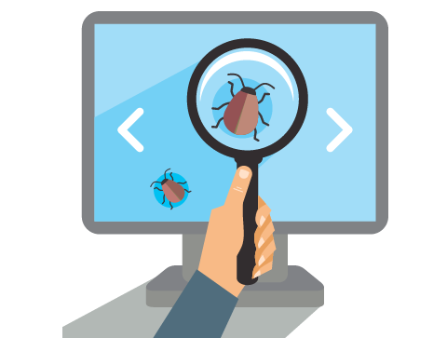
TEST
Customize
  Logging
  Performance
    Enforce startup parameter limits
  Culture
    Use your own locale

Slide 24
Share to Team

Slide 25

SHARE TO TEAM
Configuration files
  Database connections
  PROPATH
  Project Properties (project.xml)
  Run Configurations(.launch files)
  Shared AVM settings
  Database definitions
  Editor Macros
  Templates
  Custom Projects

Slide 26
Advanced?

Slide 27
Hosting ABL Tools in PDS OE
showView
hideView
getViewHwnd
setEmbeddedWindow
addWindow
setViewTitle
isIDERunning
IDE_Command
showView
hideView
getViewHwnd
setEmbeddedWindow
addWindow
setViewTitle
ABL
Application
PDS OE
IDE
Progress
AVM
Eclipse
Framework
SESSION:IDE-DEFAULT-PARENT-HWND
hWindow:IDE-PARENT-HWND
hWindow:IDE-WINDOW-TYPE
showView
hideView
setPartName

Slide 28
PDS OE on Eclipse
Progress Developer Studio for OpenEdge (PDS OE)
ABL Editor
DB Navigator
Appbuilder
Debug
Unit Testing
ABLDoc
Servers
BPM
3rd party
Eclipse Platform
JAVA Platform

Slide 29
Write your own plug-in
Write your Java code
Deploy to PDS OE
Know the plugin to extend

Slide 30
Demo

Slide 31
REFERENCES
Whitepapers
  Custom Templates https://community.progress.com/community_groups/openedge_general/w/openedgegeneral/1243.openedge-architect-working-with-custom-templates
  Embedding ABL Windows in PDS OE https://community.progress.com/community_groups/openedge_general/w/openedgegeneral/1244.openedge-architect-embedding-abl-windows
  Support for Java Style comments in ABLDoc https://community.progress.com/community_groups/openedge_development/m/documents/1957

