Slide 1
Monitoring OpenEdge Applications using BPM
Workshop
Jawahar Surapaneni
26th June 2016

Slide 2
The Support Team
Jawahar Surapaneni, Principal Engineer
Satyam Dhavala , Sr. Engineer
David Atkins, PhD, Principal Solution Engineer

Slide 3
Schedule
Time | Type | Description
01:00 – 01:15 pm | Presentation | Introduction to OpenEdge BPM and Monitoring Process
 | Lab 1 | Understanding the LoanApproval ABL Application functionality
 | Lab 2 | Model Loan Approval Monitoring Process in BPM
 | Lab 3 | Publishing Loan Approval Monitoring Process
 | Lab 4 | Adding ABL code to update Monitoring Process
 | Lab 5 | Monitoring Loan Approval ABL Application in BPM

Slide 4
Introduction – In This Workshop You Will Learn
Understand the basics of OpenEdge BPM
How to design Monitoring Process using Progress Developer Studio for OpenEdge
Adding ABL code to invoke, update the BPM Process
Update the monitoring process using OpenEdge Application
Getting the visibility for OpenEdge Application and Identifying the bottle necks in the existing flow.

Slide 5
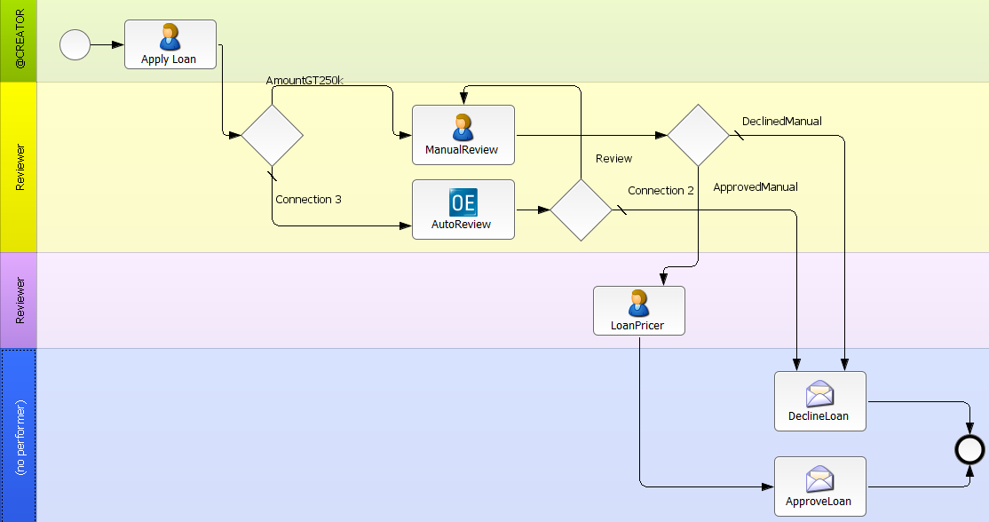
Progress OpenEdge BPM
Provides ability to develop and deploy business process applications
Rapid development, easier customization, and modernization of existing applications
Identify and address bottlenecks and Streamline operations
Modify business apps at the speed of business and independent of SDLC
“Decision”
User activity
“Task”
System step
“Managed
Adapter”
Swim lane
“Performer”
Notes:
From Progress, we offer a BPM solution on top of OE platform, which is OE BPM
Business Process Applications
OpenEdge BPM combines industry leading BPM solution with OpenEdge development platform. One installation process with unified security model and seamless integration of data to simplify development and deployment of dynamic business process applications
Agile
With simple drag and drop offering, it allows to create or change custom applications to be simple workflow models by avvoiding costly repair replace cycles and reducing cost errors and time to market, while increasing business agility and speedy time value
It allows to create new business oppurtunities , slashing development time for custom applications and quickly tailor existing applications to meet volatile business demands
Visibility
OEBPM is a single tool for developers , Business Analysts and managers that unlock the power of BPM to improve the process visibility and quickly respond to new business oppurtunities and make better decisions and stream line existing applications
Using OEBPM, one can model and simulate business process using BPMN compilant
Continuous Improvement
With OEBPM, processes can be separated from application code and replaced with flexible configurable workflows that can be easily modeled with the simplified graphical tool we provide
This enables developers , BA to easily modify applications at the speed of business and independent of software development lifecycles

Slide 6
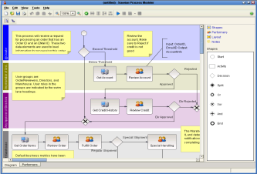
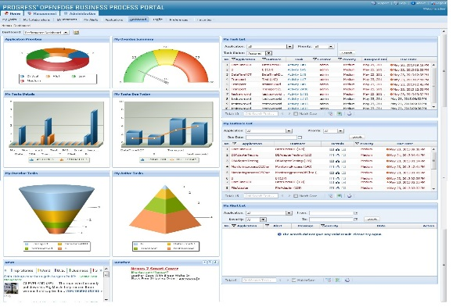
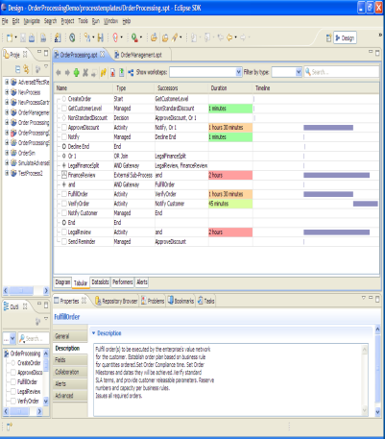
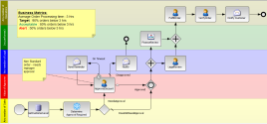
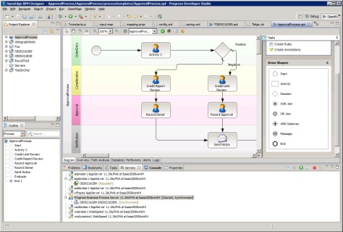
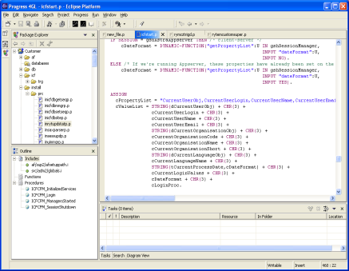
Key Components of OpenEdge BPM
Process Modeler
Business Process Portal
Business Process Server
Progress Developer Studio for OpenEdge
Progress Developer Studio for OpenEdge
OpenEdge
AppServer

Slide 7
How to Enable BPM for OE Applications
- BPM UI ( Form Editor and Webflow)
- BPM UI / Mobile UI / GUI for .NET
- Monitoring Process

Slide 8
Monitoring Process

Slide 9











Monitoring Process Evolution
Application
Business Events
Banking
WebServices Enabled ABL API

Slide 10
Designing Monitoring Process
Modelling
Follow Traditional Modelling Pattern
Participants
External Worksteps
External Adapters
Hook Point
Unique ID aka External Instance ID (EIID)
Adding ABL Code
Create,Activate and Complete Process Instances

Slide 11
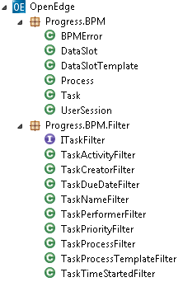
ABL Calling BPM: ABL Classes
Progress.BPM.UserSession
  IsValidSession()
  GetMyInstances()
  GetActivityNames()
  GetNextAvailableTask()
Progress.BPM.Process
  Remove()
  GetAvailableTasks()
Built in ABL classes
Implement ITaskFilter Interface
Implements filter on one property of the task class

Slide 12
Machine details
User name: <TBD>
Password: <TBD>
Workshop document: <TBD>

Slide 13
Schedule
Time | Type | Description
01:00 – 01:15 pm | Presentation | Introduction to OpenEdge BPM and Monitoring Process
 | Lab 1 | Understanding the LoanApproval ABL Application functionality
 | Lab 2 | Model Loan Approval Monitoring Process in BPM
 | Lab 3 | Publishing Loan Approval Monitoring Process
 | Lab 4 | Adding ABL code to update Monitoring Process
 | Lab 5 | Monitoring Loan Approval ABL Application in BPM
 |  | Q&A

Slide 14
Lab 1 - Understanding the LoanApproval ABL Application functionality

Slide 15
Lab 2 - Model Loan Approval Monitoring Process in BPM

Slide 16
Lab 3 - Publishing Loan Approval Monitoring Process

Slide 17
Lab 4 - Adding ABL code to update Monitoring Process

Slide 18
Lab 5 - Monitoring Loan Approval ABL Application in BPM

Slide 19
Questions

