Slide 1

Michael Marriage
Senior Principal Product Manager
mmarriag@progress.com
www.progress.com

Slide 2
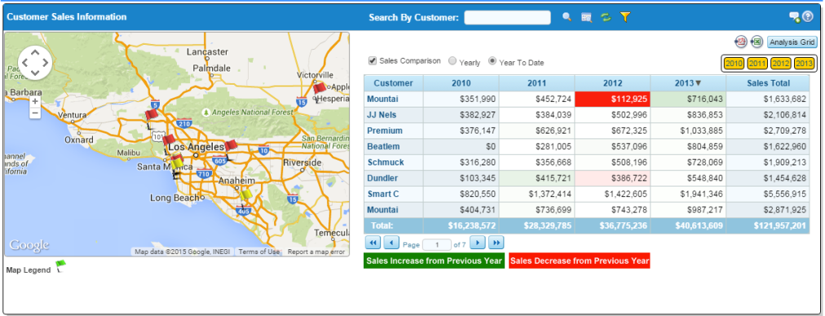
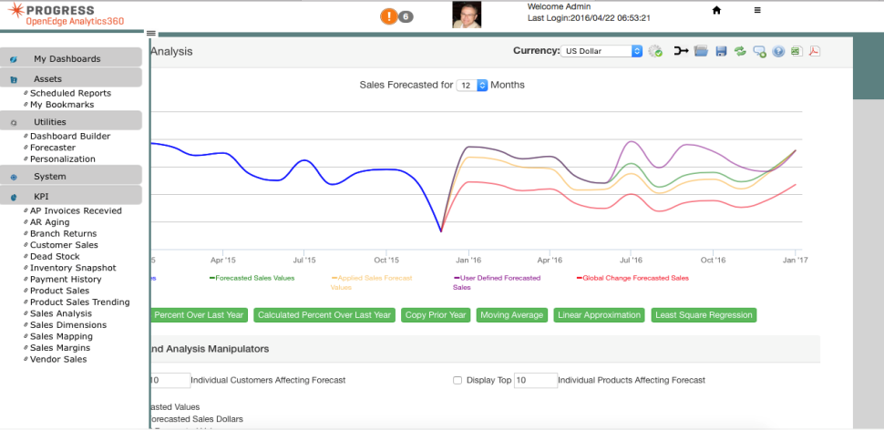
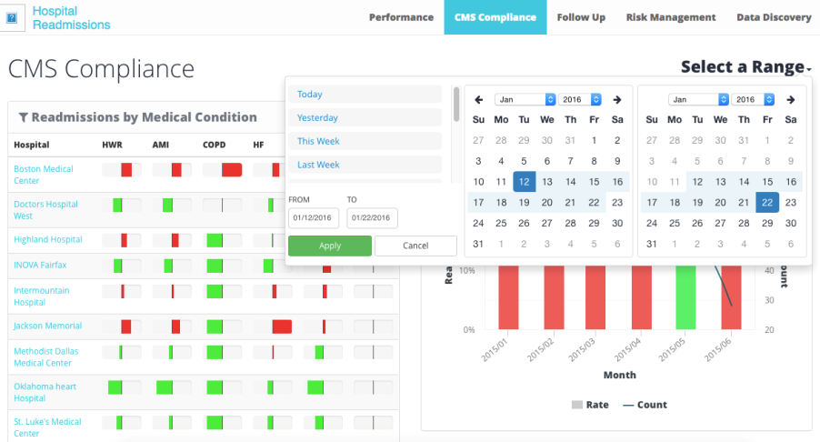
Agenda
Introduction
Analytics360 Overview
Solution Examples
Architecture Recap
Development Example
Questions

Slide 3

A Few Industry Statistics
For every dollar spent on a business intelligence solution, a company will receive an average return of $13.
Yet, Only 27% of companies use any form of BI.
Why?
Only 43% of in-house BI projects are successful.
Stakeholder satisfaction of these teams is 3.6/10.
Average total cost of a BI solution is well into 6 figures.
Statistics provided by Nucleus Research Group, Forrester Research, and Ambrysoft.

Slide 4
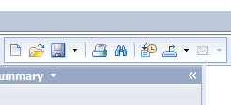

Build vs. Buy
Conventional approaches are problematic…
Coding Yourself
BI Apps
Takes too long
Distracts from core software development
Can’t keep up with evolving market demands
Disjointed user experience
Not aligned to brand
Difficult to integrate and scale
… and you need expertise in addition to software

Slide 5
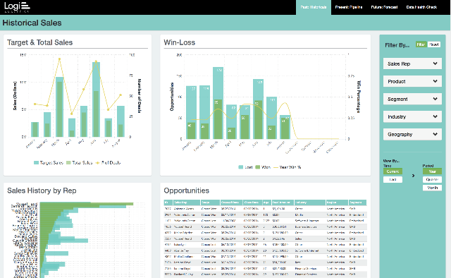
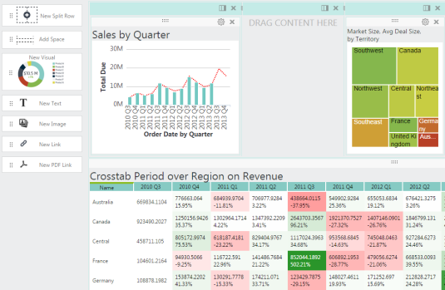
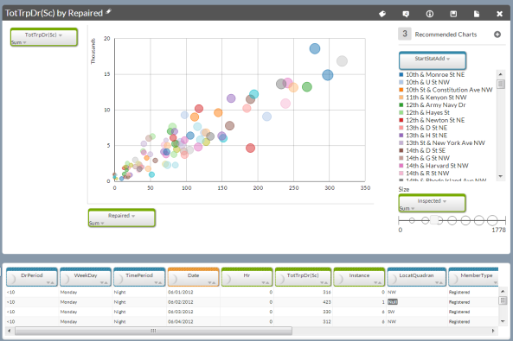
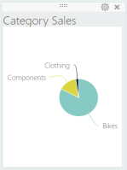

BI User Personas
“Consumers”
“Creators”
“Analysts”
Defined Experience
Managed Experience
Self-Directed Experience
Consume
Interact
Personalize
Query
Author
Share
Connect
Discover
Collaborate

Slide 6
Business Intelligence Trifecta
Complete Set Of BI Tools
Professional Services & Training
Framework & Pre-Built Content
Complete Set Of BI Tools
Framework manages security, multi-language, multi-currency support, etc. The pre-built content will springboard your BI project which means a faster ROI.
All required tools from data extraction and preparation to the presentation of that information are included with Analytics360.
Framework & Pre-Built Content
BI ProServ will help design, develop, and implement your BI solution, while training and mentoring your team.
Professional Services & Training

Slide 7
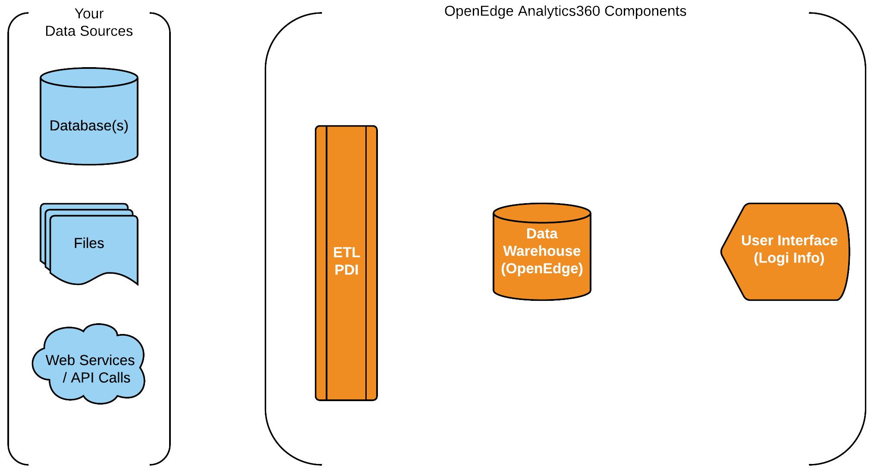


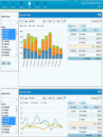





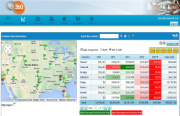

A Complete Set of BI Tools
Included With OpenEdge Analytics360
Databases such as
OpenEdge, Oracle,
SQL Server.
Big data sources such
as MongoDB, Hadoop.
Flat files. CSV & Excel files. XML files. JSON files. Etc.
Data Extraction & Preparation.
(ETL)
Data Warehouse
(Includes OE
AEE DB License)
Business Intelligence Server
Web services & API
calls.

Slide 8
Analytics360 Demonstration
Sample Applications

Slide 9













Architecture Recap
1
Browsers
Desktop
Mobile
End User Tier
Studio
BI Server
Develop
APPS
Presentation Engine
Process Engine
IN THE CLOUD
Deploy
Data Engine
Security Engine
Data Warehouse
ON-PREMISE
Direct Connection
Real Time Analytics
AppServer
ETL Tool
Data Sources

Slide 10


Development Example In 30 Minutes Or Less!

