Slide 1
OpenEdge journey through 11.X
Srinivas Kantipudi
28 June, 2016

Slide 2
Agenda
Introduction to PDS for OE
Features over the releases – 11.X

Slide 3

Introduction to Progress Developer Studio for OpenEdge
Configure
Develop
Build
Publish
Test
OEDK Classroom editions

Slide 4
Features over the 11.x releases
Opening multiple files in same instance
Remote Debugger
OE 11.3
OE 11.4
OE 11.5
Analytics
OE 11.0
OE 11.1
OE 11.2
ABL Unit
REST
Win 64 support
Support for creating WebSpeed apps
Custom project types
Mobile
AppBuilder integration to PDS OE
Integration with Corticon
Support for Organize USINGs
PUSH notification service
ABLDoc
Pacific AppServer
Debug listing support
OE 11.6
WebSpeed support in PASOE
Profiler support from PDS OE
Telerik UI for Winforms
Mark files/folders as non-compilable
Integration of BPM plugins in PDS OE
ABL Scratchpad view
Find References

Slide 5
Features over the releases – By Theme
New technologies
REST
Mobile
Integrations
AppBuilder integration
Productivity
ABL Scratchpad
Support for Organize USINGs
Custom project types
Telerik Winforms
Win 64 support
Integration with Corticon
Find References
Enhancing ALM capabilities
ABLUnit
ABLDoc
Profiler from PDS OE
WebSpeed integration in PDS OE
BPM support in OpenEdge
Improved Server support
PASOE server support

Slide 6
New technologies

Slide 7
New Technologies:
What we have before 11.0 and what we provided in 11.X
11.0 and before
CHUI applications
Desktop applications
Web applications
Infragistics & Microsoft controls
11.6
Telerik UI for Winforms
11.2
REST
OpenEdge mobile
11.3
Win 64 support
BPM support in OpenEdge

Slide 8
New Technologies:
REST (REpresentational State Transfer)
11.2
Resource based, light weight, stateless
Can use JSON or XML
CRUD Model -
Cloud-based, mobile and highly scalable stateless applications
Create, Read, Update and Delete

Slide 9
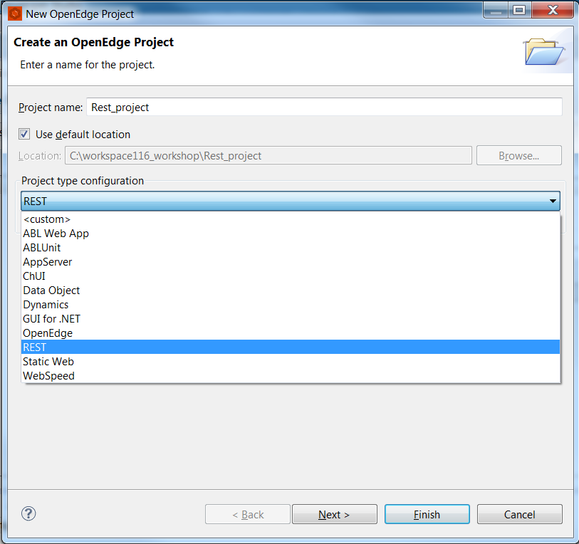
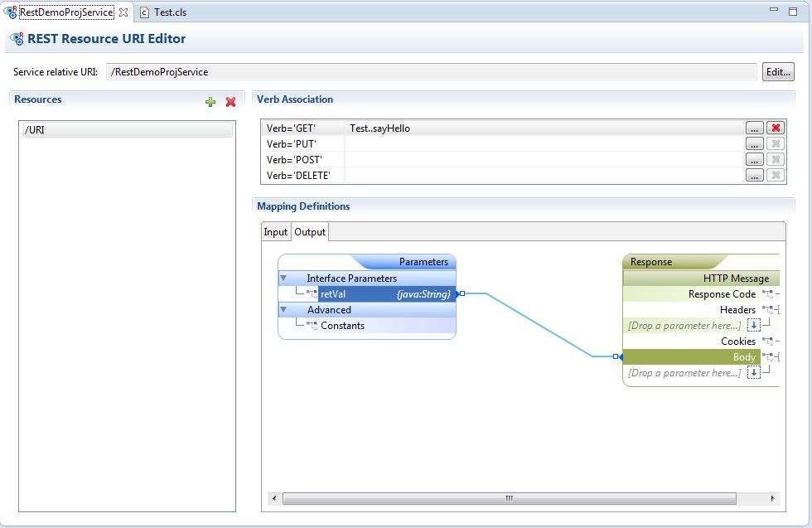
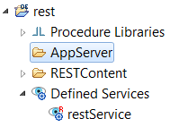
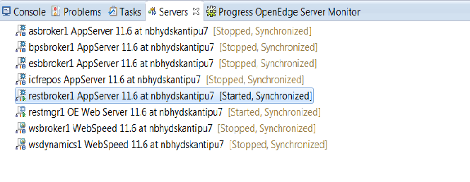
New Technologies:
Developing a REST Application
11.2
REST Client

Slide 10
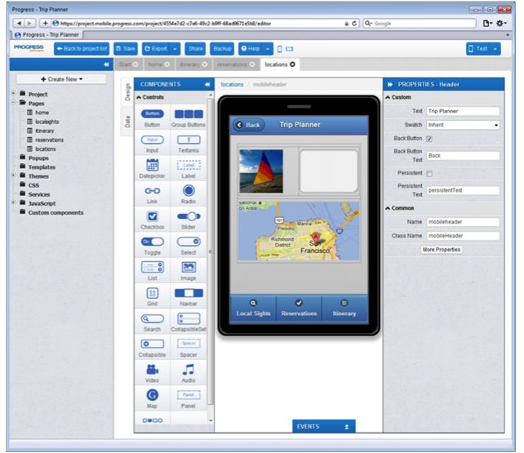
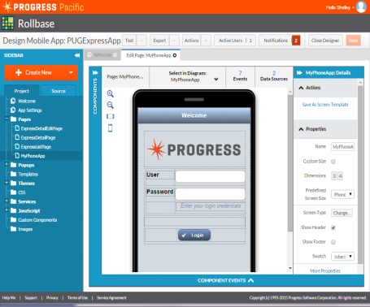
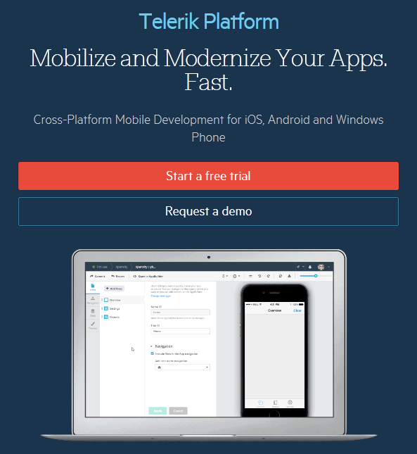
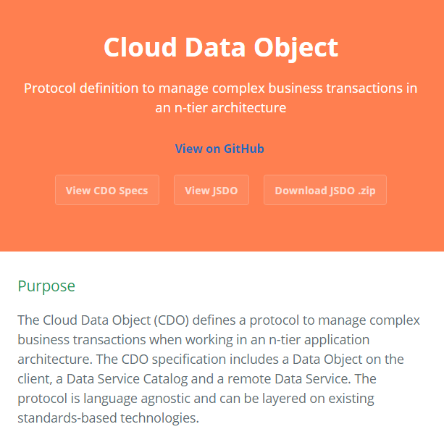
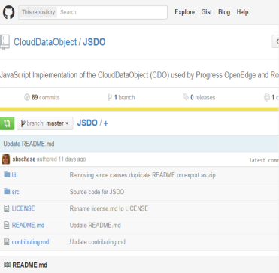
The Evolution of Mobile Development in OpenEdge
11.2
2012
2014
Q1 2015
Q2 2015
OE Mobile
Mobile App Builder
Business Entity
Mobile Service
JavaScript Data Object (JSDO)
Rebrand Mobile for Pacific
Announce move to Telerik Platform
JSDO Open Sourced
Kendo UI DataSource for JSDO

Slide 11
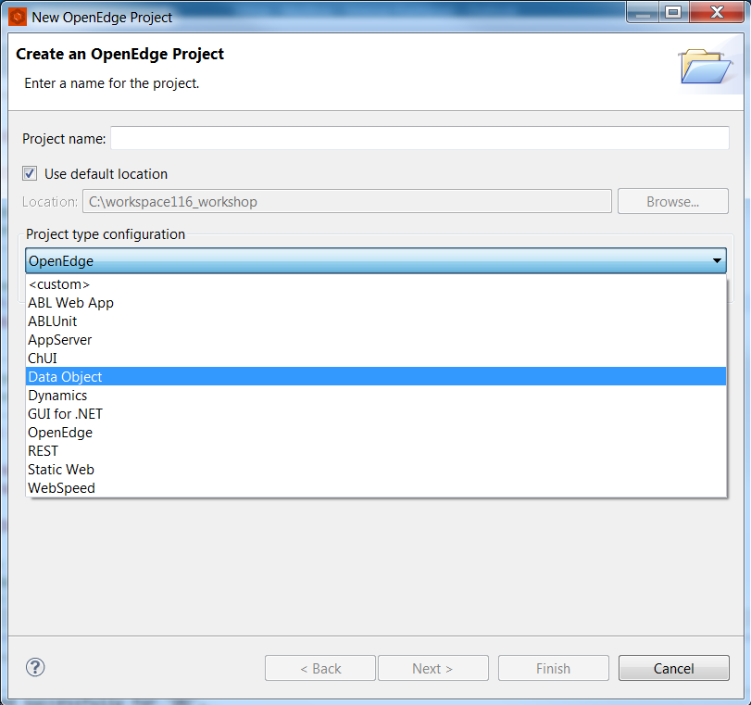
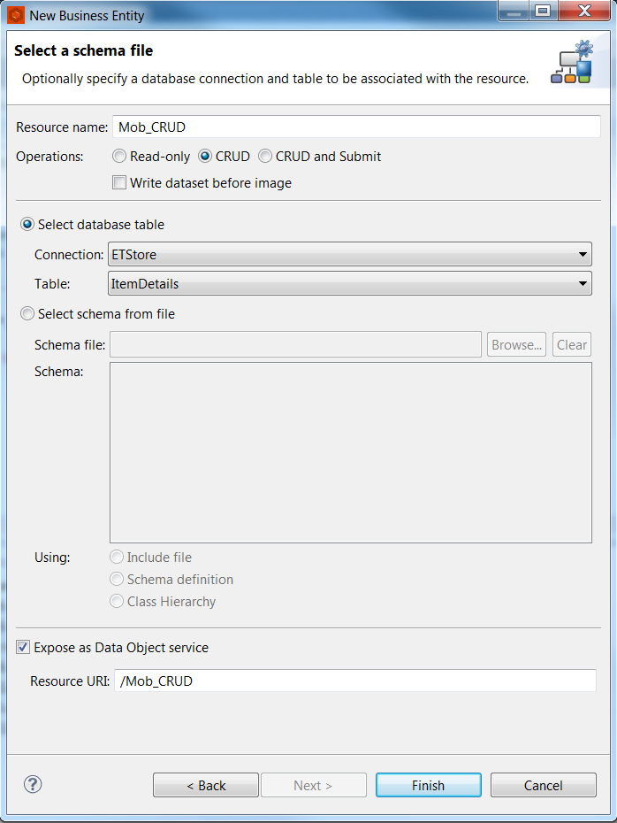
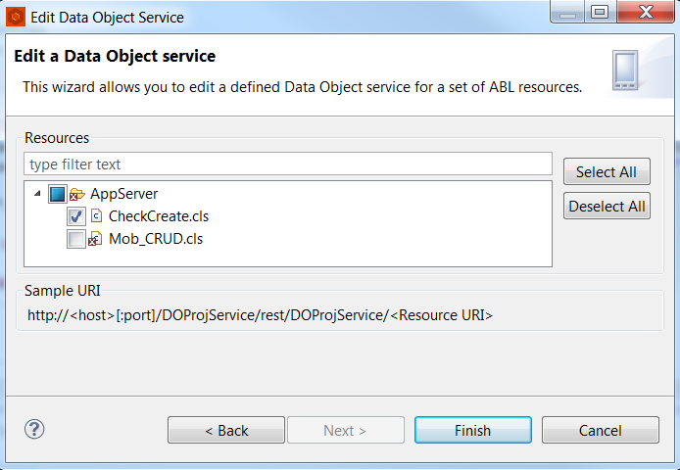
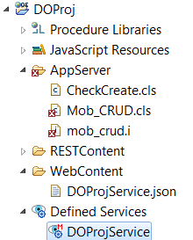
New Technologies:
Developing backend for Mobile application
11.2

Slide 12
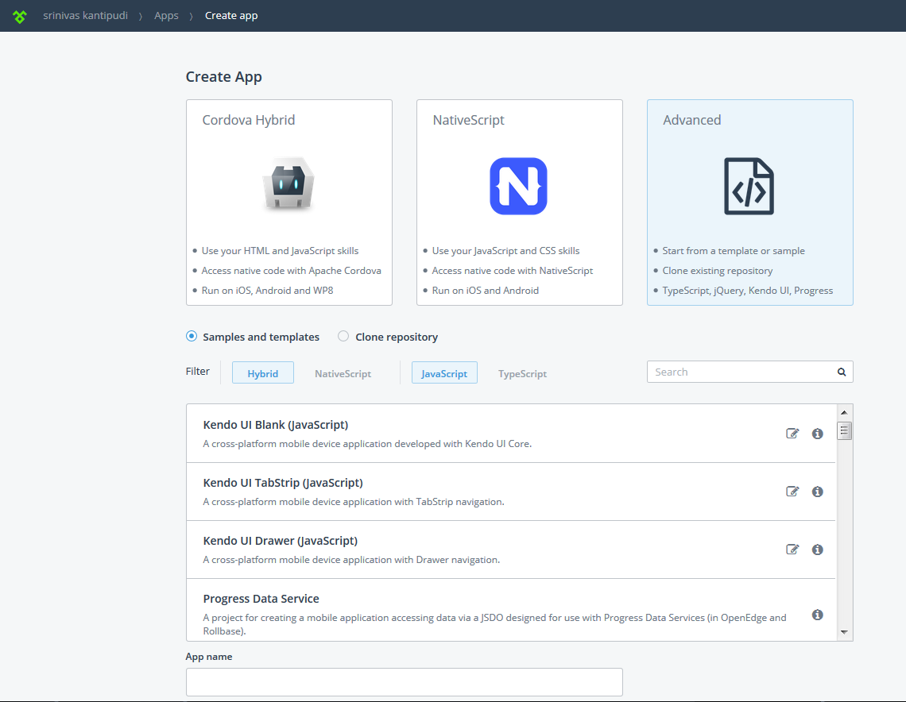
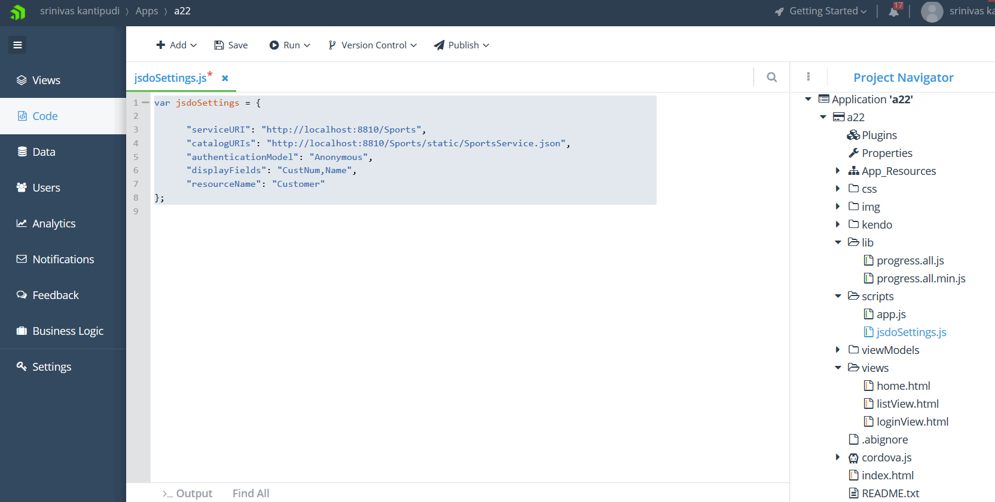
New Technologies:
Integrate Telerik Platform with OpenEdge
11.2
Telerik AppBuilder: https://platform.telerik.com

Slide 13
New Technologies:
Progress Application Server support from PDS OE
11.5
11.5 - REST and Mobile
11.6 – WebSpeed

Slide 14
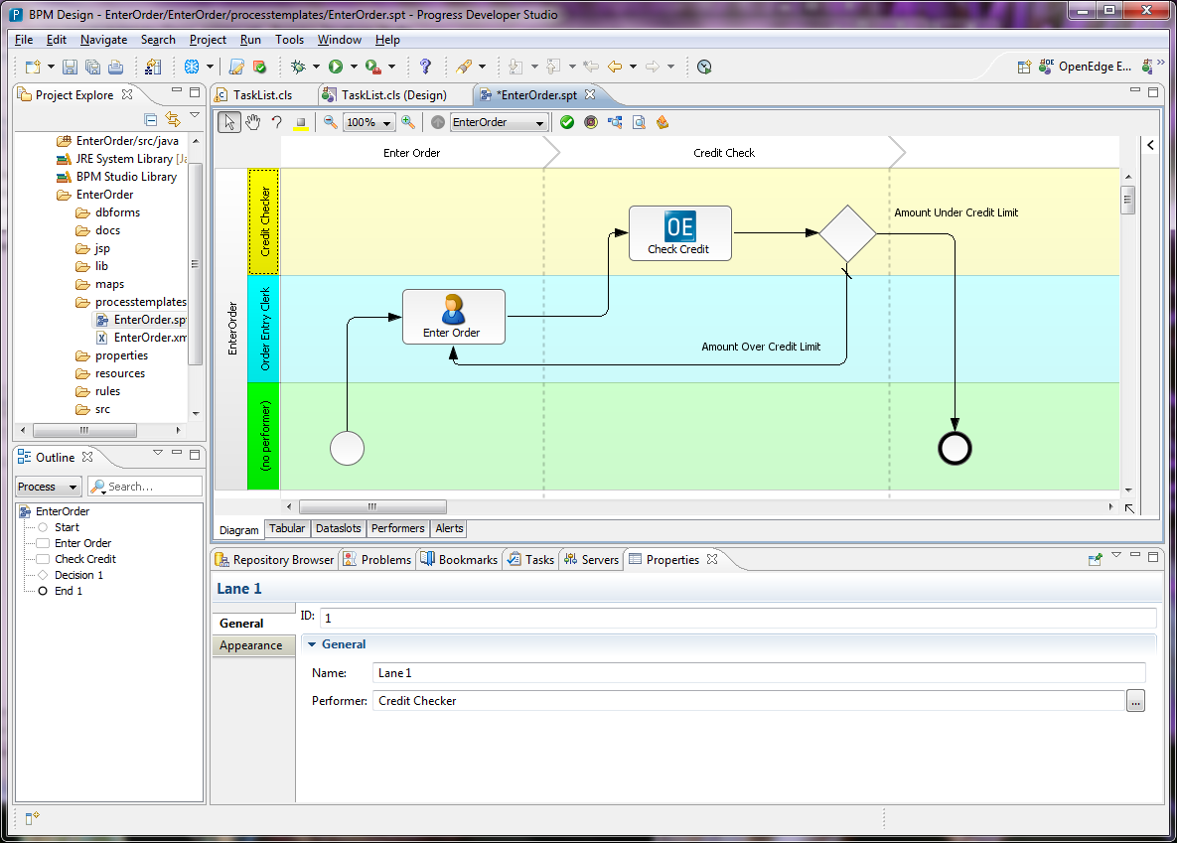
New Technologies:
OpenEdge BPM
11.3
Provides ability to develop both transaction-oriented and process-centric applications
Allows customers to automate the workflows
Allows customers to get visibility into how well their processes are performing
Allows customization without code changes
System step “Managed Adapter”
Swim lane “Performer”
User activity “Task”
Decision

Slide 15
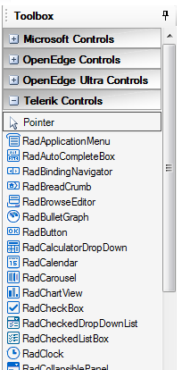
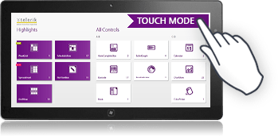
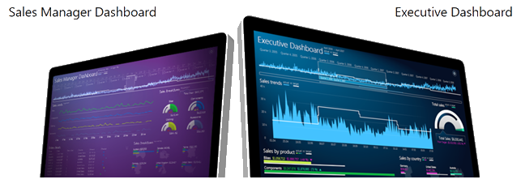
New Technologies:
Telerik UI for WinForms - Enterprise Development for Windows Desktops
11.6
Enterprise Business Applications
Vibrant Dashboards
Touch Enabled Applications

Slide 16
Integrations

Slide 17
Integrations:
What we have before 11.0 and what we provided in 11.X
Before 11.X
AppBuilder loosely coupled
WebSpeed components scattered
11.2
AppBuilder integration
11.3
Corticon Business rules integration
11.0
WebSpeed integration into PDS OE

Slide 18
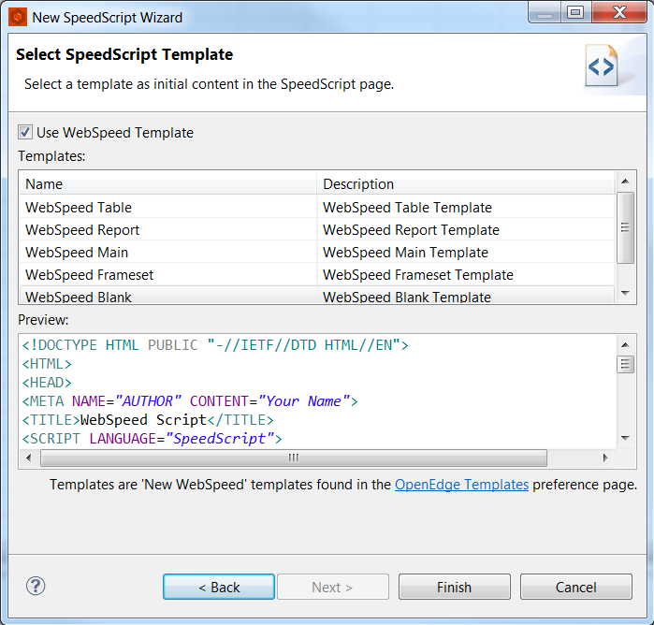
Integrations:
WebSpeed Development
11.0
Completely revamped in 11.0
New WebSpeed project type
Different templates provided for SpeedScript
Multi-tabbed SpeedScript Editor
All programming models supported
  SpeedScript, CGI wrapper, HTML mapper

Slide 19
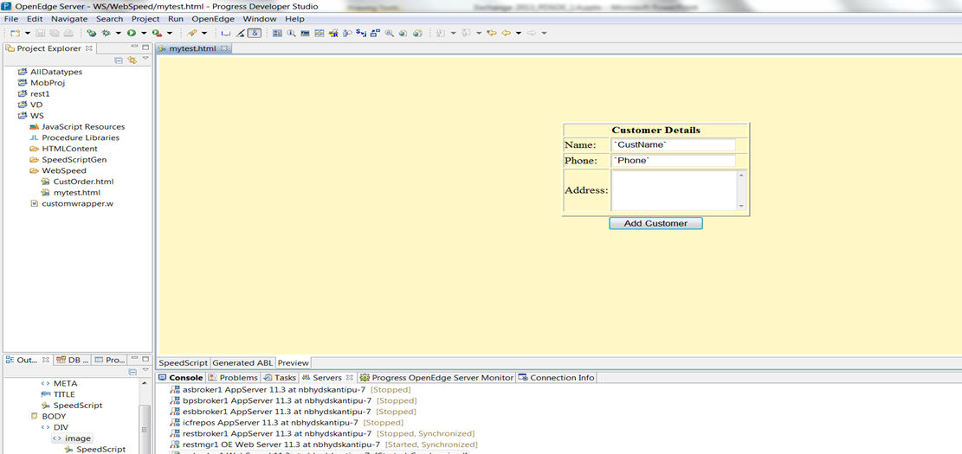
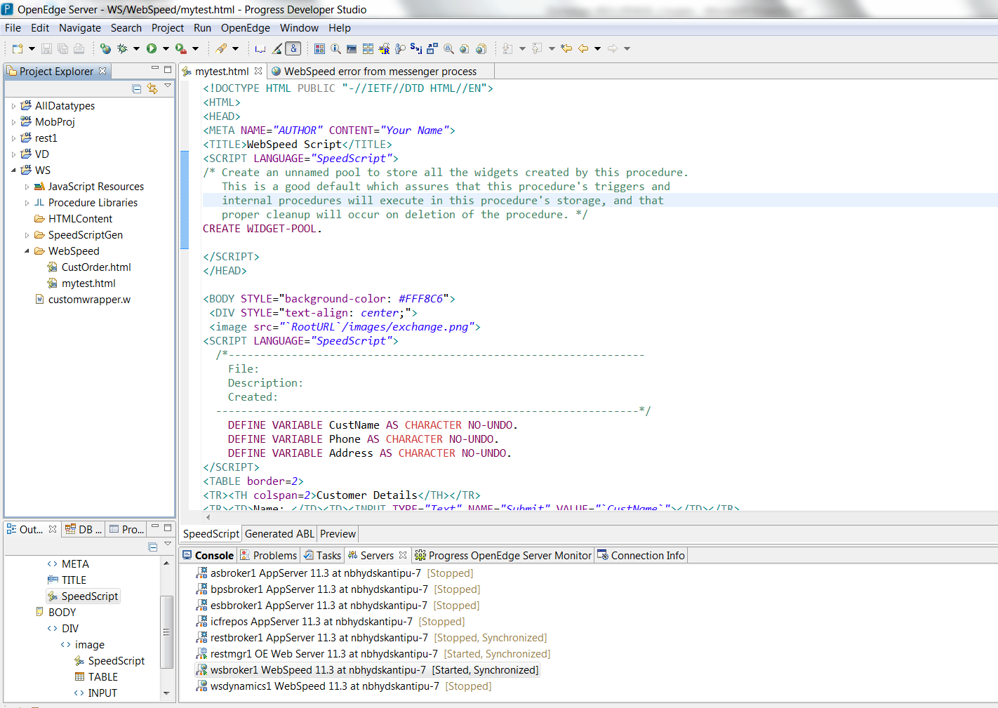
Integrations:
SpeedScript Editor
11.0
Supported Actions:
ABL color coding
Correct case
Expand keywords
Compile/ Syntax check
Hover/ Keyword help
Content Assist / Open declarations
Surround with Catch/ finally block
Add Procedure/ Add Function
Multi Page Editor with three tabs
SpeedScript
Generated ABL
Preview
HTML section
SpeedScript section

Slide 20
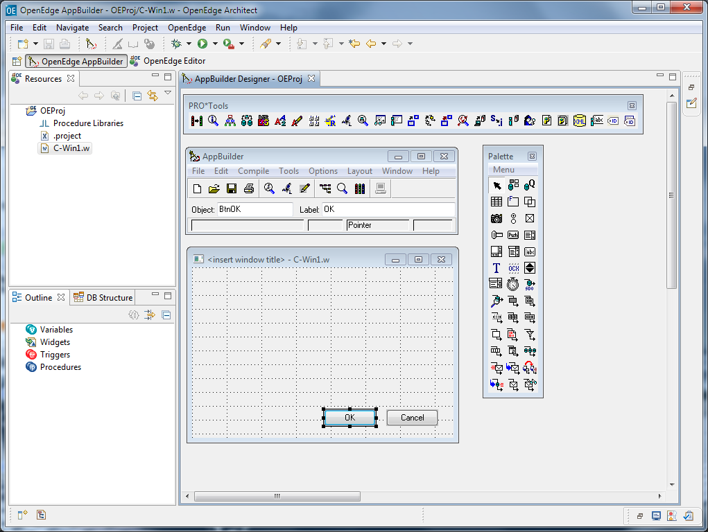
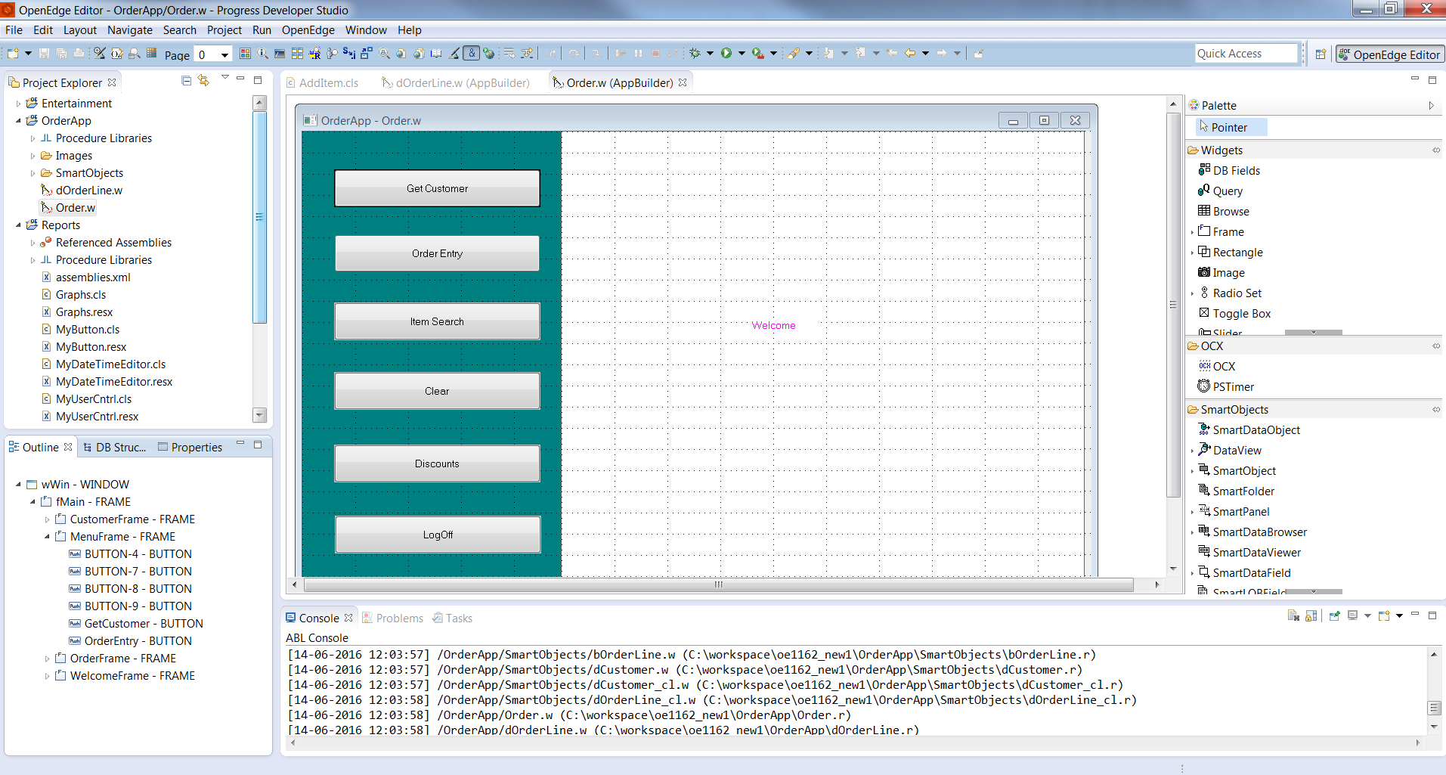
Integrations:
AppBuilder Integration
11.2
Brings native AppBuilder functionality to
PDS OE
Dock-able widget palette inherits look and feel of GUI for .NET Designer
Hierarchical widget outline view
Synchronization between design and source editor
Moved to Menu & Toolbar
Moved to dockable Palette

Slide 21
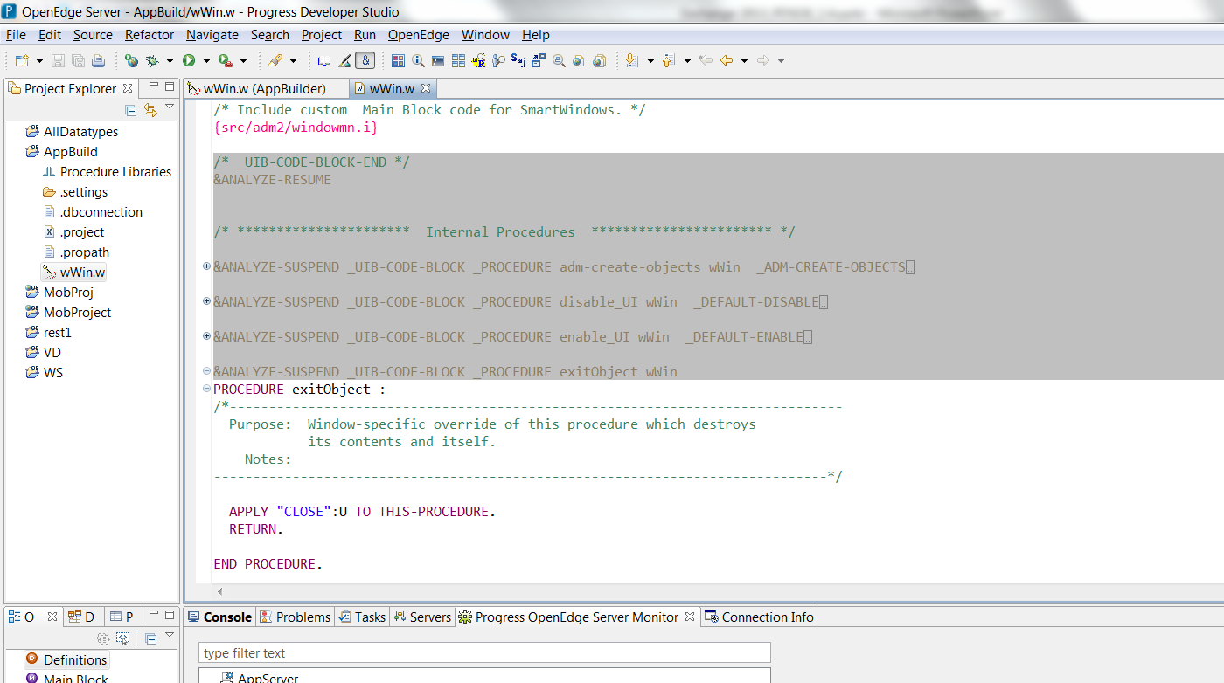
Integrations:
AppBuilder Integration - Improved ABL Source Editor
11.2
11.2
Ease of editing AppBuilder generated source file
Protects AppBuilder generated code
AppBuilder Editor preference options are provided to turn on/off this feature
Code folding for AppBuilder specific blocks
Customized Find and Replace dialog
Non-editable section for AppBuilder generated code
By default AppBuilder
read-only code block will be close folded
Editable code block

Slide 22
Integrations:
What is Corticon Rules and when can OpenEdge apps benefit from Corticon?
11.3
What
BRMS engine to create rules for your business logic
A spreadsheet like interface for writing rules
When
Is Business logic enabling relatively complex decisions?
Myths
Rules engines are complex and heavy to use
We can handle rules in application code
Is Business logic customized or personalized for each end user?
Are changes frequently required to the applications decision logic?
Is accuracy/integrity of logic critical?
Do you require more transparency into how decision are made?
Checks for completeness, correctness
Integration with application code is complicated.

Slide 23
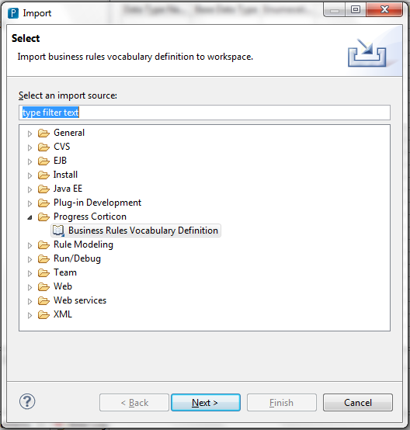
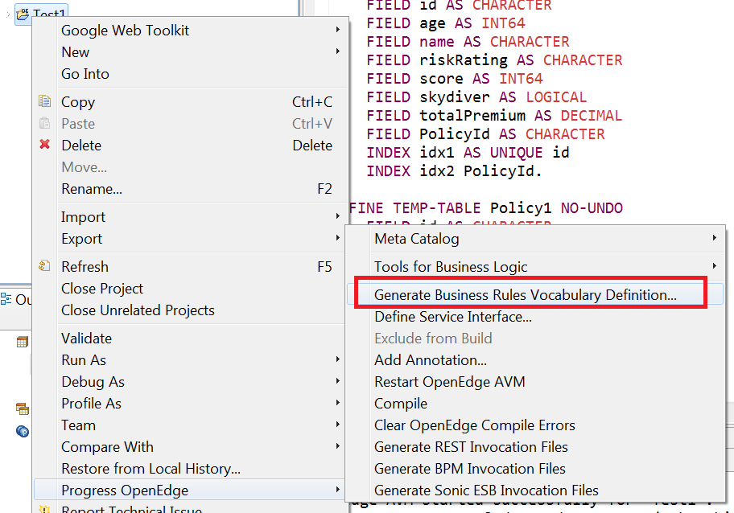
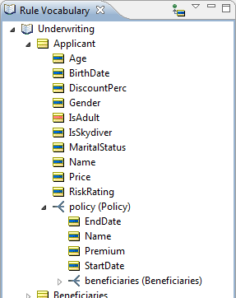
Integrations:
OpenEdge – Corticon integration: Design-time Meta-data Integration
11.3
Export Temp table or Prodataset as Business rules Vocabulary Definition file (.brvd file)
Import to Corticon as Vocabulary entities
Create Business rules and flow in Corticon Studio
Deploy them to server as decision services
Access from ABL

Slide 24
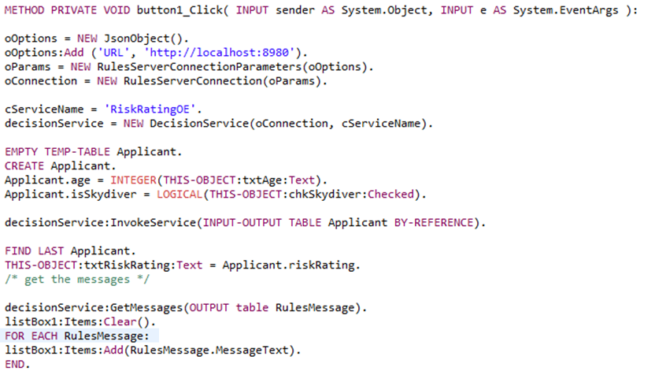
Integrations:
OpenEdge – Corticon integration: ABL API
11.3
Establish connection with decision service
Call decision service
Work with the rule execution messages

Slide 25
Productivity

Slide 26
Productivity
11.4
Organize USINGs
11.0
Custom Project types
11.2
ABL Scratchpad

Slide 27
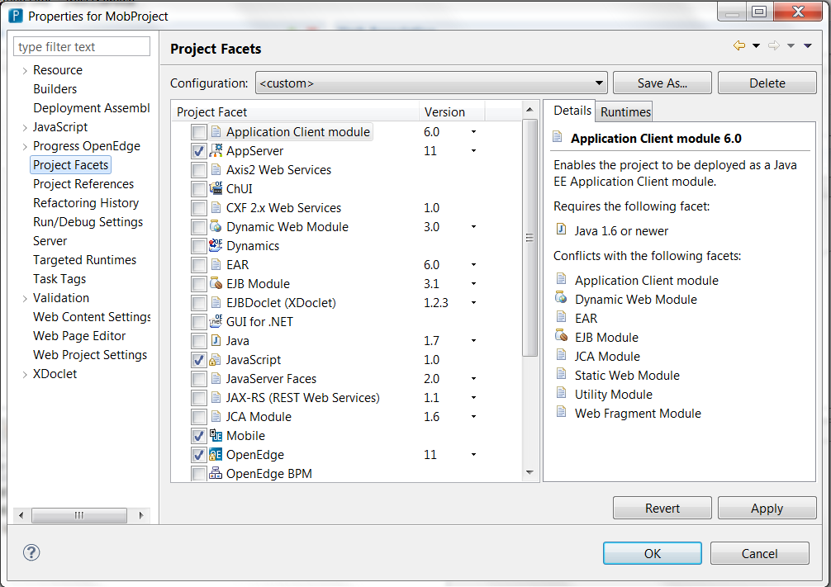
Productivity:
Custom Project Types
11.0
OpenEdge Project is facet based
  Specific project type for each development domain
  Ability to create custom project types
  Advantages
    Provides better visibility and organization of code
    Tailored functionality based on the project type
Different Project Types
10.2B
11.0
11.2
11.4, 11.6
  AppServer
  WebSpeed
  GUI for .NET
  Dynamics
  Static web
  ChUI
  REST
  Mobile
  ABLUnit
  ABL Web App
  Data Object

Slide 28
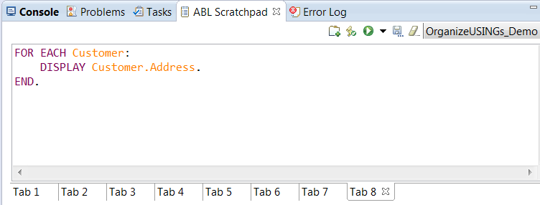
Productivity:
ABL Scratchpad
11.2
ABL Scratchpad
  Experiment your new logic without creating any new ABL file
  Keeps your project clean
Menu: Window→ Show View→ ABL Scratchpad

Slide 29
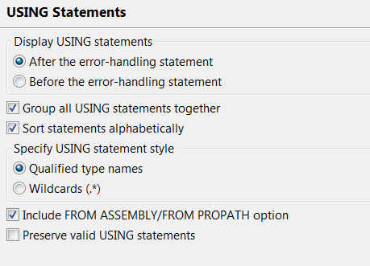
Productivity:
Organize USINGs
11.4
Organize USING Statements
  Eliminates duplicate and removes unused USING statements
  Expands USING Statements to fully qualified type
  Sort and group USING statements
  Preferences to suite your styles
Preferences: Progress OpenEdge → Advanced → USING Statements
Menu: Source → Organize USING Statements (Ctrl+Shift+O)

Slide 30
Enhancing ALM capabilities

Slide 31
Enhancing ALM capabilities
11.5
ABLDoc
11.4
ABLUnit
11.6
Profiler support from PDS OE

Slide 32
Enhancing ALM capabilities:
ABLUnit
11.4
What
An unit testing framework for writing unit tests for ABL code
Why?
Verify expected functionality
To eliminate regressions
How?
Annotation based
Same as all other Unit testing tools
Features
Supports both procedural and class based test cases
Rich set of Assert APIs
  OpenEdge.Core.Assert, OpenEdge.Core.Assertion.AssertObject, OpenEdge.Core.Assertion.AssertFile, OpenEdge.Core.Assertion.AssertError, OpenEdge.Core.Assertion.AssertJson
Support from command line and Ant task
  Useful for integrating with build system

Slide 33
Enhancing ALM capabilities:
Sample ABLUnit Test Class
11.4
ABL Class
ABL Test class
CLASS TemparatureConverter:
/* Purpose: The method computes the Celsius for the given Fahrenheit value.
Notes: This method returns the value which is truncated to 2 digit after decimal point. */
METHOD PUBLIC STATIC DECIMAL Fahrenheit2Celsius (INPUT f AS DECIMAL):
DEFINE VARIABLE c AS DECIMAL NO-UNDO.
c = (f - 32) * 5 / 9.
RETURN TRUNCATE(c, 2).
END METHOD.
END CLASS.
CLASS TemparatureConverterTest:
@Test.
METHOD PUBLIC VOID testPassF2C ( ):
Assert:Equals(37.77, TemparatureConversion :Fahrenheit2Celsius(100)).
RETURN.
END METHOD.
@Test.
METHOD PUBLIC VOID testFailF2C( ):
Assert:NotEquals(50, TemparatureConversion :Fahrenheit2Celsius(100)).
RETURN.
END METHOD.
END CLASS.

Slide 34
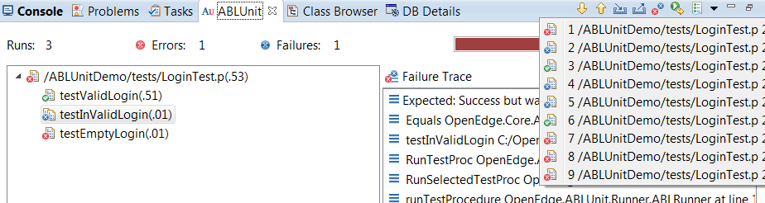
Enhancing ALM capabilities:
ABLUnit view
11.4
Test Result
history
Bar is green if all tests
Pass, red otherwise
Only
Failures
Rerun
tests
Import/Export
results
This test passed
Time taken to run
the test
This test failed
Error raised
Failed test reason

Slide 35
Enhancing ALM capabilities:
ABLDoc
11.5
What
Tool for generating API documentation in HTML format
Why?
Easier understanding of code
Provides details on classes, procedures
How?
  Based on the ABL comments
  Can generate from project or automatically from ANT
Features
Annotation in comments
  Parse the code for author, date of creation, information about input/output
Generates HTML output
  Change the template - footer, header information, CSS to suite your branding
Ant support
  Generate documentation as part of your build process
Extensibility
  Write code to support for custom formats (eg PDF)

Slide 36
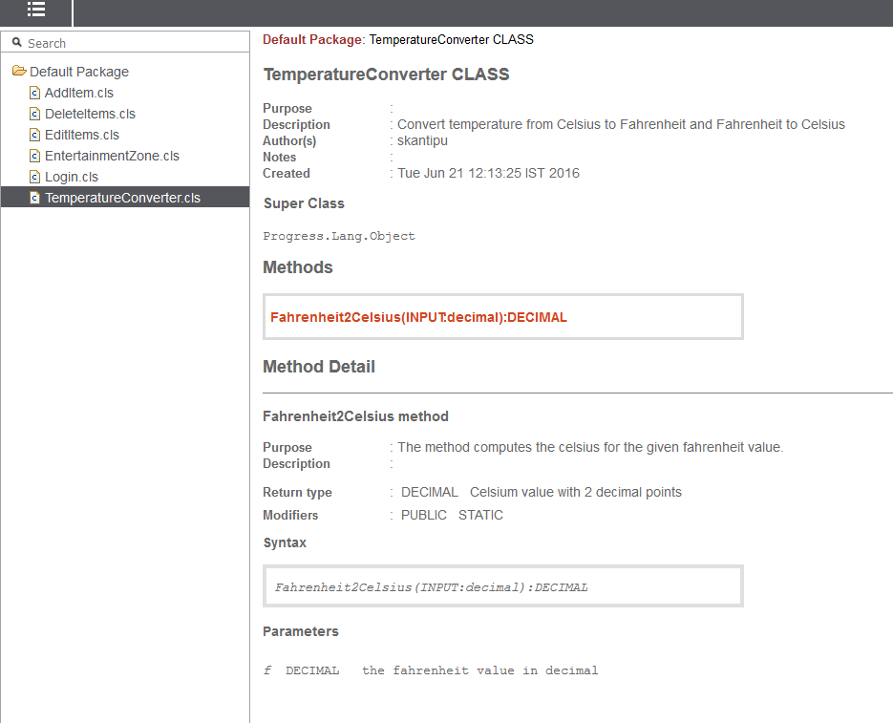
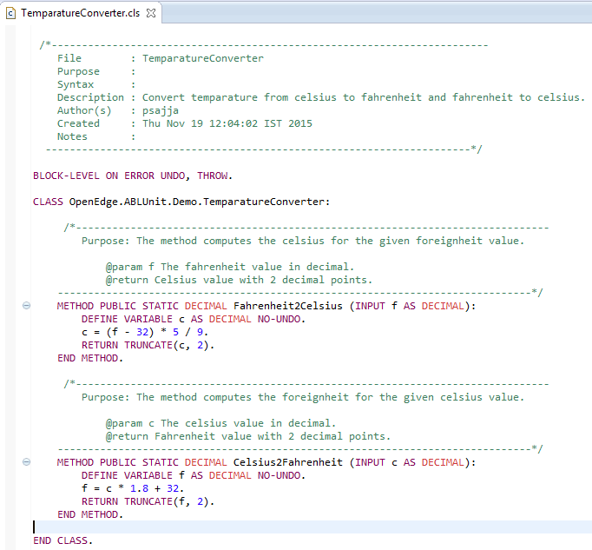
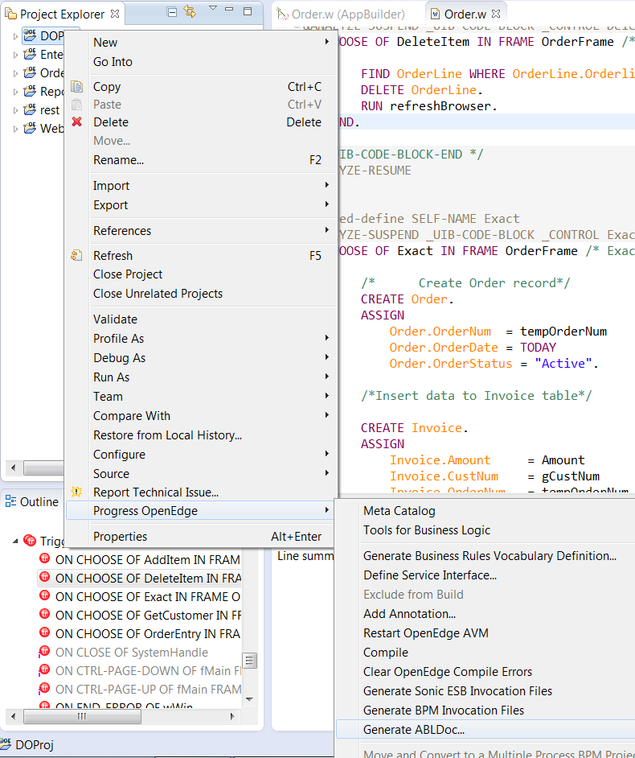
Enhancing ALM capabilities:
ABLDoc
11.5

Slide 37
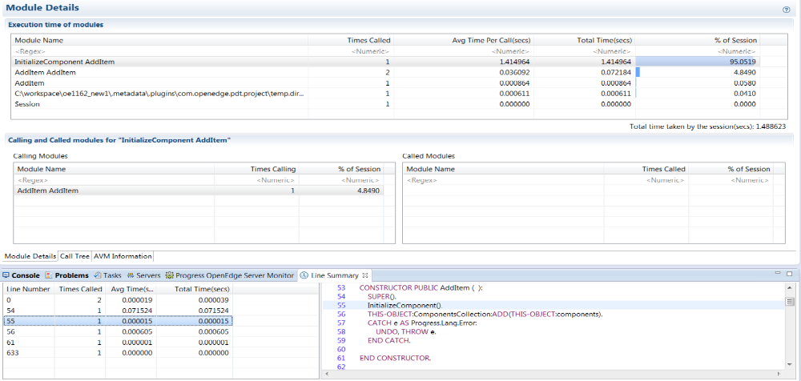
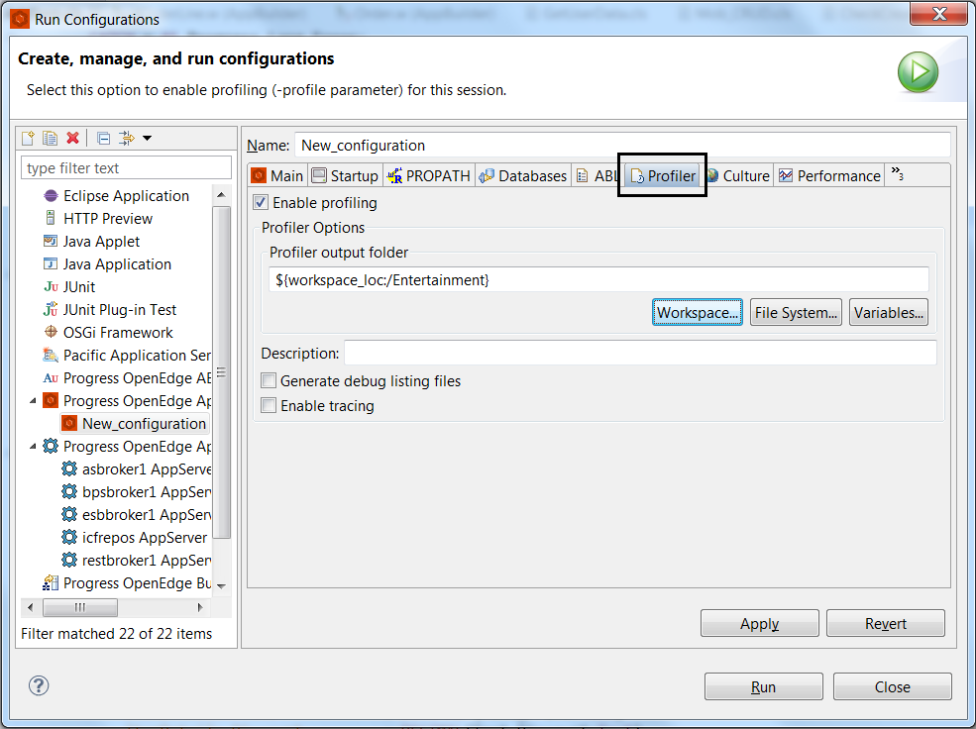
Enhancing ALM capabilities:
ABL Profiler in PDS OE
11.6
Introduced in 9.0 (-profile)
Tightly integrated with PDS OE in 11.6
Execution time of modules with micro second precision
Complete tracing information of entire session
Per-Line execution times
Most expensive lines
Percentage of time taken
No. of times called

Slide 38
To Conclude – Why should you be on 11.6?
Complete support for PASOE
Capabilities to test and profile your applications
Full support for Mobile and REST development
64 bit support
Improved server support

