Slide 1
Case Study:
Application Modernization
June 27, 2016
Rob Marshall

Slide 2
Agenda
What is Modernization
Why we did the effort
How long did this take
The old and the new
What we learned and how we worked around issues
Questions

Slide 3
What is Modernization ?
A New UI ?
Move to OO ?
A Re-write ?
Something else

Slide 4
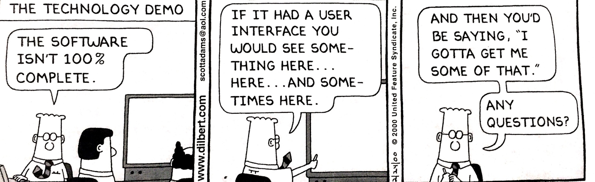
Why we did this
We wanted to expose our new consultants to a real application to get some practical experience
We wanted to prove the process
We had a subject matter expert who could work with the team

Slide 5
The “old” application
Character procedural code with embedded UI and business logic
The user interface is 80x25 terminal
There were database issues (field names) that were outdated
The code constructs and style were Progress v6 based

Slide 6
The New Environment
PDSOE was used for development, currently using restbroker but designed to support the Progress Application Server.
Developed in OpenEdge 11.5.1
The existing business logic was harvested into new Object Oriented Business Entities
The new application uses REST services and JSON datasets
The UI is Kendo, jQuery and Bootstrap
The UX team provided a vision to the team
ABL Unit was used to perform reproducible unit test cases of each condition in the new Business Entities

Slide 7
The Benefits
Runs on any computer using just the browser
Mobility can be leveraged by using Tablets
Interface is self-explanatory and extremely easy to use
User Interface relies on technologies with wide availability of professionals (JavaScript, HTML5, CSS)
Modern User Experience can improve end-user productivity
Architecture can help reduce infrastructure costs
Uses current IT leading Security Technology
(Tomcat & Spring Security framework)

Slide 8
What was done:
Login page
Single Page Application Landing Page with Menu
6 Maintenance screens (CRUD) converted
Patron Inquiry function migrated (approx. 130 character screens)
88 new web template pages created
34 new Business Entities created

Slide 9
How long did it take ?
Good question.
Staff:
1 Senior developer who knew the application very well
5 Junior developers
Time:
Total of 10 weeks elapsed time

Slide 10
Agenda
What is Modernization
Why we did the effort
How long did this take
The old and the new
What we learned and how we worked around issues
Questions

Slide 11
The current look of the application

Slide 12
The vision from the UX team

Slide 13
The reality

Slide 14
Current Maintenance Screens

Slide 15
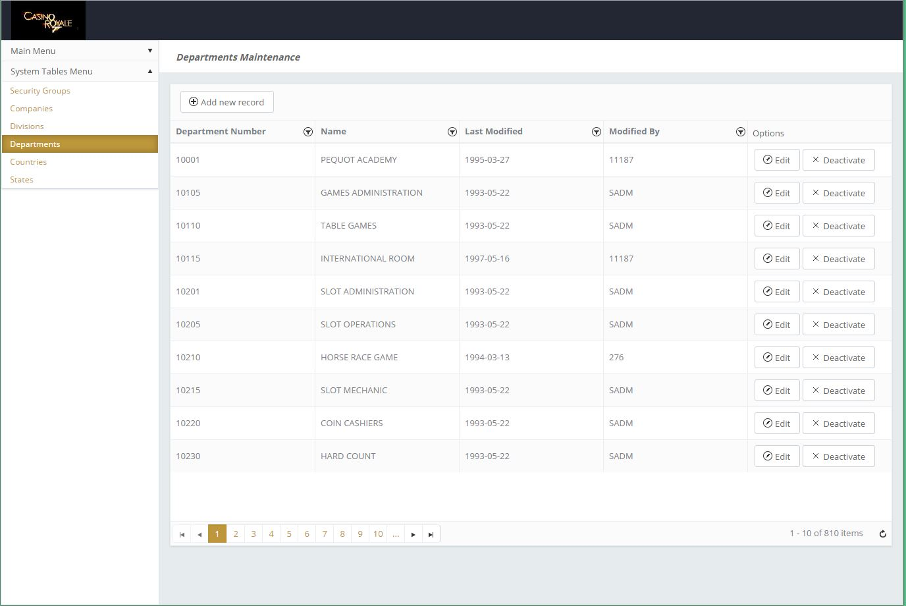
The reality

Slide 16
Current Patron Search

Slide 17
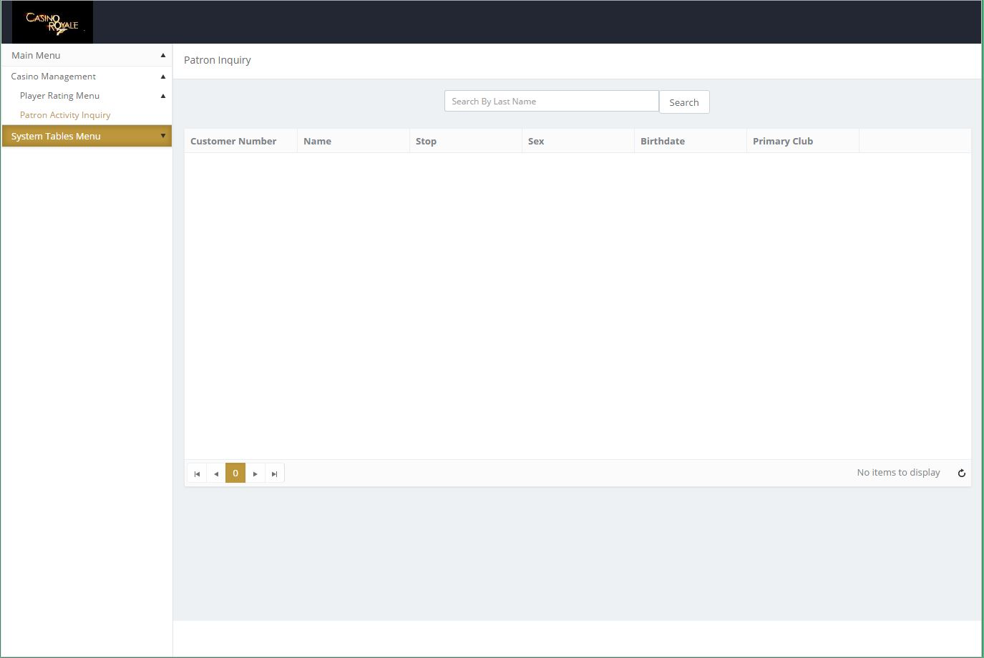
The reality

Slide 18
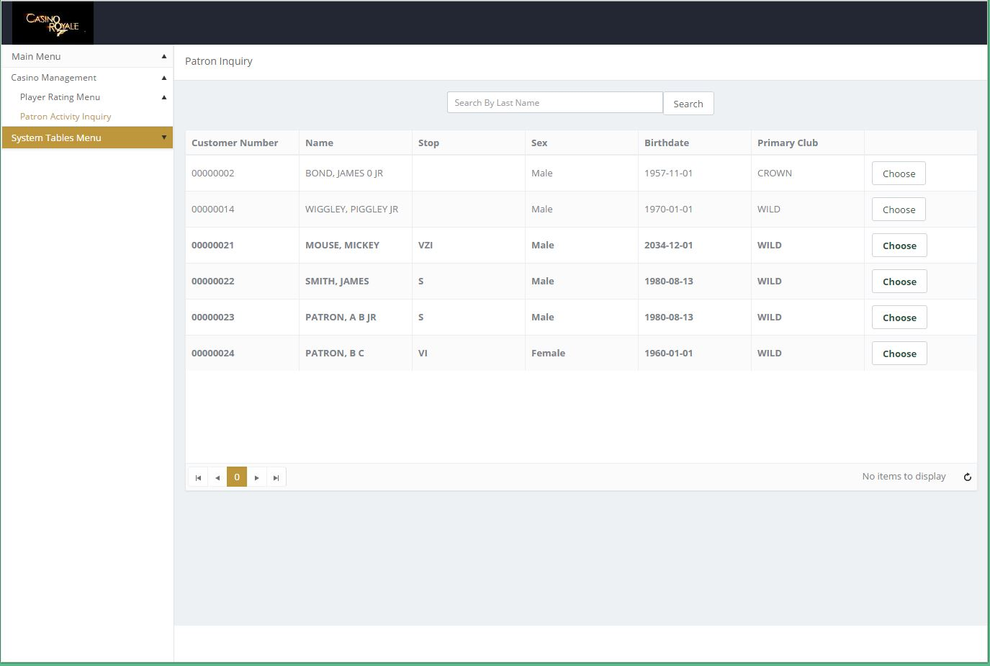
The reality

Slide 19
Patron Landing Screen

Slide 20
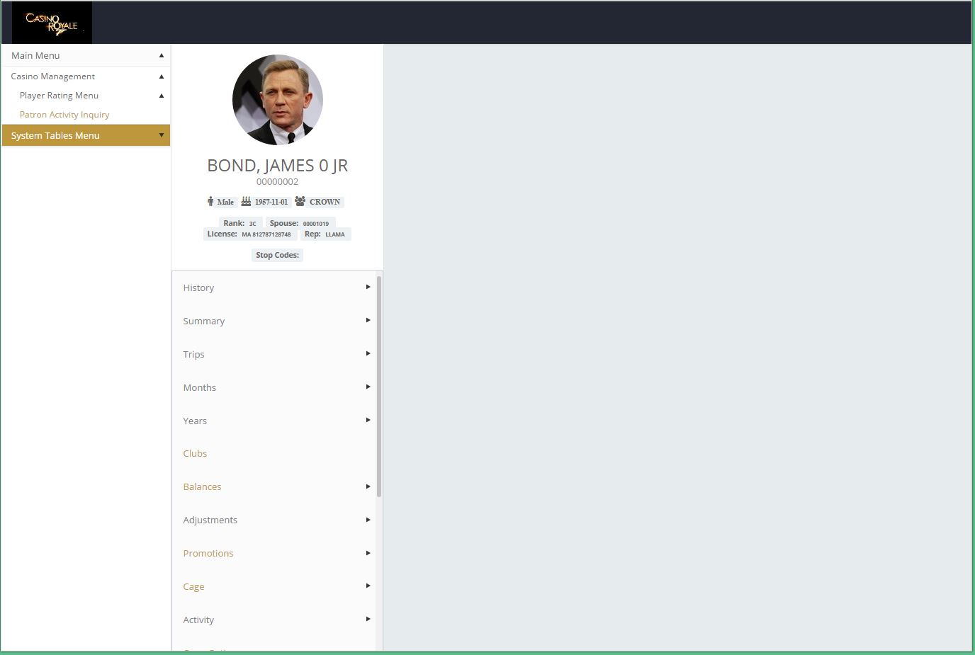
The reality

Slide 21
Patron Activity Screen

Slide 22
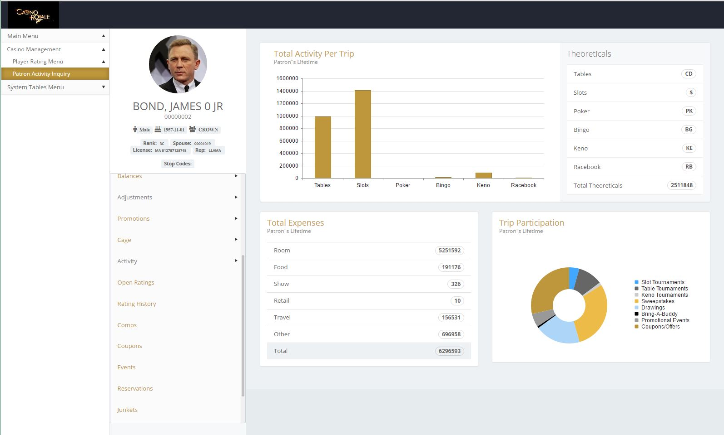
The reality

Slide 23
Patron Club Screen

Slide 24
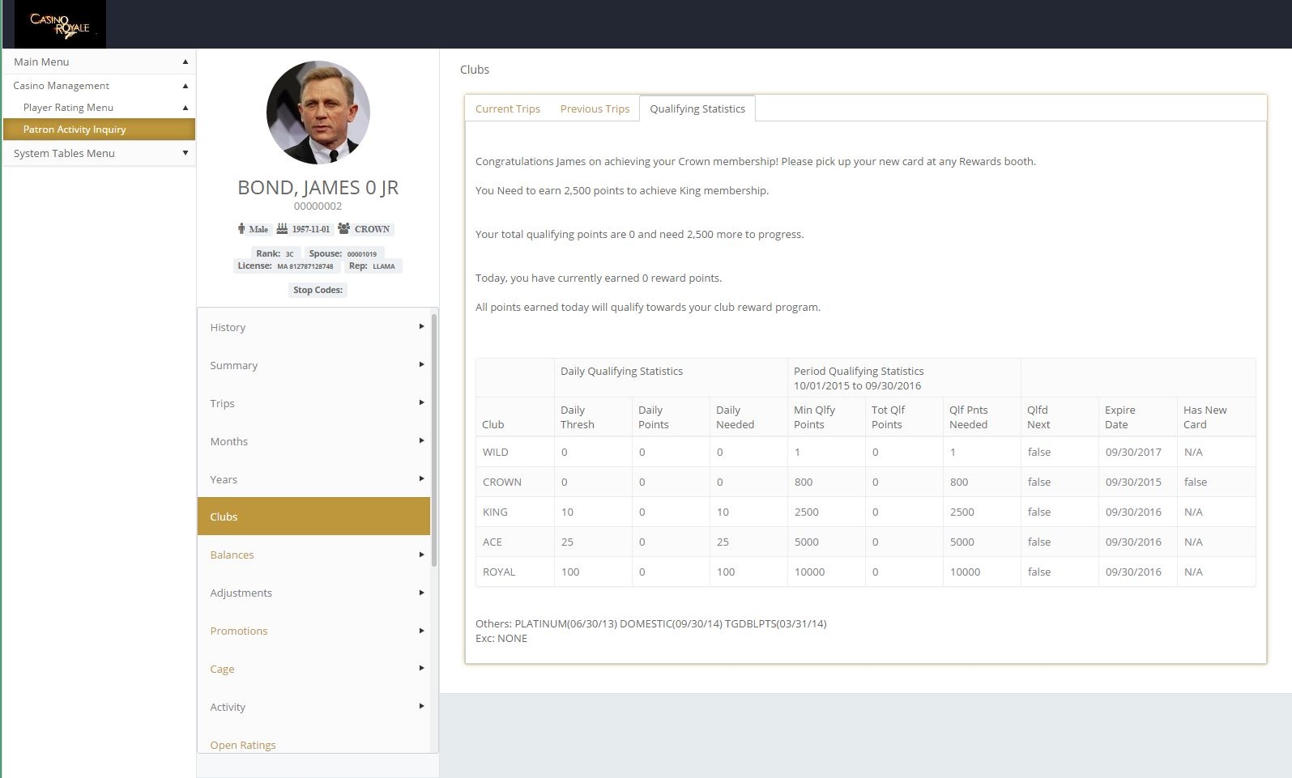
The reality

Slide 25
Patron Summary Screen

Slide 26
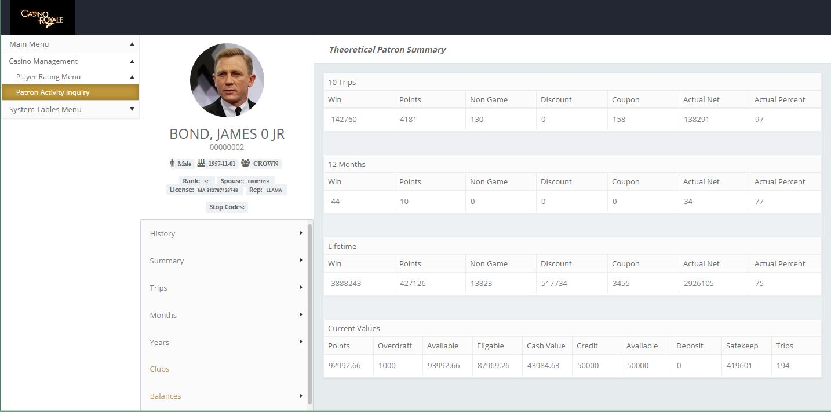
The reality

Slide 27
What we learned and how we worked around issues

Slide 28
Related Sessions:
484: Give Your Project a Spark
380: A Simple Approach to Modernize WebSpeed with Kendo UI
844: Pulling Back the Curtain on Application Modernization

Slide 29
Questions ?

