Slide 1
Integrating & Troubleshooting SSL/TLS Connections with Various OpenEdge Clients and Servers.
Mike Jacobs
Senior Software Architect
Progress
Arun Kumar Mohapatra
Principal Software Engineer
Progress

Slide 2
Agenda
Essentials of SSL/TLS
SSL/TLS in OpenEdge
Configuration & Debugging SSL/TLS in OpenEdge

Slide 3
SSL/TLS Layers of Security.

Slide 4

SSL/TLS Layers of Security
Widely used protocols for transport layer security.
SSL (Secure Socket Layer)
  Developed by Netscape in mid 1990s.
    SSLv1.0 (never publicly released)
    SSLv2.0 (is deprecated now)
    SSLv3.0 (is widely supported.)
TLS (Transport Layer Security)
  Internet Engineering Task Force (IETF) enhanced SSL to TLS.
    TLSv1.0 ( released in 1999)
    TLSv1.1 (released in 2006)
    TLSv1.2 (released in 2008)
  (IETF is a large open international community of network designers, operators, vendors, and researchers concerned with the evolution of the Internet architecture and the smooth operation of the Internet)

Slide 5
SSL/TLS Layers of Security… continue
Provides
Authenticity
The ability to identify user/application/system before making communication
Using digital certificate
Confidentiality
Protecting sensitive data/information from unauthorized user
Using encryption
Configuration
Comprises of three things
Standard ( cryptographic protocols)
i.e. TLSv1.2/TLSv1.1/TLSv1.0/SSLv3)
Cipher
Integrity
Process to identify the unauthorized modification of data during transit
Using MAC (Message Authentication Code)
Certificate

Slide 6
Cipher.

Slide 7


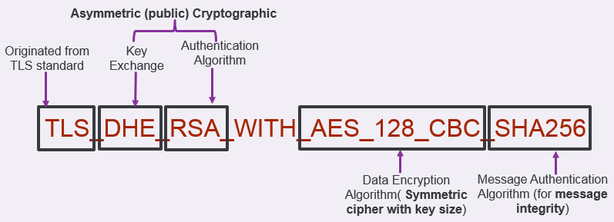
Cipher - An assortment of cryptographic algorithms.
During SSL handshake, both Client and Server should agree on a common cipher suite/cipher suite name.
Basic elements of a cipher
  Protocol (SSL/TLS)
  Key Exchange Algorithm (RSA/DH/ECDH/ECDHE)
  Authentication Algorithm (RSA/DSA/ECDSA)
  Data Encryption Algorithm (AES/RC4/3DES)
  MAC Algorithm (SHA/MD5/SHA2 family)

Slide 8
OpenEdge Ciphers
OpenEdge uses abbreviated names for cipher.
OE Cipher Suite Name | Fully Qualified Name
AES256-SHA256 | TLS_RSA_WITH_AES_256_CBC_SHA256
DHE-RSA-AES128-GCM-SHA256 | TLS_DHE_RSA_WITH_AES_128_GCM_SHA256
AES128-GCM-SHA256 | TLS_RSA_WITH_AES_128_GCM_SHA256
DHE-RSA-AES128-SHA256 | TLS_DHE_RSA_WITH_AES_128_CBC_SHA256
ADH-AES128-GCM-SHA256 | TLS_DH_anon_WITH_AES_128_GCM_SHA256
DHE-RSA-AES256-SHA256 | TLS_RSA_WITH_AES_256_GCM_SHA256
AES128-SHA256 | TLS_RSA_WITH_AES_128_CBC_SHA256
AES256-GCM-SHA384 | TLS_RSA_WITH_AES_256_GCM_SHA384
DHE-RSA-AES256-GCM-SHA384 | TLS_DHE_RSA_WITH_AES_256_GCM_SHA384
ADH-AES256-GCM-SHA384 | TLS_ADH_WITH_AES_256_GCM_SHA384
AES128-SHA | TLS_RSA_WITH_AES_128_CBC_SHA
RC4-SHA | SSL_RSA_WITH_RC4_128_SHA
RC4-MD5 | SSL_RSA_WITH_RC4_128_MD5

Slide 9
Digital Server Certificates and it’s content.

Slide 10
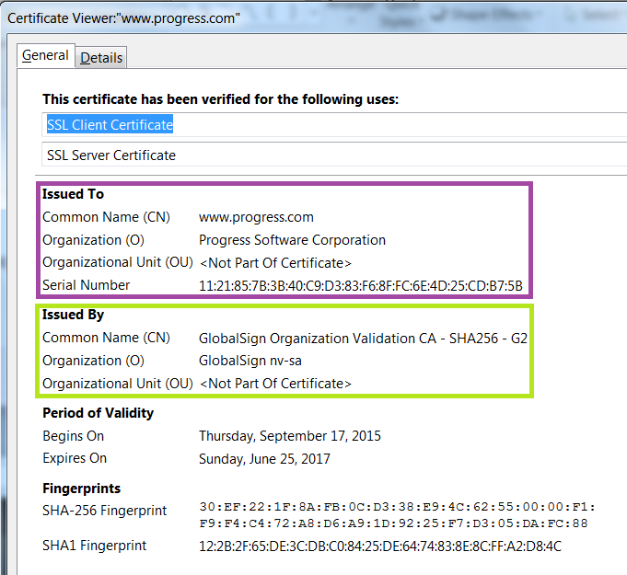
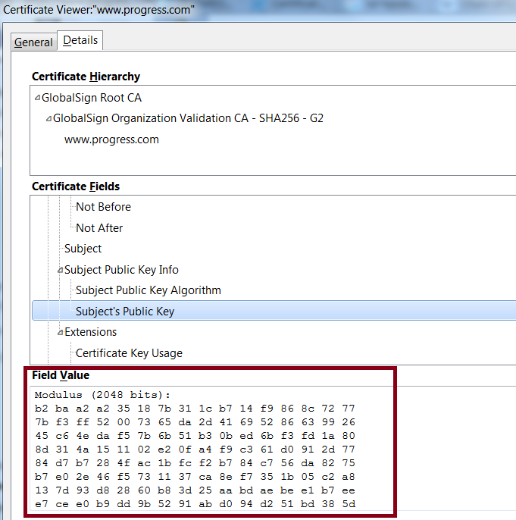
Digital Server Certificate
Identity of application (server) on network (just like personal ID cards)
Digital Server Certificate contains
  Public Key
  Identity of Certificate Owner
  Identity of CA ( Certificate Authority who validates identity of certificate holder and issue the certificate)
Windows Certificate Viewer info
Digital Server Certificate contents can also be viewed using proenv command
  sslc x509 –text –noout –in <cert name> i.e. sslc x509 –text –noout –in defaultxx

Slide 11




How to get Digital Server certificate?
OpenEdge ‘pkiutil’ command-line tool helps to get digital server certificate.
OE User
OE User
Certificate Authority
Private Key (*.pk1 format)
Private Key (*.pk1 format)
Verify
User Identification
Build Certificate for user
OE PKIUTIL
OE PKIUTIL
Public Key
+
User Identification
(*.pk10 format)
*.cer
*.pk10
Public Key
Certificate Authority Identification
User Identification
import
CA Root
Certificate
*.0
Inside DLC/certs
Digital Server Certificate(*.pem)
DLC/keys
OE CERTUTIL
import

Slide 12

SSL/TLS Handshake

Slide 13

SSL/TLS Handshake
SSL/TLS Client
(Ex: OE Client or Web Browser)
SSL/TLS Server
(Ex: OE AppServer or any Web Server)
Non Secure Transport connection
1. Client Request includes supported SSL version, ciphers suites etc.
3. Client Validation: Client checks crypto parameters & validates server public key (checking signature from trusted CA from its certificate store), and successfully authenticates server.
OE client uses DLC/certs as certificate store.
2. Client Response includes compatible SSL protocol & cipher, AND server certificate containing its public key (NOT private!)
4. Key Exchange client creates a pre-master secret for the session, encrypts it with the server public key and send the encrypted pre-master secret to server **
5. Session Key Exchange Client generate session keys* from pre-master secret.
5. Session Key Exchange Server generate session keys* from pre-master secret.
6. SSL Session Established Messages encrypted with shared secrete key are exchanged between client & server.

Slide 14
SSL/TLS Handshake (Host Name Verification)
Apart from standard SSL handshake , OpenEdge Client does host name verification to validate server.
OpenEdge verifies the host name against the Common Name listed in the server certificate.
If that does not match , it returns authentication error (9991) in handshake and terminate the connection in between.
SSL/TLS Server
(Ex: OE AppServer or any Web Server)
OE SSL/TLS Client
hServer:CONNECT ("-AppService ASName -H alias1a.mydomain.com
-S 12345 –ssl…)
Client matches the CN name (from server certificate) to the host it is connecting.
If that matches then SSL handshake will be successful.
If not then client will terminate the connection with 9991 authentication error.
Host verification is an optional process, if anyone wants to disable it , then use ”-nohostverify”, connection parameter.
SSL Handshake
CN: alias1a.mydomain.com
Digital Server certificate

Slide 15
SSL/TLS Vendors in OpenEdge.

Slide 16

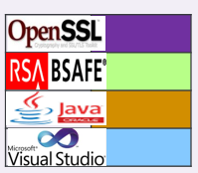


OpenEdge communication endpoint.
OpenEdge
ABL
applications
(GUI,Char,AppServer,WebSpeed)
OpenEdge
ABL
applications
(GUI,WebClient)
OpenEdge
ABL
applications
(GUI,WebClient)
Web browser clients
PDSOE
Java Open Clients
Dot Net Open Client
Java Open Clients
Dot Net Open Client
OEM
AppServer (Broker)
OpenEdge Generic JMS Adapter
Internet HTTPS
AppServer (Agent)
1.0.1m
6.1.2
Sonic MQ
WS MQ
Active MQ
Sonic ESB (SSL Server)
WebServer (SSL Server)
PAS for OpenEdge
1.7.0_45
OpenEdge Adapter for Sonic ESB
Web Service Adapter
(WSA)
OpenEdgeREST Adapter
AppServer Internet Adapter (AIA)
WebSpeed Messenger
HTTP
APSV(AIA)
SOAP
REST/Mobile
4.0/4.5
JDBC
ODBC
Session Manager
Session Manager
AppServer (Broker)
WebSpeed (Broker)
OpenEdge RDBMS (SQL or ABL database server)
OpenEdge Generic JMS Adapter
Multi-Session Agent
AppServer (Agent)
WebSpeed (Agent)
MQ Broker

Slide 17
SSL/TLS Known Vulnerabilities.

Slide 18

SSL/TLS Known Vulnerabilities
SSL Endpoint Vulnerability
BEAST (Brower Exploit Agent SSL/TLS )
FREAK (Factoring Attack on RSA-Export keys)
SSL Certificate Vulnerability
Exploits SHA1 & MD5 singed certificates
BREACH (Browser Reconnaissance & Exfiltration via Adaptive Compression of Hypertext)
CRIME (Compression Ratio Info-leak Made Easy)
RC4 attack
Weak Public Keys
Certificate generated with a weak key (less than 2048 bits), has more chance to vulnerable.
Exploits TLSv1.0/SSLv3 with CBC ( i.e. block-cipher-suite) ciphers
Exploits Export ciphers suite (i.e. TLS_RSA_EXPORT_XXXX_XXXX)
Exploits HTTP Layer compression
Affect TLS layer data compression
RC4 ciphers with all SSL/TLS version
POODLE (Padding Oracle On Downgraded Legacy Encryption)
Exploits SSLv3/TLSv1.0 protocols

Slide 19
SSL/TLS Known Vulnerabilities…continue
Industries best practices to avoid SSL/TLS vulnerabilities
s
Update the systems regularly (Regular system updates can fix most know vulnerabilities)
Use safer protocols
  TLSv1.2 – Safest ; Supports the newest cipher suites
  TLSv1.1 – Safe; Some ciphers are not supported
  TLSv1.0 – SSL/TLS baseline; BEAST vulnerability
  SSLv3 – Unsafe/outdated; POODLE vulnerability
  SSLv2 – Unsafe/outdated; multiple vulnerability
1
Use Secure Digital Certificates
  Use newer SHA2/SHA-256 singed certificates.
  Public key size of 2048 bits (or higher)
2
Use Safe cipher suites
3
 | Algorithm to be replaced | Algorithm to be used
Encryption algorithm | MD5, RC4, DES, 3DES | AES128, AES256 (CBC & GCM mode)
Hash algorithm | SHA1 | SHA256, SHA384
4
Disable SSL/TLS compression settings on server/client side, however using SSL/TLS compression is susceptible to CRIME attacks.

Slide 20
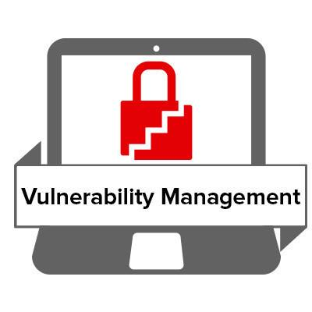

Does OpenEdge mitigates SSL/TLS POODLE & recent vulnerabilities?

Slide 21


OpenEdge changes to mitigate vulnerabilities
Changed default SSL protocol to TLSv1.2 (Servers & Clients)
Supported safe ciphers suites (like AES128-SHA256 & AES256-SHA256) as default.
Mitigates
SSL Endpoint vulnerability
Disabled SSL/TLS compression setting (at server & client).
Changes default server certificate (DLC/keys/default-server.pem) to singed with SHA256.
Supported complete SHA2 family singed certificates.
Mitigates
SSL Certificate vulnerability

Slide 22
Default SSL protocols & ciphers - OpenEdge Server
OE | Default SSL protocols | Supported protocols | Default SSL ciphers | Supported SSL ciphers | Mitigates
11.6.X | TLSv1.2 | TLSv1.2 TLSv1.1 TLSv1 SSLv3 | AES128-SHA256 AES128-GCM-SHA256 AES256-SHA256 DHE-RSA-AES256-SHA256 DHE-RSA-AES128-GCM-SHA256 DHE-RSA-AES128-SHA256 | AES128-SHA256 AES128-GCM-SHA256 AES256-SHA256 DHE-RSA-AES256-SHA256 DHE-RSA-AES128-GCM-SHA256 DHE-RSA-AES128-SHA256 AES256-GCM-SHA384 DHE-RSA-AES256-GCM-SHA384 ADH-AES256-GCM-SHA384 AES128-SHA RC4-SHA RC4-MD5 | TLS POODLE SSL POODLE FREAK (no export ciphers) CRIME (No TLS compression) BREACH (No HTTP compression) RC4 attack BEAST
11.5.1 | TLSv1 | TLSv1 SSLv3 | AES128-SHA | AES128-SHA RC4-SHA RC4-MD5 | SSL POODLE FREAK CRIME BREACH RC4 attack Note: BEAST affected.
11.4.0 (Latest HF) | TLSv1 SSLv3 SSLv2 | TLSv1 SSLv3 SSLv2 | RC4-SHA RC4-MD5 | AES128-SHA RC4-SHA RC4-MD5
11.3.3 (Latest HF)
102b08 (Latest HF)

Slide 23
Default SSL protocols & ciphers - OpenEdge Client
OE | Default SSL protocols | Supported protocols | Default SSL ciphers | Supported SSL ciphers | Mitigates
11.6.X | TLSv1.2 | TLSv1.2 TLSv.1.1 TLSv1 SSLv3 | AES128-SHA256 AES128-GCM-SHA256 AES256-SHA256 DHE-RSA-AES256-SHA256 DHE-RSA-AES128-GCM-SHA256 DHE-RSA-AES128-SHA256 | AES128-SHA256, AES128-GCM-SHA256 AES256-SHA256 DHE-RSA-AES256-SHA256 DHE-RSA-AES128-GCM-SHA256 DHE-RSA-AES128-SHA256 AES256-GCM-SHA384 DHE-RSA-AES256-GCM-SHA384 ADH-AES256-GCM-SHA384 AES128-SHA RC4-SHA RC4-MD5 | TLS POODLE SSL POODLE FREAK (no export ciphers) CRIME (No TLS compression) BREACH (No HTTP compression) RC4 attack BEAST
11.5.1 | TLSv1 | TLSv1 SSLv3 | AES128-SHA | AES128-SHA RC4-SHA RC4-MD5 DES-CBC3-SHA DES-CBC-SHA | SSL POODLE FREAK CRIME BREACH RC4 attack Note: BEAST affected.
11.4.0 (Latest HF) | TLSv1 SSLv3 SSLv2 | TLSv1 SSLv3 SSLv2 | RC4-SHA RC4-MD5 | AES128-SHA RC4-SHA RC4-MD5 DES-CBC3-SHA DES-CBC-SHA
11.3.3 (Latest HF)
102b08 (Latest HF)

Slide 24
Changing default protocols & ciphers - OpenEdge Server
Servers | Options (to change default ciphers & protocols) | Description
AppServer Broker | PSC_SSLSERVER_PROTOCOLS PSC_SSLSERVER_CIPHERS | Environment variable need to be set in Environment variable section of ubroker.properties file. [Environment.<Broker_Name>] PSC_SSLSERVER_PROTOCOLS=TLSv1.1,SSLv3 PSC_SSLSERVER_CIPHERS=AES128-SHA,RC4-MD5 Set these environment variables before start the database in SSL mode to set ciphers & protocols other than default.
WebSpeed Broker
REST Broker
ESB Broker
OpenEdge Database
OpenEdge PAS Server | psc.as.https.protocol psc.as.https.ciphers | tcman config psc.as.https.protocol=TLSv1 tcman config psc.as.https.ciphers=AES128-SHA256
PDSOE | defaultHttpProtocol configuredCipherSuites | dlc\oeide\eclipse\plugins\com.openedge.pdt.debug.core_11.x.x.00\clientProtocols.properties.
OpenEdge SQL Database | PSC_SSLSERVER_PROTOCOLS PSC_SQL_SSLSERVER_CIPHERS | OE SQL DB uses same environment variable for SSL protocol change but different environment variable for ciphers.

Slide 25
Changing default protocols & ciphers - OpenEdge Clients
Client Environment variables:
  PSC_SSLCLIENT_PROTOCOLS
  PSC_SSLCLIENT_CIPHERS
Connection specific configuration:
Clients | Options (to change default ciphers & protocols) | Description
ABL | -sslprotocols, -sslciphers | As connection parameters to OE AppServer or any external Webserver.
ABL (SOAP out) | -sslWSDLProtocols,-sslWSDLCiphers, -sslSOAPProtocols, -sslSOAPCiphers | As connection parameter to external SOAP services.
Java Open Client | PROGRESS.Session.sslprotocols PROGRESS.Session.sslciphers | As system property to Java client process. Example -DPROGRESS.Session.sslprotocols=TLSv1.2 -DPROGRESS.Session.sslciphers=AES128-SHA256
Dot Net Open Client | PROGRESS.Session.sslprotocols PROGRESS.Session.sslciphers | Need to set these properties inside application config file.

Slide 26
Changing default protocols & ciphers - Adapters & OEM
Adapters |  | Options (to change default ciphers & protocols) | Description
REST Adapter |  | PSC_SSLCLIENT_PROTOCOLS PSC_SSLCLIENT_CIPHERS | Set these environment before stating the web server in which AIA,WSA, REST & Messengers are configured.
Approver Internet Adapter(AIA)
Web Service Adapter (WSA)
WebSpeed Messenger (Cgiip, wsasp etc.)
OEM (Makes uses of SSL in two places) | Jetty Web Server | SSLEnabledProtocols SSLEnabledCipherSuites | $DLC/properties/fathom.properties
 | ActiveMQ transport connector for remote monitoring. | enabledProtocols enabledCipherSuites | $DLC/properties/management.properties

Slide 27
OpenEdge SHA2 singed certificate Support to mitigate SSL Certificate vulnerability.

Slide 28

SHA2 Support
Pre 11.x releases OE supported only SHA1 & MD5 singed certificates.
OpenEdge extended supporting SHA2 singed certificate to mitigate “SSL certificate vulnerability”.
OpenEdge releases support SHA2 family.
11.6.0
OE supports complete SHA2 family
SHA256
11.5.1 (11.5 Service Pack-1)
102b08 (latest HF)
11.3.3 (latest HF)
11.4.0 (latest HF)
SHA224
SHA384
SHA512
‘SSLC’ command to check supported message digest (sslc dgst -h)

Slide 29
Troubleshooting
SSL/TLS errors in OpenEdge

Slide 30
Logging
OE Components build on top-up“OpenSSL” library
OE Components build on top-up
“BSAFE-RSA & JSSE” library
OE Components build on top-up
.Net Framework
Environment Variable:
SSLSYS_DEBUG_LOGGING
Java System Properties:
javax.net.debug
com.rsa.jsse.logFile(=<log file >)
.Net Framework:
Application Configuration file

Slide 31
Logging(Using SSLSYS_DEBUG_LOGGING)
OpenEdge components which are build on top OpenSSL library has support of environment variable “SSLSYS_DEBUG_LOGGING” to generate SSL layer logs.
There are 2 separate log files are created “cert.client.log” & “cert.server.log” for client and server components.
ABL client and when AppServer/WebSpeed agent running as a client to other AppServer or OE Database then it will generate “cert.server.log” file.
All other server components like AppServer/WebSpeed agent, OE DataBase & OE SQL database generate “cert.server.log” file.
SSLSYS_DEBUG_LOGGING=1, logs only errors.
SSLSYS_DEBUG_LOGGING=2,
SSLSYS_DEBUG_LOGGING=3,
SSLSYS_DEBUG_LOGGING=4,
SSLSYS_DEBUG_LOGGING=5,
logs errors and progress internal ssl messages.
adds rsa state information.
adds rsa buffer information
adds rsa buffer dumps.

Slide 32
Logging (Using Java System properties)
Classic AppServer Broker
DLC/properties/ubroker.properties file in ‘jvmArgs’ properties of the broker.
PAS Server
pasinstance/conf/jvm.properties
PDSOE
  DLC/oeide/eclipse/eclipse.ini
Java OpenClient
Command line argument to Java Open Client application.
Debugging Option:
-Djavax.net.debug=ssl ~ turn on ssl debugging
The following options can be use with ssl:
handshake print each handshake message
keygen print key generation data
session print session activity
defaultctx print default SSL initialization
sslctx print SSLContext tracing
sessioncache print session cache tracing
keymanager print key manager tracing
trustmanager print trust manager tracing
Example:
-Djavax.net.debug=ssl:handshake ~ handshake debugging
Adapters (AIA/WSA/
REST)
If deployed inside PAS Server then define the java system properties in pasinstance/conf/jvm.properties
OpenEdge Management
(OEM)
  Using java properties in AdminServerPlugins.properties” file in “PluginPolicy.Fathom”

Slide 33
Logging (Using .Net Framework)
Dot-Net Open Client
  Enable “System.Net” trace in application configuration file.
  Refer this link
  https://blogs.msdn.microsoft.com/asiatech/2009/04/08/using-system-net-trace-to-troubleshooting-ssl-problem-in-net-2-0-application/

Slide 34
Common SSL Errors Codes
OpenEdge SSL Error Code | Description
12056 | Invalid SSL parameter.
12061 | SSL Threading failure.
12063 | SSL Server initialization error.
12064 | SSL is not supported on this platform.
12065 | SSL Server Unable to load private key.
12066 | SSL Server private key check failure.
12067 | SSL Server create client error.
12068 | SSL Server accept error
12069 | SSL write error
12070 | SSL read error
12071 | SSL Client initialization error
12072 | SSL Client server authentication error.
12073 | SSL Client handshake error.
12193 | SSL Server certificate expired or not yet valid
Channel Error Codes
OpenSSL
https://www.mkssoftware.com/docs/man1/openssl_verify.1.asp
BSAFE RSA
http://www.convertwriteservices.com/assets/docs/API/certc_reference/Reference/Cert-C_ErrorCodes_AlphaList.html
JSSE
http://docs.oracle.com/javase/7/docs/technotes/guides/security/jsse/JSSERefGuide.html
.Net Framework
https://msdn.microsoft.com/en-us/library/windows/desktop/dd721886(v=vs.85).aspx

Slide 35
Tools for debugging

Slide 36
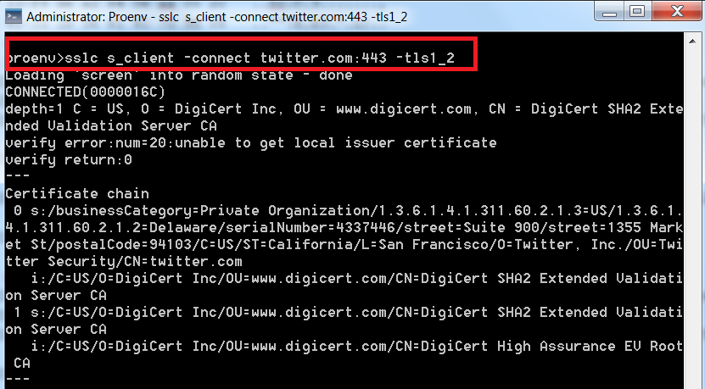
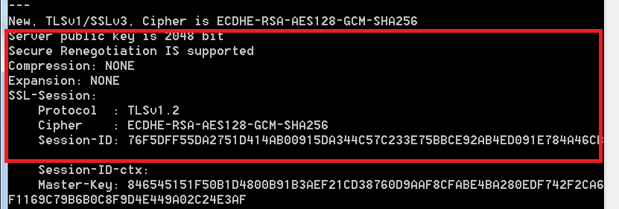
Tools
Command line tools
  DLC/bin/sslc
  SSLyze
DLC/bin/sslc tool use to check ssl connection and cipher suites/protocols

Slide 37
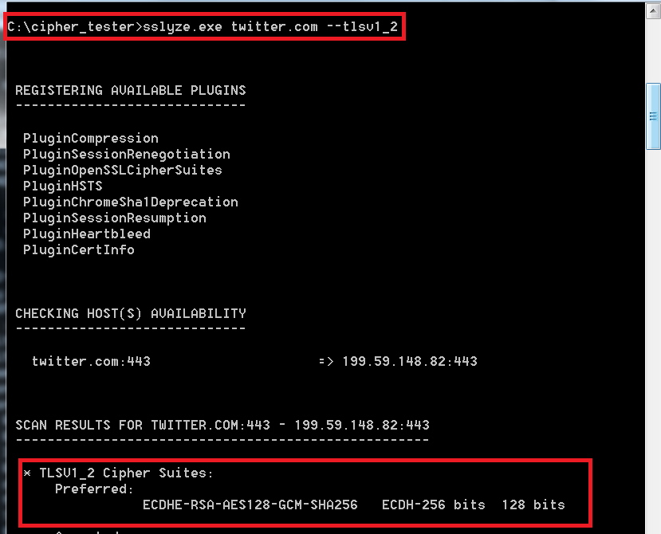
Tools
SSLyze tool for checking preferable cipher suites.
Online tools
  https://www.ssllabs.com/ssltest/
  https://www.poodletest.com/
  http://www.whodig.com/poodle/
  http://poodletest.ntt-security.com/

Slide 38


