Slide 1
A Migration Story: From Big Iron to a "Commodity Server"
Abstract: This real-life case-study of the migration of a 1,500+ user system from
Solaris to Linux will examine the question of how large a user load a Linux
Server can support. We will explore the reasons for the migration, the
tools used to benchmark and validate the target system, discuss tuning
adjustments and changes, the methodology used to ensure a successful
migration, share the results of this project and talk about where projects
like this might go in the future!

Slide 2

A Migration Story
From Big Iron
to a
"Commodity Server"
Tom Bascom
White Star Software
tom@wss.com

Slide 3
A Few Words about the Speaker
Tom Bascom; Progress user & roaming DBA since 1987
Partner, White Star Software, LLC
  Expert consulting services related to all aspects of Progress and OpenEdge.
  tom@wss.com
Partner, DBAppraise, LLC
  Remote database management service for OpenEdge.
  Simplifying the job of managing and monitoring the world’s best business applications.
  tom@dbappraise.com
Notes:
I have been working with Progress since 1987
… and today I am both President of DBAppraise;
The remote database management service…
where we simplify the job of managing and monitoring the worlds best business applications;
and Vice President of White Star Software;
where we offer expert consulting services covering all aspects of Progress and OpenEdge.

Slide 4


Who is White Star Software?
The oldest and most respected independent OpenEdge DBA consulting firm in the world!
Four of the world’s top independent OpenEdge DBAs!
Author of ProTop, the #1 FREE OpenEdge Database Monitoring Tool:
      http://dbappraise.com/protop.html

Slide 5
The Starting Point
A large, international distribution center
Approximately 1,500 users all over Latin America
Running OpenEdge 11.3 on Solaris
The bulk of users are “green screen” TTY users
There is a “web store” and various bolt-ons
A GUI transformation project is underway

Slide 6
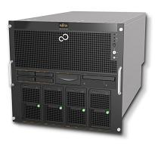
Production Server
SUN M5000
Introduced in 2007, live in 2010
48 cores @ 2.5GHz, 128GB RAM
10 U of rack space
List price $150,000 (stripped)
E-bay now has them for $4,000

Slide 7
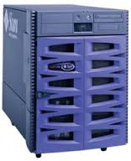
Replication Target
SUN V890
First shipped in 2001, EOL 2009
16 cores @ 1.5GHz, 64GB RAM
17 U of rack space
List price $50,000 (stripped)
E-bay now has them for $80

Slide 8

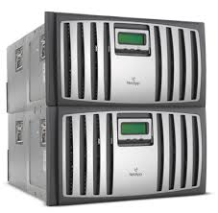

NetApp Filers
Ugh ☹
Expensive, proprietary and slow
Not Appropriate Storage
You couldn’t pay me to take one

Slide 9
Pain Points
Expensive, proprietary and aging servers
Expensive, proprietary and aging storage
No in-house Solaris or Netapp expertise
Poor support from the HW vendors
Business growth is being limited by the hardware

Slide 10


Slide 11
What to Do?

Slide 12
(Important Planning Meeting)

Slide 13

Important Planning Meeting

Slide 14
Business Goals
Reduce capital expense
Reduce operating costs (power, data center space, specialized staff)
More nimble growth

Slide 15
Technical Goals:
Avoid proprietary systems
Use commodity hardware
Reduce the footprint of systems
Leverage easily found admin skills
Improve DR capabilities
Consider cloud platforms

Slide 16
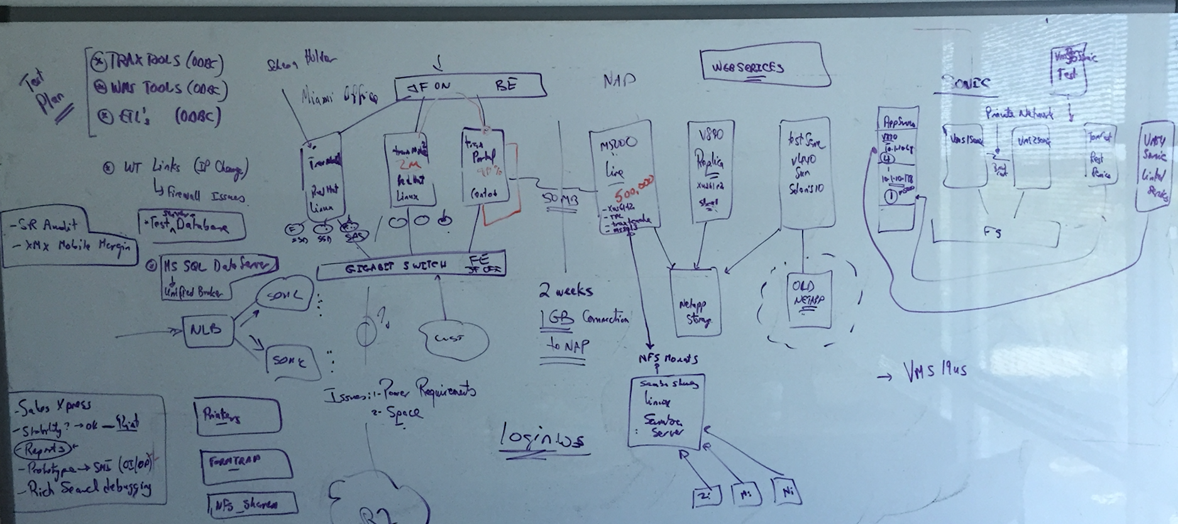
The Plan

Slide 17

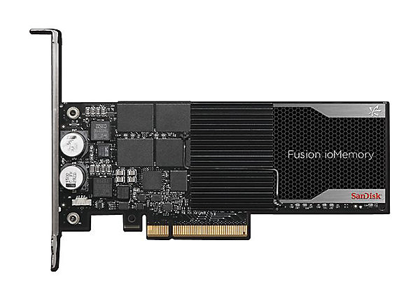
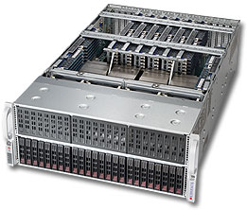
The Plan (explained a bit)
Linux (RHEL6.6) on Intel Servers
  Focus on FAST cores (Xeon 3.32GHz)
  Not lots of cores!
  We ended up with 4x6 = 24 (plus HT)
With on-board FusionIO SSD storage
  No “filer” for the db!!!
Lots of RAM – 512GB
No virtualization
Consider client/server vs shared memory
  Performance tested well
  Deferred due to cost of client networking licenses
Consider cloud (Amazon)
  Deferred until we build confidence on
  Intel HW scalability

Slide 18

Challenges
Application testing
  The initial port is easy, the application vendor supports Linux
  But “the devil is in the details” and there are a lot of customizations
  “Testers” are in limited supply
Data center space
  Not enough space in the data center for the new gear
  Many unknowns related to retiring old gear to make room
  Limited network bandwidth from office to data center (new gear started out in the office)
Scheduling
  Difficult to get commitment to a long outage window

Slide 19



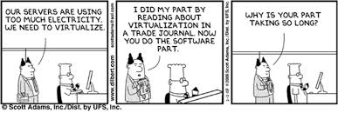
Will it even work?
Can Linux support 1,500 to 2,000 users on Intel HW?
How many TRX/sec can the proposed HW perform?
How many Record Reads/sec?
Simultaneous users?
CPU and memory?
NUMA ☹
Network?

Slide 20

Historical Data!
Luckily we have historical data – so we know what our main targets are:
  1,000 TRX/sec
  500,000 RecRd/sec
  2,000 users
At a minimum we must be able to reliably hit those metrics!
(But everyone expects big improvements)

Slide 21
Benchmarks!
ATM – ensure that we can write data fast enough
Readprobe – verify that we can read data fast enough
Spawn – make sure that everyone can login and perform useful work

Slide 22

Benchmarks are just benchmarks!
What worked well for one particular customer on a certain configuration at a particular point in time may, or may not, also work well for you.
You are strongly advised to do your own benchmarking and testing!

Slide 23
Benchmark Results
ATM; not very interesting. Bunker-tested to death. The server is plenty fast enough.
Readprobe; 20+ iterations, fastest config:
  -spin 7500
  1.3M records/sec (328K single session)
  25% CPU utilization, load average ~4
Spawn
  sysctl -w kernel.sem="8192 32000 32 8192“
  ulimit -n 1024 -u 4096 # numfiles, numproc
  ip link set eth0 mtu 9000
Notes:
# ping -M do -s 8800 traxnode1 # force 8k packets, verifies jumbo frames
PING traxnode1.intcomex.com (172.16.51.53) 8800(8828) bytes of data.
8808 bytes from traxnode1.intcomex.com (172.16.51.53): icmp_seq=1 ttl=64 time=0.048 ms
8808 bytes from traxnode1.intcomex.com (172.16.51.53): icmp_seq=2 ttl=64 time=0.018 ms
# ping -M do -s 8800 172.16.51.47 # jumbo frames being fragmented :(
PING 172.16.51.47 (172.16.51.47) 8800(8828) bytes of data.
ping: local error: Message too long, mtu=1500
ping: local error: Message too long, mtu=1500

Slide 24
Bonus Benchmark Result!
The Impact of –Mm…
…and Jumbo Frames
-Mm | Records | Messages | Rec/Msg | MB | Mbit | %Improve | Note
1024 | 216,380 | 63,584 | 3.40 | 52.31 | 418 |  | Default Mm
4096 | 430,687 | 25,652 | 16.79 | 96.08 | 768 | 183.67%
8192 | 492,149 | 14,420 | 34.13 | 109.35 | 874 | 209.04%
16384 | 519,634 | 7,358 | 70.62 | 111.36 | 890 | 212.88%
8192 | 533,143 | 15,135 | 35.23 | 114.61 | 916 | 219.10% | MTU = 9000

Slide 25

The Migration
How long will it take?
What do we do if it fails?

Slide 26
How Long Will it Take?
Dry run #1
Dump…
Load...
Index Rebuild...

Slide 27

How Long Will it Take?
Dry run #1
Dump… 24 hours
Load... 6 hours
Index Rebuild... 3 hours
Total Time: 33 hours

Slide 28

Possible Dump Improvements
Transfer of dumped data to target
Selection of index to dump with
Number of simultaneous dump sessions

Slide 29
Data Transfer
Using a shared NFS filesystem
Poor (50Mbit) network between sites:
  Dump process completely saturates network
  Other transfer methods do not help
  Compression adds too much time on both ends
If we can get the servers co-located we can use Gbit network…
But there are space problems at the data center ☹
Eventually resolved in late summer – 12 hour improvement

Slide 30
Selection of Index to Dump
“Smallest Index” helps some tables
But not the “long pole” table because it only has one index ☹
“No index” works much better
  2 hr improvement!
  (Requires type 2 storage areas)
Using “dump specified” ranges was awful
  Largest table took 16 hr vs 2hr 23min

Slide 31
Number of Dump Sessions
Reducing sessions from 16 to 8 helped a lot (Netapp appeared to be overwhelmed)
proutil multi-threaded dump was a very minor improvement
  6 minutes
  Not worth the added complexity on the load
Dump is now down to 7hr 45min...
Total time 13 hr 5min

Slide 32
Load Configuration
Tested single user vs MT with and without server
One single user session was fastest
  MT: 6hr
  Single session, with server: 3hr 26min
  Single session, no server: 2hr 20min
Overlapping load with dump works best – why wait to start loading?

Slide 33

One Last Trick…

Slide 34
One Last Trick…
OpenEdge Replication is in use…

Slide 35
One Last Trick…
OpenEdge Replication is in use…
Use the replication target to off-load some work
Specifically move the dump of the 8 largest tables to the replication server

Slide 36
One Last Trick…
OpenEdge Replication is in use…
Use the replication target to off-load some work
Specifically move the dump of the 8 largest tables to the replication server
Dump time reduced to 2hr 31min
Total time: 5hr 30min

Slide 37
Is There More?
Maybe…
There is 25-30 minutes of waiting for the longest dump to finish
By re-arranging the dumps and moving that one to the server with faster CPUs I could probably eliminate that wait.
Testing the “in-line” index rebuild might be interesting too.
But we are out of time for experiments ☹

Slide 38
Final Dry Run
Use both Production and Replication Target servers
Use no-index binary dumps
Use a pre-built database with fixed extents
Use a single-user, single-thread binary load
Leverage the new(ish) idxbuild parameters
Overlap the dumping & loading
Improved from 33hrs to under 6 hours!

Slide 39
Are We Ready?

Slide 40
What if it Fails?
(and we don’t notice problems right away?)
Rekey?
  Feasible for a short period...
  Especially if inventory and financial transactions are carefully controlled
Dump & Load in Reverse?
  The dump will be fast ☺
  The load and index rebuild will not be described as “fast”
Subvert Auditing?
  Maybe someday ;)

Slide 41


Actual Migration #1
Started out fast! The dumps were going very well!
But the loads seemed to draaaaag…
3x slower than dry runs ☹
Idxbuild awful ☹ ☹
Record count mismatch ☹ ☹ ☹
Transaction and inventory data is wrong!!!

Slide 42

Oh The Humanity!

Slide 43

What Went Wrong?
A lot of last minute configuration changes on the target server – it should have been rebooted
I was persuaded to allow some read-only batch jobs to run during the dump

Slide 44

On the bright side…
The source database is untouched. We can revert to it at any time.
We caught it – just imagine if we had not ☹
Even though it was a lot slower than hoped it is still only Saturday afternoon!
We have plenty of time to do it again

Slide 45
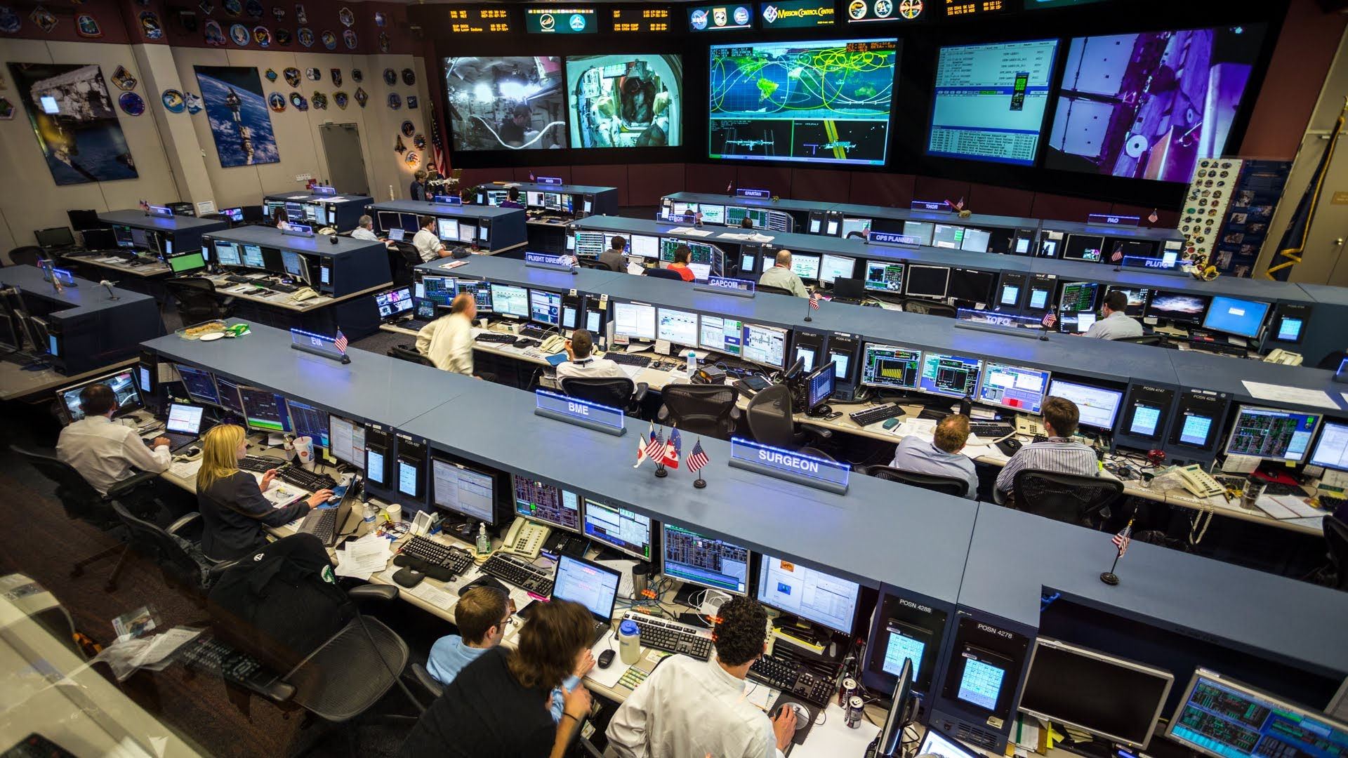

Slide 46
Actual Migration #2
Target server rebooted, no extra processes running…
Servers are all responding properly
Dump and load completes in 5hr 27min
Records counts match!
Transaction and inventory data is right!!
We are good to go live!!!

Slide 47



Slide 48


Slide 49
Before and After

Slide 50
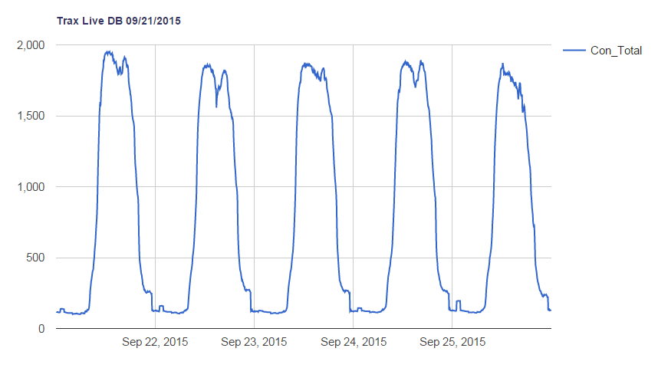
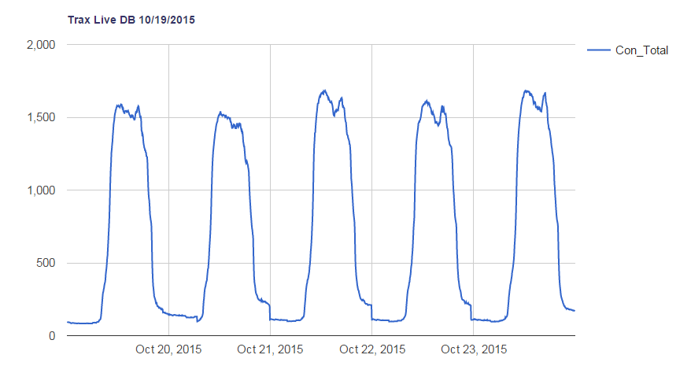
Connections
Fewer users with multiple sessions

Slide 51
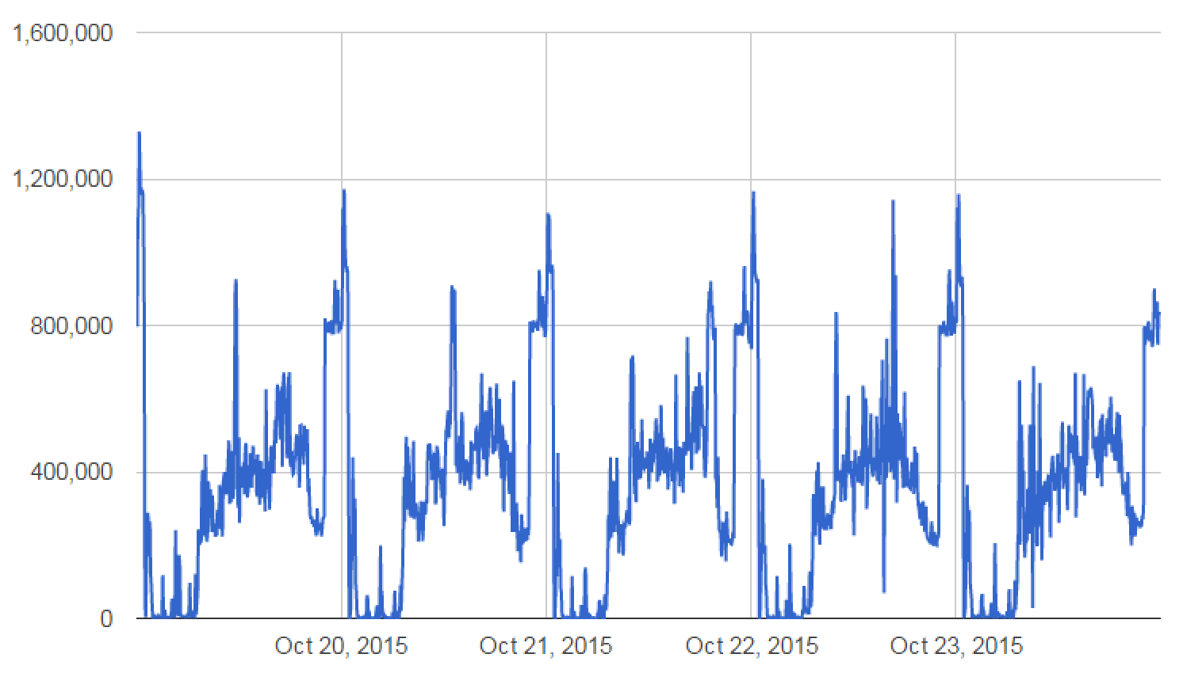
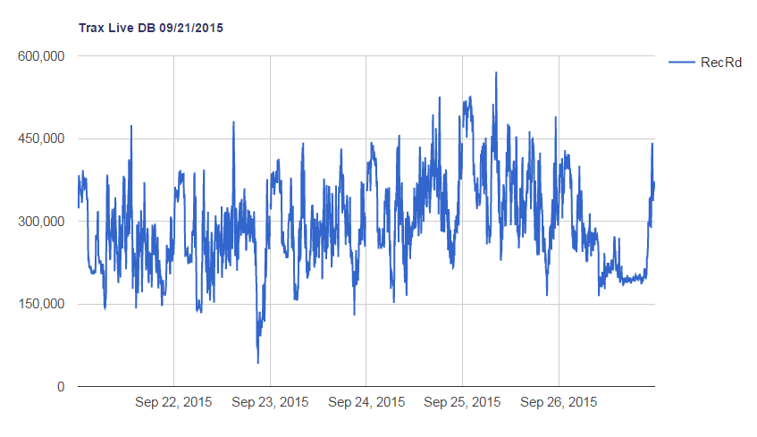
Record Reads
Same amount of “core” work is being done.
Peaks are 3x!
Valleys are 0!
Big jobs are getting done much faster.

Slide 52
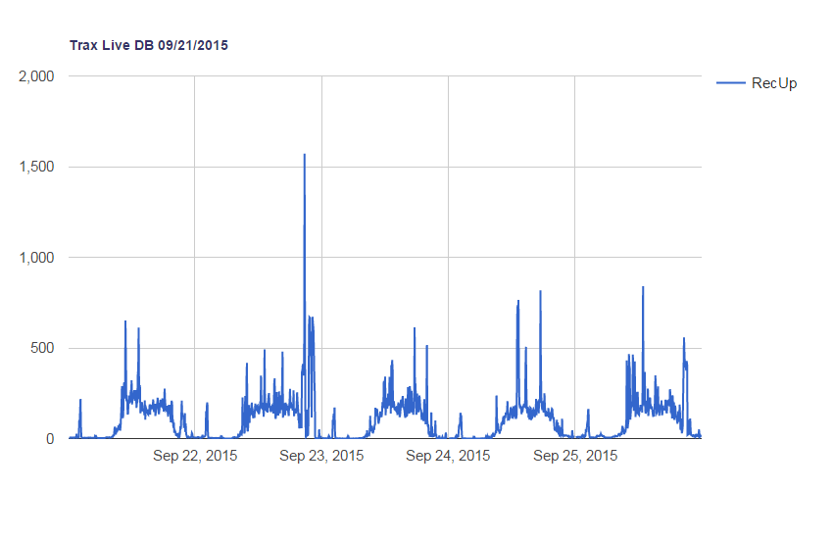
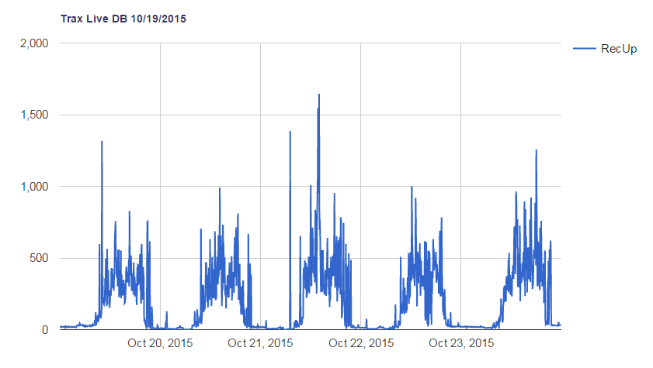
Updates
Higher peaks, more valleys…
Stuff is getting done faster.

Slide 53
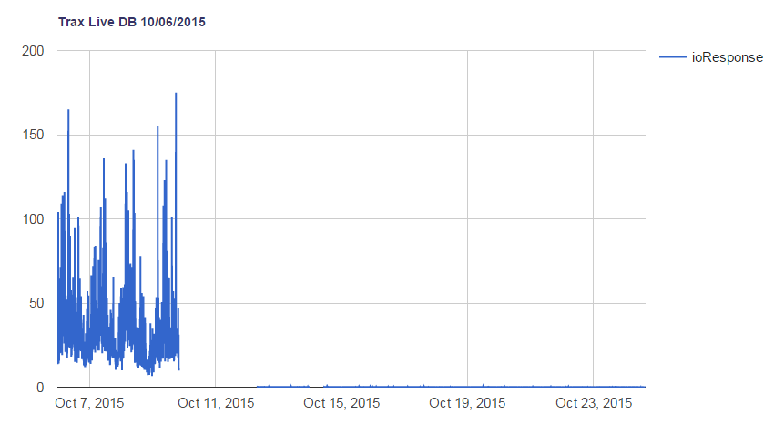
IO Response
What happened to the IO?
Is it broken?

Slide 54
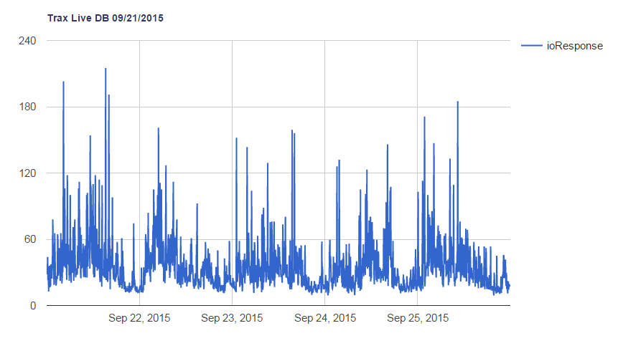
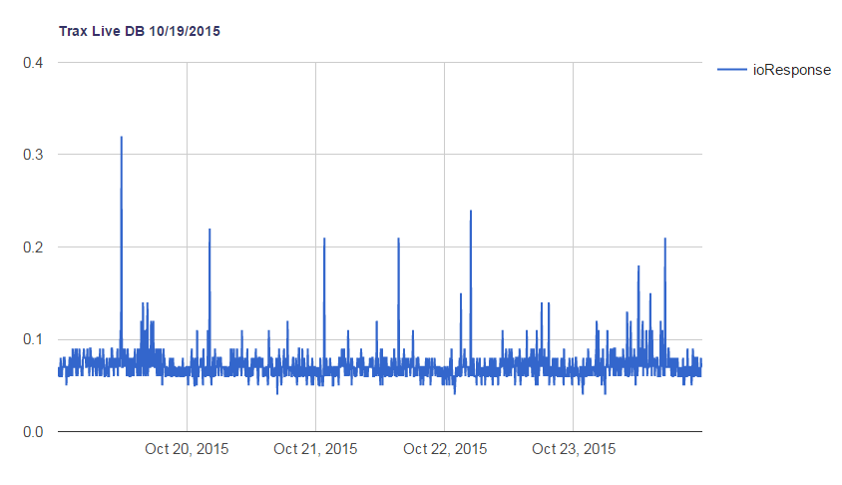
IO Response (magnified)
Average IO response is 5,000x faster!

Slide 55
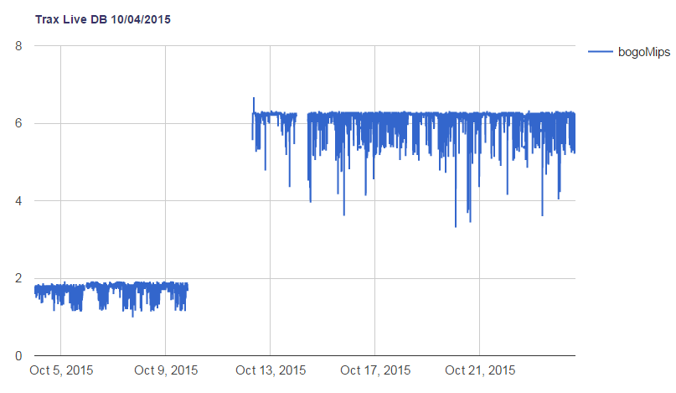
BogoMIPS
The new server is > 3x faster at pure execution!

Slide 56
Other Comparisons
 | Before | After | Note
bigrow 1MB (synch) | 12sec | 3sec | 3x faster
Create 16GB extent | 116sec | 47sec | 2.5x faster
Backup | 8hr 31min | 56min | 9x faster
DB Analysis | 12hr 14min | 22min | 33x faster

Slide 57
CPU Utilization
Time | %usr | %sys | %iowt | %idle
9:02 | 6.01 | 0.93 | 0.02 | 93.05
10:02 | 6.24 | 1.26 | 0.02 | 92.49
11:03 | 10.38 | 2.41 | 0.02 | 87.18
12:03 | 11.79 | 2.52 | 0.03 | 85.67
13:03 | 11.49 | 2.32 | 0.02 | 86.17
14:04 | 11.25 | 2.28 | 0.03 | 86.44
15:04 | 8.65 | 1.89 | 0.02 | 89.44
16:04 | 9.69 | 1.96 | 0.02 | 88.33
17:05 | 12.10 | 2.49 | 0.03 | 85.37
18:05 | 13.00 | 2.25 | 0.03 | 84.72
Avg: | 7.27 | 1.20 | 0.02 | 91.51

Slide 58
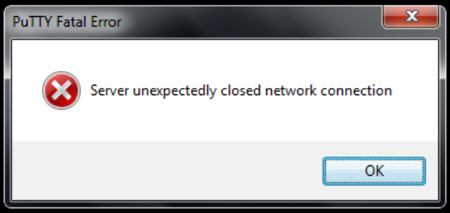
Other Observations
Memory Utilization is around 50%
CPU Utilization is less than 20%
  CPU affinity is sometimes visible via “nmon”
  Probably really only need 6-8 cores.
“Go live surprise!”
  SSH Daemon needed to
  be tweaked to permit
  hundreds of simultaneous
  logins.

Slide 59

User Feedback
What have you done to the system? It is flying!
The web store is amazingly faster!
I used to start running a report and go get coffee and come back and it is still running…
Now I don’t even have a chance to go get coffee.
Amazing!

Slide 60
Conclusion
Yes, Linux can support thousands of users
  at least 2,500
  this particular configuration seems to be at about half capacity or less
Fast CPUs are very helpful
Large numbers of CPUs are a waste of silicon
Eliminating inappropriate storage is a big win

Slide 61
Questions?
Notes:
And now we have some time for questions…

Slide 62
Thank You!

