Slide 1
214: The OpenEdge DBA Checklist, Things an OE DBA Ought to be Doing
People often ask what tasks an OpenEdge DBA should be performing? What should my daily, weekly, monthly etc checklist have on it? In this session we will explore that question and provide recommendations for the tasks that an OpenEdge DBA should be regularly executing.
And then, just for fun, we will discuss some of the frequently useful numbers that a DBA might want to monitor on a regular basis.

Slide 2

OpenEdge DBA Checklist
Things an OE DBA Ought to be Doing

Slide 3

Categories
Mornings
During the Day
Weekly
Monthly
Quarterly
Annually
Upgrades & Service Packs
Pre-Release
Post-Release
Post-Outage
Free Time

Slide 4

Mornings

Slide 5
Mornings
Verify successful backup
Verify that after-imaging is enabled and properly switching extents
Verify that warm spare is available and up to date
Verify that monitors are running and that alerts are flowing
Verify sufficient file system free space

Slide 6
Mornings
Check bi file size
Check fixed extent free space
Check free space in ai archive filesystem
Check free space in backup filesystem
Check for “runaway” processes
Check for overnight processes that may still be running (but should not be)
Check for long open transactions

Slide 7
Mornings
Review db log file for overnight messages
Review B2, ensure that there are free blocks and that lru2 is disabled
Check monitored metrics for trends that are approaching actionable thresholds
Read Progress PANS alerts

Slide 8
Mornings
Review OS logs
Review OS free memory
Review summary of previous day’s CPU and disk utilization
Check OS configuration for unwelcome changes

Slide 9

During the Day

Slide 10
During the Day
AI switching & warm spare apply
Number of users/connections
High disk IO rates, low buffer hit ratio
Unusually active tables or indexes
Unusual log file messages and alerts
Lock Table HWM, active locks
Time between checkpoints
OS bottlenecks and constraints

Slide 11
During the Day
Long open TRX & BI file growth
  Find the oldest transaction (usually a code problem)
Blocked users/connections
  REC = record locking, coding issue
  BK*, TX* etc indicate system resource constraints
Excessively active connections or “rapid readers”
  What are they doing?
  Is it legitimate?
  Is there a better way?
Use the “client statement cache” or “proGetStack” to identify specific code causing a problem.
  Work with development to get it fixed.

Slide 12

Weekly

Slide 13
Weekly
Rotate/Truncate the .lg file
Cleanup trash in db directories
  protrace, leftover scratch files, core files, etc
  Don’t forget –T!
Refresh dbanalys
Refresh “prostrct list”
Refresh DEV/TEST/QA/Training etc.
  This may involve restoring a PROD backup which will verify that backups are good.

Slide 14
Weekly
After refreshing dbanalys review:
  Index utilization, identify idxcompact targets
  Check rows per block settings
  Check RM chains
  Fragmentation
  Scatter
Schedule appropriate remediation activities

Slide 15
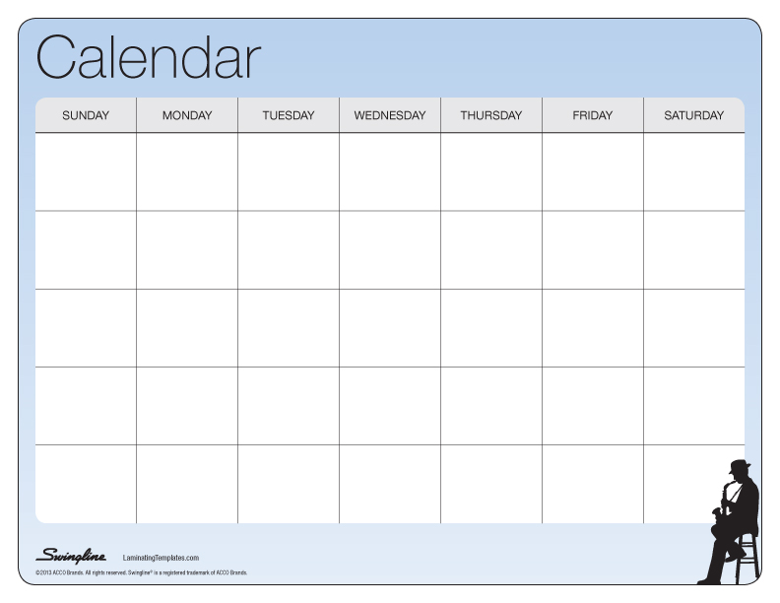
Monthly

Slide 16
Monthly
Outage summary: planned and unplanned
Capacity Planning Reports:
  Basic CRUD & TRX trends
  Overall DB growth
  User/Connection trends
  IO response
  Project disk space needs
  Project disk throughput needs
  Project memory & CPU utilization

Slide 17

Quarterly

Slide 18
Quarterly
Review all startup parameters and config options
Review storage area configuration
If allowing SQL-92 connections:
  Run dbtool to adjust SQL-width
  Run “update statistics” for the optimizer
If using SSL etc – review certificate validity & expiration
Review OS configuration, kernel params etc.
  Test IO throughput: random reads & synchronous writes
Review Progress release level
Review monitored metrics and alerts
Review any new business growth plans

Slide 19
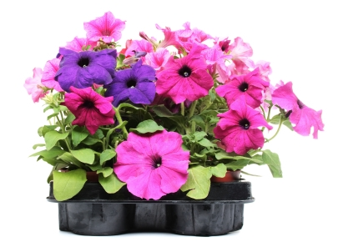
Annually

Slide 20
Annually
DR Test
License review & “true-up”
Review HW landscape and potential upgrades
Review business growth plans & projections
PUG Challenge/Exchange

Slide 21

Special Events

Slide 22
Upgrades & Service Packs
Shutdown
Truncate the bi
Backup
Install the upgrade or SP (or change $DLC)
proutil –C updatevst
proutil –C updateschema
Restart

Slide 23
Pre-Release or Upgrade
Review any online changes that should be made permanent: -spin, -L, etc.
Run “proutil –C describe” and confirm that you have the config options that you need (large files etc).
Review all startup parameters & config options:
  General: -n, -L, -B, -B2, -lruskips, -lru2skips, -spin, -M* (if used)
  Schema related: -omsize, -*rangesize
  Other Config: bi cluster & block size
Review storage areas – are any new areas needed? (Perhaps a table should be split out?)
Review .df for problems – i.e. RECID fields, no storage area etc
Review Progress service packs – should a SP be applied?

Slide 24
Post-Release
Check schema area for stray objects
Check that no RECID fields have snuck in
Verify that tables, indexes and LOBs are all in proper storage areas
Verify –omsize, -*rangesize etc.
Verify B2 assignments

Slide 25
Post-Outage (unplanned)
Root cause analysis
Remediation plan
Lessons learned
  New or improved alerts
  Additional instrumentation
  Improved procedures
  Additional training

Slide 26

Free Time

Slide 27
Planning, Testing & Optimizing
Benchmarking and stress testing
Alternative configurations
New OpenEdge releases and features
Reducing required downtime

Slide 28
Bonus Slides!
Monitoring Checklist

Slide 29
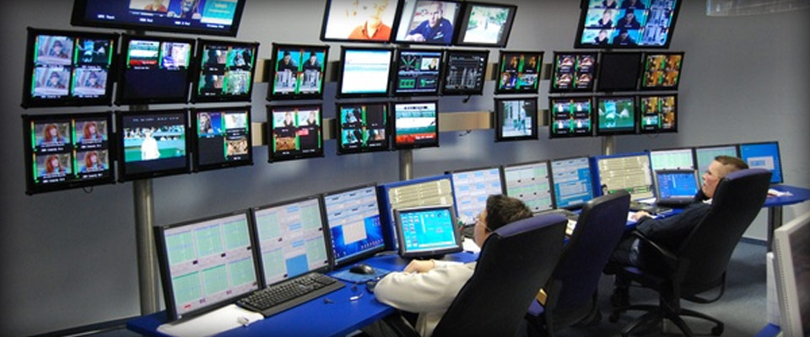
What to Monitor

Slide 30
What to Monitor
The Business
The Application
The Infrastructure
The Database

Slide 31
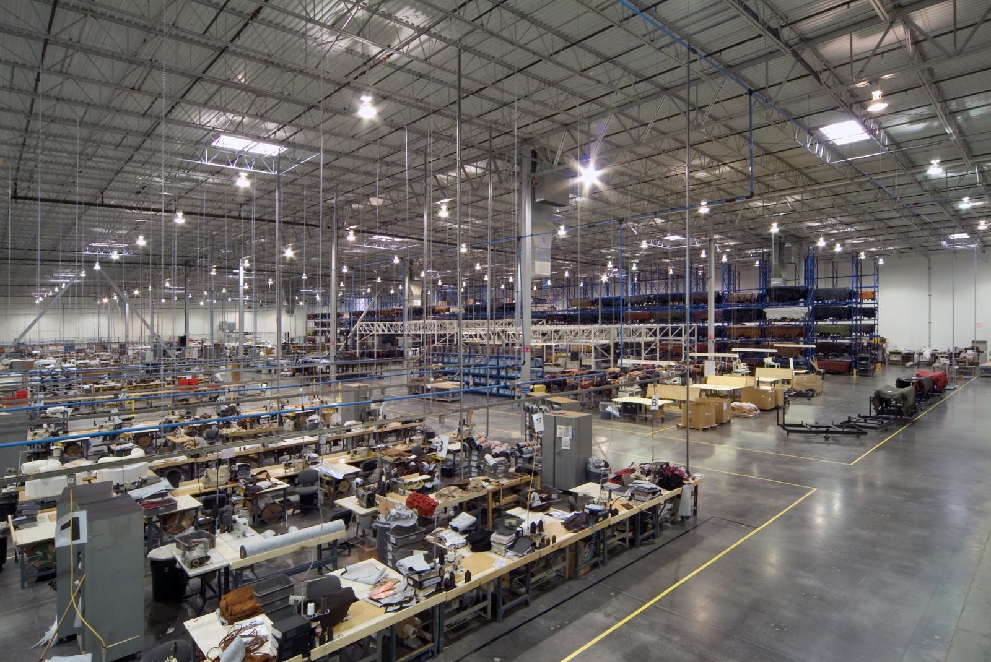
The Business

Slide 32
The Business
How does your company make money?
  What are your products or services?
  Who are the customers?
What are the industry trends?
  Are there looming threats? Opportunities?
  Waves of consolidation?
Key Suppliers?
Competitors?
How is your company special?
What are the company’s future plans?

Slide 33

The Application

Slide 34
The Application
How does your application support the business?
Who are the users?
What business processes drive the workload?
What business processes cannot proceed without the application?
What are the critical inputs? Outputs?
How are 3rd party inputs and outputs reconciled if there is an outage?

Slide 35
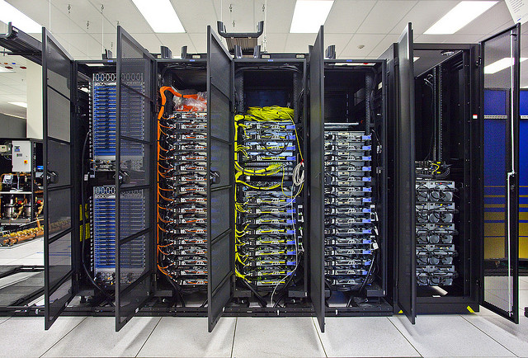

The Infrastructure

Slide 36
The Infrastructure
How do users access the application?
  Local Network? WAN? Internet?
  Green Screen? Client/Server? Web?
How is data stored?
  Internal disks? SAN? NAS?
What is the DR/High Availability Strategy?
Virtualization?
Is the tail wagging the dog?

Slide 37

The Database

Slide 38

The Database

Slide 39
What are the Top 10 Metrics?
…

Slide 40
Top 10?
There is no
“one size fits all”
answer

Slide 41
Frequently Useful Numbers
Is the DB up?
Backup Age
Number of connections
Oldest active transaction
Commits/sec
Logical Reads/sec
After-image # of full extents
Busy users, tables and indexes
Latch timeouts
Locks in use
Blocked users
IO response
CPU performance
Disk Space

Slide 42
Is the DB up?
Do the users call you first?

Slide 43
Backup Age?
When was the last successful probkup?
Where is it?
When was it successfully restored?

Slide 44
Number of connections
Connections <> Users <> Licenses
A useful proxy for workload
Often an indicator of other problems:
  Suddenly 1/3rd of connections disappear…
  ... Or suddenly there are 200 more than usual
Capacity management
Licensing

Slide 45
Oldest active TRX
Drives abnormal BI growth – old transactions are the *cause*, bi growth is the *symptom*
Uncontrolled BI growth can put in you in a (very) difficult recovery situation
Even well behaved applications sometimes have bugs…

Slide 46
Commits/sec
Indicator of activity & workload
Very sensitive to IO responsiveness

Slide 47
Logical Reads/sec
Driven by inquiries & lookups
Very sensitive to code quality…
  Poor index selection leads to very slow, inefficient queries and user complaints
  Lack of appropriate indexes
  Inappropriate use of CAN-DO, MATCHES
Why not record reads?
  # of levels in an index influences # of reads per record
  The upper limit within the db engine is logical reads – not record reads
  Searching for things that aren’t there shows up as logical reads – not record reads

Slide 48
After Image # of Full Extents
Should always be 0 or 1
If it is larger than 1 this is your first indication that your recoverability is potentially compromised.

Slide 49
Latch Timeouts
Latches are supposed to be very fast!
Timeouts mean that people are waiting or that the engine is approaching a limit:
  LRU – read activity, may indicate table scans
  BHT/BUF – read activity, the same data being read over and over and over at a very high rate
  LKP – “lock purge”
  MTX – micro transactions, you may have your BI or AI on RAID5 ☹ or, even worse, RAID 6 ☹ ☹
  OM – object manager, your schema may have a lot of tables, indexes & LOBs

Slide 50
Locks in Use
How many locks does a user really need?
How many users are actually busy at any given moment?
How many of those busy users are updating something vs inquiries?
Does your lock usage grow as your data grows?

Slide 51
Blocked Users
What are they waiting for?
  REC – could be a deadlock or other coding issue
  Sequences
  BKSH, BKEX
  TXE
  STCA ☹

Slide 52
Busy users, tables and indexes
Know what is “normal”
Be on the lookout for changes
Meaningful “user” names are very helpful!

Slide 53
IO Response Time (random reads)
Indicator that disks are under stress
… perhaps due to other applications (SAN)
Even if you have low IO rates you want to know:
  There is no such thing as a “high performance SAN” – but 5ms is usually “acceptable” for a SAN
  Internal disks should have response times of 2 or 3ms
  Internal SSD should be 0.1ms or less
Consistency is critical

Slide 54
CPU Utilization
BOGOMIPS = bogus millions of instructions per second:
  Circa 2016 CPUs should be 4 or better
  Large variation potentially indicates overcommitted virtual machine
What is normal?
%USR vs %SYS
What is %WIO all about?
Notes:
WIO – processes could have been scheduled to run but were NOT because they were blocked on IO. As a result they did NOT consume x% CPU. You do NOT need more CPU to cure wio – you need faster IO.

Slide 55
Disk Space
BI & AI
Data extents
-T space
Archived after-image logs
Backups
Application data

Slide 56
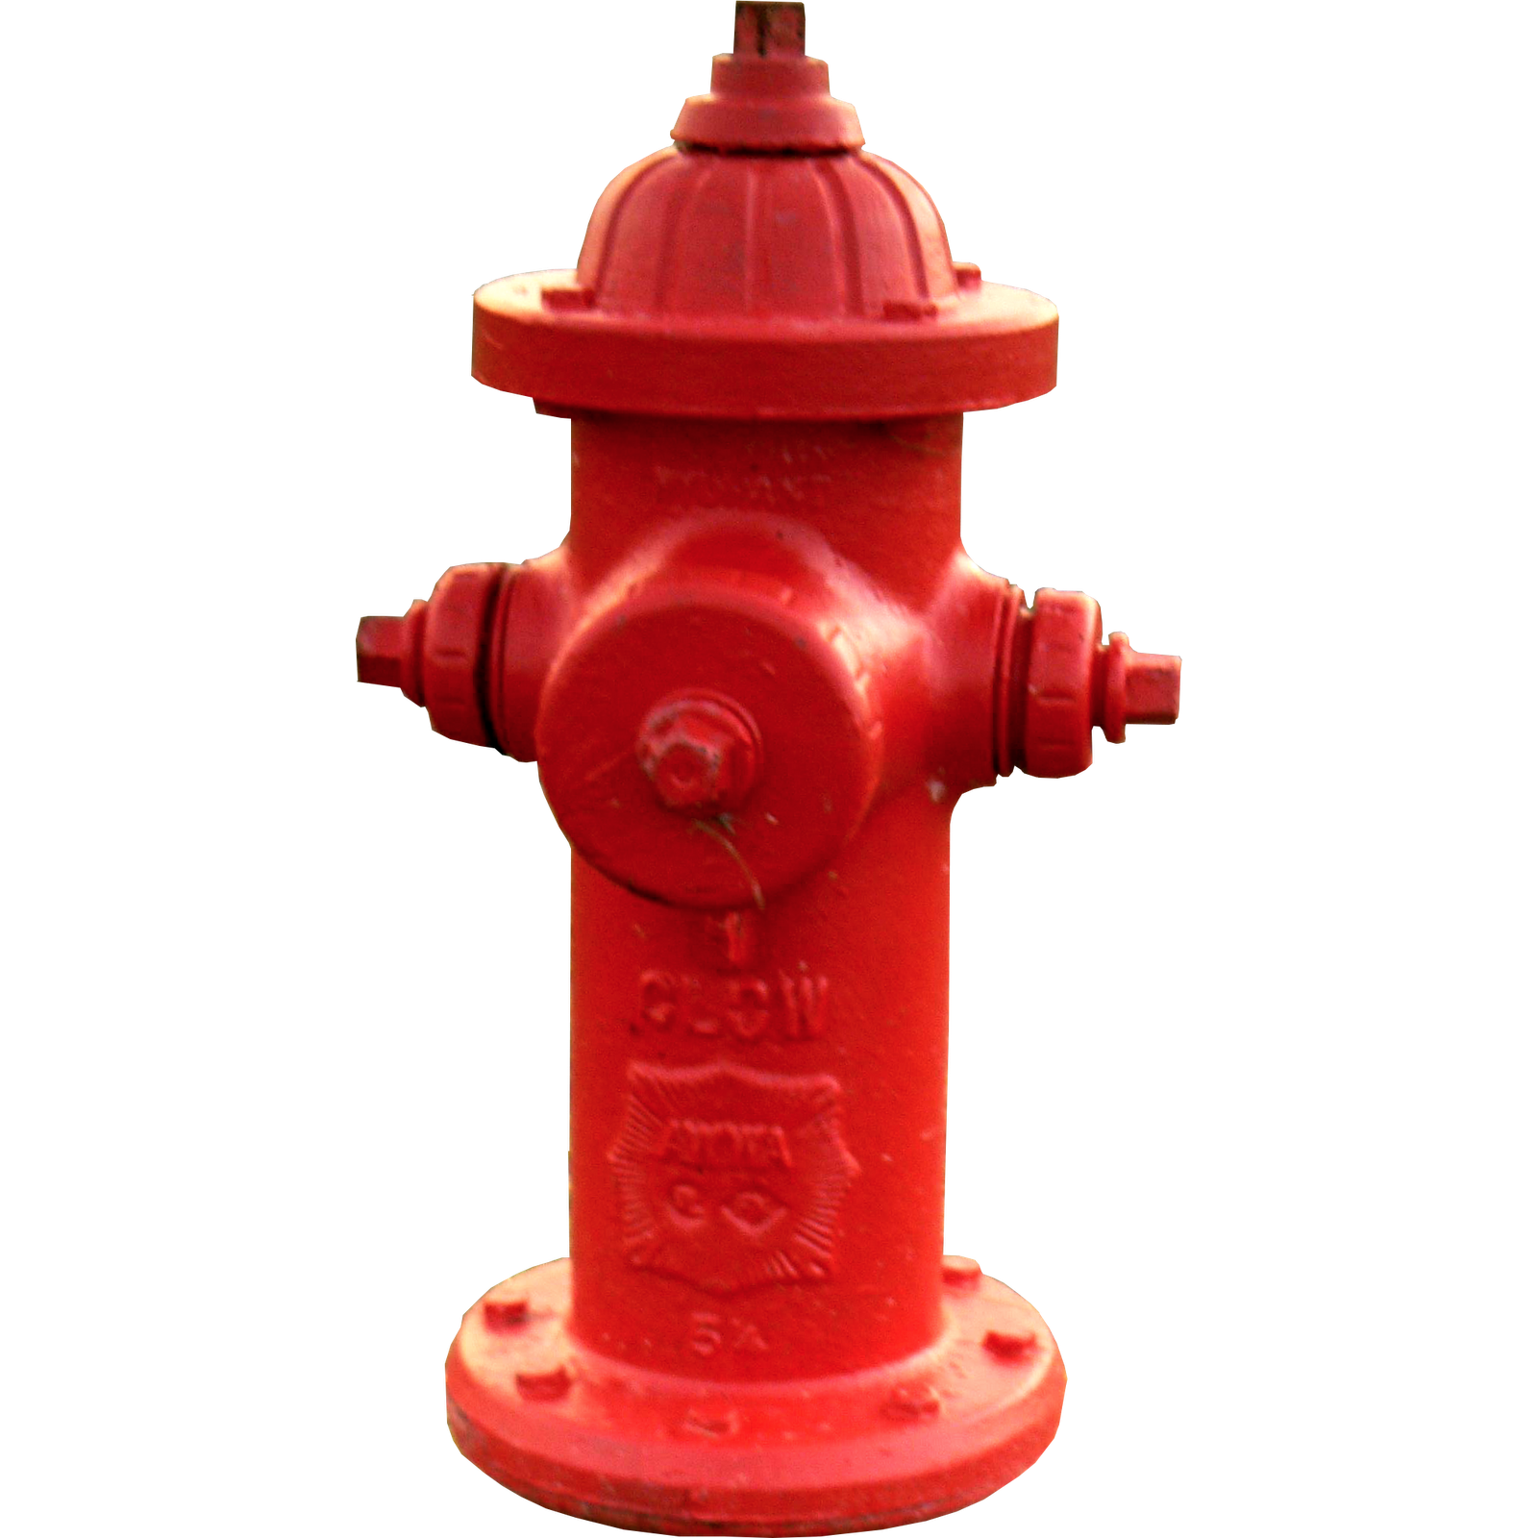
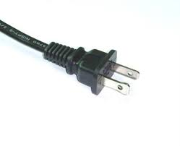
Shameless Plugs
Session 1201: DBAppraise
Monday at 3:30pm in Curriers
Visit the White Star Software booth in the Expo!

Slide 57

“Classic”
For Discerning Tastes in Elegant and Understated UI Design…
trax Auto Interval Rate JSON 83588 0 1.071 ProTop Version 3.3mx 2016/06/23 10:23:03
xus61t2 0 0 /db/trax/xus61t2 traxnode1
Hit% 99.88 Commits: 200 New RM: 487 Oldest TRX: 00:46:27 Connections: 1,439
Log Reads: 1,469,962 Undos: 938 From RM: 487 Curr BIClstr: 11,214 Brokers: 10
OS Reads: 1,809 Lock Tbl HWM: 1,000,014 From Free: 0 Oldest BIClstr: 11,191 4gl Servers: 73
Rec Reads: 332,262 Curr # Locks: 663 Examined: 502 Num BIClstrs: 23 SQL Servers: 20
LogRd/RecRd: 4.42 Modified Bufs: 4,486 Front2Bk: 14 BI MB Used: 1,472 4gl Clients: 1,281
Log Writes: 2,797 IO Response: 0.11 Remove Lk: 494 Curr AI Extent: 12 of 12 SQL Clients: 4
OS Writes: 54 BogoMIPS: 4.69 Curr AI Seq#: 2,664 App Server: 52
Rec Creates: 487 BogoMIP%: 86.38 Empty AI Exts: 10 Web Speed: 0
Rec Updates: 363 Full AI Exts: 0 BIW: 1
Rec Deletes: 8 Locked AI Exts: 1 AIW: 1
Rec Locks: 196,926 Notes: 6,765 6,765 APW Writes: 54 APWs: 4
Rec Waits: 0 BIW/AIW Write% 77 99 APW Write% 100 WDOG: 1
Idx Blk Spl: 0 Writes to Log: 39 35 Bufs Scanned: 16,014 Local: 1,264
Resrc Waits: 5 BIW/AIW Writes: 30 35 APW Scan Wrts: 7 Remote: 4
Latch Waits: 273 Partial Buf Wr: 4 0 APW Q Wrts: 0 Batch: 69
pica Used: 0 Busy Buf Waits: 2 0 Chkpt Q Wrts: 47 TRX: 525
pica Used% 0.00 Empty Buf Wts: 0 0 Flushed Bufs: 0 Blocked: 0
.......................................................... Table Activity ..........................................................
. Tbl# Area# Table Name RM Chain #Records Turns Create Read v Update Delete OS Read .
. ............................................................................................................................... .
. > 790 20 s_crm-valid-queue 60 1193966 0.16 0 194743 0 0 0 .
. 670 112 so-trans 93793 18779417 0.00 1 27955 10 0 1790 .
. 699 130 so-trans-s 407 45720437 0.00 2 26867 2 0 0 .
. 450 174 loc-group 35 25 782.75 0 19569 0 0 0 .
. 468 22 oper-param 100 179732 0.01 0 2675 0 0 0 .
.......................................................... Index Activity ..........................................................
. Idx# Area# Index Name Lvls Blocks Util Idx Root Create Read v Split Delete BlkDl Note .
. ............................................................................................................................... .
. > 1744 21 s_crm-valid-queue.s_crm-changes 3 1,872 90% 35839 0 194,436 0 0 0 .
. 1506 113 so-trans.complete 3 1,228 74% 191 1 148,052 0 0 0 .
. 1507 113 so-trans.ctrl-machine 3 3,216 60% 255 1 135,468 0 0 0 .
. 1582 131 so-trans-s.so-trans-s 3 65,206 96% 127 2 29,357 0 0 0 PU .
. 1518 113 so-trans.trans-code 3 1,437 71% 831 1 26,062 0 0 0 .
. 908 175 loc-group.loc-group 1 1 3% 68 0 21,898 0 0 0 PU .
. 3 6 _Field._Field-Name 0 0 0% 68352 0 12,558 0 0 0 U .
......................................................... User IO Activity .........................................................
. Usr# Tenant Name PID Flags Blk Ac v OS Rd OS Wr Hit% Rec Lck Rec Wts Line# Program Name .
. ............................................................................................................................... .
. > 780 0 traxcrm 40626 SXB* 390486 0 0 100.00% 194551 0 582 crmim/apply.p .
. 1047 0 xclasaav 16049 SX 337960 1785 0 99.47% 1 0 4421 so/waveoro.p .
. 1956 0 xgterfig 19594 SX * 26535 5 0 99.98% 8 0 98168 so/orderle4.p .
.......................................................... Storage Areas ...........................................................
. # Area Name Allocated Variable Tot KB Hi Water Free KB %Allo v BSZ RPB CSZ #Tbls #Idxs #LOBs #Exts Var? * .
. ............................................................................................................................... .
. > 19 misc64_idx 4096000 496 4096496 3351032 745464 82% 8 1 64 0 211 0 2 yes .
. 157 price-lp_idx 2048000 496 2048496 1608696 439800 79% 8 1 64 0 4 0 2 yes .
. 162 prod-exp-loc-ql_dat 4096000 4080 4100080 3158008 942072 77% 8 128 512 1 0 0 2 yes .
....................................................................................................................................

Slide 60


