Slide 1
Progress OpenEdge
MDBA Services

Slide 2

Progress MDBA
Database Administration
With Peace of Mind
Comprehensive database expertise at your service from the people who helped build it.
Notes:
Overview Slide.

Slide 3
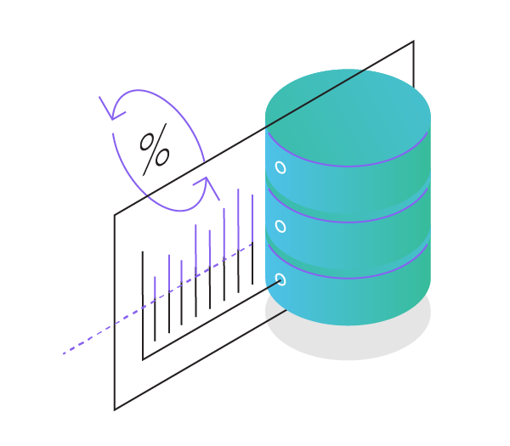
Database Health Checks
Comprehensive look at the application environment
  Collect performance metrics for 24 hours or more
  Machine configuration and speed of various components
  Database configuration
  AppServer and WebSpeed configuration
  Client configuration
DB Health Check Report
  Comprehensive – 30+ page reports
  Shows key metrics and graphs
  Value based recommendations
Notes:
The Database Health Check Process – A 24 Hour engagement
Install performance collection scripts
No special software
Learn about the environment
Create the Health Check report
Collaborate on what to fix and when

Slide 4
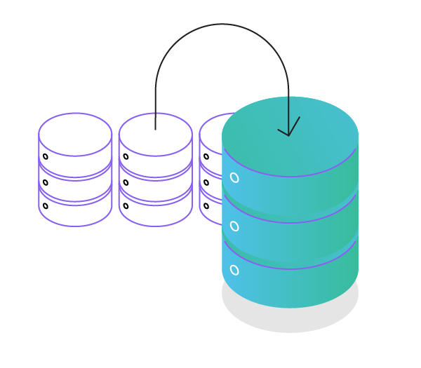
Disaster Recovery Planning
Create a DR strategy for your OpenEdge database
Built on the knowledge from the MDBA Service
Database experts provide the know-how to ensure continuous service and availability with zero latency
Uses OpenEdge Replication and Replication Plus
Flexible, affordable and specifically designed to support your Progress-based systems

Slide 5
Operation Evolution – On Premise
Benefits
You have control of the application and data
Tried and True
Infrastructure exists already
Drawbacks
Need to maintain Infrastructure
Need to have resources to maintain the application and data
May be difficult to find talent

Slide 6
Operation Evolution - Cloud
Benefits
Lower cost then on-premise
No longer need to worry about Infrastructure
No longer need to find talent
A growing trend
Drawbacks
Data Security
WAN Infrastructure
FUD

Slide 7
Operation Evolution

Slide 8
Operation Evolution

Slide 9
Operation Evolution
Benefits
You have control of the application and data
Tried and True
Infrastructure exists already
No need to find talent
Lower cost than traditional on-premise
Drawbacks
Need to maintain Infrastructure

Slide 10
Managed Database Administration
Software based solution
  Sampling and monitoring software installed
  Sends email alerts to on-call DBA
  Each database has it’s own thresholds
Each customer has a Primary DBA
  Clear documentation for on-call rotation
On-call
  No level 1 support – DBA Team is on-call
On-boarding Service
  Install the management software
  Document the environment
  Make stability and tuning recommendations
  A Mini DB Health Check
Web based monitoring dashboard
Monthly Reports
All for a valued-based monthly Subscription

Slide 11
What the service includes
Included
  Any Reactive Service for business critical issues
    Normal billing rates start after the 1st hour
  Web Based Dashboard
  Proactive Analysis
  Monthly Reports
    Provide 6 month trend
    Capacity planning forecast for next 6 month period
    Identifies upcoming maintenance items
  Technical Advice
Not Included
  Planned Maintenance
  Non-production Issues
  Project work
  Database Health Checks
  Disaster Recovery

Slide 12

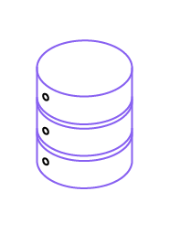


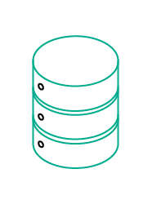

The Heartbeat Process
Heartbeat process
runs every minute
Thresholds are tested and
alerts are sent out to the team by email
mfgprod
admprod
Appserver
Monitoring
cusprod
Daily upload of metrics to PSC for Dashboards and Reporting
Webspeed
hipprod
Periodic Sampling
Every 15 minutes
Monitoring
Notes:
Thresholds are tested and alerts are sent out to the team by email. Both local DBA support
and Progress DBA team
Daily metrics are uploaded to the backend database at Progress.
This is where reporting takes place. There is also an external dashboard
based on this data

Slide 13

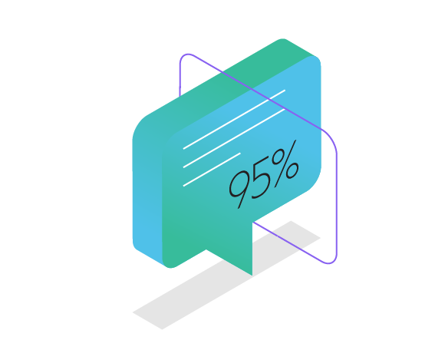
The Managed Database Services Team
10 DBAs in North American each with 20+ years of experience
  Gus Bjorklund, Mike Furgal
    Developers of the database
  Tom Cattigan, Darren Rhoads
    Technical Support Background
  Dan Foreman – Recognized OpenEdge DB Expert
Follow the Sun support
  Australia Support
    3 former PSC Tech. Support reps, each with 20+ years exp.
  EMEA Support
    3 former PSC Tech. Support reps, each with 20+ years exp.
95% of surveyed businesses using
Progress Managed DBA describe
the knowledge and experience of their
Progress consultants as really great or
“off the charts amazing!”
Notes:
SOURCE: TechValidate

Slide 14
Managed Database Metrics
Customers | 100+
Number of Databases | 1,800+
Total Database Size | 72+Terabytes
Total Connected Users | 138,000+
Metrics as of June 21st, 2016

Slide 15














Progress MDBA Customers
Direct Customers and End-users of Application Partners
MANUFACTURING
HEALTHCARE
WAREHOUSING & DISTRIBUTION
FINANCIAL
SERVICES

Slide 16

Database Consulting
OpenEdge Feature Implementation
  OpenEdge Management
  OpenEdge Auditing
  Transparent Data Encryption
  Table Partitioning
  OpenEdge Replication
  OpenEdge Multi-tenancy
  OpenEdge SSL
  etc
DBA team is available for database projects
Platform Migration
  We do this once a month for a customer
Dump and Loads
  We do this every weekend
OpenEdge Version Upgrades

Slide 17

MDBA Services
Comprehensive Database Management
  Extension of the existing team
  Alerting, Trending, Planning
Database Health Checks
  Complete Analysis
  Educational
Largest and Strongest team in the industry
  Includes follow the sun support
www.progress.com/mdba

