Slide 1
What is My Application Doing? Monitoring with OE BPM
29th June 2016
Jawahar Surapaneni

Slide 2

Agenda
Introduction to ABL
Introduction to BPM
OpenEdge BPM Overview
Enabling BPM for OE Applications
Monitoring Process
How to Design Monitoring Process
Demo

Slide 3

Progress OpenEdge ABL
Powerful Language
Purposed to develop business applications
Strengths
Business logic, user interfaces, complex data management
Customization
Enables to write character, web, mobile applications
Code Distribution
Across multiple platforms that adopts strong, adaptive syntax

Slide 4


Business Process Management (BPM)
Process Centric Approach
Improve Business Performance
Keep track of things
Transform several inputs into meaningful output
Strategy
Goals
Policies
Compliance
Process
People
Systems
Information

Slide 5
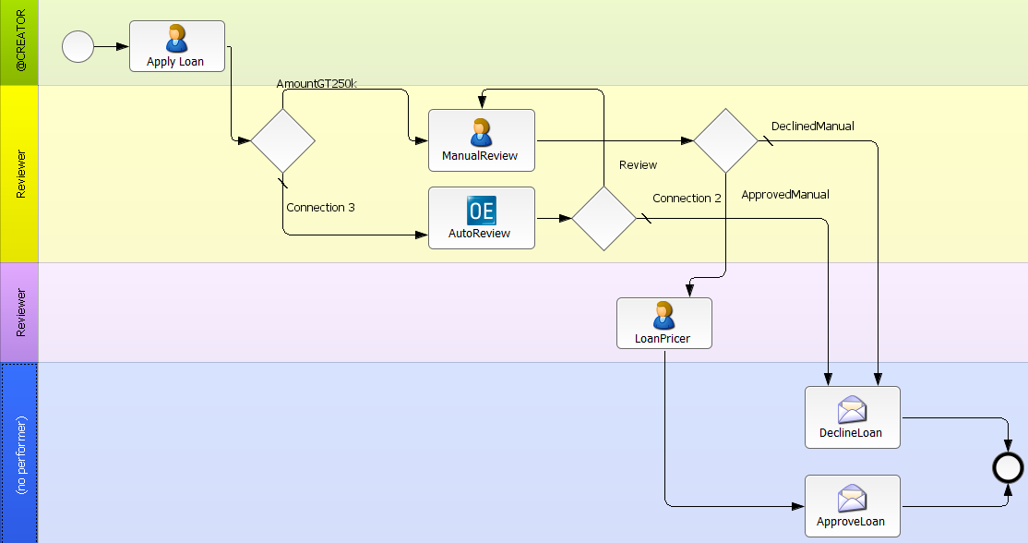
Progress OpenEdge BPM
Provides ability to develop and deploy business process applications
Rapid development, easier customization, and modernization of existing applications
Identify and address bottlenecks and Streamline operations
Modify business apps at the speed of business and independent of SDLC
“Decision”
User activity
“Task”
System step
“Managed
Adapter”
Swim lane
“Performer”

Slide 6
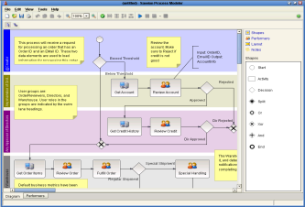
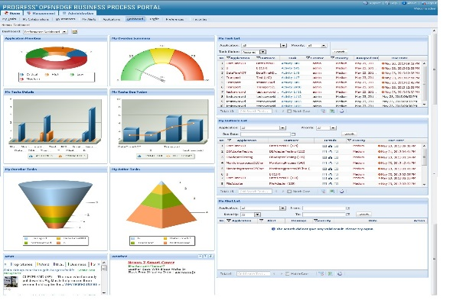
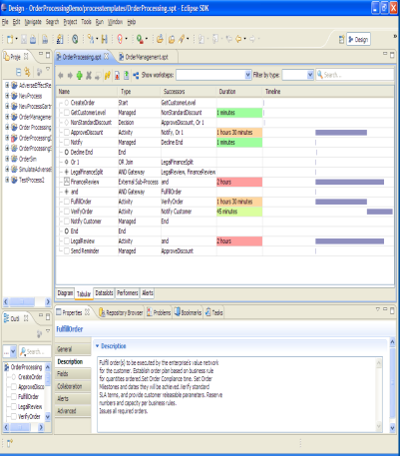
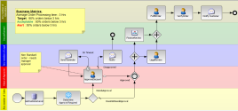
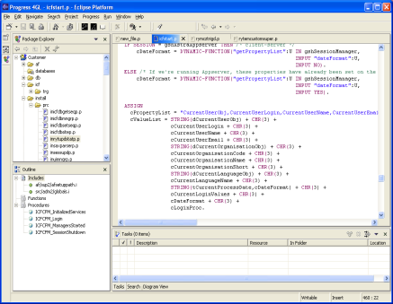
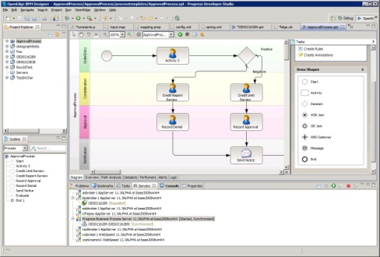
Key Components of OpenEdge BPM
Process Modeler
Business Process Portal
Business Process Server
Progress Developer Studio for OpenEdge
OpenEdge AppServer

Slide 7
How to Enable BPM for OE Applications
- BPM UI ( Form Editor and Webflow)
- BPM UI / Mobile UI / GUI for .NET
- Monitoring Process

Slide 8
Monitoring Process

Slide 9











Monitoring Process Evolution
Application
Business Events
Banking
WebServices Enabled ABL API

Slide 10
BPM Process vs Monitoring Process
Traditional BPM Process | Monitoring Process
Completely driven by Core BPM Engine | Driven by External ABL Application
Performers are Human Work Steps System Adapters | Performers are External Work Steps, External Adapters
Application interaction medium can be OE BPM Portal or ABL Applications | Dedicated ABL Application
In order to Fix or improve the process, the change needs to be done in the BPM Process | ABL Application needs to be changed

Slide 11
Starting Point for Monitoring Process
Gather Participants list
Performers Involved
Explore complete business flow using UI and Business Logic
Steps Involved
Implementation
Identify process start/end points
Data to be monitored
Process flow
Identify workstep beginning/completion points

Slide 12
Designing Monitoring Process
Modelling
Follow Traditional Modelling Pattern
Participants
External Worksteps
External Adapters
Hook Point
Unique ID aka External Instance ID (EIID)
Adding ABL Code
Create,Activate and Complete Process Instances

Slide 13
External Instance ID (EIID)
Unique Identifier for Process Instance
Typically a CHARACTER dataslot
It can also be Process Instance ID
Multiple EIID’s can be handled by Sub Process
Originally specified by application developer

Slide 14
Adding ABL Code to Monitor the Process
Create Process Instance
Activate Work Step
Complete Process Instance
Using OpenEdge ABL, for every deployed BPM Process we can
Use Progress.BPM.UserSession and Progress.BPM.Process classes to perform these tasks

Slide 15
Demo

Slide 16
Adding ABL Code to Monitor the Process
Create Process Instance
Activate Work Step
Complete Process Instance
Create User Session object
Establish connection with User Session
Disconnect the User Session
Use StartProcess() method of the Progress.BPM.UserSession to create process instance
StartProcess ( INPUT TemplateName AS CHARACTER, INPUT dsTemplateArray AS Progress.BPM.DataSlotTemplate EXTENT, INPUT NamePrefix AS CHARACTER, INPUT Priority AS CHARACTER )
LAProcess = BPMSession:STARTPROCESS ("LoanApproval", LADataslotTemplates, "MP_LoanApproval_" + eiid, "").

Slide 17
Adding ABL Code to Monitor the Process
Create Process Instance
Activate Work Step
Complete Process Instance
Activate each workstep
Send monitoring information to update dataslots
Pass performer as arguments if defined in BPM
Use ActivateWorkstep() method of the Progress.BPM.Process class to Activate Workstep
ActivateWorkstep( INPUT name AS CHARACTER )
ActivateWorkstep( INPUT name AS CHARACTER, INPUT dataslots AS DATASLOT EXTENT, INPUT performer AS CHARACTER)
LAProcess:ActivateWorkstep("Verify Loan Amount", LADataslots, "manager").

Slide 18
Adding ABL Code to Monitor the Process
Create Process Instance
Activate Work Step
Complete Process Instance
CompleteWorkstep( INPUT name AS CHARACTER )
CompleteWorkstep( INPUT name AS CHARACTER, INPUT dataslots AS DATASLOT EXTENT, INPUT duration AS INT64)
Complete the workstep
Send monitoring information to update dataslots
Time taken to complete the workstep
Use CompleteWorkstep() method of the Progress.BPM.Process class to Complete Workstep
Retrieve the Process Instance
LAProcess:CompleteWorkstep("Verify Loan Amount", LADataslots, 90).
GetProcess( INPUT processTemplateName AS CHARACTER, INPUT eiid AS CHARACTER)

Slide 19
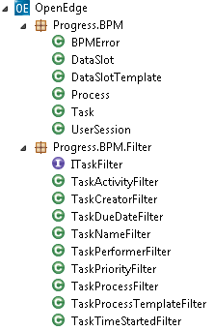
ABL Calling BPM: ABL Classes
Progress.BPM.UserSession
  IsValidSession()
  GetMyInstances()
  GetActivityNames()
  GetNextAvailableTask()
Progress.BPM.Process
  Remove()
  GetAvailableTasks()
Built in ABL classes
Implement ITaskFilter Interface
Implements filter on one property of the task class

Slide 20
Monitoring Process Advantages
Get visibility into your OpenEdge application without extensive re-engineering effort.
Extend capabilities of existing monitoring processes.
Provide path for Application Modernization.

Slide 21
Questions

