Slide 1
SQL Tuning
27/06/2016
Chandra Sekhar
Mohd Sayeed Akthar

Slide 2
Agenda
SQL client parameters
SQL specific broker parameters
SQL Server tuning

Slide 3
SQL client parameters

Slide 4






The Driver is the network
ODBC/JDBC

Slide 5
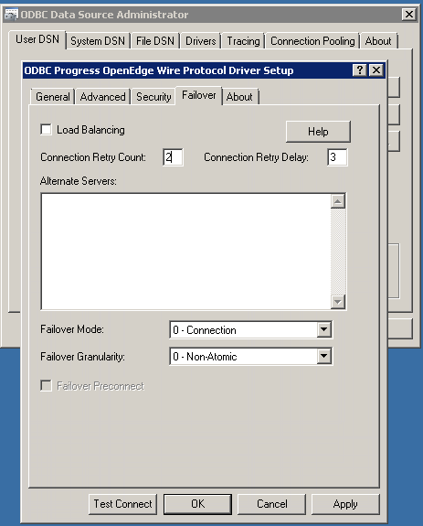
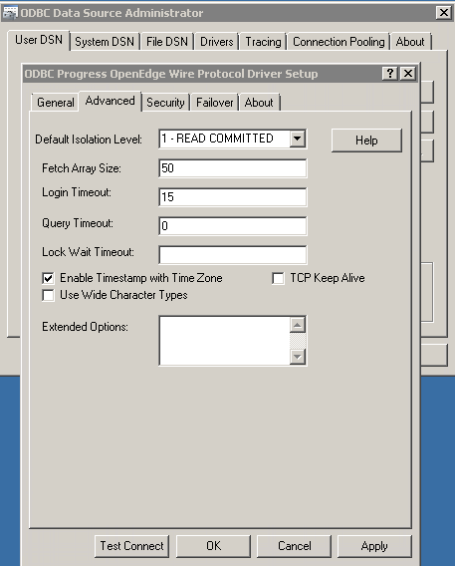

Managing connections
- Connection Retry Count
- Connection Retry Delay
Client
Client
Client
- Login Timeout
Retry??
SQL
How long should I wait??
After what delay ??
DB
How many times??

Slide 6
Query Timeout
- Query Timeouts
SELECT * FROM
Pub.vBigTable
Application
ODBC
SELECT * FROM
Pub.vBigTable
How much can I wait for one query execution??
SQL Server
SQL Server
DB
DB

Slide 7
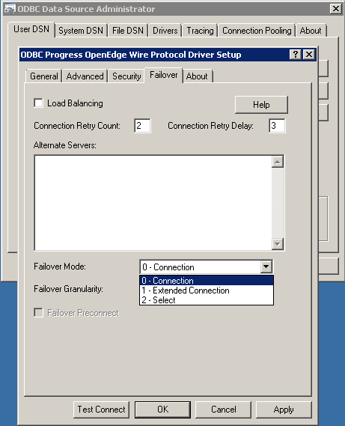
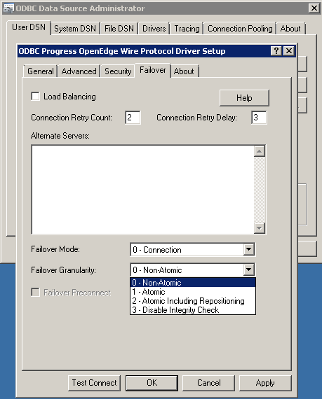
Managing Availability
  - Alternate Servers
  - Failover Mode
Client
Client
Client
  - Failover Granularity
  - Failover Preconnect
  - Load balancing
SQL
SQL
SQL
DB
DB
DB

Slide 8
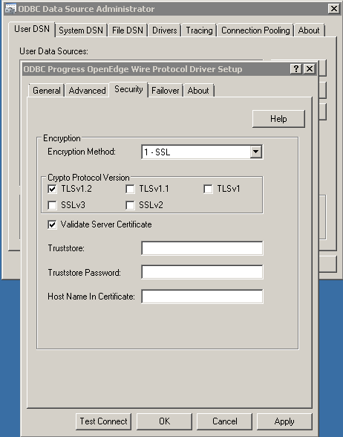

Security configurations
  -EncryptionMethod
SQL
Client
  - CryptoProtocolVersion
SELECT * FROM
CUSTOMER
XY&*X#$
*(KNJ$(#$
  - ValidateServerCertificate
  - HostNameInCertificate
Are protocol ver. and encryption method same at both the ends??
$ | @ | %
% | ( | ^ | (
^ | ^ | * | *
& | ! | ! | ^
* | @ | $ | #
A | A | A | A
B | B | B | B
C | C | C | C
D | D | D | D
E | E | E | E
SQL Server
Start Broker with -ssl
DB

Slide 9
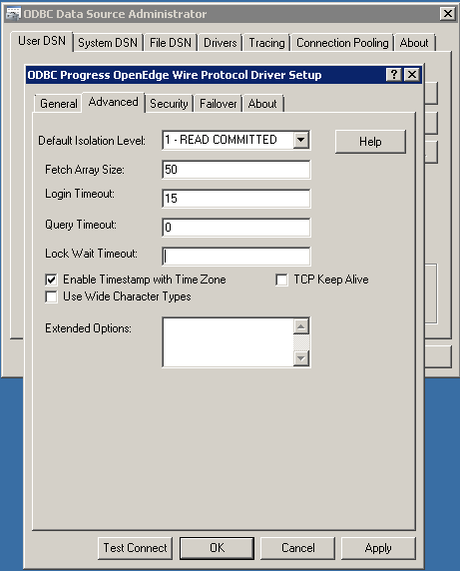

Network – Using more efficiently
  - Fetch Array Size
SQL
Client
A | A | A | A
B | B | B | B
C | C | C | C
D | D | D | D
E | E | E | E
What should I configure??
SQL Server
DB
How many rows in one request??

Slide 10
Handling with different code pages
  IANAAppCodePage=18
SELECT * FROM
米国. 大統領
Application
EUC-JP
ODBC
{“ケネディ”, “オバマ ”, …}
SELECT * FROM
USA.Presidents
UTF-8
How to synchronize between different Character sets??
SQL Server
SQL Server
{“Kennedy”, “Obama”, …}
DB
DB

Slide 11
SQL specific broker parameters

Slide 12
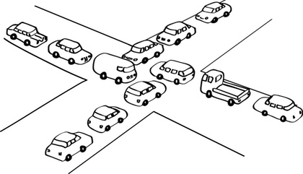

All about Locks
What should I configure???
Transaction T1
Transaction T2
SQLLockWaitTimeout
Res-A
Res-B
Locks
Default: 5 Seconds
DFLT_LOCKWAIT-TIMEOUT
Transaction Management
proserve –db <dbname> -S <port-number> -SQLLockWaitTimeout 15
Max: 32 bit integer
4,294,967,295 Seconds

Slide 13
All about Locks
Transaction T1
Transaction T2
TRANSACTION
ISOLATION LEVEL
Res-A
Res-B
  SET TRANSACTION ISOLATION LEVEL READ UNCOMMITTED
NO LOCK
Locks
  SELECT CustNum, Name from Pub.Customer Where City=‘Bedford’ (NOLOCK)
  LOCK TABLE Pub.Customer IN EXCLUSIVE MODE;
Transaction Management

Slide 14
ABL inserted more
SQLTruncateTooLarge
SQL: “ahh, I can see you (California)”
SQLWidthUpdate
SQL: “I can see but partially (Califor)!!”
SQL: “I cannot understand you!!”
ABL: “I Can see (California)!!”
How should I configure???
SQL
ABL
proserve –db <dbname> -S <port-number> -SQLTruncateTooLarge <on/off>
DB
jdbc:datadirect:openedge://<ip>:<port>;databaseName=<dbname>; truncateTooLarge=<on/off>;
varchar(7) :
“Hey, can you see (California)?”

Slide 15
SQL query plan caching
-SQLStmtCache
O
O
O
Statements
Cache
SQL
DB

Slide 16
Temporary tables, buffers - configurations
-SQLTempBuff
-T
-t
O
O
O
buffer
Temporary Tables
SQL
Select CustNum, Count(OrderNum) From Pub.Order Group By CustNum Order By Custnum
DB
Sorting
Aggregation
Temp. Result Set
Temp
DB

Slide 17
Configuring Stack size
…
Local Data
Return 3
Local Data
Return 2
Local Data
Return 1
Local Data
Return 0
  Default - 1MB
-SQLStack
O
O
O
How big it should be???
SQL
DB

Slide 18
SQL Server Tuning

Slide 19







Optimizer and Statistics
Statistics
SELECT * FROM Customer, Order WHERE
Customer.CustNum=Order.CustNum
Cost
Based
Opt..
Which one is good???
SQL
Join
Join
DB
Order
Customer
Customer
Order

Slide 20
What to look for
UPDATE STATISTICS;
Statistics
UPDATE TABLE STATISTICS AND
INDEX STATISTICS AND
COLUMN STATISTICS FOR Customer;
How often I should update?
Table
Column
_SysTblStat
_SysColStat
Index
_SysIdxStat
On 20% change in data!!

Slide 21
Is it good to create many indexes?
Indexes comes with some overhead.
  Overhead in terms of INSERT, UPDATE and DELETE
  In terms on memory consumption
Creating indexes on right columns.
  Columns which are most often used in WHERE clause
  Columns which are most often used as JOIN predicate
  Columns which are most often used in GROUPING (Aggregations)
  Columns which are most often used in ORDERING (Sorting)
Use Type-2 areas

Slide 22
SQL Hints
  NOEXECUTE
    SELECT CustNum, Name from Pub.Customer Where City=‘Bedford’ NOEXECUTE;
  NO REORDER
    SELECT CustNum,OrderNum from
    Pub.Customer c, Pub.Order o {NO REORDER}
    Where c.custNum = o.CustNum
  FORCE INDEX
    SELECT CustNum,Name from Pub.Customer FORCE ( INDEX (IDX_NAME))
Where CustNum > 10 and Name=‘American Express’

Slide 23
Questions?

