Slide 1
Progress Keynote
Jerry Rulli
COO, Progress

Slide 2
So, What’s New with Progress?
Notes:
Thanks so much for having us speak to you this morning…What a great video – huh? I love that the Progress Community is continuing to THRIVE and that there is so much excitement amongst all of you…..it is great to see so many people at this conference…I believe it is a PUG Challenge America’s RECORD…that is Awesome!
So – we are here to talk to you this morning about what is happening at Progress….Lots of exciting times for us!

Slide 3
Yes, We’ve gone GREEN
Notes:
First of all – if you had not noticed We’ve gone GREEN…..yes that’s right – we launched out new brand and new LOGO and our new COLOR last month……

Slide 4
Progress at a Glance
EMPLOYEES | ~ 2000
FY15 REVENUES | $412 million 90%+ renewal rates
STRONG FREE CASH FLOWS | $102 million in FY15*
FY15 Non-GAAP OPERATING MARGIN | 29%
GLOBAL REVENUE STREAMS | ~ 42% international
CUSTOMER DIVERSIFICATION | 140,000 customers in over 180 countries
Notes:
4
And we had a good year last year from a business perspective…..with over 412M in revenue…….

Slide 5

Our Mission:
Become the destination site for the largest developer population on the planet
Notes:
Last year when I was here I talked about the Telerik acquisition and how we were so excited to bring these two companies together – and that we have done…I also talked about the fact that we were focused on GROWTH and that journey to growth was going to start with becoming the destination site for the largest developer population on the planet.
By making THE MOST developers THE MOST productive, every IT shop on the planet needs Progress to succeed. We continue to do that and obviously a big part of our success is all of you in this room’s continued commitment to using Progress technologies……but let’s put this into perspective….

Slide 6
Let’s Put This in Perspective
18.5 million
software developers globally (IDC)
Notes:
According to IDC - there are approximately 18.5 million software developers in the world, and with our portfolio of products, we’re able to reach nearly all of them.
From .NET to Java to JavaScript to ABL…...

Slide 7

Over 1.7 MILLION
Developers
Use Progress TODAY!
Notes:
With more than 1.7 million developers using Progress today
We help the planet’s app developers and all of you in this room to get your jobs done.

Slide 8




Notes:
But things are changing...and as developers have requirements to build apps that run on the screens of TODAY, and the screens of TOMORROW – like mobile devices, wearables and who knows what else ther emight be - so we need to be able to support all of those requirements – and so that is exactly what our Development Teams are working on all around the world......

Slide 9
Better looking.
Less time.
Do more.
Delight users.
Notes:
With our Developer Tools and Platforms at Progress, we are constantly focused on helping to make you more productive.
Our focus is to help you make
BETTER LOOKING apps…
In LESS TIME…
That DO MORE…
And DELIGHT THE USERS you all need to support.
And we do it better than anyone else.

Slide 10

Notes:
For nearly 20 years, many developers have grown accustomed to creating software for this.
Rows of identical machines, running the same operating system, with the same form factor. The Windows PC.
Then, overnight, they were being asked to create apps for…

Slide 11
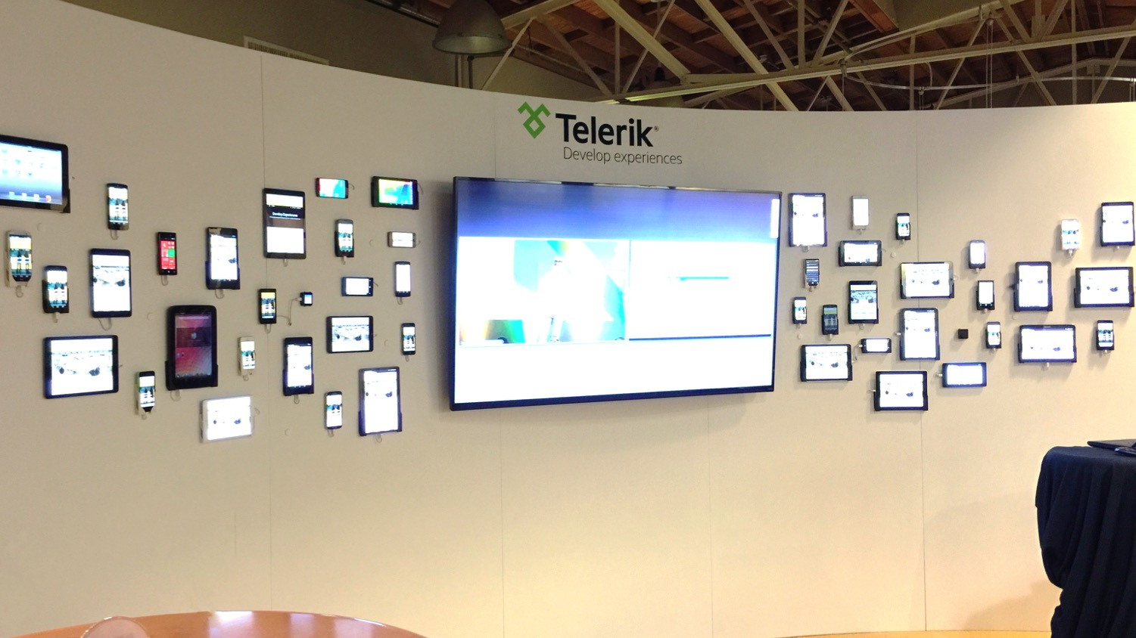
Notes:
This! Many different platforms, many different form factors…unpredictable and lots of new challenges.
Turns-out it’s kinda hard to create apps that run everywhere, don’t have reliable network connections and that have to access legacy data on-the-go.

Slide 12

Developers Need to Keep Pace with the Speed of Business
Diverse requirements
Demand for flexibility
“Consumer” expectations
Notes:
And all of you in this room need to keep up with how your business is changing…many of your companies or your customers are going though a significant paradigm shift right now…with mobile and digital devices changing the way we all do business – that has added more diverse requirements than ever – many different systems to integrate, many different screens to reach,
And at the same time, user expectations were significantly higher. “Just works” enterprise software wasn’t good enough anymore.
It needed to have “consumer grade” usability. It needed to look good and be easy to learn and use.
That is why Progress has launched a new brand to the market that focuses on supporting and enabling this Digital Transformation that is happening inthe world today………..

Slide 13





Enabling Digital Transformation
Progress empowers organizations to rapidly develop
and deliver beautiful, customer experiences and applications
Superior customer experiences on any device
Delivering “state of the art” application development tools
Connecting systems/data to serve customers better.
Notes:
13
Our approach and strategy is all about helping drive business success by leveraging technology advancements while exceeding the expectation of the “end users” – users that run the gamut from customers to employees to partners.
Progress vision is to turn ideas into digital business reality, empowering organizations to rapidly develop and deliver transformative cloud and mobile apps.

Slide 14







Foundation for Digital Transformation
Managing Web Scale | Omni-Channel Engagement | Enterprise Mobility
App Development & Deployment
Development Platforms
Development Tools
Deployment Platform
Testing
Business Automation
Business Rules
Business Process Management
Data Connectors
Relational
SaaS/Cloud
Big Data
Text/XML/EDI
Customer Experience
Content Management
Digital Experience
Reporting & Analytics
Notes:
14
We offer different solutions and products to support your various needs....
Starting with solutions that are specifically designed for digital transformation efforts:
Managing web scale
Delivering omnichannel experiences
Mobilizing your enterprise
We can support various modernization efforts including:
User experience, data and content efforts, application replacement/augmentation, etc.
And we provide a variety of products that help you:
Develop and deliver apps
Automate your business rules and processes
Ensure optimal data connectivity whether in the cloud or on premise
Manage your content and marketing efforts
Reporting and analytical services
+++
Digital Factory
Managing Web Scale - Digital Factory for Sites
Omni-Channel Engagement - Digital Factory for Engagement
Enterprise Mobility - Digital Factory for Mobile
“Products”
App Development & Deployment
Development Platforms – Progress OpenEdge & Progress Rollbase
Development Tools – Telerik DevCraft by Progress
Deployment Platform – Modulus
Testing – Telerik Test Studio by Progress
Business Automation
Business Automation – Progress Corticon, OpenEdge BPM
Data Connectivity
Data Connectivity – Progress DataDirect
Customer Experience
Content Management – Progress Sitefinity
Digital Experience – Progress Sitefinity Digital Experience Cloud
Reporting & Analytics
Reporting & Analytics – OpenEdge Analytics, Telerik Reporting + DEC + Embedded Throughout

Slide 15

Now, even Forbes is writing about Progress…
http://www.forbes.com/sites/joemckendrick/2016/06/04/what-exactly-is-a-digital-strategy-it-depends-upon-who-you-ask/#55c74d675ac9
JUN 4, 2016 @ 01:31 PM
What, Exactly, Is A Digital Strategy? It Depends Upon Who You Ask
Since the article was posted, it has been viewed on Forbes.com thousands of times and has been shared across social channels, reaching an estimated 2.6M in Twitter impressions.

Slide 16
We know that you want the industry to know WHO PROGRESS is and that is what we are focused on doing……..
Key Priority in 2016 and beyond…..

Slide 17
So, THANK YOU – for being a part of the most loyal and active developer community…..and a continued member of the largest developer community on the planet…..in the future!

Slide 18
Product/Technology Update
Colleen Smith
VP/GM OpenEdge

Slide 19
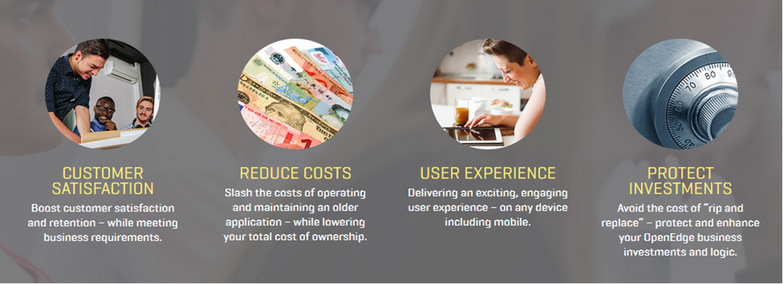
Digital Transformation begins with Modernization……
Notes:
To move from Consumption to Transformation starts with modernization. And that modernization project can have a number of drivers, such as improving customer satisfaction, reducing costs whilst protecting the investments previously made in business applications. In fact “modernization” of business applications is a continuous process where these drivers are concerned.
But we are finding that the biggest driver and desire for change is with the user experience, whether that is to support different devices, have a different user interface or providing a more engaging user journey through the functions of your business application.
Changing the user experience is key to transformation in the digital world.

Slide 20

3 Key Technology Areas for Digital Transformation
  User Experience

Slide 21

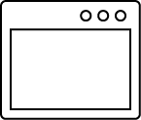




User Experience
Mobile Apps
Web Apps
Satellite Apps
Desktop Apps
Websites
Various Personas
API Layer
OpenEdge Platform
Data Management

Slide 22
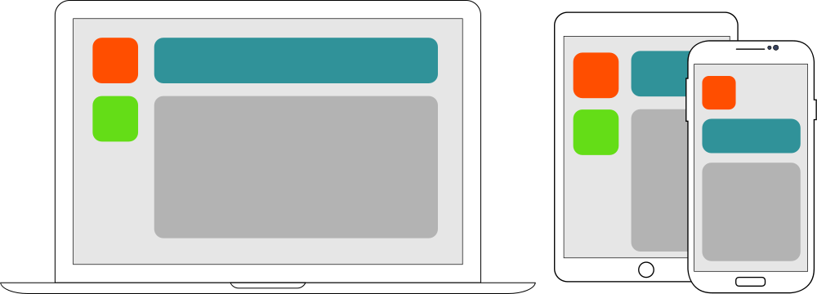
User Experience
Web and Mobile Applications
  Responsive technologies
  Rapid change
  Modern Look & Feel

Slide 23
Notes:
We help developers and development teams go from creating ugly, hard to use apps that users simply TOLLERATE, to…[NEXT]

Slide 24
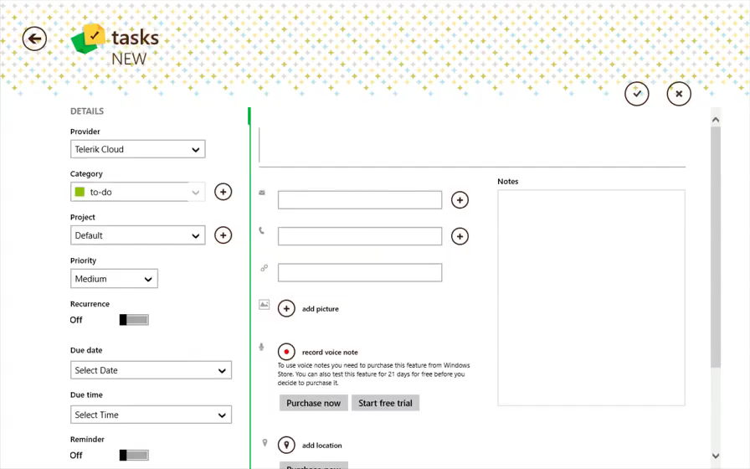



Notes:
…Creating modern, beautiful apps that delight users and make developers heroes within their organizations or for their clients.
Apps that embrace the latest in user experience.
That are ready for touch, voice or traditional keyboard/mouse input.
Apps for the desktop (like we see here)…[NEXT]

Slide 25

Responsive web UI productivity platform that significantly accelerates OpenEdge modernization efforts and provides a modern look and feel with industry-leading web technologies while future-proofing your UI.

Slide 26
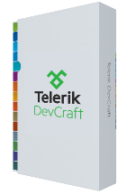

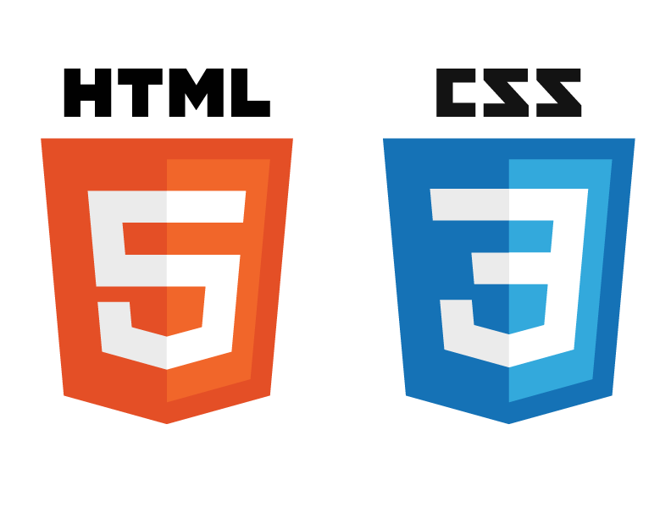



Building Modern “Business Applications of the Future”
JSDO
Progress Developer
Studio
REST Interfaces
OpenEdge
Mgmt
Advanced Business Language
Progress Application Server for OpenEdge
WebSpeed
OpenEdge
BPM
Corticon Rules
Telerik Platform for OpenEdge
OpenEdge
RDBMS
OpenEdge
Replication
OpenEdge
DataServers

Slide 27
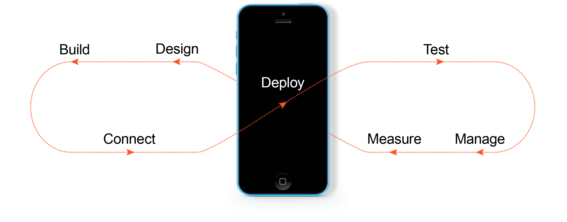
Telerik Platform for OpenEdge
Turn JavaScript into cross-platform apps.
Quickly create stunning UI for your app.
Run automated tests against mobile devices.
Deploy to public or private app stores.
Leverage your data or our cloud services.
Learn how your app is being used.
Control who has access to your app.
Notes:
But we figured out how to solve the mobility problems with Telerik Platform and this past year we delivered an Edition specifically for OpenEdge…….
We provide and end-to-end mobile development and deployment platform that help EXISTING teams create CONSUMER GRADE cross-platform mobile apps for every business problem. And we eliminate a lot of the complexity and cost along the way.

Slide 28

Omni-Channel Capability
  Great customer experiences
  Integrated applications
Internet of Things
  New devices
  New ways to engage customers

Slide 29

3 Key Technology Areas for Digital Transformation
  User Experience
  Cloud Computing

Slide 30






Cloud Computing
Providing Agility
  Deployment choice
  Containerization
  Seasonal or situational bursting
Cost
  Low barrier of entry
  Operating Expense
IBM Bluemix

Slide 31

OpenEdge Advanced Enterprise Edition –
Supporting Business Applications in the Cloud
Multi-tenancy at the database level
Data replication support
Table partitioning for improved performance and maintenance
Access management and authentication
Data is encrypted in transit and at rest
Data management and @Cloud scalability
Open, scalable and reliable database solution to meet the demands of SaaS

Slide 32
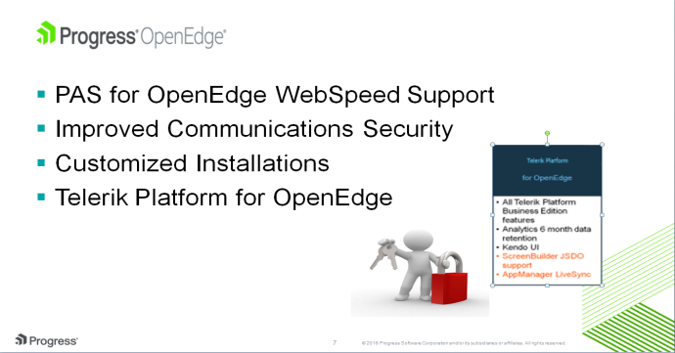
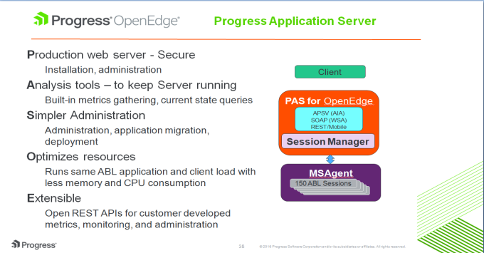
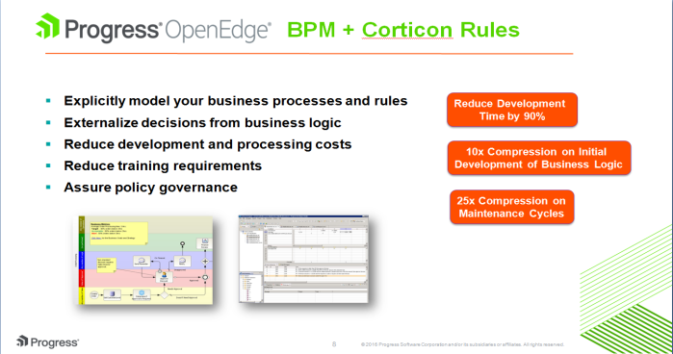
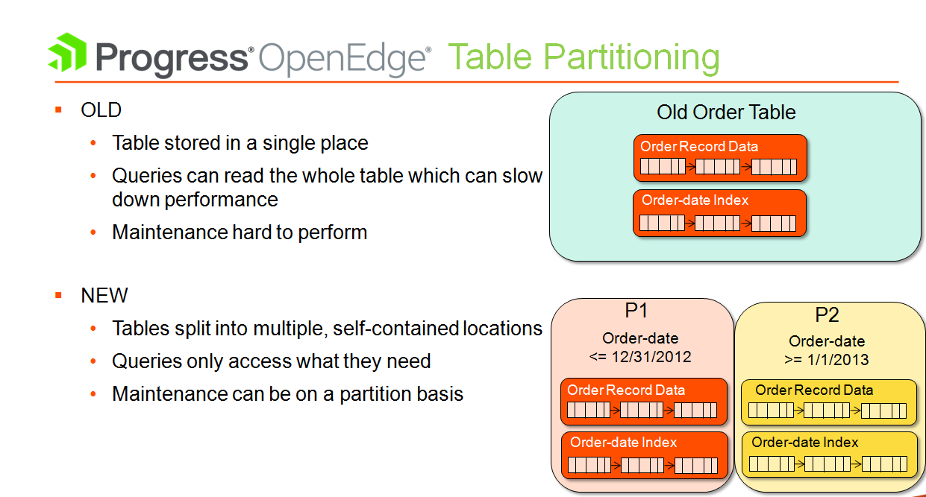
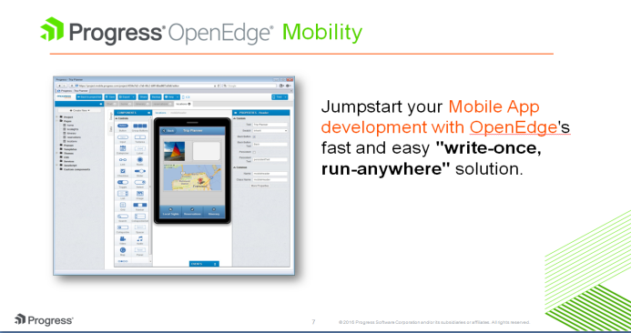
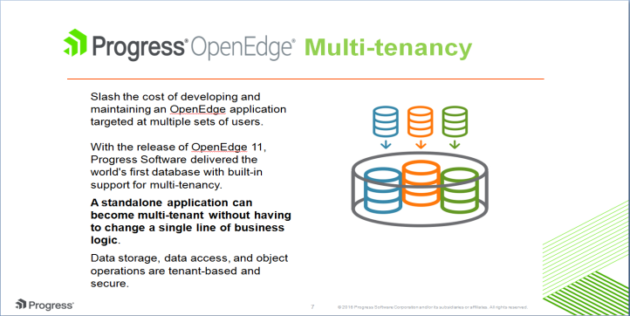
OpenEdge: Journey to SaaS/Cloud
Version 11.6
Version 11.5
Version 11.3
Version 11.4
Version 11.2
Version 11.0/11.1
Notes:
But we have already been working on supporting digital transformation since the introduction of OpenEdge 11 back in 2011, where we set out to provide more capabilities that allowed customers to move to the Cloud and partners to support the SaaS business model.
11.0 – DEC 2011 | 11.1 – JUN 2012 – MT | 11.2 – NOV 2012 – OE Mobile | 11.3 – JUL 2013 – OE BPM + Corticon | 11.4 – AUG 2014 – TP | 11.5 – DEC 2014 – PAS for OE
And finally 11.6 – OCT 2015 – WebSpeed + Telerik Platform for OE
Last 5 years – 7 Releases, 7 Service Packs

Slide 33
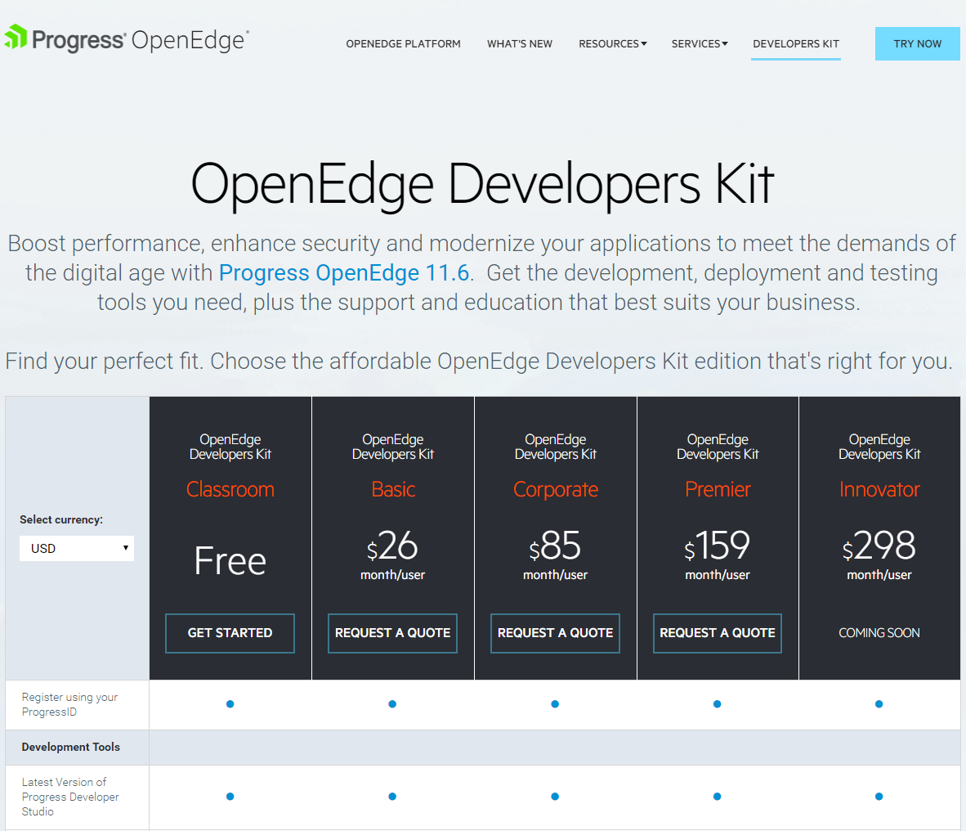
Notes:
The final offering made available with OpenEdge 11.6 was the OpenEdge Developers Kits. This has various editions to suit the different developers, from students wanting to learn more through to those building enterprise business applications and supporting many customers, across many platforms and on previous versions of OpenEdge.
To support the requirements to modernize, to take those steps towards digital transformation, we are creating the Innovator Edition of OEDK.

Slide 34

Rollbase 4.0
Integration with Mobile Platform
New User Experience
Progress data catalogs for Telerik Platform AppBuilder
Progress data service (JSDO) for using Rollbase data in Telerik “screenbuilder”
Totally redesigned user interface uses Kendo UI with a rich set of widgets
Responsive web UI
15 built-in themes
Notes:
Progress data catalogs for Telerik Platform AppBuilder
Rollbase 4.0 provides a Progress data catalog file (.Json)
Data model and data from Rollbase can be imported into Telerik platform
Telerik Platform can be used to develop mobile apps for Rollbase
Progress data service (JSDO) for using Rollbase data in Telerik “screenbuilder”
Simpler & faster ‘point-and-click’ configuration of mobile access to rollbase data
Includes basic and password-based user authentication
Available in TP “enterprise” and new “business for Progress” subscriptions
Kendo UI Professional bundled in the kit
Very large set of widgets – opportunities to do custom work (ISV – Service Providers)
Most customers and field people do not realize they can leverage any of the kendo ui widget for customization work
New page structure, headers, menus, grids, calendar, etc
Kendo UI Professional bundled in the kit at no additional cost: Applications can be customized with any widgets (Gant Charts, Pivot tables, Spreadsheet, etc…).
Responsive UI: You just design your pages and Rollbase take care of the responsiveness automatically, no need to define various rules like in some other products. In other words, application designers do not need to learn Bootstrap responsiveness to have applications work on various size.
Automatically adjusts to different screen size to enable apps to work well on a variety of devices.
Application designers do not need to know anything about Bootstrap V3 grid system.
15 built-in themes
Including two sets of complementary light and dark themes
Enables greater flexibility/individuality in the appearance of an application

Slide 35

3 Key Technology Areas for Digital Transformation
  User Experience
  Cloud Computing
  Big Data/Analytics

Slide 36







Big Data/Analytics –
Turning information into a Competitive Advantage
Knowing your customer
Big Data databases
Notes:
Know your customer
Predict results from changes to the customer journey
Targeted marketing
Big Data Databases
Massive amounts of data produced and available
Specialized stores for different types of data
Hadoop, MariaDB, Hive, Couchbase, MongoDB, Hbase, Cassandra, etc., etc., etc.
OpenEdge Analytics360

Slide 37
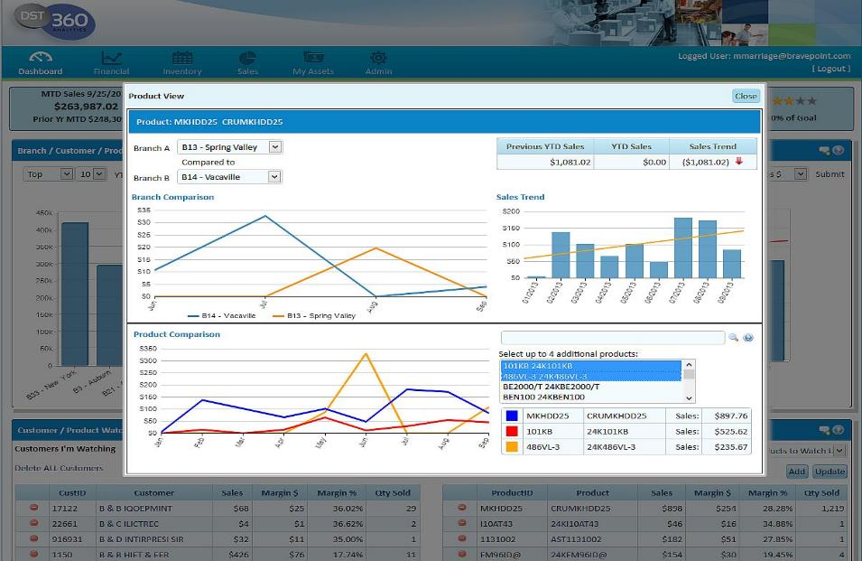

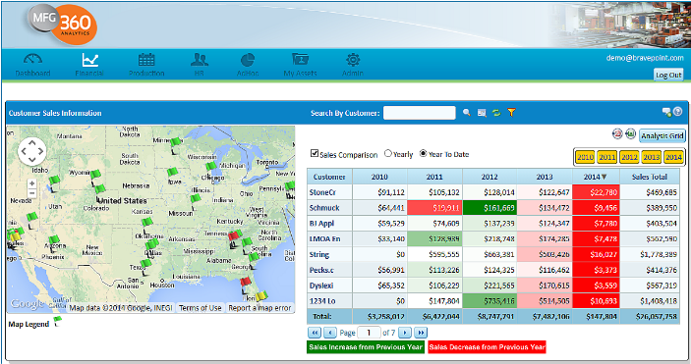
Progress OpenEdge Analytics360
Industry leading toolset
Pre-built content to accelerate time to market
Complete solution, including technical & business training
Notes:
Last year we delivered Anlytics360 – this was based on feedback from many of you that said you would like a better way to deliver analytics as part of your applications…….

Slide 38
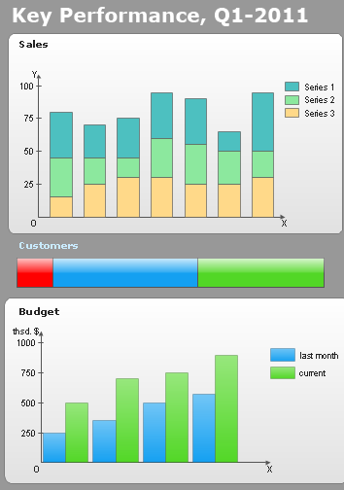
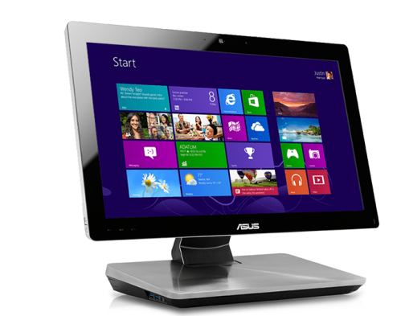
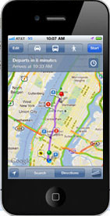
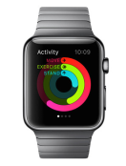
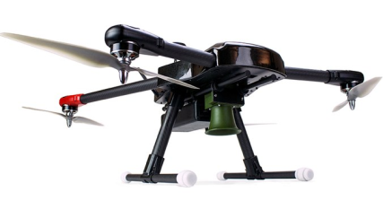
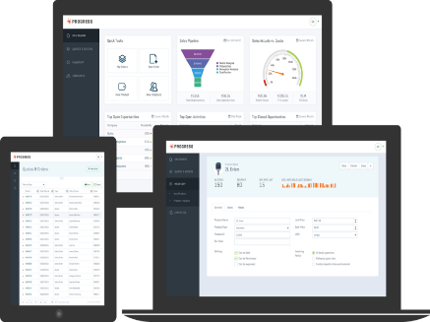

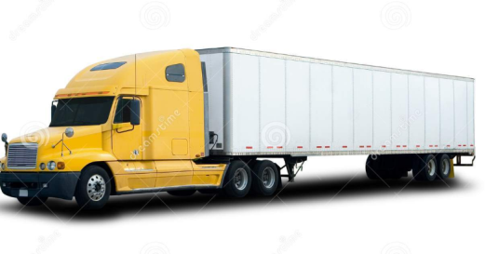

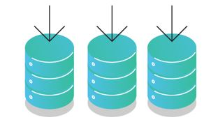
Progress Vision for Future of Business Applications
Key Performance, Q1
Key Performance, Q1
Support Multitude of Devices
Embedded Analytics
Support Multiple APIs
Embedded Analytics
Access Data from Heterogeneous Data Sources

Slide 39


Common Component Specification
1st Anniversary Update
Community driven, Open Standards Body to define Specifications for various components required to build Business Applications Of The Future
87 Members from 60 different companies
Two Specifications In Community Review
One Specification Finalized
Notes:
Launched in June 2015, Common Component Specification (CCS) is a community driven, open standards body to define standard specifications for various components required to build Business Applications of the Future.
As of June 2016, 87 Members from 60 different companies are participating in CCS
Advantages of CCS:
Enables creation of standards based business application components and tools that can inter-operate
Fosters a vibrant community of OpenEdge customers that can collaborate and compete
Call to Action: Urge the community to get more involved; We are looking for additional specification leads and specification writers;
Noteworthy accomplishments in the last year –
1. CCS Architecture Specification has been finalized
2. Following two specifications are in Community Review
Startup Specification
Business Entity Specification
3. Following two specifications being actively worked on:
Service Manager Specification
Session Manager Specification
4. Based on community feedback, following significant process improvements have been made since launch in June 2015 --
Removed NDA clause from CCS agreements
Simplified enrollment process for CCS
Goals for next year:
Finalize at least three inflight specifications in the next year
Kick off at least two more new specifications. E.g.
Security Token Service specification
Common Meta-data definition for User Interfaces (Kendo UI Builder meta-data standardization)
3. Work with community to get least two CCS specification compliant frameworks

Slide 40
Digital Transformation initiatives typically start with a
Website or a Mobile app
But information from Systems of Record are required -
Progress is the only vendor that can deliver the integration needed to make Digital a reality TODAY

