Slide 1



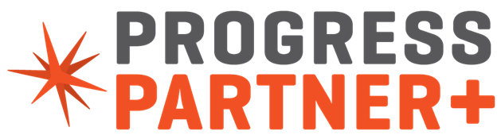
“Your System, Your Way!”
Increasing the Capabilities and Competitiveness
of Open Edge Applications
ProStar Software , a Progress Technology Alliance Partner
Including
®

Slide 2



ProStar Software:
a Technology Alliance Partner
The Progress TAP Program enables other Application Partners to improve the capabilities and competitiveness of their OE application by using the complementary application (or services) of the Technology Alliance Partners.
© copyright ProStar Software, Inc.

Slide 3
TailorPro’s Purpose:
“Get Better at What Matters”
Adaptations of the OE system via TailorPro can:
Improve business performance by adding high-value functionality into the OE application to meet the unique requirements of each enterprise
Enforce compliance with business policies
Coordinate complex business activities
Modernize applications including mobile and web UI
Improve application competitiveness by providing solutions for all the must-have requirements
© copyright ProStar Software, Inc.

Slide 4
“Get Better at What Matters”
TailorPro enables “Non-invasive Customizations” of OpenEdge applications to better fit business requirements
MEI enables “automated coordination” of people and systems, across platforms, including any participant in business activity
  E.g. Customers, suppliers, executive, engineers, etc.
MEI users can work on any mobile device or browser, in OE screens, or in .NET
© copyright ProStar Software, Inc.

Slide 5

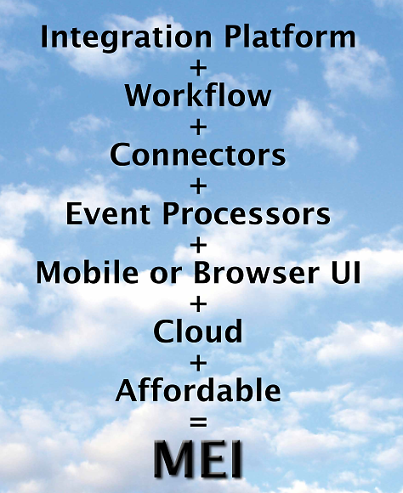
TailorPro Includes
Mobile Enterprise Integration (MEI)
© copyright ProStar Software, Inc.

Slide 6
“Your system; your way!”
Software development kit with libraries that simplify the most common customization elements
Methodology dramatically simplifies development of:
  Integration of new functionality into OE application
  New and revised business logic
  New and revised data elements and structures
  New in-line screens and revised existing screens
  Context-sensitive behaviors
Self-documenting repository of customizations
No change to OpenEdge application code or schema
No hindrance to future upgrades
© copyright ProStar Software, Inc.

Slide 7
TailorPro Architecture
© copyright ProStar Software, Inc.

Slide 8
ProStar History
TailorPro invented by John Campbell: 1999
Commercial product: 2001
  “Non-Invasive Customizations”
  “Your system; your way”
  More than 100,000 customizations created by in-house developers; with every requirement met
ProStar Workflow: 2011
Mobile Enterprise Integration (MEI): 2013
© copyright ProStar Software, Inc.

Slide 9
“Catch Weights” example (in QAD)
© copyright ProStar Software, Inc.

Slide 10
Development required
When request was made of ProStar, in-house developers had spent to date “80 hours and were unsure as to how to finish.”
TailorPro Anchors required: 2
ProStar Development time required: 2 hours
  Plus 2 additional hours in data prep and setup
Works in all versions of the QAD applications
© copyright ProStar Software, Inc.
Notes:
Anchors:
Entry of the "line" field at the bottom of the line detail screen of 7.9.15, Sales Order Shipments, in order to change the default value of "Cancel B/O".
Entry of the Quantity field in order to invoke the pop-up frame for capturing the catch-weights.
Total development time
to set up the anchors and write the Progress code was about 2 hours.
There was related set-up involving item master maintenance, alternate units of measure, and generalized codes. Another hour in "think time" to plan what to do and to complete the set-up. Total door to door time: 4 hours.
This was an ideal TailorPro application, because the integration involves data that is available on the screen and the results are clearly visible to the user. There is very little "overhead" code beyond the functionality required by the solution, since TailorPro handles the rest. The underlying program is somewhat complex and may have been difficult to modify, but that is irrelevant since the flow of the screen is straightforward and that is all that needs to be considered.

Slide 11
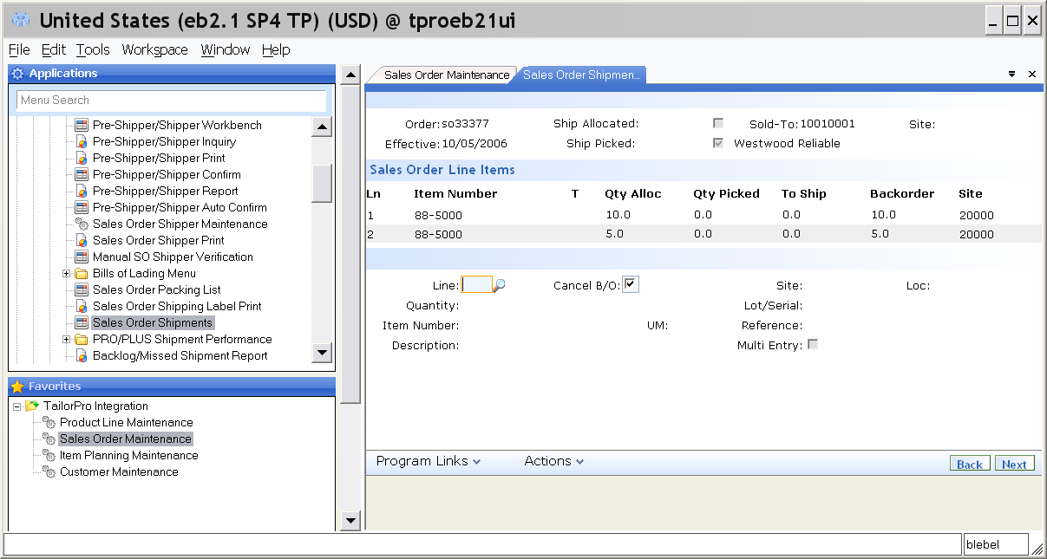
Sales Order with Catch Weight Item(s)
Item identified as catch weight by item group
© copyright ProStar Software, Inc.

Slide 12
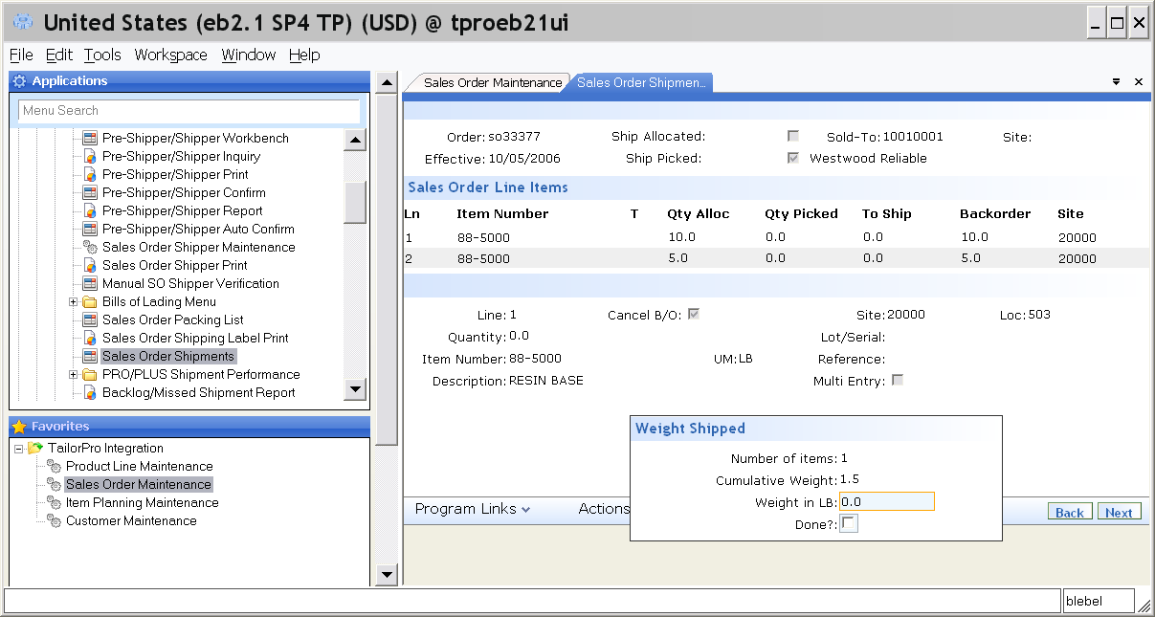
Accumulate Ship Weights
New frame tallies weight total from multiple units of different weights
© copyright ProStar Software, Inc.
Notes:
Ship weights accumulated from multiple items weighed
In this example the item's UOM equals the sales order UOM
The fields in this popup frame could be incorporated into an existing QAD frame
Each subsequent item's weight can be entered

Slide 13
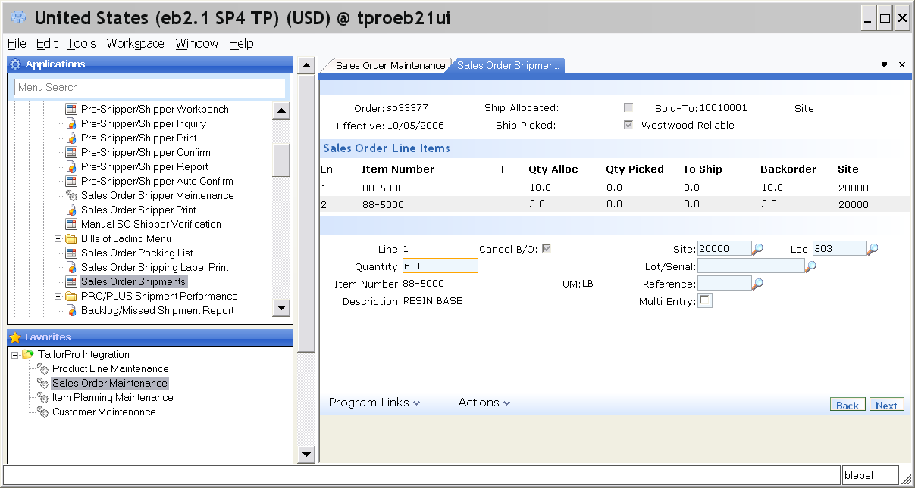
Post Accumulated Ship Weight
Weight total automatically entered in Qty shipped. Also Cancel B/O flag automatically default to Y for catch weight items
© copyright ProStar Software, Inc.

Slide 14
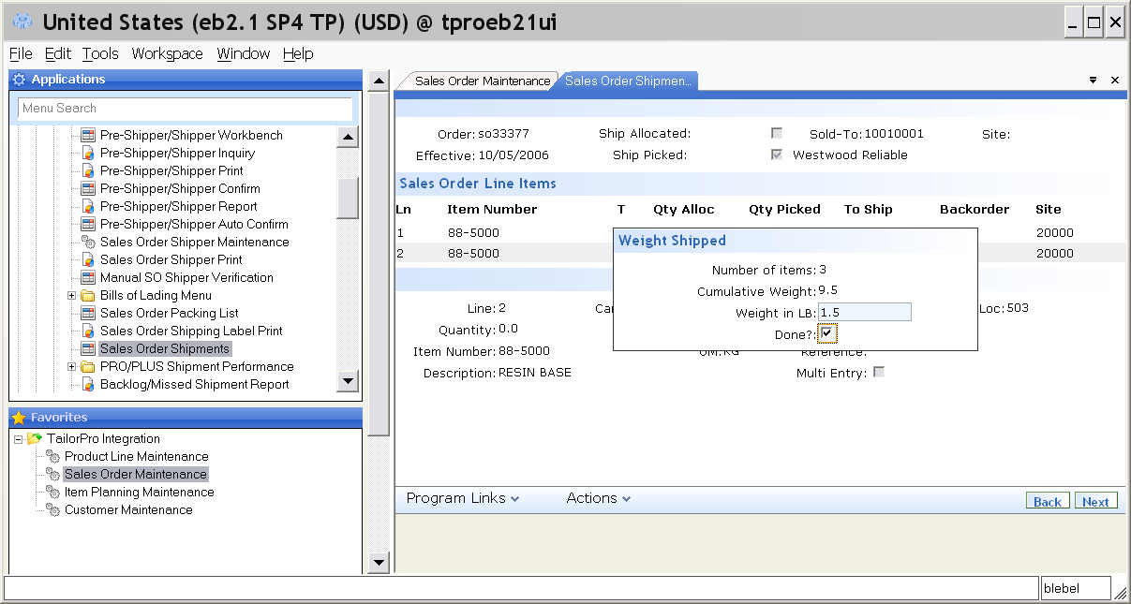
Different SO Line UOM from Item UOM
Weights tallied for item being weighed in LBS and shipped in KG
© copyright ProStar Software, Inc.

Slide 15

Convert Item UOM to SO UOM
Weight converted from measured weight (item UOM = LBS) to SO line UOM of KG. Also, Cancel B/O flag default to Y for catch weight items.
© copyright ProStar Software, Inc.

Slide 16
TailorPro EE
Summary of Functionality for True .NET Frames
Developer's ToolKit: extensive library of functions that enable complex functions and simplify the most common customization needs.
Business logic and rules control: modify existing functions
Add new functionality where needed in the business process
Event-driven invoking of custom programs to perform required functions
Pop-up Frame wherever needed in the process
Add New Fields in Pop-up Frames
Anchor technology to invoke functionality where needed in the UI
Table Rules to invoke functionality from database events
Record Extension for new data structures married to QAD tables
Rules-based Default Values, Fixed Default Values
Data Filtering: control the data available to programs
Data Hiding: control the data available to users
Field Changes: format, enable/disable, hide/visible, password/e-signature
Audit trail on any field
Translation table - for all users' languages
Project grouping and administration of anchor sets
© copyright ProStar Software, Inc.

Slide 17

Mobile Enterprise Integration
for “Automated Coordination”
®
© copyright ProStar Software, Inc.

Slide 18
MEI Workflow Benefits Include:
OpenEdge engine and logic – no Java!
Enforce business policies and drive business procedures for improved business performance
Selectively “build in” coordination, timeliness, validation, compliance and traceability to business processes across the organization
Improve communications with all participants in business processes, including customers and suppliers
Integrate users and databases outside of primary system
Gain visibility and control, for performance management, across the organization
© copyright ProStar Software, Inc.
Notes:
18
7 June 2015

Slide 19
Essential Business Processes (Mfg Context)
that may merit selective controls include:
Sales order→shipment→AR for key account or large $
Purchase→receipt→AP for key item or large $
New product introduction, including auditable PPAP
Engineering change
Credit collections process
Customer service / technical support
Quote-to-Close
Any or all of your ISO/QS/FDA/OSHA/etc. compliance
© copyright ProStar Software, Inc.
Notes:
19
7 June 2015

Slide 20
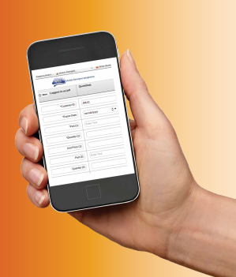
MEI User Interface and Integration
  Interaction available to users via:
    MEI application OE screens
    Any mobile device or browser
    Hyperlinks embedded in email messages
  Mobile and browser frames defined dynamically, by the data stream itself.
  Users can interact with several business systems through their MEI frames
  Integration connectors include event processors with logic for real-time awareness of database activity
© copyright ProStar Software, Inc.

Slide 21
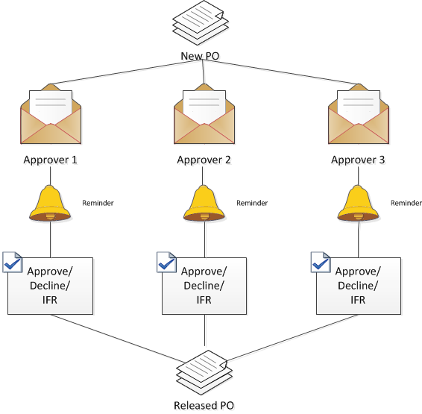
MEI Workflow Example: PO Approval
Automated coordination of users
Automated coordination of systems
Enterprise System
Controls
Communications “Open task”
MEI
  Broker
  Mobile UI
  Browser UI
  Progress UI
System actions
Communications “Process complete”
Result: Business policy enforced, business procedure completed
© copyright ProStar Software, Inc.

Slide 22
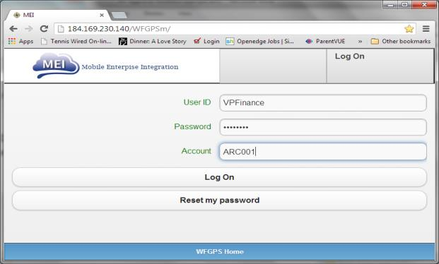
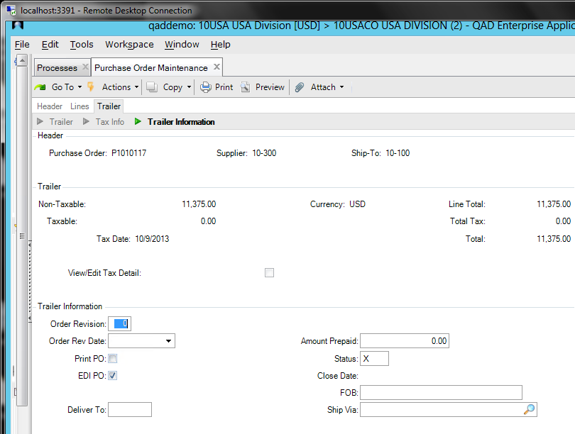
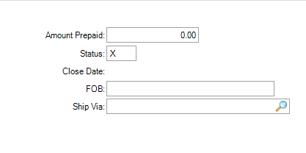
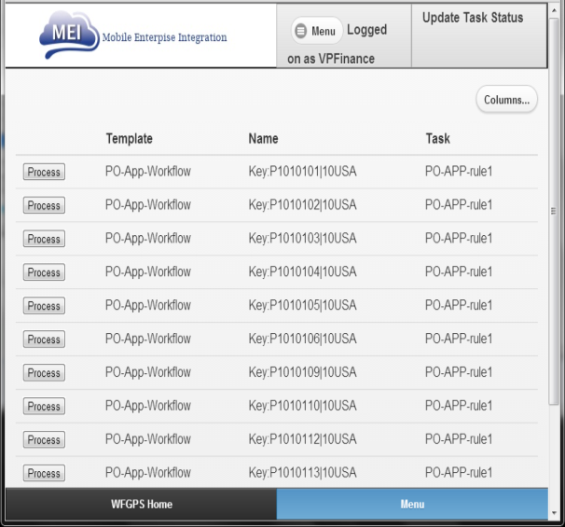
MEI Workflow Example: PO Approval
© copyright ProStar Software, Inc.

Slide 23
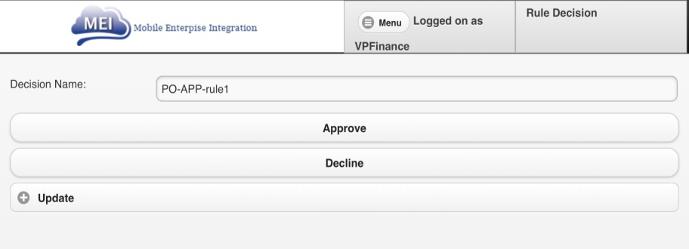
MEI Workflow Example: PO Approval
  Purpose: Enforce executive approval policy
  Functions integrated with ERP
  Rules applied to Approval Levels
    Approvers assigned dynamically
    Approvers not required to be ERP users
  Approvers approve, decline or request change
  Approval by hyperlink, browser entry or Workflow Processor Engine
  PO is held until all Approvals complete
© copyright ProStar Software, Inc.

Slide 24
MEI Controls Business Procedures
MEI provides a library of workflows
  to improve communication
  and automate coordination of business activities
Tasks can be internal or external
  including but not limited to Progress/OpenEdge applications
  Including other systems connected by MEI
Workflows are customizable and configurable
  Who is involved?
    What should they do?
    When should they do it?
    What happens next?
    How long should it take?
    How long did it take?
© copyright ProStar Software, Inc.

Slide 25
MEI Workflow: Quote To Close
  Purpose: Team effort for closing significant sales
  Rule after a new quote entered via MEI screen
    Automated entry of Quote in ERP and Opportunity in Salesforce
    if quote exceeds a threshold, then MEI invokes Quote to Close Workflow
  VP Sales, Credit Manager, Inside Sales and Field Sales all coordinated towards closing the sale
  Status flags include: Need confirmed, Budget approved, Time frame, Right contact, Credit OK
  When all flags ready then Sales should close deal
© copyright ProStar Software, Inc.

Slide 26
MEI Workflow: Supplier Feedback
  Purpose: Assure PO delivery data for “key” items is accurate for MRP planning
  Suppliers emailed two (or X) weeks before due date to confirm PO lines for key items
    Supplier can re-affirm or request change to PO
    Supplier response can be done via hyperlink, browser or Workflow Application
  Buyer (ERP-licensed user) receives updates and accepts for automated entry by MEI, or “issue for resolution”

Slide 27
MEI Developer Application
  Progress-OpenEdge based application used to create and maintain workflows (templates)
    Create, configure and customize workflows
    Defines objects to include in a workflow
      ERP actions, actions outside of ERP
      Emails, SMS text messages, Google Calendar
      Documents
      Reminders, Escalations, Re-assignment, etc.
  Workflows can be created in Visio and imported
© copyright ProStar Software, Inc.

Slide 28
How do you do customizations today in your application?
Has your application not been selected for lack of function(s) that could be provided through TailorPro with MEI?
© copyright ProStar Software, Inc.

Slide 29
“Your System, Your Way!”
Increasing the Capabilities and Competitiveness
of Open Edge Applications
ProStar Software , a Progress Technology Alliance Partner
Including
®

