Slide 1
OpenEdge BPM
Rob Straight
Senior Manager, OpenEdge Product Management
David Atkins
Principal Systems Engineer, OpenEdge

Slide 2
Challenges
  Process implementation not documented
  Processes should be explicit – not buried within an application or handled thru “tribal knowledge”
Difficult to get visibility into business processes
Businesses need insight and control over business processes
  Companies business processes change rapidly
  Difficult to keep up with changes to application requirements
  Every company’s processes are unique to that business
  Processes should be configurable

Slide 3
OpenEdge BPM Solutions
  Process implementation not documented
  Rule Modeling
Difficult to get visibility into business processes
Monitoring Processes
  Companies business processes change rapidly
  Model-Driven Process
  Model-Driven Process Automation
  Every company’s processes are unique to that business

Slide 4
Incremental Adoption Path
  Rule Modeling
All the tools & dev servers needed for OE BPM Rule Modeling and Process Simulation are included in PDS for OpenEdge!
OpenEdge BPM ABL API simplifies connecting ABL apps to Monitoring Processes for visibility & pro-active alerting
Exception processing can be handled by OpenEdge BPM
ABL workflow logic can be migrated if/when it makes sense
Monitoring Processes
  Model-Driven Process
  Model-Driven Process Automation

Slide 5
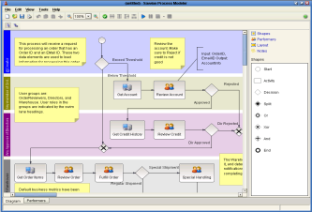
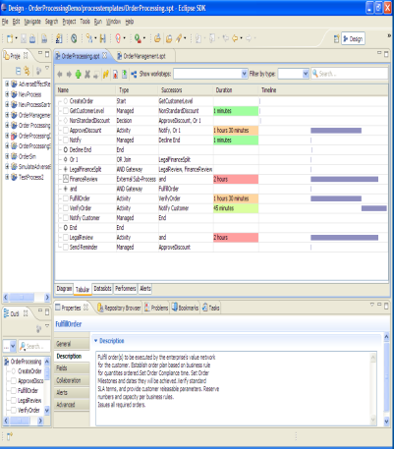
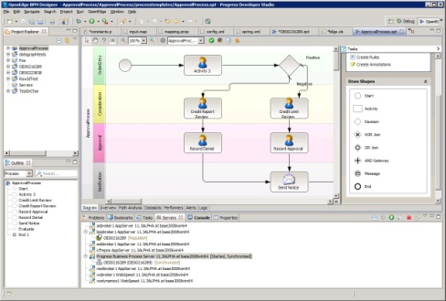
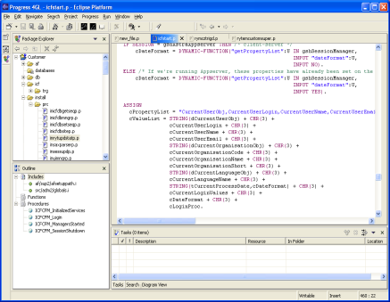
Key Components of OpenEdge BPM- Modeling
Process Modeler
An easy-to-use graphical process model designer is available stand-alone and free, or in Developer Studio
Progress Developer Studio for OpenEdge
BPM-enabled Progress Developer Studio
Use Developer Studio to further enrich your process models, for example, calling ABL business logic
Notes:
This slide contains an animation that begins with the 11.2 BPM configuration and then shows [CLICK 1] how we have added BPM studio to make a BPM Enabled Progress Developer Studio. [CLICK 2] Note the lines of communication between products remain active. [CLICK 3] and we want to emphasize the ability for the OpenEdge App Server to continue to communicate directly with BPM Server.

Slide 6
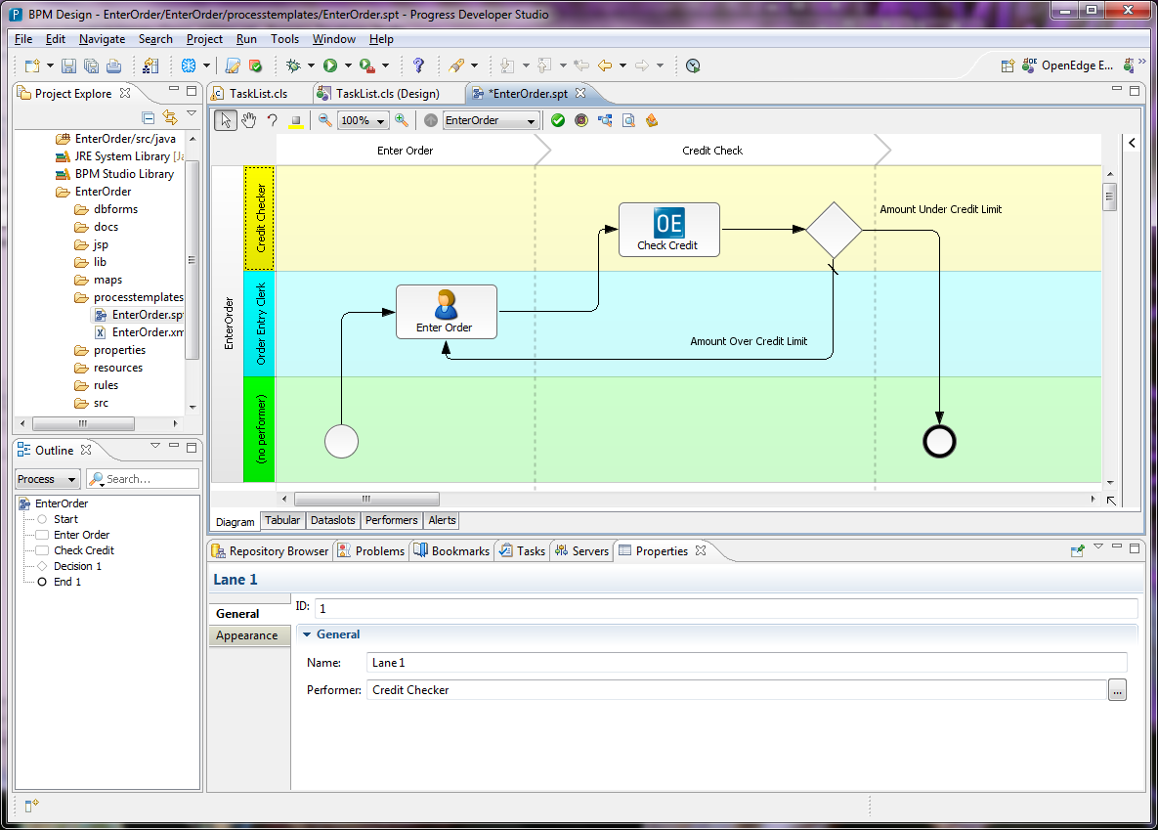
It Starts With Modeling
Process Phase
Swim lane “Performer”
User activity “Task”
System step “Managed Adapter”
Decision

Slide 7
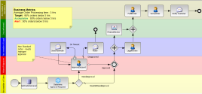
Key Components of OpenEdge BPM- Process Automation
Business process definitions are deployed to the Server, where they are instantiated as many times as needed in the production environment
Business Process Server
Progress Developer Studio for OpenEdge
BPM-enabled Progress Developer Studio
OpenEdge
AppServer
Executing processes typically call ABL business logic on the AppServer
Notes:
This slide contains an animation that begins with the 11.2 BPM configuration and then shows [CLICK 1] how we have added BPM studio to make a BPM Enabled Progress Developer Studio. [CLICK 2] Note the lines of communication between products remain active. [CLICK 3] and we want to emphasize the ability for the OpenEdge App Server to continue to communicate directly with BPM Server.

Slide 8





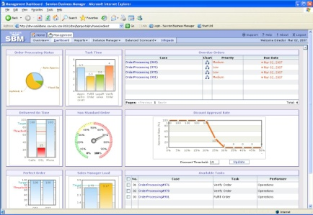
Key Components of OpenEdge BPM: Visibility (Monitoring Process)
One key payoff: immediate visibility into how your business is operating!
And with visibility comes the opportunity to identify areas for improvement!!
Business Process Portal
Business Process Server
Notes:
Alternate version of the Visibility slide that focuses on the Monitoring Process use case stressing the connectivity of the apps to the BP Server.

Slide 9
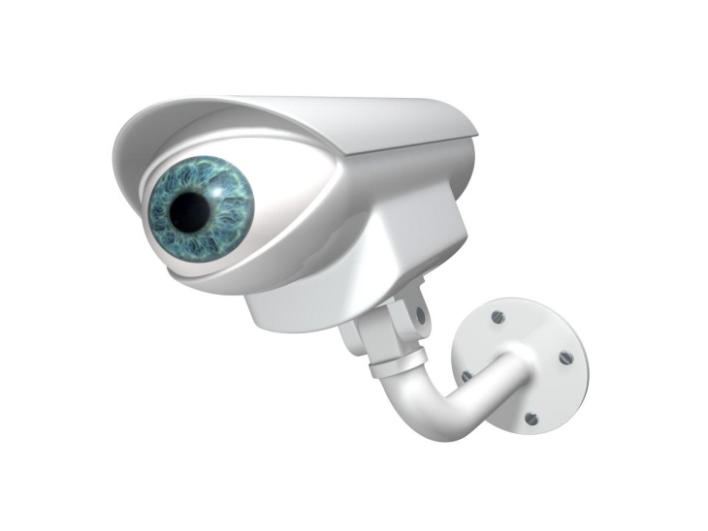
Visibility Into Your OpenEdge Applications: Monitoring Process
Diagram your current process in a model
Quickly instrument your existing OpenEdge application
  Mark start & end of process steps
Monitor as a BPM process
  Achieve immediate visibility into your running application!
IF isSkyDiver THEN
DO:
ruleStatement = "Warning" + CHR(1) + "Applicants who skydive have a high risk rating regardless age." .
riskRating = "High".
totalPremium = 150.
ruleStatement = ruleStatement + CHR(3) + "Info" + CHR(1) + "Applicants who are " + riskRating + " risk pay a premium of " + parmCurrency + STRING(totalPremium) + "." .
RETURN.
END.
ELSE
DO:
IF applicantAge < parmAge THEN
DO:
ruleStatement = "Info" + CHR(1) + "Applicants less than " + STRING(parmAge) + " years of age have a low risk rating." .
riskRating = "Low" .
totalPremium = 50.
ruleStatement = ruleStatement + CHR(3) + "Info" + CHR(1) + "Applicants who are " + riskRating + " risk pay a premium of " + parmCurrency + STRING(totalPremium) + "." .
RETURN.
END.
ELSE
DO:
ruleStatement = "Info" + CHR(1) + "Applicants who are " + STRING(parmAge) + " year or older and don't skydive are medium risk." .
riskRating = "Medium" .
totalPremium = 100.

Slide 10
Getting Started: Monitoring OE Applications
I’d like to get business visibility into the operation of our existing OpenEdge application
  Modeling
  Instrumentation
  Dashboard & Alerting
I need a more fine-grained, technical view
  What code is most volatile
  Business rules
Fast Reward!

Slide 11


Slide 12
OpenEdge BPM Incremental Adoption Paths
Modeling
Formal unambiguous definition of process
Insights possible through process simulation
Monitoring
Hook apps into processes via BPM APIs
Apps still control their own workflow
Continuous Process Optimization
Exception Automation
Incrementally add automated worksteps to handle exceptional scenarios
Full Automation
Gradually remove workflow logic from code
Maximizes agility to adapt & evolve workflow
OpenEdge BPM can model and automate both your application-level workflows AND also the broader business process contexts within which your OpenEdge applications participate

Slide 13
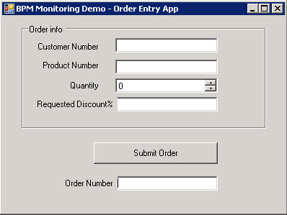
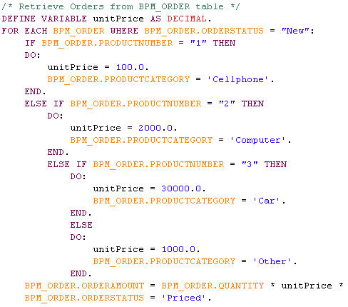

Demo Scenario: “Order Processing”
Manual/Auto-
Approvals
(?Browser/ABL?)
Picking /
Shipping
(?Mobile?)
Order Entry
(GUI for .NET)
Pricing
(Batch ABL)

Slide 14
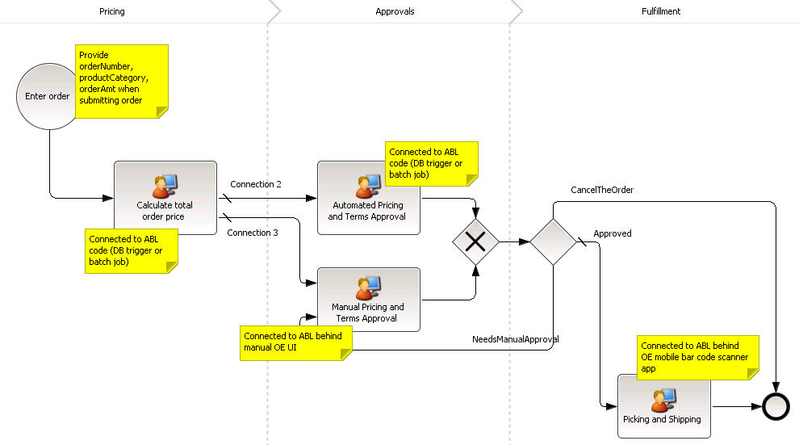
Demo Scenario: “Order Processing”

Slide 15

Demo Scenario: “Order Processing”

Slide 16
Order Entry Step: BPM Monitoring Process Integration “pseudocode”
Add simple ABL to your Order Entry app that will:
- Connect to the Business Process Server
- Retrieve list of “Order Entry” Monitoring Process variables
- Set values of appropriate process variables
- Create a Monitoring Process instance using Order Number as its identifier
DOES NOT CHANGE THE BEHAVIOR OF YOUR APPLICATION
Notes:
Initially position value of Visibility that BPM can provide (for Business or IT) (minimally intrusive)
Add value of real-time alerting
Add value of process simulation
Add value of exception case automation (with no coding)
(Potential to then move workflow logic from ABL to BPM IF IT MAKES SENSE)
Add value of Corticon to further improve process agility & efficiency

Slide 17
Other steps’: BPM Monitoring Process Integration “pseudocode”
Add simple ABL to other apps/procedures that will:
- Connect to the Business Process Server
- Retrieve Monitoring Process instance using Order Number as unique identifier
- Update/Set values of appropriate process variables
- Complete the appropriate WorkStep in the process
ADDITIVE, NOT REPLACING OR CHANGING YOUR CODE
Notes:
Initially position value of Visibility that BPM can provide (for Business or IT) (minimally intrusive)
Add value of real-time alerting
Add value of process simulation
Add value of exception case automation (with no coding)
(Potential to then move workflow logic from ABL to BPM IF IT MAKES SENSE)
Add value of Corticon to further improve process agility & efficiency

Slide 19
SUMMARY: OE BPM supports many incremental adoption paths
Start with Process modeling (single unambiguous version of the truth)
Add IT & Business Visibility (with lightweight instrumentation code)
Configure alerts on workstep delay (early warning system)
Start automating exception cases (with no coding)
Gradually migrate ABL workflow into BPM process IF/WHERE/WHEN IT MAKES SENSE
Utilize Corticon to improve process agility & efficiency
No rip and replace
Not highly intrusive
Incremental adoption path
Notes:
Initially position value of Visibility that BPM can provide (for Business or IT) (minimally intrusive)
Add value of real-time alerting
Add value of process simulation
Add value of exception case automation (with no coding)
(Potential to then move workflow logic from ABL to BPM IF IT MAKES SENSE)
Add value of Corticon to further improve process agility & efficiency

